Slide 1
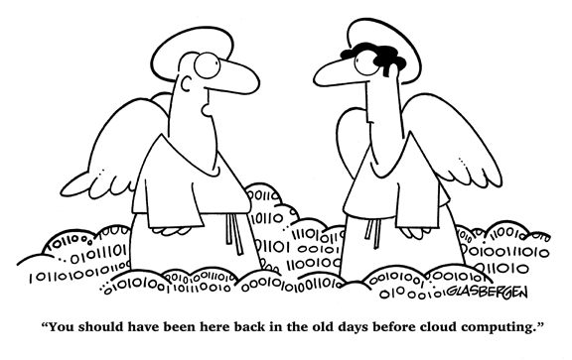
Ethical, Social and Legal Issues on the Web
Lecture 10 – COMPSCI111/111G SS 2017

Slide 2
Recap
We’ve already discussed a number of social issues:
L5- electronic communication:
Spam
Misrepresentation online
L6- publishing online:
Reliability of information on Wikipedia
L7- the World Wide Web:
Search engines and the implications of their data collection

Slide 3
Today’s lecture
Ethical
Online anonymity
Different kinds of malware
Social
Online bullying
Cultural dominance
Legal
Copyright and file sharing
Censorship on the Web

Slide 4
Ethical issues
Online anonymity, malware

Slide 5
Online anonymity
It is impossible to be completely anonymous on the Web
However, it is possible to remain fairly anonymous on the Internet
Used to be difficult to associate an IP address with a person’s computer
Easy to give fake information when creating an account on a website
Most websites don’t perform an ID check on their users

Slide 6
Online anonymity
Anonymity on the Internet is being eroded:
Advertisers are able to effectively track users’ preferences and browsing habits
Eg. fingerprinting computers better than using cookies
Websites demand more personal information and keep track of users’ activities
Laws require ISPs to keep a record of the IP addresses assigned to users
Governments are expanding their online surveillance powers

Slide 7
Online anonymity
Advantages:
Encourages free expression online, especially around sensitive or personal issues
Supports other rights such as the right to privacy
Disadvantages:
Use of anonymity to harass and offend other people
Eg. ‘trolls’ on Twitter
Difficult to authenticate whether a message (eg. email) is from the purported sender
Makes it difficult for authorities to track criminal activity online

Slide 8
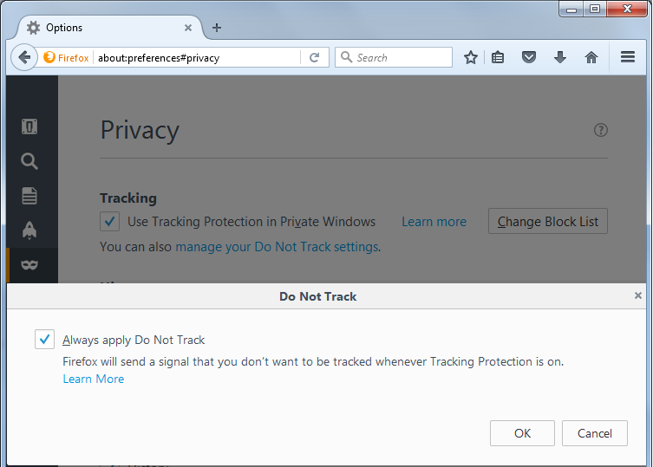
Online anonymity
Do Not Track initiative:
A browser option that tells an advertiser you do not want them to track your browsing habits
Voluntary system; the advertiser is under no obligation to abide by Do Not Track requests
Potential solution to the creation of filter bubbles?

Slide 9
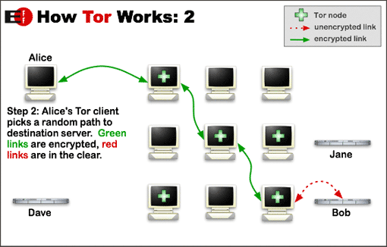
Online anonymity
The Tor Project:
A network of servers that use onion routing to obscure the path that packets take when moving from sender to receiver
Onion routing involves sending the packet along a random path through a set of encrypted relays
Need to use the Tor browser in order to browse the Web over the Tor network

Slide 10
Online anonymity
By protecting data as it is being transported, Tor makes it difficult to intercept data or find the source/destination
However, it doesn’t protect a user’s computer from cookies or from being fingerprinted
While the extra anonymity provided by Tor is useful, it has also been misused (eg. the Silk Road)

Slide 11
Malware
Malware: malicious software, which includes:
Viruses: inserts itself into another program; runs and spreads itself when the program is opened (eg. macro viruses)
Worms: similar to viruses except they don’t need a program in order to run; spreads by itself (eg. Stuxnet)
Trojans: malware disguised as legitimate software (eg. Koobface)
Spyware: runs in the background, monitoring the user’s activities and sending the info back to the operator (eg. keyloggers)
Logic bombs: malware deliberately inserted into a program which runs when a certain condition is fulfilled (eg. the Roger Duronio case)

Slide 12
Malware
The best protection against malware is a good anti-virus program and the use of safe browsing practices:
Don’t click on unknown links
Delete spam messages
Don’t open unknown attachments

Slide 13
Social issues
Online bullying, cultural dominance

Slide 14
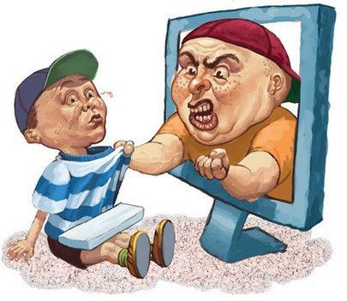
Online bullying
Some people take advantage of online anonymity to bully and harass others online
One UoA study found 11.5% of people in NZ over 18 have experienced online bullying
Online bullying is a growing problem among youth. Our ‘always online’ society makes it difficult to avoid online bullying

Slide 15
Online bullying
The Harmful Digital Communications Act 2015 (HDCA) is one response to this growing problem
s3: purpose of this Act is to:
Deter and mitigate harm caused by digital communications
Provide redress to victims of harmful digital communications
s4: key definitions
‘digital communication’ means “any form of electronic communication” – includes texts, emails, IM, forum posts, Snapchat etc.
‘harm’ means “serious emotional distress”
Two main avenues of redress under the HDCA

Slide 16
Online bullying
First option: complain to the Approved Agency
Approved Agency is Netsafe; a non-profit organization
If the complaint is genuine, Netsafe will use “negotiation, mediation, and persuasion (as appropriate) to resolve complaints” – s8(1)(c)
s11: after Netsafe has assessed the complaint, the person can apply to the District Court for an order
s12: Court must be satisfied that the communications principles have been breached (s6) and that the person has been harmed
Orders under sections 18 and 19 include:
Take down material, cease conduct, publish a correction, publish an apology

Slide 17
Online bullying
Second option: person or Netsafe can complain to online content host (a person who controls “an electronic retrieval system”) where the harmful digital communication can be accessed
Includes social media sites, blogs, search engines
s24: when a host gets a complaint, it must try to contact the author of the harmful digital comm.
If the author responds and refuses to remove the material, then the host can’t do anything
If author doesn’t respond or the author agrees, the host must take down the content within 48 hours
s23: following this process protects the online content host from any legal liability arising from the harmful digital communication

Slide 18
Cultural dominance
The Internet was popularised in the USA and English is the dominant language online
Other cultures now have a strong presence and influence on the Web
Chinese social media platforms, eg. Weibo, Wechat
K-pop
Diverse control over key pieces of Internet infrastructure. Examples:
We’ve seen backbone cables are mostly owned by private companies
ICANN now manages the DNS system (news article)

Slide 19
Legal issues
Copyright and file sharing, censorship on the Web

Slide 20
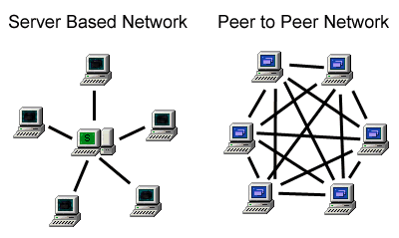
File sharing
One of the Web’s main aims was to help people easily share information
Today, cloud storage (eg. Dropbox, Google Drive) is an easy way of storing and sharing files
Peer-to-peer (P2P) networks provide another way of sharing files
P2P networks use the BitTorrent protocol to enable computers to connect to each other and share data

Slide 21
File sharing
Unfortunately file sharing on P2P networks is used for copyright infringement
Copyright protects an author’s work from being copied without their permission
One of the most famous P2P networks is The Pirate Bay
The Copyright Act 1994, sections 122A to 122U, provides a way for copyright holders to complain about file sharing on P2P networks

Slide 22
File sharing
Up to three notices are given to the infringer by their ISP in a nine month period
Infringer can challenge each notice
Detection notice
First warning for infringement
Warning notice
Second warning for infringement
Issued at least 28 days after detection notice
Enforcement notice
Final notice for infringement
Issued at least 28 days after warning notice

Slide 23
File sharing
When an enforcement notice is issued, the infringer can be penalised:
Copyright Tribunal can impose a penalty of up to $15,000
Example of a decision by the Tribunal
District Court can suspend the infringer’s Internet connection for up to 6 months
This section of the Copyright Act is NOT in force … yet

Slide 24
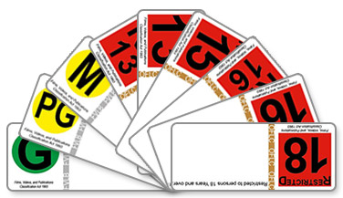
Censorship on the Web
The Office of Film and Literature Classification is responsible for determining the age classification of publications
Includes movies, books, games, clothing, pictures, computer files etc.
Three levels of classification:
G, PG, M: publication can be viewed by anyone, caution needed around PG and M
R13, R15, R16, R18: publication can only be viewed by people of the given age and over
RP13, RP16: publication can only be viewed by people of the given age and under if accompanied by their parent

Slide 25
Censorship on the Web
Any publication on the Web (movies, games, music etc) is subject to NZ’s censorship laws when accessible in NZ
So movies and games sold online must have a classification label if required
Sometimes, a publication is classified as objectionable, meaning it can’t be owned or sold in NZ
Objectionable publications are those with extremely sexual, violent or offensive content

Slide 26
Censorship on the Web
Software can help to restrict access to certain content on the Web
Blocking software
Uses a blacklist or whitelist of IP addresses to determine which websites can be accessed and which websites should be blocked
Eg. Department of Internal Affairs DCEFS
Web filter
Prevents access to websites based on their content (eg. image/video screening, keywords, malware etc)
Eg. K9 web filter, tutorial for running a filter on a proxy

Slide 27
Questions
What is the main weakness of the Do Not Track initiative?
What is the key difference between a virus and a worm?
Name one of the orders that a court can make under the Harmful Digital Communications Act
What are the differences between the R13 and the RP13 classification?

Slide 28
Answers
What is the main weakness of the Do Not Track initiative?
It is voluntary, so advertisers can choose to ignore a Do Not Track setting
What is the key difference between a virus and a worm?
A virus needs a host program in order to run and spread but a worm can run and spread without needing a host program

Slide 29
Answers
Name one of the orders a court can make under the Harmful Digital Communications Act
Any of: take down harmful material, cease harmful conduct, publish a correction, publish an apology
What are the differences between the R13 and the RP13 classification?
R13: publication only viewable to persons 13 and over
RP16: publication only viewable to persons 13 and under if accompanied by a parent or guardian

Slide 30
Summary
Ethical
Online anonymity is eroding but can still be protected
Malware includes viruses, worms, spyware, Trojan horses and logic bombs
Social
Online bullying and the Harmful Digital Communications Act
Cultural dominance
Legal
Copyright Act 1994 and file sharing
Censorship on the Web through classifications and web filtering

