Slide 1
COMPSCI 111 / 111G
An introduction to practical computing
HTML5 and CSS
Notes:
CSS Cascading Style Sheets

Slide 2
Essential Tags
HTML5 requires the following tags to be in your html source file:
html
head
title
body

Slide 3
Block-level tags
Define the structure of a “block”
Headings
Paragraphs
Lists
Tables
Preformatted text
Notes:
block level tag or in-line tag
block level goes from one side to other, if don’t cover the entire width, then centered
Preformatted like verbatim in latex

Slide 4
HTML5 Lecture 2
Inline tags
Sections
CSS stylesheets

Slide 5
Inline tags
Appear within the blocks
Apply to words within paragraphs etc.
Common inline tags
Line Breaks
Images
Hypertext References
Notes:
Within a block

Slide 6
Empty tags
Tags that apply at a given point
Do not format content
Only the opening tag is required.
Line breaks
<br>
Images
<img>
Notes:
Empty tags – only an opening tag

Slide 7
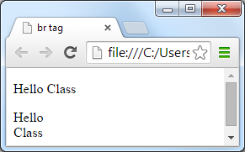
Line break
Breaks a line
Same as hitting the Enter key
Use <br>
<p>Hello Class</p>
<p>Hello<br>Class</p>

Slide 8
Images
Pages may contain images
But images are not plain text
Can’t be inserted directly into HTML page
Solution
Store the image on the internet (or locally on disk)
Tag contains the address of the image
Web browser loads image when required
Only use images the browser understands
GIF, JPG, PNG
Notes:
Image not plain text!!!
images are a tag that require attributes
this is because images aren’t stored inline but usually in a file somewhere

Slide 9
Image tag
<img>
Insert an image at this location
src
The source file of the image
Attribute that specifies the file name
alt
Attribute to specify alternate text
Displayed if the image can’t load
Important for people with visual impairment
<img src="filename" alt="description">

Slide 10
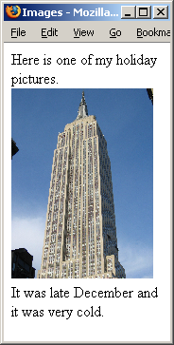
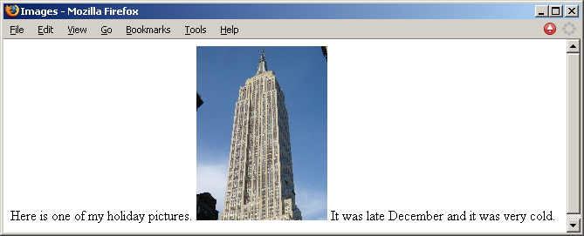
<img> example
An image is inserted inline, so it is used inside a block-level element (a paragraph in this example).
<p>
Here is one of my holiday pictures.
<img src="Empire.jpg" alt="The Empire State Building">
It was late December and it was very cold.
</p>

Slide 11
Hypertext reference
A link to another resource on the WWW
References to other documents
Pages, images, files, sections
<a>
Anchor tag
href
Attribute used to specify the destination of the link
URL
<a href="…url…">link text</a>
Notes:
Text underlined and in blue

Slide 12
URLs
Fully specified
Protocol
Host name
Path
File
Relative
Omit the first parts
Path and file
File
http://www.cs.auckland.ac.nz/courses/compsci111/index.html
/courses/compsci111/index.html
lectures/index.html
index.html

Slide 13
HTML5 Exercise
Exercise 1: What HTML5 code is required to create a hypertext reference that links to a page at the location "http://www.cs.auckland.ac.nz/courses/compsci111/". The underlined link on the page should be the text “111 home page”.
<!DOCTYPE html>
<html lang="en">
<head>
<meta charset="UTF-8">
<title>Simple Page</title>
</head>
<body>
<p>
<a href="http://www.cs.auckland.ac.nz/courses/compsci111/">
111 home page
</a>
</p>
</body>
</html>

Slide 14
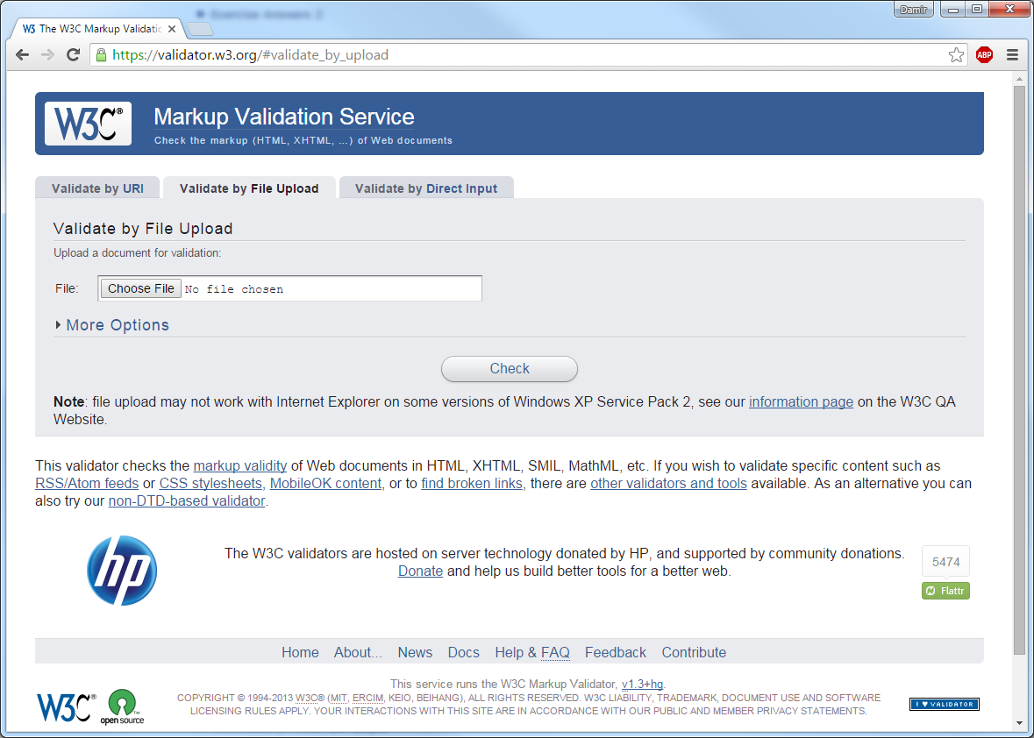
Validated Code
Online system to check correctness of code
Provided by W3C
http://validator.w3.org

Slide 15
Example
<!DOCTYPE html>
<html lang="en">
<head>
<meta charset="UTF-8">
<title>A sample page</title>
</head>
<body>
<h1>Example</h1>
<p>This is a complete html5 web page. You can verify that all the code is correct using the <a href="http://validator.w3.org">W3C Validator</a>.</p>
<h2>Images</h2>
<p>If your code is correct, you will get this message showing that your page has validated.</p>
<p>
<img src="validated.png" alt="Validated html5">
</p>
<p>
Author: Damir Azhar<br>
Date: 19/01/15<br>
</p>
</body>
</html>

Slide 16
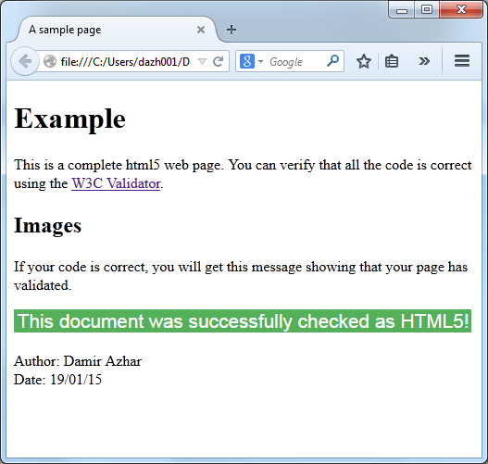
Example page

Slide 17
Sections
<section> tag defines a section in a HTML5 document.
Can be used to split a web page into different sections.
Is an example of a semantic element.
An element that clearly defines its content to both the browser and the developer.
Notes:
Block level tage
New in html5

Slide 18
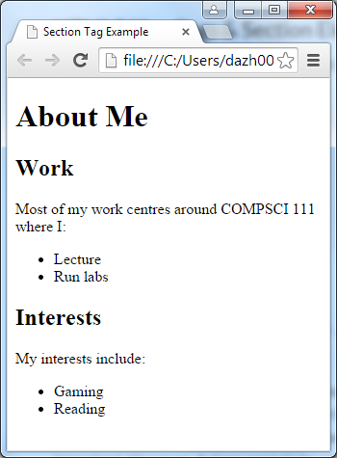
<section> example
<!DOCTYPE html>
<html lang="en">
<head>
<meta charset="UTF-8">
<title>Section Tag Example</title>
</head>
<body>
<h1>About Me</h1>
<section>
<h2>Work</h2>
<p>Most of my work centres around COMPSCI 111
where I:</p>
<ul>
<li>Lecture</li>
<li>Run labs</li>
</ul>
</section>
<section>
<h2>Interests</h2>
<p>My interests include:</p>
<ul>
<li>Gaming</li>
<li>Reading</li>
</ul>
</section>
</body>
</html>

Slide 19
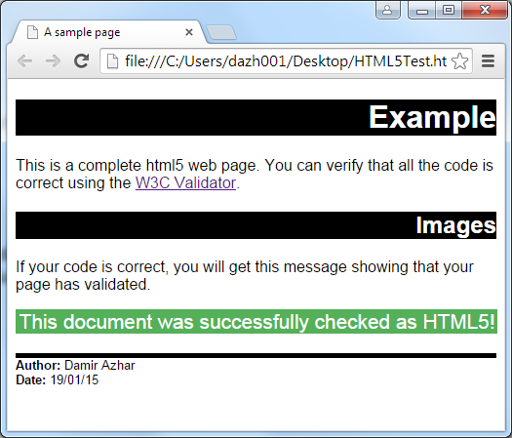
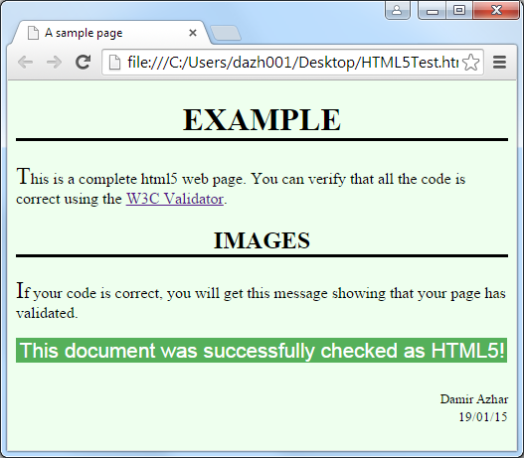
Styles
A style changes the way the HTML code is displayed
– Same page displayed using different styles
http://csszengarden.com
Notes:
Presenter
2014-04-24 01:34:37
--------------------------------------------
html captures the structure of the document, like an outline, the style says how the structure should be displayed
These styles are not part of XHTML they are part of something called CSS cascading style sheets

Slide 20
Defining a style
Styles are defined using rules
Selector – determines what the rule applies to
Property – the thing that will be changed
Value – the value that will be used
Property
Value
h1 { color:
green; }
Selector
Notes:
Presenter
2014-04-24 01:34:37
--------------------------------------------
selector selects what type of tag – can use BODY
GENERAL selector defines attribute values for specific tags need semicolon to separate pairs
Colon
semicolon

Slide 21
Grouping rules
Multiple tags that use the same rule
h1 { font-weight: bold }
h2 { font-weight: bold }
Same style defined for multiple selectors
– h1, h2 { font-weight:
bold }
Notes:
Presenter
2014-04-24 01:34:37
--------------------------------------------
don’t need the semicolon for the last “rule”, but it’s good practice
Notice ,

Slide 22
Grouping rules
Same tag using multiple rules
h1 { color: green }
h1 { text-align: center }
Apply multiple properties to the same selector
– h1 {
color: green;
text-align: center;
– }

Slide 23
Class selectors
Sometimes want to apply a style to specified tags
Most paragraphs are normal
Some paragraphs are quotes
Define a style that can be applied to a group of tags
Class selector
.className { property: value; }
In HTML5 source code
Assign the tag to the class
Use an attribute
<tag class=“className”> … </tag>
Notes:
Presenter
2014-04-24 01:34:37
--------------------------------------------
User specified selectors – two types class and ID
want to have quotes appear as italics how do u specify this
need to specify a class: put a full stop and put new class name after, no spaces

Slide 24
Example – class selector
Style defined as follows:
.quote
{
text-align: font-style:
center; italic;
}
HTML5 source code uses the style as follows:
<p class="quote">
Let's face it, the average computer user has the brain of a Spider Monkey --- Bill Gates
</p>

Slide 25
Id selectors
Sometimes want to apply a style to a single tag
E.g. Defining a special heading
Define a style that can be applied to a single tag
Id selector
#idName { property: value; }
In HTML5 source code
Use an attribute to specify the id used for the tag
<tag id="idName"> … </tag>
Notes:
Presenter
2014-04-24 01:34:37
--------------------------------------------
what is diff between class and id??

Slide 26
Example – id selector
Style defined as follows:
#footer
{
text-align: font-style:
}
center; italic;
HTML5 source code uses the style as follows:
<p id="footer">
Copyright 2015
</p>
Notes:
Presenter
2014-04-24 01:34:37
--------------------------------------------
id s can only occur once in an html page(e.g., footer)
classes can occur many times on an html page (e.g., pargraphs) general selectors apply to all instances of that tag
class selectors only apply to some instances fo that tag id selelctor only apply to one instance of that tag
Etiquette - like capital letters in tags

Slide 27
CSS Exercise
Exercise 2: What is a “selector” in a CSS style?
A selector specifies where in a web page CSS styles will be applied. Selectors are typically names of tags e.g. body, p, h1 etc. There are 2 types of user specified selectors as well; class selectors and id selectors.
Notes:
Presenter
2014-04-24 01:34:37
--------------------------------------------
give them a minute to do
a selector select what types of tags to apply the rule to

Slide 28
Location of the styles
Three possible locations
External style sheet
Internal style sheet
Inline styles

Slide 29
External Style Sheet
Styles are defined in a file
Used when styles apply to more than one web page
Entire site has a consistent visual theme
.quote { text-align: center; }
Saved in a file called theme.css
h1 { color: green; }
Web page must be told where to find the style sheet
<link> tag has 3 attributes:
rel specifies relationship between current document and linked document
href specifies location of linked document
type specifies media type of linked document
Is an empty tag so only an opening <link> tag is required.
<head>
<title> … </title>
<link rel="stylesheet" href="theme.css" type="text/css">
</head>
Notes:
Presenter
2014-04-24 01:34:37
--------------------------------------------
href = url
Plain text css code

Slide 30
Internal Style Sheet
Styles are defined in the head of the page
Used when styles apply to only the one web page
Keeps all the visual formatting located in the same place
<style type="text/css">
Used in the head of the document to contain styles
type attribute specifies media type of the <style> tag
<head>
<title>Example</title>
<style type="text/css">
.quote { text-align: center; }
h1 { color: green; }
</style>
</head>
Notes:
Only 1 style sheet
Best for 1 page websites

Slide 31
Inline styles
Styles are defined in the tag
Used when style is applied only to that tag
Can be required to override styles
Rarely used (why would you?)
<p style="text-align: center;">
This paragraph will be centred using an inline style.
</p>
Notes:
Presenter
2014-04-24 01:34:37
--------------------------------------------
in general bad practice to use inline styles Stopped AM
Advantage – takes priority

Slide 32
Cascading Style Sheets
Order to apply styles
Browser default
External style sheet
Internal style sheet
Inline styles
Increasing priority
http://en.wikipedia.org/wiki/Cascading_Style_Sheets http://en.wikipedia.org/wiki/Comparison_of_layout_engines_(CSS)
Notes:
Presenter
2014-04-24 01:34:37
--------------------------------------------
why do they call it cascading???
BECAUSE the styles can appear at different levels in the document, and higher priority rules override lower priority ones

Slide 33
CSS Exercises
Exercise 3: Write a simple HTML5 page with the title “Simple CSS example”. The body of the page should contain a single paragraph with the text “Hello”. The text should have the “color” property set to “green”. An internal style sheet should be used to define an appropriate style that can be applied to the paragraph.
<html>
<head>
<meta charset="UTF-8">
<title>Simple CSS Example</title>
<style type="text/css">
p {color: green;}
</style>
</head>
<body>
<p>Hello World</p>
</body>
</html>
Notes:
Presenter
2014-04-24 01:34:37
--------------------------------------------
give 4 minutes stopped PM

Slide 34
CSS Exercises
Exercise 4: Put the following into increasing order of priority. The item at the bottom of the list should have the highest priority.
Internal Style, Browser Default, Inline Style, External Style
Browser default
External style sheet
Internal style sheet
Inline Style
Notes:
Presenter
2014-04-24 01:34:37
--------------------------------------------
Browser Default, External Style, Internal Style, InlineStyle

Slide 35
<div> and <span>
Two additional tags used with CSS
Allow a style to be applied to arbitrary group of elements
<div>
Block-level tag
May contain other block-level tags
Invisible in HTML5, but can have styles applied
<span>
Inline tag
May contain other inline tags
Invisible in HTML5, but can have styles applied
Notes:
Presenter
2014-04-24 01:34:37
--------------------------------------------
why do you need two different tags for this?? need block-level so that they can contain blocks need inline so that it can apply to part of a line

Slide 36
Examples
<!DOCTYPE html>
<html>
<head>
<meta charset="UTF-8">
<title>A sample page</title>
<link rel="stylesheet" href="mystyle.css" type="text/css">
</head>
<body>
<h1>Example</h1>
<p>This is a complete html5 web page. You can verify that all the code is correct using the <a href="http://validator.w3.org">W3C Validator</a>.</p>
<h2>Images</h2>
<p>If your code is correct, you will get this message showing that your page has validated.</p>
<p>
<img src="validated.png" alt="Validated html5">
</p>
<p class="footer">
<span class="catName">Author:</span> Damir Azhar<br>
<span class="catName">Date:</span> 19/01/15<br>
</p>
</body>
</html>
Notes:
Presenter
2014-04-24 01:34:37
--------------------------------------------
note link use of span use of <br>

Slide 37
No CSS

Slide 38
Same page with a style sheet
body
{
font-family: sans-serif;
}
h1, h2
{
text-align: right; background-color: color: white;
}
black;
.footer
{
border-top-width: border-top-style: font-size: small;
}
thick; solid;
.catName
{
font-weight: bold;
}
Notes:
Presenter
2014-04-24 01:34:38
--------------------------------------------
note that rules end in “;”

Slide 39
Same page, different style sheet
body { background-color: #eeffee; }
h1, h2
{
text-align: center;
border-bottom-color: black; border-bottom-style: solid; color: black;
text-transform: uppercase;
}
p:first-letter { font-size: x-large; }
.footer { text-align: right; font-size: small; }
.catName { visibility: | hidden; | }

