Slide 1
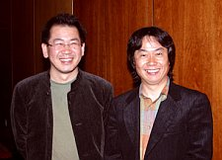
Digital Game Design
Adapted from “Toward a Unified Theory of Digital Games”,
P. Ralph and K. Monu, Computer Games Journal 4(1), 2015

Slide 2
What is Game Design?
What is a game?
A set of interconnected elements for structuring play
An event where one or more players interact with a play structuring system
What is a game element?
Anything that is “found in most (but not necessarily all) games, readily associated with games and found to play a significant role in gameplay”
Game design involves creating a system of game elements to facilitate interaction

Slide 3
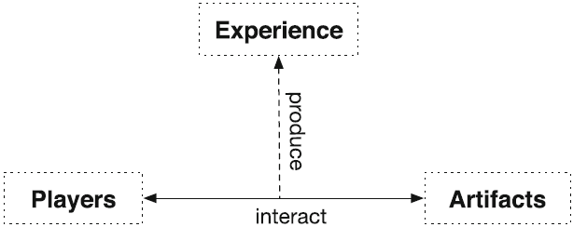
Game Element Classes
Artifacts
Artificial objects and systems used to structure play
Players
Human or non-human agents who use game artifacts to structure play
Experience
Elements that emerge from player-artifact interaction

Slide 4
Artifact Elements
Element | Definition | Examples
Game mechanics | Elements used by game developers to challenge players | Quest, combo, puzzle, timer, skill, randomness, level, loot drop
Narrative mechanics | Elements used by game developers to advance plot | Dialogue, comm chatter, audio log, video log, moral choice, codex entry
Technology | Tangible or intangible artifacts used to deliver game elements or play the game | Gamepad, mouse, keyboard, tablet, smart phone, game engine, programming language
Embedded narratives | Stories told by the developers to players through narrative and game mechanics | Overall story told through cut scenes, dialogue, codex entries, and game progression

Slide 5
Experience Elements
Element | Definition | Examples
Dynamics | Emergent behaviour of both the game and the player during player-game interaction | Twitch gameplay, strategic gameplay, grinding, difficulty, balance, immersion
Emergent narratives | A meaningful sequence of events that emerges during player-game interaction | EVO 2004 Moment # 37

Slide 6
Player Elements
Element | Definition | Examples
Aesthetics | The emotions evoked by a game | Challenge, competition, drama, exploration, horror, humour, fellowship
Interpreted narrative | A player’s mental representations and interpretations of a game’s intended or emergent narratives | Player interpretation of twist or ambiguous game endings

Slide 7
Game and Narrative Mechanics
Game mechanics challenge the player while narrative mechanics advance the plot of a game
Not mutually exclusive – an element can be a game and a narrative mechanic

Slide 8
Narrative Examples

Slide 9
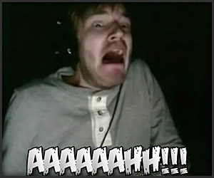
Aesthetics
Sensation – game as sense-pleasure
Fantasy – game as make-believe
Narrative – game as drama
Challenge – game as obstacle course
Fellowship – game as social framework
Discovery – game as uncharted territory
Expression – game as self-discovery
Submission – game as pastime
Competition – game as dominance
A game can evoke multiple aesthetics
Aesthetics are player specific

Slide 10
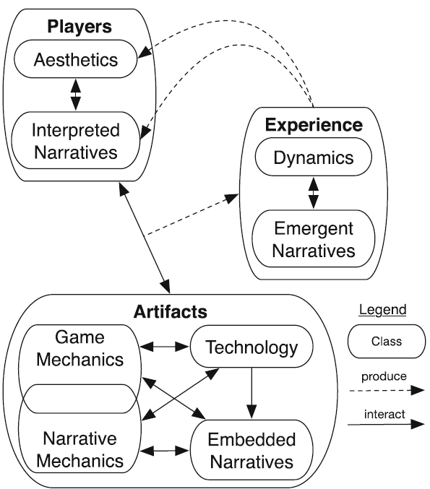
Interconnections
Game elements are interconnected
Within classes and between classes

Slide 11
Bad Game Design
Often occurs as a misalignment game elements
Examples:
Game mechanics and embedded narrative (ludonarrative dissonance)
Game mechanics and emergent narrative
Game mechanics and aesthetics
Dynamics and aesthetics
Game mechanics and technology

