Slide 1

COMPSCI 111 / 111G
Mastering Cyberspace:
An introduction to practical computing
L
T
X
A
E

Slide 2
Revision
LaTeX is a document preparation system
  Typesets documents
Commands
  Start with a backslash (\)
Environments
  \begin{name}
  \end{name}
\documentclass[a4paper]{book}
\begin{document}
...
\end{document}

Slide 3
Text Styles
\textbf{ Argument will be bold }
\textit{ Argument will be italic }
\textsl{ Argument will be slanted }
\textsf{ Argument will be sans-serif }
\textrm{ Argument will be serif (roman) }
\texttt{ Argument will be monospace }
\textsc{ ARGUMENT WILL BE SMALL CAPITALS }

Slide 4
\emph versus \textit
\emph{I want to \emph{emphasize this}}
I want to emphasize this
\textit{I want to \textit{emphasize this}}
I want to emphasize this

Slide 5
Exercise
What is the output of the following LaTeX code?
The \textbf{quick} \textit{brown} \textsl{fox} jumps \textsf{over} the \texttt{lazy} \textsc{Dog}

Slide 6
Font Style
Forms
  Declarative form (Set style from this point forward)
  Environmental form (Create an environment that uses this style)
  \bfseries Bold
  \mdseries Normal weight (i.e. not bold)
  \itshape Italic
  \slshape Slanted
  \upshape Upright (opposite of slanted}
  \scshape Small Capitals
  \rmfamily Serif (roman)
  \sffamily Sans-serif
  \ttfamily Monospace (typewriter)

Slide 7
Example
%Normal way to set italics
\textit{This text will be italic}
%Environment form
\begin{itshape}
This text is also italic
\end{itshape}
%Declarative form
\itshape
All text from this point forward will be italic
This text will be italic
This text is also italic
All text from this point forward will be italic

Slide 8

Exercise
What would the output of the following code be?
\begin{sffamily}
The quick brown fox
\end{sffamily}
jumps over \bfseries the lazy dog

Slide 9
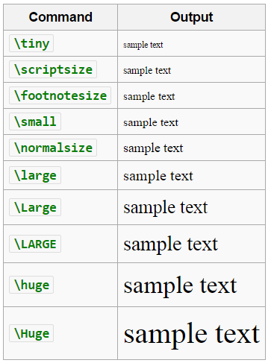
Font Size

Slide 10
Setting the scope of a command
New way to apply a command
  Set the scope of the command
  Command only applies within the curly braces
  Note: this works with the declarative forms for font style and font size
Format:
{\command ... text goes here ... }

Slide 11
Example
{\small This text is small}
{\Large\itshape This text is large and italic}
{
\tiny
\textit{This text will be tiny and italic}
This text will be tiny, but not italic.
}
This text is small
This text is large and italic
This text will be tiny and italic
This text will be tiny, but not italic.

Slide 12
Aligning paragraphs
flushleft
  Environment that aligns a paragraph to the left
flushright
  Environment that aligns a paragraph to the right
center
  Environment that aligns a paragraph to the centre
\begin{center}
furuike ya\\
kawazu tobikomu\\
mizu no oto
\end{center}
\begin{center}
Three things are certain:\\
Death, taxes, and lost data.\\
Guess which has occurred!
\end{center}

Slide 13
Unordered Lists
Unordered Lists
  List that uses bullet points
  itemize environment
  \item used to identify each item in the list
\begin{itemize}
\item Pears
\item Apples
\item Bananas
\end{itemize}
Pears
Apples
Bananas

Slide 14
Ordered Lists
Ordered Lists
  List that is enumerated
  enumerate environment
  \item used to identify each item in the list
\begin{enumerate}
\item Pears
\item Apples
\item Bananas
\end{enumerate}
Pears
Apples
Bananas

Slide 15
Description Lists
Description Lists
  List that is used to define terms
  description environment
  \item[ term ] used to identify each term in the list
\begin{description}
\item[Pears] Say something really really really long about fruit
\item[Apples] More fruit
\item[Bananas] Still more fruit
\end{description}
Pears Say something really really really long
about fruit
Apples More fruit
Bananas Still more fruit

Slide 16
Quotes and Quotations
quote environment
  Used for short quotes
  Entire environment is indented
  The first line of a new paragraph inside quote is not indented.
quotation environment
  Used for longer quotes
  Entire environment is indented
  The first line of a new paragraph inside quotation is indented
This is a quote by Aristotle:
\begin{quote}
There is only one way to avoid criticism: do nothing, say nothing, and be nothing. - Aristotle
\end{quote}

Slide 17
Quote versus Quotation Example
This is a quote by Aristotle:
There is only one way to avoid criticism: do nothing, say
nothing, and be nothing. - Aristotle
This is a quote by Aristotle:
There is only one way to avoid criticism: do nothing, say
nothing, and be nothing. – Aristotle
There is only one way to avoid criticism: do nothing, say
nothing, and be nothing. - Aristotle
There is only one way to avoid criticism: do nothing, say
nothing, and be nothing. - Aristotle

Slide 18
Verbatim
verbatim environment
  Reproduces text exactly as it appears
  Uses a monospace font (courier)
  Often used for computer code
  No latex commands can be used in verbatim
The following commands are used in LaTeX
\begin{verbatim}
Use \\ to create a line break. Use
\section{ name } to create a new section.
\end{verbatim}
The following commands are used in LaTeX
Use \\ to create a line break. Use
\section{ name } to create a new section.

Slide 19
Mathematics
Three ways to enter mathematics mode
Inline text
  $ ... $
displaymath environment
  Centres the maths on a line of its own
equation environment
  Centres the maths on a line of its own
  Numbers the maths with an equation number

Slide 20
Examples
The equation $x = y$
is a simple equation.
The equation x = y is a simple equation.
The equation:
\begin{displaymath}
x = y
\end{displaymath}
is a simple equation.
The equation:
x = y
is a simple equation.
The equation:
\begin{equation}
x = y
\end{equation}
is a simple equation.
The equation:
x = y
is a simple equation.
(1.1)

Slide 21
Laying out mathematics
Too many commands to memorise
  Look up the commands when we need them
  Any symbol, any structure exists somewhere
  We will look at the most common commands
  To apply letters to a group, we put curly braces around them
Exponent
  Carat (^)
  Example: n^{th}
Subscripts
  Underscore (_)
  Example: s_0
n^{th}
s₀

Slide 22


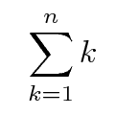
Other common functions
Square roots
  \sqrt{ ... }
  Example: \sqrt{ x^2 + y^2 }
Fractions
  \frac{ numerator } { denominator }
  Example: 3\frac{ 1 }{ 2 }
Sum
  \sum
  Example: \sum_{k=1}^{n} k

Slide 23
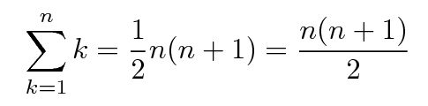
Example
\sum_{k=1}^{n} k = \frac{1}{2}n(n+1) = \frac{n(n+1)}{2}

Slide 24
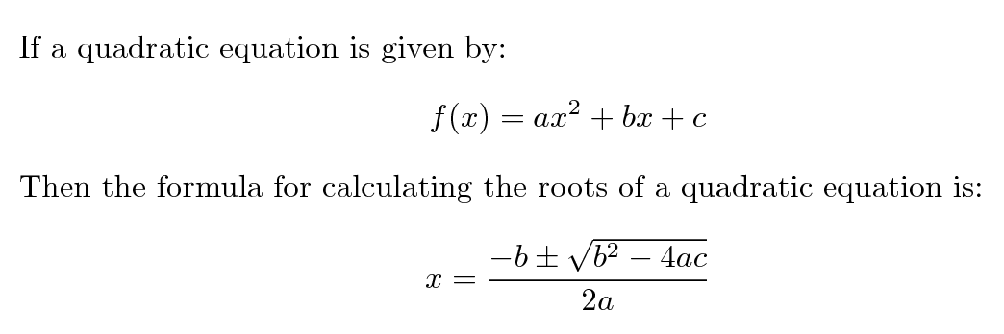
Exercise
If a quadratic equation is given by:
\begin{displaymath}
f(x) = ax^2 + bx + c
\end{displaymath}
Then the formula for calculating the roots of a quadratic equation is:
\begin{displaymath}
x = \frac{-b \pm \sqrt{b^2 - 4ac}}{2a}
\end{displaymath}

Slide 25
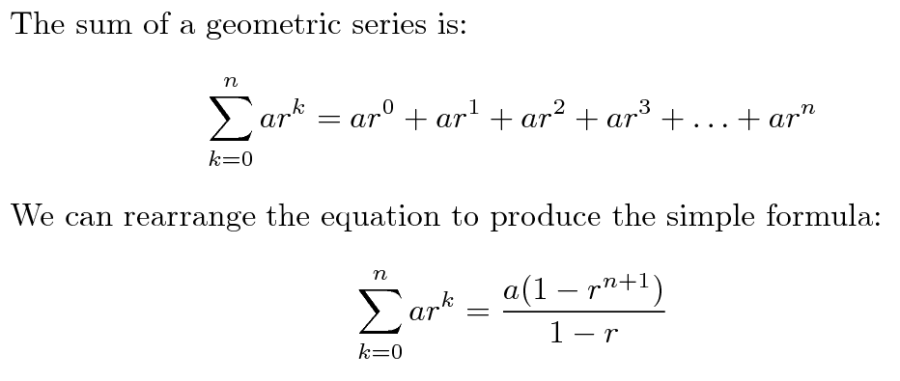
Exercise
Write the code that reproduces the following LaTeX:

Slide 26
Exercise
The sum of a geometric series is:
\begin{displaymath}
\sum_{k=0}^{n}ar^{k}=ar^{0}+ar^{1}+ar^{2}+ar^{3}+\ldots+ar^{n}
\end{displaymath}
We can rearrange the equation to produce the simple formula:
\begin{displaymath}
\sum_{k=0}^{n}ar^{k}=\frac{a(1-r^{n+1})}{1-r}
\end{displaymath}

Slide 27
Adding functionality
\usepackage{ packagename }
  A library that adds or modifies the commands available
  Thousands of packages available
  Some are very useful
Add the \usepackage command to the preamble
\documentclass[a4paper]{article}
\usepackage{graphicx}
\begin{document}
...
\end{document}

Slide 28
graphicx
Package that allows you to import graphics
  Graphics must be in .eps format (latex compiler) or .jpg/.png (pdflatex compiler)
  Can set width and height
  Other options are also available
\includegraphics[options]{Example.png}
\documentclass[a4paper]{article}
\usepackage{graphicx}
\begin{document}
This is a simple picture
\begin{center}
\includegraphics[width=10cm]{Example.png}
\end{center}
\end{document}

Slide 29
Summary
LaTeX is a very good typesetting package
  Excellent for mathematics
  Excellent for long documents
  Excellent for people who really care about presentation
  Very configurable
  Steep learning curve (but worth it for those that bother)
Recommended software for use on Windows
  MikTeX (LaTeX distribution)
  TeXWorks (text editor with built in LaTeX compiler)

