Slide 1

COMPSCI 111 / 111G
Mastering Cyberspace:
An introduction to practical computing
L
T
X
A
E

Slide 2
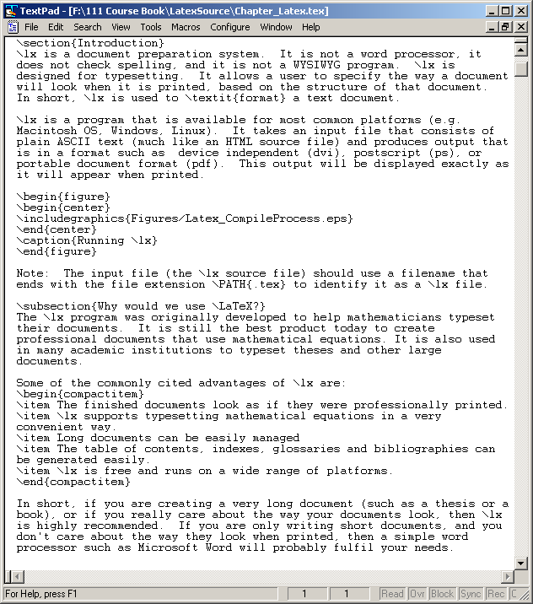
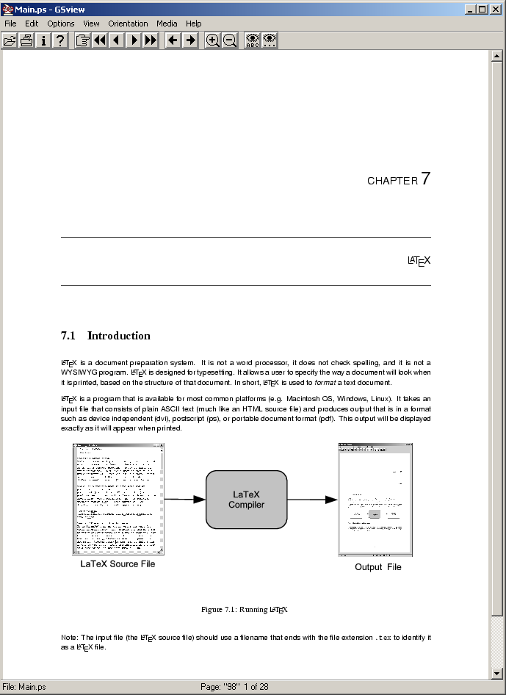
What is LaTeX?
A document preparation system
  Used to typeset a document
LaTeX
Compiler
http://en.wikipedia.org/wiki/LaTeX

Slide 3
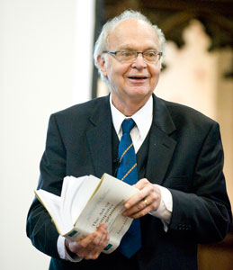
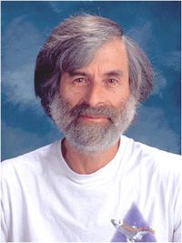
History of LaTeX
Donald Knuth created TeX in 1978
  Aim was to make it easy to create books
  and to ensure that documents looked the
  same on any computer
  TeX files can be typeset into PDF files
Leslie Lamport created LaTeX in 1985
  LaTeX = Lamport TeX
  Introduced a number of extensions to TeX
  which made it faster and easier to use
  Soon, LaTeX became the standard way to
  use TeX

Slide 4
Why?
Why use LaTeX when we have word processors?
  Results look better
  Focus on structure helps document development
  Excellent tool for mathematical layout
  Works well for large documents
  Automatically generates:
    Table of contents
    Lists of figures
    Lists of tables
    Index
    Glossaries
    Bibliographies
  Free and runs on many platforms

Slide 5
Commands
Used to tell LaTeX how to typeset something
  Commands are case sensitive
  Optional parts are in square brackets
  Compulsory parts are in curly braces
\commandname[options]{argument}
\documentclass[a4paper]{article}
\documentclass[a4paper,twocolumn]{article}
\documentclass[a4paper,twocolumn]{article}{}

Slide 6
Comments
Used to annotate the document
  Ignored by the compiler
  Aimed at other humans
% Comments starts with a percentage sign
% All text is ignored until the end of the
% line is reached.

Slide 7
Whitespace
Whitespace characters
  Space
  Tab
  Line break
White space is largely ignored apart from:
  Space between words.
  Blank lines between blocks of text that are used to make paragraphs.
Two or more consecutive whitespace characters
  Reduced to a single space
A B C
D E F
A B C D E F

Slide 8
Special characters
Characters that are used in the syntax of the language
  Can't type these characters directly
  Need a special way to print them
  10 characters
\ $ % ^ & _ ~ # { }

Slide 9
Environments
Apply a change to the content within the environment
  New environments start new paragraphs
\begin{center}
Content within the center
Environment, is centered on
The page.
\end{center}
\begin{environmentname}
...
\end{environmentname}

Slide 10
Creating a LaTeX document
\documentclass
  Defines the type of document
  Book
  Report
  Article
  Letter
The document environment encloses the contents of the document
The space between the document class command and the start of the document environment is called the preamble.
  Contains commands that affect the entire document.

Slide 11
Creating a LaTeX document
\documentclass[a4paper]{article}
\begin{document}
...
\end{document}
Preamble
Document environment
Document contents

Slide 12
Adding a title
Require four commands to create a title
  \title{ put the title here }
  \author{ author goes here }
  \date{ date goes here }
    will put today’s date if date not specified
Once the information has been defined, insert the title
  \maketitle
...
\begin{document}
\title{A very short document}
\author{Damir Azhar}
\date{2017}
\maketitle
This is the document.
\end{document}

Slide 13
Structuring a document
\part{part name goes here}
\chapter{chapter name goes here}
  Only books and reports
\section{section name goes here}
  Bold, larger, numbered automatically
\subsection{subsection name goes here}
\subsubsection{subsubsection name goes here}

Slide 14
Table of contents
Table of contents is automatically generated using the \tableofcontents command.
  place after \maketitle – sometimes need to recompile
  Parts
  Chapters
  Sections
  Subsections
Each command has a table of contents option
  Displays a different name in the table of contents
\section[Introduction]{An introduction
to typesetting using the LaTeX language}

Slide 15
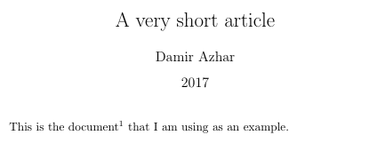

Footnotes
Footnotes are created in the text as you type them
  \footnote{footnote text goes here}
\documentclass[a4paper]{article}
\begin{document}
\title{A very short article}
\author{Damir Azhar}
\date{2017}
\maketitle
This is the document\footnote{Note that the document is an article} that I am using as an example.
\end{document}

Slide 16
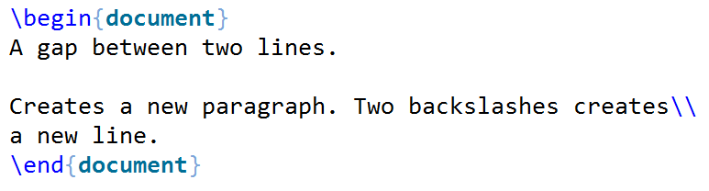
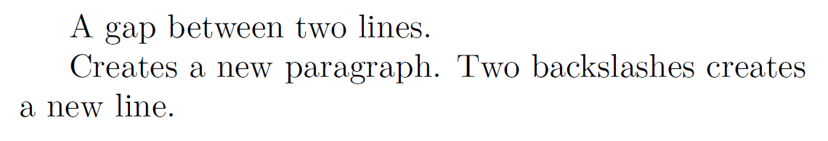
Paragraphs and line breaks
LaTeX will remove excess whitespace
  Need to explicitly include paragraphs and line breaks
Paragraph
  Leave a blank line in the input
Line break
  Use the command \\

Slide 17


Quote marks
Unidirectional quotes (") are inadequate
  Use the symbols ` and ' for single quotes
  Use the symbols `` and ' ' for double quotes
Single quotes
  Open using ` character and close using ' character
Double quotes
  Open using `` characters and close using '' character
`Hello'
``Hello''

Slide 18

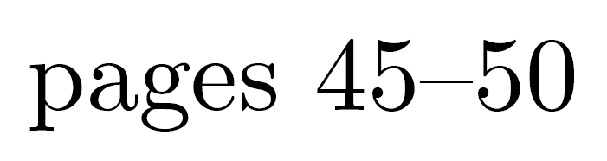

Dashes
Hyphen (-)
  Short dash to join different words together
En dash (--)
  Longer dash used to indicate a range of values
Em dash (---)
  Very long dash between words or phrases
merry-go-round
pages 45--50
the start --- the finish

Slide 19

Ellipsis
Three dots in a sequence
  Used to indicate text that ... has been removed
  Or an unfinished ...
Can't just use three full stops in a row
  LaTeX will use incorrect spacing
  Use the \ldots command
There is \ldots missing

Slide 20
Spaces
Lines have to be broken to wrap text
  Try to break at a space
  Try to break at a syllable
Some spaces we don't want to be broken
  E.g. between initials and surnames
Use a tilde ~ to signify a space that we can't break
The lecturer for this course is A. J. Luxton-Reilly
Bad layout
The lecturer for this course is A.~J.~Luxton-Reilly

Slide 21


Basic Formatting
\emph command emphasises the enclosed text
\textbf command makes the enclosed text bold
This was a \emph{long} lecture
This was a \textbf{cool} lecture

Slide 22
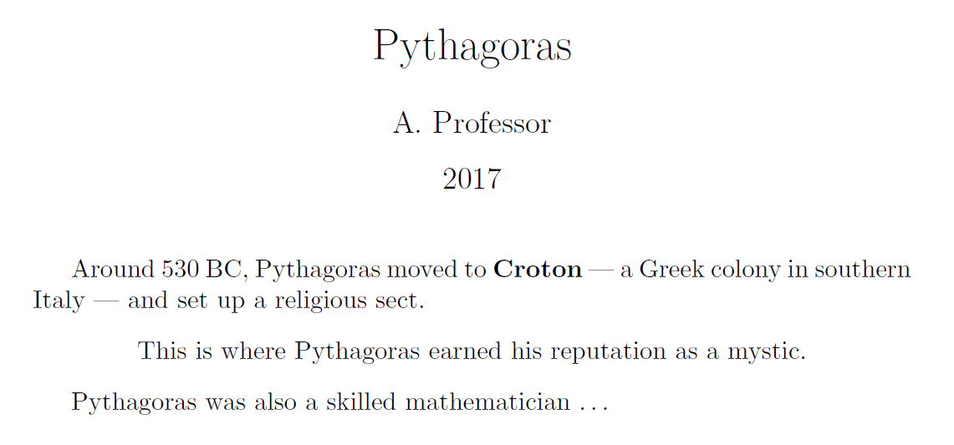
Exercise
What is the LaTeX code that would generate the following document?

Slide 23
Answer
\documentclass[a4paper]{article}
\begin{document}
\title{Pythagoras}
\author{A. Professor}
\date{2017}
\maketitle
Around 530 BC, Pythagoras moved to \textbf{Croton} --- a Greek colony in southern Italy --- and a set up a religious sect.
\begin{center}
This is where Pythagoras earned his reputation as a mystic.
\end{center}
Pythagoras was also a skilled mathematician\ldots

Slide 24
References
There are many LaTeX tutorials on the Internet
  http://www.tug.org/interest.html
  http://www.latex-project.org/
  http://www.ctan.org
Web site that allows you to try it out
  http://sciencesoft.at/index.jsp?link=latex&size=1280&js=1&lang=en
Tutorial documents
  The (not so) short guide to LaTeX
Online course reference manual

