Slide 1
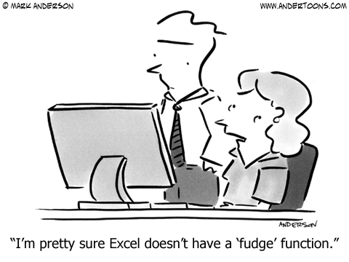
Spreadsheets 2
Lecture 20 COMPSCI 111/111G S2 2020

Slide 2
IF functions
Makes a decision
– Different values used in the cell depending on the logical test
IF( logical_test , value_if_true, value_if_false )
Must be either true or false
value
condition (test)
boolean function
This value appears in the cell if the boolean is false
This value appears in the cell if the boolean is true

Slide 3
Example - coffee data
Imagine an experiment where we record the number of cups of coffee that we drink, and whether it was morning or afternoon. The table of data might appear as shown below:
How can we calculate the average number of coffees that we drink in the morning?

Slide 4
Example - coffee data
Add a new column to store the morning coffee data.
– If the contents of column B is the text "am" then use the value stored in column A. Otherwise, leave it blank.
=IF(B2="am",
A2, "")

Slide 5
Exercises
Given the wind speed as shown in the table below, write the formula that would appear in cell C2. Note that a Gale Warning is issued when the wind speed exceeds 63 km/hr.
=IF(B2 > 63, “Gale Warning”, “”)

Slide 6
Exercises
IF less than 50 percent of tickets available at a venue were sold, then the venue is too large. To produce the result in cell F7, what formula should you use in this cell?
=IF(C7/B7 < 0.5, “Yes”, “No”)

Slide 7
Exercises
Ticket Sales
– Check if more than 90% of the tickets were sold, or if less than 50% of the tickets were sold. In either case, a new venue is required next time.
=IF(OR(C9/B9>0.9,C9/B9<0.5), “Yes”, “No”)

Slide 8
Looking up values in a table
Often have tables of data
We want to look up a value
e.g. given ID number, what is the name?
Student ID | Name | Phone
9100983 | Andrew | 123-4567
2098382 | Albert | 234-7654
2289483 | Adrienne | 321-7839
2109374 | Ann | 567-8932
Use a lookup formula
VLOOKUP - looking up values in a vertical table
HLOOKUP - looking up values in a horizontal table

Slide 9
VLOOKUP
VLOOKUP( value, table, column, [range] )
Value.
This is the value we already have written down. We want to use this value to look up a corresponding value in a table.
Boolean value.
Range of cells.
True if we want to match a range of values
This is the table we are using to look up the value in.
Number.
This specifies which column in the table contains the data we want.
False if we want an exact match.
Usually we want to use absolute references for the table.

Slide 10
Example
=VLOOKUP( value, table, column, range )
False
1
2
3

Slide 11
Exercises
Use a VLOOKUP to find the description for a recorded wind speed
=VLOOKUP( value, table, column, range )
=VLOOKUP(B26, $E$25:$G$37, 3, TRUE)

Slide 12
Exercise: ThinkGeek T-Shirts
http://www.thinkgeek.com/

Slide 13
Exercises
What formulae should be used in cells D15, E15, F15 and F26?
D15:
F15:
=VLOOKUP(A15,$E$3:$F$9,2,FALSE)
=C15 * E15
E15:
F26:
=VLOOKUP(B15,$A$3:$B$8,2,FALSE)
=SUM(F15:F21)

Slide 14
HLOOKUP
Same as VLOOKUP, but for horizontal tables
HLOOKUP( value, table, row, [range] )
Value.
This is the value we already have written down. We want to use this value to look up a corresponding value in a table.
Boolean value.
Range of cells.
True if we want to match a range of values
This is the table we are using to look up the value in.
Number.
This specifies which row in the table contains the data we want.
False if we want an exact match.
Usually we want to use absolute references for the table.

Slide 15
Exercises
What formula would be used in cell C7?
– Use a HLOOKUP
=HLOOKUP(B7,$B$2:$H$3,2,FALSE)

Slide 16
Graphing data
Start by sorting the data into dependent and independent variables
Independent | Dependant
1 | 1.5
2 | 4.9
3 | 2.4
4 | 2.6
5 | 3.3

Slide 17
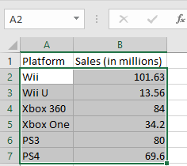
Enter the data
Highlight the data that you wish to graph by holding down the left mouse button & drag over your numbers, then release.
The area highlighted will be graphed. So make sure that you have selected all the data that you want to appear on your graph.

Slide 18
Create a chart
With your data highlighted, click on the “Insert” tab. The “Charts” section of the “Insert” ribbon lets you choose from a variety of different charts.

Slide 19
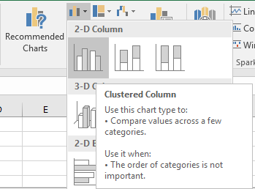
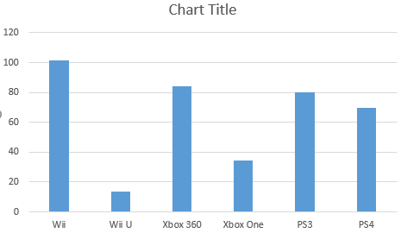
2-D Clustered Column Chart

Slide 20
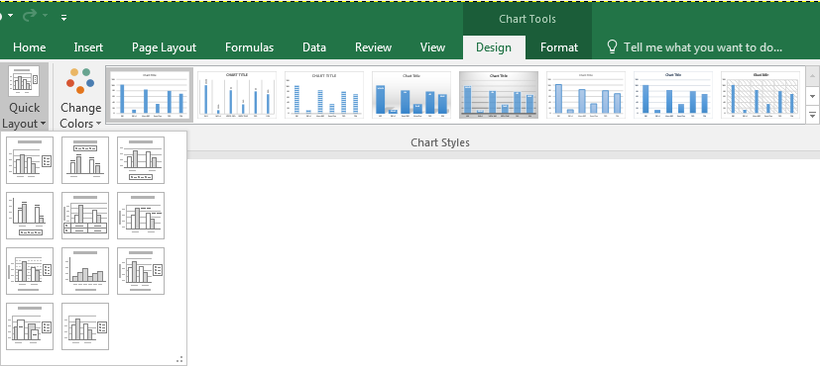
Change layout/style
Styles
Layouts

Slide 21
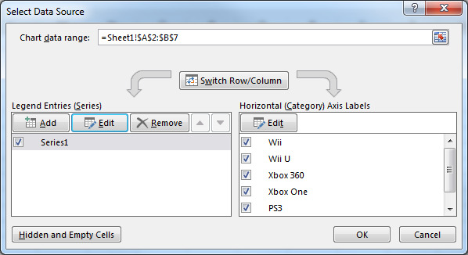
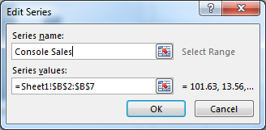
Naming Your Data
Click on “Select Data” in the “Design” ribbon of the “Chart Tools” Tab.
Click on edit to provide a label for the data you are charting.

Slide 22
Click on the title or axes labels and enter your own text

Slide 23
Other Charts
Similar procedure required for other types of charts.

