Slide 1
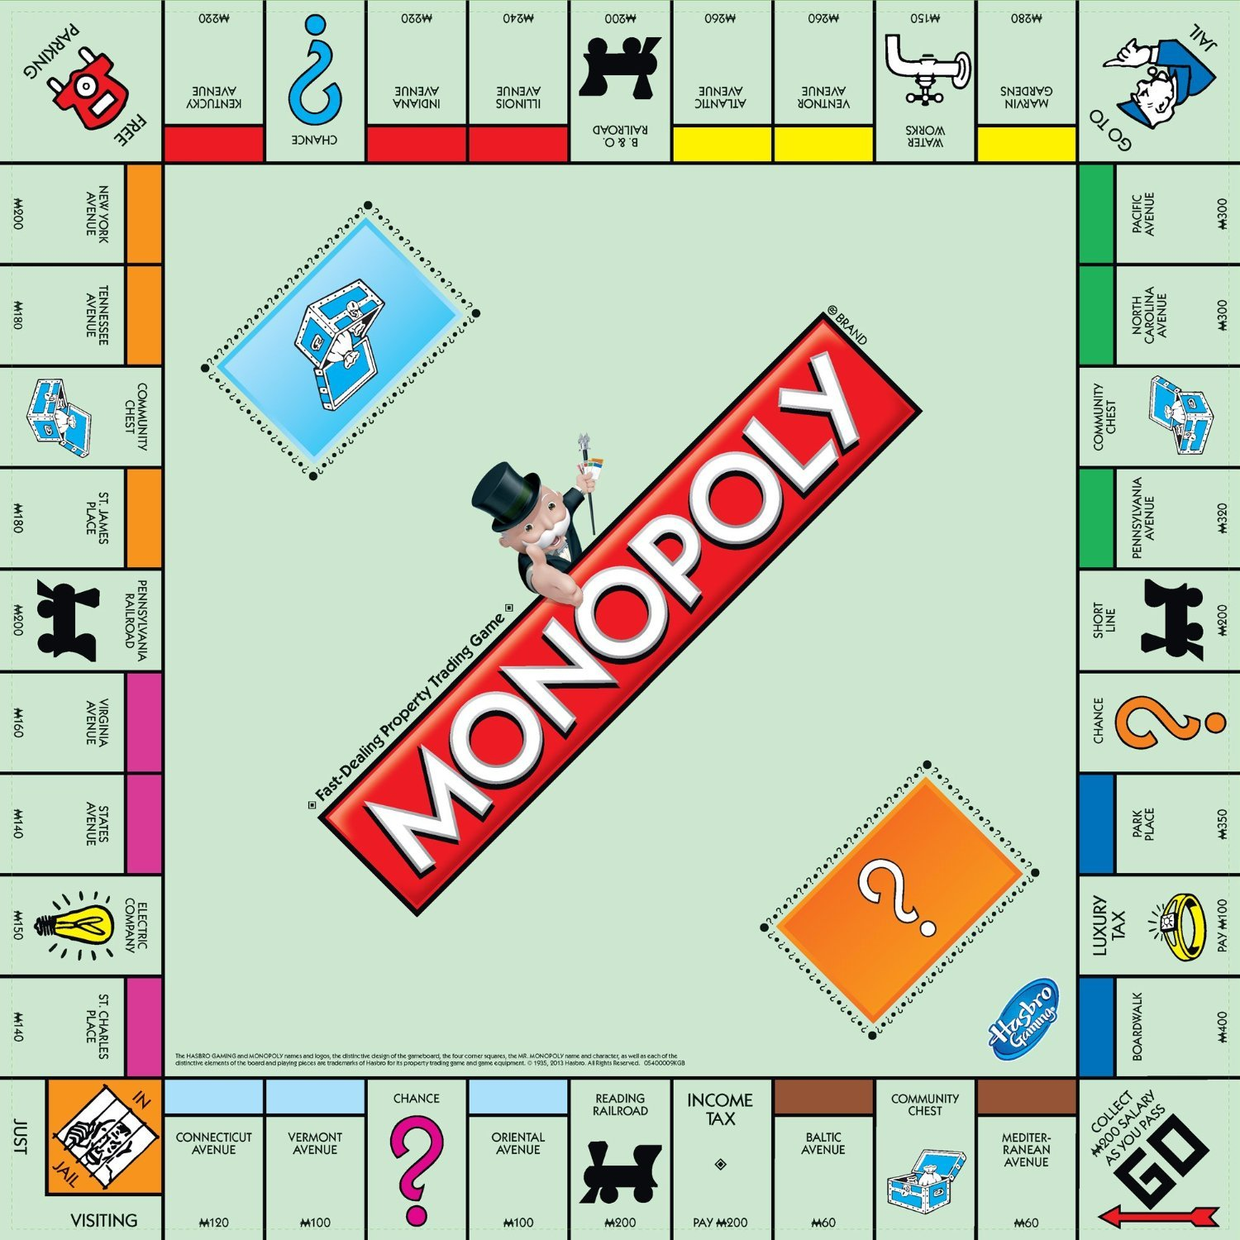
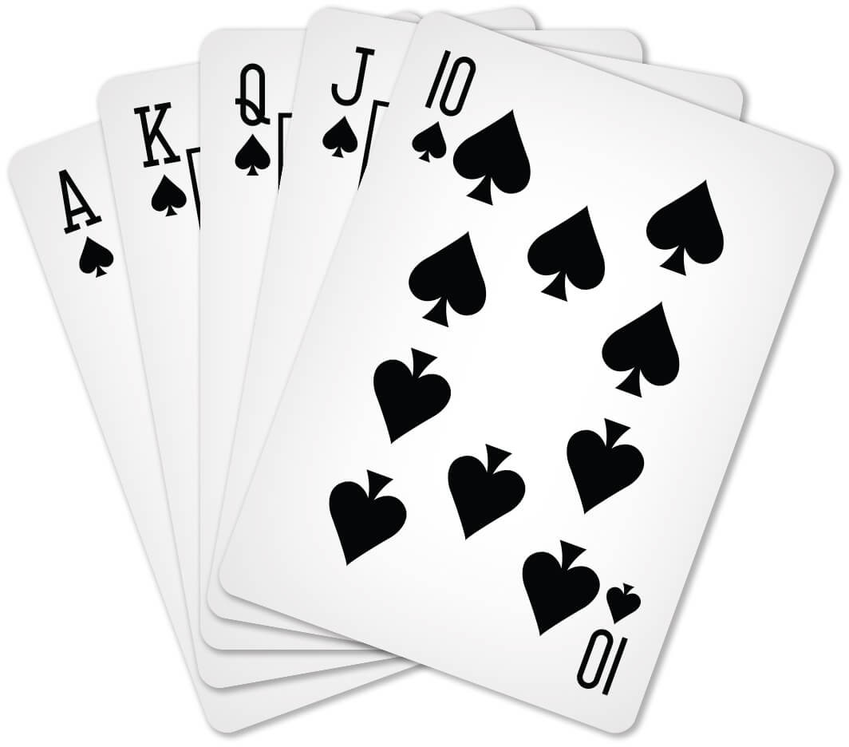
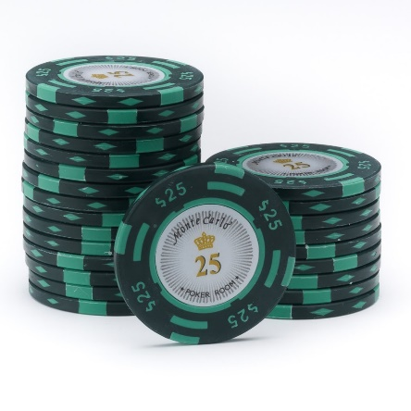
Games I
An Introduction
Lecture 26 – COMPSCI 111/111G S2 2020

Slide 2

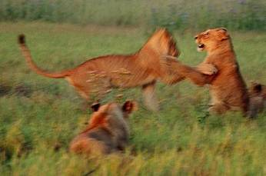
Definitions: Play
Range of activities done for recreational pleasure and enjoyment.
Playing is done by many animal species:
  Usually associated with juvenile activities but occurs at any life stage.
  Possible between species.
  May be used to determine social rank.
  Provides opportunity for learning/training.

Slide 3
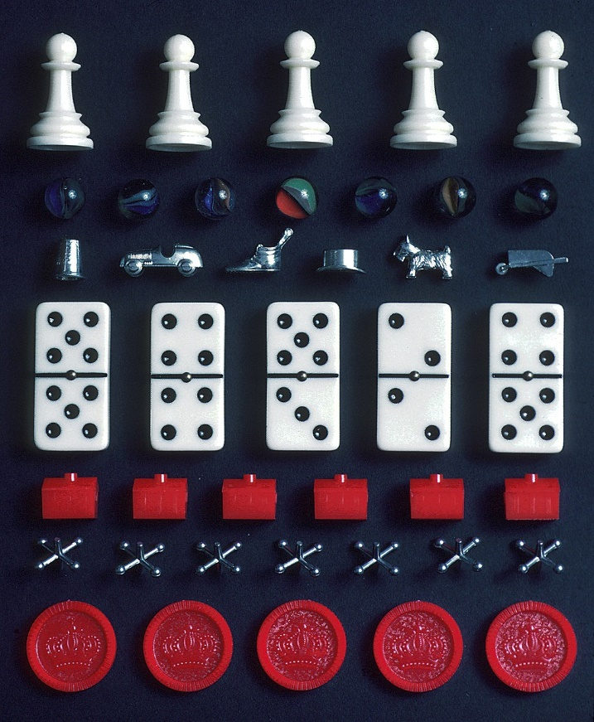
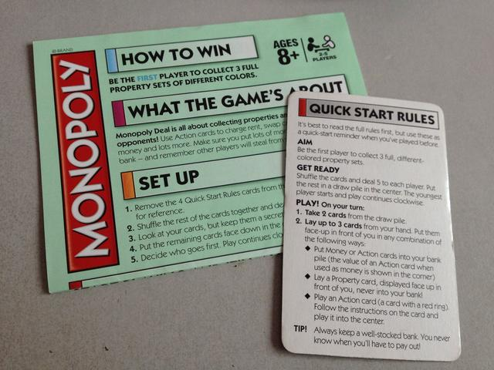
Definitions: Game
Structured form of play governed by rules.
Participants are referred to as players.
Gameplay characterizes what players do.
  Tools and rules that define the overall context of the game.

Slide 4
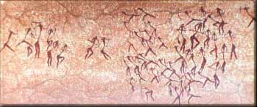
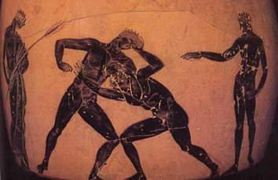
First Games? Sport
Ritualized forms of other activities (hunting)
    Running
    Spear throwing
    Archery
Gameplay features
  Produce a measure of physical skill by competition against other person

Slide 5
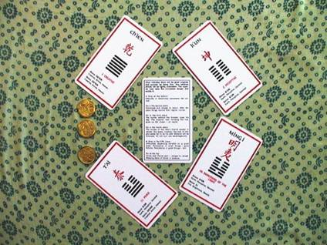
First Games? Divination
Randomizers
  Objects used for divination
Evidence
  Staves found in Tutankhamen’s tomb (~1323 BC) together with game board
  Similar staves found in the royal tombs at Ur together with another game board
  I Ching divination (~1000 BC)
Gameplay features
  Produce a random outcome within well-defined limits and clear states
Source:
Parlett, David, The Oxford History of Board Games, Oxford University Press, 1999

Slide 6
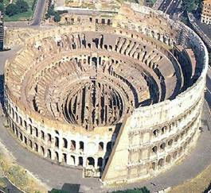
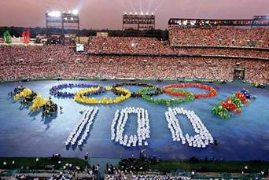
First Organized Games
Gladiator Games
  Celebrate battles at funeral
  Changed when Julius Caesar organized games in honor of his father and then his daughter
Religious festivals
Olympic Games, 776 BC
  Judges
  Truces between countries,
  Participants status as religious pilgrims

Slide 7
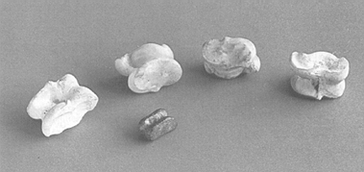
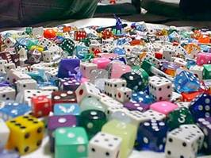
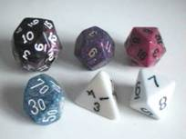
Dice Games
Inventors
  Lydians of Asia according to Herodotus
Predecessors
  Binary Lots
  Astragals
    Depicted ~800 BC
Gameplay features
  Provide variety of ranges for randomizers and tie results to abstract measures – numbers
  Meta game – betting on outcome (but equally possible from sports)
    Will of the gods - not taxed!

Slide 8
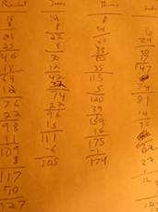
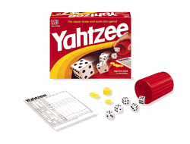
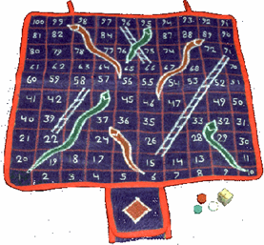
Board Games
Origins
  traced to keeping track of player’s scores in dice games
Gameplay features
  Introduced game token to maintain game state
  Linked series of actions to randomized values to manipulate game state

Slide 9
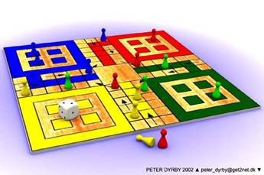
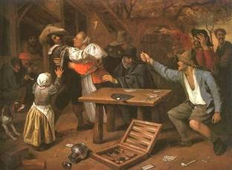
Racing games
Interpreting movement on board as physical movement
  Ludo (from Pachisi, ~700 BC)
  Backgammon (from Senet & Mehen, 2650+ BC)
Gameplay features
  Introduction of the concept of a game world
  Introduction of several game tokens controlled by one player introduced choice
  Capturing other tokens meant that effects of changing one part of the game state by have additional effects – abstract events

Slide 10
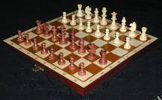
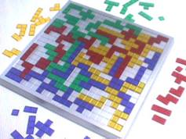
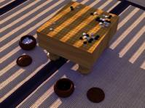
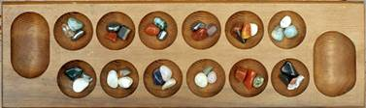
Perfect Information Games (non-stochastic)
Removal of randomness from board games
  Chess (referred ~600 AD)
  Go (from Wei-qi, 2000 BC)
Gameplay features
  2D game world
  Focus on mental skills
  Actions defined by tokens
    Context-dependent actions
    Functionally different tokens
  Possible to predict opponent
  Additional goals based on space control, space filling, connection, and collection

Slide 11
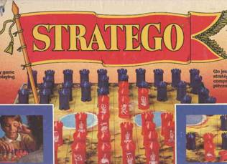
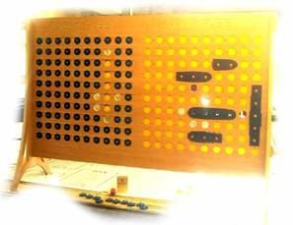
Imperfect Information Games (stochastic)
Making part of the game state unknown to players
  Stratego
  Battleship
  Blind Chess/Kriegspiel
Gameplay features
  Hidden game state
  Heterogeneous information availability

Slide 12
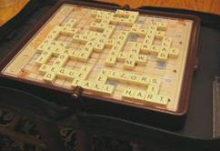
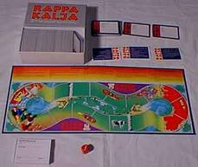
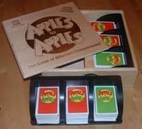
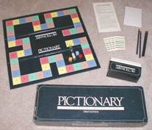
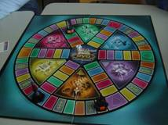
Skill Games
Board games where movement is determined by successful action or performance
  Scrabble
  Trivial Pursuit
  Pictionary
  “Normality Game”
  Balderdash (Rappakalja)
  Apples to Apples
Gameplay features
  Introduction of variety of skills – social, artistic, intellectual

Slide 13
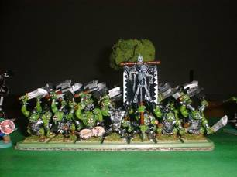
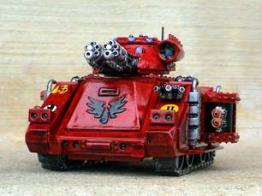
Tabletop or Miniature Games
Origins in forms of kriegspiel
Similar to board games but use graphically depicted miniatures
  Warhammer 40K
Gameplay features
  Continuous game world
  Players own game tokens they use
  Requires players to do extra-game activities

Slide 14
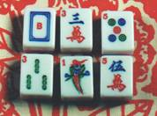
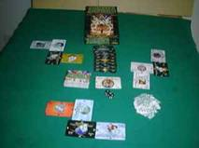
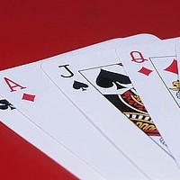
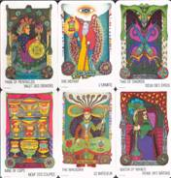
Card Games
Background intertwined with Dominoes & Mah-Jong tiles
  Modern variants probably Persian origin
  Brought to Europe by Arabs 13th century
  Specialized decks quite late
Gameplay features
  Game systems
  Random but fixed distribution

Slide 15
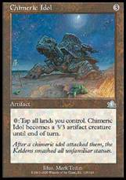
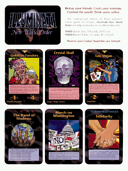
Collectable Card Games
Combines card games with idol cards
  Magic: the gathering
  Illuminati: new world order
Gameplay features
  Cards have self-contained rules within a rule framework
  Physical rarity affects value of game token

Slide 16
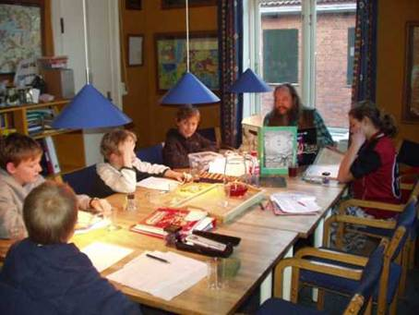
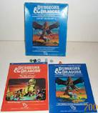
Roleplaying Games
Expansion from miniature games
  Dungeons & Dragons, 1974
  The Basic Roleplaying System
Gameplay features
  Unclear winning conditions
  Unclear end conditions
    campaigns
  Game master
    Unequal power structure
    Open-ended rule set
    Mediates the Game World
  Character development
  Roleplaying
  Novel narrative structure – adventure modules

Slide 17
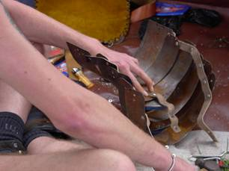
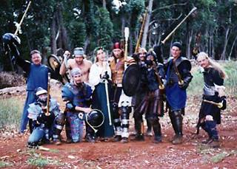
Live-Action Roleplaying Games
Arose from roleplaying games, improvisational theatre and re-enactment societies
Earlier similar activities
  re-enactments of battles between Osiris and Seth in ancient Egypt
  ‘carrousel’ games at European courts during the 17th and 18th centuries
  psychoanalytic methods in the 1920s
Gameplay features
  Players represent their characters
  Players physically act out what they do in the game
  Extra-game activities may take a majority of time spent

Slide 18
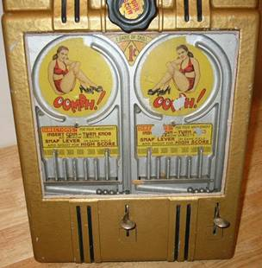
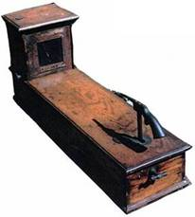
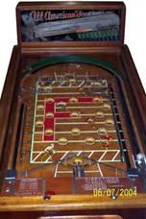
Novelty Games
Machines that provide gameplay or lets players test skills
Gameplay features
  Coin-op
  Machine controls game flow

Slide 19
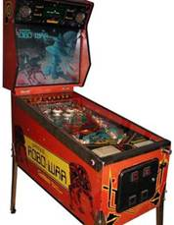
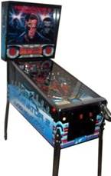
Pinball
Gameplay features
  Flippers
  Electro-mechanical game system
Pinball games were initially used for gambling.
  Lead to legal issues and then banning in certain places.
  Generally considered games of skill rather than chance now.
  Pachinko is a similar electromechanical game system that is used for gambling in Japan.

