Slide 1
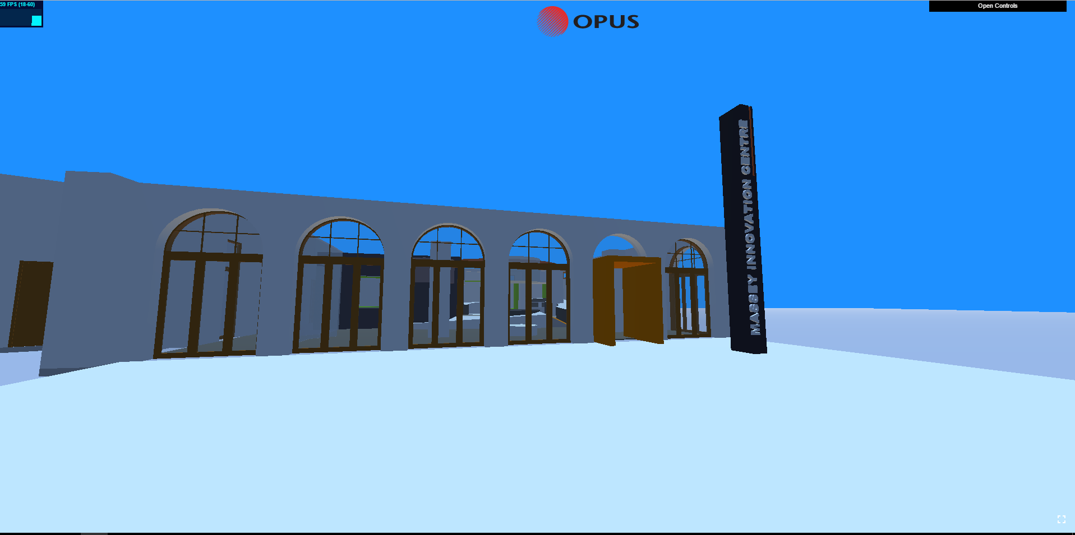
Opus WebVR
By Zeeshan Sarwar
Notes:
Im working with Opus International Consultants in developing a web-based platform which will allow clients to perform VR walkthroughs within 3D models

Slide 2
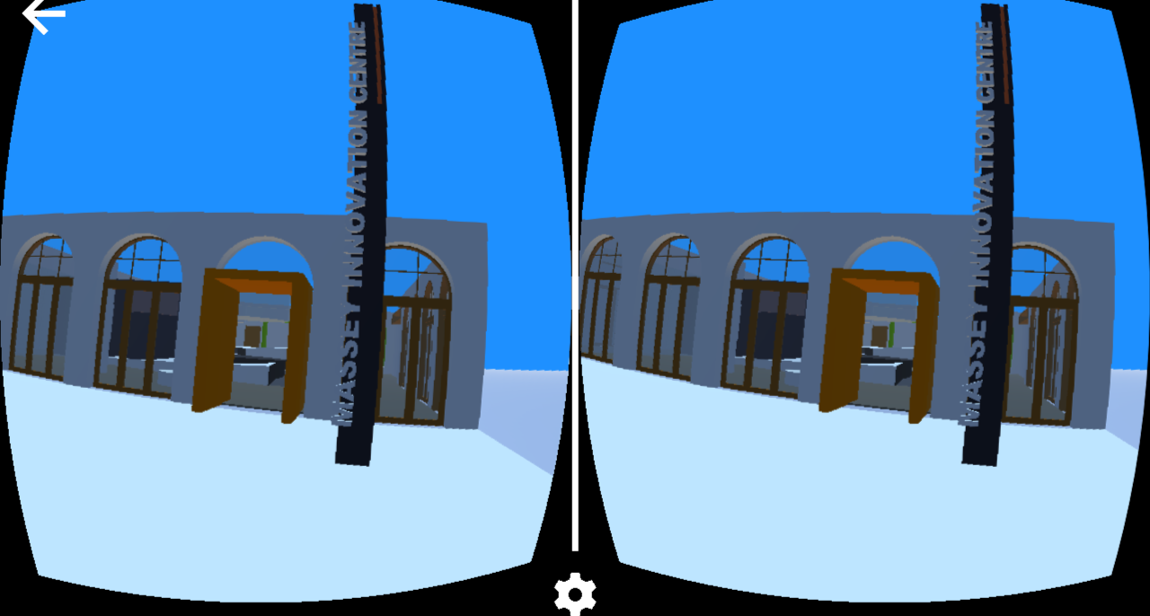
The Project
WebVR: A webgl-based VR platform
Notes:
~ 0:40
WebVR architecture:
The application will allow users to perform VR walkthroughs within 3D models via utilizing a smartphone and the Google Cardboard headset
The solution will be pluginless, so it wont require the client do download anything
All they will have to do is visit the webpage on their PC or mobile device
Its very powerful tool for conveying visual information to users
VR team:
I am closely working with the Opus VR team
Based on the success of this WebVR solution, it has potential to be used as commercial software

Slide 3
Recap
Small recap of mid year seminar
  Motivation
  Technologies required
    Web-based: HTML, CSS, Javascript
      Graphics Libraries: WebGL and ThreeJS
Notes:
~ 1:20 (80s)
Motivation:
Next big thing
8/10 large companies are invested in VR – includes Google, Samsung , Apple and Microsoft
So this motivates me to work on such new technologies which have a promising future
Technologies
- HTML, CSS, Javascript
WebGL – Allows you to render complex 3D graphics via utilizing the GPU on the webpage without the use of any plugins
Multi-platform so it will scale with many systems
ThreeJS
A open-source library on top of WebGL which abstracts much of the complicated WebGL code while still maintaining its performance
WebGL is still run under the hood
The WebVR platform heavily utilizes 3JS
I defined a 6-step implementation workflow which assist me in implementing the WebVR solution

Slide 4
Implementation Procedure
Initialize a WebGL scene (ThreeJS) scene and render a basic object
Load a 3D model into the scene
Implement player controls (PC) to navigate the scene
  Implement physics
Extend support to VR for mobile platforms (stereoscopic scene view)
Implement VR controls
Implement intuitive GUI controls
Notes:
~ 1:20 (80s)
The workflow was broken down into 6 milestones which were used to implement the WebVR solution:
The first was to initialize a scene and render a 3D object
The second was to load in a 3D model onto the webpage
Both these steps were covered in the mid-year seminar
The next step is to implement player controls to navigate the scene on PC
This also includes implementing important features such as keyboard and mouse support and also physics
Which incorporates both gravity and collision detection
The next step is to extend the support to mobile platforms so we can view the scene within the Google Cardboard headset
Once we are able to do that, we must implement mobile controls which will allow the user to walkthough the scene in mobile
It must be noted that the Google Cardboard has limited interactivity, so we can only use 1 button for movement
The final step is to implement a GUI which will give users dynamic control over elements within the scene
This basically will allow the VR team to adjust scene parameter and save and load scenes without being required to read code

Slide 5
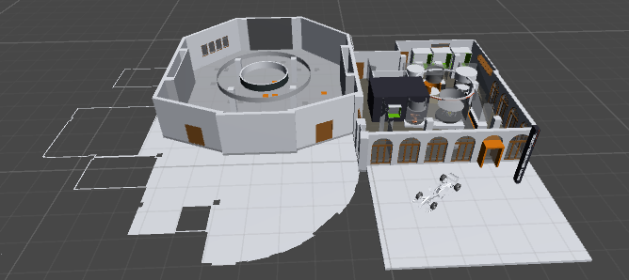
Live Demo
http://zsar419.github.io/webvr_prototype/
Notes:
About ~5 mins max
~ 0:10
- I will now demonstrate a live demo with the following 3D model – provided by Opus VR team
I will show the basic procedure how one can setup VR walkthroughs within 3D models using the architecture
Show you the procedure which Opus can take to setup 3D VR walkthroughs for their clients
Show Google sketchup (model)
Files in the Models folder
Export the Google sketchup model to a collada format
This will give us a file which defines the structure of the model
And a textures folder which represents all the textures within the model
You can put as many models in this folder as you wish
This directory will typically be on a server
Explain controls:
Mouse
Keyboard
Physics
Gravity (jump) - Jump off the plane
Pictures
FPS stats viewer
Try to maintain 60fps for best walkthrough experience
Implement intuitive GUI controls
This will allow Opus to make changes to the scene dynamically on the fly without having to touch any code
They can also save and load scenes with this
And they can make profiles for different users based on what they required
Load model: typing into the name
Forward based collision detection
Show picture (2d)
Show picture 3D
In VR you only have 1 button control – which will be for forward movement
Show fly-mode
Save Scene and reload
So changes remain persistent
Now clients and other users can walkthrough this VR-ready scene
VR
As you can see I don’t need to download anything to perform VR walkthroughs, all I need to do is visit the webpage and if the scene has been setup, I can perform a walkthrough in it

Slide 6
Results (Discussion)
General trend:
  Bigger 3D model → Slower scene → Bad VR experience
Categories: | Model Size (mb):
Small | 0 - 5
Medium | 5 - 10
Large | 10 +
Notes:
~ 0:50
After performing some tests with different kinds and sizes of 3D models, I realized that 3D models with bigger file sizes tended to take longer to load and were also slower to render
It must be noted that this more apparent on smartphones due to inferior hardware
This implies that some models may work very well on PC but may not be viable for VR walkthroughs on smartphones
From my observations I produced a table for categorizing viable model sizes – for smartphones
The general trend was that the quality of the walkthrough experience deteriorates as the model becomes larger

Slide 7
Limitations
Issues with large 3D models
Lower FPS in VR
Cannot dynamically adjust VR parameters
Notes:
~ 1:00 (60s)
Issues with large 3D models
A lot of time taken to load and render large 3D models since they inherently have a large polygon count
This may frustrate some users due to the bad quality of the walkthrough experience
Lower FPS in VR:
This is an inherent problem – since in VR, the same scene is rendered twice for each view which decreases scene performance
No way to fix this problem other than viewing smaller 3D models
Cannot dynamically adjust VR parameters
Currently you cant adjust your field-of-view, eye-separation, screen-to-lens distance and distortion

Slide 8
Potential Improvements
Model crunchers to make larger 3D models more viable
Dynamic object removal
  Shoot objects to make them disappear
  Identify performance bottlenecks at run-time
Notes:
~ 1:50 (110s)
Model crunchers
Model crunchers reduces the polygon count of a model while still maintain the overall template
They work by identifying areas of high polygon density and remove them from the model
This will allow us to walkthrough large models since their template is retained but size is reduced
Dynamic object removal
Currently it might be difficult to identify which object in the model is causing the scene to be rendered slowly
One way to do this would be to have the ability to remove objects in the model after the scene has loaded
Can be implemented by having a first-person-shooter approach
Upon clicking, a ray can be cast from the player to the scene and upon intersecting with an object, it will cause it to disappear
Its basically like shooting objects to make them disappear
This will give the user more fine-grained control over objects within the model

Slide 9
Future work
Extension to multiplayer walkthrough capabilities
  VR tours
  Collaborative 3D model visualizations and walkthroughs
Web based dynamic First Person Shooter games
  Just need ray casting for bullets, moving entities (enemies) and basic level design
  With natural support for VR
Notes:
~1:50 (110s)
I believe that the implemented architecture has a lot of potential
Extension to support multiplayer capabilities is also very interesting
Can extend the WebVR architecture to support multiplayer capabilities so that many people can experience Walkthroughs within the same 3D models
This can allow Opus-VR team to arrange virtual web-based VR tours which will greatly enhance VR experiences for their clients
Can be used to produce a web-based dynamic FPS game
The implemented architecture already supports the main FPS elements such as first person controls, movement and physics
All we need to add shooting via guns, moving entities or enemies, level design and give the user an incentive to play
We also have the ability to use VR on top of all this which further immersifies the experience
Implementation of these features and additionally multiplayer would make this a robust web-based platform to play FPS games
It must be noted that the the WebVR solution is a naturally improving platform
- This is because development efforts are continuing in in ThreeJS, WebGL and mobile hardware
Advances in these 3 fields will naturally allow the proposed WebVR architecture to scale

Slide 10
What iv’e Gained
Ability to follow client requirements (Opus-VR team) to implement software
Experience in utilizing cutting edge web-based technologies
Developed a robust platform which has potential to be used in many types of industries
A great addition to my Portfolio
Significance for Opus
  Allows their clients to get a better insight on the structure of their 3D models by walking in them (VR)
  Allows clients to make well-informed decisions for the model of interest
Notes:
~ 0:40
Now I will just quickly outline what I’ve gained from this project
- Experience in following client requirements (Opus) to implement a potentially commercial architecture
- Experience with cutting-edge web-based technologies for the implementation of a novel WebVR platform
- A robust multi-platform application which has potential to be used in many types of industries
- Something to put onto my CV for potential employers
For Opus
For the purposes of Opus, this platform can allow their clients to view and walkthrough 3D models from the freedom of their homes
This will allow clients to get a better sense of scale once they walk through that model in VR (using their smartphone) too.
Addionally, via the use of GUI controls, the client can fine tune the parameters of the actual building/structure of interest, thus allowing them to make a well-informed decision whether to proceed to construction or not.

Slide 11
Fin
Questions???
Notes:
- Full project details available in report (feel free to ask)
~ 12 mins (without demo)

