Slide 1
BTECH 451 Final Seminar
Tianyun Gu

Slide 2
Introduction
Kiwiplan is an industry software solutions development company for software used in many areas of the supply chain, in manufacturing of rigid packaging.
Droid is the automated testing system used by Kiwiplan, developed in house to fit their specific uses.
Tests are performed by checking for discrepancies between expected output in the form of a screen capture and the screen produced from the test.
My project aims to develop a system to address the challenge of matching expected output images to associated tests, for which there is currently no intuitive method.

Slide 3
Proposed Solution
My solution performs the following:
Convert image file type.
Extract text from image through OCR.
Index images with search terms: OCR results stored to allow for search in an efficient manner.
Search the database though a web based interface.

Slide 4
Optical Character Recognition (OCR)
The process of converting images of text into a machine readable format.
Images often come from a variety of sources, including photographs and document scans.
Common applications: Transcribing printed documents to digital form, data entry from physical records, conversion of handwritten text.
Not often used for digitally sourced images.

Slide 5
OCR Cont’d
A number of OCR engines were examined: Evernote OCR, ABBYY Finereader, Tesseract OCR.
Tesseract OCR
Originally developed by Hewlett Packard and currently open source.
Uses an ‘adaptive classifier’, which actively learns from the content as it is processed, e.g. estimating character widths, to improve accuracy of later processing.

Slide 6
OCR Challenges
Unique challenges are introduced due to images being generated from screen display.
Most OCR packages are not designed with this use case in mind.
Initial attempts with Tesseract OCR produced very inaccurate results.
Pre-processing steps involve cropping the image and upscaling resolution.

Slide 7
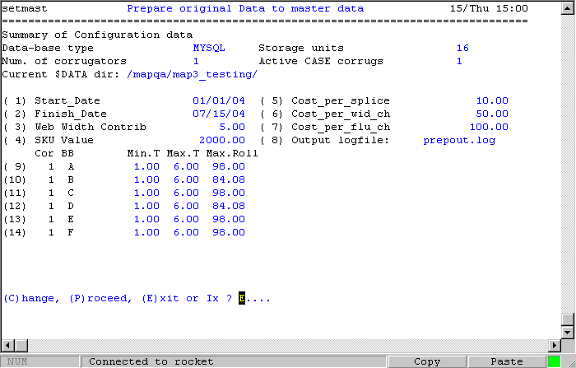
Example of an actual Droid image:

Slide 8
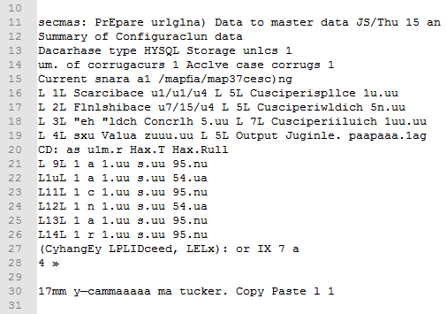
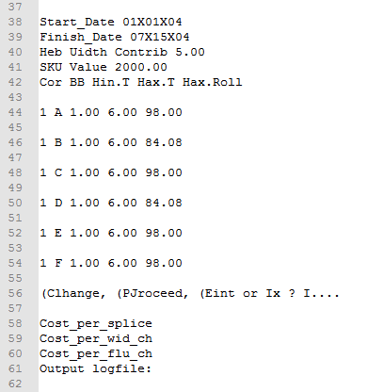
Above: OCR Result without preprocessing.
Left: OCR Result with image scaled up 400%

Slide 9
Indexing & Search
A number of search engines were considered: Xapien, Solr, Hibernate.
Hibernate Search:
A pure java implementation.
Built on Hibernate ORM and Lucene search engine.
Allows indexing and full text search of Java objects based on instance variables.
Vendor independent implementation of SQL.

Slide 10
Object-Relation Mapping (ORM)
ORM is the conversion of data from an object-orientated paradigm to relations in the relational model.
Allows the transparent conversion of object-orientated data to relational data.
Reduces the need for programmers to be concerned about how to store object data.
Hibernate updates the search index every time an image is translated through ORM. Index must be rebuilt for existing databases.

Slide 11

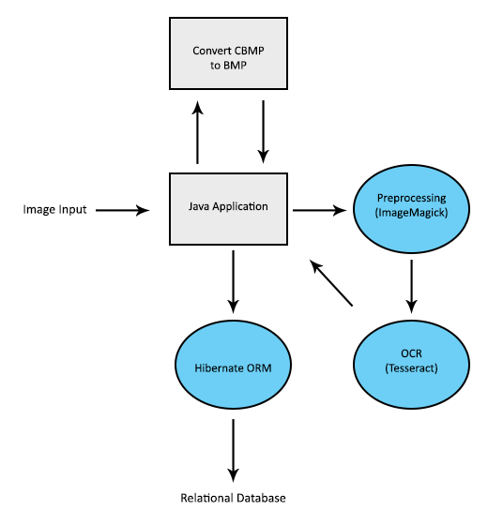
System Architecture
Input: list of image directories.
Image preprocessing: decompress CBMP file, then prepare image for OCR.
Perform OCR
Data Storage: java objects converted to relational database.
Two data object classes are mapped to three relational tables.

Slide 12
Database Design
TestImage Table
ImageID | ImageName | ImagePath
ImageTag Table
TagID | TagText
TagMap Table
ImageID (FK) | TagID (FK)

Slide 13

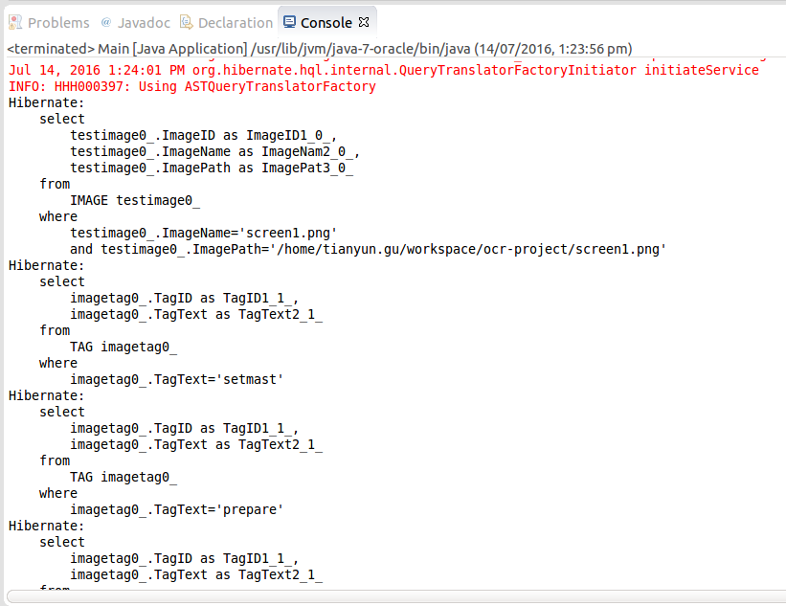
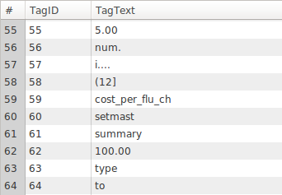
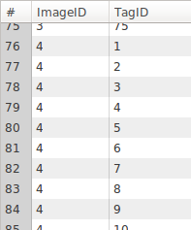
Adding an Image

Slide 14
The Web Service
Web service to be deployed on Tomcat server.
There are many approaches to communicating with java application.
A Traditional Approach: Website communicates with service through HTTP requests. Data objects returned, eg. JSON. Dynamic content generated client-side through Javascript.

Slide 15
Spring MVC
Web service deployed as a single application. Web pages and back end are combined.
Automatic creation and management of servlets and other resources through JavaServer Pages (JSP).
Separation of concerns.
Handles mappings of request URLs to JSPs.
Content of web page is dynamically generated by the server: no communication of data objects to client

Slide 16
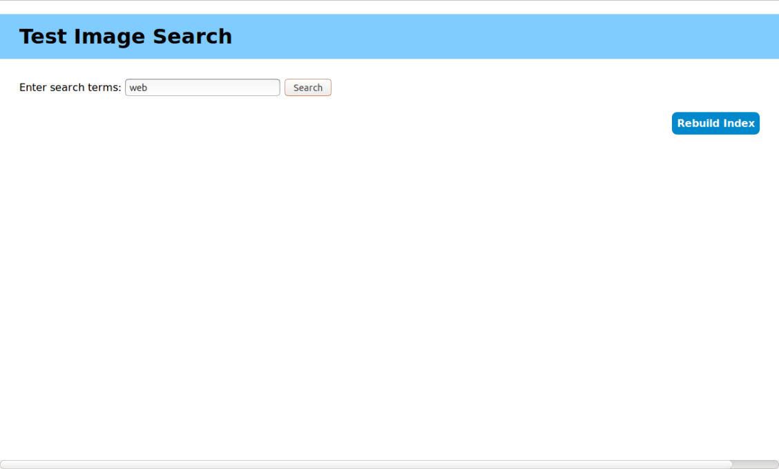
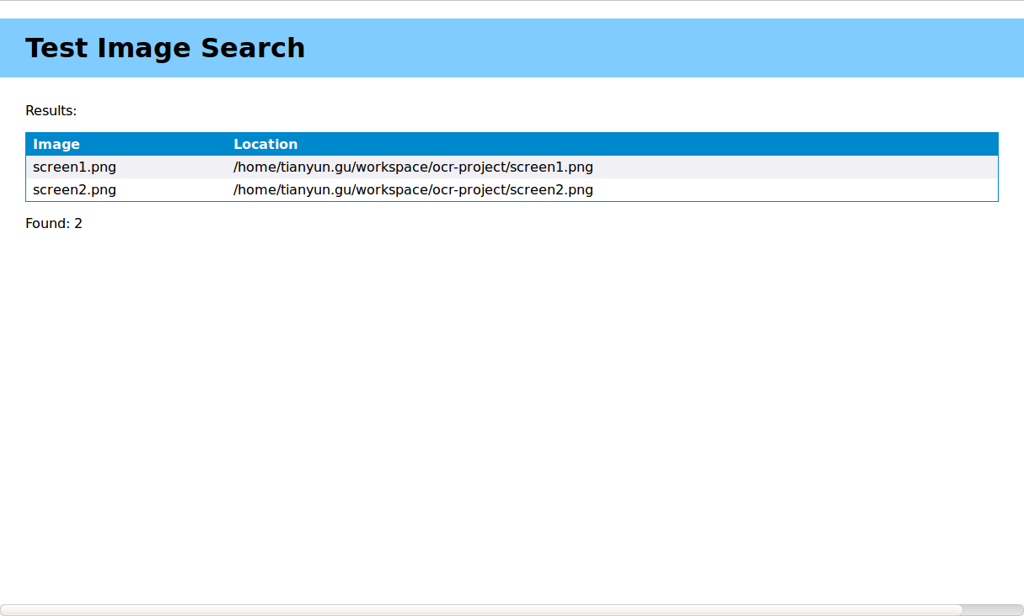
User Interface

Slide 17
Web Service Implementation
Separation of data objects, data access objects, and controllers.
Lucene index must be present on the server machine to successfully complete search. The function to build this is included in the service.
When using multiple search terms, results must contain both. (This can be changed through Hibernate configuration.)
Dynamic page content is generated server-side. The JSP is converted to HTML by client, and styling is applied through CSS.

Slide 18
Possible Extensions
Improve accuracy of OCR results: tweaks to image pre-processing steps, training Tesseract with image data.
Customisable search options.
User interface enhancements.

Slide 19
Thank you!
Questions?

