Slide 1
BTECH 451
Mid-Year Seminar
Tianyun Gu

Slide 2
Introduction
Kiwiplan is an industry software solutions development company for software used in many areas of the supply chain, in manufacturing of rigid packaging.
Droid is the automated testing system used by Kiwiplan, developed in house to fit their specific uses.
Tests are performed by checking for discrepancies between expected output in the form of a screen capture and the screen produced from the test.
This project aims to develop a system to address the challenge of matching expected output images to associated tests, for which there is currently no intuitive method.

Slide 3
Proposed Solution Concept
My solution should perform the following:
Convert image file type: Decompress the proprietary format.
Extract text from image: OCR
Images indexed with search terms: OCR results stored stored to allow for search in an efficient manner.
Communication through web based service: Other machines on the network should able to access image database through search interface.

Slide 4
Related Work
World Digital Library: System for full text search of digital book scans. Tesseract OCR engine; Apache Solr for search.
New Zealand Journal of History: Academic Journal of NZ history, with older issues digitalised from scans. ABBYY Finereader OCR engine.

Slide 5
Optical Character Recognition (OCR)
The process of converting images of text into a machine readable format.
Images often come from a variety of sources, including photographs and document scans.
Common applications: Transcribing printed documents to digital form, data entry from physical records, conversion of handwritten text.

Slide 6
Evernote’s OCR
Application for creating digital ‘notes’ with support for a range of media types, including both text and images.
OCR is performed on images contained in notes through a series of ‘passes’, each with differing initial assumptions.
Places emphasis on extracting as many text strings as possible for comprehensive index coverage, rather than high accuracy.
This OCR system is complex.

Slide 7
OCR Cont’d
ABBYY Finereader
Leading product in the field with very high reported accuracy.
Geared towards converting scanned images into an editable form.
Proprietary license with many features unnecessary for my purposes.
Tesseract OCR
Originally developed by Hewlett Packard and currently open source.
Uses an ‘adaptive classifier’, which actively learns from the content as it is processed, e.g. estimating character widths, to improve accuracy of later processing.

Slide 8
OCR Challenges
Unique challenges are introduced due to images being generated from screen display.
Most OCR packages are not designed with this use case in mind.
Initial attempts with Tesseract OCR produced very inaccurate results.
Need for image preprocessing to improve the accuracy of results.

Slide 9
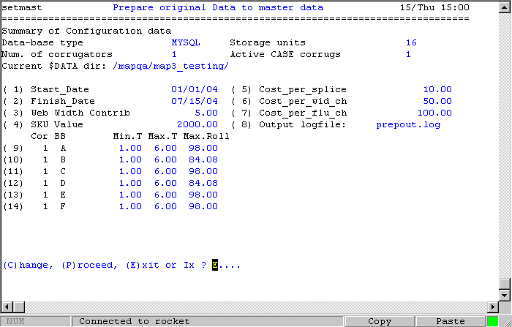
Example of an actual Droid image:

Slide 10
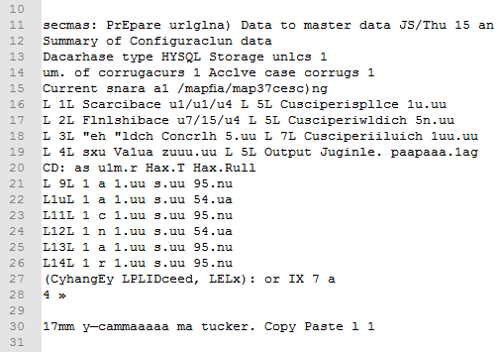
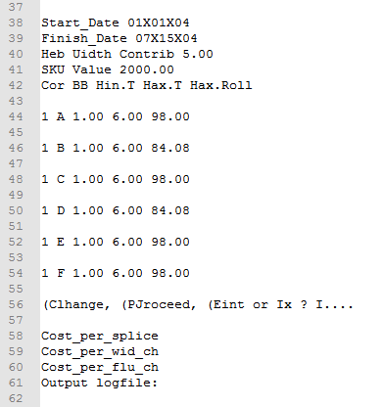
Above: OCR Result without preprocessing.
Left: OCR Result with image scaled up 400%

Slide 11
Indexing & Search
Must store data in SQL database to conform with existing Kiwiplan systems.
Hibernate Search:
A pure java implementation.
Built on Hibernate ORM.
ORM is the conversion of data from an object-orientated paradigm to relations in the relational model.

Slide 12
Database Design
TestImage Table
ImageID | ImageName | ImagePath
ImageTag Table
TagID | TagText
TagMap Table
ImageID (FK) | TagID (FK)

Slide 13

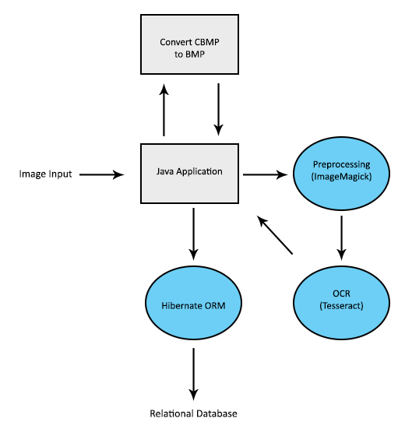
System Architecture
Image preprocessing: decompress CBMP file with call to external conversion program, then prepare image for OCR.
OCR: performed with Tesseract OCR.
Data Storage: java application defines data structures to represent OCR results, then passed to Hibernate ORM for conversion and storage as relations.

Slide 14
Next Steps
First semester’s work has focused on implementing server side features.
Currently limited to command line functionality, to be converted to a web service.
Web-based GUI will facilitate searching of images.

Slide 16

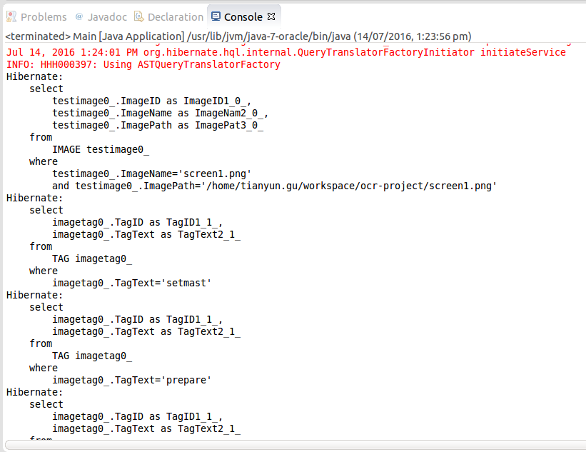
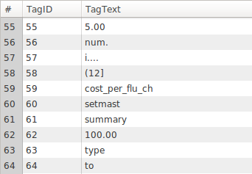
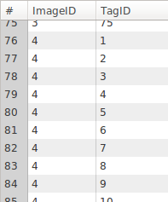
Adding an Image

Slide 17
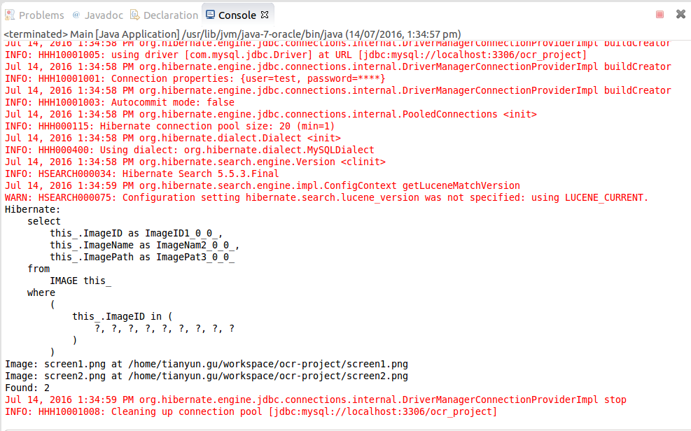
Search for a Tag
Back

