Slide 1
BTECH 451
Tianyun Gu

Slide 2
Introduction
Droid is the automated testing service used by Kiwiplan.
Test compares screen capture to base case image of expected output.
Very large test set with unintuitive names. Tests are difficult to search through.
Seeking a solution to increase ease of searching test cases.

Slide 3
Goals
Make test images searchable by text and keywords present on image.
User interacts with a web based interface to perform search and retrieve results.
Reach results in a timely manner.
Updates to changes in test set is processed automatically.

Slide 4
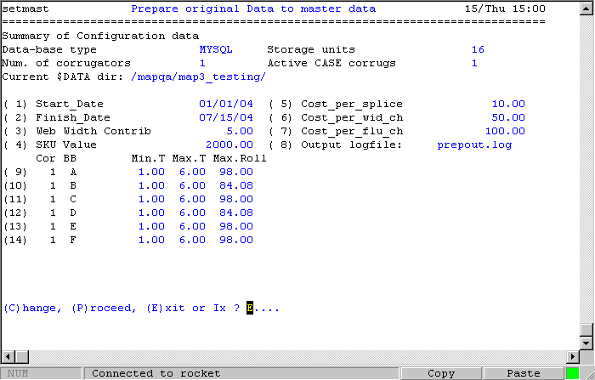
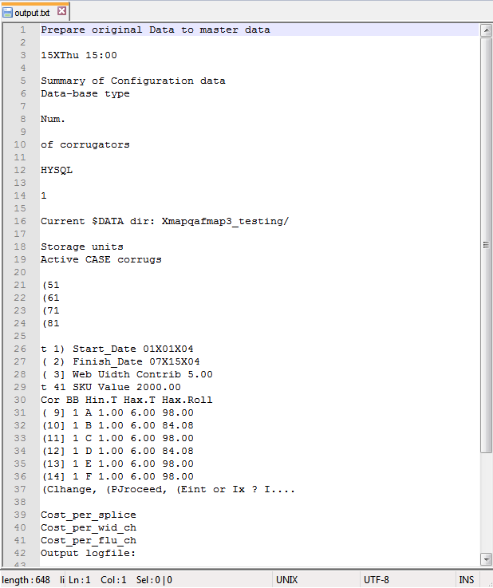
Example of image to text file through OCR.

Slide 5
Rationale
Value in being able to automate meaning extraction from data (in this cases finding relevant tests).
This saves time and reduces human effort, as one does not have to search through tests manually
Useful for scalability; compatibility with legacy tests and handling increasing number of tests

Slide 6
What I hope to gain
Familiarity with project management.
Experience with building a web based service.
Skills in integrating different functionality from many libraries into a single service.

