Slide 1

Mid-Year Seminar
BTECH 451 | Shane Singh | ssin924@aucklanduni.ac.nz

Slide 2
Freedawn – The Company
A start-up focusing on a new niche social platform
A platform allowing everyone to communicate with others in fields they wish to learn about
A platform allowing people to achieve goals they thought they would never be able to
Started up by the company operating Experiences across New Zealand as well as operating the Supercars Driving Experiences in Auckland

Slide 3
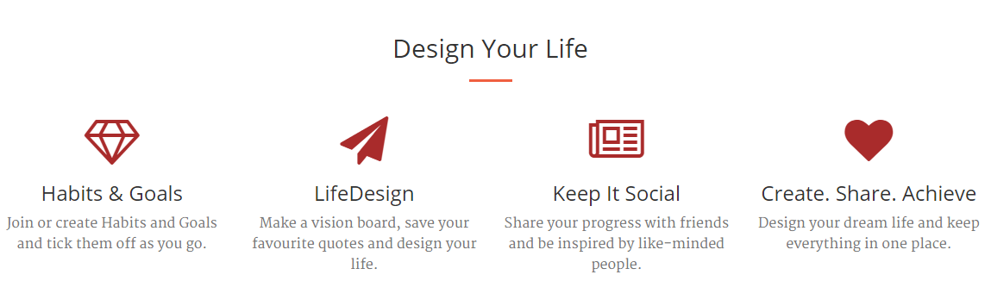
Freedawn Overview
Notes:
Habits + Goals – join/create and tick them off as you go
LifeDesign – visionboard, favourite quotes and design what you want to do and where you want to go
Keep it Social – share across multiple platforms – Facebook, Twitter, LinkedIn integration

Slide 4
Current Stage
Beta site is currently open for registrations for testing
Most modules are working well with minimal bugs but still requires copious testing
Variety of different variables and factors that were not thought of during development have been brought up by Beta Testers resulting in further development and redevelopment of particular areas.
Notes:
Beta – currently listed on Beta testing sites, reviews on current performance has been used to redevelop.
Feedback system in place on website to allow beta testers to place feedback in a discussion area
Feedback is discussed with other beta testers and developers, once a sufficient fix has been discussed it is implemented
Integration of goals, habits with personal page is almost complete, but still requiring a bit of testing and fixing

Slide 5
Progress
Evolution of both Freedawn model and development of new business model
Added a new section/module – Habits
Implementation of Bootstrap Tour
Grid Layout Library Changes
Web Server Changes
Additional Live Testing Server implemented
Notes:
Development on monetizing Freedawn, personal free – implementation with business however different
Adding an interactive walkthrough the website, for new users to guide them through the differences between many other social website
Cascading Grid Layout for the pages, how the goals and habits are displayed to users and over devices
Web Server Changes – optimizing the software to suit the hardware as load and stress on resources increase before increasing the available hardware
Added another instance for testing changes

Slide 6
Model Change
Freedawn holding off from Experts/Mentors
Optimization of site and performance as well as bug testing and correction
Freedawn for Business developing
Launching a social platform for businesses based on development and growth within a business but also personal development.
Notes:
Holding off from Experts/Mentors – before monetizing make sure site is 100%
Discussions and development with HR Departments at Sharp / Crombie Lockwood / TradeTools
Adjusting and creating new modules for an in-house social platform

Slide 7
Habits
A new module of Freedawn
Based on Grid Layout + Goals section
A selection of habits you would like to do, and check of upon completion daily
Implementation in personal page as well as Habit Mine
Notes:
Habits – module completion and integration with personal page and AJAX for ticking off/completed/streaks and total completed

Slide 8
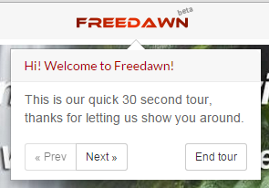
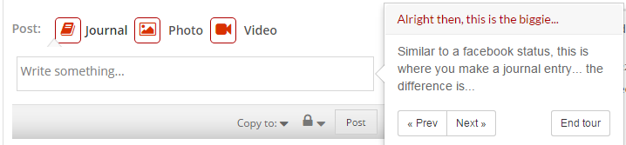
Bootstrap Tour
jQuery-based plugin for interactive walkthrough implemented in Freedawn
Requires minimal amount of JavaScript and works with existing DOM structure

Slide 9
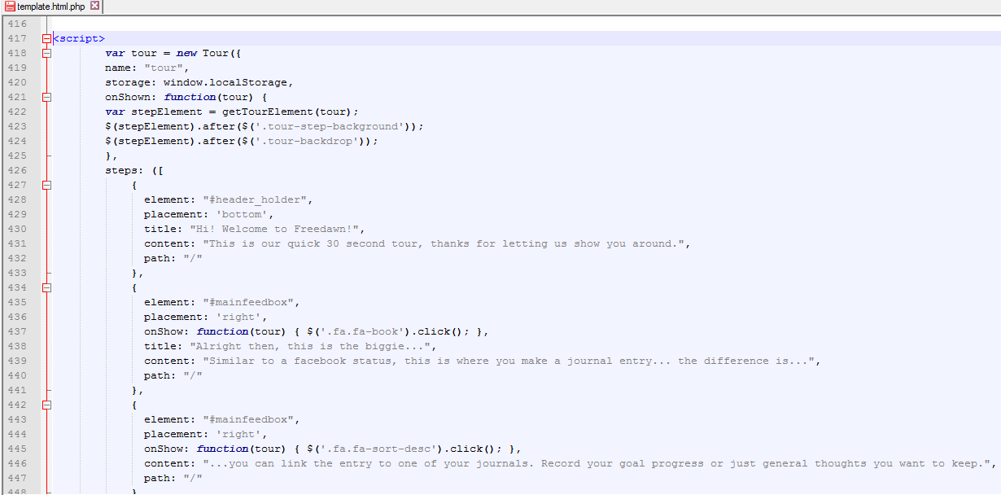
Bootstrap Tour

Slide 10
Grid Layout Changes
Variety of options for Javascript Cascading Grid Layouts
Gridster
Masonry
Shuffle
Freewall
Isotope
Chosen – Masonry
Testing had to be done on most popular options to test both performance and stability
Notes:
Different options were tested – based on performance and scalability

Slide 11
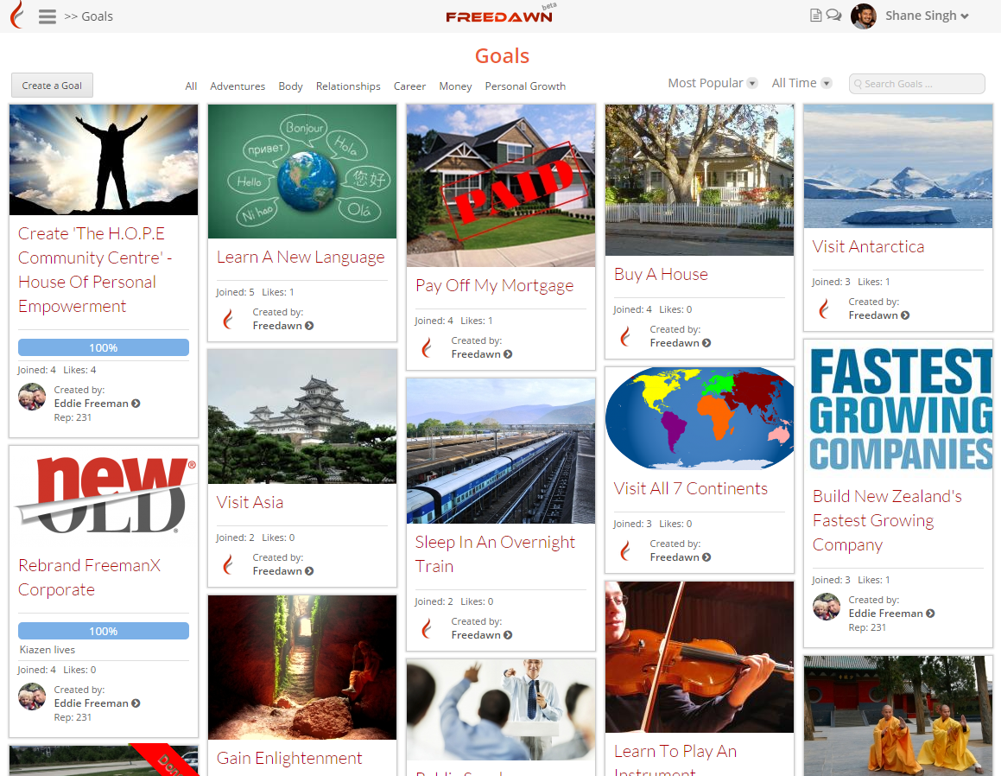
Grid Layout Example – Goal Mine
Notes:
This is the global goal mine, how you view all goals that are publically accessible on the site from the Menu and this is how they are displayed. Continiously populating as you scroll down.

Slide 12
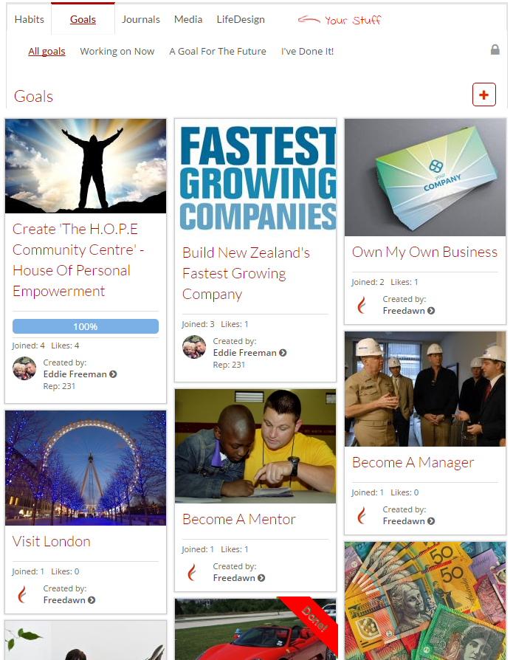
Grid Layout Example – Personal Goals
Notes:
Width based on screen resolution or specified depending on what part of the website. Example of how displayed on Personal section. Completely responsive dependent upon device

Slide 13
Web Server Changes
Freedawn was originally running on lighttpd
Various other stable options
Apache
Nginx
Nginx was implemented as performance was significantly impacted for the better
Notes:
Lighttpd – asynchronous server – runs everything as a single process with a single thread
Apache – process based server, essentially each simultaneous connection requires a thread = significant performance overhead but has greater functionality/features
Nginx – asynchronous server – focuses on a smaller pool of functions. Similar to Lighttpd however instead of having a single process, works as a master process but delegates work into worker processes

Slide 14
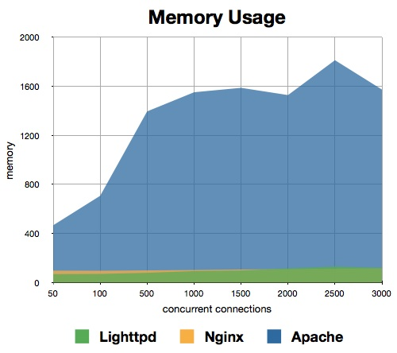
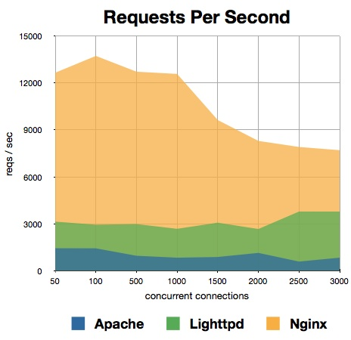
Web Server Comparison
Notes:
As you can see the memory usage, and consumption of Apache is massive for the number of concurrent connections vs. both lighttpd and nginx.
In regards to requests per second this essentially measures how fast the server can receive and serve requests and different levels of concurrency.
The more they can handle per second, the greater the ability to handle large amounts of traffic.
Nginx dominates in this area of performance, as you can see from the graph – at higher levels it can handle fewer requests however is still double what Lighttpd.

Slide 15
Questions?

