Slide 1

Final Seminar
BTECH 451 | Shane Singh | ssin924@aucklanduni.ac.nz
Notes:
Good morning everyone! Welcome to my Final End of Year Seminar on my progress on Freedawn!
My name’s Shane and I’ll take you through the progress of where Freedawn has come from, what the progress has been and what components I’ve been directly involved in

Slide 2
Freedawn – Background
A start-up focusing on a new niche social platform
A platform allowing everyone to communicate with others in fields they wish to learn about
A platform allowing people to achieve goals they thought they would never be able to
Started up by the company operating Experiences across New Zealand as well as operating the Supercars Driving Experiences in Auckland
Notes:
Just a recap on what my project entailed across the year – Freedawn is a start-up social platform that allows users to communicate with others with fields they wish to learn about and things they want to achieve!
It’s a local start up – that is based in Albany, Auckland.

Slide 3
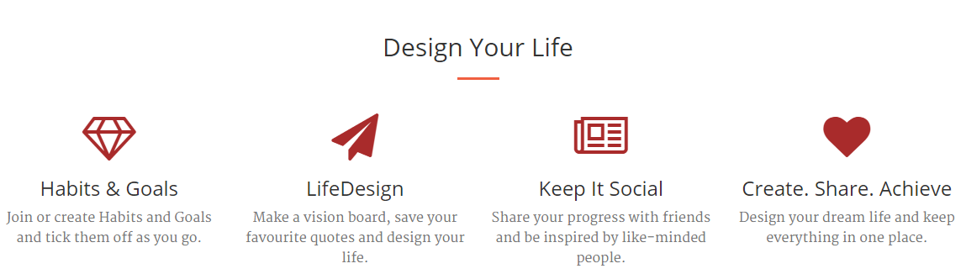
Freedawn Overview
Notes:
Habits + Goals – join/create and tick them off as you go
LifeDesign – visionboard, favourite quotes and design what you want to do and where you want to go and now a Library!
Keep it Social – share across multiple platforms – Facebook, Twitter, LinkedIn integration

Slide 4
Current Stage
Now open for Public Registration
Development of Freedawn for Business
New Modules + Fixes
Mobile Usability
Mobile App Development

Slide 5
Progress from Mid-Year
Development and creation of Freedawn for Business
New Module Developed - Library
Mobile Usability & Testing
Web Usability Testing
Google API Integration
Amazon API Integration

Slide 6
Freedawn for Business
Platform where organisations can have their employees in a semi-professional social environment
Allow employees to contribute improvements to better current processes in an organisation
Builds a robust intranet for organisations
Based of current Freedawn platform
Integrates with Google Apps
Notes:
Freedawn for Business – allows employees in an organisation to view all the business processes, contribute improvements and help benefit the company in a positive manner while being in a collaborative environment.
Based on the current PHPFOX Platform, I can access it from the personal navigation menu and go to the business side if the email address is recognised as part of a particular organisation
Integrates with Google Apps and uses Google Drive especially to maintain documentation and file structure as well as security of documents too.

Slide 7
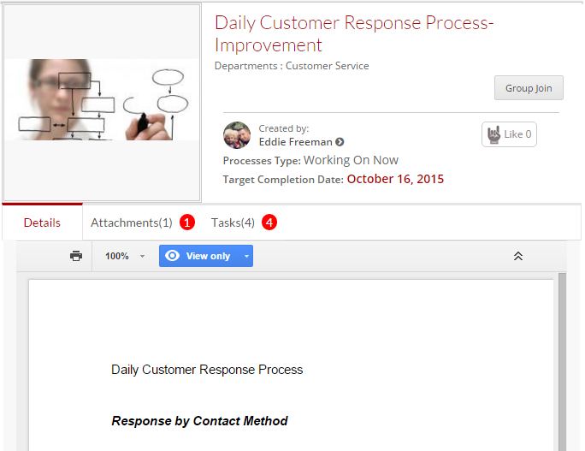
Integration with Google API
Implementing use of Google Apps
Used to store documentation securely
Embedded inside Freedawn for Business Pages
Notes:
With FD4B the implementation and integration of Google Apps has been quite beneficial in terms of setting up a file structure service for each organisation, files and documents containing all the processes and improvements, managing version control as well as overall document security.
Google complies with, based on independent third-party auditors - SSAE 16, ISAE 3402 and SAS 70 standards. These standards help maintain a large array of security concerns that are associated with storage of data but also cover redundancy which means that Google Drive isn’t likely to be a single point of failure with Freedawn for Business.
I’ll cover the integration and how it works further on in the live-demo but you guys can see an example in the screenshot -

Slide 8
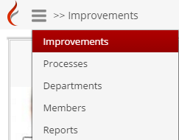
Freedawn for Business - Modules
Improvements
Processes
Departments
Members
Reports
Notes:
FD4B is made up of a number of different modules, compared to the personal side of Freedawn. These modules, have been broken down into Improvements, Processes, Departments, Members and Reports.
We cover these a bit more in-depth in a moment and these are all accessible from the main navigation menu.

Slide 9
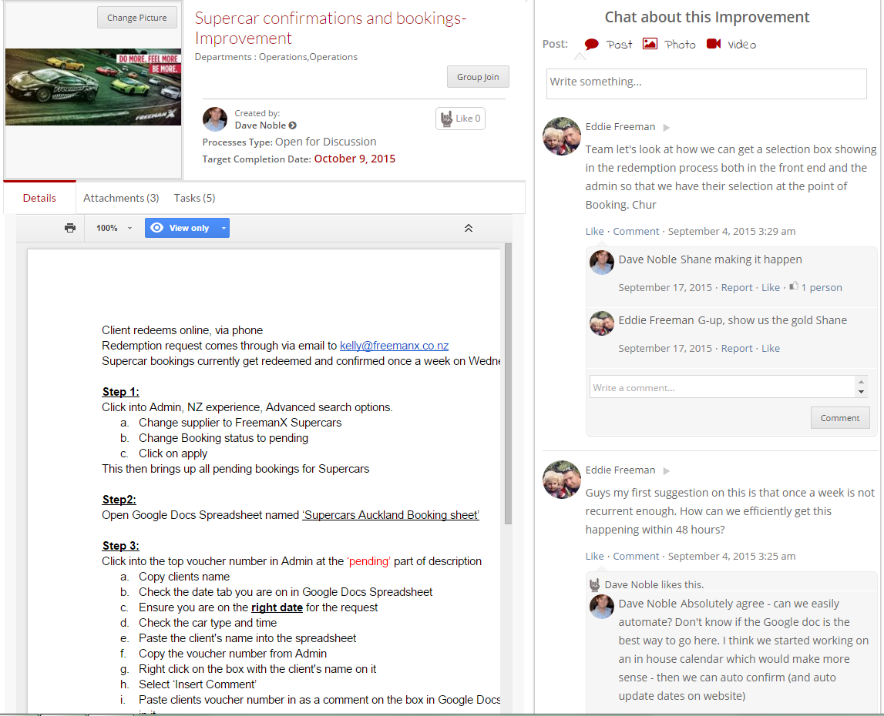
Freedawn for Business - Improvements
Notes:
This is an example of an improvement – in particular how our Supercar Experience Bookings are currently being done and what we can do to improve them.
Here we can see how the Google Doc is integrated, inside the page. At present, I can not edit this document only the owner of the document is but it remains fairly flexible in terms of allowing users to set permissions as they see fit. Inside is the current Best Practice or Process that is currently being applied.
On the right hand side, you can see the ability to Chat about this improvement. Although Google Docs has a chat function in their site, their API was quite limited with that aspect and as we use the discussions and comments are utilised in reporting which we will see later on. This meant everything was to be pulled into this one page and maintain a consistent layout between all of Freedawn and tie in the Google Doc.

Slide 10
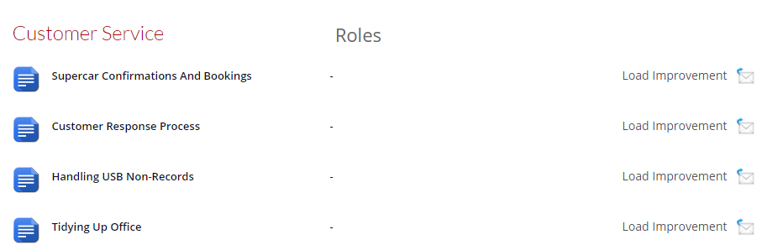
Freedawn for Business - Processes
Allow employees to see how global and departmental processes are currently structured in a single location

Slide 11
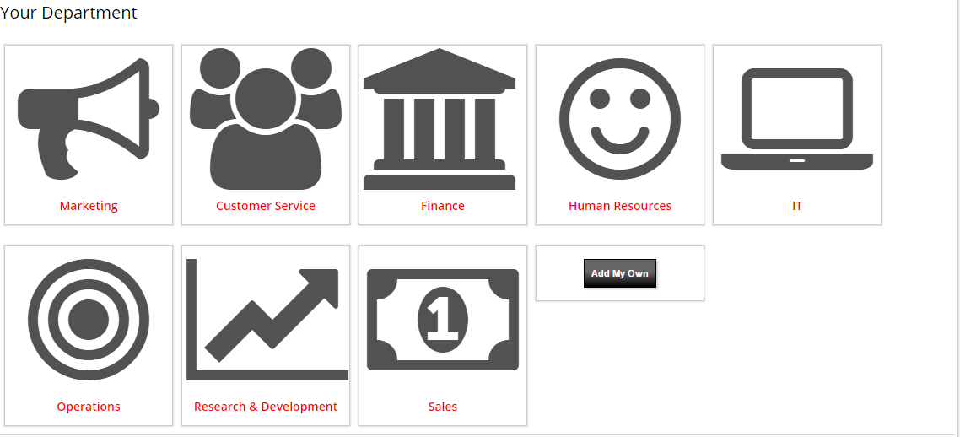
Freedawn for Business – Departments

Slide 12
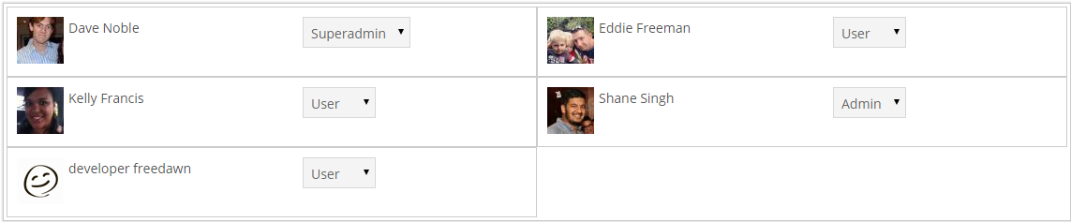
Freedawn for Business - Members
All members in the organisation and their access levels
Filterable by Department

Slide 13
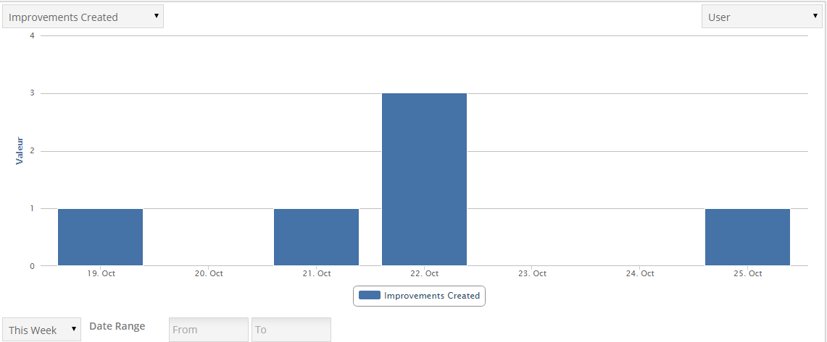
Freedawn for Business - Reports
Provides metrics based on type of activity or particular user
Allows management to track user performance
Filterable by date
Notes:
Aggregation of data from

Slide 14
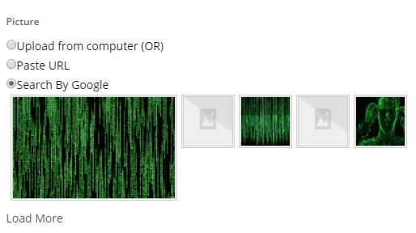
Google Search Integration
Integrated Image Searching when creating different objects such as Goals, Habits, Improvements etc.
Usability enhancement

Slide 15
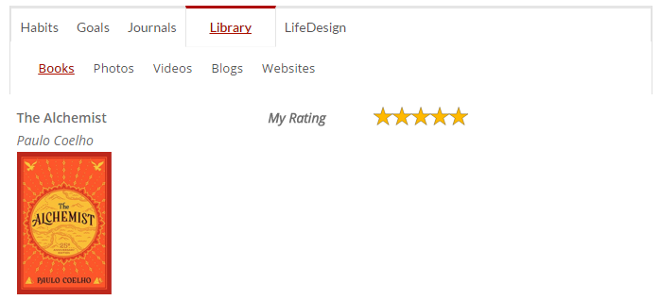
New Module - Library
Arrange your collection of Books, Photos, Videos, Blogs & Websites for others to check out
Library stores books that you’ve read and want to read in the near future

Slide 16
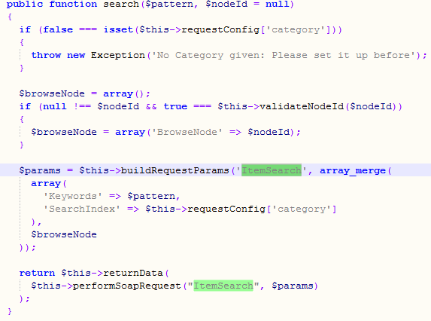
New Module – Library – Development
Implementing AmazonECS ItemSearch using API
Uses SOAP PHP Extension
Enabled RequestDelay after testing
Field population

Slide 17
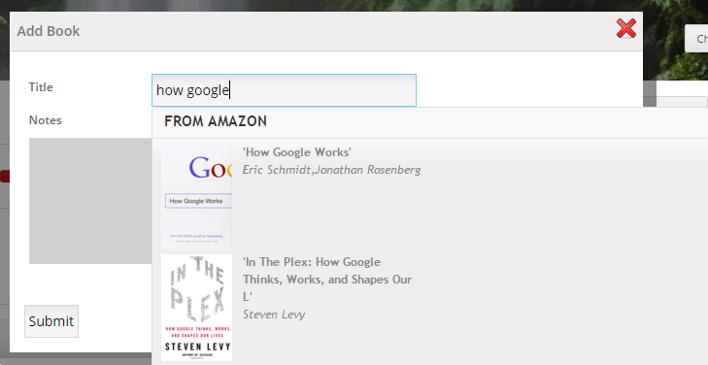
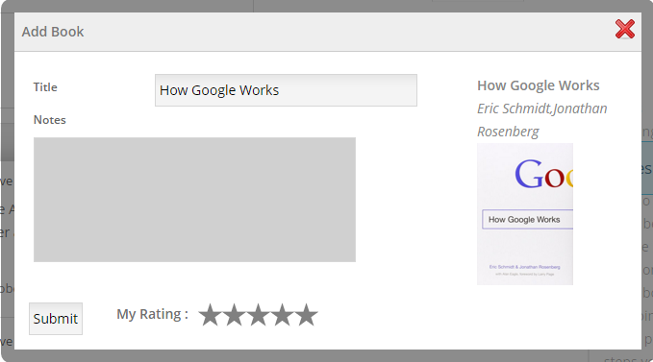
Amazon Integration

Slide 18
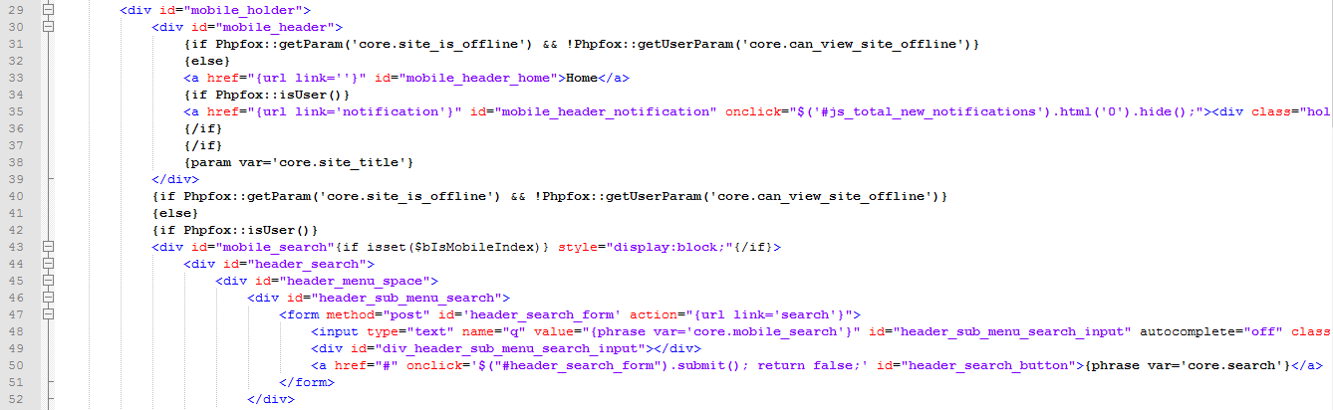
Mobile Usability
Majority of devices now accessing social media and websites are generally mobile devices including tablets & smartphones
Smaller resolution
Balance between being detrimental to usability

Slide 19
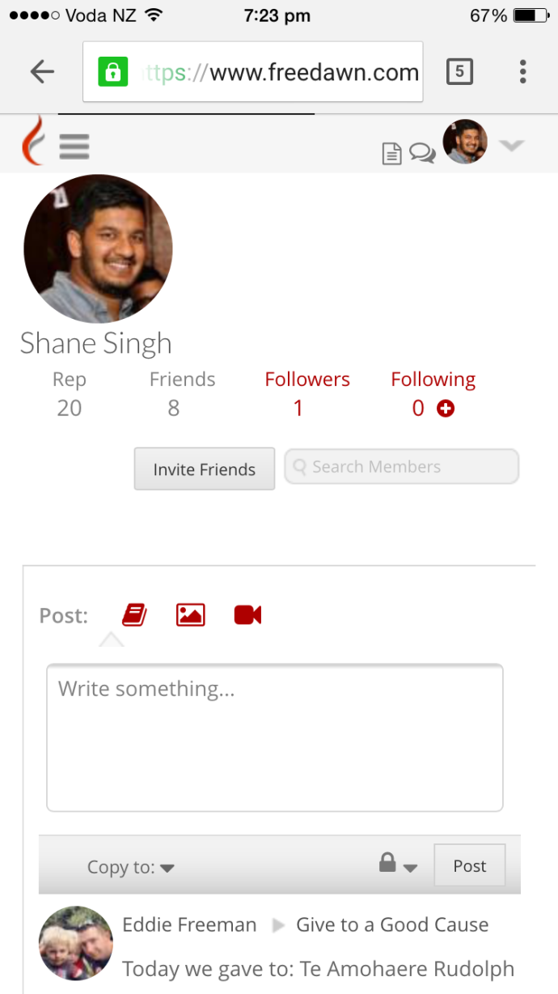
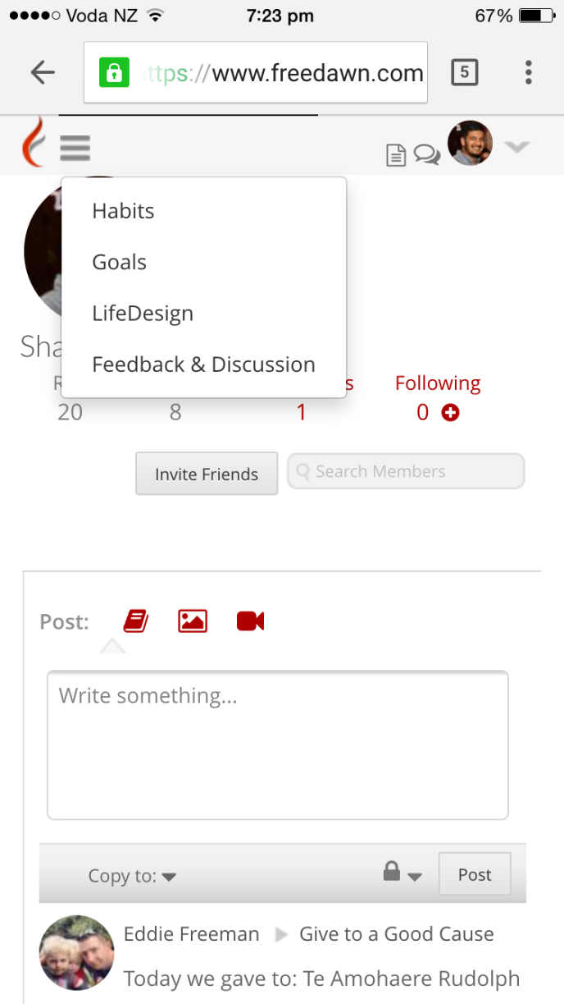
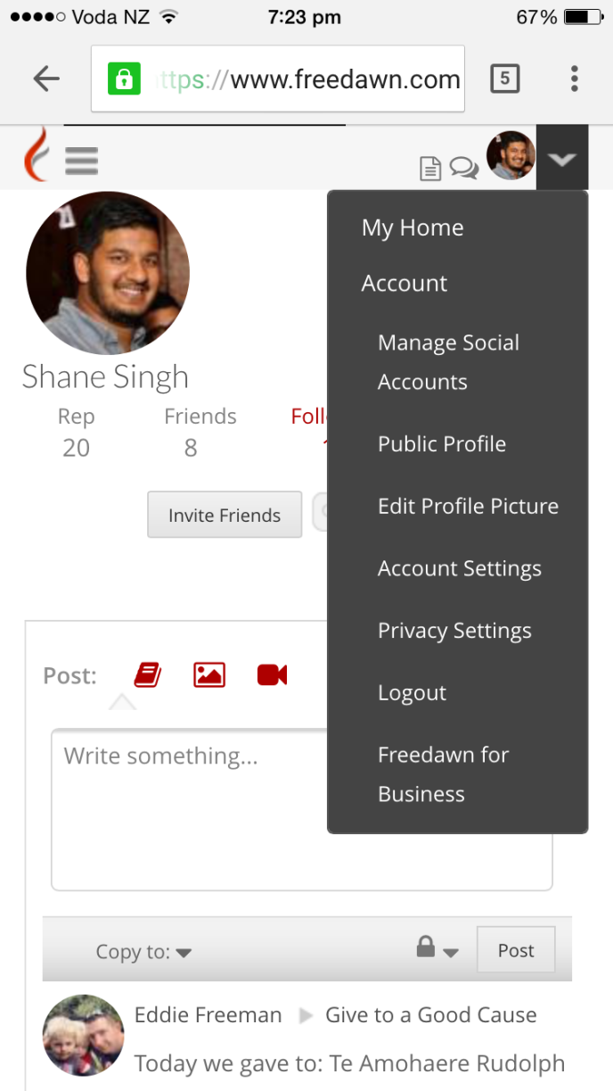
Mobile Usability

Slide 20
Live Demo

Slide 21
Questions?

