Slide 1
HazApp
The geospacial hazard management system
Rowan Carmichael

Slide 2
Base Application
Focus on the on-site reporting through use of tablets and mobile phones, rather than the statistical analysis (which will be coming later)
Preparation for user acceptance testing (which will consist of a small group of Opus employees primarily using tablets for on-site hazard reporting)

Slide 3
Demonstration

Slide 4
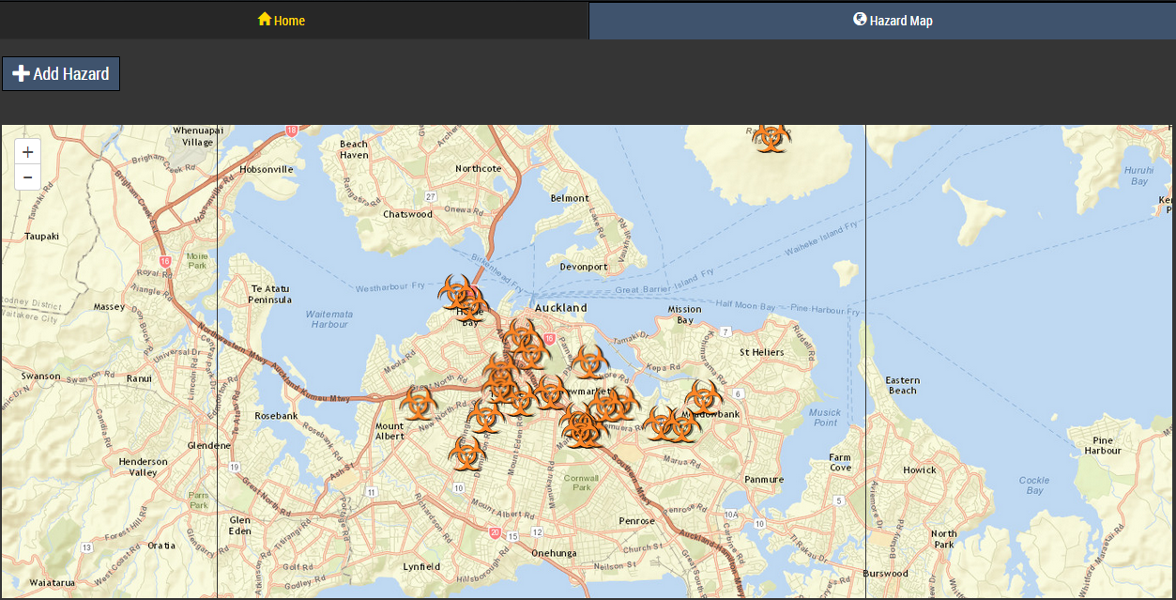
Map View
Shows all currently active hazards
Allows for the addition of new hazards through spatial selection

Slide 5
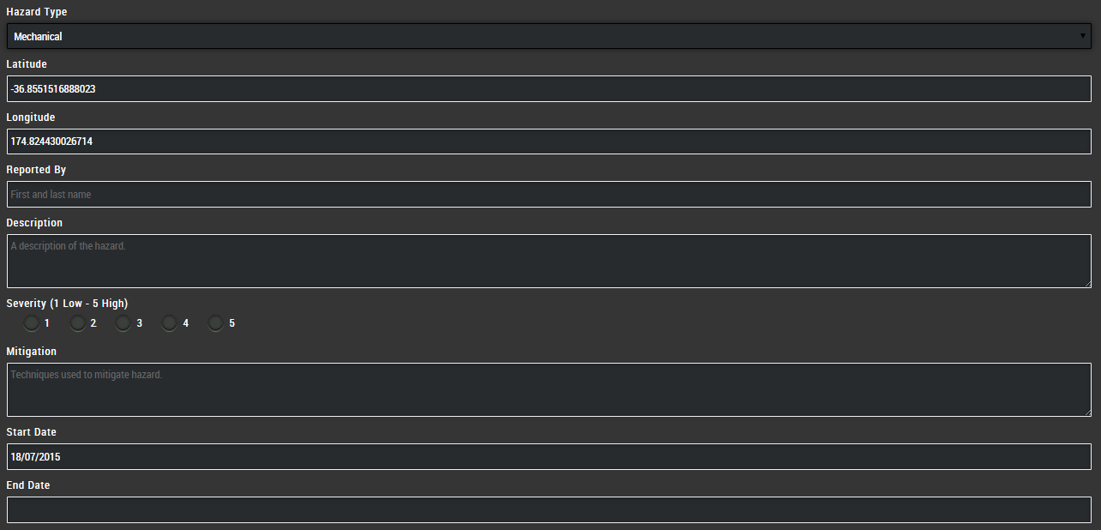
Hazard Form
Dynamically generated hazard types for the dropdown
Latitude and longitude taken from the coordinates of selected point on the map
Option to add additional files (such as photos or videos)

Slide 6
User Acceptance Testing (1st Round)
A small group of Opus employees (safety site managers) primarily using tablets for on-site hazard reporting
Will hopefully provide insightful feedback on the user interface, any unnecessary functionalities, and the overall flow of the application
Positive user experience of critical importance for overall acceptance and ultimately the success of the application. If the application is difficult to understand and/or a hassle to use, it will not be used
Success at this stage is not nearly as important as learning from the users’ feedback and addressing the issues accordingly

Slide 7
What’s Next

Slide 8
User Interface Improvements
Making the hazard information from the map view more readable, especially for mobile/tablet users. This will be done through improving how the information is presented as well as limiting the information to only those necessary
Having representative symbols of the current hazards on the map
Including some filtering functions of the specific hazard types/severities to ease the cluttering of the map view in the event of having multiple active hazards in a small area

Slide 9
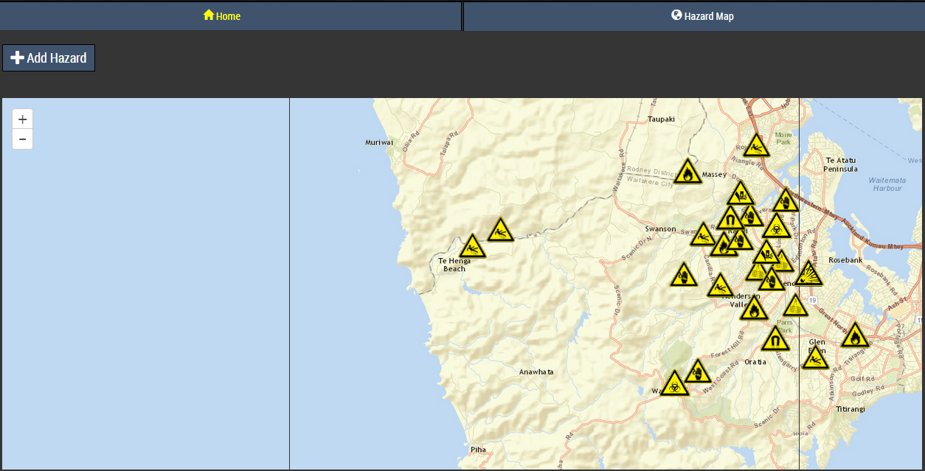

Slide 10
Incorporating Phone/Tablet Features
Capturing photo/video within the application, rather than having to take a photo/video outside of the application then attaching them
Including function to either automatically detect and move the map location to the user’s current location, or move to the user’s location after a button click.
Limiting the data retrieved from the server to those that are in the direct vicinity of the user’s device, or in specified areas. This will especially targeted at mobile devices which should cater for limited data transmission levels/rates.
Offline or limited service capabilities

Slide 11
Management Side (Desktop Computer)
Editing/deleting current hazards
Compiling statistical analysis from the reported hazard data
Generating alerts for severely dangerous hazards so that all nearby Opus employees can be informed

Slide 12
Questions?

