Slide 1


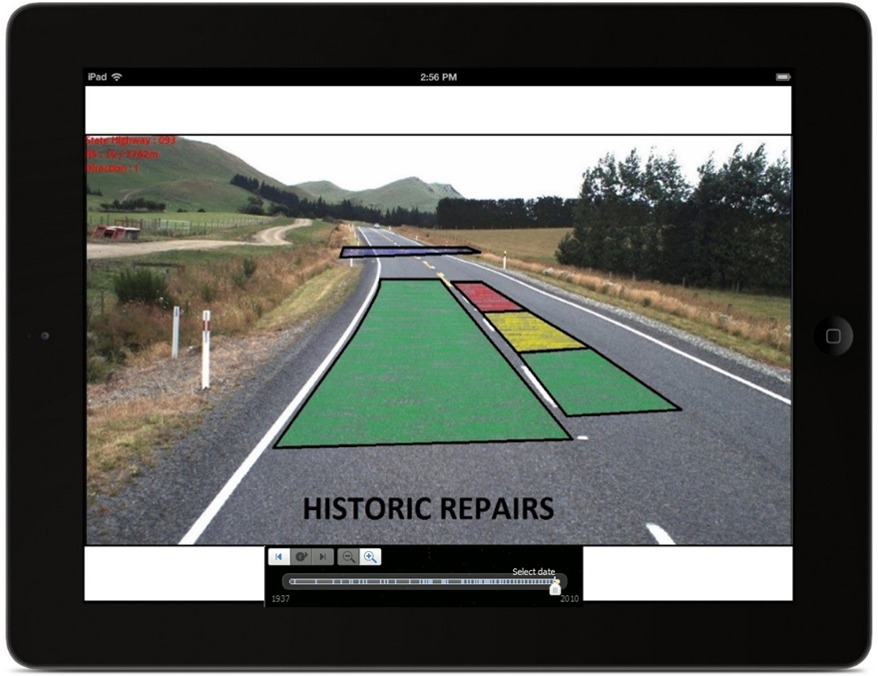
‘ASIST’
ASset hISTory in real time

Slide 2
‘ASIST’
Recap of project
Progress so far
What’s next
-What & Why?
-Current Products
-Development Platforms and Tools
-Hardware
-Testing
-6 Week Development Plan

Slide 3
Project Recap
Consolidate Asset Database
Identity + Condition Data
RAMM – Road Assessment & Maintenance Management Data

Slide 4
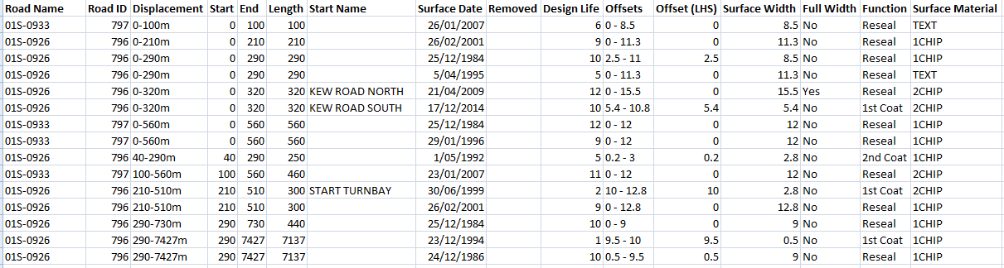
Project Recap
Motivation?

Slide 5
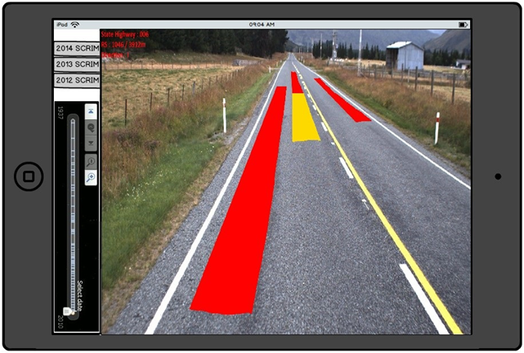
Project Recap
Outcome

Slide 6
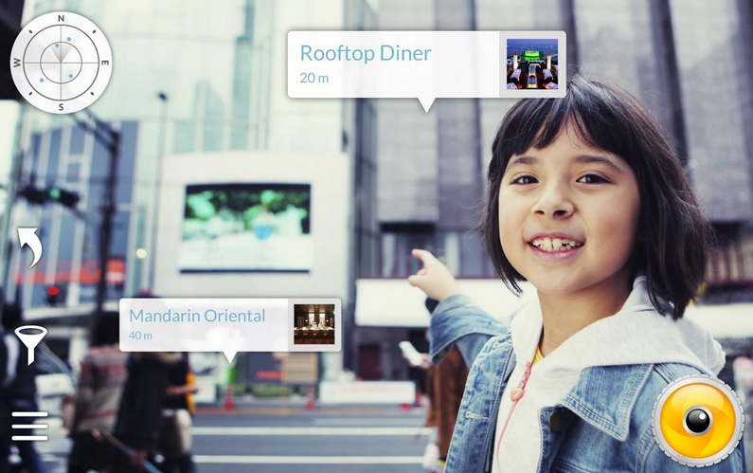
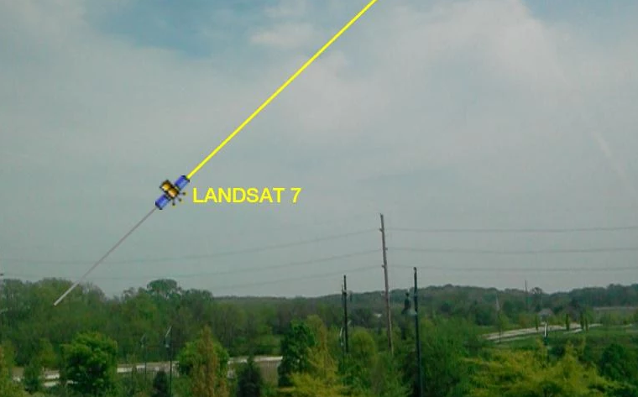
Progress
Augmented Reality Products
-Wikitude Places & Satellite AR

Slide 7
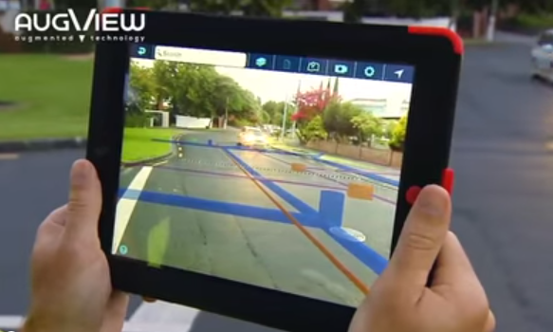
Progress
Augmented Reality Products
-Augview

Slide 8
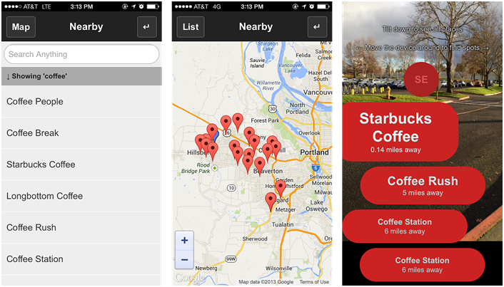
Progress
Platform Research and Testing
-Web Development

Slide 9
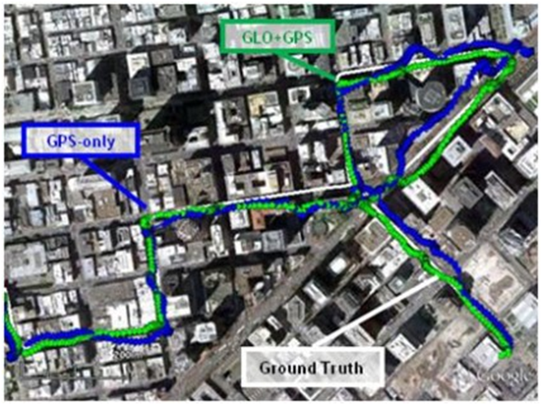
Progress
Hardware Research
-Required Specifications
-GPS Technology

Slide 10
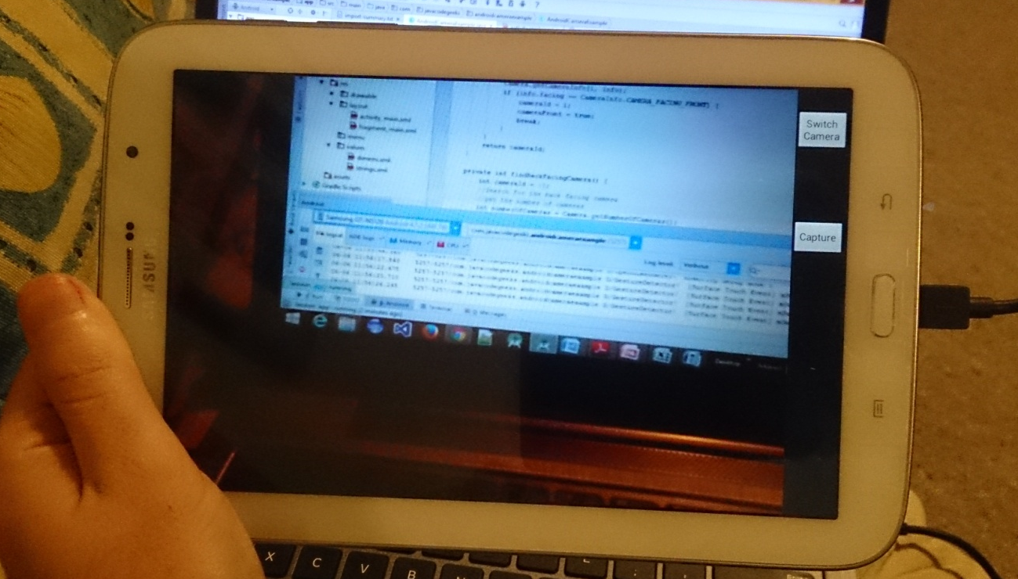
Progress
Platform Research and Testing
-Native Android Development

Slide 11
Future
Live View Development
Task | Iteration (Week) | Time (Hours)
Application Setup | 1 | 20
Camera Preview | 2 | 10
GPS Tracking | 2 | 10
Accelerometer and Compass Tracking | 3 | 10
Data Layer | 3-4 | 20
Generate Data and Test | 4 | 10
Transform Real Data to Test | 5 | 20
Re-evaluate Performance | 6 | 5
Compile Documentation of Process | 6 | 10
Basic Documentation and Stakeholder Meeting | 6 | 5
Testing by Invercargill Team | 6 | 1
Report on Outcome | 7 | 10

Slide 12
Questions?

