Slide 1


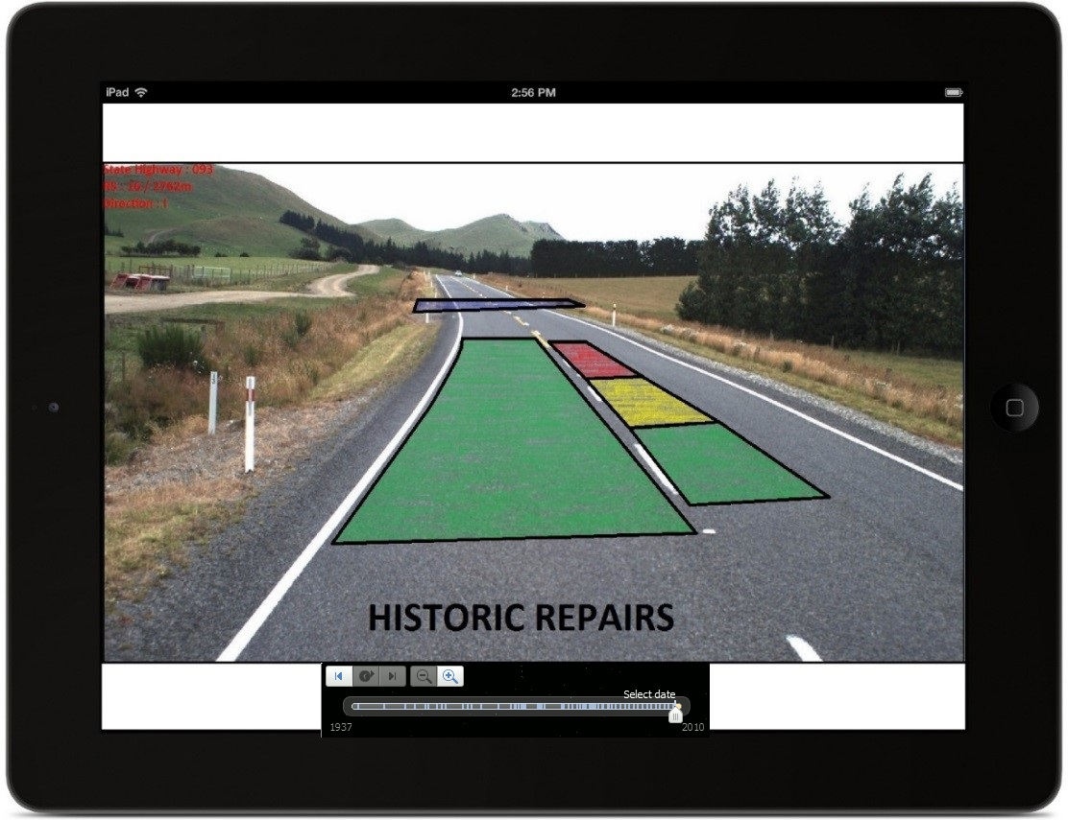
ASIST
ASset hISTory in real time

Slide 2
Goal for Asist
To supply on site workers with an:
Easy to use
Accurate
Intuitive
And Responsive
Mobile application to increase efficiency in the workplace.

Slide 3




Technology
Augmented Reality
3D Asset Rendering Overlay
GPS Tracking
Accelerometer
Compass

Slide 4
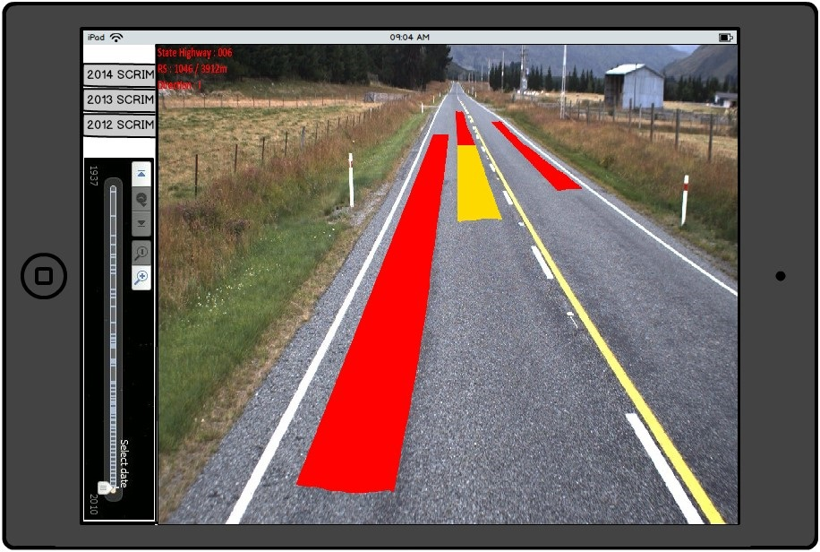
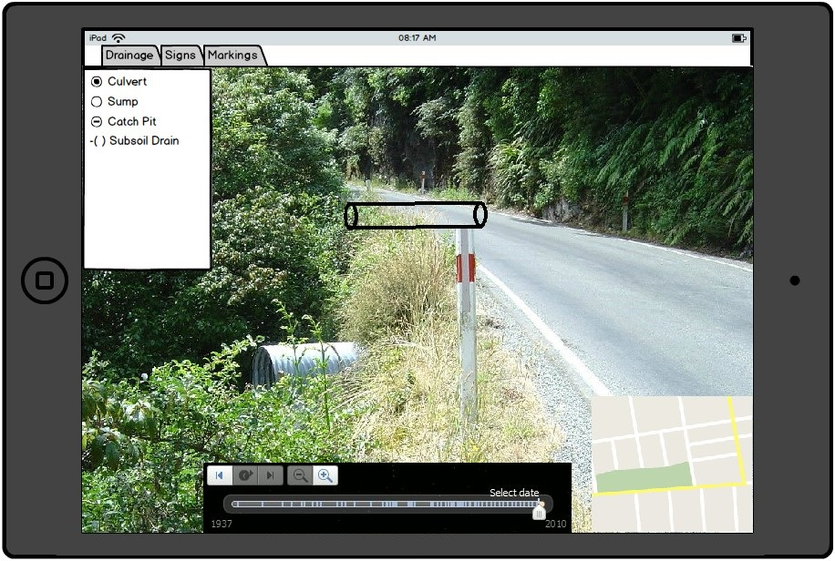
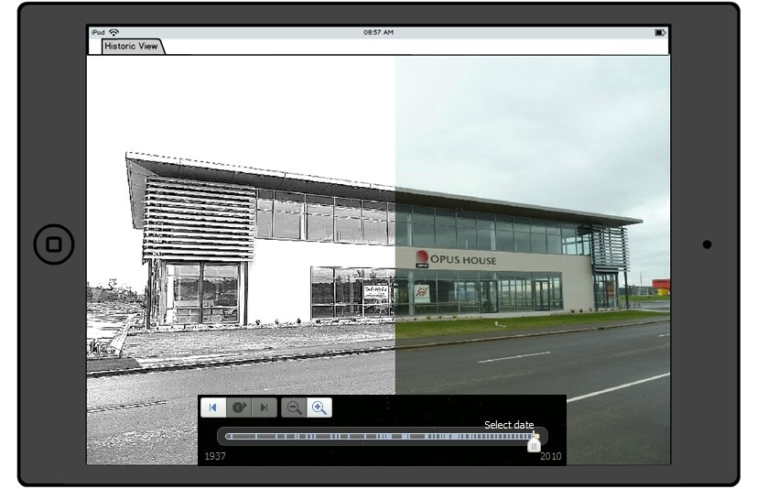
Asset History
Inventory Validation
Image Comparison

Slide 5
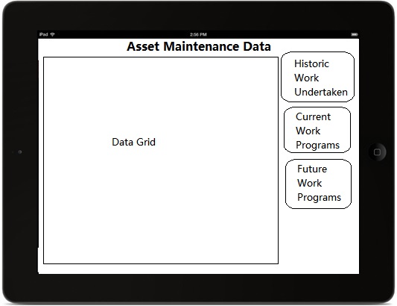
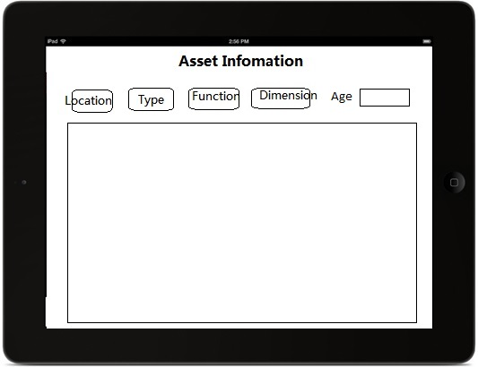
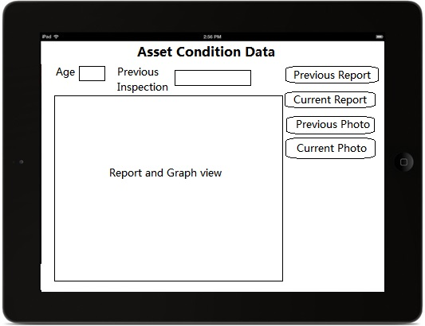
Asset Management
Asset Data
Condition Data
Maintenance Data
Management Portal
Asset Photo Library
Investigation Assistance
Asset Additional Information

Slide 6
Schedule
Research
Hardware Requirements
Current Solutions
Most Appropriate Platform & Languages
Development Milestones
Basic Augmented Reality with Test Scenario
Increase Accuracy
Expand Database
Iterate

Slide 7
Learning Objectives
Real life experience:
Co-development
Consultation
Technical:
Device APIs
New Languages
Cross Platform Distribution

Slide 8
