Slide 1

A LabVIEW Interface
Rina Gao
07/08/2014
1

Slide 2
Presentation Structure
Project Overview
LabVIEW
The Optrode
System Upgrade
LabVIEW Interface Screens
Set Up System
Power Meter Calibration
Background Acquisition
Signal Acquisition
Conclusion
Semester Two Plan
Questions
2

Slide 3
Project Overview
3

Slide 4
Project Overview
“The Optrode is a device which captures fluorescence emitted by microorganisms, and analyses some data in real-time. LabVIEW is used to synchronise the different hardware components, and provide a user interface for control over the Optrode.”
Goals of the project
Upgrade software system
Conduct usability study on the Optrode and produce a more intuitive user interface design
4

Slide 5
LabVIEW
5

Slide 6
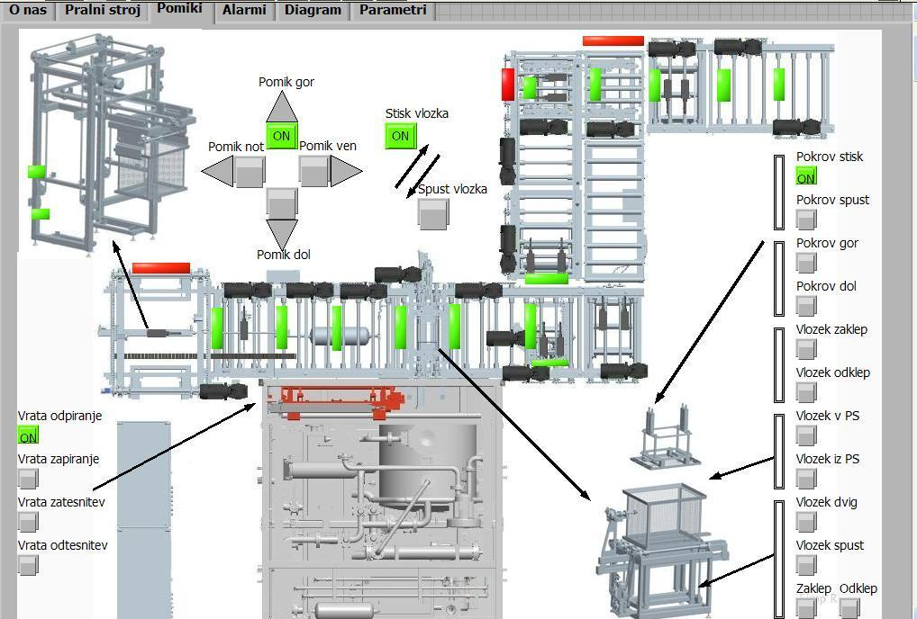
LabVIEW
Design and development platform
Visual programming
Instrument control
Industrial automation
Fig 1. fully automated industrial washing machine line
6

Slide 7
The Optrode
7

Slide 8
The Optrode
Delivers light and receives signal through single or dual fibre optic probes
Theoretical and industrial application
Microbiology: fluorescence in bacteria
Biomedical: cardiac activity
Chemical engineering: sensors for compounds or ions
8

Slide 9
System Upgrade
9

Slide 10
System Upgrade
LabVIEW 2009 32-bit LabVIEW 2013 64-bit
Virtual Instruments(code packages):
UL(legacy code library) ULx(new code library)
Problem:
UL is compatible with LabVIEW ver. 6.0-8.2.1, while ULx is compatible with LabVIEW ver. 8.5-2013, so existing code built with UL cannot be run
Fix dependency issues with subVIs (VIs used as external subroutines)
Explore and restructure LabVIEW code for Ulx on new simplified hardware setup
10

Slide 11
LabVIEW Interface Screens
11

Slide 12
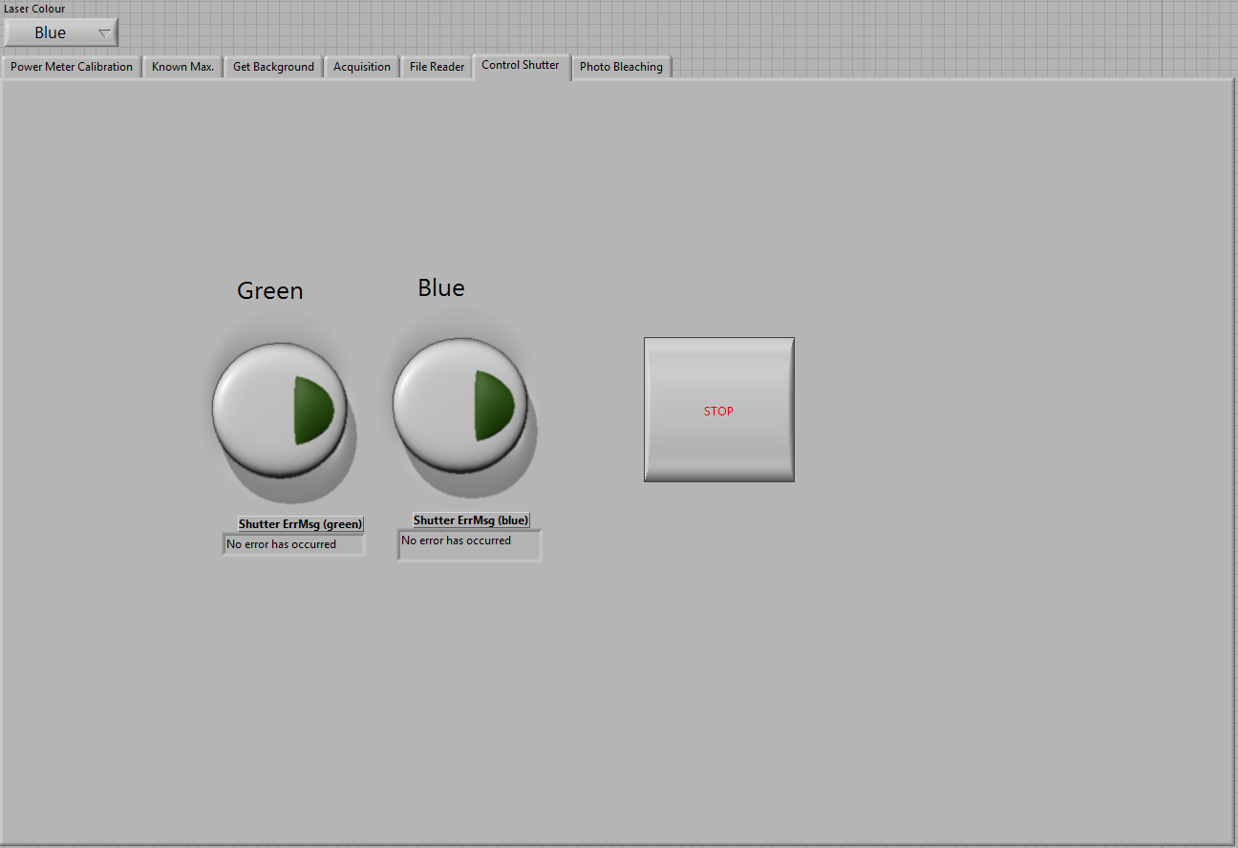
Set Up System
Outside tab screen area, difficult to associate relationship and use
Order of tab is random and does not help user understand flow of action
One color button to be pressed at the very start, and STOP at the
very end. Currently no mitigation against user selecting both
colors. Intended operation is hard to derive intuitively
Save path
Error message textboxes rarely
utilized and is a distraction
Fig 2. control shutter screen
Save path should be chosen here at the start of the experiment
12

Slide 13
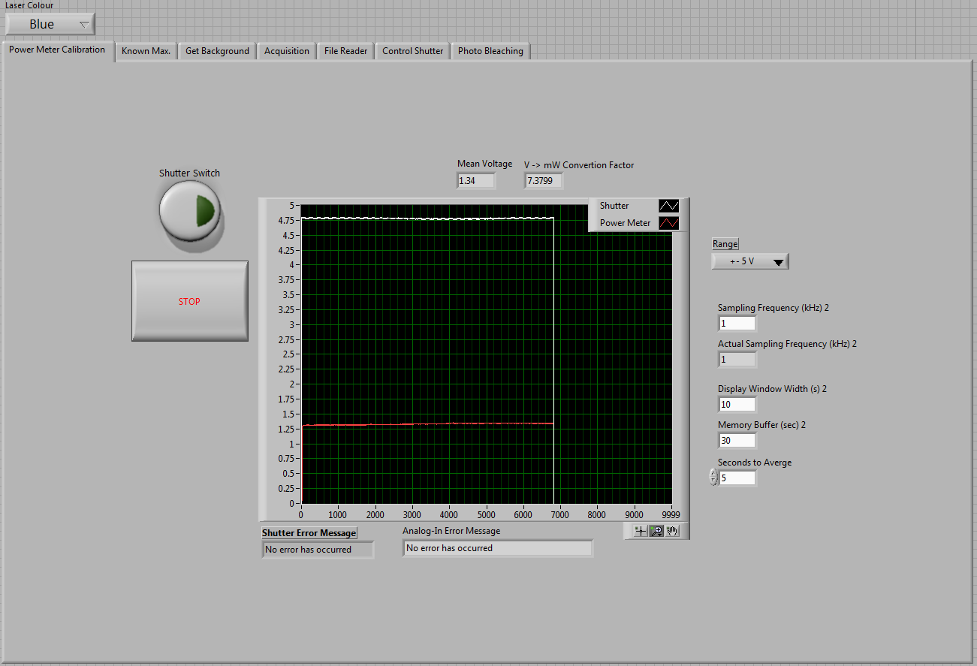

Power Meter Calibration
Location of buttons does not guide user in flow of action
A dialogue appears asking for a
“V-> mW convertion factor” (also
spelling error). Redundant action or display
Redundant display – can be hidden
Values not used in existing setup
Error messages clutter screen
Fig 3. power meter calibration screen
Screen elements are cluttered in a blob in the centre, with redundant large empty spaces around
13

Slide 14
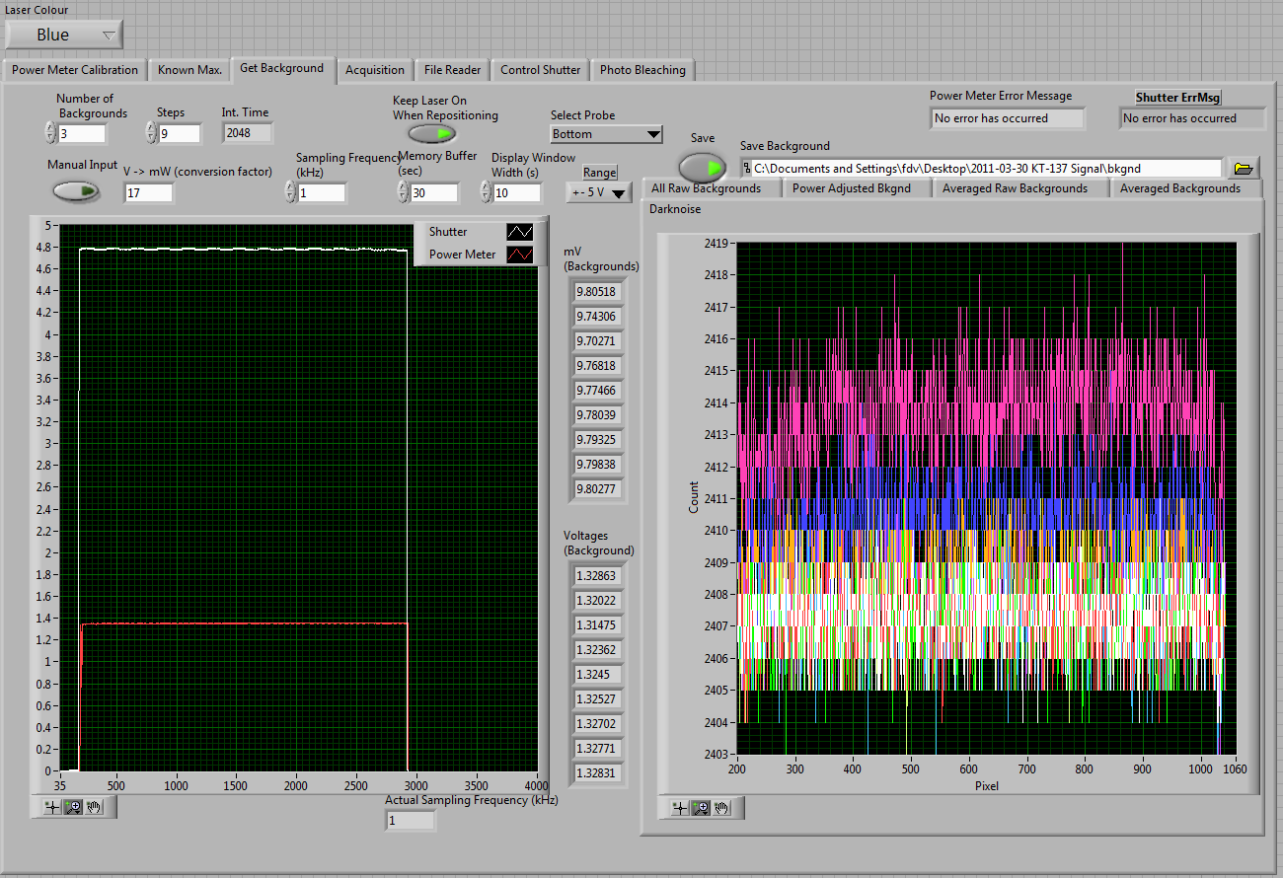
Background Signal Acquisition
These controls MUST be used but
are not emphasised
Manual input could be used to make controls disappear on command, not just disabled, to reduce clutter
Not applicable to new hardware setup
Values have never been changed in demos I observed. Can ‘hide’ not used
Can be removed if location is
specified in shutter control
screen
Fig 4. background signal acquisition screen
Error messages clutter screen
14

Slide 15
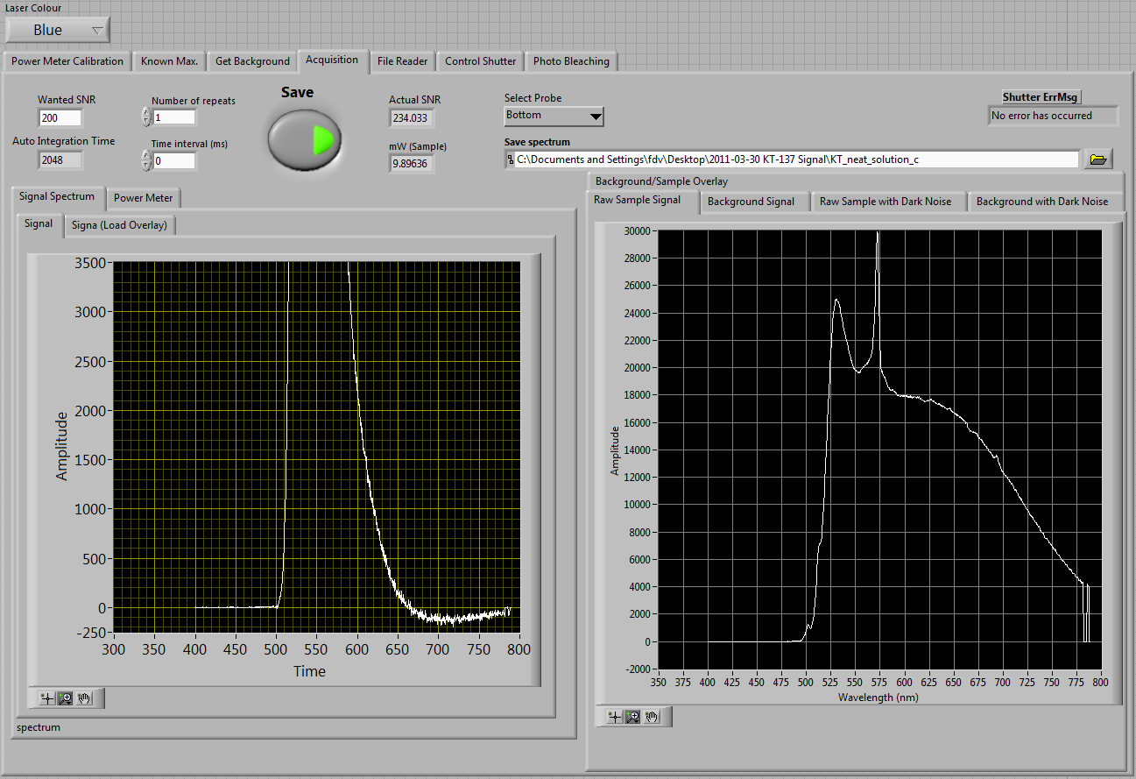
Sample Signal Acquisition
These controls MUST be used but
are not emphasised
Values were not changed in demos I observed. Can ‘hide’ if not used
A button could be used to make
controls appear when necessary
Can be removed if location is
specified in shutter control
screen
Fig 5. sample signal acquisition screen
Error message clutters screen
Spelling error
15

Slide 16
Conclusion
16

Slide 17
Conclusion
Achieved so far:
LabVIEW upgraded to 2013 version
ULx installed (however there is a setup error which is currently still being investigated with Measurement Computing, the company that produces ULx)
Notes made of possible improvements to the user interface, cross referencing knowledge of UX heuristics and user comments
Progress in project scope
Upgrade software system: 50%
Usability study: 10%
Current status: on track to finish in mid October.
17

Slide 18
Semester Two Plan
18

Slide 19
Semester Two Plan
Add missing functionality:
Laser shutter is to close automatically when the laser is not in use.✓ Complete
Acquisition data to be saved as a float rather than an integer. ✓ Complete
Background power measurements are to be saved. ✓ In progress
Conduct user study
Specify KPIs
Conduct user test on existing system and implement changes
Re-test and re-iterate until KPIs are met
Compile documentation and write new user manual
19

Slide 20
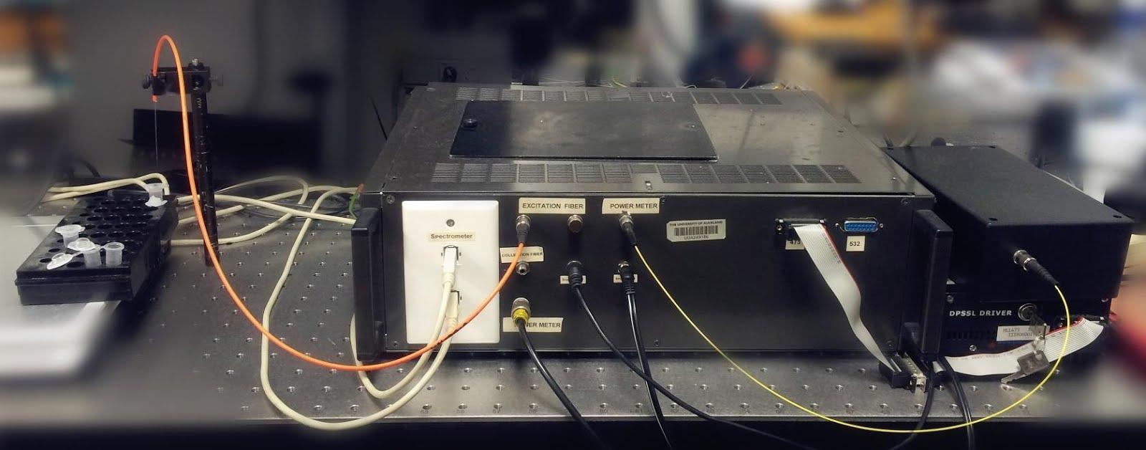
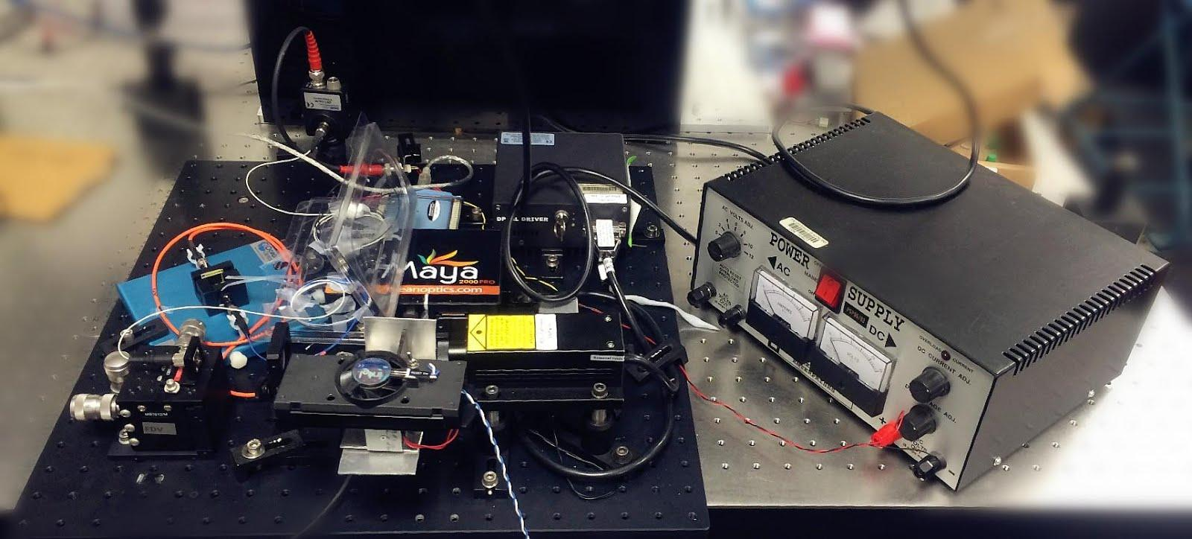
Questions?
Old Optrode setup
New Optrode setup
20

