Slide 1

A LabVIEW Interface
Rina Gao | BTech451

Slide 2
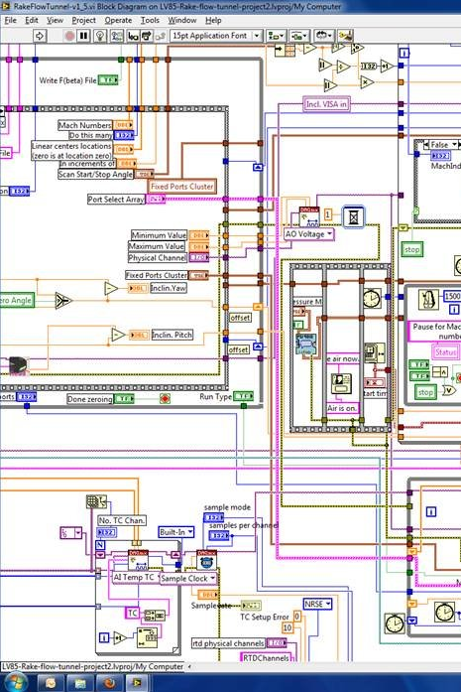
What is LabVIEW?
Visual programming
Data acquisition
Instrument control
Industrial automation
Optrode
  Measures fluorescence in bacteria
  Biomedical and chemical engineering

Slide 3
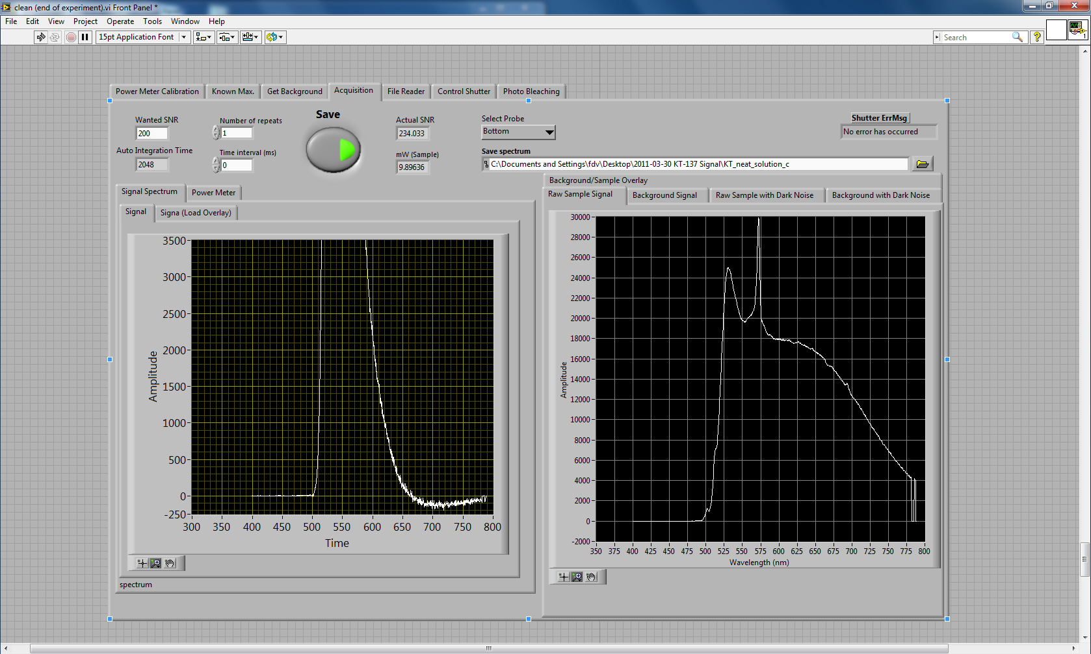
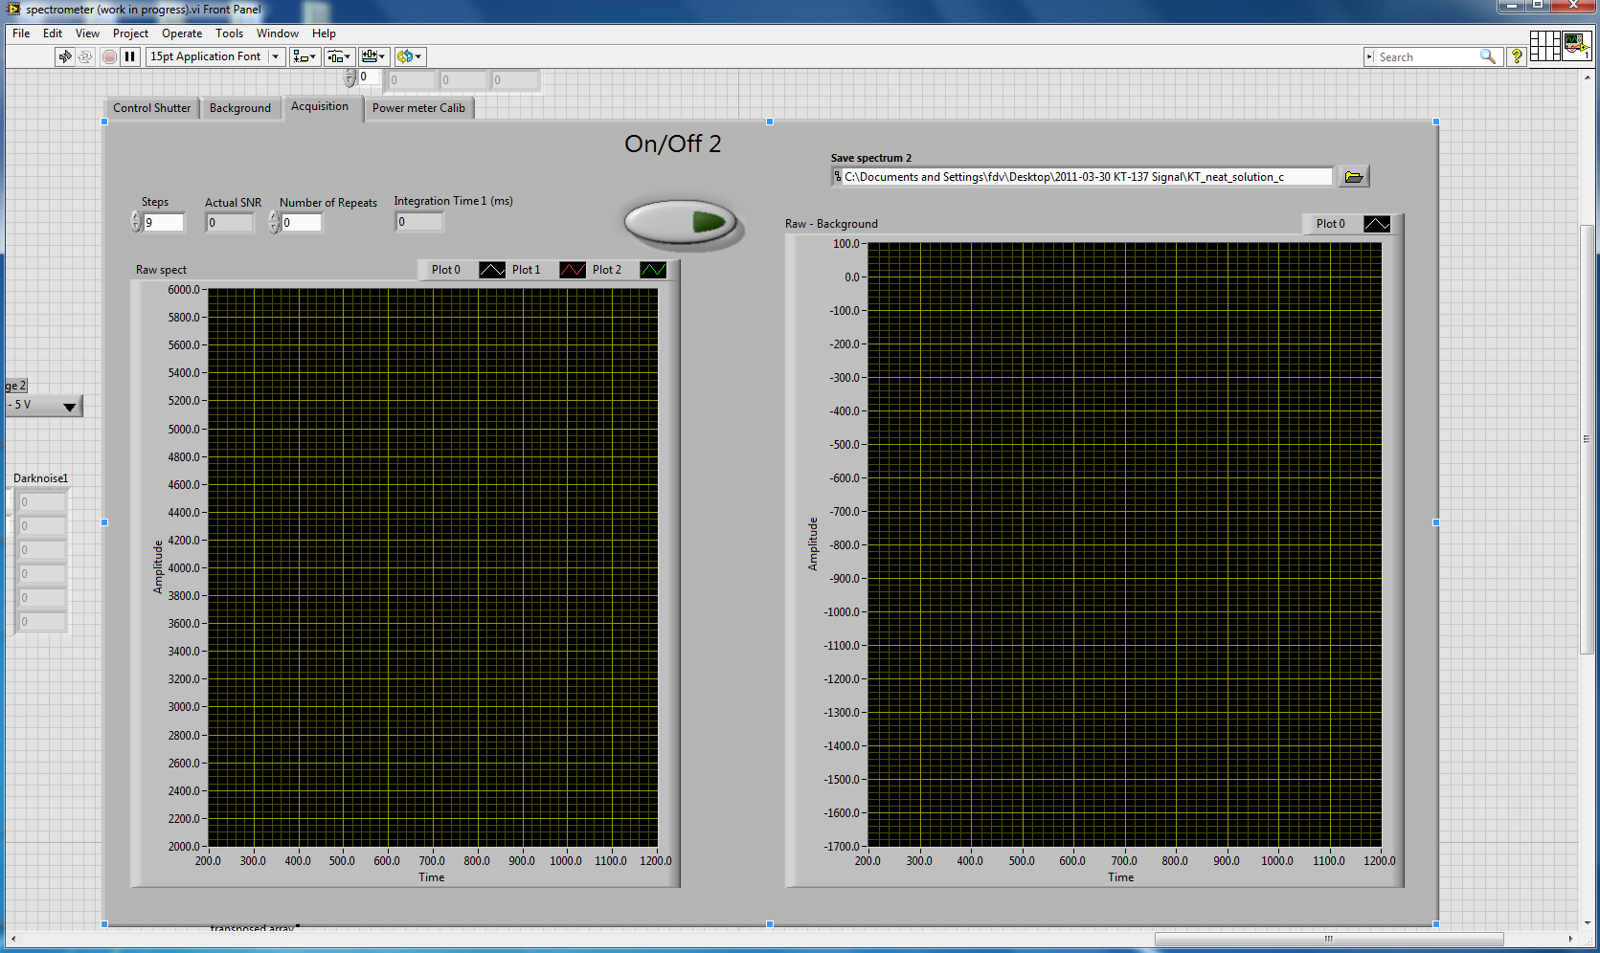
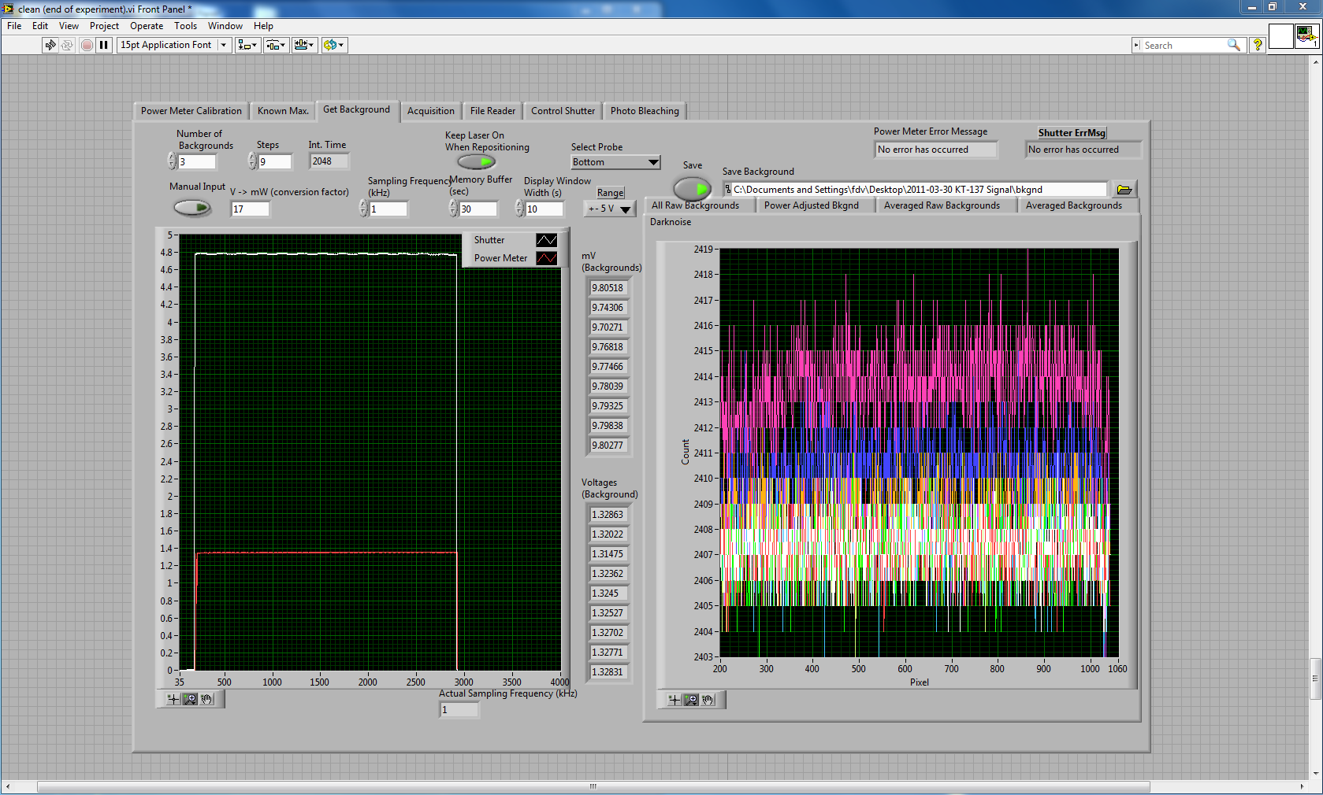
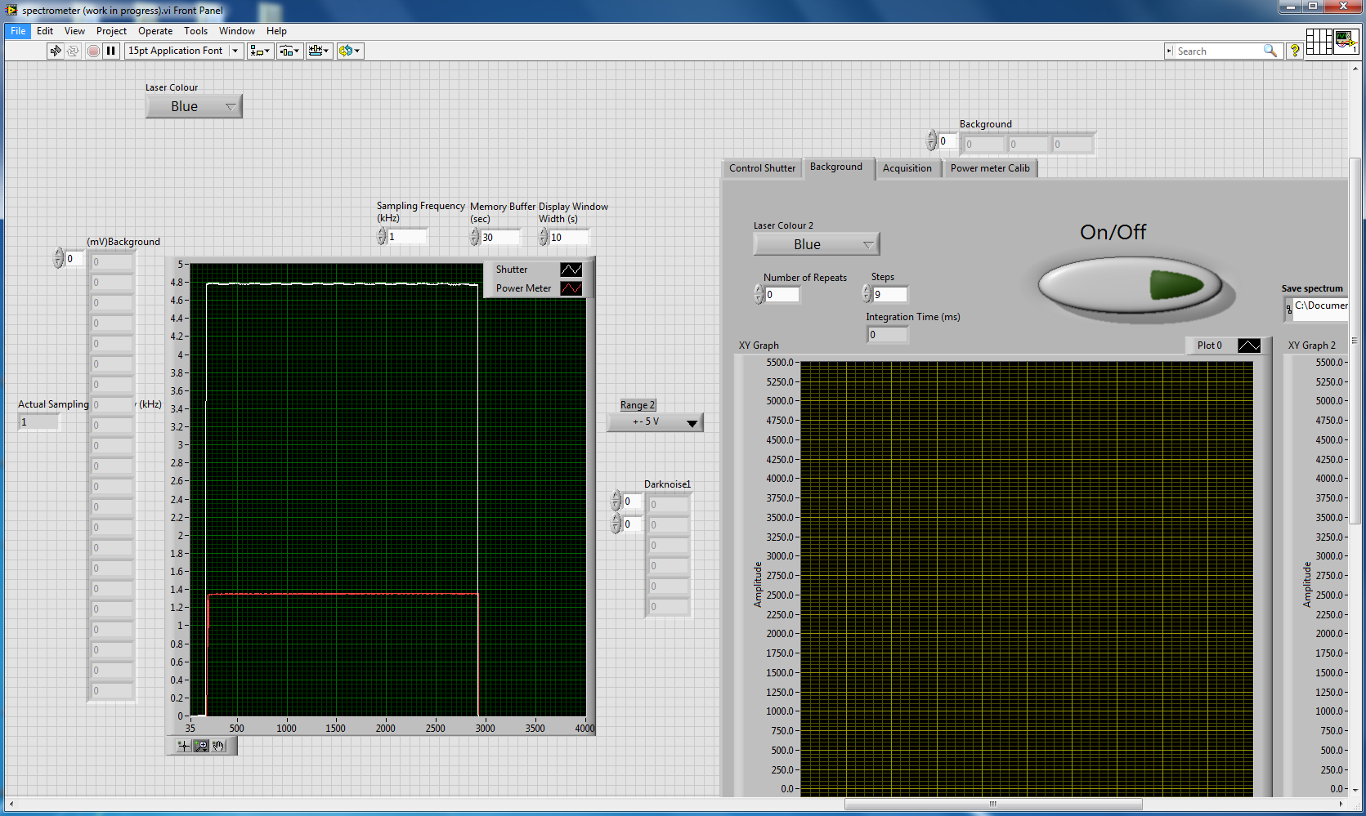
32bit
64bit

Slide 4
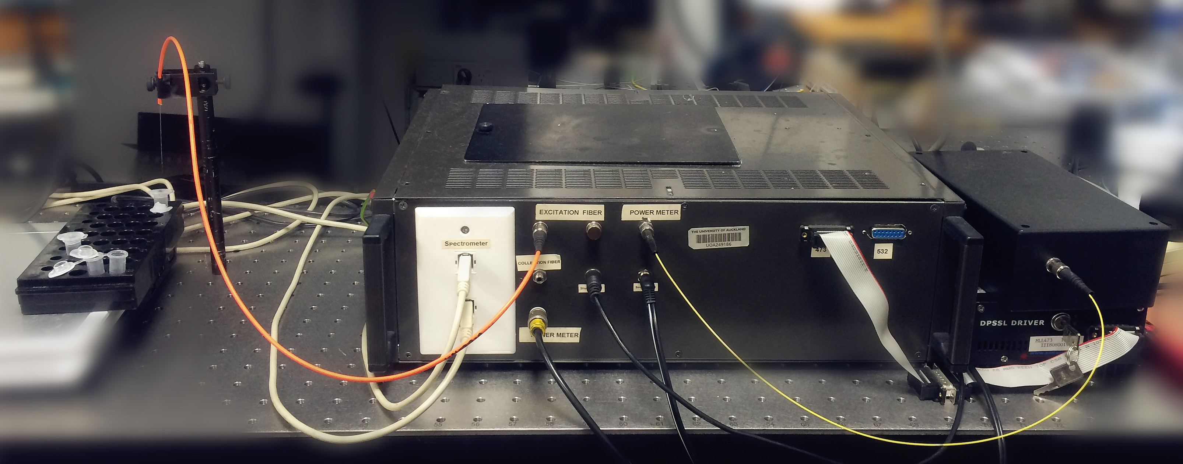
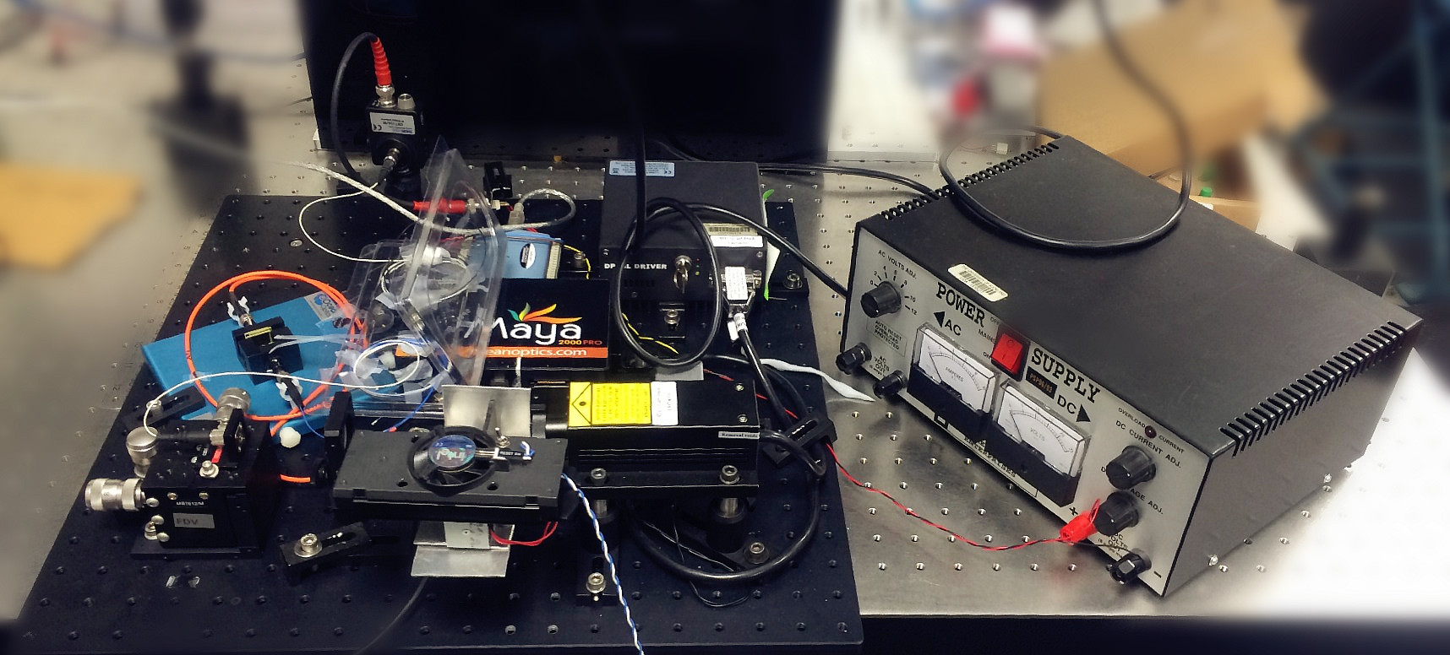
Old
New

Slide 5
Project Scope | Progress
Upgrade from 32-bit to 64-bit [100%]
Upgrade from UL to ULx (DAQ driver) [20%]
Transfer relevant functions [20%]
Add new functions (saving readings) [0%]
Improve usability for front end view [0%]
Bonus: LabVIEW qualification test!

Slide 6
Questions

