Slide 1
SnapInspect: Vehicle Identification
Btech 451 Introductory Seminar

Slide 2
The Project
BTech 451
SnapInspect
Project for SnapInspect
Company well known for its Property Inspection App
www.snapinspect.com

Slide 3
People Involved
Academic Supervisors
Professor Reinhard Klette
Dr. Sathiamoorthy Manoharan
Industry Mentor
Terry Sun

Slide 4
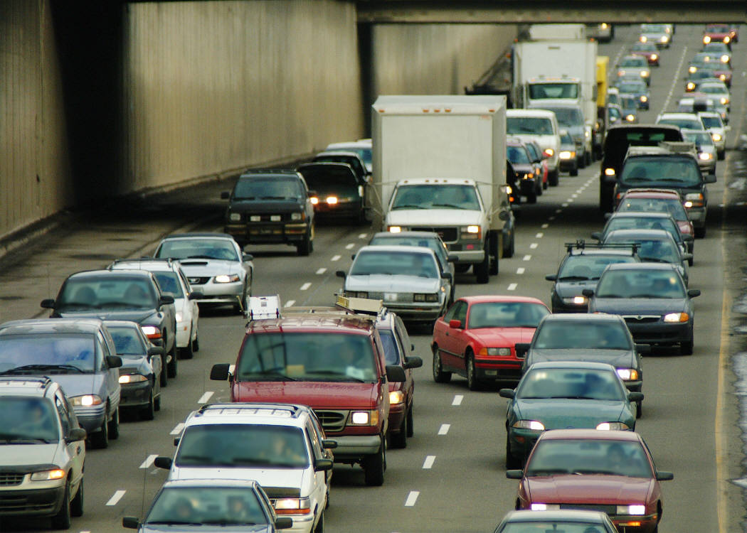
Project Description
Automatically identify vehicles by reading their number plates. A useful application for the automotive and transport industry.
Toll Roads
Parking Meters, Parking lot
Service Stations
Traffic Management
Police

Slide 5
Main focus
Reading license plates in a parking lot
Cameras mounted on walls
Automatically read license plates

Slide 6
Project Goals
Read License Plates at Short Distances
Build an application for an Android-based device which uses license plate reading and can triggers some additional programmable events.

Slide 7
License Plate Recognition and Reading System
Collect video frames
Localize license plate in frames
Carry out segmentation to get each character
Perform optical character recognition
Print out the result

Slide 8
Work in progress
Researching on computer vision basics
Researching on different methods of license plate localization and segmentation
Learning Open CV and experimenting on random images

Slide 9
Future Milestones
Implement license plate localization and segmentation methods by the end of this semester
Start researching on optical character recognition

Slide 10
Hope to Learn and Achieve
Develop planning, presentation and time management skills
Learn Open CV
Improve my programming skills
Learn Android app development
Produce a great end result ☺

Slide 11

Thank you
Any questions and/or feedback?

