Slide 1

Scion BTech Project
Dasarsh Vadugu

Slide 2
Problem
Processes in the nursery are being done on paper
Long process of information being entered into the system
Can be streamlined

Slide 3
Solution
Android application suitable for a tablet
No writing - eliminates legibility issues
Can be made clear what is to be recorded
Validation can be enforced on entered data
Camera allows for photos to be taken and attached
Essentially carrying many sheets

Slide 4
What processes?
There are many processes
Rate of growth
Root structures
Colouration
Mapping
Static
Dynamic

Slide 5
Design
Five forms in total
Dropdown boxes offer choices from other sheets
Mapping forms access camera to attach and edit photos
Sheet preview to show current state and updates
Files are synced between server and device

Slide 6
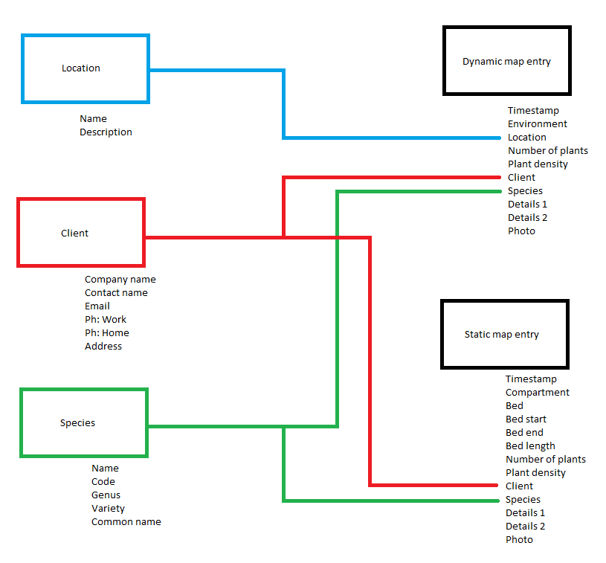

Slide 7
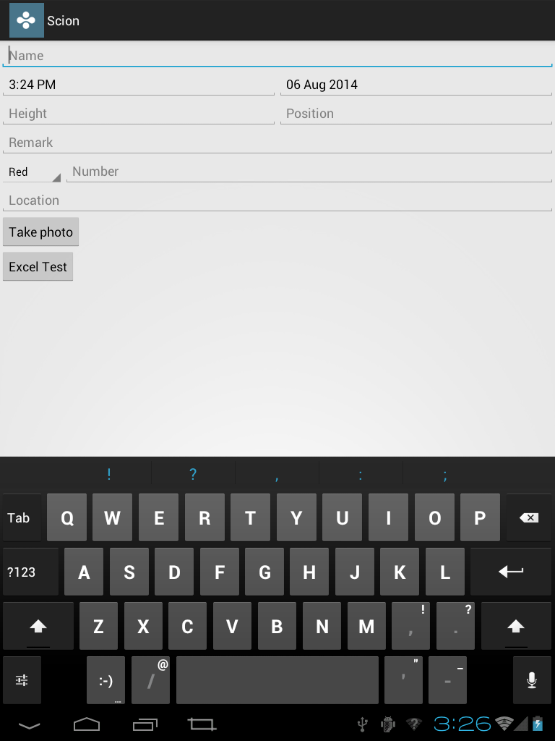

Slide 8
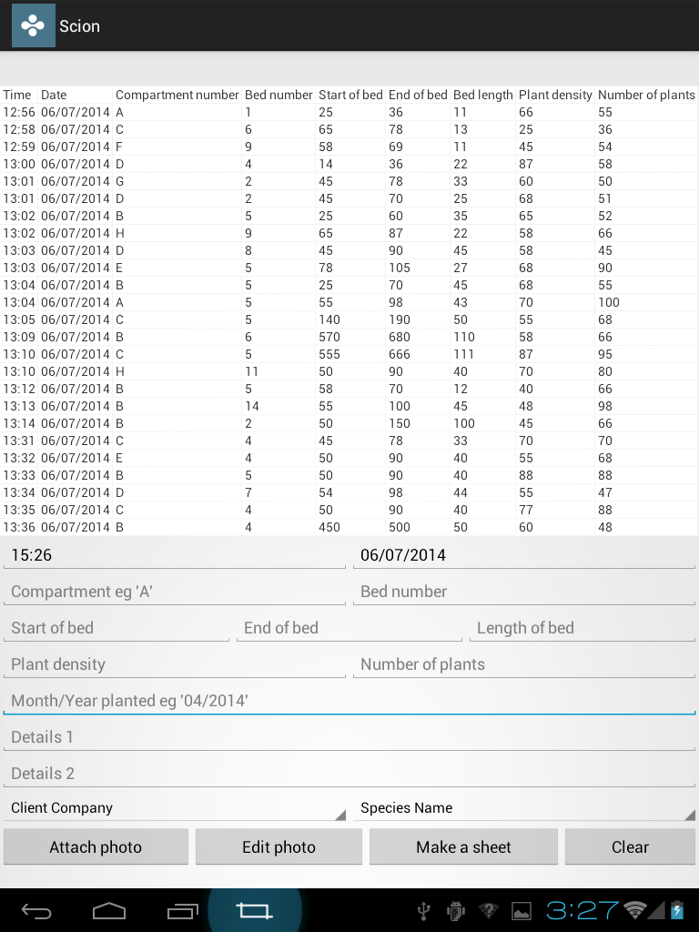
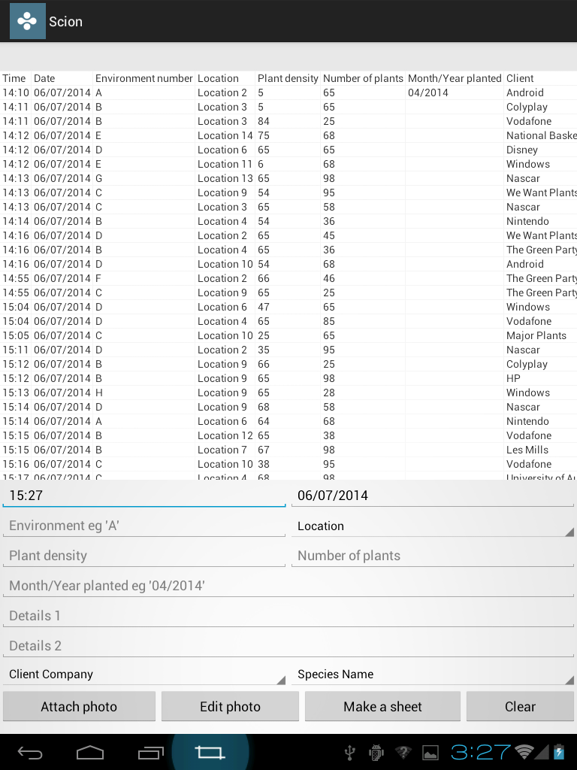
Static
Dynamic

Slide 9
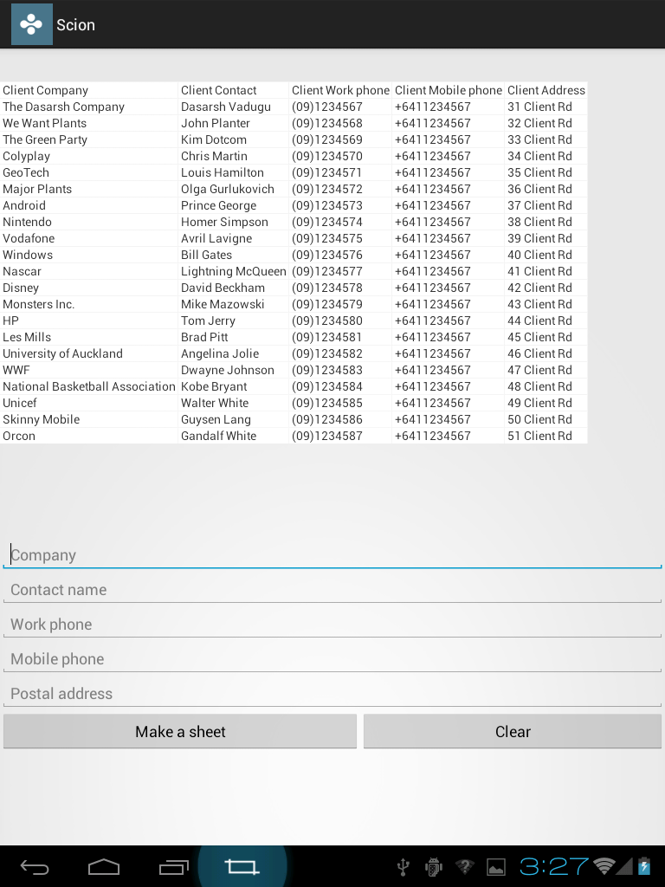
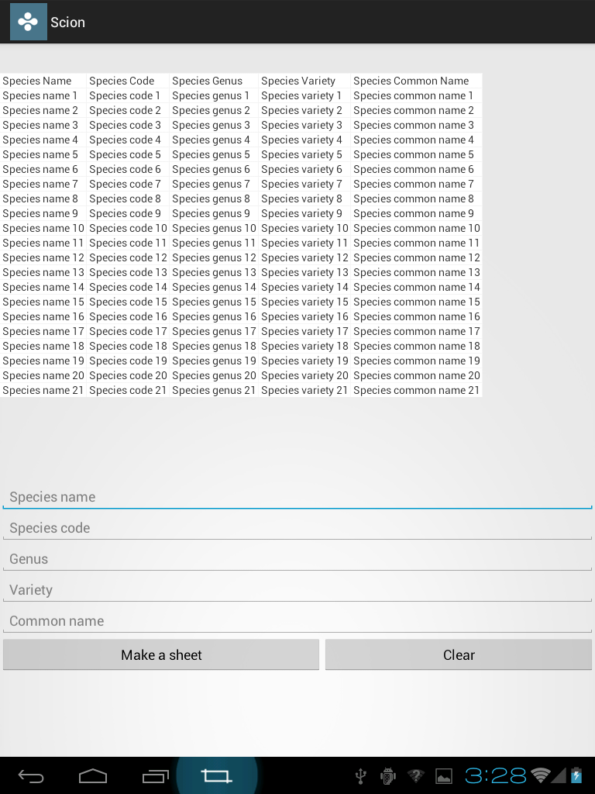
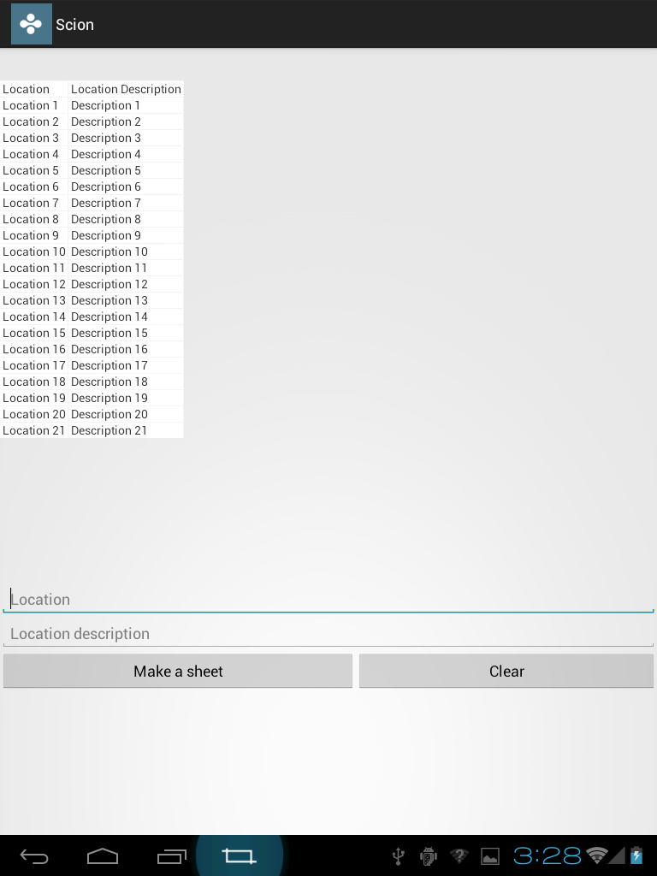
Client
Species
Location

Slide 10
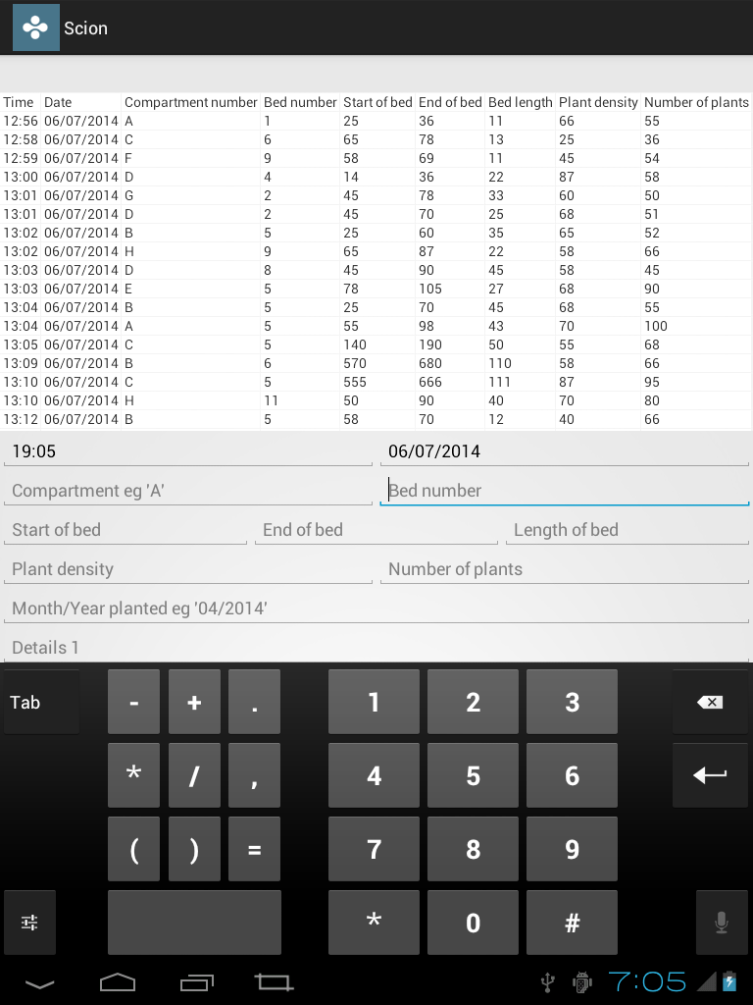
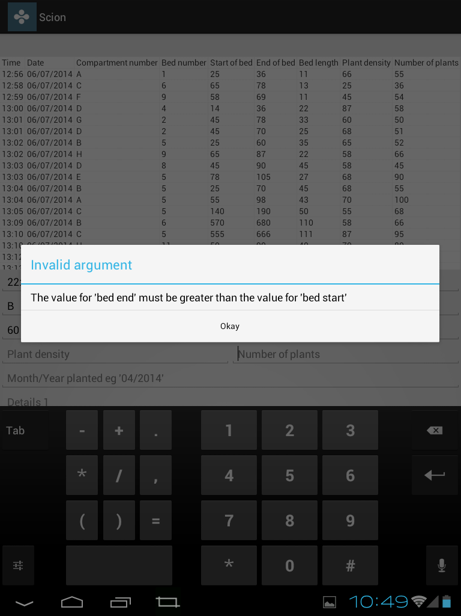

Slide 11
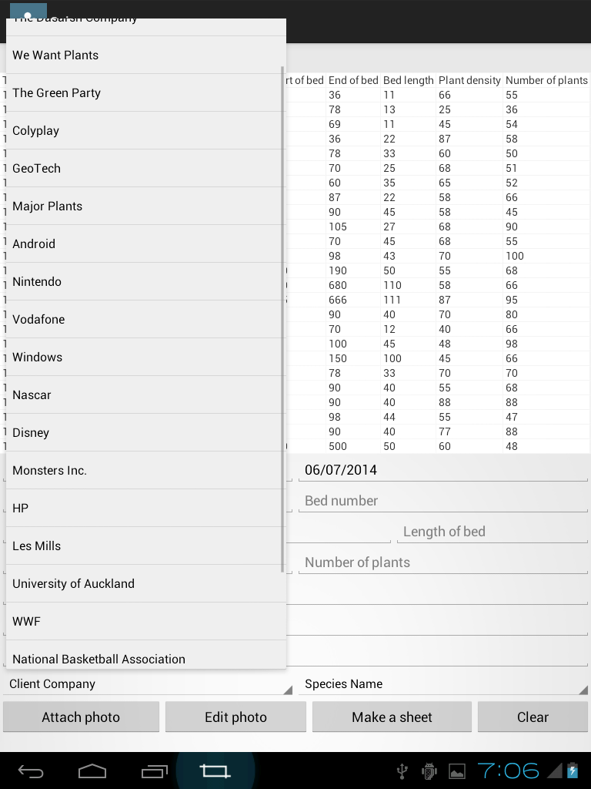

Slide 12
Next?
Syncing of files over wireless network
Google Drive API
Management of versions and merges

