Slide 1

Scion BTech Project
Dasarsh Vadugu

Slide 2
Introduction and recap
Removal of a paper-based form system
Paper-based systems are error-prone and potentially dangerous
Proposed solution
Digitise forms onto a tablet device

Slide 3
Why a tablet device?
Several notable advantages which are not even applicable to paper
  Activities and Services
  Adaptability
  Activity Lifecycle
  Media capabilities
  Inbuilt sensors
  Connectivity
  Data validation

Slide 4
Scion
New Zealand Crown Research Institute
Specialises in research and the science and technology development for many biomaterial sectors
In their nursery, records of the plants must be taken

Slide 5
Problem
Processes in the nursery are being done on paper
Long process of information being entered into the system
Can be streamlined

Slide 6
Solution
Android application suitable for a tablet
  No writing - eliminates legibility issues
  Can be made clear what is to be recorded
  Validation can be enforced on entered data
  Camera allows for photos to be taken and attached
  Essentially carrying many spreadsheets

Slide 7
Related Solutions
Not a new concept
There is a clear advantage in using digitised forms over paper
  Consistency
  Data integrity
  Speed
Recent changes in technology demand a revision of this idea

Slide 8
What processes?
There are many processes
  Rate of growth
  Root structures
  Colouration
  Mapping
    Static
    Dynamic

Slide 9
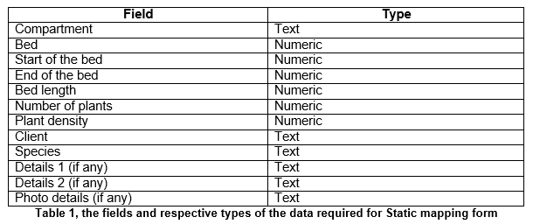
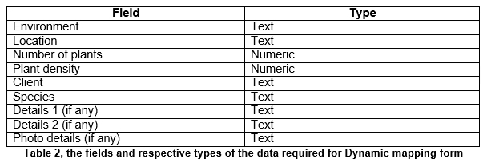
Mapping

Slide 10
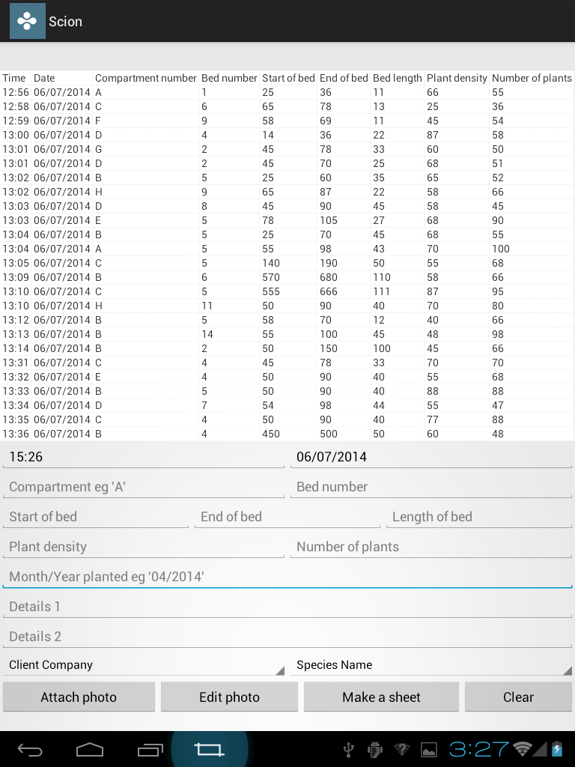
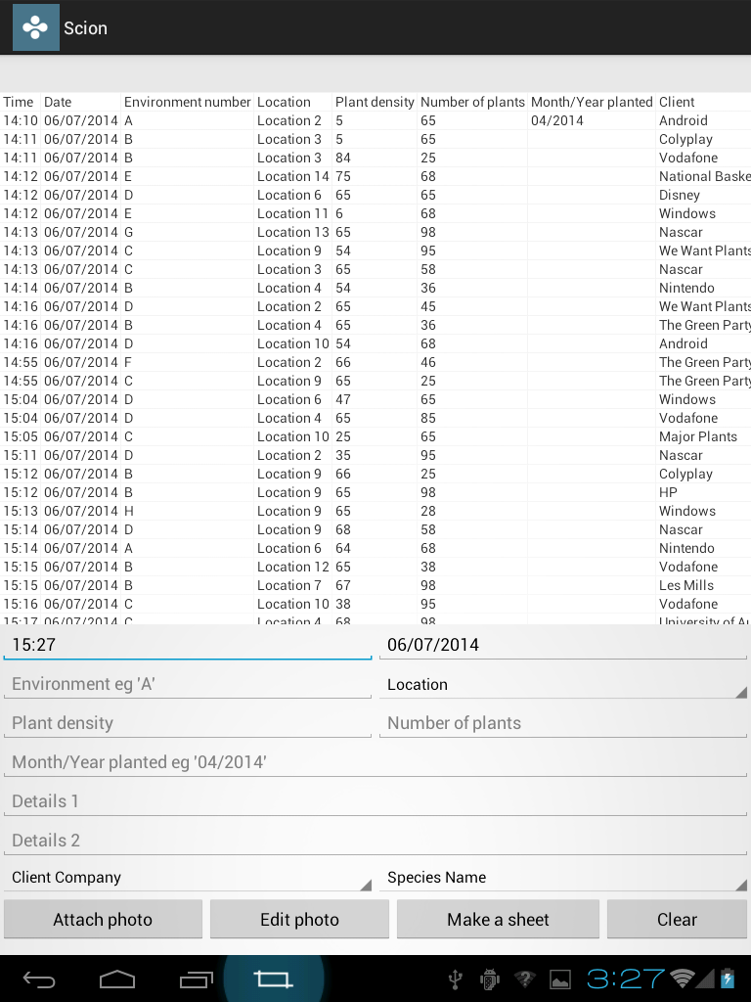
Static
Dynamic

Slide 11
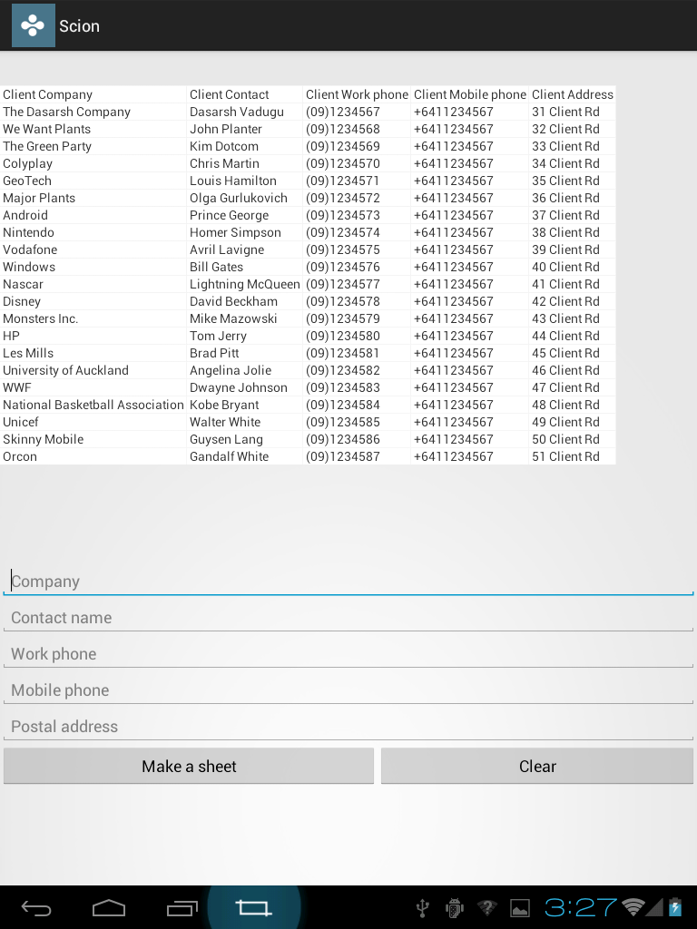
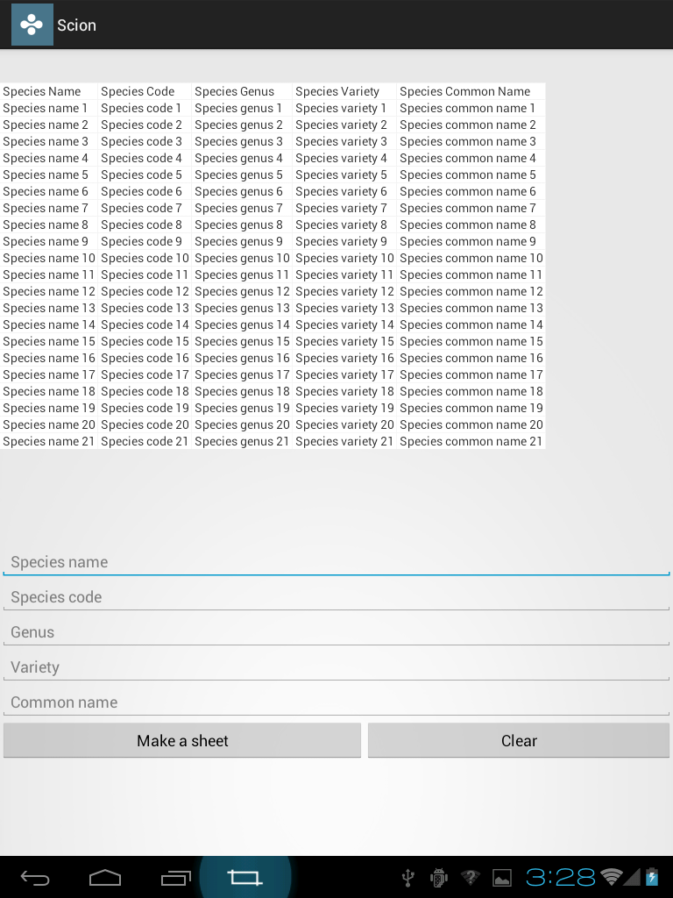
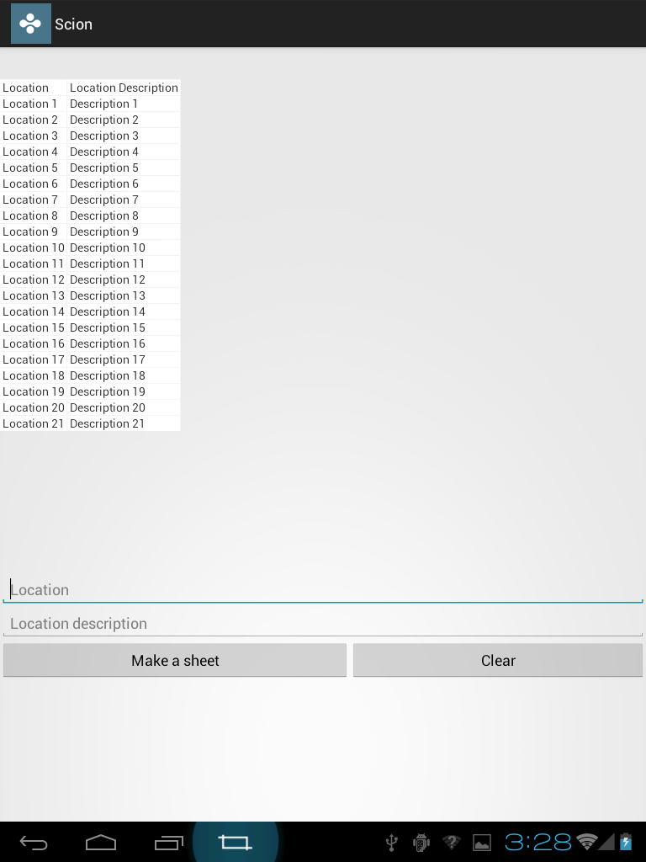
Client
Species
Location

Slide 12
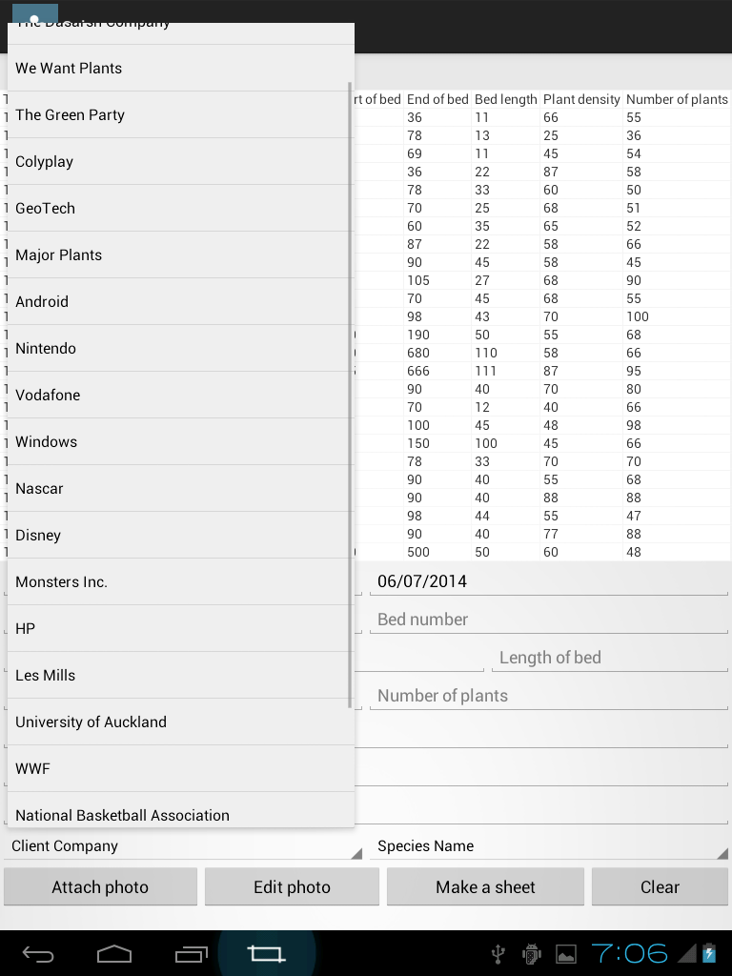

Slide 13

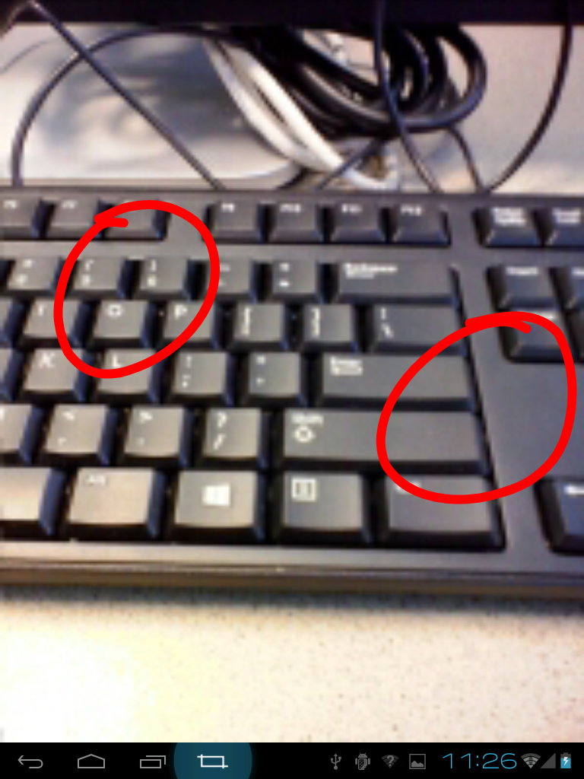

Slide 14
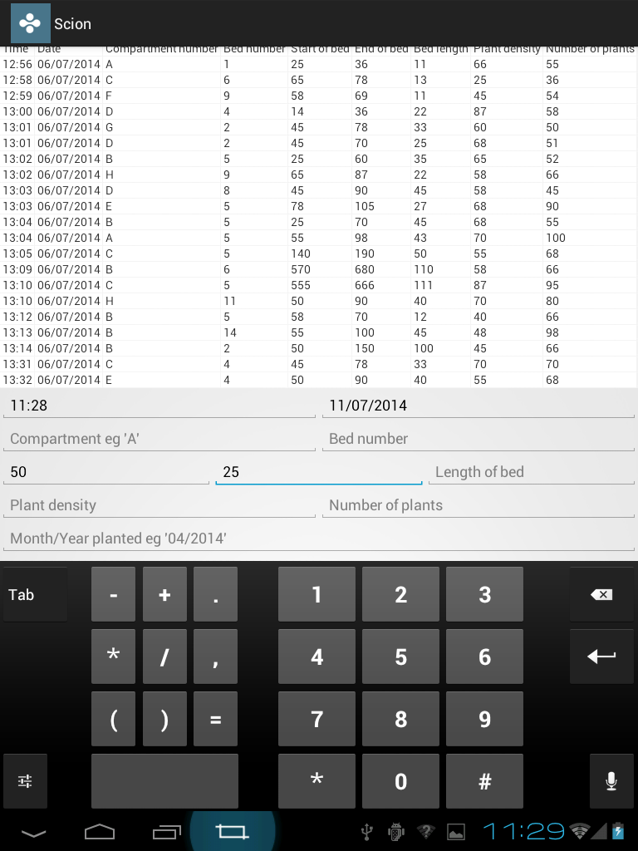
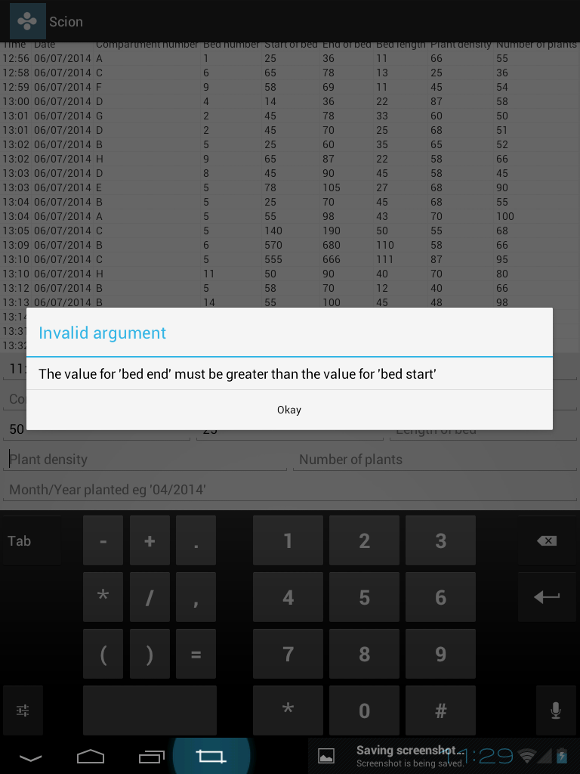

Slide 15
Abstraction
The level of abstraction could be lifted
No longer bound to five forms
Work for all digital forms in all situations
Sheet preview to show current state and updates
Make any digital questionnaire based on specifications

Slide 16
New design
Materialise a questionnaire based on its specifications
Present the user with an experience which is analogous to a paper-based questionnaire
Schema to define the rules of forming the XML document required for the questionnaire specifications
Retain sheet preview to show current state and updates
Files are synced between server and device

Slide 17
Types of questions
Text
Numeric
Multiple choice
  Single response
  Multiple response
Time/Date
Location
Media
  Image
  Video
  Audio

Slide 18
Demo

Slide 19
Challenges and future work
Dropbox API
  Authentication
  Saver
  Syncing functionality
    Offline sync
Future work

Slide 20
Thank you!

