Slide 1

Solar Monitoring Panel BTech 451 Mid-Year Seminar
David Armstrong – 5636534
Academic Supervisor: Ulrich Speidel
This project is with Vector Limited

Slide 2
Background – Vector Limited
Vector Limited
Auckland-based
Primary a power distribution company
Gas
Fibre
Recently begun to investigate a solar optimisation challenge
As with other distribution networks

Slide 3
Background – Solar Panel System
Solar panels on the roof generate power
Power can be stored in onsite battery for later use
Can be used overnight or during power cuts
Excess power can be exported to the grid
Components are connected together by an onsite computer
Connected to the internet via home internet connection
Can be remotely controlled

Slide 4
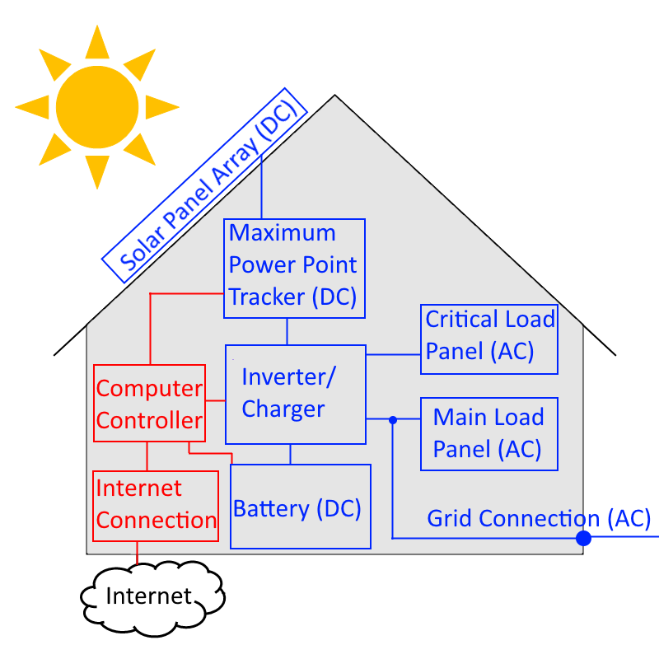
Background – Logical Diagram

Slide 5
Background - API
HTTPS based
GET, POST, DELETE methods
Features
Initiate / end session
Get current system status in XML/JSON format
View/modify power plans
Newer version of API was released recently
Better features
Had to rewrite API code

Slide 6
Research Question
Assigned to me by Vector for me to work on
Based on a current challenge that the global solar industry is facing
Situations of power use where there is optimisation potential
Exporting power when reimbursement rate is low
Exporting early then importing to later power a device
The research question: “Can the strategic use of excess power provide additional value to the customer?”

Slide 7
Solution and Answer
Have an optional load in the house turn on to consume the excess power
Decision is made on current system status and recent history
Load would be switched on automatically
Could potentially alert user to turn a load on manually
Use a local device in the house to this
Connect using API
Make decisions
Send control signal
Answer the research question based on this solution

Slide 8
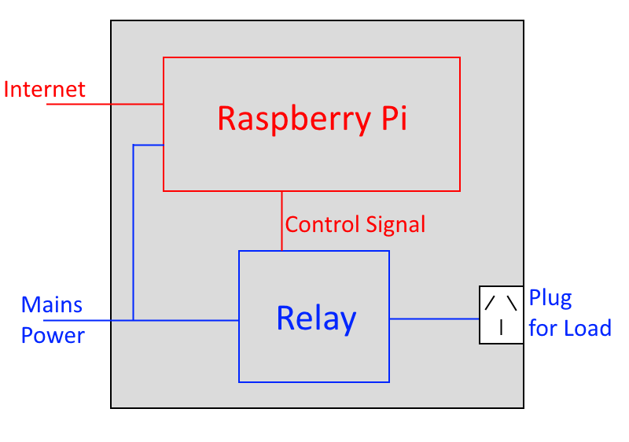
Solution – Logical Diagram

Slide 9
Technical Choices
Device - Need a cheap but reasonably powerful device to connect using API, make decisions and send control signal (GPIO)
Arduino
Raspberry Pi
Operating System – Need a Stable OS for the Raspberry Pi that supports modern programming languages
Raspbian
Pidora
Arch Linux

Slide 10
Technical Choices
Programming Language – Needs to be to run for a long time and have HTTPS and GPIO libraries
Python
Java
C++
Status return format – Needs to use low bandwidth
XML
JSON

Slide 11
Current Progress - Overview
Raspberry Pi configuration
Decision Making Program
Functional – Program structure works
Lacks intelligent decision-making logic
API Methods
GPIO control signal tested and working with a LED, but not connected to a relay yet

Slide 12
Current Progress - Classes
DecisionMaker.java
Contains the main method, initiates the program
APIConnection.java
Contains methods for using the API, like getting current status
LoopTask.java
Contains high-level logic , Subclass of Thread
Logger.java
Wrapper methods for logging
LoadController.java
Wrapper methods for controlling GPIO

Slide 13
Live Demo

Slide 14
Future Work
Improve decision-making algorithm logic
Record recent history on the device
Compare the current day to recent history
Estimate the remaining power to be generated this current day
Make a decision accordingly
Setup up the Raspberry Pi in a box with a relay
Set up Raspberry Pi in a circuit with a relay to turn load on/off
Feed decision information back to Vector

Slide 15
Thank you, any questions?

