Slide 1

Solar Monitoring Panel BTech 451 Final Seminar
David Armstrong – 5636534
Academic Supervisor: Ulrich Speidel
This project is with Vector Limited

Slide 2
Background – Vector Limited
Vector Limited
Auckland-based
Primary a power distribution company
Gas
Fibre
Recently begun to investigate a solar optimisation challenge that the global solar industry is facing
As with other distribution networks

Slide 3
Research Question
The research question: “Can the strategic use of excess power provide additional value to the customer?”
The goal of the project is to answer this question
To answer the question, I will produce a load-switching solution
Question is based on optimising the use of excess power to provide additional value
Example situation with optimisation potential:
Exporting power when reimbursement rate is low

Slide 4
Background – Solar Panel System
Solar panels on the roof generate power
Power can be stored in onsite battery for later use
Can be used overnight or during power cuts
Excess power can be exported to the grid
Reimbursed at different rates
System is connected to internet via home internet connection
Has an HTTPS-based API
Can retrieve system status and power plan information in XML or JSON formats

Slide 5
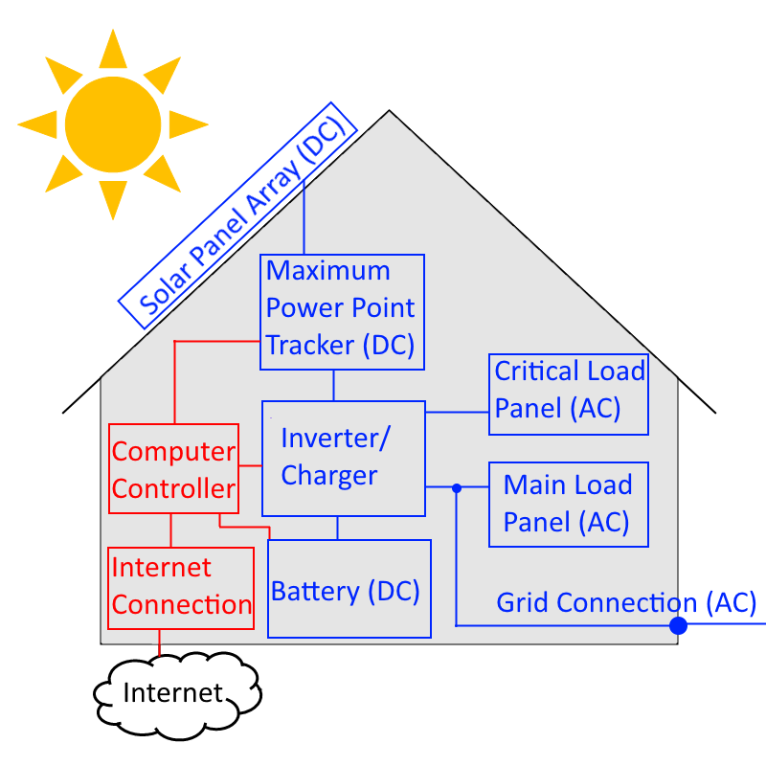
Background – Logical Diagram

Slide 6
Solution Design
Hardware component
A cheap, low-powered device running in the house
Needs to support an appropriate programming language
Switch both wireless and/or wired loads
Software component
Program that loops indefinitely
Retrieve system status using the HTTPS-based API
Make decisions based on status and recent history each loop iteration
Send control signal to switches

Slide 7
Solution Design - Choices
Device - Need a cheap but reasonably powerful device to connect using API, make decisions and send control signals
Arduino
Raspberry Pi
Programming Language – Needs to be to run for a long time and have HTTPS and GPIO libraries
Python
Java
C++

Slide 8
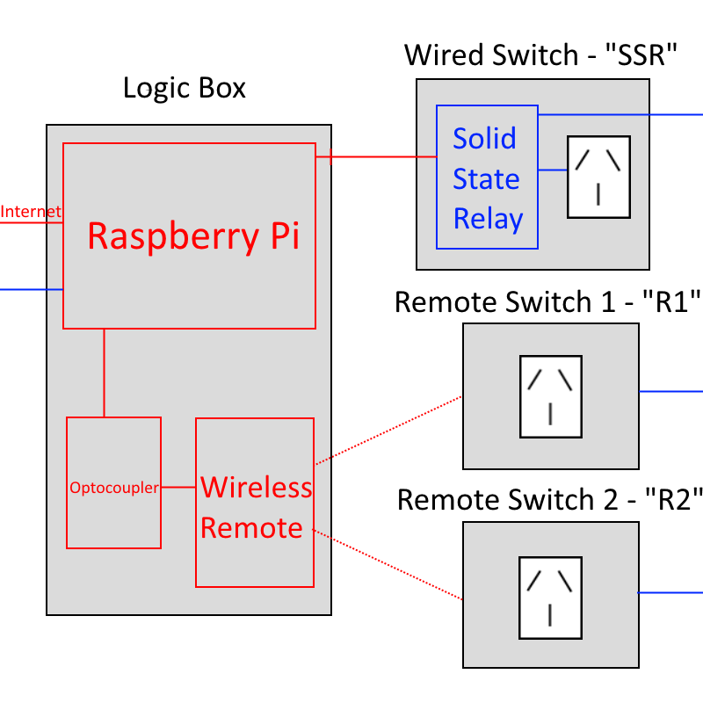
Solution Design– Logical Diagram

Slide 9
First Semester Progress
Understanding of the system and API
Raspberry Pi configuration
Got Java programs to run
Decision Making Program
Functional – Program structure works
API Methods working correctly
GPIO control signal tested and working with a LED
Lacks intelligent decision-making logic

Slide 10
Second Semester Progress
Decision making logic algorithms
Iterative process – several versions
Store recent information, in memory and in CSV files
Use this recent information to help make decisions
Controlling multiple loads
Updated GPIO controller to switch additional loads
Decision logic takes multiple loads into account
Loads have priorities
php parameter editor
Change load information via web (local network)

Slide 11
Decision Making Algorithms
1st Algorithm
4 Basic conditions based on information such as:
Amount of power currently being exported
How much power has been exported recently
Designed for a single load
Found it didn’t turn on loads enough
2nd Algorithm
Based on the first algorithm but with state machine simulations
Designed for a single load
Found it was too hard to simulate systems

Slide 12
Decision Making Algorithms
3rd Algorithm
Based on the first algorithm, but with a few changes
Designed for a single load
Better than the first, but still didn’t turn loads on enough
4th Algorithm
The most simple, but also the most effective
Designed for multiple loads
Turns on loads effectively

Slide 13
Implementation- Classes
DecisionMaker.java
Contains the main method, initiates the program
Contains decision making logic
APIConnection.java
Contains methods for using the API, like getting current status
Logger.java
Contains static methods for logging to CSV files
LoadController.java
Contains methods for controlling GPIO

Slide 14
Implementation- Classes
DayData.java
Stores data in memory for a particular day
Statistic info is generated at the end of the day
DataRecord.java
Stores multiple DayData objects in memory
Calculates information from multiple days to be used for decision making
SystemStatus.java
Basic data class that holds information about a system

Slide 15
Implementation Summary
Program consists of 7 Java classes
The program runs successfully on the device and loops indefinitely
At each iteration of the loop, the device successfully turns multiple loads on or off depending on:
The current state and recent history of the system
Priority of the loads
Loads only turn on during power export
Loads are switched either by a wired switch, or remote switches

Slide 16
Live Demo

Slide 17
Answer to the Research Question
The research question: “Can the strategic use of excess power provide additional value to the customer?”
Answer: Yes, if the loads being turned on are useful and don’t just waste power
No point turning on a load just to waste it
Loads should consume excess power in a useful way that can provide additional value, e.g. Hot-water preheater

Slide 18
Potential future work
Test more thoroughly
Look at longer term effects/trends
Display statistical information to the user
Web interface
Smartphone app
Alert users when excess power is available
Instead of switching on loads automatically
Send user an email
App notification on local network (if home)

Slide 19
What I have gained
Long term project experience
Time management
Enhanced Java and OOP skills
Basic php experience
Written communication skills
From reports, documentation and emails
Verbal communication skills
From presentations and meetings
Business experience

Slide 20
Thank you, any questions?

