Slide 1

Smart devices to assist the conservation of biodiversity
BTech 451 Project
-- End-of-Semester Seminar
Presented by Zhu Yanzhao

Slide 2
Outline
Overview
Requirement
My application Design
Development tool
Project plan

Slide 3
Overview
The purpose of my project is to develop a mobile application to assist the environmental protection organization The Pacific Invasives Initiative (PII).
This will strengthen their capacity for managing invasive species.
The application can help managers to monitor and evaluate the effectiveness, efficiency and accountability of an invasive plant object.
The collection, management and analysis of data is central to the success of this project.

Slide 4
Requirement
The database has been developed before.
Collection, transcription, storage and analysis of those data are functions which the application should provide.
Client could be able to directly record the data of invasive species, such as photograph, location… And smart device application would capture and send data to the agency’s database by easy and quick way.
Application would have the ability to work offline.
Additional function: identification of plants
Use the photograph to match existing items in the database
Receive information from the database

Slide 5
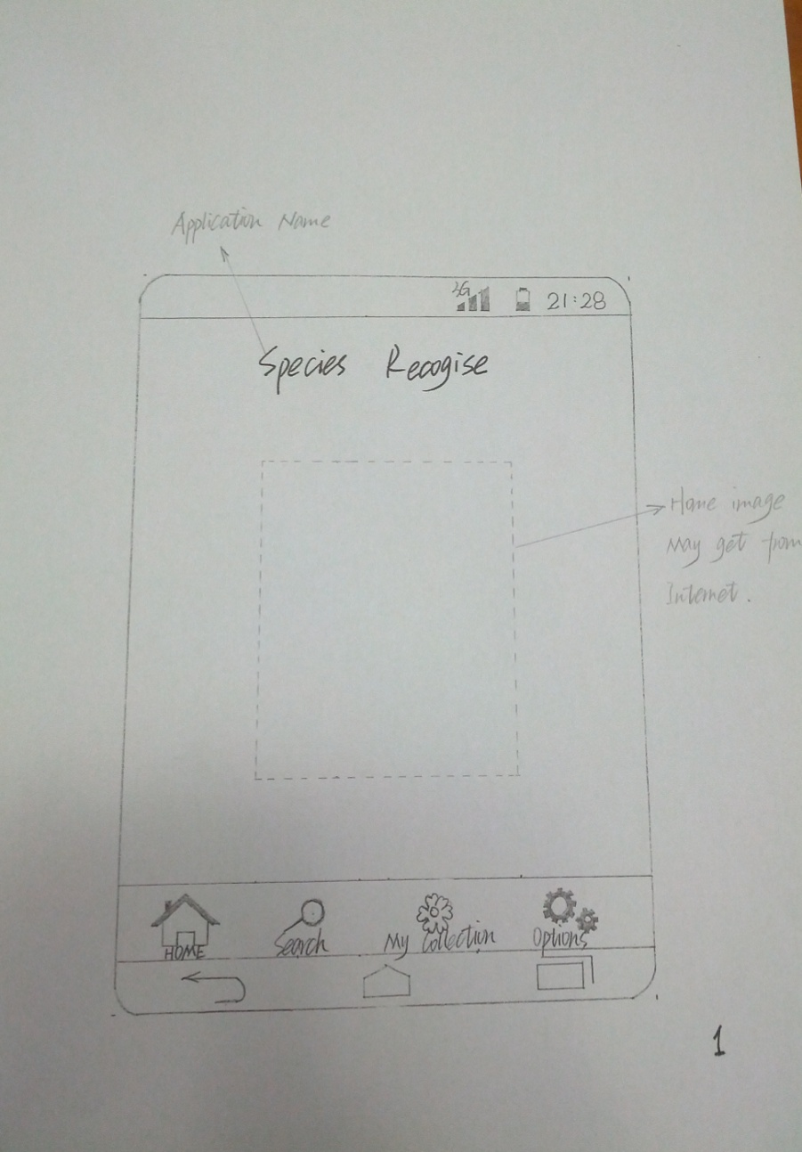
Design
Home Page
Home image can be downloaded from the Internet.
Home image can be changed per five seconds, like auto-player.
Four Buttons
Home
Search
My Collection
Options

Slide 6
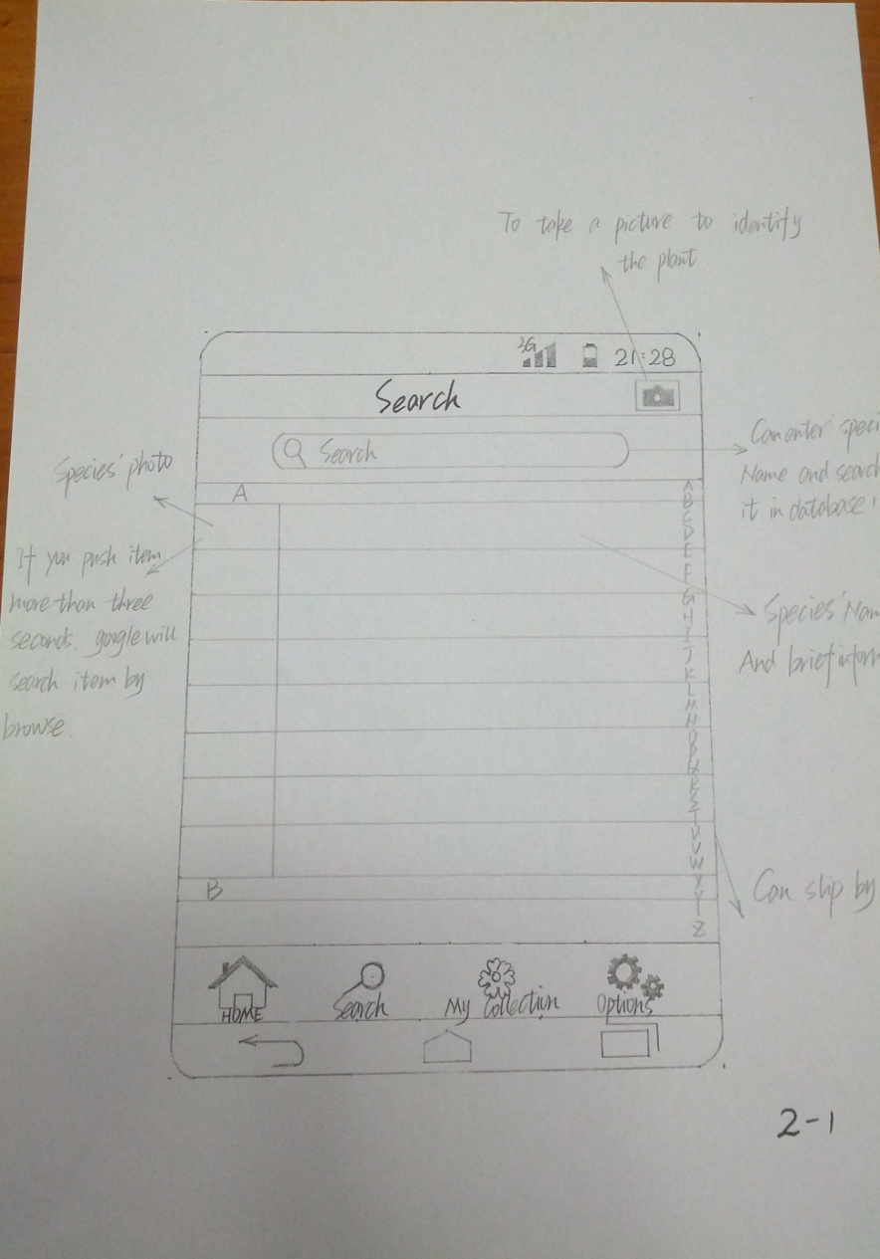
Design
Can enter species’ name and search it in database
Display species’ photo, name and brief information
Ability to Google search selected items
To take a picture to identify the plant
List view can be scrolled by touch.

Slide 7
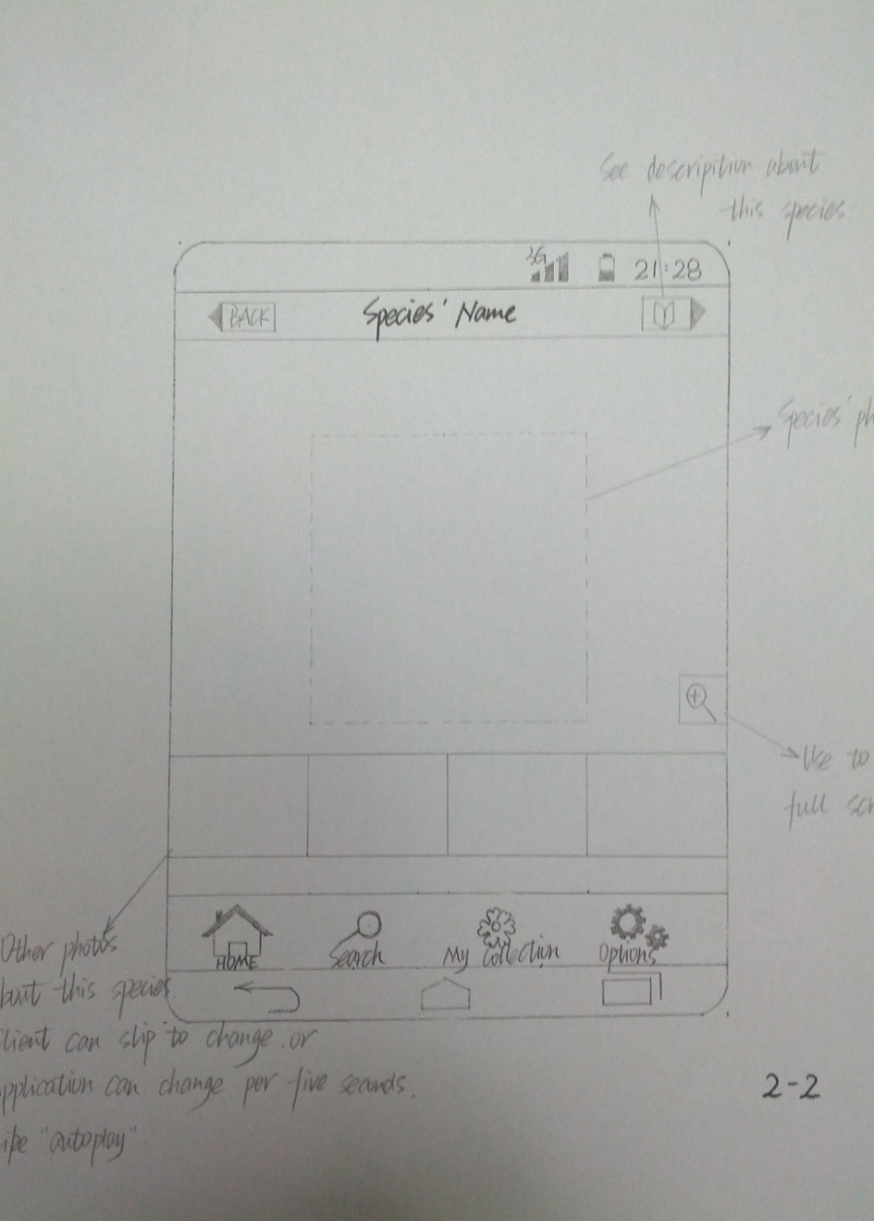
Design
Display species’ photo
Tool to see full screen
Other photos are on the bottom. User can scroll to change, or application can change photo per five seconds, like auto-player.
Button – click to see description about this species.

Slide 8
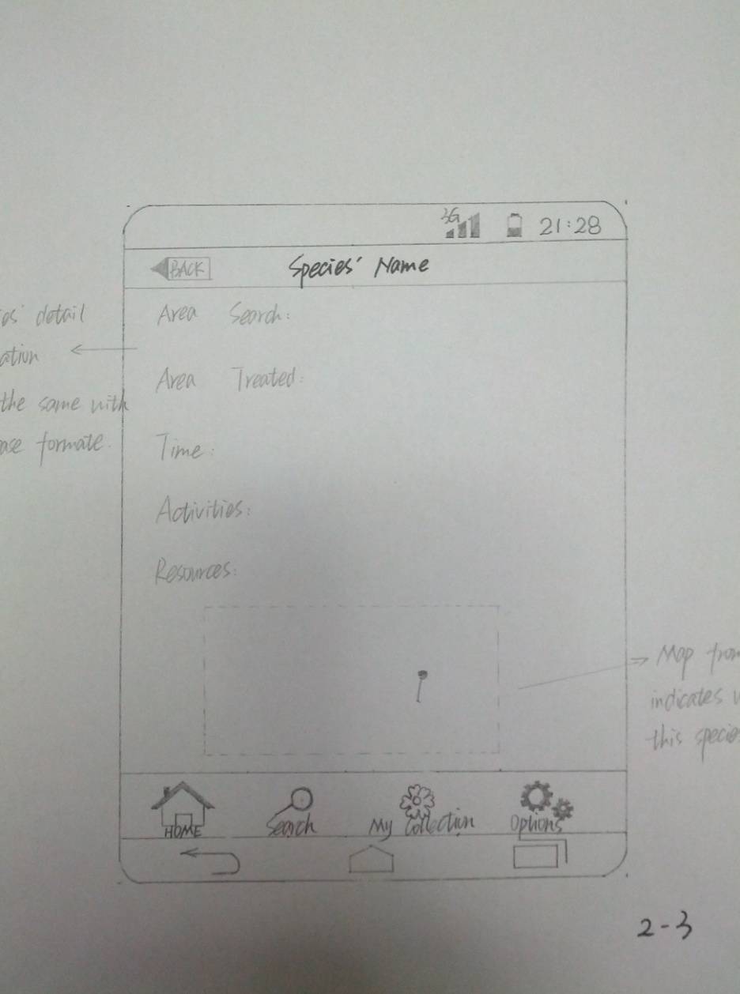
Design
Main screen will display the detail information of this species, which is the same with the database format.
On the bottom of the screen, there is a Google map to indicate the location where this species was found.

Slide 9
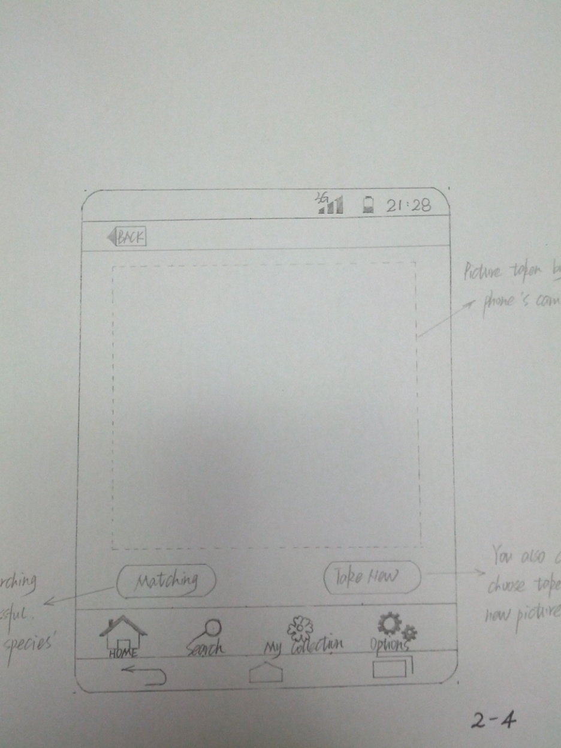
Design
Main screen will display the picture taken by phone’s camera.
Two Buttons
Matching
Take New
If matching is successful, display the species’ card.
You can also choose to take a new picture.

Slide 10
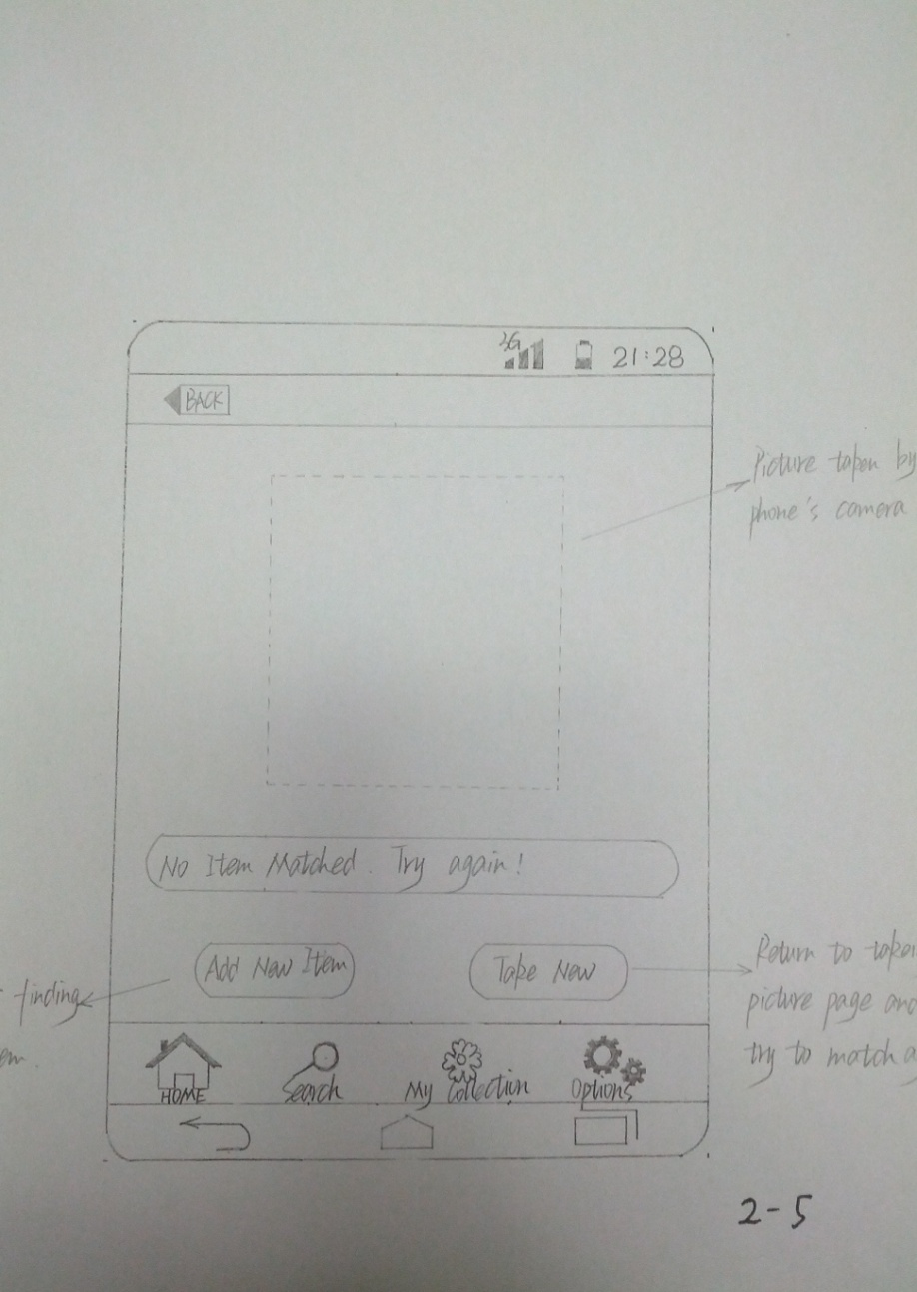
Design
Blow the picture, there is a textbox which displays “No Item Matched. Try again!”
Two buttons
Add New Item
Take New
Client can consider finding new item and add it to the database.
Return to taking picture page and try to match again.

Slide 11
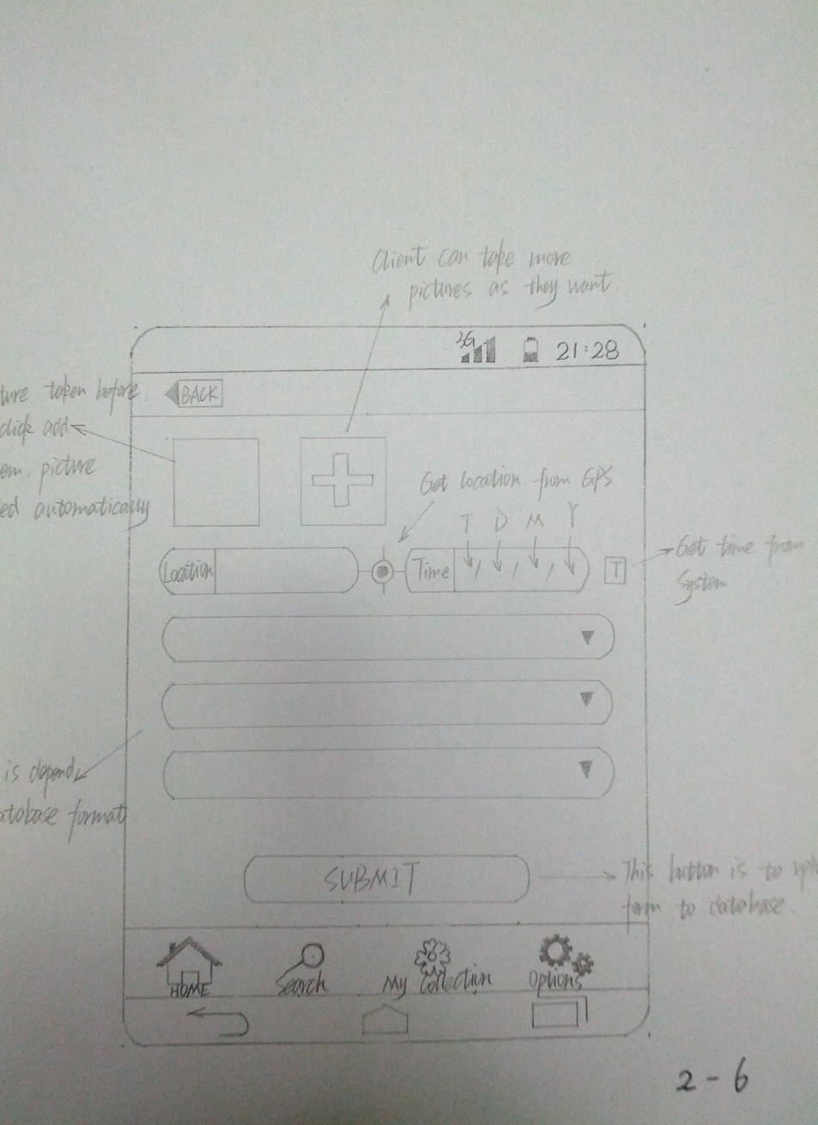
Design
When clicked to add new item, picture will upload automatically.
User can take more picture if required.
User can enter location by hand, or get location from GPS.
User can enter time by hand, or get time from system.
Rest of the information will be filled as required.
Click submit button to upload and store data to the database.

Slide 12
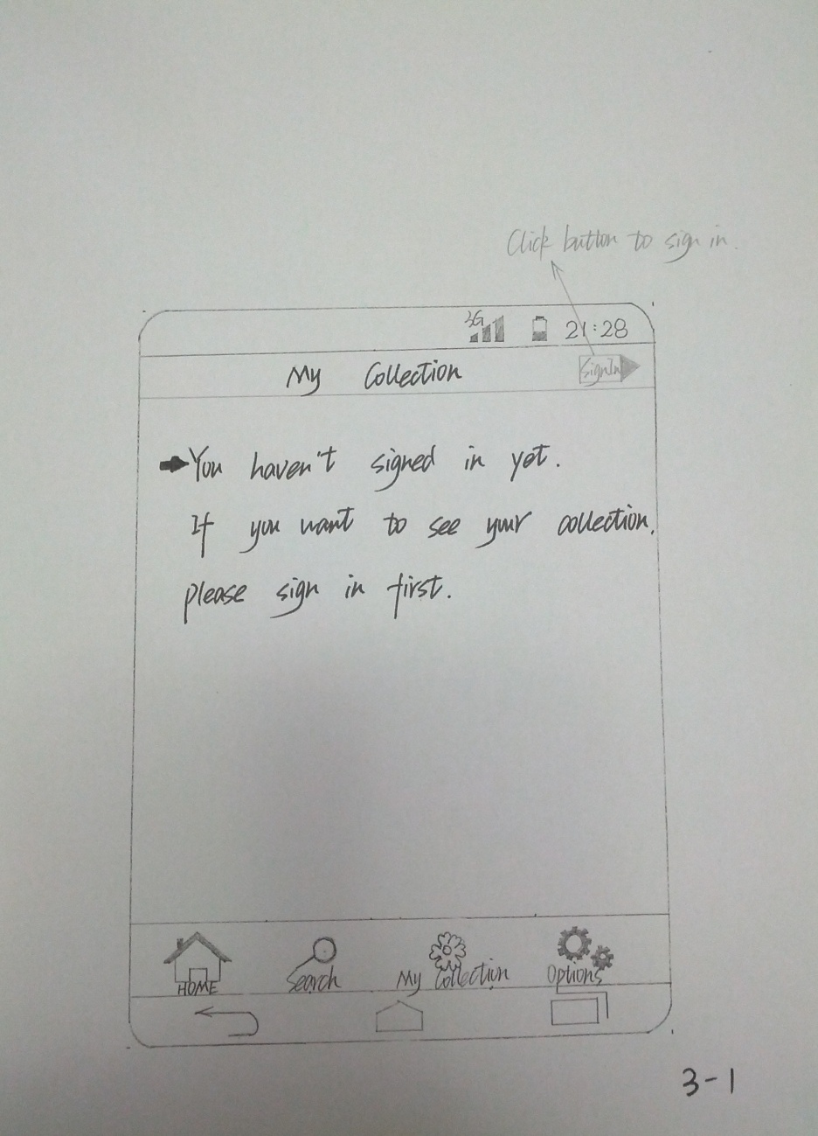
Design
This page is My Collection.
Firstly, main screen will display “You haven’t signed in yet. If you want to see your collection, please sign in first”.
On the top-right corner, there is a “Sign In” button to allow client to log in.

Slide 13
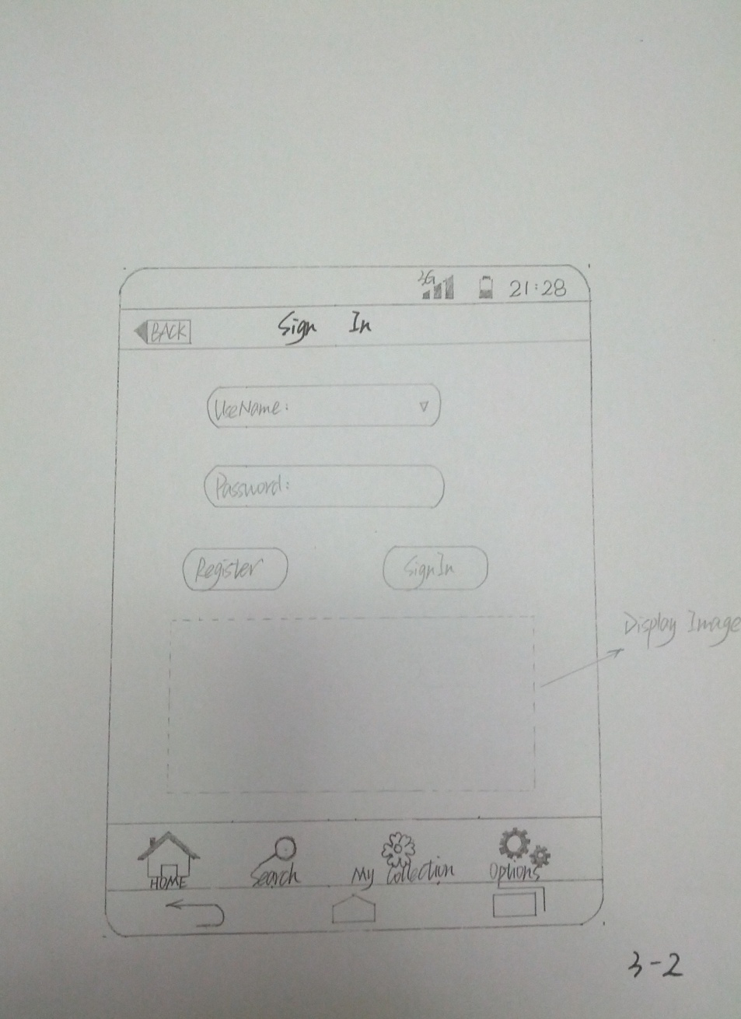
Design
Sign-in page
User can enter user name by hand, if client has entered once, he could find his user name in drop-down list.
User can enter password to sign in.
Two buttons
Register
Sign in
User can register.

Slide 14
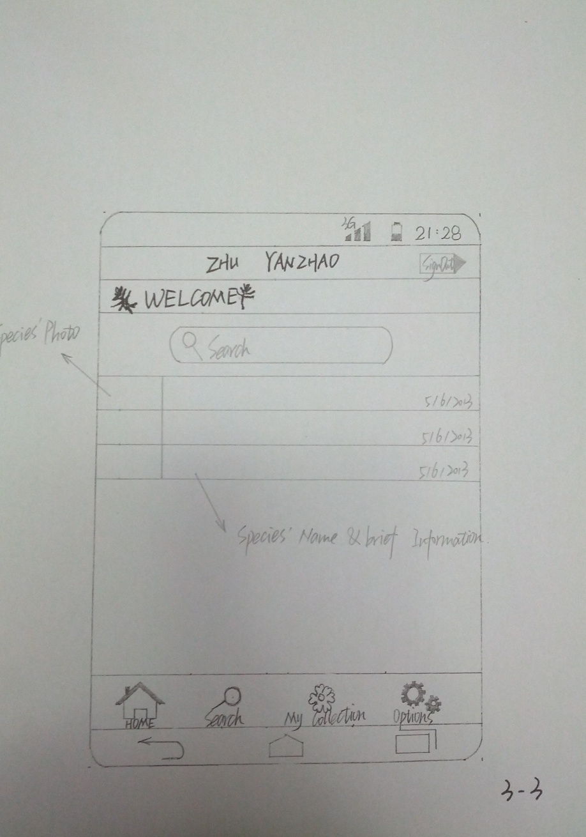
Design
User name will be displayed on the top.
All species will appear in the list view.
Can click each item to view the detail information.
And adding time will be listed.

Slide 15
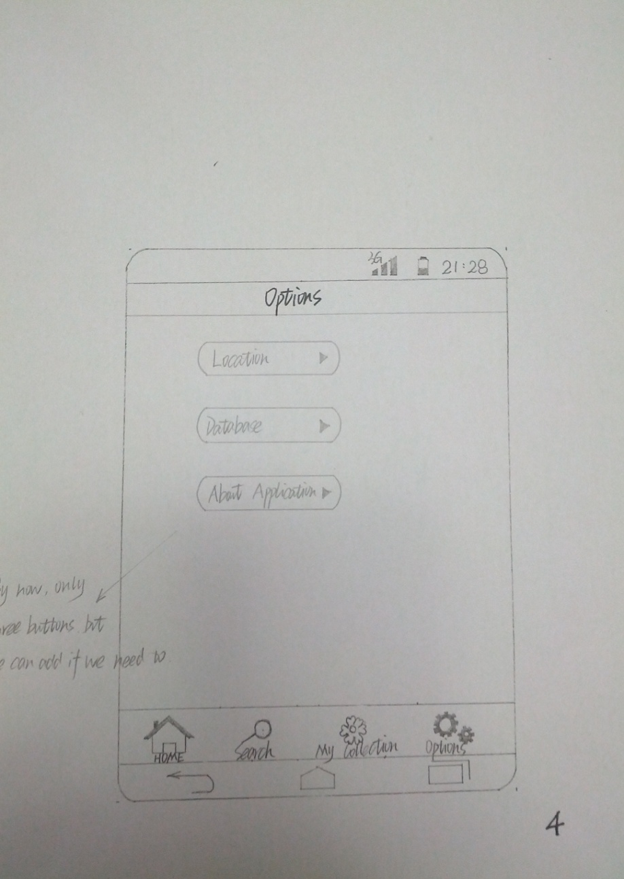
Design
Options page
Get location
See database information
The number of species in database.
See application information, such as version. Allow client to update to latest version.
New button can be added.

Slide 16


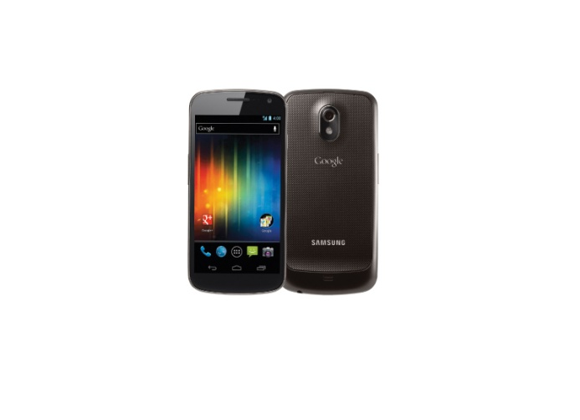

Development Tool
Java SE JDK  Android SDK
Eclipse  Samsung Nexus

Slide 17
Project Plan
I have done research part and design part. Practical and implementation part is on the schedule now.
Modify and prefect my application design in the process of implementation.
Issues I would meet in implementation:
User interface implementation
Build connection between client application and database
Application would work offline
Picture matching analysis
Calling phone’s system function, such as camera

Slide 18

Thank you…
Any Question…

