Slide 1

Smart devices assist the conservation of biodiversity
BTech 451 Project
-- Introductory Seminar
Presented by Zhu Yanzhao

Slide 2
Outline
About Company
People
Project Introduction
Project Plan
Hope to Achieve
Question

Slide 3

Company -- PII
The Pacific Invasives Initiative(PII)
Operating from The University of Auckland since 2004, PII works with Pacific agencies (both government and non-government organizations) to strengthen their capacity for managing invasive species in the Pacific region.
Website of PII: www.pacificinvasivesinitiative.org

Slide 4
People
Project Coordinator
Bill Nagle -- w.nagle@auckland.ac.nz
Programme Support Officer
Natasha Doherty -- n.doherty@auckland.ac.nz
Academic Supervisor
Dr S. Manoharan -- mano@cs.auckland.ac.nz
Student
Zhu Yanzhao – yzhu114@auckland.ac.nz

Slide 5
Project Introduction
Background -- Invasive plant management projects, in particular, are usually complex and long-term.
Solutions -- Develop a smart device to assist managers to monitor and evaluate the effectiveness, efficiency and accountability of an invasive plant project.
Proposal – Database has been developed. Smart device will enable direct recording of data(location, timing, area searched, photographs,…) in the field and transfer to the agency’s database. The application would have to be able to work offline, i.e. pick up location without being online.
Continue…

Slide 6
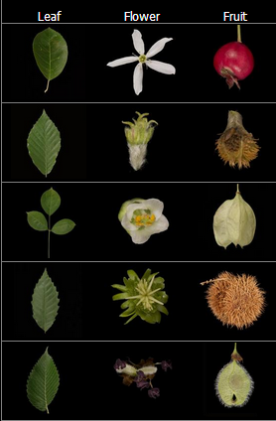
Project Introduction
Special function – Smart device application would also enable to assist field teams to identify the plants. A photograph of plant or plant part taken in the field could be matched against records stored on the device.
Graph is captured from www.leafsnap.com

Slide 7
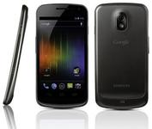
Project Plan
The application will be developed by Java Programming Language.
The application will be useable with Android Operation System.
Aim at Android smart phone – Samsung Galaxy Nexus.
Client User Interface will be designed friendly, conveniently. It will mostly use multiple choice question and avoid handwriting problem.
Set up data communication between client and database.

Slide 8

Hope to Achieve
Achieve project planning skills
Enhance the programming skills
Gain the skills about how to collect, transmit, store and analysis data.
Learn lots of knowledge about mobile application development
Practice working skills in business environment
Get experience about how to make communication with partner and client

Slide 9

Thank you…
Any Question…

