Slide 1

BTECH 451
31st March, 2012
Presented By Vishal Naidu
The Mid-Semester Seminar..
Tyre Monitoring Application System

Slide 2

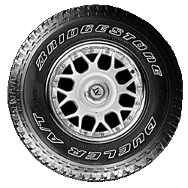
Presentation Overview
Recap
The Refined Project Goal
Web Services
The Field Trip
Design Specifications
The Future

Slide 3
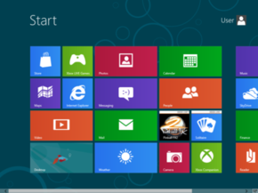
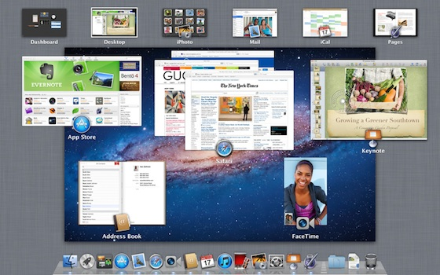
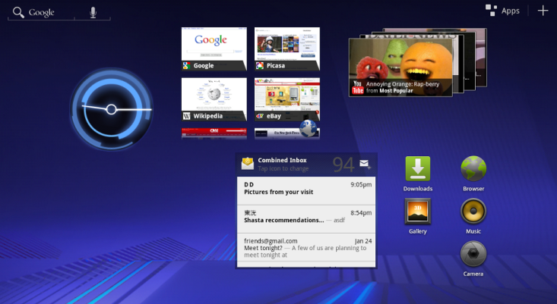
What I’ve done previously
Decided on what OS the mobile application the application is going to be developed on.
It fits in with the OS's within the Bridgestone corporation
Windows 8 OS was chosen. The other options was also considered

Slide 4
What I’ve done previously (2)
Got a thorough understanding of Bridgestone systems

Slide 5
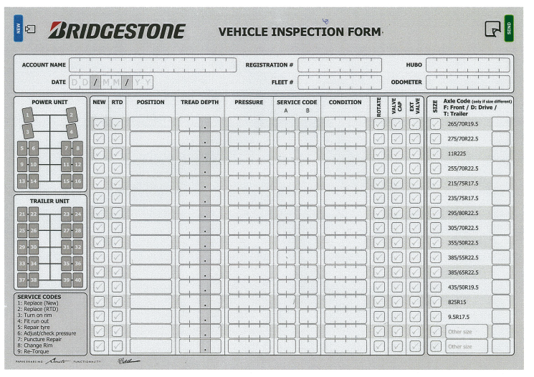
The Refined Project Goal
The goal is to build a mobile application that helps employees hired by Bridgestone with a digital possibility of a Vehicle Inspection Report. It is designed to reduce the redundancy of having the employees manually filling out each form and entering into the database.

Slide 6
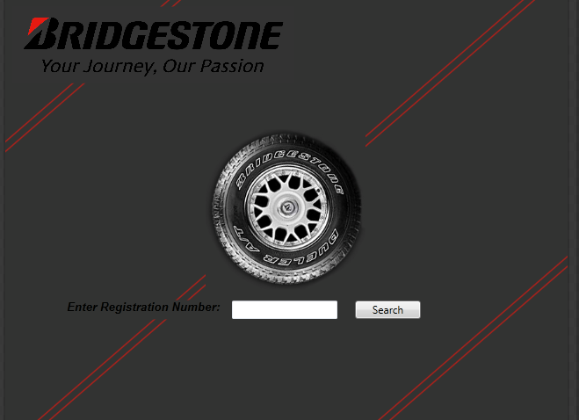
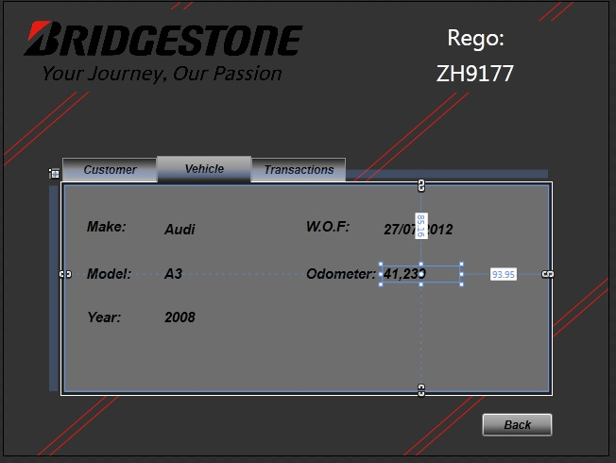
Web Services Application
Had to create a web service which interacts with the Bridgestone databases.
Designed queries, so it could pull out information like Registration Numbers, Models and Customer Information related to that vehicle.
Designed an interface for this web service

Slide 7
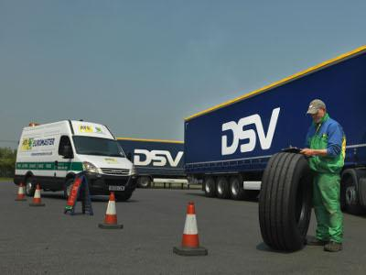
The Field Trip
Out primary objective was to find out what is the current work flow process been undertaken by the fleet technicians.
Also, opinions from the fleet technicians about the application and how it would fit in the daily scheme of things.

Slide 8
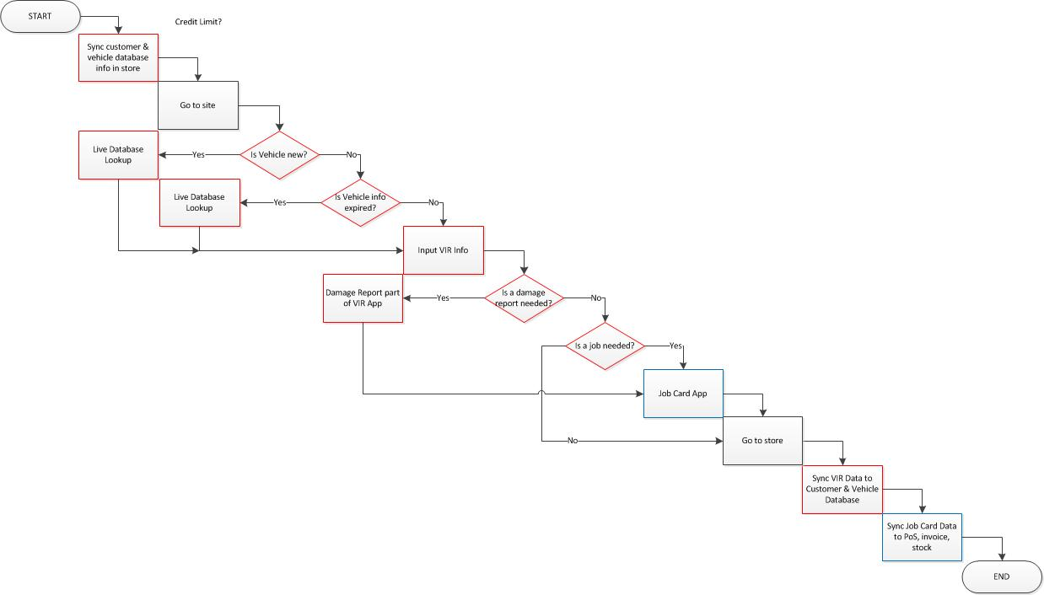
Work-flow process of the app

Slide 9
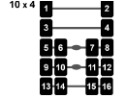
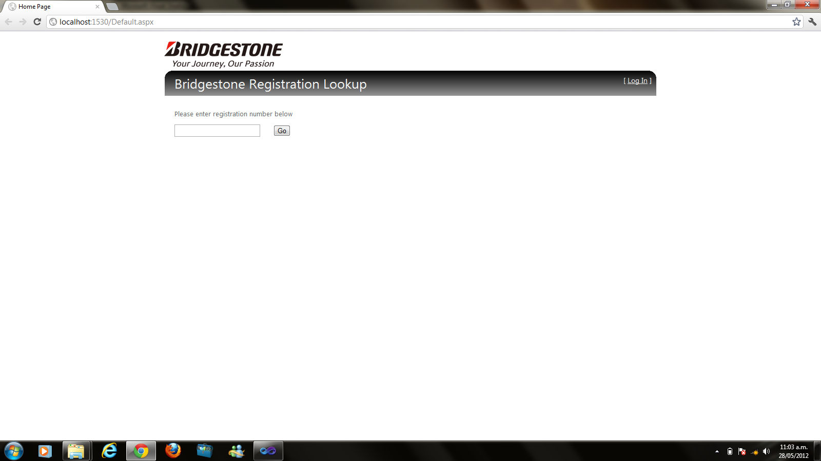
Key Design Specifications
Interactive Vehicle configuration diagram
A Live Vehicle Lookup
Having an interactive diagram on the tablet is very useful. The user highlight’s the wheels being rotated, and this diagram gets synced to the Job Card Application.
A Live search of vehicles when the fleet technicians need to search up the vehicles that don’t exist in the database.
Requires 3G for this search to work.

Slide 10
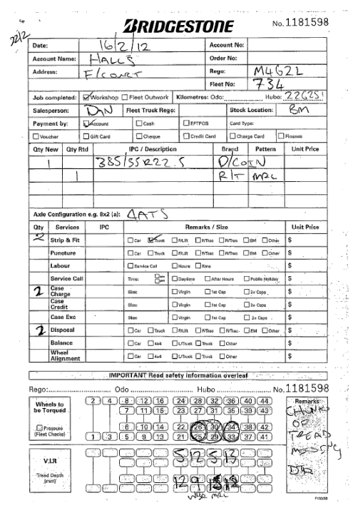
Key Design Specifications (2)
Synchronize Function
The Application must have a synchronize function of some sort to sync the TMSA (Tyre Monitoring System Application) with the Job Card Application.
Ideally all the information recorded from the TSMA application for e.g., highlighted rotated tyre configuration, should be able to be viewed on the Job Card application.

Slide 11
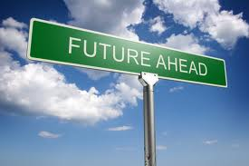
Future goals
Design the interface prototypes and the final of the mobile application.
Design a method to image the current database onto the tablet.
Create and design a web service to extract all the data required in order to complete a Vehicle Inspection Report.
Design the synchronization process between the two applications.
Design, Test, Modify, Test!!

Slide 12
Thank You !
Questions ?

