Slide 1

Electronic Data Capture
BTech 451
End of Semester Seminar presented by Siyu Zeng

Slide 2
Outline
Overview
Requirement
Design
Progress
Demo
Issues
Plan

Slide 3
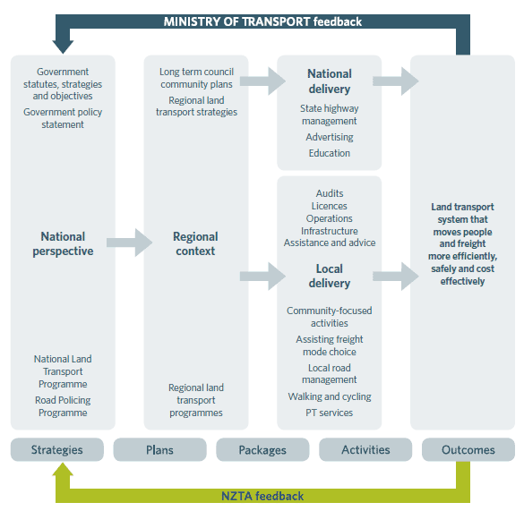
Overview
NZTA is a government agency that creates transport solution for New Zealand

Slide 4
Overview
Current transport crash reports (TCR) recorded by police are paper-based
A crash of single car requires 5 pages
Takes time for police to process
The information in the report is coded and entered into computer later with the original copy still kept
Data invalidation is the most critical problem that makes it difficult to know what actually happened in the crash

Slide 5
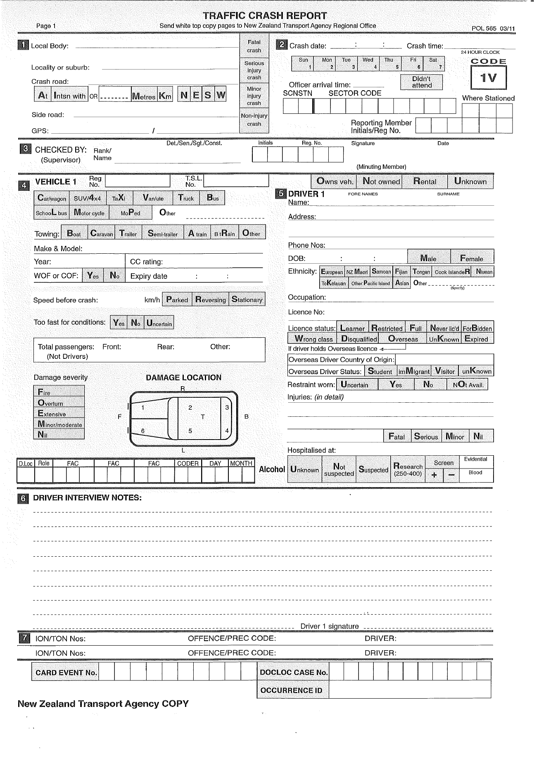
Current crash diagram

Slide 6
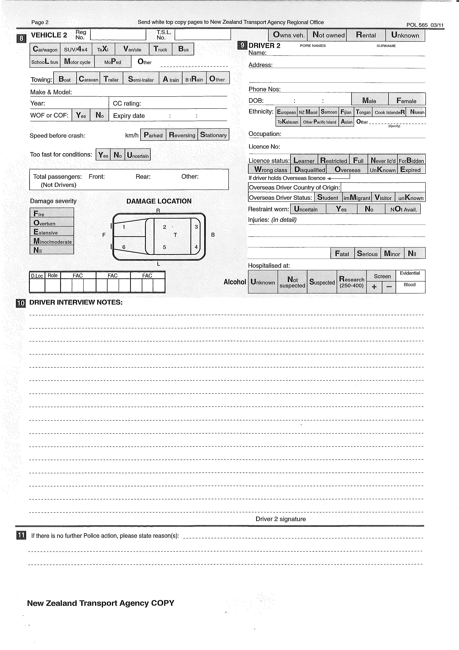
Current crash diagram(cont.)

Slide 7
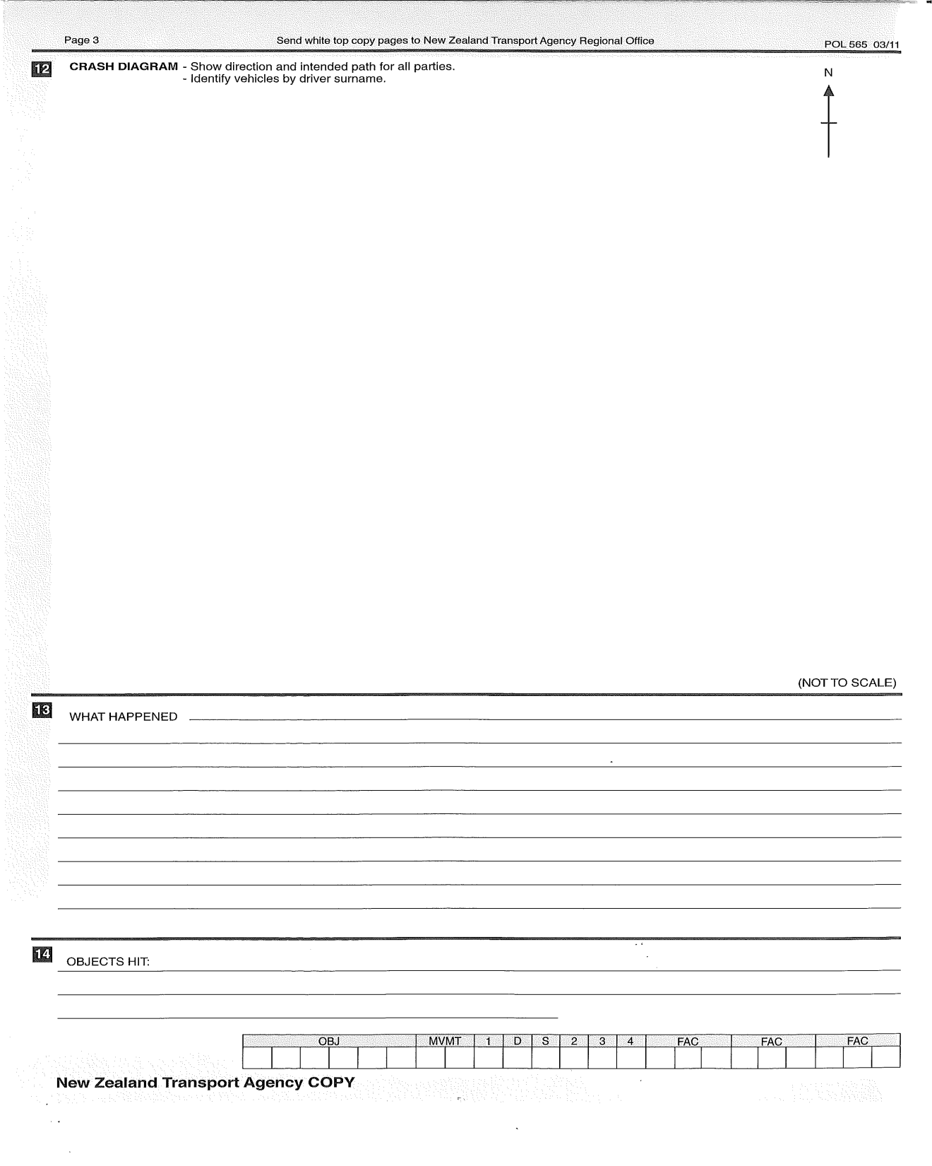
Current crash diagram(cont.)

Slide 8
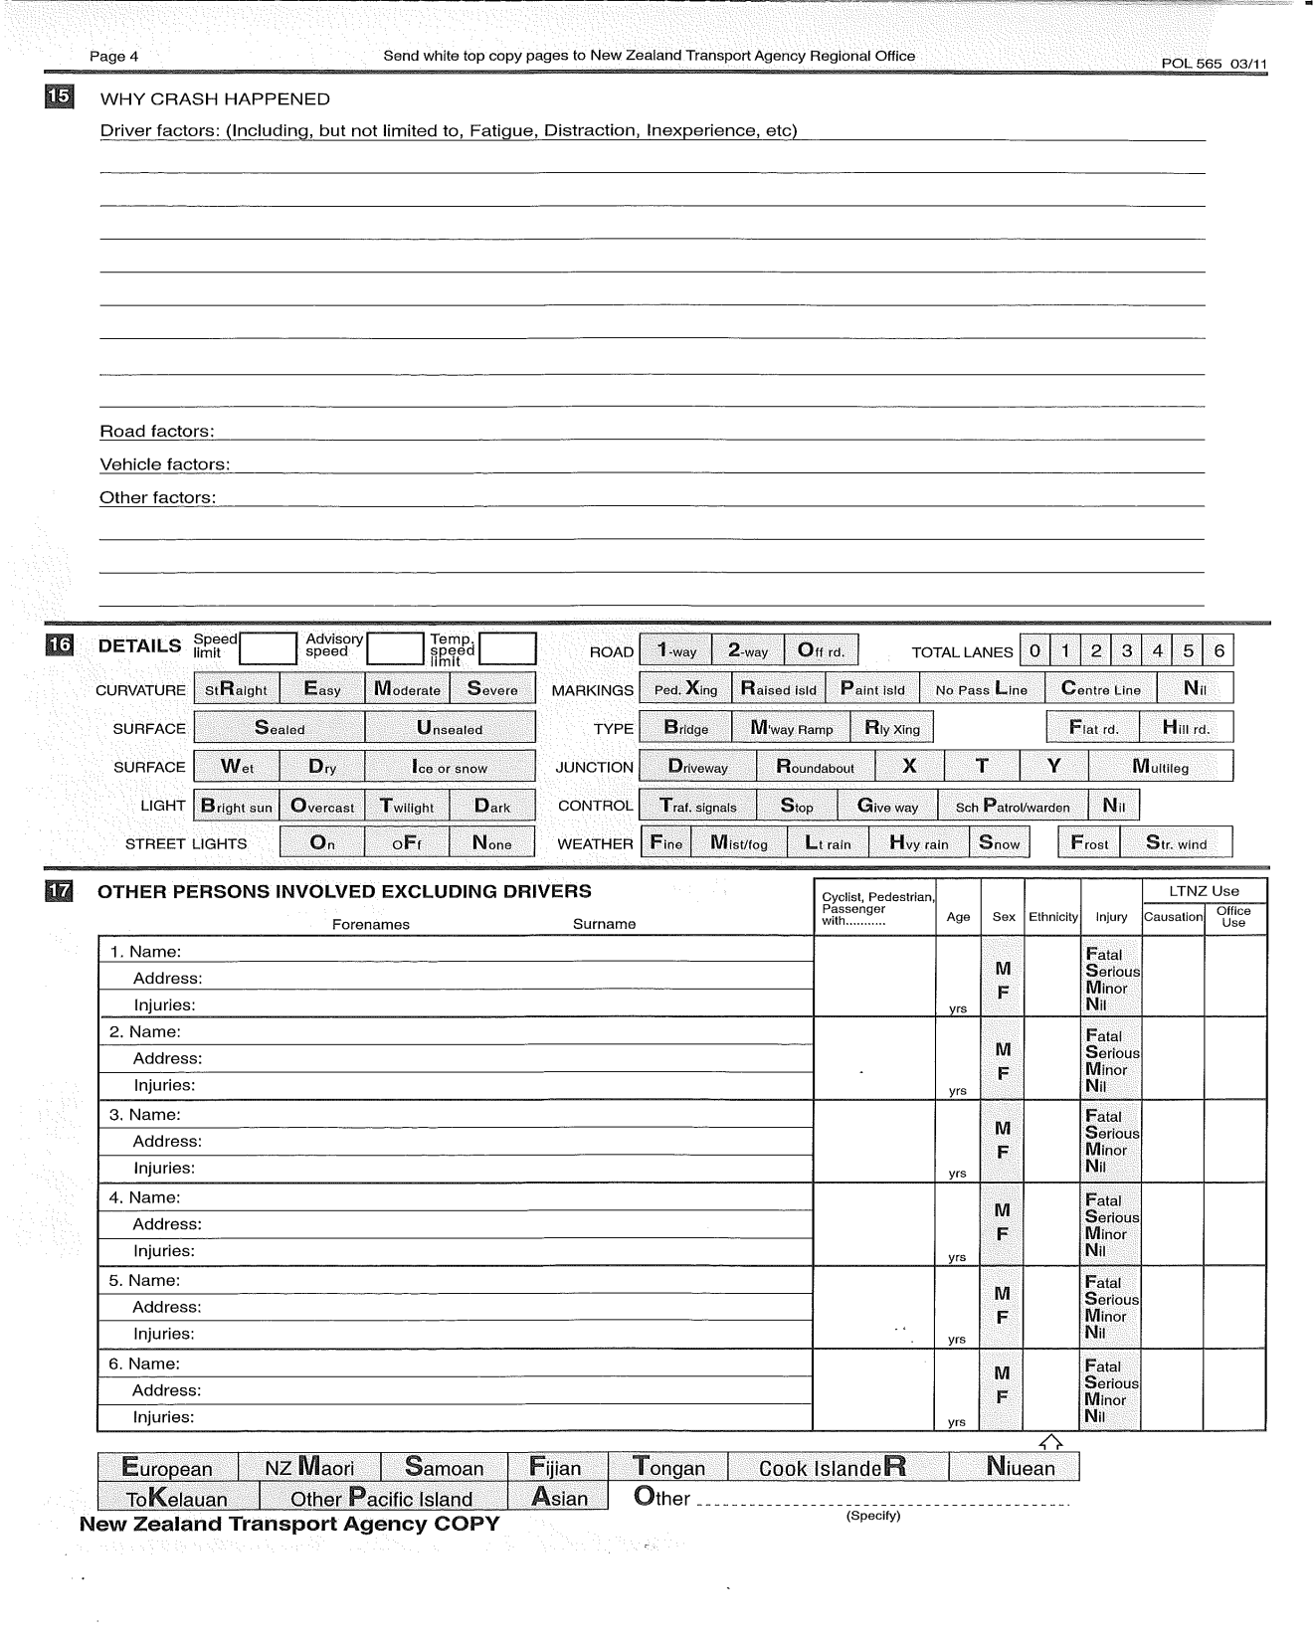
Current crash diagram(cont.)

Slide 9
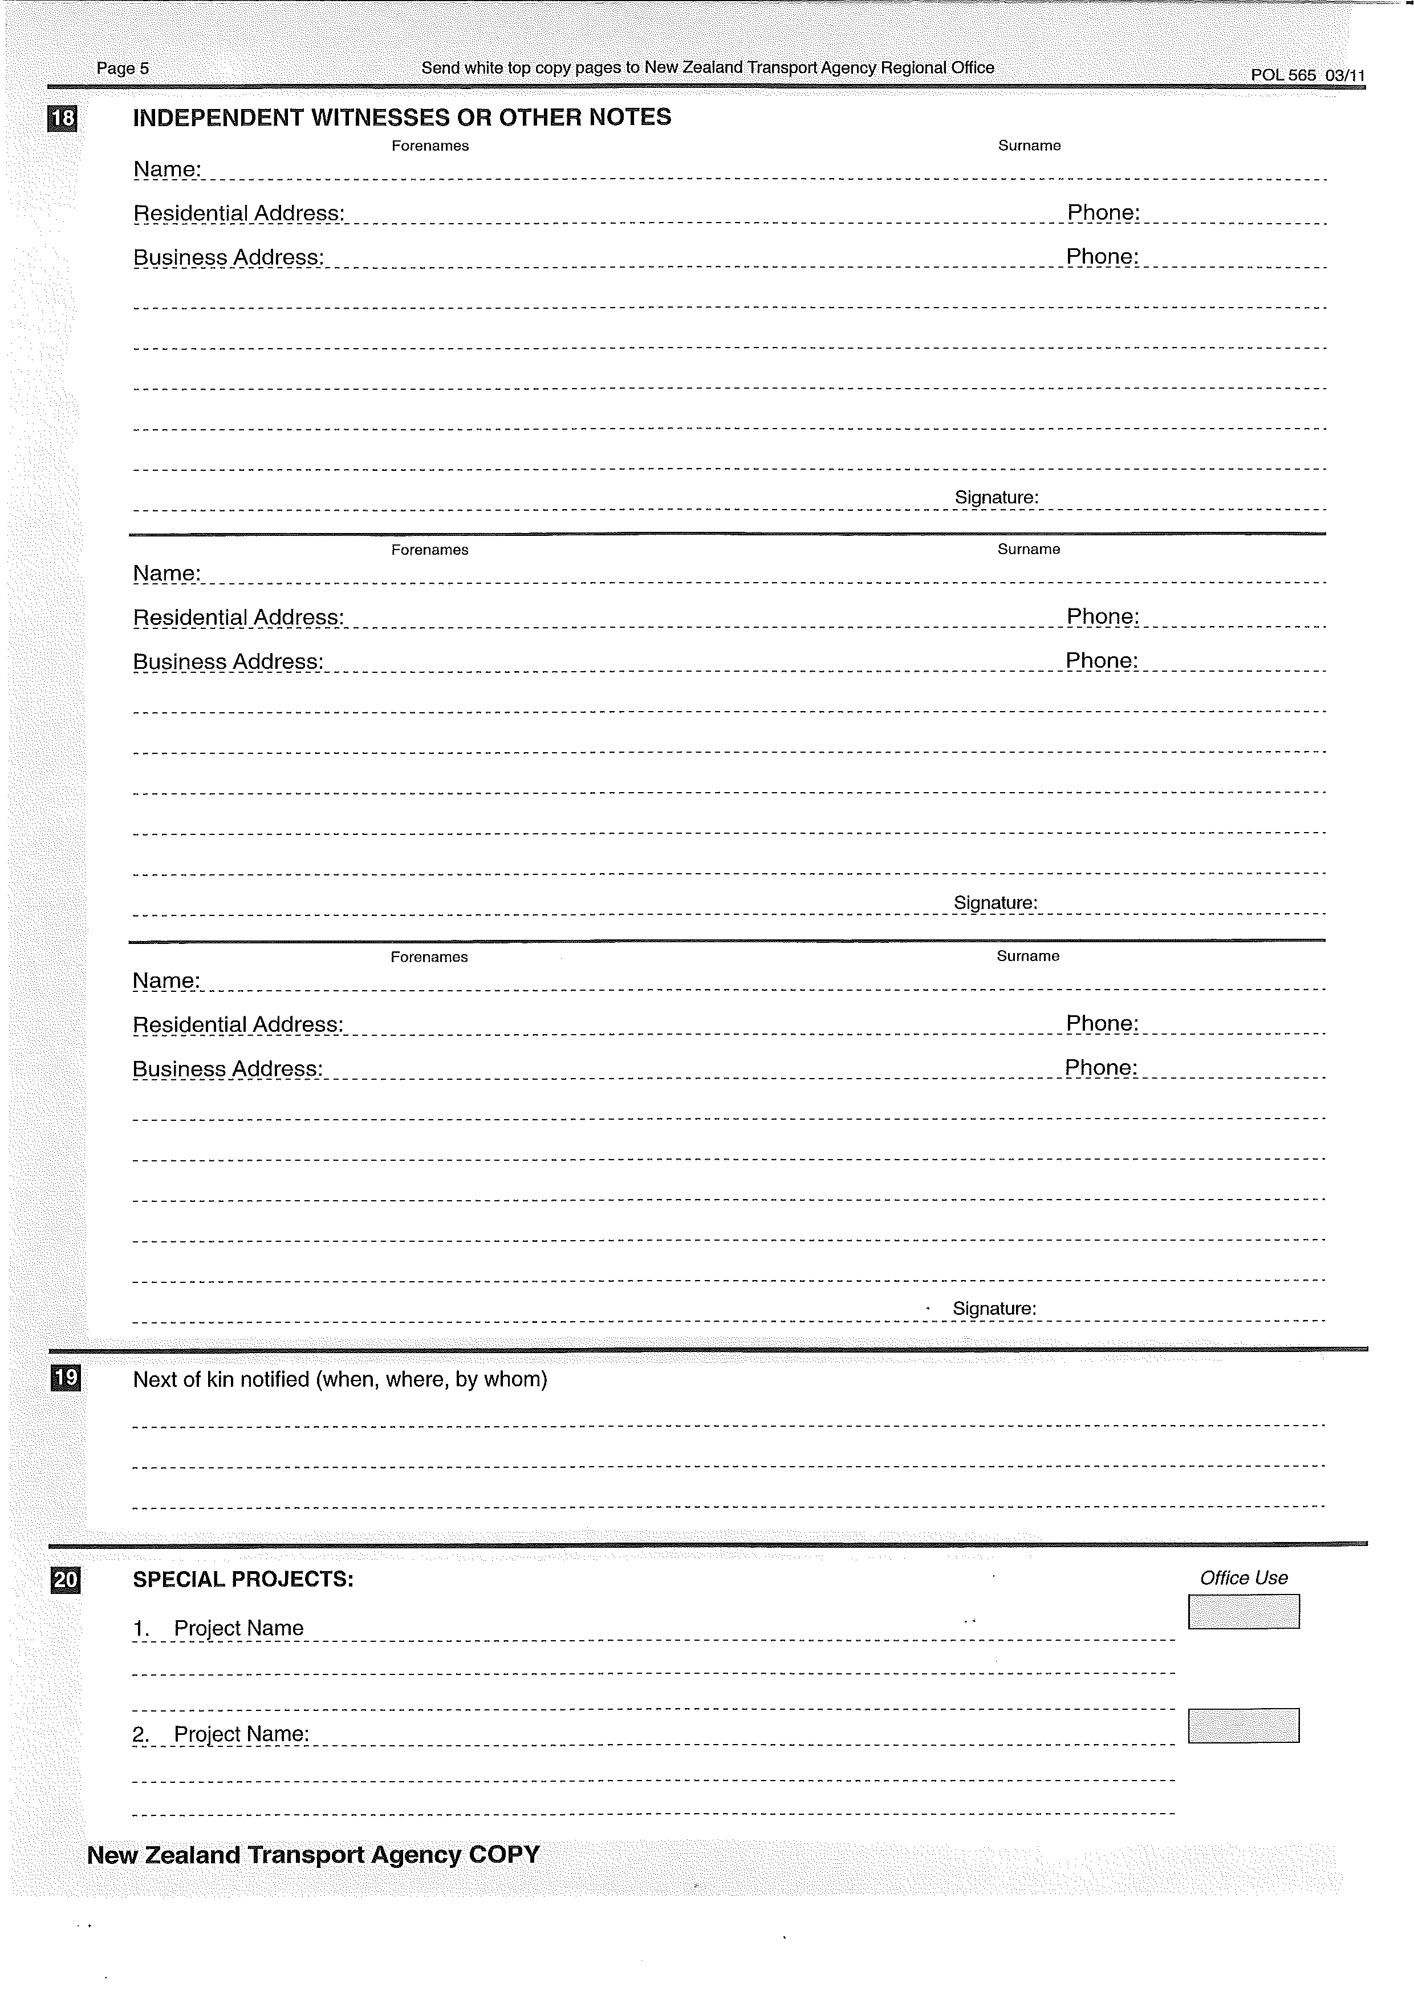
Current crash diagram(cont.)

Slide 10
Requirement
The goal is to build a prototype mobile application as a replacement of current TCR
This prototype should have reliable functionality for capturing and sending data and should be capable of reducing processing time for both police and coders
Also some additional functions can be provided such as automatic geo-location capture
Through the meetings with stakeholders, it was stressed that the geo-location as well as the crash diagram are important and data consistency should be strictly maintained

Slide 11
Design
At the first glance of the project, it seems simple as everything we need is to interpret the forms into our application
However, since mobile applications have many powerful features that provide better support for interaction, the design considerations vary
Hence my implementation will be based on an intuitive design centered by crash diagram
Users are guided by crash diagram for entering data rather than by screen navigation
Captured data are parsed into XML for transmission

Slide 12
Progress
Currently working on crash diagram as well as XML schema
The crash diagram is implemented as a drawing panel which allows user to add objects
It is now capable of drawing several objects such as roads, vehicles and a variety kinds of lines
Touch events on these objects are handled such as dragging , selecting and deleting
Also the program is able to save the whole drawing surface as a picture for crash report

Slide 13
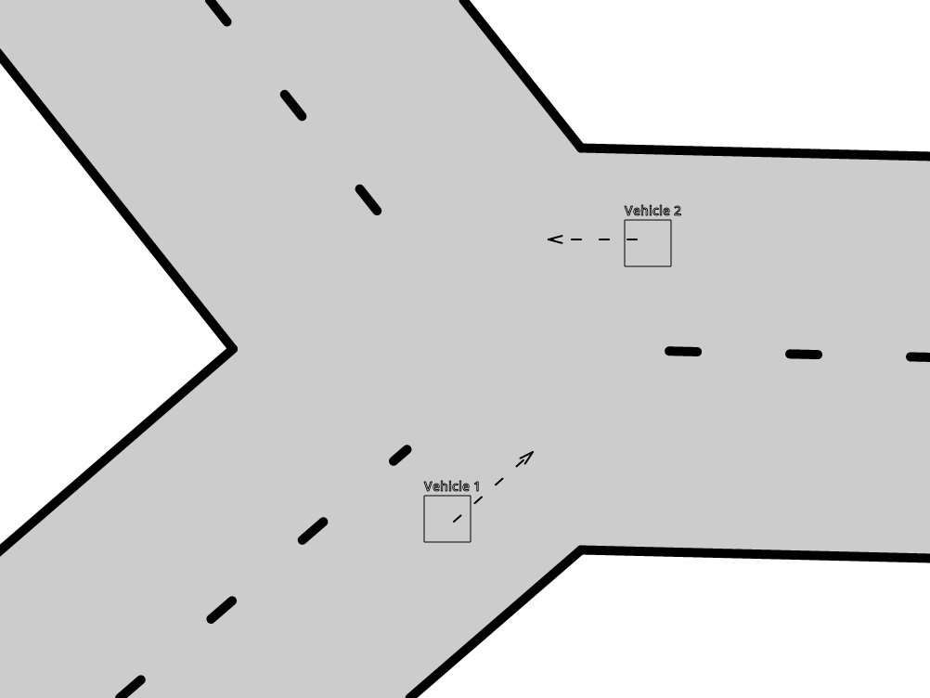
A simple 3-way junction with two vehicles

Slide 14
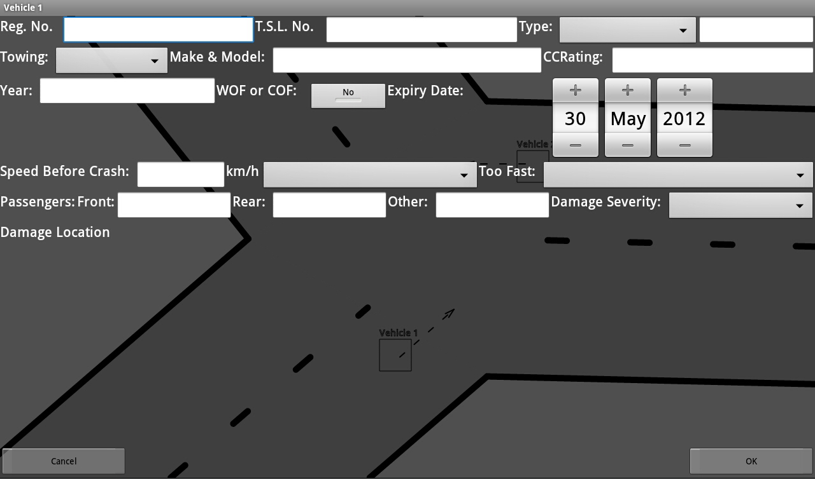
a form pops up for entering relative data when user click on a vehicle

Slide 15
Demo

Slide 16
Issues
It is not predictable whether the intuitive design will be preferred by police or not
However, since the original TCR has been used for quite a few decades, it’s probably time to have some change
For the first delivery, we will send all recorded data by email because we don’t have a server at present
While rotating objects is possible, applying it on whole diagram is hard
Meanwhile, zooming on whole diagram seems unachievable

Slide 17
Plan
Objects will be categorized and put together into toolkits selected from the menu
The icons are used later instead of simple shapes for better appearance and easier drawing and maintenance
With the inaccurate GPS system we currently have, special algorithm is needed for obtaining geo-location precisely
Concerns of such algorithm include taking several measurements according to fixed time intervals or user movement

Slide 18
Questions?

