Slide 1
Btech451 Final Presentation SGM on CUDA
Presented by HaoYu, Gan
UPI: hgan006
ID: 1184198

Slide 2
Outline
Project Goal
SGM
Correspondence problems
Algorithm (SGM)
CUDA programming model
Heterogeneous Programming
Results
Conclusion and Future work
Acknowledgments

Slide 3
Project goal
For this semester, we would like to have our own experience of applying CUDA to speed up semi-global matching (SGM)
The comparison could also be drawn with SGM on normal CPU.
Explore and research on CUDA implementation

Slide 4
What is SGM ?
Stereo vision has been an intensive research area in the last decades. The solutions proposed were originally split into two main categories, local and global methods.
Local methods: computations in a local pixel neighborhood only that allows real time application; did not prove to be accurate.
Global methods: improved quality but slow.
SGM: “semi-global” means “in-between”, but trying to keep the quality of the global methods

Slide 5
Semi-global matching
Hirschmüller’s original semi-global matching algorithm uses a mutual-information based pixel matching cost, and aggregates matching costs in multiple directions, for instance, 8 or 16 directions.
SGM finds at each pixel a minimum cost along a column of all possible disparity values.

Slide 6

Correspondence problem
The approach is called correlation-based method.
A simple cost function is shown below:
The simplest form is to calculate the absolute difference, for each pixel, at coordinate I₁(x, y) in left image compared to right image at disparity d which is the pixel at I₂(x-d,y).

Slide 7
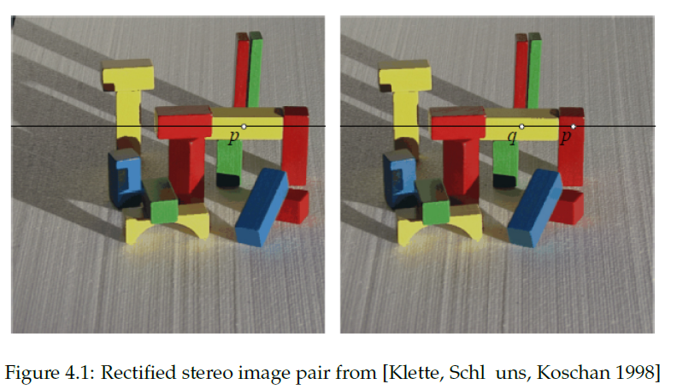
Correspondence problem
The most similar pixel value along epipolar line
“the winner takes it all”

Slide 8

Correspondence problem
A more complex local cost function:
In a small window (neighborhood)
may not capture enough image structure and
may be too noise sensitive
many false matches
If using a large window
makes matching less sensitive to noise but also
decrease precision (blurs disparity map)

Slide 9
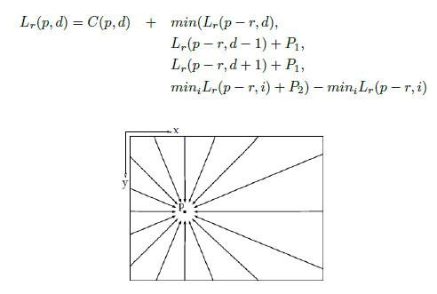
Algorithm (SGM)
For each linear path, cost is aggregated over all pixels from each starting point p0 (border pixel) to the current pixel p.

Slide 10
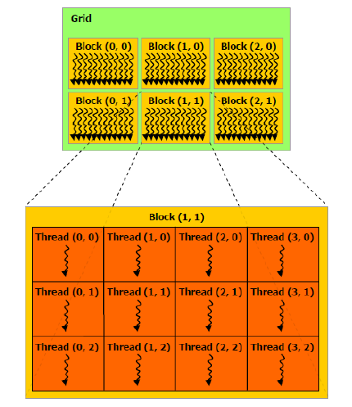
CUDA programming model
In CUDA, it launched a “grid” of “blocks” of “threads” onto a GPU
gridDim.x and gridDim.y
blockId.x and blockId.y
threadID.x and threadID.y

Slide 11
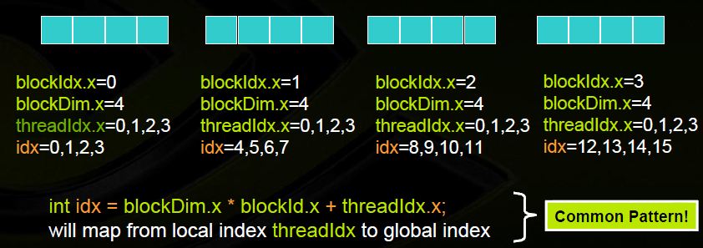
CUDA programming model
Let’s assume N =16, blockDim=4 -→ 4 blocks

Slide 12
Heterogeneous Programming
The idea is to divide the code into two parts,
Serial code executed in a host thread (i.e. CPU thread) and
Parallel kernel code executed in many device threads across multiple processing elements (i.e. GPU threads).

Slide 13

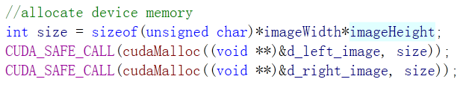
Heterogeneous Programming
Memory allocation

Slide 14
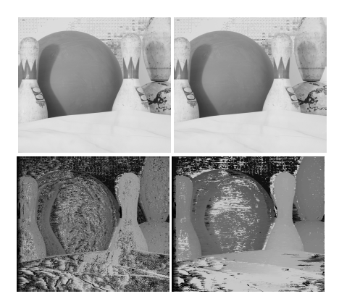
Result
Disparity range = 50,
3x3 window size,
width x height = 1252x1110

Slide 15
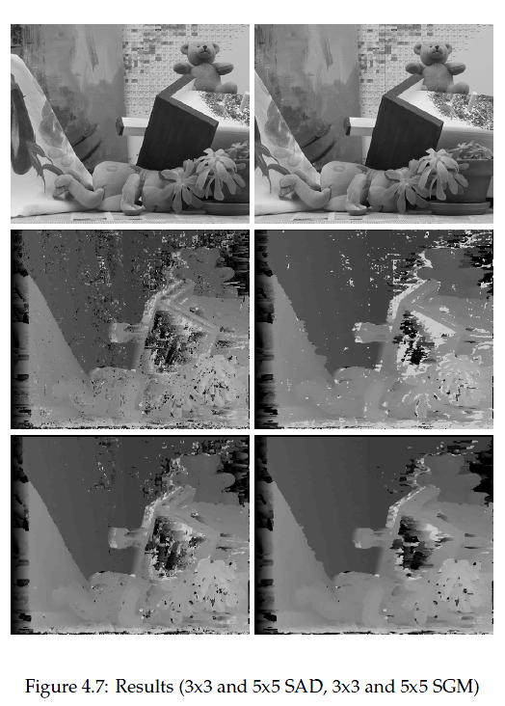
Result
Second row:
3x3 SAD
3x3 SGM
Third row:
5x5 SAD
5x5 SGM

Slide 16
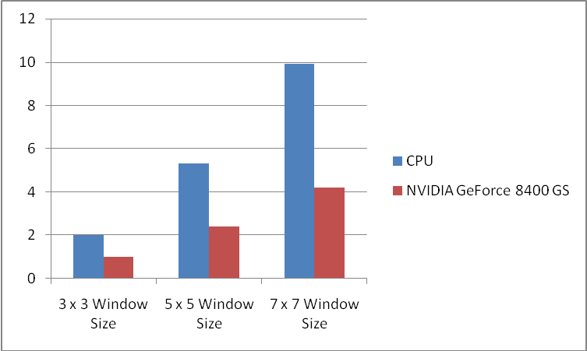
Result
An image size 450x375 with disparity of 50
Run at different window sizes of 3x3, 5x5 and 7x7
Image size: 450 x 375 Disparity = 50 | 3 x 3 Window Size | 5 x 5 Window Size | 7 x 7 Window Size
Quad CPU Q6600 2.40Ghz | 2.0 sec | 5.3 sec | 9.9 sec
NVIDIA GeForce 8400 GS | 1.0 sec | 2.4 sec | 4.2 sec

Slide 17
Result
Image size: | Disparity = 50 | Disparity = 100 | Disparity = 150
450 x 375
3x3 Window Size
Quad CPU Q6600 2.40Ghz | 2 sec | 3.7 sec | 5.1 sec
NVIDIA GeForce 8400 GS | 1.1 sec | 1.7 sec | 2.5 sec
An image size 450x375 with 3x3 window size
Run at different disparity ranges

Slide 18
Conclusion
The run-time of the method is scaled linear with the size of the window as well as the disparity range.
Acceptable solution, even though “Peaks”, “Noise” and untextured background still exist.
Due to that the number of paths is limited to only one path at this stage, the complexity of SGM is not fully implemented.

Slide 19
Future work
Apply census cost as suggested by Ralf Haeusler and Prof. Reinhard Klette.
Explore 8 or 16 directions to achieve better SGM results.
Get access to shared memory in order to improve speed.
Compare with other stereo image processing methods if possible.

Slide 20
Acknowledgments
I would like to thank everyone involved in this project.
I thank T.N. Chan and Prof. Reinhard Klette for project supervision, Dr. S. Manoharan for his advice, and Ralf Haeusler for introducing me to semi-global matching.

Slide 21


Questions ?

