Slide 1
Project In Information Technology
2011 BTECH 451
By Yihui Zheng (Jerry)
yzhe065@aucklanduni.ac.nz

Slide 2


Project Introduction
Not like other projects, this project contains two topics with similar frame work:
Topic 1: develop an online searchable database with user friendly web-page for ISSG.
Topic 2: develop an mobile application on Iphone for Blackhawk Tracking System.

Slide 3

Project Introduction
Both of the projects involve online database servers. They all send SQL queries to the server and displayed results to the users.
The differences are: topic 1 with ISSG will access the server and display the searching results by web page, where the topic 2 with Blackhawk require an individual Iphone application to achieve it.

Slide 4
ISSG Project Introduction
ISSG as Invasive Species Specialist Group is a group aims to reduce threats to natural ecosystems and the native species they contain by increasing awareness of invasive alien species, and of ways to prevent, control or eradicate them.
The online database is playing a big role for the ISSG, as it contains most of the data for each invasive alien species based on name or other identifications.

Slide 5

ISSG Project Goal
As there is already a MySQL database existed which contain all kinds of data. This project won’t need to create a completely new database and enter all data again. THE goal of this project will be more focus on refine the existed database and the usability of the new web. Perhaps extend more functions on the webpage if possible.

Slide 6
Rationale for the ISSG Project
In order to achieve the goal, the database needs to be converted to MSSQL first. Then use asp.net to develop a user friendly web page. The basic procedure of the web page is shown below:
Users connect to the Web page and enter key words to search
Modify input keys to SQL queries.
Web page send SQL queries to the server
Database Server search the tables based on the queries
Return final results.
Display data on web page based on the user’s inputted keyword

Slide 7
Plan of action for ISSG Project
Kick off meeting to gathering general ideas about the project.
(Done)
Second meeting to confirm function requirements .
(Done)
Third meeting to ensure the equipments and software's are ready to use.
(Done)
Database design/implementation phase:
Create a virtual map for existed MySQL.
Transfer the MySQL to MSSQL.
(Done)
Web page design phase:
Develop a prototype for the web page. This may not include real connection to the SQL database.
(Two weeks after the mid term break)
Web page implementation Phase:
Link the web page to MSSQL and perform search function.
(During the semester break.)
Final Meeting.
Get users’ feed back and refine the web page based on the feedbacks.
(first month of the second semester.)

Slide 8

Learning from the ISSG Project
Design and implement a project like this, will require several knowledge in multiple areas:
Developer have to be familiar with SQL data structure and query to perform the search option.
Human and computer interaction will definitely be a major topic during the design phase for creating a user friendly web page with searching option.
Asp.net needs to be learned in order to implement the designs.
Good communication skills and schedule management will also be required.

Slide 9
Blackhawk Project Introduction
Basically Blackhawk is a system made for tracking car and finance status. It has a huge database which contains multiple data in different areas such as: GPS, car registration detail, finance status etc.
Today’s smartphones, typically Iphone are very powerful and popular. It will be a great improvement in usability and marketing if users can simply use the Iphone application to connect to the Blackhawk tracking system while they are moving around the city without a PC.

Slide 10
Blackhawk Project Goal
The goal is to develop an Iphone application for Black Hawk Tracking system. The Iphone application will allows specific users to check related data based on different input from the mobile server.
A separate mobile datababase server will be created in order to cooperate with the application.

Slide 11
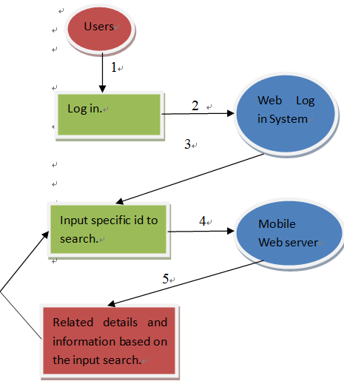
Rationale for the Blackhawk Project
1.Open App on Iphone
2.User name/password.
3.Provide user identification.
4.Input keys for search
5.Run select query and return results.

Slide 12
Plan of action for Blackhawk Project
Kick off meeting to gathering general ideas about the project.
(Done)
Second meeting to confirm function requirements .
(Done)
Third meeting to ensure the equipments are ready to use.
(Coming soon)
Design Phase:
Design the application and web server without any implementation. Giver many alternative designs.
(Before end of the first semester)
Fourth Meeting to discuss which design will be used.
(Before end of the first semester)
Implementation Phase:
Build the application and web server.
(During the first month of the second semester)
Fifth Meeting:
Review the output with users, get feed back.
(After the implementation is completed)
Maintains Phase:
Refine the application such as interface or functions based on users' feed back.

Slide 13
Learning from the Blackhawk Project
Mobile database servers are slightly different from normal web database servers. There will be a learning process to get used to mobile servers.
Not like other mobile platform such as windows7 and Android that can run directly in our familiar Windows System. Iphone applications have to be developed under Mac system with XCode language. It will be a challenge and also a great opportunity for me to learn these new things.
Again, as this is a real-world project, the users will actually use this application at the end. An excellent communication skill will be required in order to gather user requirements and feedbacks.

Slide 14
Project In Information Technology
Questions?!

