Slide 1
Btech451 Final Seminar Presentation
Yihui Zheng (Jerry)
yzhe065@aucklanduni.ac.nz

Slide 2
Overview
Project Review
Project Goal
Special Announcement
Background
Related Work
ISSG Online Database
Database
Webpage
Acknowledgements

Slide 3


Project Goal
Goal1: develop an online searchable database(Global Islands Invasive Vertebrate Eradication Database ) with ASP.NET web interface for ISSG.
Goal2: develop an mobile application on Iphone (or possible Android)for Blackhawk Tracking System.

Slide 4
Special Announcement
The second part of the project(develop a online mobile database application for BH Ltd) has been canceled due to these reasons:
Unable to get the mobile service.
Unable to get the Ipod developer account.
Improve project consistency.

Slide 5
Background
The Invasive Species Specialist Group (ISSG) is a global network of scientific and policy experts on invasive species, organized under the auspices of the Species Survival Commission (SSC) of the International Union for Conservation of Nature (IUCN).
The ISSG was established in 1994. It currently has 196 core members from over 40 countries and a wide informal global network of over 2000 conservation practitioners and experts who contribute to its work.
The Chair of the ISSG is Dr. Piero Genovesi, of the Institute for Environmental Protection and Research, in Italy.

Slide 6
Background
Mission Statement
The Invasive Species Specialist Group (ISSG) aims to reduce threats to natural ecosystems and the native species they contain by increasing awareness of invasive alien species, and of ways to prevent, control or eradicate them.
Database
They manage the Global Invasive Species Database and Global Islands Invasive Vertebrate Eradication Database online for public and other organization to search information on invasive species, their ecology, spread, management and impacts.

Slide 7
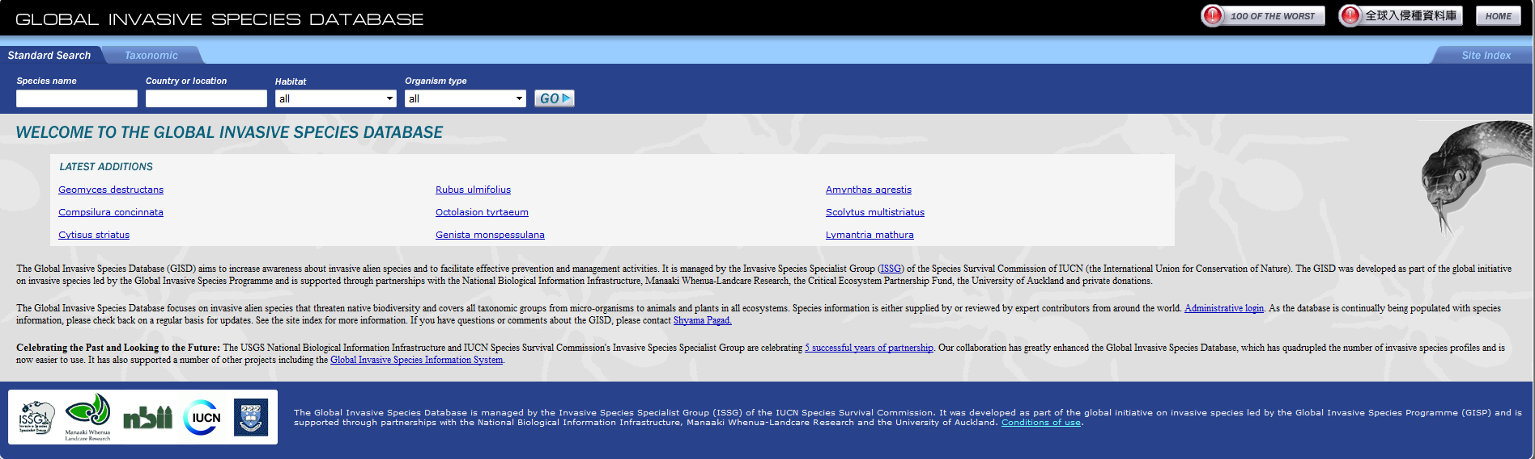
Related works
A asp.net webpage build by previous Auckland University Student for GISD (Global Invasive Species Database ).

Slide 8
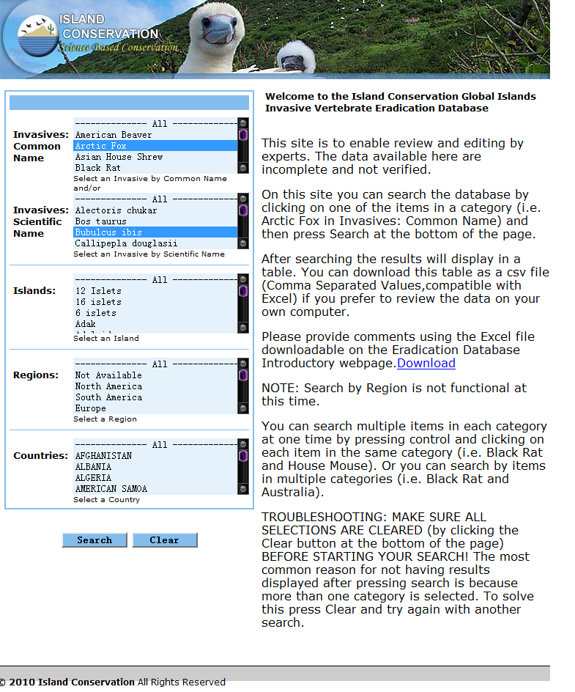
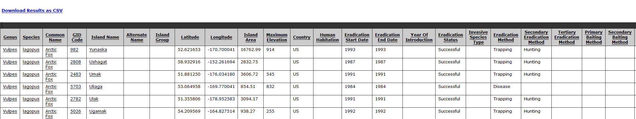
Related works
This is the previous webpage for Global Islands
Invasive Vertebrate Eradication Database . It is
obvious that this website has lots of room to improve as poor usability. Also many of the function are not working properly.

Slide 9
Schedule
Project Analyze/Design
Database Analyze/Design
Modify previous MySQL and Access data to a new MSSQL database.
Add new tables, relationships to the database.
Webpage implementation(version1)
Webpage implementation(version2)
Testing & Upload
The seven main steps for the project, also include several project
Meeting.

Slide 10
Improvements of the database Structure
The original version of database from the ISSG is very inconsistent. It is almost impossible to use the database without any modifications. The database contains huge amount of missing values and unclear keys. In order to improve the structure, I have done:
Transfer the MySQL database and the access data to a MSSQL database. Then combine them.
Add world region & country table to the new database( these two tables are extremely important for the search by location function).
Define the relationships of primary key and foreign key for each tables.
Refine empty and useless null data.

Slide 11
Understand the Structure of the Database
This database is mainly focus on storing the different eradication information for a specific invasive species in a particular location and time. Therefore the only unique(also the most important) key for the entire database is the eradication id.
It is way tricky than you think to select a correct eradiation id. A good example will be: you can have two different eradication id for one identical specie in the exactly same place, just because the eradication time is different(but the eradication time for each record can be null/ empty as it is not a key). Therefore how to guide the user to select the correct data is very important.

Slide 12
Understand the Structure of the Database
They are several key attributes I used to identify a eradication id:
World region Code
Country Code
island region
island GID Code
Invasive common or scientific name
Eradication Start or end time
General
Specific

Slide 13
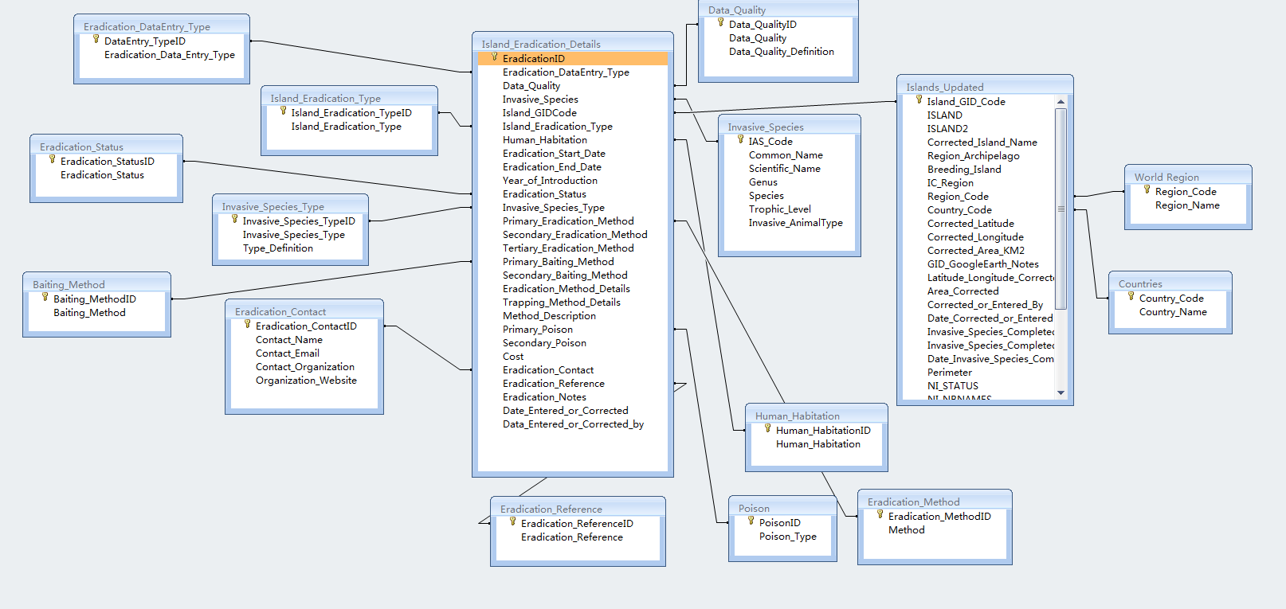
Database Structure
Final Database: 16 tables.(2 major tables: Islands_Eradication_Details and Islands Updates. Only unique primary key:EradicationID)

Slide 14
Search by Island location:
There are two major ways to search a unique data from the database. The first one is search by location. Search by location is designed for the users who doesn't know what exactly they are looking for or they want to see a list of information for one location.
1.World Region List
2.Country List
3.Island List
4.Species List
5.Species Details

Slide 15
Search by Specific invasive specie name:
The second way to search is search by name. This type of search is designed for the users (mostly biologists) to select a specific invasive specie based on either common or scientific name. It will be a faster way to search if we know what specie we are looking for at the start.
1.Common or Scientific Name
2.Country List
3.Island List
4.Species Details

Slide 16
Results
As not all data in the database are useful to the end user. Several selected categories of information will be displayed at the end based on the user input. The categories will include:
General Information: year of introduction, data quality etc.
Island Information: Name, Country, Area, economic system etc.
Species Information: Common/scientific Name, type , size etc.
Eradication Details: Eradication methods, costs, date etc
Baiting Details: Baiting methods, costs, poison type, etc.

Slide 17
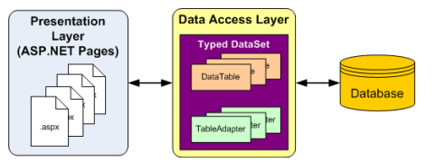
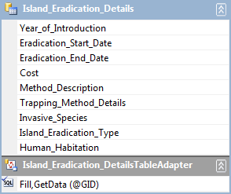
Link the database to the webpage: Data Access Layer(DAL)
A data access layer (DAL) is a layer of a computer program which provides simplified access to data stored in persistent storage.
-Wikipedia
Advantages:
Easier for Modification: Independent from the user interface.
Database Independent: Easier to switch between databases.

Slide 18
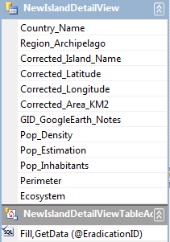
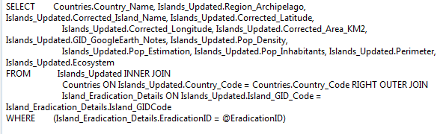
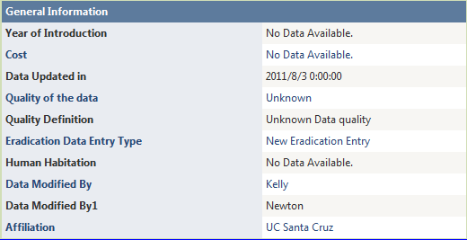
DAL Example
Select all useful information about a specific island
(based on Eradication ID)

Slide 19
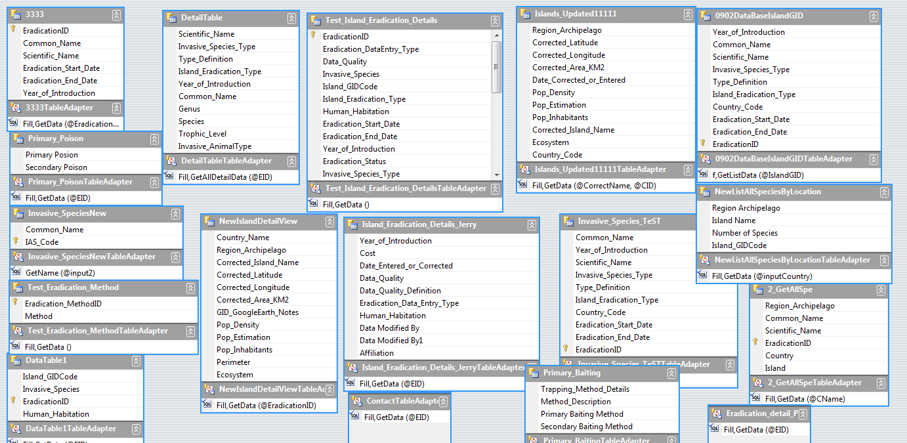
DAL Structure
DAL will be used as object database for details view and lists.

Slide 20
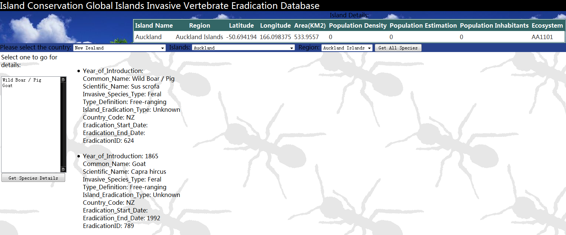
Version 1 of the Webpage(Search by Location)

Slide 21
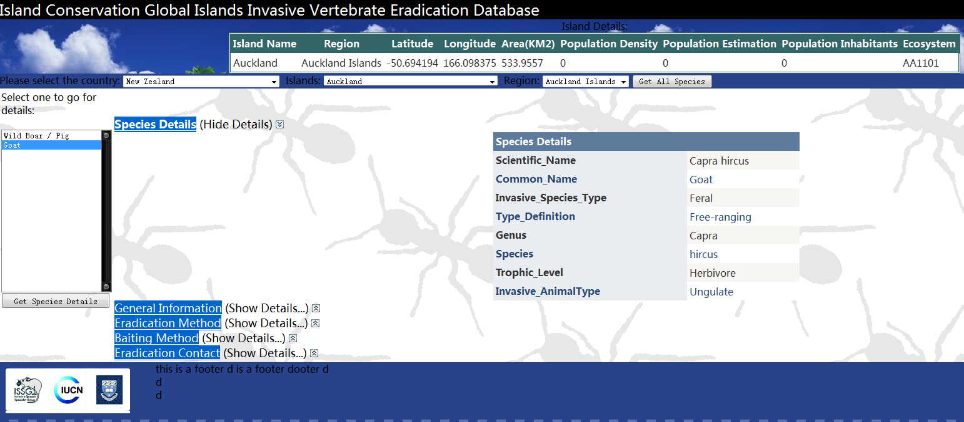
Version 1 of the Webpage(Search by Location)

Slide 22
Problems & Concerns about Version 1
This is the very first version of the webpage, it only contains the basic search functions. It works pretty well, but still have many usability problems and concerns.
The webpage contains too many dropdown lists and list box. This directly decreased the usability of this webpage. It is hard for the user to find the next step without any instruction.

Slide 23
Problems & Concerns about Version 1
Most of the users may want to export their searching result to csv, excel or word documents. This webpage doesn’t provide these kind of functions.
Search by location and search by name are made in two separate web pages, it may be better to combine them together by using tab.
The layout, especially the color of the web page may not fit to the ISSG main page.
Therefore after a few meeting with Mrs.Shyama, we decide to add Telerik toolkit and make a new version of the webpage.

Slide 24
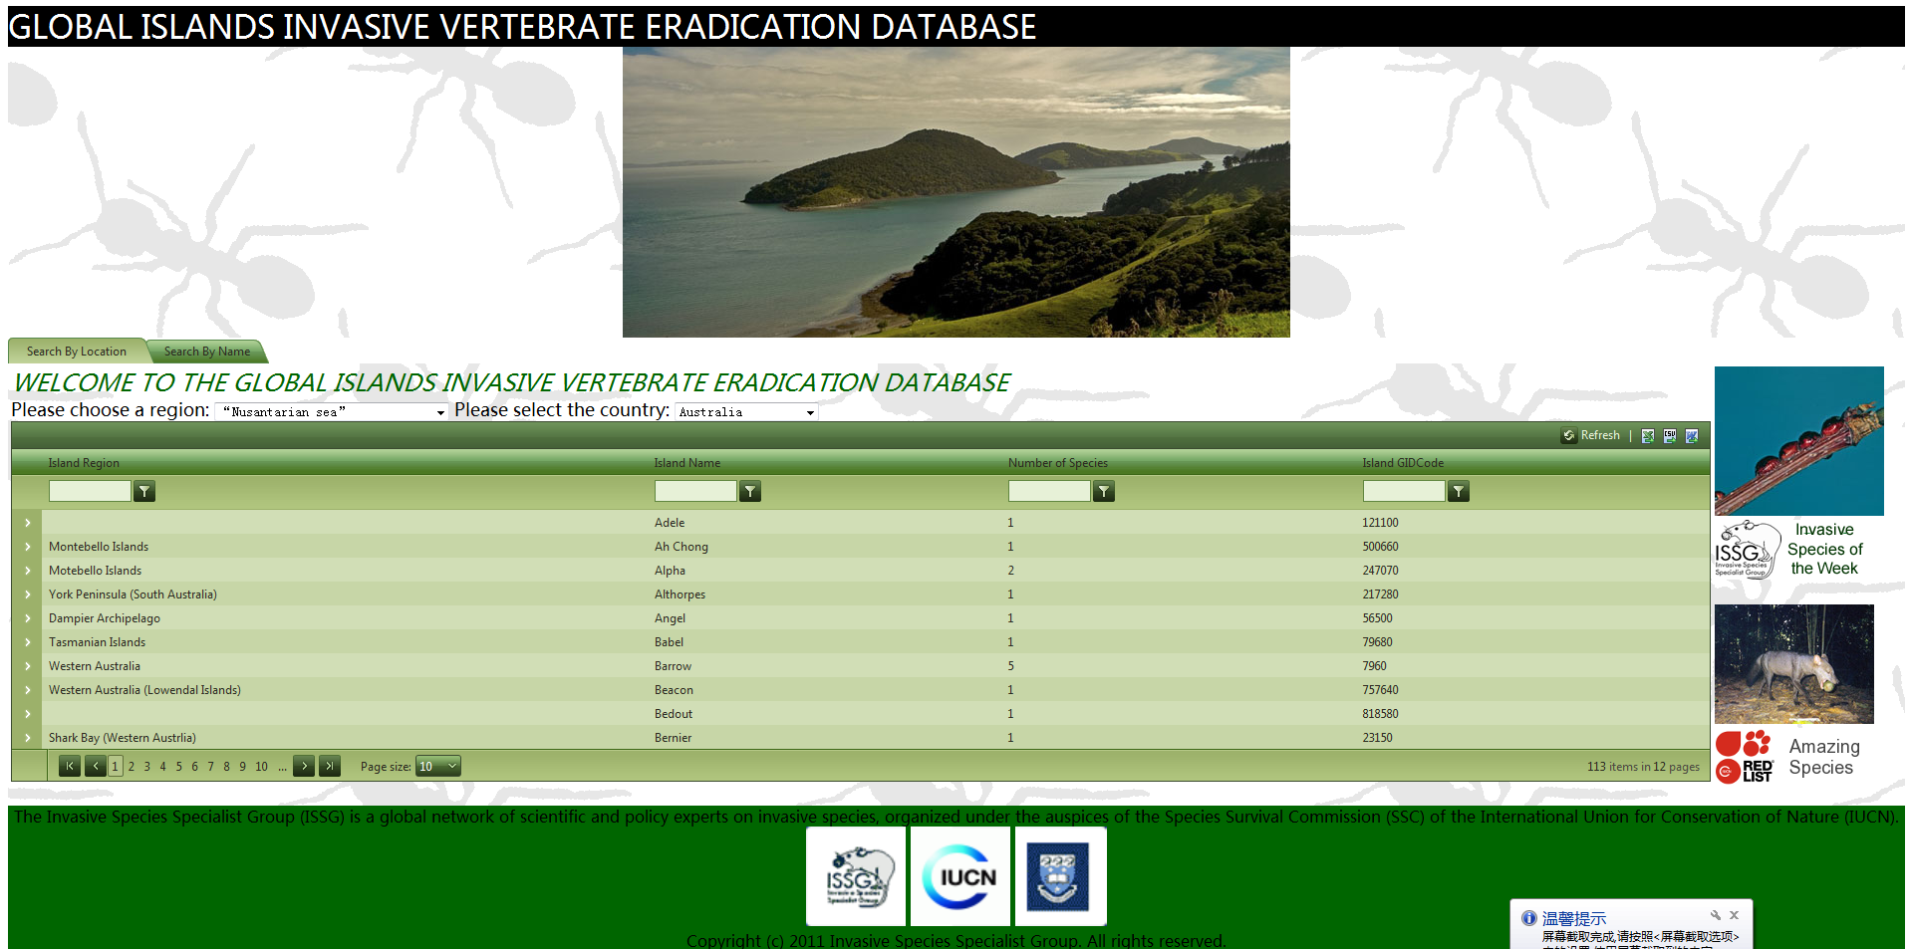
Version 2 of the Webpage(Search by Location)

Slide 25
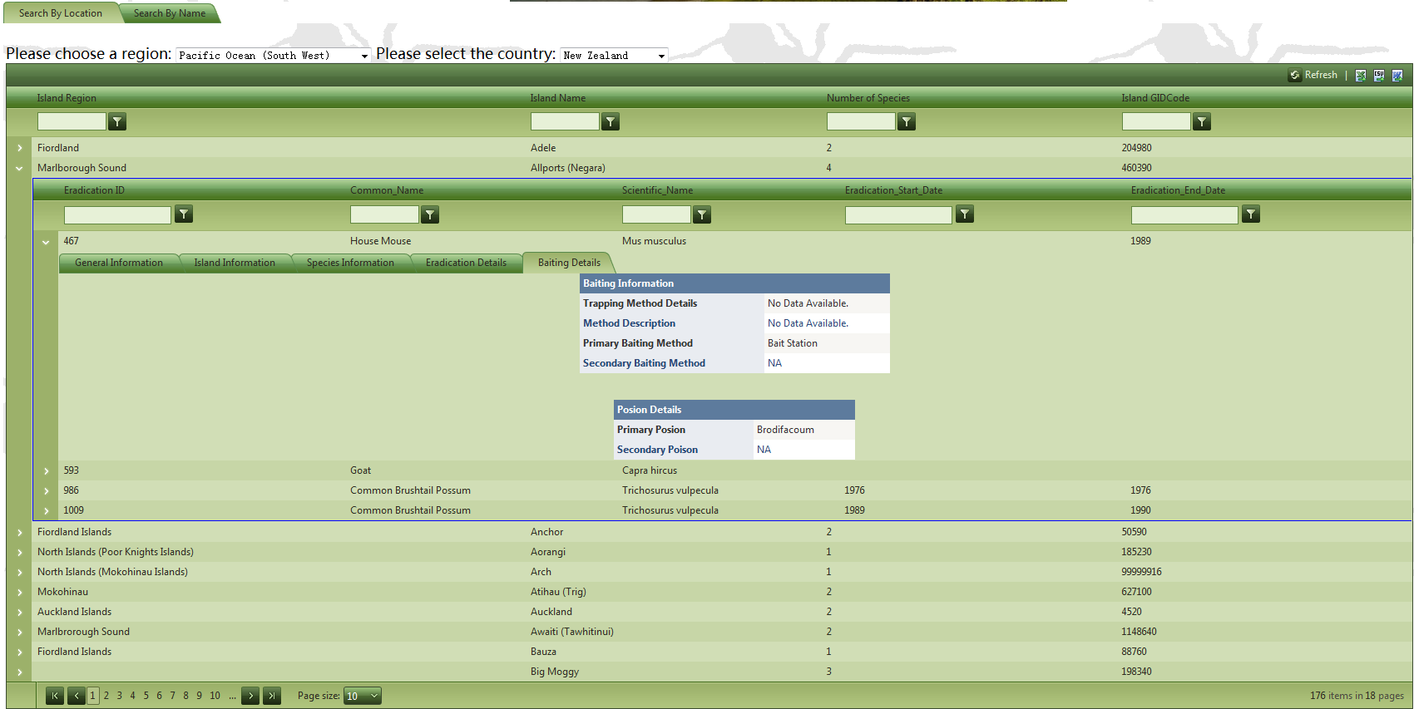
Version 2 of the Webpage(Search by Location)

Slide 26
Version 2 of the Webpage(Search by Location)
The two drop down lists at the top of the page are the only two inputs that the users need select. It provide a minimum level of filter control that ensure the webpage will load and display the data within a reasonable response time. The reason why island name is not been selected as a filter control: some of the island doesn’t have a name or the name can be duplicate(same country).
After the user has pushed the search button, they need to select a related island based on: island region, name and number of species available for the island. In this level, only the islands that count at least one specie will be displayed to the user.

Slide 27
Version 2 of the Webpage(Search by Location)
At the second level of the Radgrid view, all species that have at least one eradication record will be displayed to the user. This level is mainly used solve the problem for eradication time. As mentioned early, the eradication record can have no data for eradication start & end date (not keys), but an identical specie will have two separate eradication records based on the time period. Therefore it is not a good idea to let user manually input it. The best and only solution is list out all possible selections and let the user select what they want.

Slide 28
Version 2 of the Webpage(Search by Location)
The third level of the radgrid view contains several different details view. The details view is managed by a multi-tab control based on their category.
In this level, only the information that is not null(empty) from the related database table will be displayed. This is different from the version1.

Slide 29
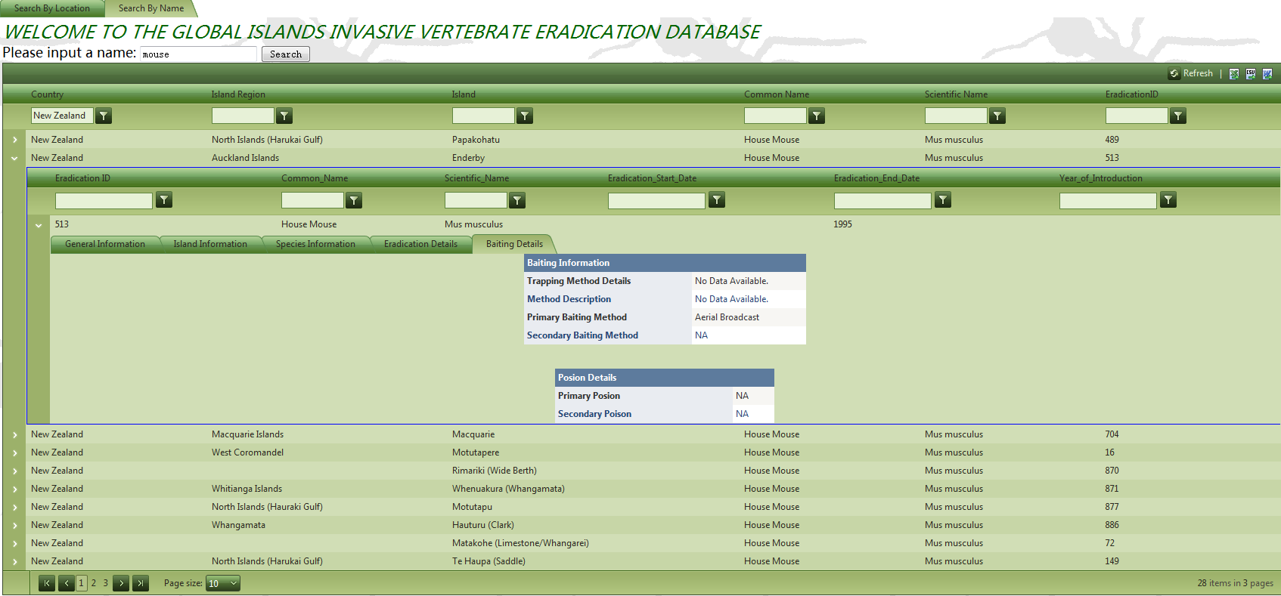
Version 2 of the Webpage(Search by Name)

Slide 30
Version 2 of the Webpage(Search by Name)
Instead of using locations, users are allowed to input a species name. It doesn't matter it is a common name or scientific name, the DAL at the background will automatically select all available data.
At the first level of the radgrid view, the user will see all available eradication records based on their input name. Then they can select a specific eradiation records and go for the details. The details view are completely same compare to the search by location.

Slide 31
Conclusion of Version 2
Version 2 is a new version of the webpage that is designed and implemented based on the previous version. Most of the DAL from the version 1 has been carried over to the new version.
This version2 contains new features such as:
A tab view that combine two search functions together.
A better layout of the webpage.
Instead of using massive drop down list boxes, a 3-level hierarchy radgrid view has dramatically increased the usability of the webpage.

Slide 32
Conclusion of Version 2
Three export functions at the top that enable users to export the searching results.
Two extra image link. One link to the invasive of the week, another link to the amazing species.
A details view filter to hide all null(empty) rows.
Despite the exciting new features and other advantages for the version2, there is still one major concern for the new webpage: loading time. The loading time for the version2 is slightly increased compare to version1. This is caused by loading all data to the Radgrid without enough filter controls. At the moment, it might not effect the overall performance as the size of database is still relatively small. However as the size of database increase, it may becomes a big problem.

Slide 33
Summary
This project is my very first real world project. It has been a great experience for me, I have learned many new skills knowledge from it.
By completing this project, I have learned:
Design and implement a project under real world conditions.
Design suitable database and webpage layout for a specific organizations.
How to transform and use several different database platforms(MySQL,MSSQL,MSAccess).
How to build a webpage by using asp.net
Apply third party toolkit to asp.net(Ajax and Telerik), especially how to manually program them by source code.

Slide 34
Future Developments
In the future, I would really like to upload this database and webpage to the servers and complete some performance testes.
By completing the performance testes, I will be able to improve the speed of loading database. Also I can add more features and functions such as data analyzes or statistical analyzes.

Slide 35
Acknowledgements
I would like to thanks to my Academic Mentor Dr S. Manoharan for providing me the opportunity to learn from this project. Dr S. Manoharan has also provided me lots of information and advices which will be very useful in my future study.
And I would like to thanks my Supervisor Angela Chan. Her advices on Visual Studio and database access layer are extremely important.

Slide 36

Questions…?

