Slide 1
Btech451 End Seminar
Yihui Zheng (Jerry)
yzhe065@aucklanduni.ac.nz

Slide 2
Overview
Project Introduction
Project Goal
Project Schedule for ISSG Database
Current Progress
Database Structure
DAL
Web designs & Structure
Future Development
Blackhawk Mobile Application Overview
Blackhawk Iphone Application Issues
Solutions
Future Schedule

Slide 3

Project Introduction
ISSG is stands for Invasive Species Specialist Group, it is a non-profitable organization aims to reduce threats to natural ecosystems and the native species they contain by increasing awareness of invasive alien species, and of ways to prevent, control or eradicate them.
They manage the Global Invasive Species Database and Global Islands Invasive Vertebrate Eradication Database online for public and other organization to search information on invasive species, their ecology, spread, management and impacts.

Slide 4

Project Introduction
Blackhawk Tracking Ltd is an IT company that use GPS tracking technology to provide products such as:
● Car finance & other finance tracking: A GPS type of finance control that designed to lower the risk of lending with financed assets. It can automatically send SMS alerts/ email and even disable a vehicle.
● Fleet management: A product that monitors the road to save petrol and increase productivity by tracking in real time. It provides information about the vehicle and road.
● Vehicle security: Blackhawk eye, the main product of the Blackhawk tracking system. It is designed to find registered vehicle’s location on computer or phone in order to protect your vehicle if it is stolen. It also includes an AI system that analyses your daily schedule to avoid any unwanted alert.

Slide 5
Project Goal
Goal1: develop an online searchable database(Global Islands Invasive Vertebrate Eradication Database ) with ASP.NET web-page interface for ISSG.
Goal2: develop an mobile application on Iphone (or possible Android)for Blackhawk Tracking System.

Slide 6
Project Schedule for ISSG
First Phase:
gathering general ideas about the project.
(Done)
Second Phase: confirm requirements .
(Done)
Database design/implementation phase.
(85% Complete)
Web page & Web Structure design phase.
(70% Complete)
Web Page Interface Implementation phase.
(30% Complete)
Testing and Deployment.
(Future)

Slide 7
Current Progress
Changes from the previous design:
Global Invasive Species Database’s structure has been completely changed.
New functions are required and added to the web interface. They will be some analyzing tool to help user compare the results rather than just showing all data.
Data Access Layer(DAL) will be used.

Slide 8
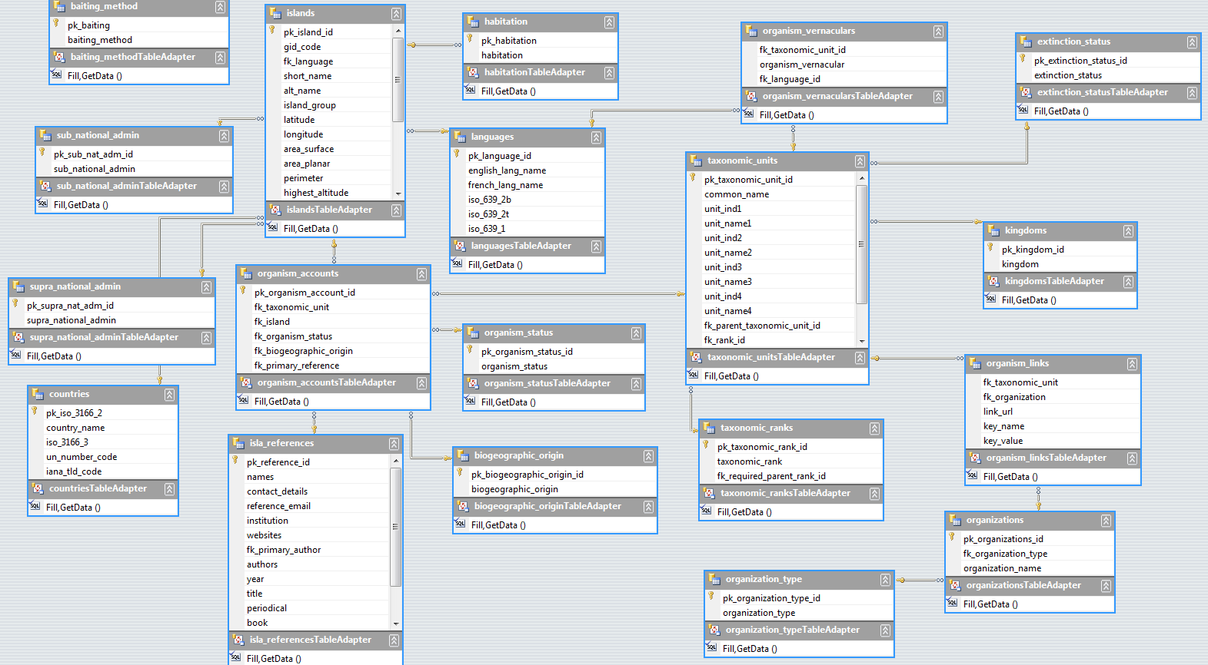
Database Structure
Previous Database:

Slide 9
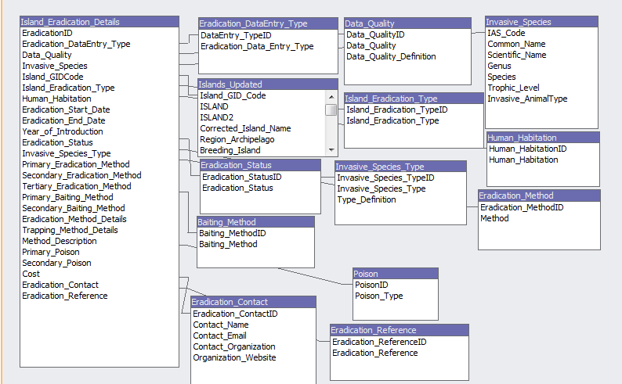
Database Structure
New Database: 14 tables, may still need some improvements.

Slide 10
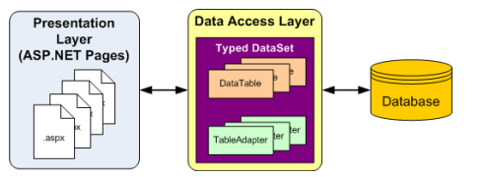
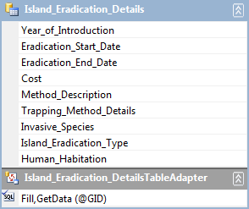
Data Access Layer(DAL)
A data access layer (DAL) is a layer of a computer program which provides simplified access to data stored in persistent storage.
-Wikipedia
Advantages:
Easier for Modification: Independent from the user interface.
Database Independent: Easier to switch between databases.

Slide 11
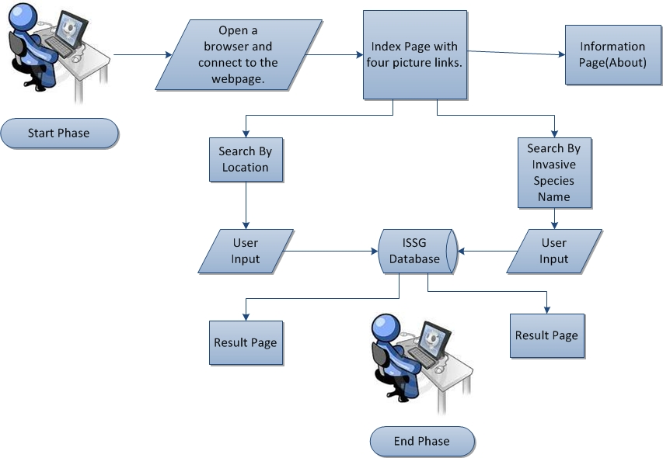
Web Structure

Slide 12
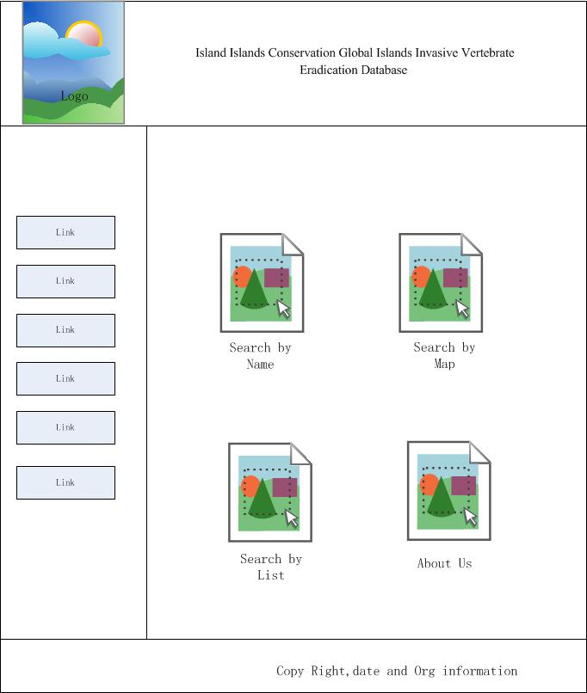
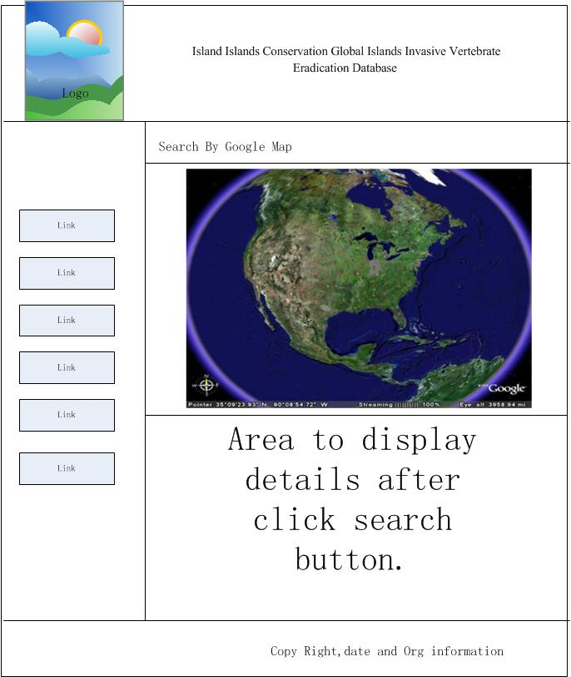
Web designs

Slide 13
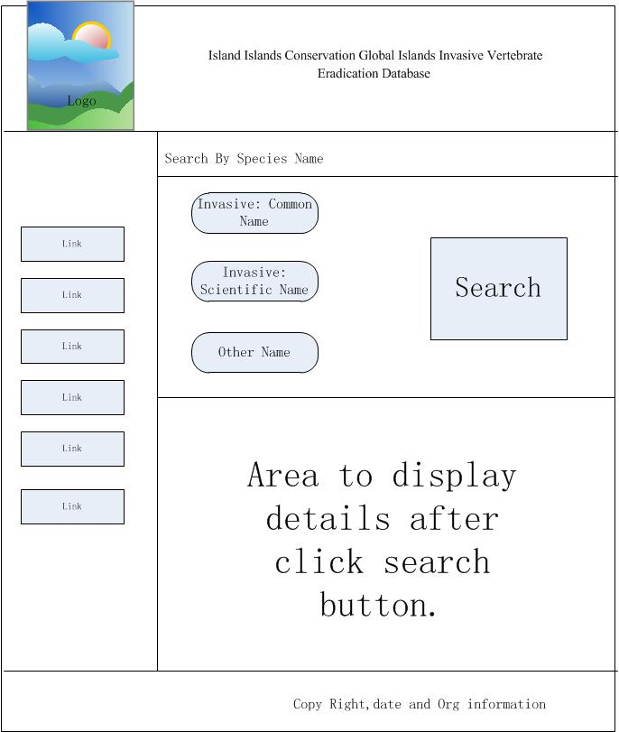
Web designs

Slide 14
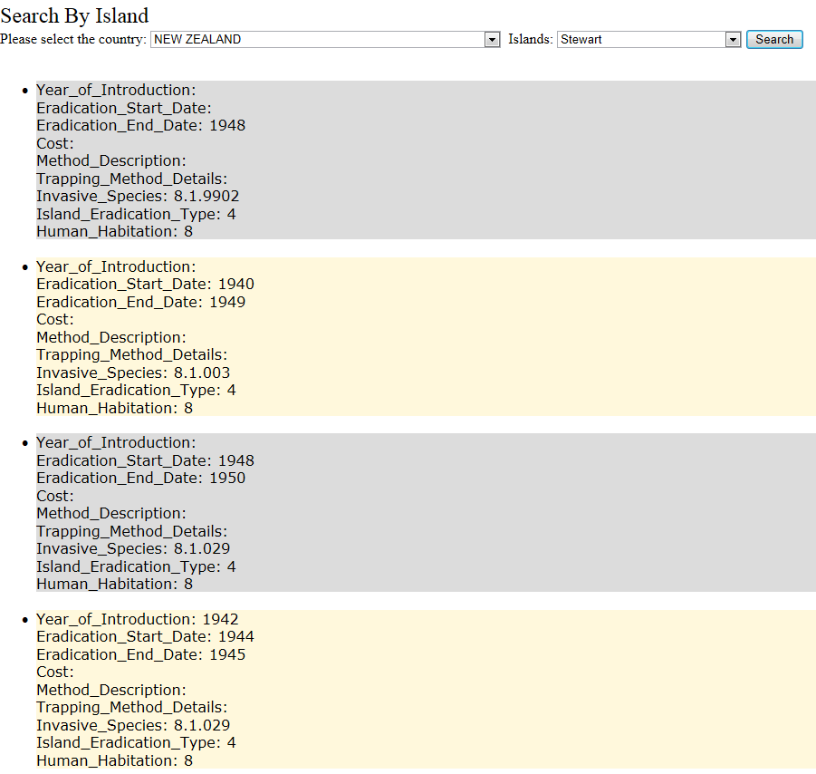
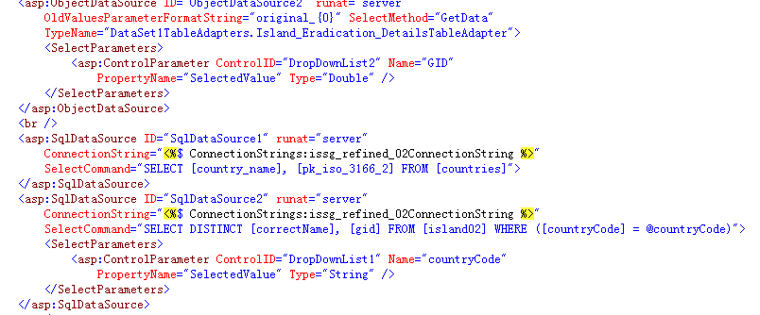
Web Page prototype.

Slide 15
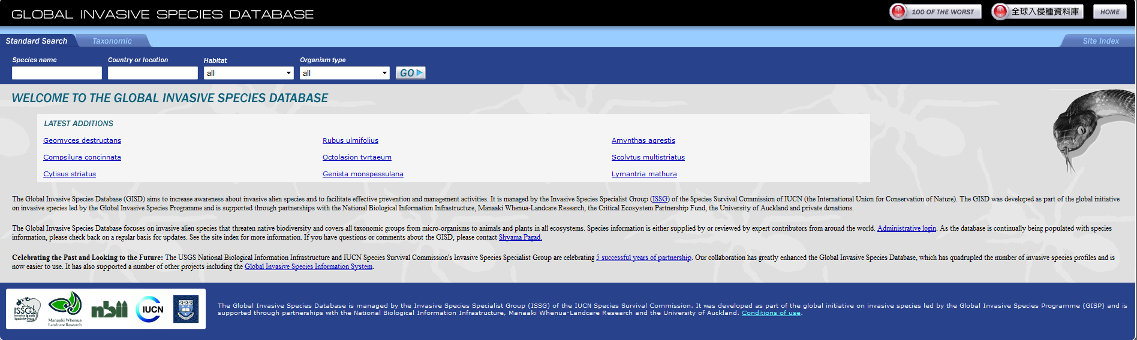
Web Page example & Related Work
A asp.net webpage build by previous Auckland University Student for GISD (Global Invasive Species Database ).

Slide 16
Future Developments
Complete and confirm the database with ISSG.
Improve the structure of the web page interface.
Complete each web interface.
Add analyze tools to the result page.
Testing and deployment.

Slide 17
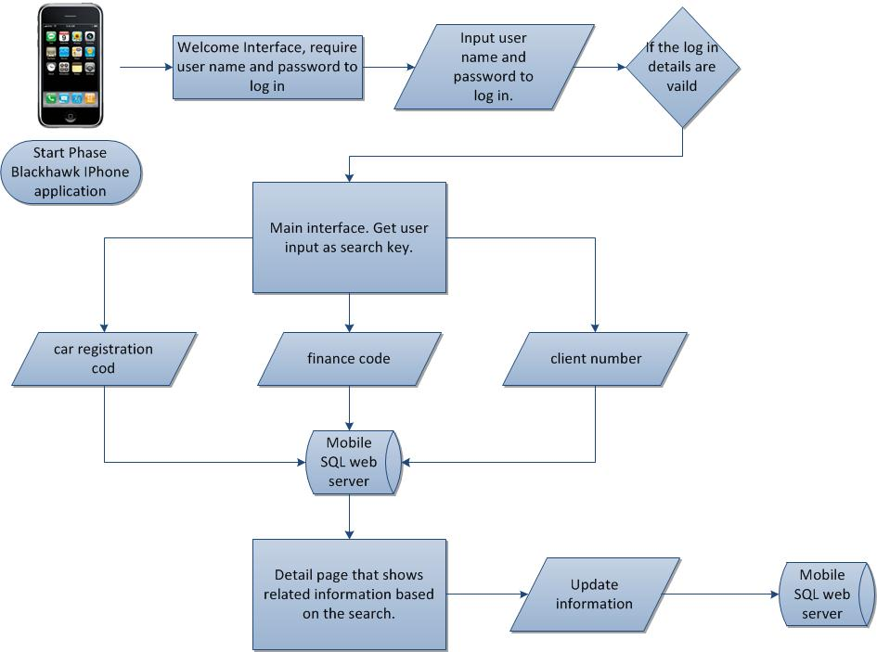
BH Mobile Application Overview

Slide 18
Mobile Application for BH
They are three major issue for the Blackhawk mobile application project:
Not able to get the server.
Can’t confirm the mobile platform.
Requirements not clear.
Most of them are caused because the lack of communication with Blackhawk Tracking Ltd.

Slide 19
Possible Solutions
Get the Server from the BH and modified it to suit mobile applications.
Build a local server as a estimation of the real server.
Build the data in the mobile application.
If the cost for develop and publish Iphone application is too high, switch to Android or windows Phone.
A few meeting are definitely required to confirm the requirements and designs.

Slide 20
Schedule
Kick off meeting to gathering general ideas about the project.
(Done)
Second meeting to confirm function requirements .
(Done)
Third meeting to ensure the equipments are ready to use.
(First Week of Second Semester)
Design Phase:
Design the application and web server without any implementation. Giver many alternative designs.
(Before end of the first semester)
Fourth Meeting to discuss which design will be used.
(Before end of the first semester)
Implementation Phase:
Build the application and web server.
(During the first month of the second semester)
Fifth Meeting:
Review the output with users, get feed back.
(After the implementation is completed)
Maintains Phase:
Refine the application such as interface or functions based on users' feed back.

Slide 21
Acknowledgements
I would like to thanks to my Academic Mentor Dr S. Manoharan for providing me the opportunity to learn from this project.
Special thanks for my Supervisor Angela Chan. Her advices on Visual Studio and DAL are extremely important for the ISSG project.

Slide 22

Questions…?

