Slide 1
Emergency SOS Mobile Application
Justin Ye-Yue Wu 3974847 22nd Jul, 2011

Slide 2
Overview
Company
Project And Requirements
Implementations
Done So Far
Interfaces And Functions
Problems
Future Work
Plan

Slide 3
About BlackHawk
NZ Owned Company
Specialize in GPS tracking
Protection For Your Vehicle and Family

Slide 4
Project And Requirement
Write an SOS emergency application on different mobile operation systems.
The mobile application will need to be able to sense collisions accidents.
Sends out emergency message to assigned contact.

Slide 5
Implementation
Uses of different SDK for different mobile operating systems.
Different programming languages.
For Android application, eclipses with android SDK is used on a windows computer. Using Java.
For iPhone (IOS) application, Xcode is used on a mac laptop. Using Objective C.

Slide 6
Done So Far
Research on different tools that are needed for different applications.
Created an Emergency SOS applications for Android operating system.
Have a running prototype.
Started Emergency SOS mobile application’s user template for iPhone (ISO).

Slide 7
Home Page
Android
Start with title, showing the application’s name “Emergency SOS application”.
With a drop down menu beneath it, where user can choose different kind of algorithms to sense the collision.
Different information that are useful for the user are provided below.
Four buttons on the end of the page to provide extra functions for the user.

Slide 8
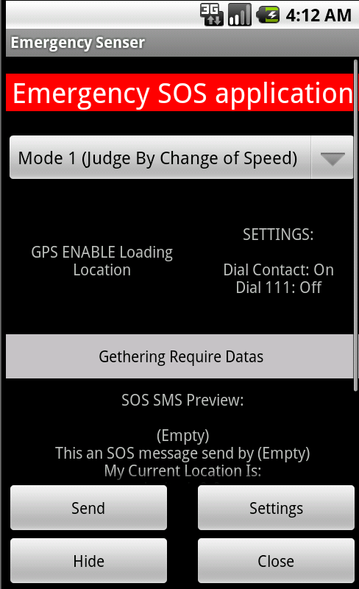
Home Page (Cont.)

Slide 9
Setting Page
Access by clicking on the Setting button on the home page.
Where users enter required information for the application.
Also provides the ability for the users to adjust functions for this application.
Two buttons located below are used to save or not save the settings the user have entered.

Slide 10
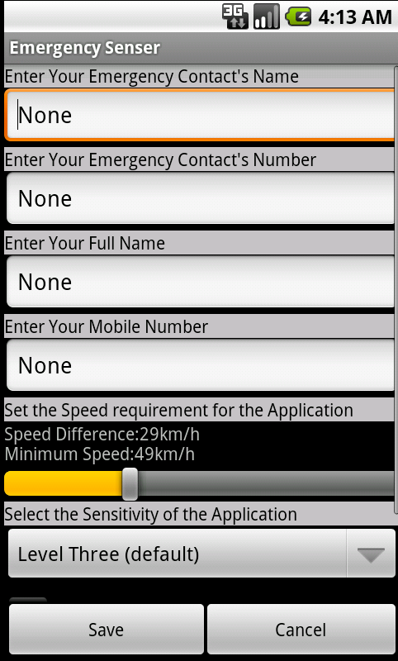
Setting Page (Cont.)

Slide 11


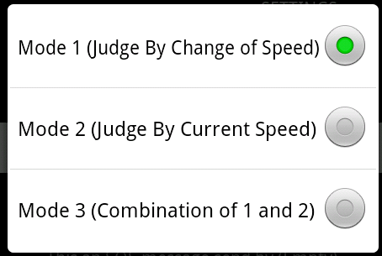
Interface And Functions.
Title is done in red background to make it stand out and easier for users to read.
The drop down menu below contains three different methods to determine collisions in a car.
Mode 1 – Determined by the change of speed (km/h) of a driving vehicle.
Mode 2 – Determined by the speed of the vehicle.
Mode 3 – Use the combination of Mode 1 and Mode 2

Slide 12
Collision Algorithm
Mode 1 – Uses the change of speed of the vehicle and the combination of vibrations that is sensed by the mobile to determine if there has been a collision.
Mode 2 – Sets up a minimal speed requirement and as long as the vehicle is driving over that speed requirement, if there is a vibration sensed by the application it will treat it as if collision has occurred.
Mode 3 – Combines the two modes above to determine collision. Both change of speed and minimal speed requirement need to be met before collision can be determined.

Slide 13
Pros and Cons
Mode 1
Pros
Accurately determines collisions, as the speed change is usually significant when collisions occurs.
Prevent false detection of collisions sensed by the vibration created when driving.
Con
Change of speed is determine by GPS and can happen in a short time period. The slow GPS update can lead collision undetected.

Slide 14
Pros and Cons (Cont.)
Mode 2
Pro
Chances of not detecting a collision are slim, as all vibration above a certain speed is sensed.
Con
Can easily make false determinations that there has been a collision, when driving on rock roads.
Mode 3
Pro
Combine the two algorithms above to more accurately sense collisions.
Con
Same as Mode 1, slow GPS update can cause collisions to happen undetected.

Slide 15
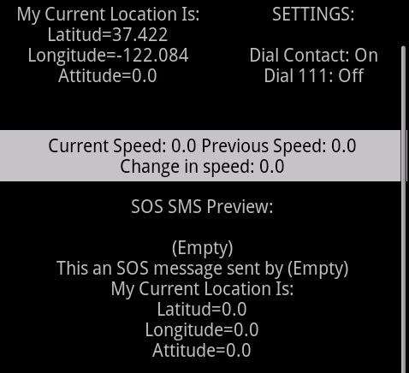
Interface And Functions (Cont.)
Shows the GPS’s state and the location of the user in latitude, longitude.
Show the setting, options that the user have chosen. (more detail later)
Shows the information of the traveling vehicle. Shows the change of speed, current speed and previous speed 0.5 second ago. All speed are shown in km/h.
Show a preview of the SOS SMS.

Slide 16
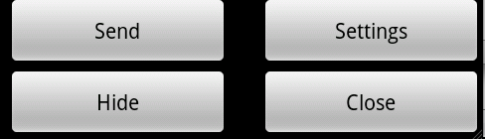
Interface And Functions (Cont.)
Four buttons located on the bottom of the Home page.
Send – Sends out a SOS SMS to your assigned contact.
Setting – Brings the user to the Setting page.
Hide - Hides the applications in back ground. So other applications can be run at the same time.
Close – Close the application to save power. Important as GPS drains power.

Slide 17

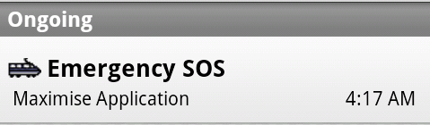
Interface And Functions (Cont.)
Once the Hide Button has been clicked, a notification message and icon will show on the top left hand side of the Android top status bar.
This is to remind the user that the Emergency SOS application is still running.
The notification message can be clicked to maximize the application.

Slide 18
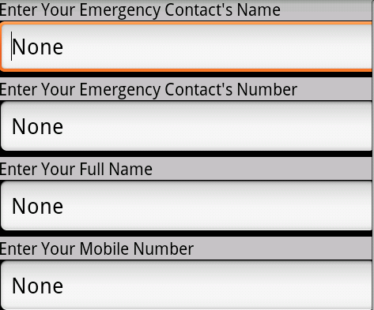
Interface And Functions (Cont.)
Once the Setting button has been clicked it will bring up the Setting Page.
Four text field space, where the user can enter the required information for this mobile application.

Slide 19
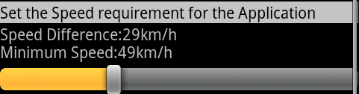
Interface And Functions (Cont.)
This control bar allows 2 things: Sets up the minimum change of speed required for mode 1 to detect collision and the minimum speed required for mode 2 to detect collision.
The change of speed can be chosen from the range of 10km/h to 70km/h.
The minimal speed can be chosen from the range of 30 km/h to 100km/h.
Notes:
This bar allows us do 2 things. Firstly set up the minimal change of speed. And secondly the speed that determines collision.

Slide 20
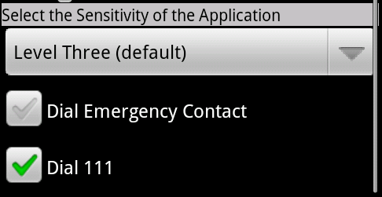
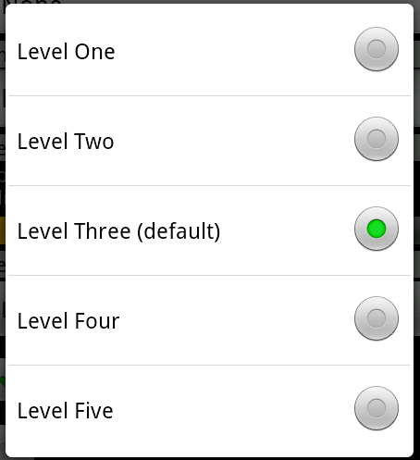
Interface And Functions (Cont.)
Drop down menu. Used to choose the sensitivity of the application on when sensing vibrate.
Has five levels, level one to level Five to choose from.
Where level one is the most sensitive and level five the lest sensitive.
Two tick box. The selected options for the tick box is shown on Home page of the application underneath the title Setting.
Dial Emergency Contact
Allows the application to call the users assigned emergency contact after a SOS SMS.
Dial 111
Allows the application to call 111 after a SOS SMS.

Slide 21


Interface And Functions (Cont.)
Two buttons located at the bottom of the Setting page.
Save – Save the newly implemented settings by the user.
Cancel – To cancel or undo any newly setting implemented by the user.
A extra Test button has been created in the Home page to show what happen when a collision has been detected.

Slide 22
Interfaces and Functions (Cont.)
When a collision is detected, a dialog will pop up before either the SMS is send or emergency number called.
The dialog will show different warning messages according to settings set by the users
The first dialog will tell the user a SOS SMS is going to be sent in 10 second. When this dialog first pop up the mobile running the application will send out a 1 second vibration to notify the user.
The second dialog will pop up when there are only 5 second left for the users before sending out the SOS SMS. This time, the phone will vibrate 5 times on each second before the SOS SMS is sent.

Slide 23
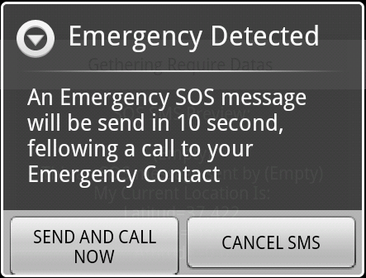
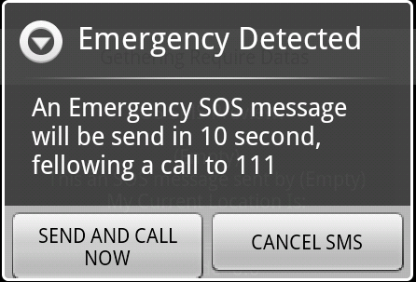
Interfaces And Functions
Each dialog will have two buttons.
Button 1 – Used to Send the emergency SOS SMS instantly with out waiting for the 5 or10 second.
Button 2 – To cancel the sending of SOS SMS before it occurs.

Slide 24
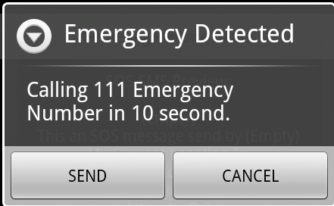
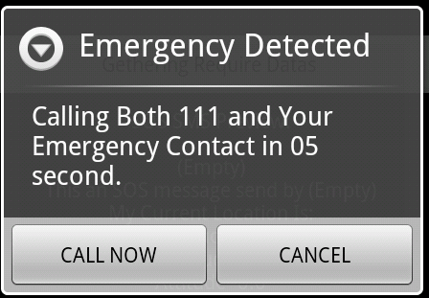
Interfaces And Functions
The same dialog templates are also used when an emergency number is going to be automatically dialed after the emergency message has been sent.
It also contains the two buttons, to cancel or call the number instantly.
The calling alert dialog will only appear, if the user has ticked either of the 2 tick box in Settings page to allow calling of your contact or 111.

Slide 25
Different Dialog Messages
Dial Emergency Contact ticked in setting.
Dial 111 has been ticked in setting.

Slide 26
Other Functions
When the application is running, it prevents the mobile from going into a sleep mode.
Functions of the application will not be blocked due to the mobile going into sleep mode.
Power life of mobile?
The mobile will once again be able to go into sleep mode once the Close button has been click in the Home page.
By Clicking the Hide buttons in the Home page, sleep mode is still block as the application is still running.
Notes:
You may thinking…wow that’s gonna take up all my power. But bare in mind, that you turn it on only when you are driving and turn it off once destination reached.

Slide 27
Problems
Unable to find a accurate way to determine height. So that the applications can be used to sense emergencies involving falling.
Alert Dialog pop up some times produces errors in the application when vibrate is detected by the application. Most likely cause by the Activity Lifecycle for Android operating system.
Solutions includes putting home and setting page into one or use toast messages instead of dialog.
However, both have strong disadvantages.
Notes:
During my testing of the application, I set up my girlfriend as my emergency contact to test. she also bought up the possible problem that the recipient may not know what the contents of the message is about. Longitude and gratitude of the GPS location may not be understood by all. So it is a good idea to perhaps have a pop up upon downloading and setting up the application in the first place, to note when installing your emergency contact, let the other person know that “ hey you are my emergency contact just in case im in an accident and just educate them on what might happen”

Slide 28
Future Work
To find solutions to the problems mentioned above.
Start implementing functions into the iPhone mobile applications.
Research more on both mobile operating systems and also to see if there are better ways to sense collisions, explore the possibilities.
Test the mobile application together and individually.
Compare the results.

Slide 29
Plan
For the next couple of weeks:
Starts on implementing functions into the iPhone mobile application.
Finish up the Android mobile application.
Weeks after that:
Finish up the iPhone applications.
If there is time to spare, start implementing on another mobile operating system. E.G. windows mobile
Test and compare results.

Slide 30
Question?

