Slide 1
Performance Analysis
BTech Project – 451A
Introduction Presentation
Presented by Arun Vejendla

Slide 2
Overview
Organisations
Project Description
Project Plan
What I can gain?

Slide 3
Organisations
2 Organisations involved in this project
University of Auckland
- Science faculty - Offers the BTech project
- Supervised by Dr. S. Manoharan
Company - CNZ (Computers New Zealand)
- Supervised by Mr. Edmond Chan

Slide 4
Computers New Zealand
Computers New Zealand (CNZ) is a total information system and solutions provider
  provides IT consulting advice, hardware platforms
  Implement information on automation system – meets clients objectives
  Software and support services
  Trouble shooting experts
CNZ is focussed on 2 solutions for customers :
  - Information Systems
  - Video Surveillance Systems (within company or outside)

Slide 5
Project Description
Project Involves: (a) individual research, (b) a bit of testing and experimentation, and (c) documenting and reporting your findings
2 Themes:
Test the Wireless bridges and Access points
- various configurations and modes (AP mode, WDS etc.)
- devices come in many versions (2 CAP501-5D models)
- Measure maximum performances and limitations of all versions
- bandwidth, reliability, throughput, delay
- Scenarios (indoor testing, outdoors – distance varies)
Investigate the impact of video transmission (Extension)
- Impact on data communication networks
- Investigating the IPVS system – performance, characteristics , limitations and scalability

Slide 6
Project Plan
Session | Theme A | Theme B
1 | Introduction to Outdoor Wireless Technologies | Introduction to IP video surveillance and problem
2 | Validation of product specifications & performance | Investigation of readily available solutions in the industry
3 | Testing the performance under different scenarios | Investigation the existence of an existing IPVS system
4 | Definition of industry & regulatory requirement for wireless networks | Propose an alternative solution or recommendations on system
5 | Propose packaged solutions for sample projects | Formulate business packages/solutions suitable for range of IPVS requirements
6 | Complete documentation for installation and technical support | Testing of software or management of video surveillance over the internet
7 | Presentation of project theme and formalize all deliverables | Presentation of project theme and formalize all deliverables

Slide 7
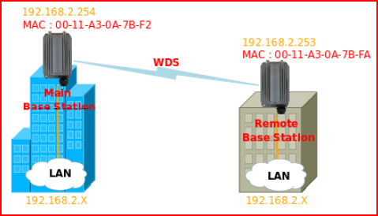
Current Work:
Research:
- Wireless technologies (Wi-Fi, Wireless devices, topologies)
- Powering Technologies (PoE)
- Antennas (CAP-501-5D, other types also)
- NZ legislation – on wireless use (power, spectrum)
Experiment: (simple – a lot of documentation)
- Point to point connection - (Indoor)

Slide 8
What can I gain?
Hands on experience:
- Industrial: hardware's and software’s
- Academic: research and technologies
Experimenting:
- wireless technologies (various configurations, modes to enable wireless networking e.g. PoE, antennas). E.g. applying theory in practice
Perform real life data communication analysis and documentation
- testing, validation and promoting through CNZ
Gain consultancy, design and implementation skills
- testing in various environments - helps me choose products wisely in real life scenarios and working with this company gives broad real time knowledge
Trouble shooting: due to the real world problems I may come across

Slide 9
Thank you
QUESTIONS??

