Slide 1

Applying Parallelism in Kiwiplan Gui Framework
Prabhjot Singh
Introductory Seminar

Slide 2
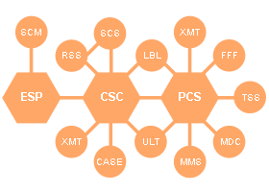
Company
Kiwiplan NZ Ltd. started in 1970’s as a small corrugating firm.
Today it is one of the world’s leading software suppliers to the packaging industry.

Slide 3
Background
Most of the Kiwiplan products displays information (report) to the clients in the form of tables.
Table has various capabilities – Sorting, Grouping, change the order of columns, adding or deleting columns etc.

Slide 4
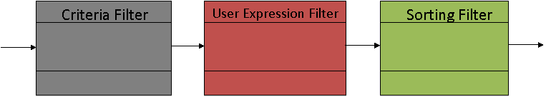
Background
When a report is processed, the data passes through a chain of “filters”.
Each filter is responsible for performing a particular reporting task.
Each query goes through the certain sequence of filters.

Slide 5
Motivation
Users sometime experience slowness when viewing tables (large size) this is due to the complex pipeline structure.
Sequential sequence of these filters makes the program quite slow for large tables.
Clients want fast access to the information.

Slide 6
Motivation
Making it efficient saves client time and hence increase product sale.
Kiwiplan is looking forward to apply parallel processing (as provided in java 7) in other possible areas as well.

Slide 7
Project Goal
To investigate the filters and parallelise them as much as possible to increase the efficiency.
Priority is to investigate parallelism within the filters.
Make the program flexible enough so that other Kiwiplan products efficiency could be increased with slight modifications.

Slide 8
Expected Outcome
Enchance my analysis and design skills.
Practical experience of the software development lifecycle and explore latest technology (Java 7).
Increase my communication and time management skills.
Familiar myself with the work environment.

Slide 9
Questions?

