Slide 1

BTech450 Silverlight Project
futuretech
Jason Wei-Lun Hsia

Slide 2
Presentation Outline
About the company
Company Products
Current Company goal
Architecture
Project Goal
Hope to Achieve

Slide 3
About the Company - futuretech
founded by Craig Meek in January 2008
Specialize in Data Visualization
Visual Business Intelligence
Focused on UI development

Slide 4
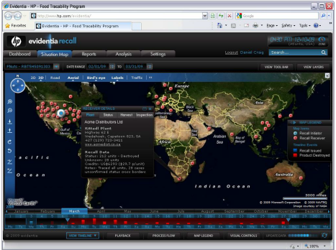
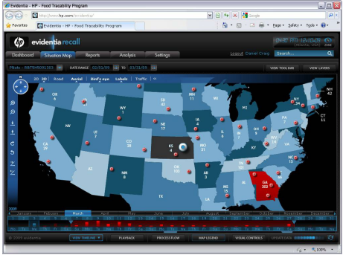
Company Products
Food product recall solution
Developing with Hewlett Packard (HP)

Slide 5
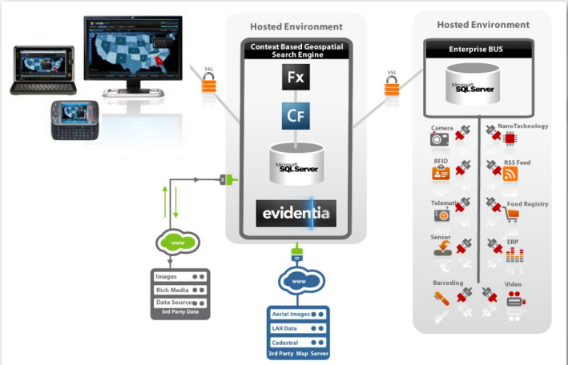
Architecture

Slide 6
Current Company goal
develop next generation enterprise dashboards
Transform from Adobe Flex to Microsoft Silverlight
port their flex libraries into their respective Silverlight libraries

Slide 7

Project Goal
Research on Silverlight
Help with the implementation/transition from Flex to Silverlight

Slide 8
Hope to Achieve
Skills in Silverlight & Flex (Flash) programming
knowledge in data visualization
Knowledge in Business Intelligence
Work experiences + cooperate environment

