Slide 1
Privacy Patterns
Presented at PST’2016
Professor Clark Thomborson
Computer Science Department
13 December 2016

Slide 2
How can software offer privacy?
What is privacy?
  I offer a constructive definition, based on Westin’s 1967 survey
  I extend Westin’s taxonomy, to cover the “information privacy” of the EU’s Data Protection Directive
I’ll teach you a bit about object-oriented design along the way…
Working manuscript: http://arxiv.org/abs/1612.01553

Slide 3
Our starting point: Aristotle(!)
All humans are mortal
All Greeks are human
Therefore: all Greeks are mortal
In an object-oriented language:
  Human has a die() method
  Greek is a subclass of Human
  Therefore: any Greek can die()
Not an exact translation
  Static logic → dynamic system

Slide 4
Extending the design
Aristotle is-a Greek
  An “instance” of his class
I am not representable
  Clark is-a NZperson
  Clark2 is-a USperson
  An instance is a member of exactly one class.
Problem: representing multiple identities

Slide 5
Design Patterns (Gamma,1994)
“Design patterns capture solutions that have developed and evolved over time.
  “Hence they aren’t the designs people tend to generate initially.
  “They reflect untold redesign and recoding as developers have struggled for greater reuse and flexibility in their software.
“Design patterns capture these solutions in a succinct and easily applied form.”

Slide 6
Privacy Patterns
A subclass of design patterns
  Foundational patterns, for private identities
  Privacy affordances, for
    Solitude
    Intimacy
    Anonymity
    Reserve
    Confidence
Your feedback is welcome, this is a work-in-progress

Slide 7
Entity, Aspect, Role, Context

Slide 8

Persona = aspect of a human
Thousands of years ago, Roman actors wore personae (masks)
to depict their roles.
A hundred years ago, Carl Jung asserted that, as social beings,
we must hide our true identity:
  A persona is “a compromise between the individual and society as to what a man should appear to be”.

Slide 9
A taxpayer is a persona
One-way navigability from Human to Persona
  ssNumber doesn’t reveal irdNumber
  irdNumber doesn’t reveal ssNumber

Slide 10
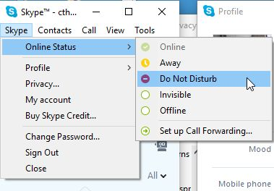
Solitude
“The first state of privacy is solitude;
  here the individual is separated from the group and freed from the observation of other persons.” (Westin, 1967)

Slide 12
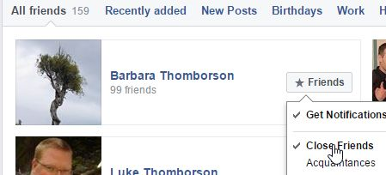
Intimacy
“In the second state of privacy, intimacy,
  the individual is acting as part of a small unit that claims and is allowed to exercise corporate seclusion so that it may achieve a close, relaxed, and frank relationship between two or more individuals.” (Westin, 1967)

Slide 14
Anonymity, Reserve
“The third state of privacy, anonymity,
  occurs when the individual is in public places or performing public acts but still seeks, and finds, freedom from identification and surveillance.
“Reserve, the fourth and most subtle state of privacy,
  is the creation of a psychological barrier against unwanted intrusion; this occurs when the individual’s need to limit communication about himself is protected by the willing discretion of those surrounding him.” (Westin,1967)

Slide 16
Confidence
I added a fifth state of privacy to Westin’s taxonomy, to handle “information privacy”
  Formally: this is a subclass of Intimacy
A private individual enters the state of confidence when they release their personal information to a Trustee e.g.
  Doctor, lawyer, social network provider.

Slide 18
Review
What is privacy?
  I offered a constructive definition, based on Westin’s 1967 survey
  I extended Westin’s taxonomy, to cover the “information privacy” of the EU’s Data Protection Directive
I taught you a bit about object-oriented design along the way…
Working manuscript: http://arxiv.org/abs/1612.01553

