Slide 1
Software Security for the Cloud
Public Lecture
for Tsinghua University
Clark Thomborson
11 March 2010

Slide 2
Questions to be (Partially) Answered
What is cloud computing?
What is a trusted cloud?
How could a cloud be secured?
What software security technologies are applicable to clouds?

Slide 3
NIST’s Definition
Cloud computing is a model for enabling
convenient, on-demand network access
to a shared pool of configurable computing resources
(e.g., networks, servers, storage, applications, and services)
that can be rapidly provisioned and released with minimal management effort or service provider interaction.
http://csrc.nist.gov/groups/SNS/cloud-computing/ (next six slides).

Slide 4
Types of Clouds
NIST identifies five essential characteristics, three service models, and four deployment models.
It’s not cloud computing unless it has...
On-demand self-service
Broad network access
Resource pooling
Customer doesn’t know location of resources, but may specify high-level constraints (e.g. within a country, state, or datacenter).
Rapid elasticity
Measured service

Slide 6
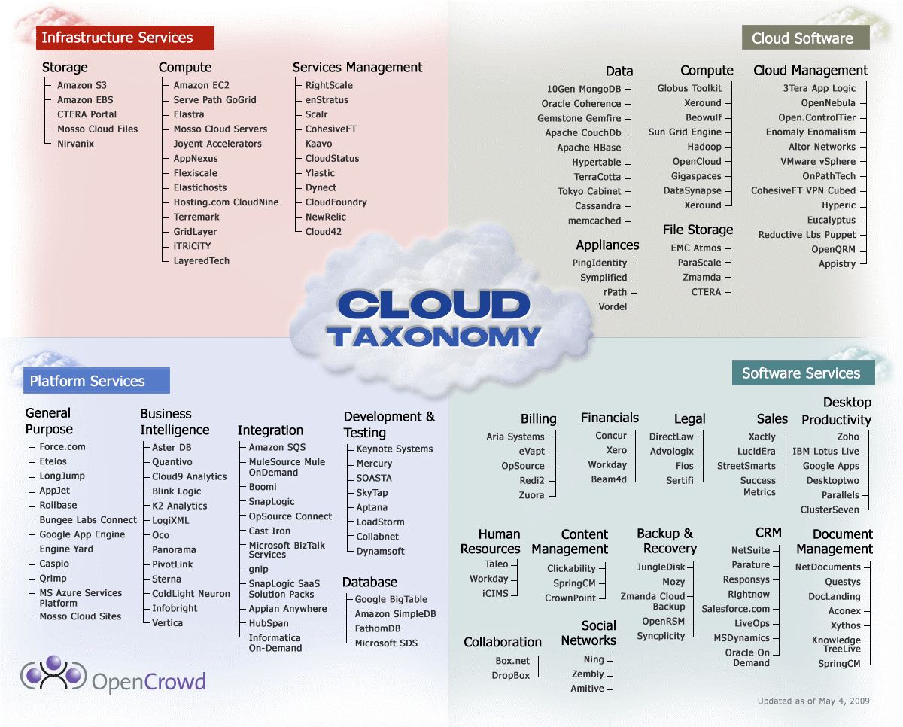

Slide 7
Early Amazon Cloud Users: New York Times and Nasdaq (2008)
New York Times
Did not coordinate with Amazon: used a credit card!
Converted 15 million scanned news articles to PDF (4TB data)
Used 100 Linux computers for 24 hours. This computation would have taken months on NYT computers.
“It was cheap experimentation, and the learning curve isn't steep.” – Derrick Gottfrid, Nasdaq
Nasdaq
Delivers historic stock and fund information, from millions of files showing price changes over 10 minute segments.
“The expenses of keeping all that data online [in Nasdaq servers] was too high.” – Claude Courbois, Nasdaq VP
Note:
low requirements for confidentiality,
high requirements for flexibility and cost-efficiency.
Notes:
Source: Infoworld, http://www.infoworld.com/article/08/04/07/15FE-cloud-computing-utility_1.html

Slide 8
Salesforce.com in gov’t apps
New Jersey Transit: call center, incident management, complaint tracking, and service portal.
600% more inquiries handled, 36% improvement in response time, with 0 new agents.
U.S. Army: tracks potential recruits who visit an Army Experience Center, saving time and resources.
Lauren Jones: “... federal spending on SaaS is largely confined to low-level productivity collaboration tools such as email and word processing, and also for CRM.”
Personally identifiable information, such as Social Security numbers, is not collected in this system.
If someone decides to enlist, the process is handled outside the SaaS application.
Notes:
http://arstechnica.com/software/news/2008/10/washington-dc-latest-to-drop-microsoft-for-web-apps.ars
Quote is from http://www.nextgov.com/nextgov/ng_20081126_1117.php
http://computerworld.co.nz/news.nsf/spec/39F776F41977E7FECC25757800115547
US Army tries out Salesforce.com in recruiting CRM vendor used in hiring programme By Patrick Thibodeau | Washington | Monday, 16 March, 2009

Slide 9
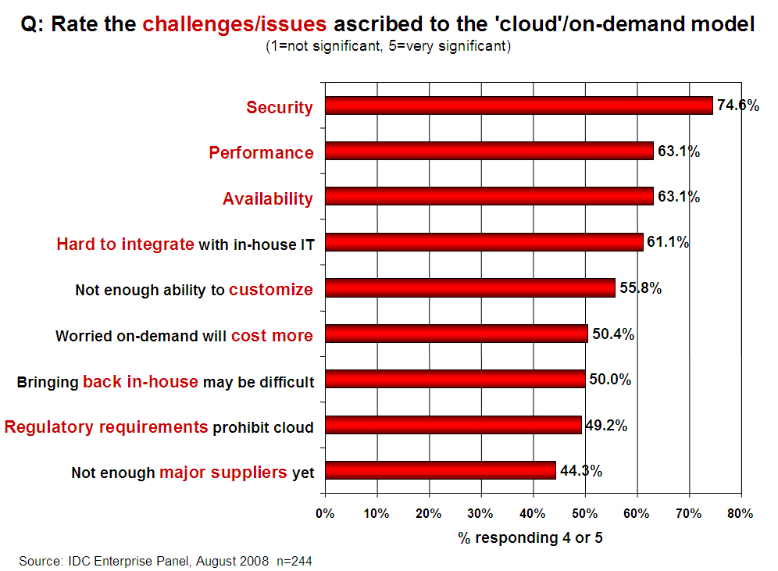
Demand for a Secure Cloud

Slide 10
Cloud Security Alliance
Security Guidance for Critical Areas of Focus in Cloud Computing v2.1, Dec. 2009, 76 pp.
“Generally, SaaS provides the most integrated functionality... with the least consumer extensibility... the provider bears a responsibility for security.”
PaaS is “more extensible than SaaS... with more flexibility to layer on additional security.”
IaaS “requires that operating systems, applications, and content be managed and secured by the cloud consumer.”

Slide 11
Service Model Architectures

Slide 12
How can we ...
... be sure that a cloud provider is adequately discharging their “responsibility for security”?
... “layer on additional security”?
... design a cloud infrastructure on which OS, application, and content security can be adequately “managed and secured by the cloud consumer”?
These are not easy questions!

Slide 13
Building Block #1: The PC
The PC is (usually) an open platform.
Software changes are very frequent.
Hardware changes aren’t difficult.
Firmware can be updated, for devices such as disk drives, and network cards.
The TPM can attest to a BIOS.
Remote attestation of a PC’s complete software configuration is meaningless,
unless you are able to distinguish a trustworthy configuration from an untrustworthy one. I can’t do this... Can you?

Slide 14
Building Block #2: The Managed PC
Imagine a world in which every PC has an owner who is responsible for (accountable for) its security.
Large enterprises already have clear lines of accountability.
Users should not administer their own PC.
My University owns my PC, and is ultimately responsible for its security.
Unauthorised, careless, and clueless administrators create big problems for their enterprises!

Slide 15
Building Block #3: The COA
The Jericho Forum defines a “collaboration oriented architecture” as an information architecture which
an enterprise can use securely, and reliably, to interact across governance boundaries.
The COA framework has principles, processes, services, attributes, and technologies.
We cannot have security without people!

Slide 16
Time for a picture...
Alice
Oscar owns a PC.
Alice owns cloud A.
Oscar’s alias (as the administrator of a virtual PC in Alice’s cloud) is accountable to Alice.
PCA can be a trusted member of A, because
Alice can control Oscar, and
Alice can remove PCA from A.
Oscar
A
Oscar: Admin of PCA
Oscar’s PC
PCA
Arrows indicate observability and control (= accountability).
Dotted lines indicate aliases: overdetermined control (= a security risk).

Slide 17
Security Threats
Alice
Oscar may be incompetent or unable to administer his PC (for example, it may be stolen from him).
Oscar’s self-interests may conflict with his role as administrator of PCA.
The security policy on Oscar’s PC may conflict with cloud A’s requirements.
Cloud A may lose control of PCA.
Alice may be unable to control A.
Alice may be unable to control Oscar.
Charles may be harmed by PCA.
Charles may be unable to hold Alice accountable.
Charles may abuse his PCA access.
Oscar
A
Admin of PCA
PCA
Oscar’s PC
PCAC
Charles
Charles: IaaS login
Alice: IaaS vendor
Arrow: control & observe.
Dotted line: alias.

Slide 18
Building Block #4: Guards
A common design pattern in secure systems:
Alice employs a guard.
Charles cannot access Alice’s resource until he proves, to the guard’s satisfaction, that he is authorised.
Alice can put Charles on the guard’s blacklist.
Alice can terminate PCAC through PCA.
Threats:
Guard may allow an unauthorised access.
Guard may disallow an authorised access.
Alice
A
Guard
PCA
PCAC
Login Agent
Alice: IaaS vendor
Charles: IaaS login
Charles

Slide 19
Implementing Guards
Guards may be human, hardware, or software.
Software guards are the most economical and flexible.
Guards should always take orders from their superiors, but never from customers.
Guards must be protected from customers!
Design pattern = prevention + detection + response.
We must design secure “guardhouses”.
Our software guards must be able to “call for help”.
We must “send in reinforcements” if a guard calls for help.

Slide 20
Guards in JavaScript
Increasingly, we use browsers for remote access to services.
Our personal guards, and their security wrappers, are typically written in JavaScript.
We give orders to our personal guards by clicking and typing.
Our guards allow access to our bank accounts, e-commerce sites, Facebook pages, work-related services, etc.
JavaScript security is insufficient, but is being improved.
Our administrators have more powerful guards in our platform hardware, OS, and apps.

Slide 21
Multilayer Guards
Alice and Bob both have guards.
Charles will not access IaaS unless both guards agree.
Charles is logged into Bob’s guarded PC.
Bob’s PC is logged into the IaaS.
Threat: personal guards might be subverted by their restricted-access aliases.
Alice
A
IaaS Guard
IaaS Guard: Login Agent
PCA
PCAC
Bob
Bob’s PC: User level
Bob’s PC
Charles
Alice: IaaS vendor
Charles: Bob’s employee
Charles: PC login
Charles: IaaS login

Slide 22
Building Block #5: Cryptography
Communications can be secured by cryptography, if both parties have a cryptographically-secure identity.
Designing a secure public-key infrastructure is easy (assuming we have secure public-key cryptography).
Designing a usable public-key infrastructure is hard.
People have trouble managing their keys.
Key distribution is also problematic.

Slide 23
Building Block #6: Identifiers
We identify other actors by
Observing their behaviour and appearance
Asking them a question, to see if they know the correct answer
Asking them to show us something that is difficult to reproduce, and that we can recognise.
This is a dark art.
When an identification method fails, we must use another one.
We may never learn about our failures!

Slide 24
Building Block #7: Steganography
If we’re clever, we can find a way to communicate without our adversaries knowing that we are communicating.
This is another dark art.
As soon as our secret is known, we must find another stegochannel.
We can never be sure that no one has discovered our secret.
Cryptography has a similar problem with secrecy, but it is restricted to the keys.

Slide 25
Putting it all together...
We need to establish clear identities for ourselves, in each of our aliases.
We need to give appropriate orders to our guards:
Who should be allowed to do what, how often, when, and under which other conditions?
If we over-constrain, our e-organisations will be unproductive.
If we under-constrain, our e-organisations will be insecure.
Our guards must be in secure guardhouses.
Our guards must be monitored: they may call for help, and they may show signs of subversion.

Slide 26
Monitoring Guards
Stegochannels and visible watermarks are important for guards.
A guard should use a stegochannel (and, possibly, also an overt channel) when calling for help.
An adversary may block all overt channels.
JavaScript offers many possible stegochannels...
A guard should have a visible watermark (soft ID, easily recognisable by others) as well as a hard (cryptographic) ID.
Soft IDs seem to need legal and social protection; technical protections seem insufficient. An important research question!
Human-factors problem: can we recognise guards?

Slide 27
Lecture Plan
Our next lecture will describe our method for modelling and analysing secure systems.
“A Framework for System Security”, by Clark Thomborson, in Handbook of Information and Communication Security, eds. Stavroulakis and Stamp, Springer, April 2010.
http://www.cs.auckland.ac.nz/~cthombor/ Pubs/Foundation/foundationv21.pdf.

Slide 28
Lecture Plan (cont.)
Techniques for software watermarking and fingerprinting.
Techniques for software obfuscation and tamperproofing.
Steganography: functions and threats.
Axiomatic and behavioural trust.

