Slide 1

COMPSCI 732:
Semantic Web Technologies
Rule Interchange Format

Slide 2
Where are we?
# | Title
1 | Introduction
2 | Semantic Web Architecture
3 | Resource Description Framework (RDF)
4 | Web of Data
5 | Generating Semantic Annotations
6 | Storage and Querying
7 | Web Ontology Language (OWL)
8 | Rule Interchange Format (RIF)

Slide 3
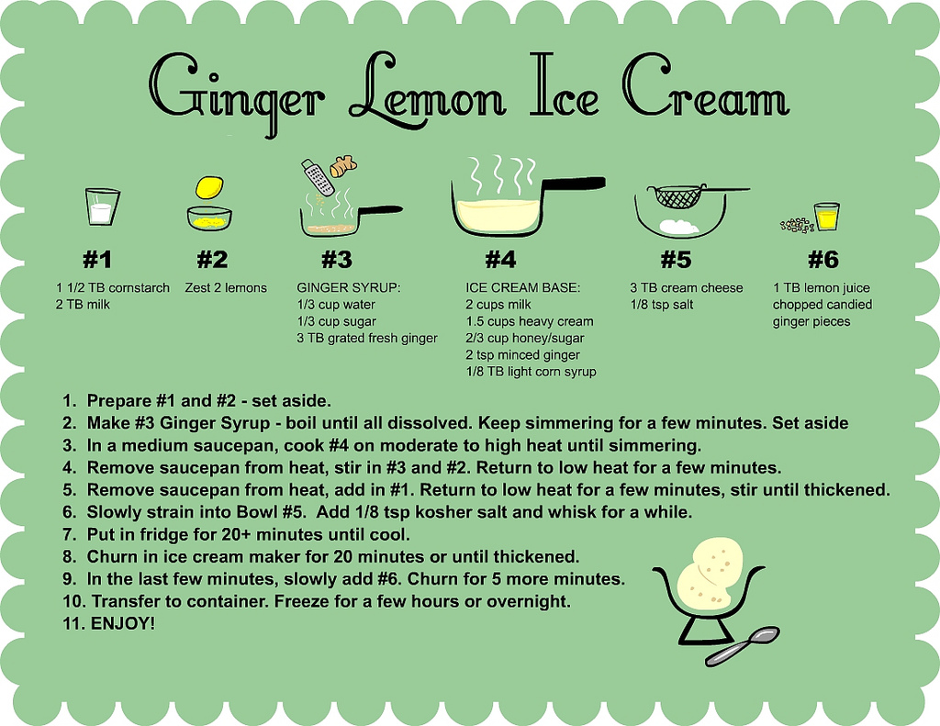
Agenda
Introduction and Motivation
Technical Solution
  Principles
  Dialects
  Syntax
  Semantics
  Tools
Illustration by an example
Extensions
Summary
References

Slide 4
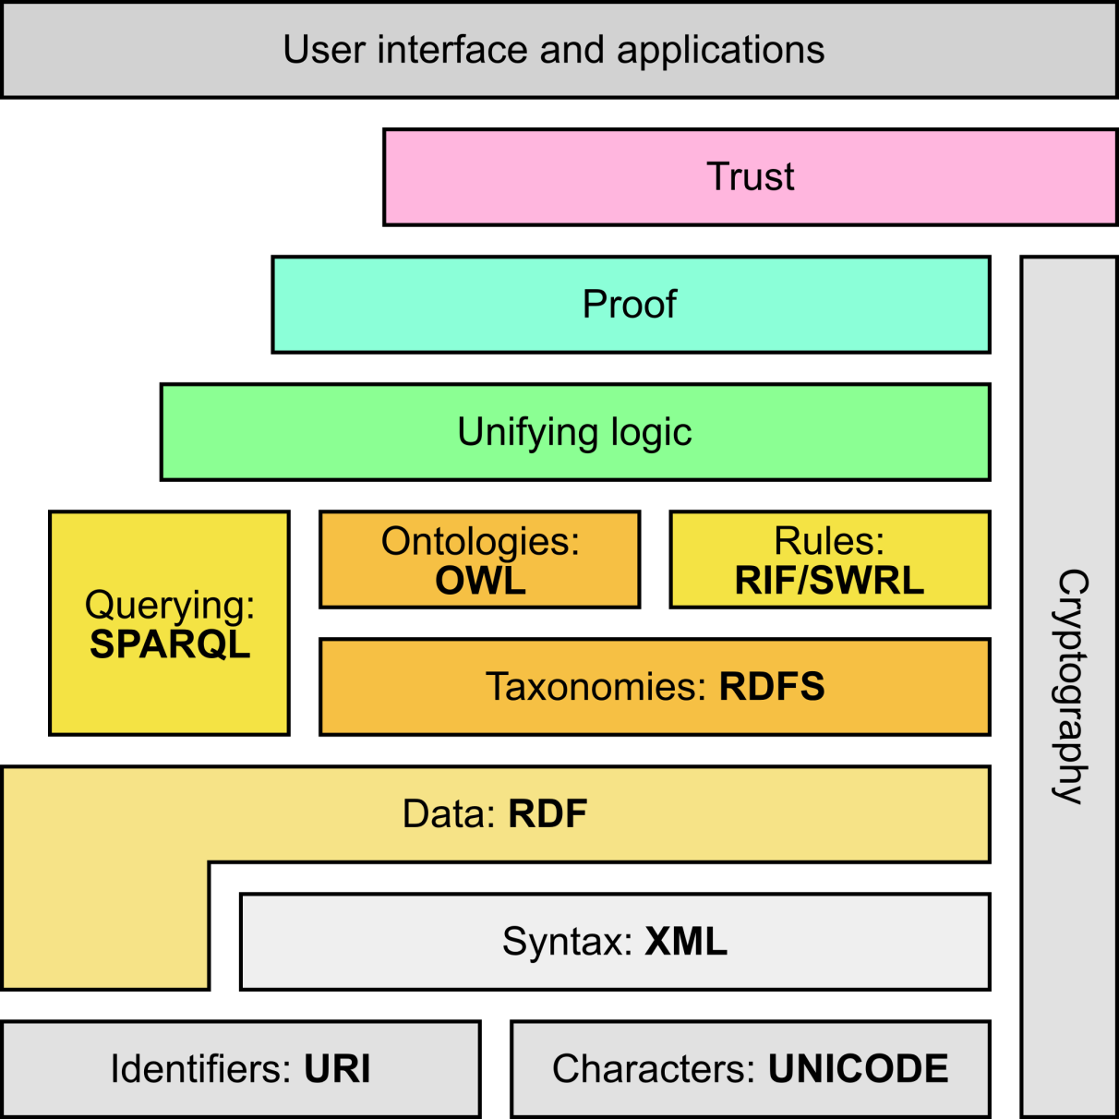
Semantic Web Stack
Adapted from http://en.wikipedia.org/wiki/Semantic_Web_Stack

Slide 5
MOTIVATION

Slide 6
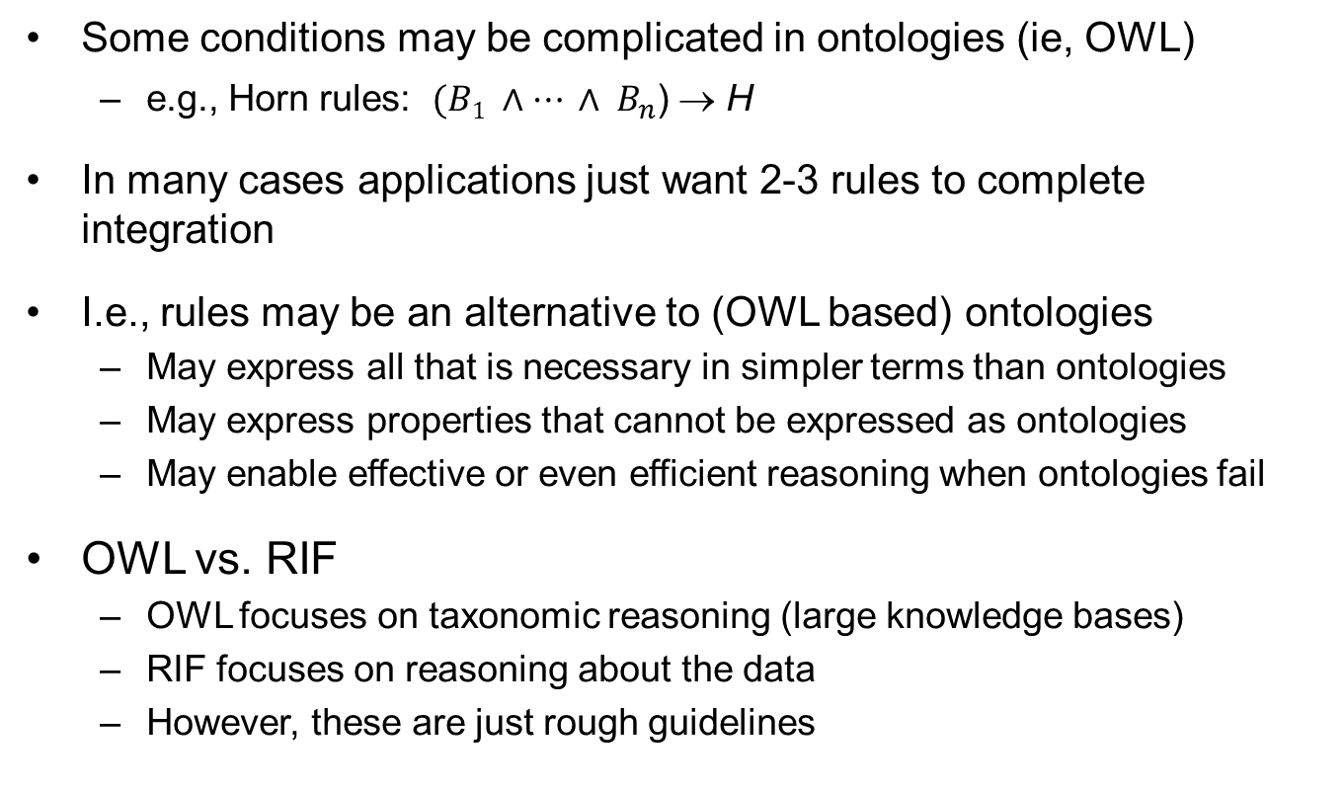
Why Rules on the Semantic Web?
Some conditions may be complicated in ontologies (ie, OWL)
  e.g., Horn rules: $(B1 ∧… ∧ B_{n}$) → H
In many cases applications just want 2-3 rules to complete integration
I.e., rules may be an alternative to (OWL based) ontologies
  May express all that is necessary in simpler terms than ontologies
  May express properties that cannot be expressed as ontologies
  May enable effective or even efficient reasoning when ontologies fail
OWL vs. RIF
  OWL focuses on taxonomic reasoning (large knowledge bases)
  RIF focuses on reasoning about the data
  However, these are just rough guidelines

Slide 7
Rules
There is a long history of rule languages and rule-based systems
  logic programming (Prolog),
  production rules
Lots of small & large rule systems (from mail filters to expert systems)
Hundreds of niche markets

Slide 8
An Example
An example from our earlier bookshop integration:
  “I buy a novel with over 500 pages if it costs less than €20”
  something like (in an ad-hoc syntax):
{
?x rdf:type p:Novel;
p:page_number ?n;
p:price [
p:currency :€;
rdf:value ?z
].
?n > "500"^^xsd:integer.
?z < "20.0"^^xsd:double.
}
=>
{ <me> p:buys ?x }

Slide 9
What you need to express in the example
p:Novel
rdf:type
p:page_number
?n
?n>500
?x
me
p:buys
?x
p:price
:€
p:currency
rdf:value
?z
?z<20

Slide 10
Why Rule Exchange?
(and not The One True Rule Language)
Many different paradigms for rule languages
  Pure first-order
  Logic programming/deductive databases
  Production rules
  Reactive rules
Many different features, syntaxes
Different commercial interests
Many egos, different preferences, ...
[Michael Kifer, Rule Interchange Format: The Framework]

Slide 11
Why Different Dialects?
(and Not Just One Dialect)
Again: many incomparable paradigms for rule languages
  First-order rules
  Logic programming/deductive databases
  Reactive rules
  Production rules
Many different semantics
  Classical first-order
  Stable-model semantics for negation
  Well-founded semantics for negation
  ... ... ...
A carefully chosen set of interrelated dialects can serve the purpose of sharing and exchanging rules over the Web
[Michael Kifer, Rule Interchange Format: The Framework]

Slide 12
The importance of logic
Rules needs a proper formalization
  Disambiguation: rules should always be interpreted consistently according to their underlying formal semantics
Rules need to be expressed in a high level language
Rules are generally structured in the form IF X THEN Y
Rules can be employed using different notions of entailment (consequence)
Logic provides
High-level language
Well-understood formal semantics
Precise notion of logical consequence
Proof systems
  Automatic derivation of statements from a set of premises
  Sound and complete (Predicate logic)
  More expressive logics (higher-order logics) are not

Slide 13
First Order Logic in Short
“Classical” logic
  Based on propositional logic (Aristotle, around 300 BC)
  Developed in 19th century (Frege, 1879)
Semi-decidable logic
  Enumerate all true sentences
  If a sentence is false, the algorithm might not terminate
FOL is the basis for
  Logic Programming: Horn Logic
  Description Logics: 2-variable fragment
A logic to describe and reason about objects, functions and relations
  Objects are “things” in the world: persons, cars, etc.
  Functions take a number of objects as argument and “return” an object, depending on the arguments: addition, father-of, etc.
  Relations hold between objects: distance, marriage, etc.
  Often, a function can also be modeled as a relation
Notes:
Propositional logic deals only with truth-functional validity: any assignment of truth-values to the variables of the argument should make either the conclusion true or at least one of the premises false.
* All men are mortal
* Socrates is a man
* Therefore, Socrates is mortal
which upon translation into propositional logic yields:
* A
* B
* Therefore C
According to propositional logic, this translation is invalid: Propositional logic validates arguments according to their structure, and nothing in the structure of this translated argument (C follows from A and B, for arbitrary A, B, C) suggests that it is valid. A translation that preserves the intuitive (and formal) validity of the argument must take into consideration the deeper structure of propositions, such as the essential notions of predication and quantification.
First Order Logic satisfies such needs!

Slide 14
Limited Expressiveness of Propositional Logic
Propositional logic deals only with truth-functional validity: any assignment of truth-values to the variables of the argument should make either the conclusion true or at least one of the premises false.
  All humans are mortal
  Socrates is a human
  Therefore, Socrates is mortal
Which upon translation into propositional logic yields:
  A
  B
  Therefore C

Slide 15
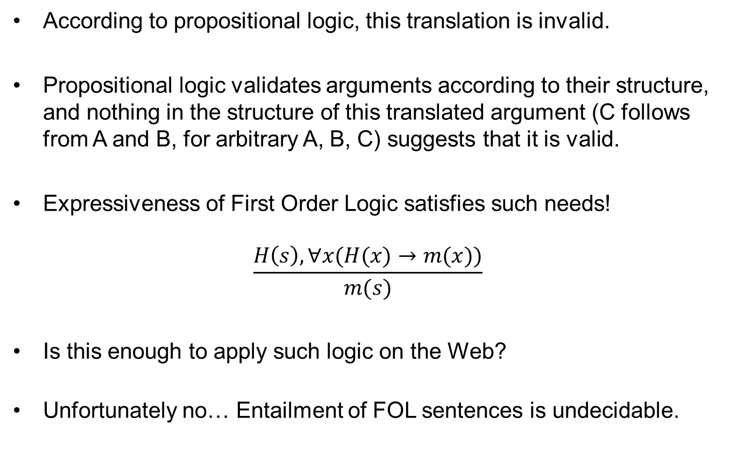
First Order Logic in Short
According to propositional logic, this translation is invalid.
Propositional logic validates arguments according to their structure, and nothing in the structure of this translated argument (C follows from A and B, for arbitrary A, B, C) suggests that it is valid.
Expressiveness of First Order Logic satisfies such needs!
$$\frac{H\left(s\right),∀x(H(x)→m(x))}{m(s)}$$
Is this enough to apply such logic on the Web?
Unfortunately no… Entailment of FOL sentences is undecidable.

Slide 16
Why cannot we use FOL in the SW?
FOL is undecidable
Reasoning is hard, e.g., Model Checking is PSPACE-complete
Can we maintain some of the advantages of FOL and achieve decidability, without stepping back to propositional logic limitations?
There are many logic families originated from FOL trying to deal with such problems

Slide 17
Horn Logic 1/3
Simpler knowledge representation
  “if ... then ...” rules
Efficient reasoning algorithms, e.g.
  Forward chaining
  Backward chaining
  SLDNF resolution
Basis for Logic Programming and Deductive Databases

Slide 18
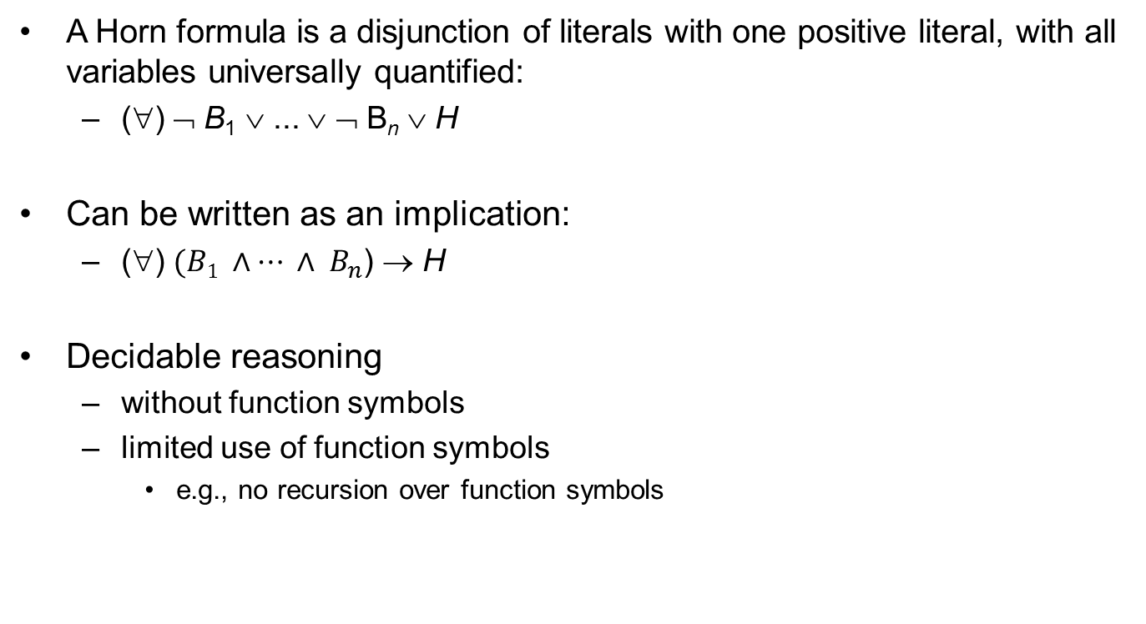
Horn Logic 2/3
A Horn formula is a disjunction of literals with one positive literal, with all variables universally quantified:
  (∀) ¬ B₁ ∨ ... ∨ ¬ B_{n} ∨ H
Can be written as an implication:
  (∀) $(B1 ∧… ∧ B_{n}$) → H
Decidable reasoning
  without function symbols
  limited use of function symbols
    e.g., no recursion over function symbols

Slide 19
Horn Logic 3/3: Algorithms
Forward chaining: An inference engine using forward chaining searches the inference rules until it finds one where the antecedent (If clause) is known to be true. When found it can conclude, or infer, the consequent (Then clause), resulting in the addition of new information to its data.
Backward chaining: An inference engine using backward chaining would search the inference rules until it finds one which has a consequent (Then clause) that matches a desired goal. If the antecedent (If clause) of that rule is not known to be true, then it is added to the list of goals (in order for your goal to be confirmed you must also provide data that confirms this new rule).
Selective Linear Definite clause resolution is the basic inference rule used in logic programming. SLDNF is an extension to deal with negation as failure.

Slide 20
Description Logics 1/2
A family of logic based Knowledge Representation formalisms
  Descendants of semantic networks and KL-ONE
  Describe domain in terms of concepts (classes), roles (properties, relationships) and individuals
Distinguished by:
  Formal semantics (typically model theoretic)
    Decidable fragments of FOL (often contained in C₂)
    Closely related to Propositional Modal & Dynamic Logics
    Closely related to Guarded Fragment
  Provision of inference services
    Decision procedures for key problems (satisfiability, subsumption, etc)
    Implemented systems (highly optimized)
Notes:
A Semantic network is a network, which represents semantic relations between the concepts.
KL-ONE is a well known knowledge representation system in the tradition of semantic networks and frames; that is, it is a frame language. The system is an attempt to overcome semantic indistinctness in semantic network representations and to explicitly represent conceptual information as a structured inheritance network.
C₂ a fragment of FOL where predicates have 2 variables

Slide 21
Description Logics 2/2
Formalization for frame-based knowledge representation
Frame = all information about a class
  Superclasses
  Property restrictions
Description Logic Knowledge Base
  Terminological Box (TBox)
    Class definitions
  Assertional Box (ABox)
    Concrete (instance) data

Slide 22
TECHNICAL SOLUTION

Slide 23
PRINCIPLES
A rule interchange format to suit all the needs!

Slide 24
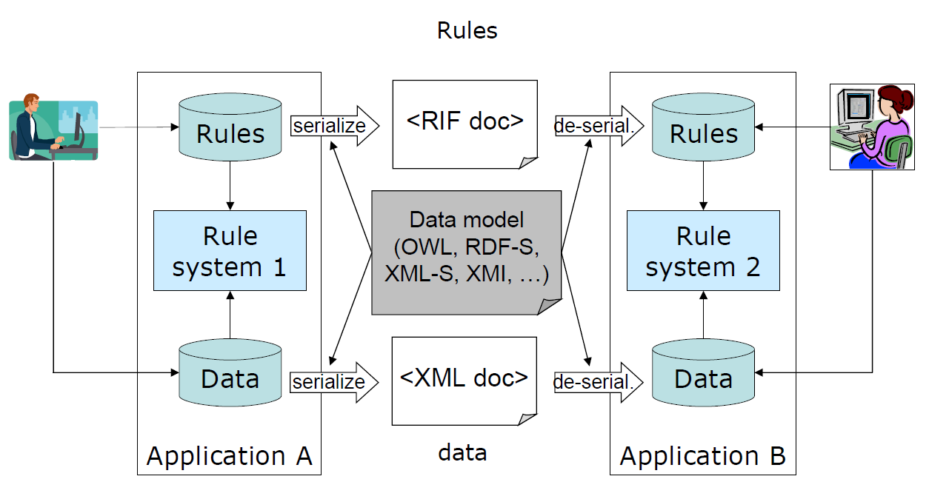
What is the Rule Interchange Format (RIF)?

Slide 25
An ideal world of rule exchange
Rule system #1
Rule system #8
Rule system #2
Universal RULE exchange format and language
Rule system #7
Rule system #3
Rule system #6
Rule system #4
Rule system #5

Slide 26
A partial interchange
Rule system #1
Rule system #4
“Core”
Rule system #2
Rule system #3

Slide 27
RIF Dialects
Dialect #1
“Core”
Dialect #3
Dialect #2
Dialect #3

Slide 28
The role of dialects
Dialect #1
“Core”
Dialect #3
Dialect #2
Dialect #3

Slide 29
The role of dialects
Rule system #1
Rule system #2
Rule system #9
Rule system #3
Dialect #1
Rule system #8
“Core”
Dialect #3
Dialect #2
Dialect #3
Rule system #10
Rule system #4
Rule system #7
Rule system #6
Rule system #5

Slide 30
The role of dialects
Rule system #1
Rule system #2
Rule system #9
Dialect #1
Rule system #3
Rule system #8
“Core”
Dialect #3
Dialect #2
Rule system #4
Dialect #3
Rule system #10
Rule system #7
Rule system #6
Rule system #5

Slide 31
The role of dialects
Rule system #1
Rule system #2
Rule system #9
Dialect #1
Rule system #3
Rule system #8
“Core”
Dialect #3
Dialect #2
Rule system #4
Dialect #3
Rule system #10
Rule system #7
Rule system #6
Rule system #5

Slide 32
The role of dialects
Rule system #1
Rule system #2
Rule system #9
Dialect #1
Rule system #3
Rule system #8
“Core”
Dialect #3
Dialect #2
Rule system #4
Dialect #3
Rule system #10
Rule system #7
Rule system #6
Rule system #5

Slide 33
However…
Even this model does not completely work
The gap between production rules and “traditional” logic systems is too large
A hierarchy of cores is necessary:
  a Basic Logic Dialect and Production Rule Dialect as “cores” for families of languages
  the common RIF Core binding these two

Slide 34
Schematically…
The “BLD (Basic Logic Dialect)” is of the form:
  “if condition true then this is true”
  conditions may include functions, hierarchies
The “PLD (Production Logic Dialect)” is of the form:
  “if condition is true then do something”
The “Core”: shared subset of major language

Slide 35
The role of dialects
Rule system #1
Rule system #2
RIF Core
RIF BLD
RIF PLD
Rule system #9
Rule system #3
Rule system #8
Rule system #10
Rule system #5
Rule system #4
Rule system #7
Rule system #6

Slide 36
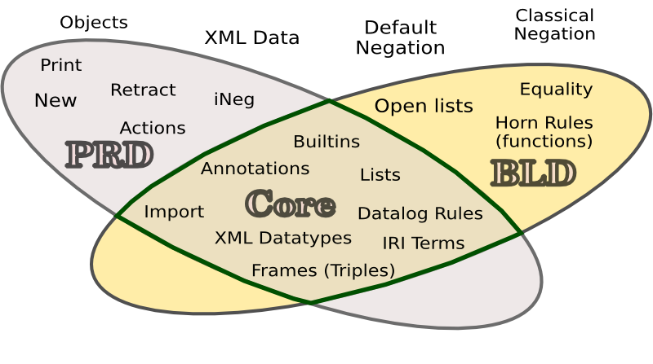
A rough division of features
Courtesy of Sandro Hawke, W3C

Slide 37
Rule Interchange Format Goals
Exchange of Rules
  The primary goal of RIF is to facilitate the exchange of rules
Consistency with W3C specifications
  A W3C specification that builds on and develops the existing range of specifications that have been developed by the W3C
  Existing W3C technologies should fit well with RIF
Wide scale Adoption
  Rules interchange becomes more effective the wider is their adoption ("network effect“)

Slide 38
RIF Requirements 1
Compliance model
  Clear conformance criteria, defining what is a conformant to RIF
Different semantics
  RIF must cover rule languages having different semantics
Limited number of dialects
  RIF must have a standard core and a limited number of standard dialects based upon that core
OWL data
  RIF must cover OWL knowledge bases as data where compatible with RIF semantics
[http://www.w3.org/TR/rif-ucr/]

Slide 39
RIF Requirements 2
RDF data
  RIF must cover RDF triples as data whenever compatible with RIF semantics
Dialect identification
  The semantics of a RIF document must be uniquely determined by the content of the document, without out-of-band data
XML syntax
  RIF must have an XML syntax as its primary normative syntax
Merge rule sets
  RIF must support the ability to merge rule sets
Identify rule sets
  RIF must support the identification of rule sets
[http://www.w3.org/TR/rif-ucr/]

Slide 40
Basic Principle: a Modular Architecture
RIF wants to cover: rules in logic dialects and rules used by production rule systems (e.g. active databases)
Logic rules only add knowledge
Production rules change the facts!
Logic rules + Production Rules?
  Define a logic-based core and a separate production-rule core
  If there is an intersection, define the common core

Slide 41
RIF Architecture
“Modules” can be added to cover new needs!
Extended syntax and semantics for logic rules
RIF-FLD
extends
RIF-PRD
Basic syntax and semantics for logic rules
Syntax and semantics for production rules
RIF-BLD
extends
extends
Data types
RIF-DTB
RIF-Core
RIF-RDF/OWL
uses
uses
RIF-XML data
Compatibility and Import of data
Minimum common Intersection (syntax)
uses

Slide 42
DIALECTS
Introduction to RIF Dialects

Slide 43
RIF Dialects
RIF Core
  Subset of both RIF BLD and RIF PRD
  Rather inexpressive by itself
  Enables limited rule exchange between logic rule dialects and production rules
RIF BLD
  Lies within the intersection of first-order and logic-programming systems
  Covers many existing rule systems, but insufficient for many applications
RIF FLD
  General logical extensibility framework
  Aims to reduce efforts required to define and verify new logical dialects
RIF PRD
  Tries to capture main aspects of various production rule systems, addressing industrial interests from major players such as IBM and Oracle
Other common specifications
  RIF DTB – Defines data types and builtins supported by RIF
  RIF OWL/RDF compatibility – Defines how OWL & RDF can be used within RIF
  RIF XML data - Defines how XML can be used within RIF

Slide 44
RIF Core
The Core dialect of the Rule Interchange Format
A subset of RIF-BLD and of RIF-PRD
  a well-formed RIF-Core formula (including document and condition formulas) is also a well-formed RIF-BLD formula
  a RIF-PRD consumer can treat a RIF-Core document as if it was a RIF-PRD rule set while it also conforms to the normative RIF-Core first order semantics
  due to the presence of builtin functions and predicates there are rule sets in the syntactic intersection of RIF-PRD and RIF-BLD which would not terminate under RIF-PRD semantics
  not the maximal common subset of RIF-BLD and RIF-PRD
Based on built-in functions and predicates over selected XML Schema datatypes, as specified in RIF-DTB

Slide 45
RIF Core
Datalog extensions to support
  objects and frames as in F-logic
  internationalized resource identifiers (or IRIs) as identifiers for concepts
  XML Schema datatypes
  RIF RDF and OWL Compatibility defines the syntax and semantics of integrated RIF-Core/RDF and RIF-Core/OWL languages
A Web-aware language
  Designed to enable interoperability among rule languages in general, and its uses are not limited to the Web

Slide 46
RIF Core Example
Document(
Prefix(cpt http://example.com/concepts#)
Prefix(ppl http://example.com/people#)
Prefix(bks http://example.com/books#)
Group
(
Forall ?Buyer ?Item ?Seller (
cpt:buy(?Buyer ?Item ?Seller):- cpt:sell(?Seller ?Item ?Buyer)
)
cpt:sell(ppl:John bks:LeRif ppl:Mary)
)
)
This infers the following relationship:
cpt:buy(ppl:Mary bks:LeRif ppl:John)

Slide 47
RIF BLD
The Basic Logic Dialect of the Rule Interchange Format
Corresponds to the language of definite Horn rules with equality and a standard first-order semantics
Has a number of extensions to support
  objects and frames as in F-logic
  internationalized resource identifiers (or IRIs) as identifiers for concepts
  XML Schema datatypes
  RIF RDF and OWL Compatibility defines the syntax and semantics of integrated RIF-Core/RDF and RIF-Core/OWL languages
RIF-BLD designed to be a simple dialect with limited expressiveness that lies within the intersection of first-order and logic-programming systems
  RIF-BLD does not support negation

Slide 48
RIF FLD
The RIF Framework for Logic Dialects
A formalism for specifying all logic dialects of RIF
  RIF BLD, RIF Core (albeit not RIF-PRD, as it is not a logic-based RIF dialect)
Syntax and semantics described mechanisms that are commonly used for various logic languages (but rarely brought all together)
  Required because the framework must be broad enough to accommodate several different types of logic languages and because various advanced mechanisms are needed to facilitate translation into a common framework
The requirements of future dialects might stimulate further evolution of RIF-FLD

Slide 49
RIF PRD
The RIF Production Rule Dialect
A formalism for specifying production rules
  FOR <variables> WITH <binding patterns>, IF <condition> THEN <actions>
  FORALL Var* (IF patterns AND condition THEN action)
  With an operational semantics as a labelled transition system
Patterns and conditions
  BLD condition language minus logic functions plus negation
  With a model-theoretic semantics (compatible with BLD)
Assert, Retract, New
  Assign, Remove, Execute
  Defining a transition relation
Datalog extensions to support
  objects and frames as in F-logic
  internationalized resource identifiers (or IRIs) as identifiers for concepts
  XML Schema datatypes
  RIF RDF and OWL Compatibility defines the syntax and semantics of integrated RIF-Core/RDF and RIF-Core/OWL languages

Slide 50
RIF PRD Example
A customer becomes a "Gold" customer when his cumulative purchases during the current year reach $5000
Prefix(ex <http://example.com/2008/prd1#>)
Forall ?customer ?purchasesYTD (
If And( ?customer#ex:Customer
?customer[ex:purchasesYTD->?purchasesYTD] External(pred:numeric-greater-than(?purchasesYTD 5000))
)
Then Do( Modify(?customer[ex:status->"Gold"]))
)

Slide 51
SYNTAX

Slide 52
Syntactic Framework
Defines the mechanisms for specifying the formal presentation syntax of RIF logic dialects
Presentation syntax is used in RIF to define the semantics of the dialects and to illustrate the main ideas with examples
Syntax is not intended to be a concrete syntax for the dialects
  the delimiters of the various syntactic components, parentheses, precedence of operators, … are left out
Uses XML as its concrete syntax

Slide 53
BLD Alphabet
A countably infinite set of constant symbols Const
A countably infinite set of variable symbols Var (disjoint from Const)
A countably infinite set of argument names, ArgNames
  disjoint from Const and Var
  ArgNames is not supported in RIF-Core
Connective symbols And, Or, and :-
Quantifiers Exists and Forall
The symbols =, #, ##, ->, External, Import, Prefix, and Base
  ##, the subclass symbol is not supported in RIF-Core
The symbols Group and Document
The symbols for representing lists: List and OpenList
The auxiliary symbols (, ), [, ], <, >, and ^^

Slide 54
BLD Terms I
Base terms: simple, positional or terms of form External(t)
Constants and variables
  If t ∈ Const or t ∈ Var then t is a simple term
Positional terms
  If t ∈ Const and t₁, ..., t_{n}, n≥0, are base terms then t(t₁ ... t_{n}) is a positional term
Terms with named arguments
  A term with named arguments is of the form t(s₁->v₁ ... s_{n}->v_{n}), where n≥0, t ∈ Const and v₁, ..., v_{n} are base terms and s₁, ..., s_{n} are pairwise distinct symbols from the set ArgNames
  Not valid in RIF-Core
List terms
  There are two kinds of list terms: open and closed
  A closed list has the form List(t₁ ... t_{m}), where m≥0 and t₁, ..., t_{m} are terms
  An open list (or a list with a tail) has the form OpenList(t₁ ... t_{m} t), where m>0 and t₁, ..., t_{m}, t are terms
  In RIF-Core there are only closed ground lists. A closed ground list is a closed list where t₁, ..., t_{m} are ground terms (no tail and no variables are allowed)

Slide 55
BLD Terms II
Equality terms
  t = s is an equality term, if t and s are base terms
Class membership terms (or just membership terms)
  t#s is a membership term if t and s are base terms
Subclass terms
  t##s is a subclass term if t and s are base terms
  Not valid in RIF-Core
Frame terms
  t[p₁->v₁ ... p_{n}->v_{n}] is a frame term (or simply a frame) if t, p₁, ..., p_{n}, v₁, ..., v_{n}, n ≥ 0, are base terms
Externally defined terms
  If t is a positional or a named-argument term then External(t) is an externally defined term

Slide 56
BLD Terms Example I
Positional term
  "http://example.com/ex1"^^rif:iri(1 "http://example.com/ex2"^^rif:iri(?X 5) "abc")
Term with named arguments
  "http://example.com/Person"^^rif:iri(id->"http://example.com/John"^^rif:iri "age"^^rif:local->?X "spouse"^^rif:local->?Y)
Frame term
  "http://example.com/John"^^rif:iri["age"^^rif:local->?X "spouse"^^rif:local->?Y]
Empty list
  List()
Closed list with variable inside
  List("a"^^xs:string ?Y "c"^^xs:string)

Slide 57
BLD Terms Example II
Open list with variables
  List("a"^^xs:string ?Y "c"^^xs:string | ?Z)
Equality term with lists inside
  List(Head | Tail) = List("a"^^xs:string ?Y "c"^^xs:string)
Nested list
  List("a"^^xs:string List(?X "b"^^xs:string) "c"^^xs:string)
Membership
  ?X # ?Y
Subclass
  ?X ## "http://example.com/ex1"^^rif:iri(?Y)

Slide 58
FLD Alphabet (as extension of BLD Alphabet)
Connective symbols, which includes Naf, Neg, and NEWCONNECTIVE
  NEWCONNECTIVE is a RIF-FLD extension point
A countably infinite set of quantifiers including the extension point, NEWQUANTIFIER
The symbols Dialect, Import, and Module
A countable set of aggregate symbols
  RIF-FLD reserves the following symbols for standard aggregate functions: Min, Max, Count, Avg, Sum, Prod, Set, and Bag (and NEWAGGRFUNC)
Auxiliary symbols {, }, |, ?, @, and an extension point NEWSYMBOL

Slide 59
FLD Terms (as extension of BLD Alphabet)
Formula term
  If S is a connective or a quantifier symbol and t₁, ..., t_{n} are terms then S(t₁ ... t_{n}) is a formula term
Aggregate term
  An aggregate term has the form sym _{?V[?X1 ... ?Xn]}(τ), where sym _{?V[?X1 ... ?Xn]} is an aggregate symbol, n≥0, and τ is a term
Remote term reference
  A remote term reference (also called remote term) is a term of the form φ@r where φ is a term; r can be a constant, variable, a positional, or a named-argument term. Remote terms are used to query remote RIF documents, called remote modules
NEWTERM
  This is not a specific kind of term, but an extension point.

Slide 60
FLD Terms Example
Formula terms
  :-("p"^^rif:local(?X) ?X("q"^^xs:string)) (usually written as "p"^^rif:local(?X) :- ?X("q"^^xs:string))
  Forall_{?X,?Y}(Exists_{?Z}("p"^^rif:local(?X ?Y ?Z))) (usually written as Forall ?X ?Y (Exists ?Z ("p"^^rif:local(?X ?Y ?Z)))
  Or("http://example.com/to-be"^^rif:iri(?X) Neg("http://example.com/to-be"^^rif:iri(?X)))
Aggregate term
  avg{?Sal [?Dept]|Exists ?Empl "http://example.com/salary"^^rif:local(?Empl ?Dept ?Sal)}
Remote term
  ?O[?N -> "John"^^rif:string "http://example.com/salary"^^rif:iri -> ?S]@"http://acme.foo"^^xs:anyURI

Slide 61
PRD Alphabet
A countably infinite set of constant symbols Const,
A countably infinite set of variable symbols Var (disjoint from Const),
Syntactic constructs to denote:
  lists,
  function calls,
  relations, including equality, class membership and subclass relations
  conjunction, disjunction and negation,
  and existential conditions.

Slide 62
PRD Terms
Constants and variables
  If t ∈ Const or t ∈ Var then t is a simple term
List terms
  A list has the form List(t₁ ... t_{m}), where m≥0 and t₁, ..., t_{m} are ground terms, i.e. without variables. A list of the form List() (i.e., a list in which m=0) is called the empty list
Positional terms
  If t ∈ Const and t₁, ..., t_{n}, n≥0, are base terms then t(t₁ ... t_{n}) is a positional term

Slide 63
PRD Terms I (Atomic Formulas)
Positional atomic formulas
  If t ∈ Const and t₁, ..., t_{n}, n≥0, are terms then t(t₁ ... t_{n}) is a positional atomic formula (or simply an atom)
Equality atomic formulas
  t = s is an equality atomic formula (or simply an equality), if t and s are terms
Class membership atomic formulas
  t#s is a membership atomic formula (or simply membership) if t and s are terms. The term t is the object and the term s is the class

Slide 64
PRD Terms II (Atomic Formulas)
Subclass atomic formulas
  t##s is a subclass atomic formula (or simply a subclass) if t and s are terms
Frame atomic formulas
  t[p₁->v₁ ... p_{n}->v_{n}] is a frame atomic formula (or simply a frame) if t, p₁, ..., p_{n}, v₁, ..., v_{n}, n ≥ 0, are terms
Externally defined atomic formulas
  If t is a positional atomic formula then External(t) is an externally defined atomic formula.

Slide 65
PRD Terms II (Atomic Formulas)
Subclass atomic formulas
  t##s is a subclass atomic formula (or simply a subclass) if t and s are terms
Frame atomic formulas
  t[p₁->v₁ ... p_{n}->v_{n}] is a frame atomic formula (or simply a frame) if t, p₁, ..., p_{n}, v₁, ..., v_{n}, n ≥ 0, are terms
Externally defined atomic formulas
  If t is a positional atomic formula then External(t) is an externally defined atomic formula.

Slide 66
PRD Terms III (Condition Formulas)
Atomic formula
  If φ is an atomic formula then it is also a condition formula
Conjunction
  If φ₁, ..., φ_{n}, n ≥ 0, are condition formulas then so is And(φ₁ ... φ_{n}), called a conjunctive formula
  As a special case, And() is allowed and is treated as a tautology, i.e., a formula that is always true
Disjunction
  If φ₁, ..., φ_{n}, n ≥ 0, are condition formulas then so is Or(φ₁ ... φ_{n}), called a disjunctive formula
  As a special case, Or() is permitted and is treated as a contradiction, i.e., a formula that is always false

Slide 67
PRD Terms IV (Condition Formulas)
Negation
  If φ is a condition formula, then so is Not(φ), called a negative formula
Existentials
  If φ is a condition formula and ?V₁, ..., ?V_{n}, n>0, are variables then Exists ?V₁ ... ?V_{n}(φ) is an existential formula

Slide 68
PRD Terms V (Atomic Actions)
Assert
  If φ is a positional atom, a frame or a membership atomic formula in the RIF-PRD condition language, then Assert(φ) is an atomic action. φ is called the target of the action
Retract
  If φ is a positional atom or a frame in the RIF-PRD condition language, then Retract(φ) is an atomic action
Retract object
  If t is a term in the RIF-PRD condition language, then Retract(t) is an atomic action
Modify
  if φ is a frame in the RIF-PRD condition language, then Modify(φ) is an atomic action
Execute
  if φ is a positional atom in the RIF-PRD condition language, then Execute(φ) is an atomic action

Slide 69
PRD Terms VI (Atomic Blocks)
Action variable declaration
  An action variable declaration is a pair, (v p) made of an action variable, v, and an action variable binding (or, simply, binding), p, where p has one of two forms: frame object declaration and frame slot value
  frame object declaration: if the action variable, v, is to be assigned the identifier of a new frame, then the action variable binding is a frame object declaration: New()
  frame slot value: if the action variable, v, is to be assigned the value of a slot of a ground frame, then the action variable binding is a frame: p = o[s->v], where o is a term that represents the identifier of the ground frame and s is a term that represents the name of the slot
Action block
  If (v₁ p₁), ..., (v_{n} p_{n}), n ≥ 0, are action variable declarations, and if a₁, ..., a_{m}, m ≥ 1, are atomic actions, then Do((v₁ p₁) ... (v_{n} p_{n}) a₁ ... a_{m}) denotes an action block

Slide 70
XML Serialization Framework
Defines
  a normative mapping from the RIF-FLD presentation syntax to XML
  and a normative XML Schema for the XML syntax
Any conformant XML document for a logic RIF dialect must also be a conformant XML document for RIF-FLD
  i.e. each mapping for a logic RIF dialect must be a restriction of the corresponding mapping for RIF-FLD
  e.g. the mapping from the presentation syntax of RIF-BLD to XML in RIF-BLD is a restriction of the presentation-syntax-to-XML mapping for RIF-FLD

Slide 71
XML Syntax
And (Exists ?Buyer (cpt:purchase(?Buyer ?Seller
cpt:book(?Author bks:LeRif)
curr:USD(49)))
?Seller=?Author )
<And><formula><Exists><declare><Var>Buyer</Var></declare>
<formula><Atom><op><Const type="&rif;iri">&cpt;purchase</Const></op>
<args ordered="yes"><Var>Buyer</Var> <Var>Seller</Var>
<Expr><op><Const type="&rif;iri">&cpt;book</Const></op>
<args ordered="yes">
<Var>Author</Var>
<Const type="&rif;iri">&bks;LeRif</Const></args>
</Expr>
<Expr><op><Const type="&rif;iri">&curr;USD</Const></op>
<args ordered="yes">
<Const type="&xsd;integer">49</Const></args>
</Expr>
</args>
</Atom></formula>
</Exists></formula>
<formula><Equal>
<side><Var>Seller</Var></side>
<side><Var>Author</Var></side>
</Equal></formula>
</And>

Slide 72
SEMANTICS

Slide 73
RIF Dialects and Semantics
Semantics of a dialect is derived from these notions by specializing:
The effect of the syntax
Truth values
Data types
Logical entailment

Slide 74
BLD Semantics
The effect of the syntax
  RIF-BLD does not support negation
Truth values
  The set TV of truth values in RIF-BLD consists of just two values, t and f such that f <_{t} t. Clearly, <_{t} is a total order here.
Data types
  xsd:long
  xsd:integer
  xsd:decimal
  xsd:string
  xsd:time
  xsd:dateTime
  rdf:XMLLiteral
  rif:text

Slide 75
BLD Semantics
Logical entailment in RIF is defined with respect to an unspecified set of intended semantic structures and that dialects of RIF must make this notion concrete. For RIF-BLD, this set is defined in one of the two following equivalent ways:
    as a set of all models
    as the unique minimal model
These two definitions are equivalent for entailment of RIF-BLD conditions by RIF-BLD rulesets, since all rules in RIF-BLD are Horn

Slide 76
BLD Semantic Structures
A semantic structure, I, is a tuple of the form:
<TV, DTS, D, I_{C}, I_{V}, I_{F}, I_{frame}, I_{SF}, I_{sub}, I_{isa}, I₌, I_{Truth}>
  D is a non-empty set of elements called the domain of I
  TV denotes the set of truth values that the semantic structure uses
  DTS is the set of primitive data types used in I
  I_{C} maps constants to elements of D
  I_{V} maps variables to elements of D_{ind}.
  I_{F} maps D to functions D* → D (here D* is a set of all sequences of any finite length over the domain D)
  I_{SF} interprets terms with named arguments
  I_{frame} is a total mapping from D to total functions of the form SetOfFiniteBags(D × D) → D
  I_{sub} gives meaning to the subclass relationship. It is a total function D × D → D
  I_{isa} gives meaning to class membership. It is a total function D × D → D
  I₌ gives meaning to the equality. It is a total function D × D → D
  I_{Truth} is a total mapping D → TV
  It is used to define truth valuation of formulas

Slide 77
BLD Interpretation of Formulas I
Truth valuation for well-formed formulas in RIF-BLD is determined using the following function, denoted TVal_{I}
Positional atomic formulas: TVal_{I}(r(t₁ ... t_{n})) = I_{Truth}(I(r(t₁ ... t_{n})))
Atomic formulas with named arguments: TVal_{I}(p(s₁->v₁ ... s_{k}->v_{k})) = I_{Truth}(I(p(s₁-> v₁ ... s_{k}->v_{k})))
Equality: TVal_{I}(x = y) = I_{Truth}(I(x = y)).
Subclass: TVal_{I}(sc ## cl) = I_{Truth}(I(sc ## cl))
Membership: TVal_{I}(o # cl) = I_{Truth}(I(o # cl))
Frame: TVal_{I}(o[a₁->v₁ ... a_{k}->v_{k}]) = I_{Truth}(I(o[a₁->v₁ ... a_{k}->v_{k}])).

Slide 78
BLD Interpretation of Formulas II
Conjunction: TVal_{I}(And(c₁ ... c_{n})) = min_{t}(TVal_{I}(c₁), ..., TVal_{I}(c_{n})).
Disjunction: TVal_{I}(Or(c₁ ... c_{n})) = max_{t}(TVal_{I}(c₁), ..., TVal_{I}(c_{n})).
Quantification: TVal_{I}(Exists ?v₁ ... ?v_{n} (φ)) = max_{t}(TVal_{I*}(φ)) and TVal_{I}(Forall ?v₁ ... ?v_{n} (φ)) = min_{t}(TVal_{I*}(φ)).
Rules: TVal_{I}(conclusion :- condition) = t, if TVal_{I}(conclusion) ≥_{t} TVal_{I}(condition); TVal_{I}(conclusion :- condition) = f otherwise.
A model of a set Ψ of formulas is a semantic structure I such that TVal_{I}(φ) = t for every φ∈Ψ. In this case, we write I |= Ψ.

Slide 79
BLD Logical Entailment
Let R be a set of RIF-BLD rules and φ an existentially closed RIF-BLD condition formula.
We say that R entails φ, written as R |= φ, if and only if
  For every semantic structure I of R:
  If I |= R, then I |= φ.

Slide 80
PRD semantics
Patterns and conditions have a model-theoretic semantics (compatible with BLD)
Groups of production rules have an operational semantics as a labelled transition system
Actions define the transition relation
Metadata has no semantics

Slide 81
PRD: Condition satisfaction and matching substitution
A set of ground formulas Φ = {φ1, ..., φm}, m ≥ 1 satisfies a condition formula ψ iff
  Φ |= (Exists ?v0 ... ?vn (ψ)), where {?v0, ..., ?vn}, n ≥ 0 = Var(ψ)
Let ψ be a condition formula; let σ be a ground substitution for the free variables of ψ, that is, such that: Var(ψ) ⊆ Dom(σ); and let Φ be a set of ground formulas that satisfies ψ. We say that σ is matching ψ to Φ (or simply, matching, when there is no ambiguity with respect to ψ nor Φ) if an only if, for every semantic structure I that is a model of all the ground formulas φi in Φ, there is at least one semantic structure I*, such that:
  I* is a model of ψ: I* |= ψ;
  I* is exactly like I, except that a mapping I*V is used instead of IV, such that I*V is defined to coincide with IV on all variables except, possibly, on the variables ?v0 ... ?vn that are free in ψ, that is, such that: Var(ψ) = {?v0 ... ?vn};
  I*V(?xi) = IC(σ(?xi)), for all ?xi in Var(ψ).

Slide 82
PRD: Operational semantics
actions
→RIF-PRD : w → w’
  w → w’: w' |= φ if and only if And(w, f) |= φ
→RS : w → w’
  actions = extractACTIONS(PICK(instances(w), strategy))
  (w, actions, w’) in →*RIF-PRD
  instance(w') = {(r σ) | r ∈ RS and σ is matching w}
  w ∉ TRS
Halts iff FINAL(c, RS)
  FINAL(w, RS) if PICK(w, strategy) = {}
Assert(f)
action

Slide 83
Core Semantics
Model theoretic semantics of RIF BLD restricted to Core syntax
  Essentially datalog
  No subclass, no logic functions, no name argument
  Only atoms and frames in the head
Operational semantics of RIF PRD, restricted to Core syntax
  No negation
  Pattern2Condition equivalence
  Only Asserts in RHS: Do2And equivalence

Slide 84
ILLUSTRATION BY AN EXAMPLE
An example of usage of RIF

Slide 85
Collaborative Policy Development for Dynamic Spectrum Access
Recent technological and regulatory trends are converging toward a more flexible architecture in which reconfigurable devices may operate legally in various regulatory and service environments
Suppose the policy states:
  A wireless device can transmit on a 5 GHz band if no priority user is currently using that band
Suppose devices with different rules:
  If no energy is detected on a desired band then assume no other device is using the band
  If a control channel communicates that a signal is detected on a particular device, then the device is being used

Slide 86
RIF-BLD Example Device Rule 1
  If no energy is detected on a desired band then assume no other device is using the band
Document(
Prefix(pred http://www.w3.org/2007/rif-builtin-predicate#)
Prefix(func http://www.w3.org/2007/rif-builtin-function#)
Prefix(ex <http://example.com/2009/ucr4.2.3#>)
Group(
Forall ?device ?band? ?user
If And (ex:detectenergyonband(?user ?band)
?band[energylevel-> ?level]
External(pred:numeric-greater-than(?level 0)))
Then Do (Assert (ex:useband(?user ?band)))
)
)

Slide 87
RIF-BLD Example Device Rule 2
  If a control channel communicates that a signal is detected on a particular device, then the device is being used
Document(
Prefix(pred http://www.w3.org/2007/rif-builtin-predicate#)
Prefix(func http://www.w3.org/2007/rif-builtin-function#)
Prefix(ex <http://example.com/2009/ucr4.2.3#>)
Group(
Forall ?device ?band ?user ?controlchannel
If And (ex:iscontrolchannel(controlchannel)
ex:communicatesignal(?controlchannel ?user
?device ?band))
Then Do (Assert (ex:useband(?user ?band)))
)
)

Slide 88
Why RIF is Perfect in This Example?
Each type of device will need to employ different "interpretations" or "operational definitions" of the policy in question.
Suppose
  10 manufacturers of these 2 different types of wireless devices
  Each of these manufacturers uses a distinct rule-based platform
  Each manufacturer needs to write 2 interpretations of the policy (for each of the two types of device).
That means that 20 different versions of the policy must be written, tested and maintained.
This can be automated adopting RIF as interchange format and automating the translation process

Slide 89
EXTENSIONS

Slide 90
Current Ongoing Works
RIF is still under development
Other dialects are foreseen
  A logic programming dialect that supports well-founded and
  stable-model negation
  A dialect that supports higher-order extensions
  A dialect that extends RIF-BLD with full F-logic support
More powerful extensions
  Aggregation operators
  Uncertain, fuzzy, and probabilistic data
  Defeasible reasoning and argumentation

Slide 91
Vocabularies and SPARQL
Question: how do SPARQL queries and vocabularies work together?
  RDFS, OWL, and RIF produce new relationships
  on what data do we query?
Answer: in SPARQL 1.0, that is not defined ☹
But, in SPARQL 1.1 it is…☺

Slide 92
SPARQL 1.1 and RDFS/OWL/RIF
RDF Data
RDFS/OWL/RIF data
entailment
SPARQL Pattern
RDF Data with extra triples
SPARQL Pattern
Query result
pattern matching

Slide 93
SPARQL 1.1 as a unifying point
Application
SPARQL Endpoint
SPARQL Endpoint
SPARQL Construct
SPARQL Construct
Triple store
SPARQL Update
SPARQL Processor
SPARQL
Update
Database
Inferencing
NLP Techniques
GRDDL, RDFa
RDFa
SQL⬄RDF
Relational
Database
RDF Graph
Unstructured Text
XML/XHTML
Inferencing
HTML

Slide 94
SUMMARY

Slide 95
Summary
RIF is an interchange rule format
  Enables exchange of rules across different formalisms
RIF is based on different dialects
  FLD (used to define more and future dialects)
  BLD
  PRD
  Core
RIF is OWL and RDF compatible

Slide 96
References
Mandatory reading:
  RIF Web site:
    http://www.w3.org/2005/rules/wiki/RIF_Working_Group
Further reading:
  CORE
    http://www.w3.org/TR/rif-core/
  BLD
    http://www.w3.org/TR/rif-bld/
  FLD
    http://www.w3.org/TR/rif-fld/
  Production rules:
    http://www.w3.org/TR/rif-prd/

Slide 97
References
Wikipedia links:
  http://en.wikipedia.org/wiki/Rule_Interchange_Format
  http://en.wikipedia.org/wiki/Production_rule
  http://en.wikipedia.org/wiki/Production_system
  http://en.wikipedia.org/wiki/Horn_logic
  http://en.wikipedia.org/wiki/Datalog

Slide 98

Questions?
98
Notes:
98

Slide 99

What have we achieved?

Slide 100

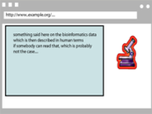


Recall the integration example from intro
Applications
Manipulate
Query
…
Data represented in abstract format
Map,
Expose,
…

Slide 101
The same with what we have learned
Applications
RESTful API
SPARQL,
Inferences
…
Data represented in RDF with extra knowledge (RDFS, SKOS, RIF, OWL,…)
R2RML,
RDFa,
GRDDL
…

Slide 102

Recall the integration example from intro
Web of Data Applications
Stand Alone Applications
Browser Applications
Query and Update
Common “Graph” Format &
Common Vocabularies
Inferencing
“Bridges”
Data on the Web

Slide 103
Same with what we have learned
Semantic Web Applications
Stand Alone Applications
Browser Applications
SPARQL, RESTful API-s
RDF Graph with vocabularies in RDFS, SKOS, OWL, RIF, …
Inferencing
RDFa, μData,
R2RML, GRDDL …
Data on the Web

