Slide 1
COMPSCI 732
Semantic Web Technologies
Web Ontology Language (OWL)

Slide 2
Where are we?
# | Title
1 | Introduction
2 | Semantic Web Architecture
3 | Resource Description Framework (RDF)
4 | Web of Data
5 | Generating Semantic Annotations
6 | Storage and Querying
7 | Web Ontology Language (OWL)
8 | Rule Interchange Format (RIF)

Slide 3
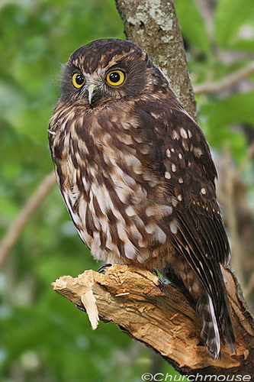
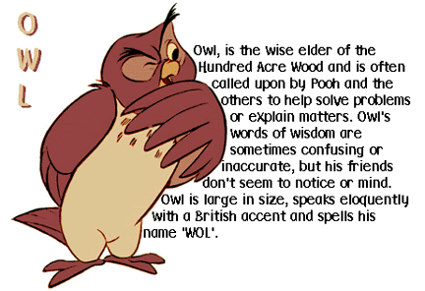
Agenda
Introduction and motivation
Technical solution
  Design principles
  Dialects
  OWL Lite
  OWL DL
  OWL Full
  Syntaxes
  Tools
Illustration by a large example
Extensions
Summary
References
Notes:
First, why RDF is not enough and we need other representation formalism?
This formalism is OWL an extension of RDFS

Slide 4
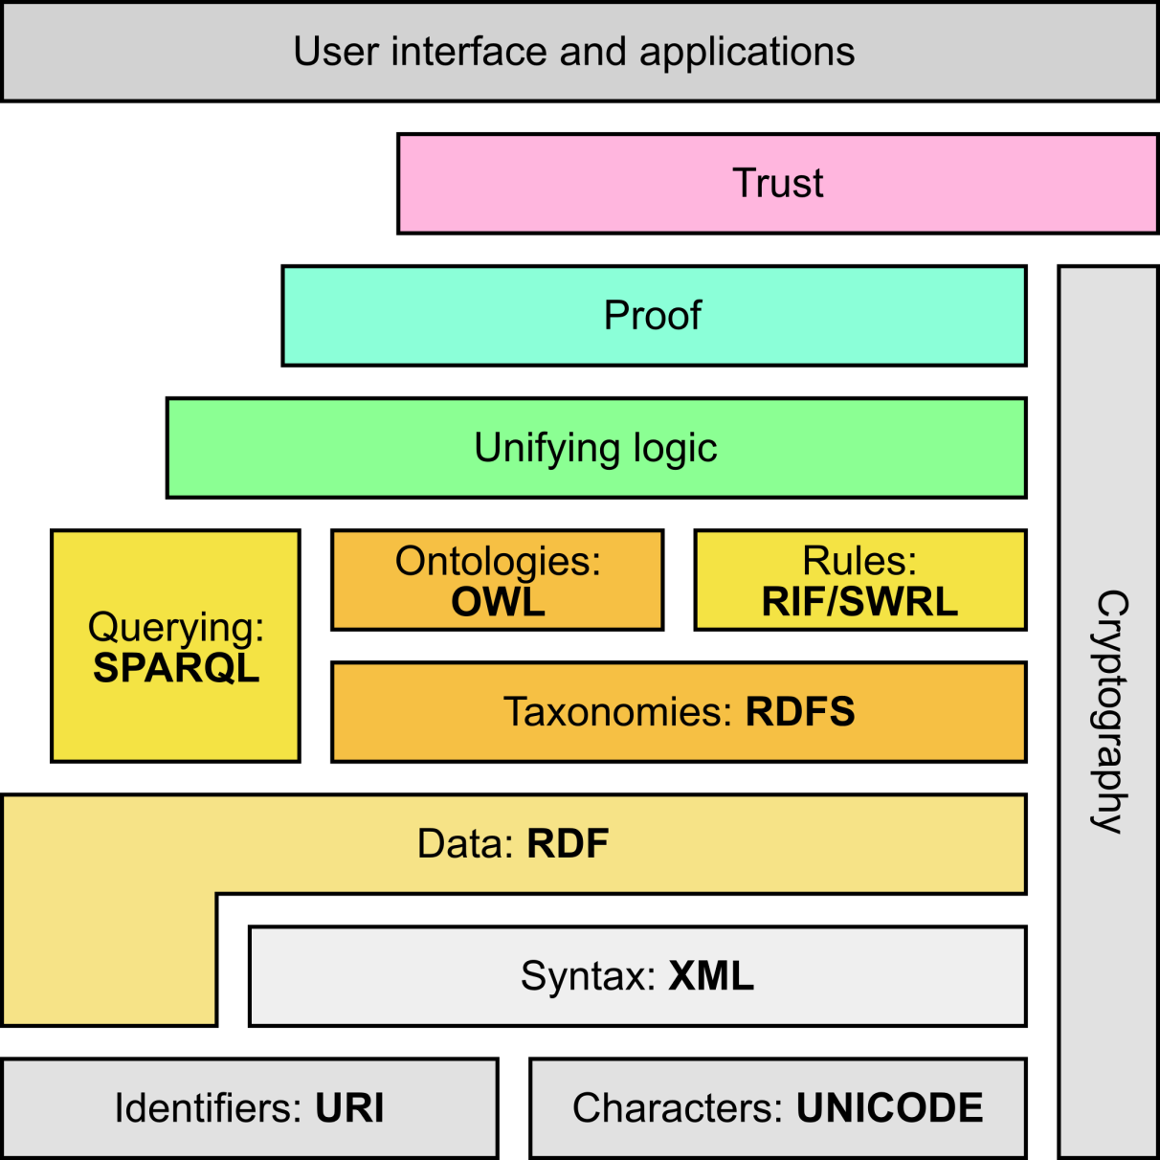
Semantic Web Stack
Adapted from http://en.wikipedia.org/wiki/Semantic_Web_Stack

Slide 5
MOTIVATION

Slide 6
What we discussed so far…
RDF Schema
  RDFS Vocabulary
  RDFS Metadata
  Literals and datatypes in RDFS
Semantics of RDF and RDF Schema
  Semantic notions
  RDF(S) Entailment
SPARQL
  SPARQL Queries
  Query answer

Slide 7
What we discussed so far…
RDF Vocabulary
Classes:
  rdf:Property, rdf:Statement, rdf:XMLLiteral
  rdf:Seq, rdf:Bag, rdf:Alt, rdf:List
Properties:
  rdf:type, rdf:subject, rdf:predicate, rdf:object,
  rdf:first, rdf:rest, rdf:_n
  rdf:value
Resources:
  rdf:nil
RDF Schema
  RDFS Vocabulary
  RDFS Metadata
  Literals and datatypes in RDFS
Semantics of RDF and RDF Schema
  Semantic notions
  RDF(S) Entailment
SPARQL
  SPARQL Queries
  Query answer

Slide 8
What we discussed so far…
RDF Vocabulary
Classes:
  rdf:Property, rdf:Statement, rdf:XMLLiteral
  rdf:Seq, rdf:Bag, rdf:Alt, rdf:List
Properties:
  rdf:type, rdf:subject, rdf:predicate, rdf:object,
  rdf:first, rdf:rest, rdf:_n
  rdf:value
Resources:
  rdf:nil
RDF Schema
  RDFS Vocabulary
  RDFS Metadata
  Literals and datatypes in RDFS
Semantics of RDF and RDF Schema
  Semantic notions
  RDF(S) Entailment
SPARQL
  SPARQL Queries
  Query answer
RDFS Vocabulary
RDFS Properties
  rdfs:domain
  rdfs:range
  rdfs:subPropertyOf
  rdfs:subClassOf
  rdfs:member
  rdfs:seeAlso
  rdfs:isDefinedBy
  rdfs:comment
  rdfs:label
RDFS Vocabulary
RDFS Classes
  rdfs:Resource
  rdfs:Class
  rdfs:Literal
  rdfs:Datatype
  rdfs:Container
  rdfs:ContainerMembershipProperty

Slide 9
What we discussed so far…
RDF Schema
  RDFS Vocabulary
  RDFS Metadata
  Literals and datatypes in RDFS
Semantics of RDF and RDF Schema
  Semantic notions
  RDF(S) Entailment
SPARQL
  SPARQL Queries
  Query answer

Slide 10
What we discussed so far…
RDF Schema
  RDFS Vocabulary
  RDFS Metadata
  Literals and datatypes in RDFS
Semantics of RDF and RDF Schema
  Semantic notions
  RDF(S) Entailment
SPARQL
  SPARQL Queries
  Query answer

Slide 11
What we discussed so far…
RDF Schema
  RDFS Vocabulary
  RDFS Metadata
  Literals and datatypes in RDFS
Semantics of RDF and RDF Schema
  Semantic notions
  RDF(S) Entailment
SPARQL
  SPARQL Queries
  Query answer

Slide 12
What we discussed so far…
RDF Schema
  RDFS Vocabulary
  RDFS Metadata
  Literals and datatypes in RDFS
Semantics of RDF and RDF Schema
  Semantic notions
  RDF(S) Entailment
SPARQL
  SPARQL Queries
  Query answer
PREFIX vCard: <http://www.w3.org/2001/vcard-rdf/3.0#>
SELECT ?fullName
WHERE {?x vCard:FN ?fullName}

Slide 13
Requirements for Ontology Languages
Ontology languages allow users to write explicit, formal specifications of conceptualizations of domain models; and to share these
Requirements include:
  Well-defined syntax
  Convenience of expression
  Formal semantics
    Needed in reasoning, e.g.:
      Class membership
      Equivalence of classes
      Consistency
      Classification
  Efficient reasoning support
  Sufficient expressive power

Slide 14
Semantics Limitations of RDFS
No semantics for:
  Containers
  Collections
  Reification
Since there are not semantic conditions for containers, RDF does not support any entailments which could arise from enumerating the elements of an rdf:Bag in a different order.
_:xxx rdf:type rdf:Bag .
_:xxx rdf:_1 <ex:a> .
_:xxx rdf:_2 <ex:b> .
does not entail
_:xxx rdf:_1 <ex:b> .
_:xxx rdf:_2 <ex:a>
Only type of axiom defined about containers is of the type: rdf:Bag rdfs:subClassOf rdfs:Container .
Notes:
If <ex:prop_a> rdf:range <ex:class_a>, all the instances of such property will have type a by inference. I.e. also if they have a different type by definition (e.g. <ex:b> rfd:type <ex:class_b>)
given the range definition the system will add to the KB also <ex:b> rfd:type <ex:class_a>. More if a property has more than one range or domain, all of them apply. E.g. if we have
Also <ex:prop_a> rdf:range <ex:class_c>, then the system will infer both <ex:b> rfd:type <ex:class_a>. <ex:b> rfd:type <ex:class_c>.

Slide 15
Semantics Limitations of RDFS
Originally domain and range of properties rather infer information than check data
<ex:a> <ex:prop_p> <ex:b>
<ex:prop_p> rdf:range <ex:class_c>
infer
<ex:b> rfd:type <ex:class_c>
Assume we further have the following triples:
<ex:b> rfd:type <ex:class_d>, and
<ex:class_c> owl:disjointWith <ex:class_d>
Now some reasoners allow use of domain and ranges for data check!
  In this case the reasoner will detect an inconsistency in the data

Slide 16
Expressiveness Limitations of RDF(S)
Only binary relations
Characteristics of Properties
  inverse (e.g. eaten by inverse to eats), i.e., (x,R,y) if and only if (y,S,x)
  transitive (e.g. greater than), i.e., (x,R,y) and (y,R,z) imply (x,R,z)
  symmetric (e.g. married to), i.e., (x,R,y) implies (y,R,x)
  functional (e.g. has IRD number), i.e., (x,R,y) and (x,R,z) imply y=z
Local range restrictions
  rdfs:range defines the range of a property (e.g. eats) for all classes
  In RDFS we cannot declare range restrictions that apply to some classes only
  E.g. we cannot say that cows eat only plants, while other animals may eat meat, too
Disjointness axioms
  E.g. nobody can be both a Man and a Woman
Complex concept descriptions
  union, intersection, complement
  E.g. Person is the disjoint union of Man and Woman
Cardinality restrictions
  E.g. a Person has exactly two parents, courses are taught by at least one lecturer

Slide 17
Layering Issues
Syntax
  Only binary relations in RDF
  Verbose syntax
  No limitations on graph in RDF
    Every graph is valid
Semantics
  Malformed graphs
  Use of vocabulary in language
    e.g. <rdfs:Class, rdfs:subClassOf, ex:a>
  Meta-classes
    e.g. <rdfs:Class, rdfs:subClassOf, ex:a>, <rdfs:Class, rdfs:subClassOf, ex:b>, <ex:a, rdf:type, ex:b>
Notes:
Meta-class: both Where

Slide 18
Layering Issues: Syntax
Triples make syntax unnatural
  Restrictions have to be split up
  Collections have to split up
Triples allow for deviant syntax
  Restrictions with too many pieces
  Collections with missing or multiple components
Triples allow additions at any time.
  Can't forbid new triples attached to old syntax.

Slide 19
Layering Issues: Semantics
Everything is triples; all triples have meaning.
All aspects of syntax contribute to meaning.
  e.g., ordering in collections
  the intersection of Student and Employee is different from the intersection of Employee and Student
All syntax refers to something.
  e.g., descriptions live in the domain
  to infer membership in a description, the description has to exist
  leads to semantic paradoxes

Slide 20
Layering Issues: Semantics (Example)
A Desirable Inference:
Premises:
  John is an instance of Student.
  John is an instance of Employee.
Conclusion:
  John is an instance of the intersection of Student and Employee.
In an RDF extension, this requires that the intersection automatically exists whenever Student and Employee exists.
Many more of these examples can be devised

Slide 21
TECHNICAL SOLUTION
The Web Ontology Language

Slide 22
Design Goals for OWL
Shareable
  Ontologies should be publicly available and different data sources should be able to commit to the same ontology for shared meaning. Also, ontologies should be able to extend other ontologies in order to provide additional definitions.
Changing over time
  An ontology may change during its lifetime. A data source should specify the version of an ontology to which it commits.
Interoperability
  Different ontologies may model the same concepts in different ways. The language should provide primitives for relating different representations, thus allowing data to be converted to different ontologies and enabling a "web of ontologies."

Slide 23
Design Goals for OWL
Inconsistency detection
  Different ontologies or data sources may be contradictory. It should be possible to detect these inconsistencies.
Balancing expressivity and complexity
  The language should be able to express a wide variety of knowledge, but should also provide for efficient means to reason with it. Since these two requirements are typically at odds, the goal of the web ontology language is to find a balance that supports the ability to express the most important kinds of knowledge.
Ease of use
  The language should provide a low learning barrier and have clear concepts and meaning. The concepts should be independent from syntax.

Slide 24
Design Goals for OWL
Compatible with existing standards
  The language should be compatible with other commonly used Web and industry standards. In particular, this includes XML and related standards (such as XML Schema and RDF), and possibly other modeling standards such as UML.
Internationalization
  The language should support the development of multilingual ontologies, and potentially provide different views of ontologies that are appropriate for different cultures.

Slide 25
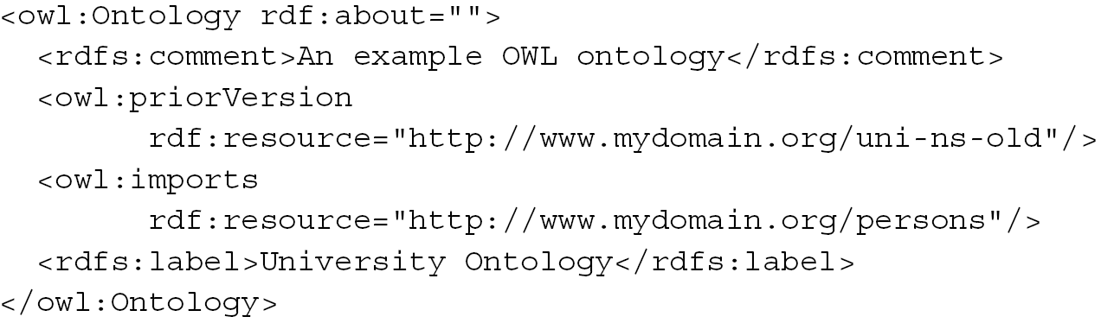
Requirements for OWL
Ontologies are objects on the Web with their own meta-data, versioning, etc...
Ontologies are extendable
From Grigoris Antoniou and Frank van Harmelen: A Semantic Web Primer, MIT Press 2004

Slide 26
Requirements for OWL
Ontologies are objects on the Web with their own meta-data, versioning, etc...
Ontologies are extendable
They contain classes, properties, data-types, range/domain, individuals
Equality (for classes, for individuals)
Classes as instances
Cardinality constraints
XML syntax
Notes:
The language must support the ability to treat classes as instances. This is because the same concept can often be seen as a class or an individual, depending on the perspective of the user. For example, in a biological ontology, the class Orangutan may have individual animals as its instances. However, the class Orangutan may itself be an instance of the class Species. Note, that Orangutan is not a subclass of Species, because then that would say that each instance of Orangutan (an animal) is an instance of Species

Slide 27
Objectives for OWL
Objectives:
  Layered language
  Complex datatypes
  Digital signatures
  Decidability (in part)
  Local unique names (in part)
Disregarded:
  Default values
  Closed world option
  Property chaining
  Arithmetic
  String operations
  Partial imports
  View definitions
  Procedural attachments
[http://www.w3.org/TR/webont-req/]
Notes:
Most of the choice has been disregarded because of the foundational logic chosen for the language: DL. (e.g. close world option)
Others for simple decision of focusing on more priority issues.

Slide 28
OWL DIALECTS

Slide 29
OWL comes in 3 Dialects
Lite
partially restricted to aid learning curve
  DL = Description Logic
  Description Logics are a fragment of First Order Logic (FOL) that can be reasoned with
lite
Full
unrestricted use of OWL constructs, but cannot reason
DL
Full

Slide 30
OWL Full
Contains OWL DL and OWL Lite
No restriction on use of vocabulary (as long as legal RDF)
  Classes as instances (and much more)
  OWL Full uses all the OWL language primitives
  OWL Full allows the combination of these primitives in arbitrary ways with RDF(S)
OWL Full is fully upward-compatible with RDF
  both syntactically and semantically
OWL Full is very expressive
OWL Full is undecidable
Enjoys only limited tool support
  No complete (or efficient) reasoning support

Slide 31
OWL DL
Contains OWL Lite
OWL DL (Description Logic) is sublanguage of OWL Full
  Restricts application of the constructors from OWL and RDF
  Application of OWL’s constructors to each other is disallowed
  Ensures correspondence to a well studied description logic
OWL DL permits efficient reasoning support
  Decidable
  Worst-case time complexity is NExpTime
  Enjoys nearly complete tool support
OWL DL is not fully compatibile with RDF:
  Not every RDF document is a legal OWL DL document
  Every legal OWL DL document is a legal RDF document

Slide 32
OWL Lite
Further restrictions of OWL DL to a subset of language constructors
  excludes enumerated classes,
  excludes disjointness statements,
  excludes arbitrary cardinality (allows only 0/1),
  excludes explicit negation or union,
  excludes nominals (oneOf)
The disadvantage is restricted expressivity
The advantage of this is a language that is easier to
  reason about (worst-case time complexity is ExpTime)
  grasp, for users
  implement, for tool builders

Slide 33
Upward compatibility
Every legal OWL Lite ontology is a legal OWL DL ontology
Every legal OWL DL ontology is a legal OWL Full ontology
Every valid OWL Lite conclusion is a valid OWL DL conclusion
Every valid OWL DL conclusion is a valid OWL Full conclusion

Slide 34
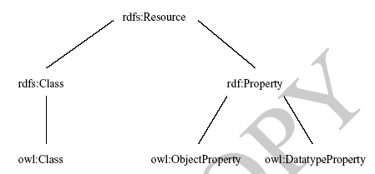
OWL compatibility with RDF Schema
All varieties of OWL
use RDF for their
syntax
Instances are declared
as in RDF, using RDF
descriptions
And typing information
OWL constructors are
specialisations of their
RDF counterparts
Semantic Web design aims at downward compatibility with
corresponding reuse of software across the various layers
The advantage of full downward compatibility for OWL is
only achieved for OWL Full, at the cost of computational intractability

Slide 35
Summary Features of OWL Dialects
OWL Lite
  (sub)classes, individuals
  (sub)properties, domain, range
  conjunction
  (in)equality
  cardinality 0/1
  datatypes
  inverse, transitive, symmetric properties
  someValuesFrom
  allValuesFrom
OWL DL
  Negation
  Disjunction
  Full cardinality
  Enumerated types
  hasValue
OWL Full
  Meta-classes
  Modify language

Slide 36
OWL Dialects vs Description Logics
OWL Lite corresponds to the DL SHIN(D)
  Named classes (A)
  Named properties (P)
  Individuals (C(o))
  Property values (P(o, a))
  Intersection (C ⊓ D)
  Union(!) (C ⊔ D)
  Negation(!) (¬C)
  Existential value restrictions (∃P.C)
  Universal value restrictions (∀P.C)
  Unqualified number restrictions (≥ nP, ≤ nP, = nP)
OWL DL corresponds to the DL SHOIN(D)
  Property value (∃ P.{o})
  Enumeration ({o₁, ..., o_{n}})
OWL Full is not a Description Logic

Slide 37
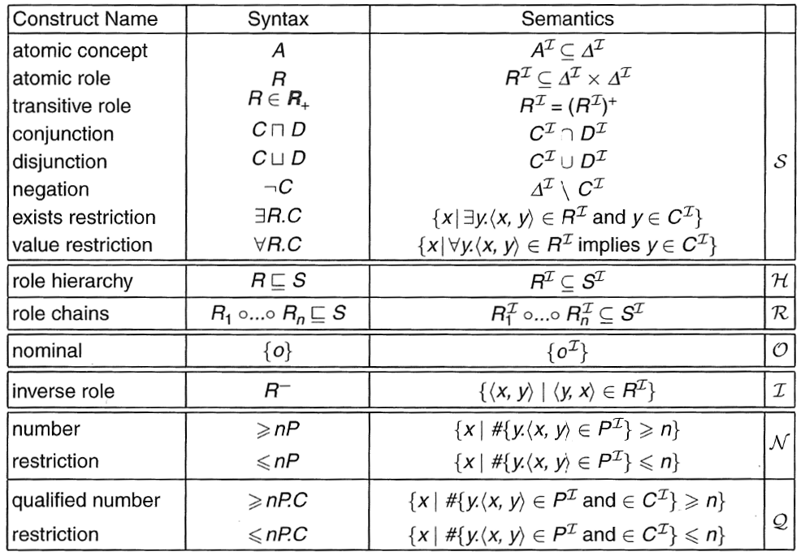
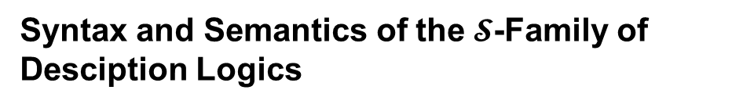
Syntax and Semantics of the $𝓢$-Family of Desciption Logics

Slide 38
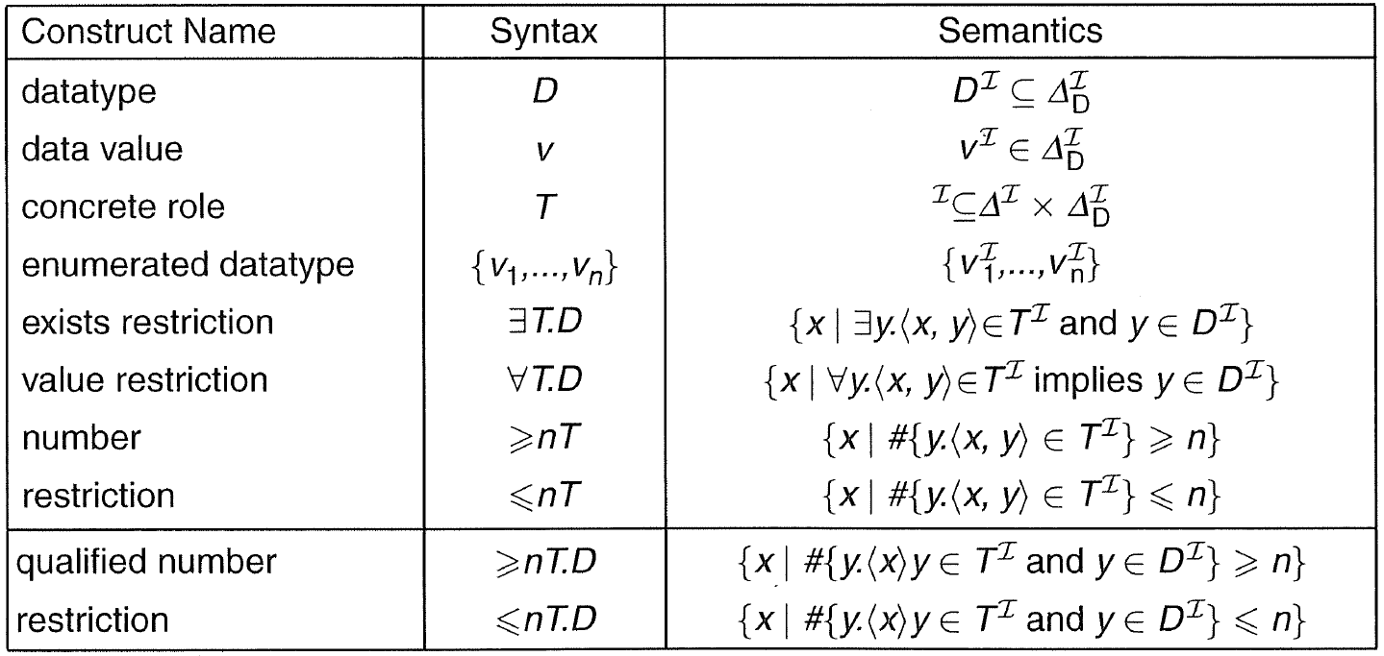
Syntax and Semantics of DL Datatypes

Slide 39
OWL SYNTAX

Slide 40
OWL: Syntactic Varieties
OWL builds on RDF and uses RDF’s XML-based syntax
Other syntactic forms for OWL have also been defined:
  An alternative, more readable XML-based syntax
  An abstract syntax, that is much more compact and readable than the XML languages
  A graphic syntax based on the conventions of UML
  Many more

Slide 41
OWL: XML/RDF Syntax – Header
<rdf:RDF
xmlns:owl ="http://www.w3.org/2002/07/owl#"
xmlns:rdf ="http://www.w3.org/1999/02/22-rdf-syntax-ns#"
xmlns:rdfs="http://www.w3.org/2000/01/rdf-schema#"
xmlns:xsd ="http://www.w3.org/2001/XLMSchema#">
An OWL ontology may start with a collection of assertions for housekeeping purposes using owl:Ontology element

Slide 42
owl:Ontology
<owl:Ontology rdf:about="">
<rdfs:comment>An example OWL ontology </rdfs:comment>
<owl:priorVersion
rdf:resource="http://www.mydomain.org/uni-ns-old"/>
<owl:imports
rdf:resource="http://www.mydomain.org/persons"/>
<rdfs:label>University Ontology</rdfs:label>
</owl:Ontology>
owl:imports is a transitive property

Slide 43
Classes
OWLClasses are defined using owl:Class
  owl:Class is a subclass of rdfs:Class
Disjointness is defined using owl:disjointWith
<owl:Class rdf:about="#associateProfessor">
<owl:disjointWith rdf:resource="#professor"/>
<owl:disjointWith rdf:resource="#assistantProfessor"/>
</owl:Class>

Slide 44
Classes continued
owl:equivalentClass defines equivalence of classes
<owl:Class rdf:ID="faculty">
<owl:equivalentClass
rdf:resource= "#academicStaffMember"/>
</owl:Class>
owl:Thing
  is the most general class, which contains everything
owl:Nothing
  is the empty class

Slide 45
Properties
In OWL there are two kinds of properties
Object properties
  relate objects to other objects
  e.g. is-TaughtBy, or supervises
Data type properties
  relate objects to datatype values
  e.g. phone, title, age, etc.

Slide 46
Datatype properties
OWL makes use of XML Schema data types, using the layered architecture of the Semantic Web
<owl:DatatypeProperty rdf:ID="age">
<rdfs:range rdf:resource= "http://www.w3.org/2001/XLMSchema#nonNegativeInteger"/>
</owl:DatatypeProperty>

Slide 47
Object properties
User-defined data types
<owl:ObjectProperty rdf:ID="isTaughtBy">
<owl:domain rdf:resource="#course"/>
<owl:range rdf:resource="#academicStaffMember"/>
<rdfs:subPropertyOf rdf:resource="#involves"/>
</owl:ObjectProperty>

Slide 48
Inverse properties
<owl:ObjectProperty rdf:ID="teaches">
<rdfs:range rdf:resource="#course"/>
<rdfs:domain rdf:resource= "#academicStaffMember"/>
<owl:inverseOf
rdf:resource="#isTaughtBy"/>
</owl:ObjectProperty>

Slide 49
Equivalent properties
owl:equivalentProperty
<owl:ObjectProperty rdf:ID="lecturesIn">
<owl:equivalentProperty
rdf:resource="#teaches"/>
</owl:ObjectProperty>

Slide 50
Property restrictions
In OWL we can declare that the class C satisfies certain conditions
  All instances of C satisfy the conditions
This is equivalent to saying that C is subclass of a class C', where C' collects all objects that satisfy the conditions
  C' can remain anonymous
A (restriction) class is achieved through an owl:Restriction element
This element contains an owl:onProperty element and one or more restriction declarations
One type defines cardinality restrictions (at least one, at most 3,…)
The other type defines restrictions on the kinds of values the property may take
  owl:allValuesFrom specifies universal quantification
  owl:hasValue specifies a specific value
  owl:someValuesFrom specifies existential quantification

Slide 51
owl:allValuesFrom
<owl:Class rdf:about="#firstYearCourse">
<rdfs:subClassOf>
<owl:Restriction>
<owl:onProperty rdf:resource="#isTaughtBy"/>
<owl:allValuesFrom rdf:resource="#Professor"/>
</owl:Restriction>
</rdfs:subClassOf>
</owl:Class>

Slide 52
owl:hasValue
<owl:Class rdf:about="#mathCourse">
<rdfs:subClassOf>
<owl:Restriction>
<owl:onProperty rdf:resource="#isTaughtBy"/>
<owl:hasValue rdf:resource="#949352"/>
</owl:Restriction>
</rdfs:subClassOf>
</owl:Class>

Slide 53
owl:someValuesFrom
<owl:Class rdf:about="#academicStaffMember">
<rdfs:subClassOf>
<owl:Restriction>
<owl:onProperty rdf:resource="#teaches"/>
<owl:someValuesFrom rdf:resource= "#undergraduateCourse"/>
</owl:Restriction>
</rdfs:subClassOf>
</owl:Class>

Slide 54
Cardinality restrictions
We can specify minimum and maximum number using owl:minCardinality and owl:maxCardinality
It is possible to specify a precise number by using the same minimum and maximum number
For convenience, OWL offers also owl:cardinality
<owl:Class rdf:about="#course">
<rdfs:subClassOf>
<owl:Restriction>
<owl:onProperty rdf:resource="#isTaughtBy"/>
<owl:minCardinality rdf:datatype= "&xsd;nonNegativeInteger">
1
</owl:minCardinality>
</owl:Restriction>
</rdfs:subClassOf>
</owl:Class>

Slide 55
Special properties
owl:TransitiveProperty (transitive property)
  E.g. “has better grade than”, “is ancestor of”
owl:SymmetricProperty (symmetry)
  E.g. “has same grade as”, “is sibling of”
owl:FunctionalProperty defines a property that has at most one value for each object
  E.g. “age”, “height”, “directSupervisor”
owl:InverseFunctionalProperty defines a property for which two different objects cannot have same value

Slide 56
Special properties – example
<owl:ObjectProperty rdf:ID="hasSameGradeAs">
<rdf:type rdf:resource="&owl;TransitiveProperty"/>
<rdf:type rdf:resource="&owl;SymmetricProperty"/>
<rdfs:domain rdf:resource="#student"/>
<rdfs:range rdf:resource="#student"/>
</owl:ObjectProperty>

Slide 57
Boolean combinations
We can combine classes using Boolean operations
(union, intersection, complement)
<owl:Class rdf:about="#course">
<rdfs:subClassOf>
<owl:Restriction>
<owl:complementOf rdf:resource= "#staffMember"/>
</owl:Restriction>
</rdfs:subClassOf>
</owl:Class>

Slide 58
Boolean combinations
<owl:Class rdf:ID="peopleAtUni">
<owl:unionOf rdf:parseType="Collection">
<owl:Class rdf:about="#staffMember"/>
<owl:Class rdf:about="#student"/>
</owl:unionOf>
</owl:Class>
The new class is not a subclass of the union,
  It is equal to the union
  We have stated an equivalence of classes

Slide 59
Boolean combinations
<owl:Class rdf:ID="facultyInCS">
<owl:intersectionOf rdf:parseType="Collection">
<owl:Class rdf:about="#faculty"/>
<owl:Restriction>
<owl:onProperty rdf:resource="#belongsTo"/>
<owl:hasValue rdf:resource= "#CSDepartment"/>
</owl:Restriction>
</owl:intersectionOf>
</owl:Class>

Slide 60
Nesting of Boolean operators
<owl:Class rdf:ID="adminStaff">
<owl:intersectionOf rdf:parseType="Collection">
<owl:Class rdf:about="#staffMember"/>
<owl: Class>
<owl:complementOf>
<owl: Class>
<owl:unionOf rdf:parseType="Collection">
<owl:Class rdf:about="#faculty"/>
<owl:Class rdf:about=#techSupportStaff"/>
</owl:unionOf>
</owl: Class>
</owl:complementOf>
</owl: Class>
</owl:intersectionOf>
</owl:Class>

Slide 61
Enumerations
<owl:Class rdf:ID="weekdays">
<owl:oneOf rdf:parseType="Collection">
<owl:Thing rdf:about="#Monday"/>
<owl:Thing rdf:about="#Tuesday"/>
<owl:Thing rdf:about="#Wednesday"/>
<owl:Thing rdf:about="#Thursday"/>
<owl:Thing rdf:about="#Friday"/>
<owl:Thing rdf:about="#Saturday"/>
<owl:Thing rdf:about="#Sunday"/>
</owl:oneOf>
</owl:Class>

Slide 62
Declaring instances
Instances of classes are declared as in RDF:
<rdf:Description rdf:ID="949352">
<rdf:type rdf:resource="#academicStaffMember"/>
</rdf:Description>
<academicStaffMember rdf:ID="949352">
<uni:age rdf:datatype="&xsd;integer">39<uni:age>
</academicStaffMember>

Slide 63
No unique-name assumption
OWL does not adopt the unique-names assumption of DB systems
  If two instances have a different name or ID, then this does not imply that they are different individuals
Suppose we state that each course is taught by at most one staff member, and that a given course is taught by two staff members
  An OWL reasoner does not flag an error
  Instead it infers that the two resources are equal

Slide 64
Distinct objects
To ensure that different individuals are indeed recognized as such, we must explicitly assert their inequality:
<lecturer rdf:about="949318">
<owl:differentFrom rdf:resource="949352"/>
</lecturer>
OWL provides a shorthand notation to assert the pairwise inequality of all individuals in a given list
<owl:allDifferent>
<owl:distinctMembers rdf:parseType="Collection">
<lecturer rdf:about="949318"/>
<lecturer rdf:about="949352"/>
<lecturer rdf:about="949111"/>
</owl:distinctMembers>
</owl:allDifferent>

Slide 65
OWL Datatypes
XML Schema provides a mechanism to construct
user-defined data types
  E.g., the data type of adultAge includes all integers greater than 18
Such derived data types cannot be used in OWL
  The OWL reference document lists all the XML Schema data types that can be used
  These include the most frequently used types such as string, integer, Boolean, time, and date.

Slide 66
Versioning information
owl:priorVersion indicates earlier versions of the current ontology
  No formal meaning, can be exploited for ontology management
owl:versionInfo generally contains a string giving information about the current version, e.g. keywords
owl:backwardCompatibleWith has reference to another ontology
  All identifiers from the previous version have the same intended interpretations in the new version
  Thus documents can be safely changed to commit to the new version
owl:incompatibleWith indicates that the containing ontology is a later version of the referenced ontology but is not backward compatible with it

Slide 67
Combination of features
In different OWL languages there are different sets of restrictions regarding the application of features
In OWL Full, all the language constructors may be used in any combination as long as the result is legal RDF

Slide 68
Restriction of features in OWL DL
Vocabulary partitioning
  Any resource is allowed to be only a class, a data type, a data type property, an object property, an individual, a data value, or part of the built-in vocabulary, and not more than one of these
Explicit typing
  The partitioning of all resources must be stated explicitly (e.g. a class must be declared if used in conjunction with rdfs:subClassOf)
Property Separation
  The set of object properties and data type properties are disjoint
  Therefore the following can never be specified for data type properties:
owl:inverseOf
owl:FunctionalProperty
owl:InverseFunctionalProperty
owl:SymmetricProperty

Slide 69
Restriction of features in OWL DL
No transitive cardinality restrictions
  No cardinality restrictions may be placed on transitive properties
Restricted anonymous classes: anonymous classes are only allowed to occur as:
  the domain and range of either
  owl:equivalentClass or owl:disjointWith
  the range (but not the domain) of rdfs:subClassOf

Slide 70
Restriction of features in OWL Lite
Restrictions of OWL DL and more
owl:oneOf, owl:disjointWith, owl:unionOf, owl:complementOf and owl:hasValue are not allowed
Cardinality statements (minimal, maximal, and exact cardinality) can only be made on the values 0 or 1
owl:equivalentClass statements can no longer be made between anonymous classes but only between class identifiers

Slide 71
Inheritance in class hierarchies
Range restriction: Courses must be taught by academic staff members only
Tim Berners-Lee is a professor
He inherits the ability to teach from the class of academic staff members
This is done in RDF Schema by fixing the semantics of “is a subclass of”
  It is not up to an application (RDF processing software) to interpret “is a subclass of”

Slide 72
OWL DLP
OWL is based on Description Logics
Description Logics are fragments of first-order logic
OWL inherits from Description Logics
  The open-world assumption
  The non-unique-name assumption

Slide 73
Open World Assumption
We cannot conclude some statement S to be false simply because we cannot show S to be true
Our axioms may be simply noncommittal on the status of S
We may not deduce falsity from the absence of truth
Question: "Did it rain in Tokyo yesterday?"
Answer: "I don’t know that it rained, but that’s not enough reason to conclude that it didn’t rain"

Slide 74
Closed World Assumption
Closed-world assumption allows us to derive falsity from the inability to derive truth
Question:
“Was there a big earthquake disaster in Tokyo yesterday?”
Answer:
“I don’t know that there was, but if there had been such a disaster, I’d have heard about it. Therefore I conclude that there wasn’t such a disaster”.

Slide 75
Unique Name Assumption
When two individuals are known by different names, they are in fact different individuals
This is an assumption that sometimes works (ex. Product codes) and sometimes doesn’t (ex. Social environment)
OWL does not make the unique-name assumption

Slide 76
OWL DLP use
Systems such as databases and logic-programming systems have tended to support closed worlds and unique names
Knowledge representation systems and theorem provers support open worlds and non-unique names
Ontologies are sometimes in need of one, sometimes in need of the other use
Discussions can be found in the literature and on the WWW about whether OWL should be more like a knowledge representation system or more like a database system
This debate was nicely resolved by Volz and Horrocks, who identified a fragment of OWL called DLP
This fragment is the largest known fragment on which the choice for CWA and UNA does not matter, see following figure

Slide 77
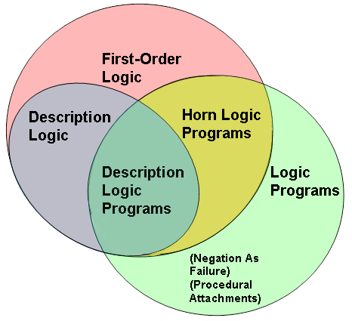
Relations of OWL DLP to other languages

Slide 78
OWL DLP
OWL DLP:
weak enough for differences between choices not to show up
Advantage: people or applications that wish to make different choices on assumptions can exchange ontologies in OWL DLP without harm
Outside OWL DLP: they will notice that they draw different conclusions from the same statements
OWL DLP: large enough for useful representation & reasoning tasks
It allows the use of such OWL constructors as:
  Class and property equivalence
  Equality and inequality between individuals
  Inverse, transitive, symmetric and functional properties
  The intersection of classes
It excludes constructors such as :
  Arbitrary cardinality constraints

Slide 79
TOOLS

Slide 80
Tool Support for OWL
Ontology editors
  Protégé (http://protege.stanford.edu/)
  OilED (http://oiled.man.ac.uk/)
  OntoStudio (http://www.ontoprise.de/en/home/products/ontostudio/)
APIs
  OWL-API (http://owlapi.sourceforge.net/)
  Jena (http://jena.sourceforge.net/)
Reasoners
  Hoolet (http://owl.man.ac.uk/hoolet/)
  Fact++ (http://owl.man.ac.uk/factplusplus/)
  KAON2 (http://kaon2.semanticweb.org/)
  Pellet (http://clarkparsia.com/pellet/)

Slide 81

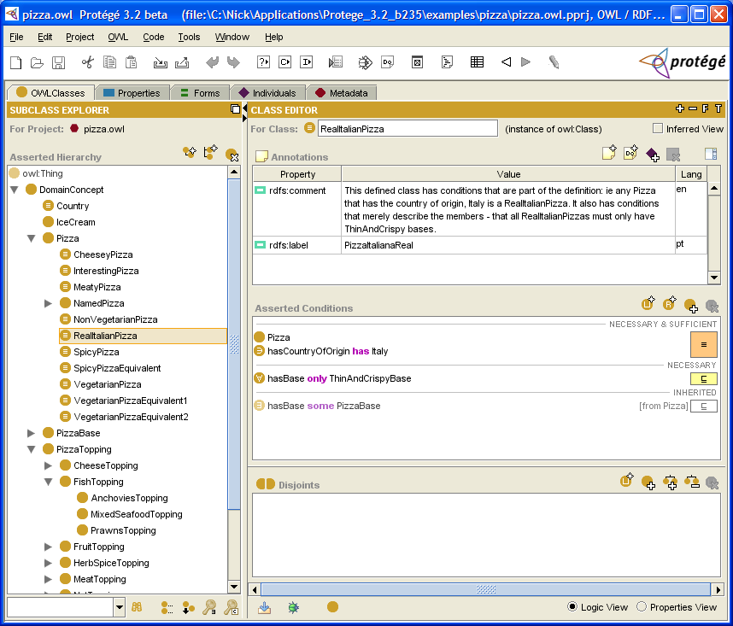
Developed by Stanford Medical Informatics
Has a large user community (approx 30k)
Support
  Graph view, consistency check, web, merging
No support
  Addition of new basic types
  Limited multi-user support

Slide 82
OilEd
Developed by Information Management Group, CS Dept., Univ. of Manchester, UK
Simple editor, not intended as a full ontology development environment
Support
  Consistency check, web
No support
  Graph view, extensibility

Slide 83
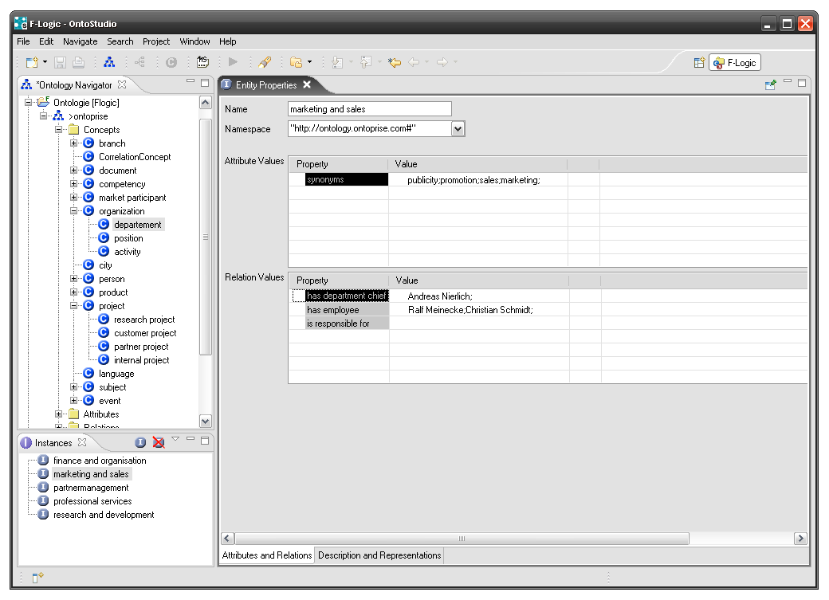
OntoStudio
Developed by Ontoprise, Germany
Support
  Graph view, consistency check, web
  Built-in inference engine, DBMS, collaborative working and ontology library

Slide 84
OWL-API
A Java interface and implementation for the W3C Web Ontology Language OWL
Open source and is available under the LGPL License
Support
  OWL 2
  RDF/XML parser and writer
  OWL/XML parser and writer
  OWL Functional Syntax parser and writer
  Integration with reasoners such as Pellet and FaCT++

Slide 85
Jena
A Java framework for building Semantic Web applications
Jena is open source
Initiated by Hewlett Packard (HP) Labs Semantic Web Programme.
Support:
  A RDF API
  Reading and writing RDF in RDF/XML, N3 and N-Triples
  An OWL API
  In-memory and persistent storage
  SPARQL query engine

Slide 86
Hoolet
An implementation of an OWL-DL reasoner
Uses a first order prover.
The ontology is translated to collection of axioms (in an obvious way based on the OWL semantics) and this collection of axioms is then given to a first order prover for consistency checking.

Slide 87
Hoolet
An implementation of an OWL-DL reasoner
Uses a first order prover.
The ontology is translated to collection of axioms (in an obvious way based on the OWL semantics) and this collection of axioms is then given to a first order prover for consistency checking.

Slide 88
KAON 2
An infrastructure for managing OWL-DL, SWRL, and F-Logic ontologies
Joint effort of: Research Center for Information Technologies, University of Karlsruhe, University of Manchester
Support
  An API for programmatic management of OWL-DL, SWRL, and F-Logic ontologies,
  A stand-alone server providing access to ontologies in a distributed manner using RMI,
  An inference engine for answering conjunctive queries (expressed using SPARQL syntax),
  A DIG interface, allowing access from tools such as Protégé,
  A module for extracting ontology instances from relational databases.

Slide 89
Pellet
Open-source Java OWL DL reasoner
Support expressivity of SROIQ(D)
Supports SWRL rules
Available through AGPL version 3 licence

Slide 90
FaCT++
New generation and C++ implementation of FaCT
Support expressivity of SROIQ(D)
No support for Rules
Available through GNU public license
Integrated in Protege 4.0

Slide 91
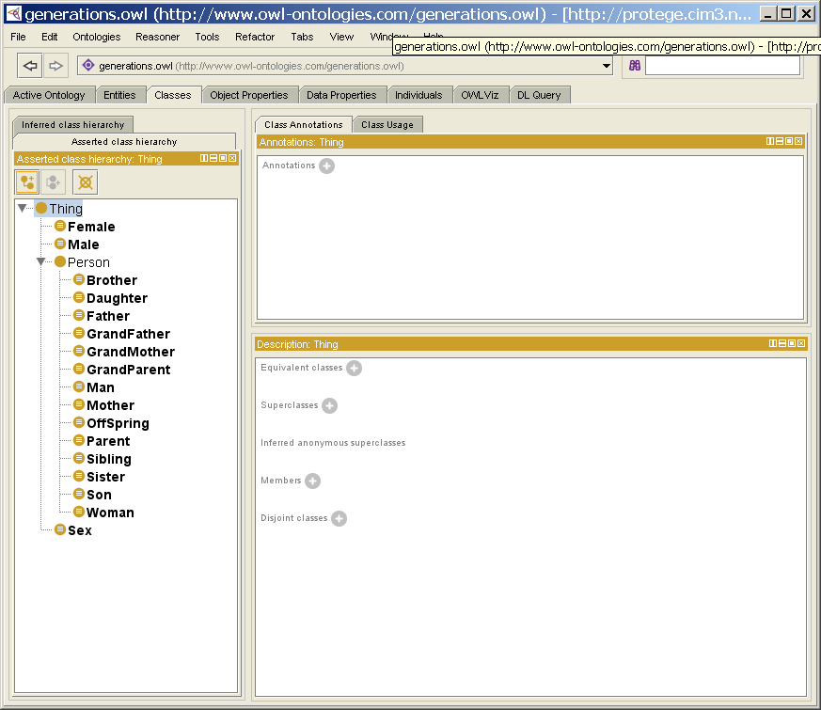
Playing with Protégé and Fact++
Let’s load an ontology that represent family relationships
  http://protege.cim3.net/file/pub/ontologies/generations/generations.owl

Slide 92
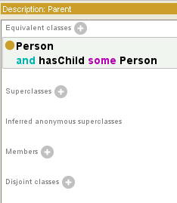
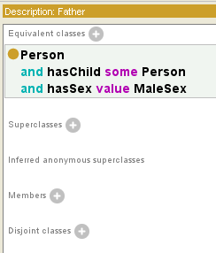
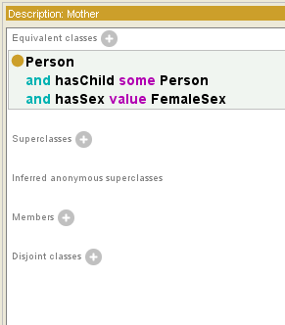
Playing with Protégé and Fact++
For example the ontology directly defines the concepts of parent and father/mother but not the relation among them
What happens if we attach the Fact++ Reasoner?

Slide 93
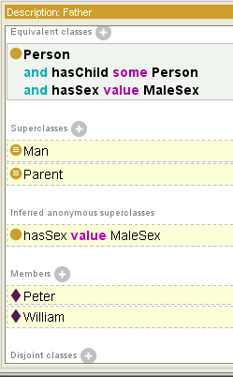
Playing with Protégé and Fact++
Father now is classified as subclass of Man and Parent
Two instances are part of this class
  William type Person
    hasChild Peter
    hasSex Male
  Peter type Person
    hasChild Matt
    hasSex Male

Slide 94
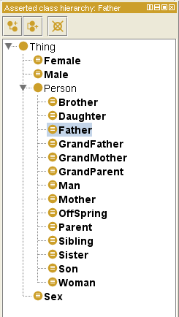
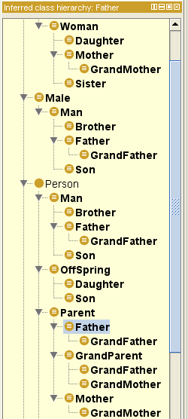
Playing with Protégé and Fact++
Asserted Hierarchy
Inferred Hierarchy

Slide 95
ILLUSTRATION BY A LARGER EXAMPLE
An example of usage of OWL

Slide 96
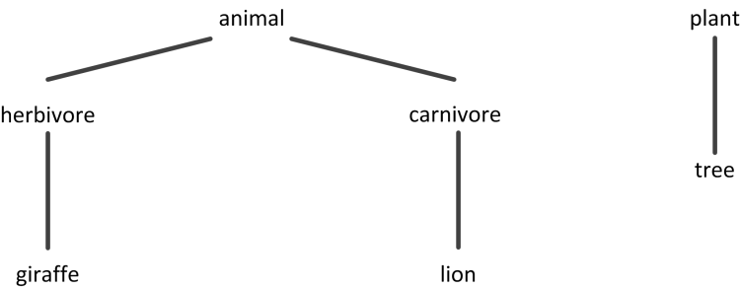
An African Wildlife Ontology
– Class Hierarchy

Slide 97
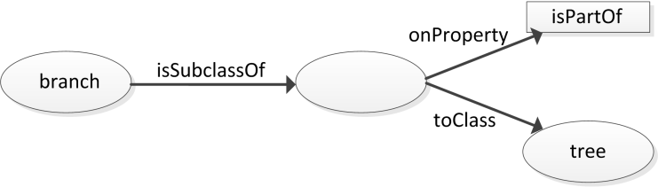
An African Wildlife Ontology
– Schematic Representation
branches are part of trees

Slide 98
An African Wildlife Ontology –
Properties
<owl:TransitiveProperty rdf:ID="is-part-of"/>
<owl:ObjectProperty rdf:ID="eats">
<rdfs:domain rdf:resource="#animal"/>
</owl:ObjectProperty>
<owl:ObjectProperty rdf:ID="eaten-by">
<owl:inverseOf rdf:resource="#eats"/>
</owl:ObjectProperty>

Slide 99
An African Wildlife Ontology –
Plants and Trees
<owl:Class rdf:ID="plant">
<rdfs:comment>Plants form a class disjoint from animals. </rdfs:comment>
<owl:disjointWith rdf:resource="#animal"/>
</owl:Class>
<owl:Class rdf:ID="tree">
<rdfs:comment>Trees are a type of plant. </rdfs:comment>
<rdfs:subClassOf rdf:resource="#plant"/>
</owl:Class>

Slide 100
An African Wildlife Ontology –
Branches
<owl:Class rdf:ID="branch">
<rdfs:comment>Branches are parts of trees. </rdfs:comment>
<rdfs:subClassOf>
<owl:Restriction>
<owl:onProperty rdf:resource="#is-part-of"/>
<owl:allValuesFrom rdf:resource="#tree"/>
</owl:Restriction>
</rdfs:subClassOf>
</owl:Class>

Slide 101
An African Wildlife Ontology –
Leaves
<owl:Class rdf:ID="leaf">
<rdfs:comment>Leaves are parts of branches. </rdfs:comment>
<rdfs:subClassOf>
<owl:Restriction>
<owl:onProperty rdf:resource="#is-part-of"/>
<owl:allValuesFrom rdf:resource="#branch"/>
</owl:Restriction>
</rdfs:subClassOf>
</owl:Class>

Slide 102
An African Wildlife Ontology –
Carnivores
<owl:Class rdf:ID="carnivore">
<rdfs:comment>Carnivores are exactly those animals
that eat animals.</rdfs:comment>
<owl:intersectionOf rdf:parsetype="Collection">
<owl:Class rdf:about="#animal"/>
<owl:Restriction>
<owl:onProperty rdf:resource="#eats"/>
<owl:someValuesFrom rdf:resource="#animal"/>
</owl:Restriction>
</owl:intersectionOf>
</owl:Class>

Slide 103
An African Wildlife Ontology –
Herbivores
<owl:Class rdf:ID="herbivore">
<rdfs:comment>
Herbivores are exactly those animals
that eat only plants or parts of plants. </rdfs:comment>
<rdfs:comment>
Try it out!
<rdfs:comment>
</owl:Class>

Slide 104
An African Wildlife Ontology –
Giraffes
<owl:Class rdf:ID="giraffe">
<rdfs:comment>Giraffes are herbivores, and they
eat only leaves.</rdfs:comment>
<rdfs:subClassOf rdf:type="#herbivore"/>
<rdfs:subClassOf>
<owl:Restriction>
<owl:onProperty rdf:resource="#eats"/>
<owl:allValuesFrom rdf:resource="#leaf"/>
</owl:Restriction>
</rdfs:subClassOf>
</owl:Class>

Slide 105
An African Wildlife Ontology –
Lions
<owl:Class rdf:ID="lion">
<rdfs:comment>Lions are animals that eat
only herbivores.</rdfs:comment>
<rdfs:subClassOf rdf:type="#carnivore"/>
<rdfs:subClassOf>
<owl:Restriction>
<owl:onProperty rdf:resource="#eats"/>
<owl:allValuesFrom rdf:resource="#herbivore"/>
</owl:Restriction>
</rdfs:subClassOf>
</owl:Class>

Slide 106
An African Wildlife Ontology –
Tasty Plants
owl:Class rdf:ID="tasty-plant">
<rdfs:comment>Tasty plants are plants that are eaten both by herbivores and carnivores </rdfs:comment>
<rdfs:comment>
Try it out!
<rdfs:comment>
</owl:Class>

Slide 107
EXTENSIONS

Slide 108
Experience with OWL
OWL playing key role in increasing number & range of applications
  eScience, eCommerce, geography, engineering, defence, …
  E.g., OWL tools used to identify and repair errors in a medical ontology: “would have led to missed test results if not corrected”
Experience of OWL in use has identified restrictions:
  on expressivity
  on scalability
These restrictions are problematic in some applications
Research has now shown how some restrictions can be overcome
W3C OWL WG has updated OWL accordingly
  Result is called OWL 2
OWL 2 is now a Proposed Recommendation

Slide 109
OWL 2 in a Nutshell
Extends OWL with a small but useful set of features
  That are needed in applications
  For which semantics and reasoning techniques are well understood
  That tool builders are willing and able to support
Adds profiles
  Language subsets with useful computational properties
Is fully backward compatible with OWL:
  Every OWL ontology is a valid OWL 2 ontology
  Every OWL 2 ontology not using new features is a valid OWL ontology
Already supported by popular OWL tools & infrastructure:
  Protégé, HermiT, Pellet, FaCT++, OWL API

Slide 110
Increased expressive power
Qualified cardinality restrictions
  e.g., persons having two friends who are republicans
Property chains
  e.g., the brother of your parent is your uncle
Local reflexivity restrictions
  e.g., narcissists love themselves
Reflexive, irreflexive, and asymmetric properties
  e.g., nothing can be a proper part of itself (irreflexive)
Disjoint properties
  e.g., you can’t be both the parent of and child of the same person
Keys
  e.g., country + license plate constitute a unique identifier for vehicles

Slide 111


Extended Datatypes
Much wider range of XSD Datatypes supported:
    e.g., Integer, string, boolean, real, decimal, float, datatime, …
User-defined datatypes using facets, e.g.:
  max weight of an airmail letter:
  xsd:integer maxInclusive ”20"^^xsd:integer
  format of Italian registration plates:
  xsd:string xsd:pattern "[A-Z]{2} [0-9]{3}[A-Z]{2}

Slide 112
Metamodelling and annotations
Restricted form of metamodelling via “punning”, e.g.:
  SnowLeopard subClassOf BigCat (i.e., a class)
  SnowLeopard type EndangeredSpecies (i.e., an individual)
Annotations of axioms as well as entities, e.g.:
  SnowLeopard type EndangeredSpecies (“source: WWF”)
Even annotations of annotations

Slide 113
Syntactic sugar
Disjoint unions
  Element is the DisjointUnion of Earth, Wind, Fire, and Water
  i.e., Element is equivalent to the union of Earth, Wind, Fire, and Water
  and Earth, Wind, Fire, and Water are pair-wise disjoint
Negative assertions
    Mary is not a sister of Ian
    21 is not the age of Ian

Slide 114
OWL 2 Species
OWL Full
OWL DL
OWL EL
OWL RL
OWL QL

Slide 115
OWL Full
Here is a syntactically valid but inconsistent ontology:
If c is of type A then it must be in B, but then it is in the complement of A, i.e, it is not of type A…
:A rdf:type owl:Class;
owl:equivalentClass [
rdf:type owl:Restriction;
owl:onProperty rdf:type;
owl:allValuesFrom :B.
].
:B rdf:type owl:Class;
owl:complementOf :A.
:C rdf:type :A .

Slide 116
OWL Full Usage
Nevertheless OWL Full is important
  it gives a generic framework to express many things
Some application just need to express and interchange terms (with possible scruffiness)
Applications may control what terms are used and how
  they may define their own sub-language via, eg, a vocabulary (eg, SKOS!)
  thereby ensuring a manageable inference procedure

Slide 117
Profiles
OWL only useful in practice if we can deal with large ontologies and/or large data sets
Unfortunately, OWL 2 DL is worst case highly intractable
  OWL 2 ontology satisfiability is 2NEXPTIME-complete, but “only” NEXPTIME-complete when role hierarchies are bounded
  New expressivity over OWL 1 DL increases complexity in general, but not in “most” cases
  Based on description logic SROIQ(D)
Possible solution is profiles:
language subsets with useful computational properties
OWL 1 defined one such profile: OWL Lite
  Unfortunately, it isn’t tractable either! (EXPTIME-complete)

Slide 118
Profiles
OWL 2 defines three different tractable profiles:
EL: polynomial time reasoning for schema and data
  Goal: Classification and instance queries in polynomial time
  Useful for ontologies with large conceptual part
QL: fast (NLogSpace) query answering using RDBMs via SQL
  Useful for large datasets already stored in RDBs
RL: fast (polynomial) query answering using rule-extended DBs
  Useful for large datasets stored as RDF triples

Slide 119
OWL 2 EL
A (near maximal) fragment of OWL 2 such that
  Satisfiability checking is in PTime (PTime-Complete)
  Data complexity of query answering also PTime-Complete
Based on EL family of description logics
  Existential (someValuesFrom) + conjunction
Can exploit saturation based reasoning techniques
  Computes classification in “one pass”
  Computationally optimal
  Can be extended to Horn fragment of OWL DL

Slide 120
SUMMARY

Slide 121
Summary
Limitations of RDFS
  Expressivity limitations
  Problems with layering
Web Ontology Language OWL
  Design of OWL
  OWL Layering
  OWL and Description Logics
  OWL Syntaxes

Slide 122
References
Mandatory reading:
  Semantic Web Primer
    Chapters 4
  [OWL Guide]
    http://www.w3.org/TR/owl-guide/
  Ian Horrocks, Peter F. Patel-Schneider, and Frank van Harmelen. From SHIQ and RDF to OWL: The making of a web ontology language. Journal of Web Semantics, 1(1):7, 2003.
    http://www.cs.vu.nl/%7Efrankh/abstracts/JWS03.html
Further reading:
  Jos de Bruijn: Using Ontologies. Enabling Knowledge Sharing and Reuse on the Semantic Web. DERI Technical Report DERI-2003-10-29, 2003.
    http://www.deri.org/publications/techpapers/documents/DERI-TR-2003-10-29.pdf
  [OWL Reference]
    http://www.w3.org/TR/owl-ref/
  [OWL Abstract syntax and Semantics]
    http://www.w3.org/TR/owl-semantics
  J. de Bruijn, A. Polleres, R. Lara, and D. Fensel: OWL DL vs. OWL Flight: Conceptual modeling and reasoning on the semantic web. In Proceedings of the 14th International World Wide Web Conference (WWW2005), Chiba, Japan, 2005. ACM.

Slide 123
References
Wikipedia links:
  http://en.wikipedia.org/wiki/Web_Ontology_Language
  http://en.wikipedia.org/wiki/OWL_2
  http://en.wikipedia.org/wiki/Description_Logic

Slide 124
Next Lecture
# | Title
1 | Introduction
2 | Semantic Web Architecture
3 | Resource Description Framework (RDF)
4 | Web of Data
5 | Generating Semantic Annotations
6 | Storage and Querying
7 | Web Ontology Language (OWL)
8 | Rule Interchange Format (RIF)

Slide 125

Questions?
125
Notes:
125

