Slide 1
COMPSCI732:
Semantic Web Technologies
Storage and Querying

Slide 2
Where are we?
# | Title
1 | Introduction
2 | Semantic Web Architecture
3 | Resource Description Framework (RDF)
4 | Web of Data
5 | Generating Semantic Annotations
6 | Storage and Querying
7 | Web Ontology Language (OWL)
8 | Rule Interchange Format (RIF)

Slide 3
Agenda
Introduction and motivation
Technical Solution
  RDF Repositories
  Distributed Approaches
  Illustration by a large example: OWLIM
  SPARQL
  Illustration by a large example
Extensions
Summary
References
Notes:
RDF by itself is not enough: you need tools and languages to support the interaction with RDF data.
Why already existing solutions are not enough?
Solutions to the problem are RDF specific storages and query languages.
We will see consider in particular native RDF repositories as mean to store RDF triples
and SPARQL as RDF native query language.
Slides 50-58 are hidden. More material in case you need.

Slide 4
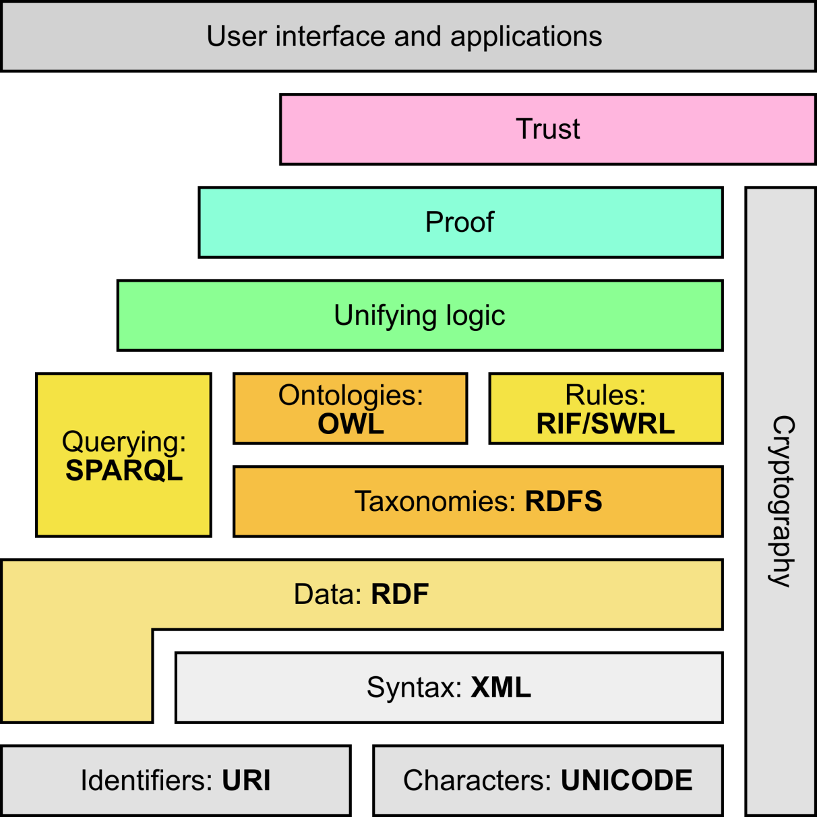
Semantic Web Stack
Adapted from http://en.wikipedia.org/wiki/Semantic_Web_Stack

Slide 5
MOTIVATION

Slide 6
Motivation
Having RDF data available is not enough
  Need tools to process, transform, and reason with the information
  Need a way to store the RDF data and interact with it
Are existing storage systems appropriate to store RDF data?
Are existing query languages appropriate to query RDF data?

Slide 7
Databases and RDF
Relational databases are a well established technology to store information and provide query support (SQL)
Relational databases have been designed and implemented to store concepts in a predefined (not frequently alterable) schema.
How can we store the following RDF data in a relational database?
<rdf:Description rdf:about="949318">
<rdf:type rdf:resource="&uni;lecturer"/>
<uni:name>Tim Berners-Lee</uni:name>
<uni:title>University Professor</uni:title>
</rdf:Description>
Several solutions are possible

Slide 8
Databases and RDF
Solution 1: Relational “Traditional” approach
Approach: We can create a table “Lecturer” to store information about the “Lecturer” RDF Class.
Drawbacks: Many times we need to add new content we have to create a new table -> Not scalable, not dynamic, not based on the RDF principles (TRIPLES)
Lecturer
id | name | title
949318 | Tim Berners-Lee | University Professor

Slide 9
Databases and RDF
Solution 2: Relational “Triple” based approach
Approach: We can create a table to maintain all the triples S P O (and distinguish between URI objects and literals objects).
Drawbacks: We are flexible w.r.t. adding new statements dynamically without any change to the database structure… but what about querying?
Statement
Subject | Predicate | ObjectURI | ObjectLiteral
101 | 102 | 103 | null
101 | 104 | null | 201
101 | 105 | null | 202
103 | … | … | null
Resources
Id | URI
101 | 949318
102 | rdf:type
103 | uni:lecturer
104 | uni:name
Literals
Id | Value
201 | Tim-Berners Lee
202 | University Professor
203 | …
… | …

Slide 10
Why Native RDF Repositories?
What happens if I want to find the names of all the lecturers?
Solution 1: Relation “traditional” approach:
  SELECT NAME FROM LECTURER
We need to query a single table which is easy, quick and performing
No JOIN required (the most expensive operation in a db query)
BUT we already said that traditional approach is inappropriate

Slide 11
Why Native RDF Repositories?
Statement
Subject | Predicate | ObjectURI | ObjectLiteral
101 | 102 | 103 | null
101 | 104 | null | 201
101 | 105 | null | 202
103 | … | … | null
Resources
Id | URI
101 | 949318
102 | rdf:type
103 | uni:lecturer
104 | uni:name
Literals
Id | Value
201 | Tim-Berners Lee
202 | University Professor
203 | …
… | …
What happens if I want to find the names of all the lecturers?
Solution 2: Relational “triple” based approach:
    SELECT L.Value FROM Literals AS L
    INNER JOIN Statement AS S ON S.ObjectLiteral=L.ID
    INNER JOIN Resources AS R ON R.ID=S.Predicate
    INNER JOIN Statement AS S1 ON S1.Subject=S.Subject
    INNER JOIN Resources AS R1 ON R1.ID=S1.Predicate
    INNER JOIN Resources AS R2 ON R2.ID=S1.ObjectURI
    WHERE R.URI = “uni:name”
    AND R1.URI = “rdf:type”
    AND R2.URI = “uni:lecturer”

Slide 12
Why Native RDF Repositories?
Solution 2
The query is quite complex: 5 JOINS!
This require a lot of optimization specific for RDF and triple data storage, that it is not included in Relational DB
For achieving efficiency a layer on top of a database is required. More, SQL is not appropriate to extract RDF fragments
Do we need a new query language?

Slide 13
Query Languages
Querying and inferencing is the very purpose of information representation in a machine-accessible way
A query language is a language that allows a user to retrieve information from a “data source”
  E.g. data sources
    A simple text file
    XML file
    A database
    The “Web”
Query languages usually includes insert and update operations

Slide 14
Example of Query Languages
SQL
  Query language for relational databases
XQuery, XPointer and XPath
  Query languages for XML data sources
SPARQL
  Query language for RDF graphs
RDQL
  Query language for RDF in Jena models

Slide 15
XPath: a simple query language for XML trees
The basis for most XML query languages
  Selection of document parts
  Search context: ordered set of nodes
Used extensively in XSLT
  XPath itself has non-XML syntax
Navigate through the XML Tree
  Similar to a file system (“/“, “../“, “ ./“, etc.)
  Query result is the final search context, usually a set of nodes
  Filters can modify the search context
  Selection of nodes by element names, attribute names, type, content, value, relations
Several pre-defined functions
Version 1.0, W3C Recommendation 16 November 1999
Version 2.0, W3C Recommendation 23 January 2007

Slide 16
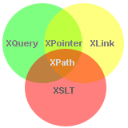
Other XML Query Languages
XQuery
  Building up on the same functions and data types
  as XPath
  With XPath 2.0 these two languages get closer
  XQuery is not XML based, but there is an XML notation (XQueryX)
  XQuery 1.0, W3C Recommendation 23 January 2007
XLink 1.0, W3C Recommendation 27 June 2001
  Defines a standard way of creating hyperlinks in XML documents
XPointer 1.0, W3C Candidate Recommendation
  Allows the hyperlinks to point to more specific parts (fragments) in the XML document
XSLT 2.0, W3C Recommendation 23 January 2007

Slide 17
Why a New Language?
RDF description (1):
<rdf:Description rdf:about="949318">
<rdf:type rdf:resource="&uni;lecturer"/>
<uni:name>Tim Berners-Lee</uni:name>
<uni:title>University Professor</uni:title>
</rdf:Description>
XPath query:
/rdf:Description[rdf:type=
"http://www.mydomain.org/uni-ns#lecturer"]/uni:name

Slide 18
Why a New Language?
RDF description (2):
<uni:lecturer rdf:about="949318">
<uni:name>Tim Berners-Lee</uni:name>
<uni:title>University Professor</uni:title>
</uni:lecturer>
XPath query:
//uni:lecturer/uni:name

Slide 19
Why a New Language?
RDF description (3):
<uni:lecturer rdf:about="949318"
uni:name=“Tim Berners-Lee"
uni:title=“University Professor"/>
XPath query:
//uni:lecturer/@uni:name

Slide 20
Why a New Language?
What is the difference between these three definitions?
RDF description (1):
<rdf:Description rdf:about="949318">
<rdf:type rdf:resource="&uni;lecturer"/>
<uni:name>Tim Berners-Lee</uni:name>
<uni:title>University Professor</uni:title>
</rdf:Description>
RDF description (2):
<uni:lecturer rdf:about="949318">
<uni:name>Tim Berners-Lee</uni:name>
<uni:title>University Professor</uni:title>
</uni:lecturer>
RDF description (3):
<uni:lecturer rdf:about="949318"
uni:name=“Tim Berners-Lee"
uni:title=“University Professor"/>

Slide 21
Why a New Language?
All three description denote the same thing:
  ⟨#949318, rdf:type, <uni:lecturer>⟩
  ⟨#949318, <uni:name>, “Tim Berners-Lee”⟩
  ⟨#949318, <uni:title>, “University Professor”⟩
But the queries are different depending on a particular serialization:
/rdf:Description[rdf:type=
"http://www.mydomain.org/uni-ns#lecturer"]/uni:name
//uni:lecturer/uni:name
//uni:lecturer/@uni:name

Slide 22
TECHNICAL SOLUTION

Slide 23
RDF REPOSITORIES
Efficient storage of RDF data

Slide 24
Semantic Repositories
Semantic repositories combine the features of:
  Database management systems (DBMS) and
  Inference engines
Rapid progress in the last 5 years
  Every couple of years the scalability increases by an order of magnitude
“Track-laying machines” for the Semantic Web
  Extending the reach of the “data railways” and
  Changing the data-economy by allowing more complex data to be managed at lower cost

Slide 25
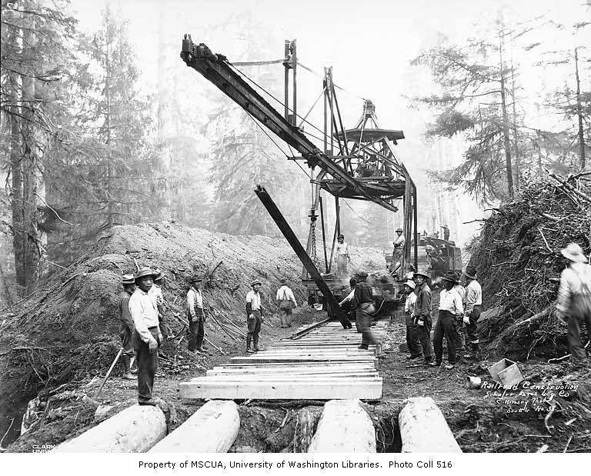
Semantic Repositories as Track-Laying Machines

Slide 26
RDBMSs vs. Semantic Repositories
The major differences with DBMS are
  Semantic repositories use ontologies as semantic schemata, which allows them to automatically reason about the data
  Semantic repositories work with a more generic datamodel, which provides a flexible means to update and extend schemata (i.e. the structure of the data)

Slide 27
RDBMSs vs. Column Stores
STATEMENT
SUBJECT | PREDICATE | OBJECT
myo:Person | rdf:type | rdfs:Class
myo:gender | rdfs:type | rdfs:Property
myo:parent | rdfs:range | myo:Person
myo:spouse | rdfs:range | myo:Person
myd:Maria | rdf:type | myo:Person
myd:Maria | rdf:label | “Maria P.”
myd:Maria | myo:gender | “F”
myd:Maria | rdf:label | “Ivan Jr.”
myd:Ivan | myo:gender | “M”
myd:Maria | myo:parent | myd:Ivan
myd:Maria | myo:spouse | myd:John
… | … | …
PERSON
ID | Name | Gender
1 | Maria P. | F
2 | Ivan Jr. | M
3 | … | …
PARENT
ParID | ChiID
1 | 2
… | …
SPOUSE
S1ID | S2ID | From | To
1 | 3
…
dynamic data schema
sparse data

Slide 28
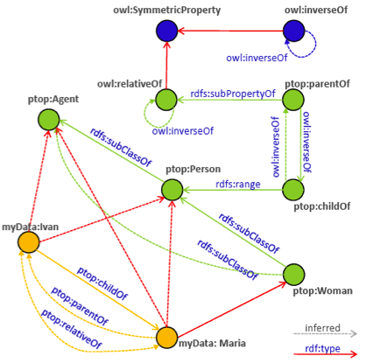
RDF Graph Materialization
<C1,rdfs:subClassOf,C2>
<C2,rdfs:subClassOf,C3>
=> <C1,rdfs:subClassOf,C3>
<I,rdf:type,C1>
<C1,rdfs:subClassOf,C2>
=> <I,rdf:type,C2>
<I1,P1,I2>
<P1,rdfs:range,C2>
=> <I2,rdf:type,C2>
<P1,owl:inverseOf,P2>
<I1,P1,I2>
=> <I2,P2,I1>
<P1,rdf:type,owl:SymmetricProperty>
=> <P1,owl:inverseOf,P1>

Slide 29
Semantic Repositories
RDF-based
Column Stores with
Inference Capabilities
RDF-based means:
Globally unique identifiers
Standard compliance

Slide 30
Major Characteristics
Easy integration of multiple data-sources
  Once the schemata of the data-sources is semantically aligned, the inference capabilities of the engine assist the interlinking and combination of facts from different sources
Easy querying against rich or diverse data schemata
  Inference is applied to match the semantics of the query to the semantics of the data, regardless of the vocabulary and data modeling patterns used for encoding the data

Slide 31
Major Characteristics continued
Great analytical power
  Semantics will be thoroughly applied even when this requires recursive inferences on multiple steps
  Discover facts, by interlinking long chains of evidence
  Vast majority of such facts would remain hidden in the DBMS
Efficient data interoperability
  Importing RDF data from one store to another is straight-forward, based on the usage of globally unique identifiers

Slide 32
Reasoning strategies
Two main strategies for rule-based inference
Forward-chaining:
  start from the known (explicit) facts and perform inference in an inductive manner until the complete closure is inferred
Backward-chaining:
  start from a particular fact and verify it against the knowledge base using deductive reasoning
  the reasoner decomposes the query (or the fact) into simpler facts that are available in the KB or can be proven through further recursive decompositions

Slide 33
Reasoning strategies continued
Inferred closure
  The extension of a KB (a graph of RDF triples) with all the implicit facts (triples) that could be inferred from it, based on the pre-defined entailment rules
Materialization
  Maintaining an up-to-date inferred closure

Slide 34
Forward chaining based materialization
Relatively slow upload/store/addition of new facts
  inferred closure is extended after each transaction
  all reasoning performed during loading
Deletion of facts is slow
  facts being no longer true are removed from the inferred closure
The maintenance of the inferred closure requires considerable resources (RAM, disc, both)
Querying and retrieval are fast
  no reasoning is required at query time
  RDBMS-like query evaluation & optimisation techniques applicable

Slide 35
Backward chaining
Loading and modification of data faster
  No time and space lost for computation and maintenance of inferred closure of data
Query evaluation is slower
  Extensive query rewriting necessary
  Potentially larger number of lookups in indices

Slide 36
Choice of Reasoning Strategy
Avoid materialization when
  Data updated very intensively
  (high costs for maintenance of inferred closure)
  Time and space for inferred closure are hard to secure
Avoid backward chaining when
  Query loads are challenging
  Low response times need to be guaranteed

Slide 37
Showcase - owl:sameAs
(Fact1) geonames:2761369 gno:parentFeature geonames:2761367
(Fact2) geonames:2761367 gno:parentFeature geonames: 2782113
(Trans) geonames:2761369 gno:parentFeature geonames:2782113 (from F1,F2)
(Align1) dbpedia:Vienna owl:sameAs geonames:2761369
(I1) dbpedia:Vienna gno:parentFeature geonames:2761367 (from A1,F1)
(I2) dbpedia:Vienna gno:parentFeature geonames: 2782113 (from A1,Trans)
(Align2) dbpedia:Austria owl:sameAs geonames:2782113
(I3) geonames:2761367 gno:parentFeature geonames:Austria (from A2,F2)
(I4) geonames:2761369 gno:parentFeature geonames:Austria (from A2,Trans)
(I5) dbpedia:Vienna gno:parentFeature dbpedia:Austria (from A2,I2)
owl:sameAs
  is highly useful for interlinking
  causes considerable inflation of the number of implicit facts

Slide 38
How to choose an RDF Triple Store
Tasks to be benchmarked:
Data loading
  parsing, persistence, and indexing
Query evaluation
  query preparation and optimization, fetching
Data modification
  may involve changes to the ontologies and schemata
Inference is not a first-level activity
  Depending on the implementation, it can affect the performance of the other activities

Slide 39
Performance Factors for Data Loading
Materialization
  Whether forward-chaining is performed at load time & the complexity of forward-chaining
Data model complexity
  Support for extended RDF data models (e.g. named graphs), is computationally more expensive
Indexing specifics
  Repositories can apply different indexing strategies depending on the data loaded, usage patterns, etc.
Data access and location
  Where the data is imported from (local files, loaded from network)

Slide 40
Performance Factors for Query Evaluation
Deduction
  Whether and how complex backward-chaining is involved
Size of the result-set
  Fetching large result-sets can take considerable time
Query complexity
  Number of constraints (e.g. triple-pattern joins)
  Semantics of query (e.g. negation-, disjunction-related clauses)
  Use of operators that cannot be optimized (e.g. LIKE)
Number of concurrent clients
Quality of results

Slide 41
Distributed approaches to
RDF Materialization

Slide 42
Distributed RDF Materialization with MapReduce
Distributed approach by Urbani et al., ISWC’2009
“Scalable Distributed Reasoning using MapReduce”
64 node Hadoop cluster
MapReduce
  Map phase: partitions the input space by some key
  Reduce phase: perform some aggregated processing on each partition (from the Map phase)
The partition contains all elements for a particular key
Skewed distribution means uneven load on Reduce nodes
Balanced Reduce load almost impossible to achieve
  major M/R drawback

Slide 43
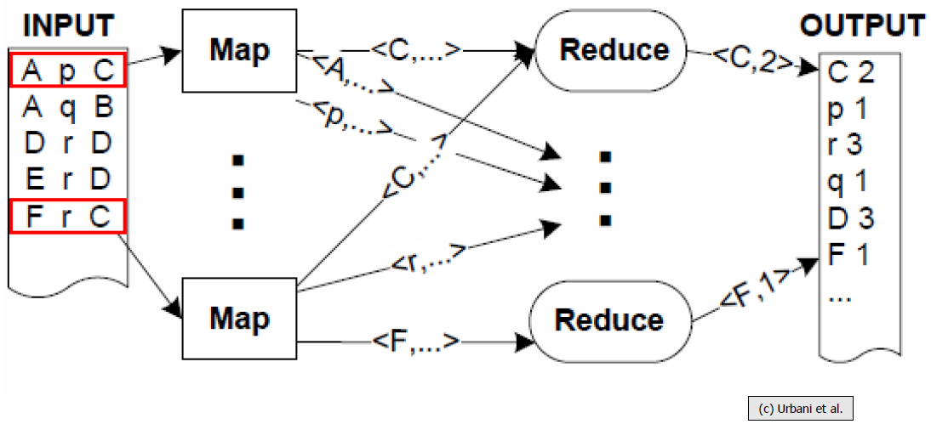
Distributed RDF Materialization with MapReduce

Slide 44
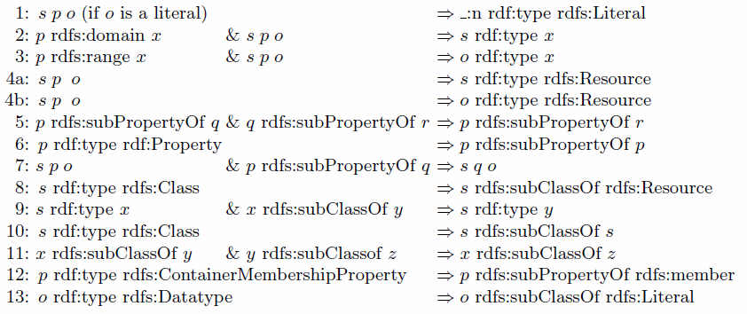
RDFS entailment (reminder)

Slide 45
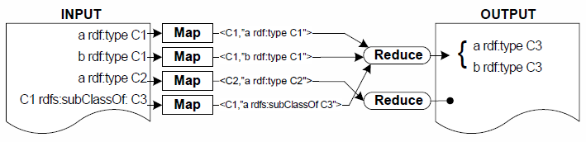
RDF Materialization – Naïve Approach
applying all RDFS rules iteratively on the input until no new data is derived (fixpoint)
  rules with one antecedent are easy
  rules with 2 antecedents require map/reduce jobs
Map function
  Key is S, P or O, value is original triple
  3 key/value pairs generated for each input triple
Reduce function – performs the join
Encoding rule 9

Slide 46
RDF Materialization – Optimized Approach
Problems with the “naïve” approach
  One iteration is not enough
  Too many duplicates generated
    Ratio of unique:duplicate triples is around 1:50
Optimised approach
  Load schema triples in memory (0.001-0.01% of triples)
    On each node joins are made between a very small set of schema triples and a large set of instance triples
    Only the instance triples are streamed by the MapReduce pipeline

Slide 47
RDF Materialization – Optimized Approach
Data grouping to avoid duplicates
  Map phase:
    set as key those parts of the data input (S/P/O) that also occur in the derived triple. All triples that would produce duplicate triples will thus be sent to the same Reducer – which can eliminate those duplicates.
    set as value those parts of the data input (S/P/O) that will be matched against the schema input in memory
  Join with schema triples during the Reduce phase to reduce duplicates
Ordering the sequence of rule application
  Analyse the ruleset and determine which rules may trigger other rules
  Dependency graph, optimal application of rules from bottom-up

Slide 48
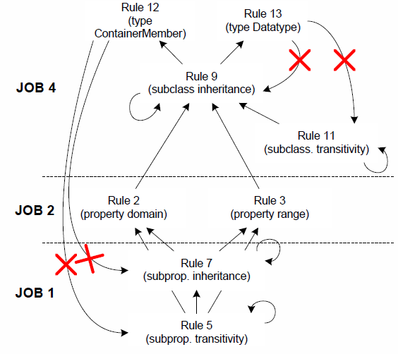
RDF Materialization – Rule reordering
Job 3:
Duplicate removal

Slide 49
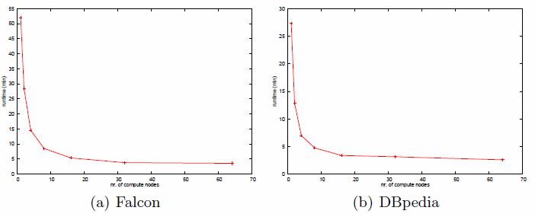
RDF Materialization with MapReduce
Benchmarks
Performance benchmarks
  RDFS-closure of 865M triples yields 30 billion triples
  4.3 million triples / sec (30 billion in ~2h)

Slide 50
ILLUSTRATION
BY A LARGER EXAMPLE
OWLIM – A semantic repository

Slide 51
What is OWLIM?
OWLIM is a scalable semantic repository
  Management, integration, and analysis of heterogeneous data
  Combined with light-weight reasoning capabilities
  http://www.ontotext.com/owlim
OWLIM is RDF database with
high-performance reasoning
  The inference is based on logical rule-entailment
  Full RDFS and limited OWL Lite and Horst are supported
  Custom semantics defined via rules and axiomatic triples

Slide 52
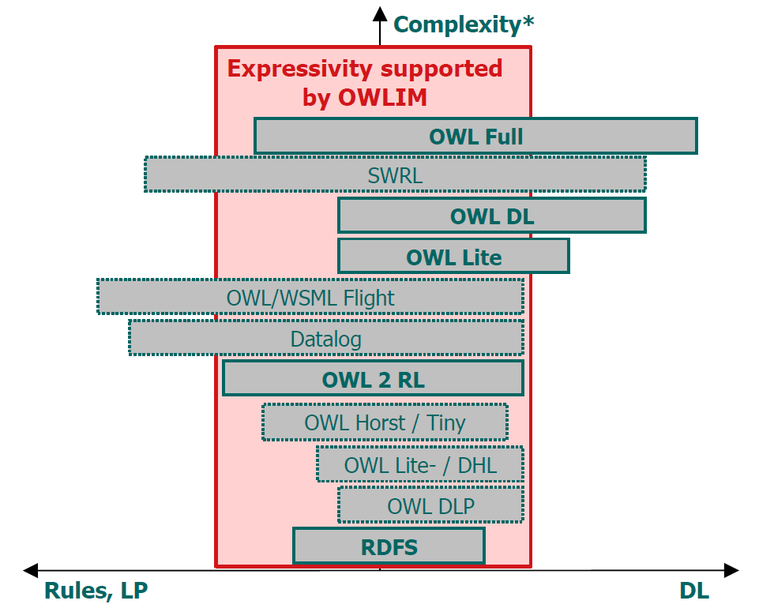
OWL Fragments and OWLIM

Slide 53
Using OWLIM
OWLIM is implemented in Java and packaged as a storage and inference layer (SAIL) for the Sesame RDF database
OWLIM is based on TRREE
  TRREE = Triple Reasoning and Rule Entailment Engine
  TRREE takes care of storage, indexing, inference and query evaluation
  TRREE has different flavors, mapping to different OWLIM species
OWLIM can be used and accessed in different ways:
  By end user: through the web UI routines of Sesame
  By applications: though the API’s of Sesame
  Applications can either embed it as a library or access it as standalone server

Slide 54
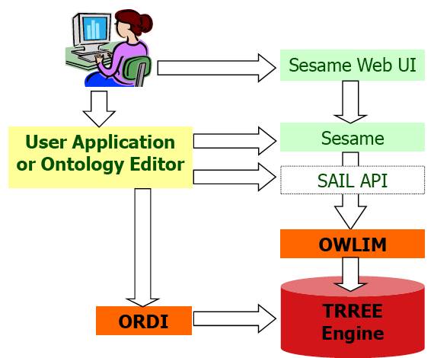
Sesame, TRREE, ORDI, and OWLIM
http://www.ontotext.com/ordi

Slide 55
OWLIM versions
Two major OWLIM species: SwiftOWLIM and BigOWLIM
  Based on the corresponding versions of TRREE
  Share the same inference and semantics (rule-compiler, etc.)
  They are identical in terms of usage and integration
    The same APIs, syntaxes, languages (thanks to Sesame)
    Different are only the configuration parameters for performance tuning
SwiftOWLIM is good for experiments and medium-sized data
  Extremely fast loading of data (incl. inference, storage, etc.)
  Reasoning and query evaluation in memory
  Can handle millions of explicit statements on desktop hardware
BigOWLIM designed for huge volumes of data and intensive querying
  Query optimizations ensure faster query evaluation on large datasets
  Scales much better, having lower memory requirements
  Can handle billions of statements on entry-level server
  Can serve multiple simultaneous use sessions

Slide 56
SwiftOWLIM
SwiftOWLIM uses SwiftTRREE engine
It performs in-memory reasoning and query evaluation
  Based on hash-table-like indices
Combined with reliable persistence strategy
Very fast upload, retrieval, query evaluation for huge KB
  It scales to 10 million statements on a $500-worth PC
  It loads the 7M statements of LUBM(50,0) dataset in 2 minutes
Persistency (in SwiftOWLIM 3.0):
  Binary Persistence, including the inferred statements
  Allows for instance initialization

Slide 57
BigOWLIM
BigOWLIM is an enterprise class repository
  http://www.ontotext.com/owlim/big/
BigOWLIM is an even more scalable not-in-memory version, based on the corresponding version of the TRREE engine
  The “light-weight” version of OWLIM, which uses in-memory reasoning and query evaluation is referred as SwiftOWLIM
BigOWLIM does not need to maintain all the concepts of the repository in the main memory in order to operate
BigOWLIM stores the contents of the repository (including the “inferred closure”) in binary files
  This allows instant startup and initialization of large repositories, because it does not need to parse, re-load and re-infer all knowledge from scratch

Slide 58
BigOWLIM vs. SwiftOWLIM
BigOWLIM uses sorted indices
  While the indices of SwiftOWLIM are essentially hash-tables
  In addition to this BigOWLIM maintains data statistics, to allow …
Database-like query optimizations
  Re-ordering of the constraints in the query has no impact on the execution time
  Combined with the other optimizations, this feature delivers dramatic improvements to the evaluation time of “heavy” queries
Special handling of equivalence classes
  Large equivalent classes does not cause excessive generation of inferred statements

Slide 59
SwiftOWLIM and BigOWLIM
 | SwiftOWLIM | BigOWLIM
Scale (Mil. of explicit statem.) | 10 MSt, using 1.6 GB RAM 100 MSt, using 16 GB RAM | 130 MSt, using 1.6 GB 1068 MSt, using 8 GB
Processing speed (load + infer + store) | 30 KSt/s on notebook 200 KSt/s on server | 5KSt/s on notebook 60 KSt/s on server
Query optimization | No | Yes
Persistence | Back-up in N-Triples | Binary data files and indices
License and Availability | Open-source under LGPL; Uses SwiftTRREE that is free, but not open-source | Commercial. Research and evaluation copies provided for free

Slide 60
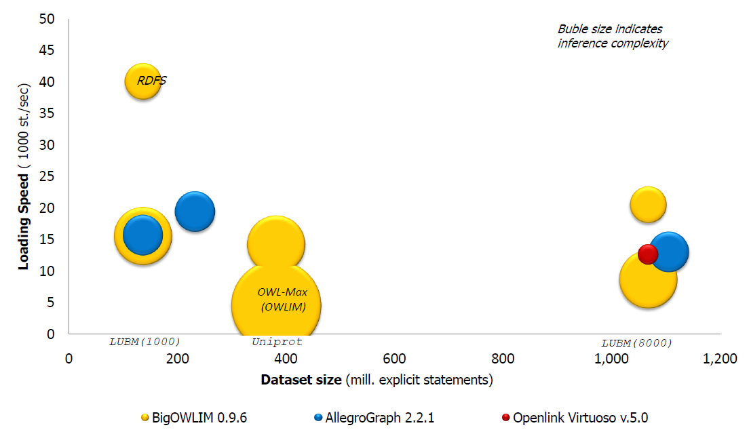
Benchmark comparison – September 2007

Slide 61
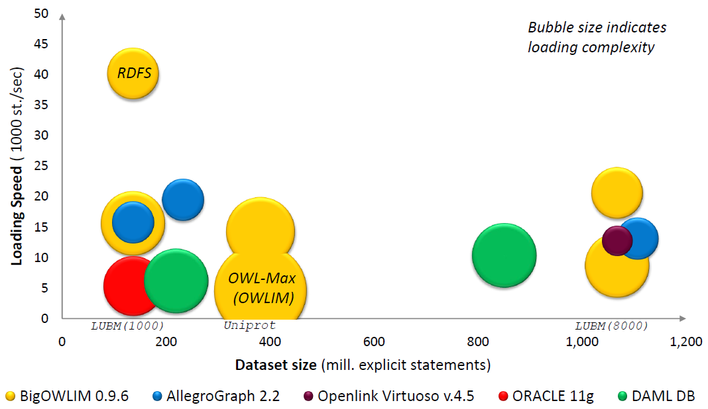
Benchmark comparison – November 2007

Slide 62
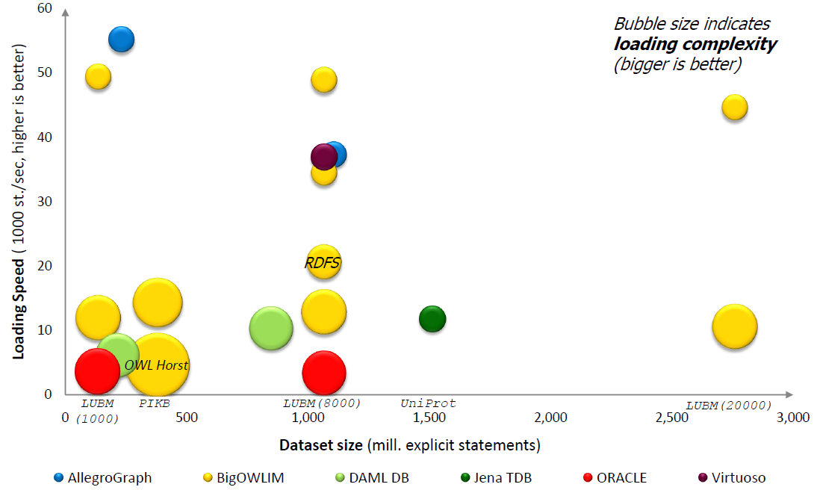
Benchmark comparison – October 2008

Slide 63
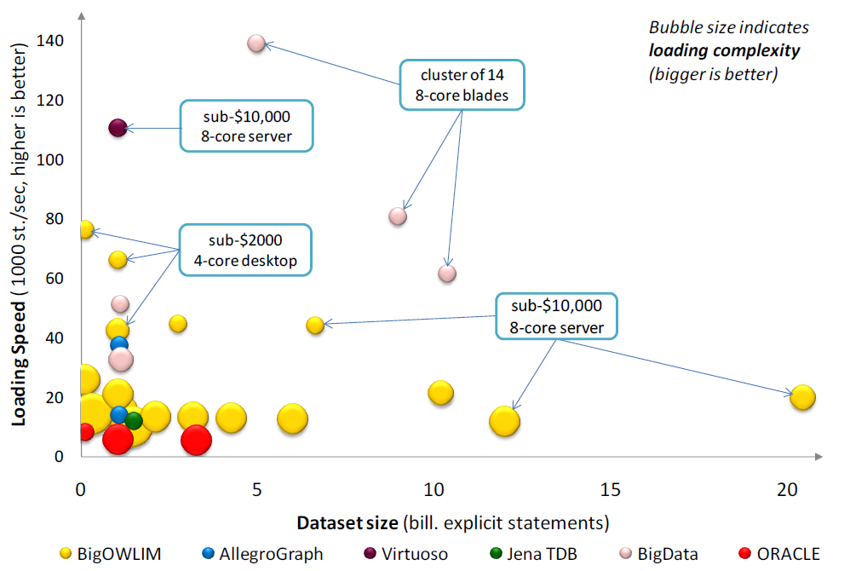
Benchmark comparison – June 2009

Slide 64
SPARQL
A language to query RDF data

Slide 65
Querying RDF
SPARQL
  RDF Query language
  Based on RDQL
  Uses SQL-like syntax
Example:
  PREFIX uni: <http://example.org/uni/>
  SELECT ?name
  FROM <http://example.org/personal>
  WHERE { ?s uni:name ?name.
  ?s rdf:type uni:lecturer }

Slide 66
SPARQL Queries
PREFIX uni: <http://example.org/uni/>
SELECT ?name
FROM <http://example.org/personal>
WHERE { ?s uni:name ?name. ?s rdf:type uni:lecturer }
PREFIX
  Prefix mechanism for abbreviating URIs
SELECT
  Identifies the variables to be returned in the query answer
  SELECT DISTINCT
  SELECT REDUCED
FROM
  Name of the graph to be queried
  FROM NAMED
WHERE
  Query pattern as a list of triple patterns
LIMIT
OFFSET
ORDER BY

Slide 67
SPARQL Query keywords
PREFIX: based on namespaces
DISTINCT: The DISTINCT solution modifier eliminates duplicate solutions. Specifically, each solution that binds the same variables to the same RDF terms as another solution is eliminated from the solution set.
REDUCED: While the DISTINCT modifier ensures that duplicate solutions are eliminated from the solution set, REDUCED simply permits them to be eliminated. The cardinality of any set of variable bindings in a REDUCED solution set is at least one and not more than the cardinality of the solution set with no DISTINCT or REDUCED modifier.
LIMIT: The LIMIT clause puts an upper bound on the number of solutions returned. If the number of actual solutions is greater than the limit, then at most the limit number of solutions will be returned.

Slide 68
SPARQL Query keywords
OFFSET: OFFSET causes the solutions generated to start after the specified number of solutions. An OFFSET of zero has no effect.
ORDER BY: The ORDER BY clause establishes the order of a solution sequence.
Following the ORDER BY clause is a sequence of order comparators, composed of an expression and an optional order modifier (either ASC() or DESC()). Each ordering comparator is either ascending (indicated by the ASC() modifier or by no modifier) or descending (indicated by the DESC() modifier).

Slide 69
Example RDF Graph
<http://example.org/#john> <http://.../vcard-rdf/3.0#FN> "John Smith“
<http://example.org/#john> <http://.../vcard-rdf/3.0#N> :_X1
_:X1 <http://.../vcard-rdf/3.0#Given> "John"
_:X1 <http://.../vcard-rdf/3.0#Family> "Smith“
<http://example.org/#john> <http://example.org/#hasAge> "32“
<http://example.org/#john> <http://example.org/#marriedTo> <#mary>
<http://example.org/#mary> <http://.../vcard-rdf/3.0#FN> "Mary Smith“
<http://example.org/#mary> <http://.../vcard-rdf/3.0#N> :_X2
_:X2 <http://.../vcard-rdf/3.0#Given> "Mary"
_:X2 <http://.../vcard-rdf/3.0#Family> "Smith"
<http://example.org/#mary> <http://example.org/#hasAge> "29"

Slide 70
SPARQL Queries: All Full Names
“Return the full names of all people in the graph”
PREFIX vCard: <http://www.w3.org/2001/vcard-rdf/3.0#>
SELECT ?fullName
WHERE {?x vCard:FN ?fullName}
result:
fullName
=================
"John Smith"
"Mary Smith"
@prefix ex: <http://example.org/#> .
@prefix vcard: <http://www.w3.org/2001/vcard-rdf/3.0#> .
ex:john
vcard:FN "John Smith" ;
vcard:N [
vcard:Given "John" ;
vcard:Family "Smith" ] ;
ex:hasAge 32 ;
ex:marriedTo :mary .
ex:mary
vcard:FN "Mary Smith" ;
vcard:N [
vcard:Given "Mary" ;
vcard:Family "Smith" ] ;
ex:hasAge 29 .
Notes:
Turtle RDF notation ☺

Slide 71
SPARQL Queries: Properties
“Return the relation between John and Mary”
PREFIX ex: <http://example.org/#>
SELECT ?p
WHERE {ex:john ?p ex:mary}
result:
p
=================
<http://example.org/#marriedTo>
@prefix ex: <http://example.org/#> .
@prefix vcard: <http://www.w3.org/2001/vcard-rdf/3.0#> .
ex:john
vcard:FN "John Smith" ;
vcard:N [
vcard:Given "John" ;
vcard:Family "Smith" ] ;
ex:hasAge 32 ;
ex:marriedTo :mary .
ex:mary
vcard:FN "Mary Smith" ;
vcard:N [
vcard:Given "Mary" ;
vcard:Family "Smith" ] ;
ex:hasAge 29 .

Slide 72
SPARQL Queries: Complex Patterns
“Return the spouse of a person by the name of John Smith”
PREFIX vCard: <http://www.w3.org/2001/vcard-rdf/3.0#>
PREFIX ex: <http://example.org/#>
SELECT ?y
WHERE {?x vCard:FN "John Smith".
?x ex:marriedTo ?y}
result:
y
=================
<http://example.org/#mary>
@prefix ex: <http://example.org/#> .
@prefix vcard: <http://www.w3.org/2001/vcard-rdf/3.0#> .
ex:john
vcard:FN "John Smith" ;
vcard:N [
vcard:Given "John" ;
vcard:Family "Smith" ] ;
ex:hasAge 32 ;
ex:marriedTo :mary .
ex:mary
vcard:FN "Mary Smith" ;
vcard:N [
vcard:Given "Mary" ;
vcard:Family "Smith" ] ;
ex:hasAge 29 .
Notes:
What is doing this query?

Slide 73
SPARQL Queries: Complex Patterns
“Return the spouse of a person by the name of John Smith”
PREFIX vCard: <http://www.w3.org/2001/vcard-rdf/3.0#>
PREFIX ex: <http://example.org/#>
SELECT ?y
WHERE {?x vCard:FN "John Smith".
?x ex:marriedTo ?y}
result:
y
=================
<http://example.org/#mary>
@prefix ex: <http://example.org/#> .
@prefix vcard: <http://www.w3.org/2001/vcard-rdf/3.0#> .
ex:john
vcard:FN "John Smith" ;
vcard:N [
vcard:Given "John" ;
vcard:Family "Smith" ] ;
ex:hasAge 32 ;
ex:marriedTo :mary .
ex:mary
vcard:FN "Mary Smith" ;
vcard:N [
vcard:Given "Mary" ;
vcard:Family "Smith" ] ;
ex:hasAge 29 .

Slide 74
SPARQL Queries: Blank Nodes
“Return the first name of all people in the KB”
PREFIX vCard: <http://www.w3.org/2001/vcard-rdf/3.0#>
SELECT ?name, ?firstName
WHERE {?x vCard:N ?name .
?name vCard:Given ?firstName}
result:
name firstName
=================
_:a "John"
_:b "Mary"
@prefix ex: <http://example.org/#> .
@prefix vcard: <http://www.w3.org/2001/vcard-rdf/3.0#> .
ex:john
vcard:FN "John Smith" ;
vcard:N [
vcard:Given "John" ;
vcard:Family "Smith" ] ;
ex:hasAge 32 ;
ex:marriedTo :mary .
ex:mary
vcard:FN "Mary Smith" ;
vcard:N [
vcard:Given "Mary" ;
vcard:Family "Smith" ] ;
ex:hasAge 29 .
Notes:
What is doing this query?

Slide 75
SPARQL Queries: Blank Nodes
“Return the first name of all people in the KB”
PREFIX vCard: <http://www.w3.org/2001/vcard-rdf/3.0#>
SELECT ?name, ?firstName
WHERE {?x vCard:N ?name .
?name vCard:Given ?firstName}
result:
name firstName
=================
_:a "John"
_:b "Mary"
@prefix ex: <http://example.org/#> .
@prefix vcard: <http://www.w3.org/2001/vcard-rdf/3.0#> .
ex:john
vcard:FN "John Smith" ;
vcard:N [
vcard:Given "John" ;
vcard:Family "Smith" ] ;
ex:hasAge 32 ;
ex:marriedTo :mary .
ex:mary
vcard:FN "Mary Smith" ;
vcard:N [
vcard:Given "Mary" ;
vcard:Family "Smith" ] ;
ex:hasAge 29 .

Slide 76
SPARQL Queries: Building RDF Graph
“Rewrite the naming information in original graph by using the foaf:name”
PREFIX vCard: <http://www.w3.org/2001/vcard-rdf/3.0#>
PREFIX foaf: <http://xmlns.com/foaf/0.1/>
CONSTRUCT { ?x foaf:name ?name }
WHERE { ?x vCard:FN ?name }
result:
#john foaf:name “John Smith"
#marry foaf:name “Marry Smith"
@prefix ex: <http://example.org/#> .
@prefix vcard: <http://www.w3.org/2001/vcard-rdf/3.0#> .
ex:john
vcard:FN "John Smith" ;
vcard:N [
vcard:Given "John" ;
vcard:Family "Smith" ] ;
ex:hasAge 32 ;
ex:marriedTo :mary .
ex:mary
vcard:FN "Mary Smith" ;
vcard:N [
vcard:Given "Mary" ;
vcard:Family "Smith" ] ;
ex:hasAge 29 .
Notes:
SPARQL Construct returns a new graph

Slide 77
SPARQL Queries: Building RDF Graph
“Rewrite the naming information in original graph by using the foaf:name”
PREFIX vCard: <http://www.w3.org/2001/vcard-rdf/3.0#>
PREFIX foaf: <http://xmlns.com/foaf/0.1/>
CONSTRUCT { ?x foaf:name ?name }
WHERE { ?x vCard:FN ?name }
result:
#john foaf:name “John Smith"
#marry foaf:name “Marry Smith"
@prefix ex: <http://example.org/#> .
@prefix vcard: <http://www.w3.org/2001/vcard-rdf/3.0#> .
ex:john
vcard:FN "John Smith" ;
vcard:N [
vcard:Given "John" ;
vcard:Family "Smith" ] ;
ex:hasAge 32 ;
ex:marriedTo :mary .
ex:mary
vcard:FN "Mary Smith" ;
vcard:N [
vcard:Given "Mary" ;
vcard:Family "Smith" ] ;
ex:hasAge 29 .
<rdf:RDF
xmlns:rdf="http://www.w3.org/1999/02/22-rdf-syntax-ns#"
xmlns:foaf="http://xmlns.com/foaf/0.1/“
xmlns:ex="http://example.org“>
<rdf:Description rdf:about=ex:john>
<foaf:name>John Smith</foaf:name>
</rdf:Description>
<rdf:Description rdf:about=ex:marry>
<foaf:name>Marry Smith</foaf:name>
</rdf:Description>
</rdf:RDF>

Slide 78
SPARQL Queries:
Testing if the Solution Exists
“Are there any married persons in the KB?”
PREFIX ex: <http://example.org/#>
ASK { ?person ex:marriedTo ?spouse }
result:
yes
=================
@prefix ex: <http://example.org/#> .
@prefix vcard: <http://www.w3.org/2001/vcard-rdf/3.0#> .
ex:john
vcard:FN "John Smith" ;
vcard:N [
vcard:Given "John" ;
vcard:Family "Smith" ] ;
ex:hasAge 32 ;
ex:marriedTo :mary .
ex:mary
vcard:FN "Mary Smith" ;
vcard:N [
vcard:Given "Mary" ;
vcard:Family "Smith" ] ;
ex:hasAge 29 .

Slide 79
SPARQL Queries: Constraints (Filters)
“Return all people over 30 in the KB”
PREFIX ex: <http://example.org/#>
SELECT ?x
WHERE {?x hasAge ?age .
FILTER(?age > 30)}
result:
x
=================
<http://example.org/#john>
@prefix ex: <http://example.org/#> .
@prefix vcard: <http://www.w3.org/2001/vcard-rdf/3.0#> .
ex:john
vcard:FN "John Smith" ;
vcard:N [
vcard:Given "John" ;
vcard:Family "Smith" ] ;
ex:hasAge 32 ;
ex:marriedTo :mary .
ex:mary
vcard:FN "Mary Smith" ;
vcard:N [
vcard:Given "Mary" ;
vcard:Family "Smith" ] ;
ex:hasAge 29 .

Slide 80
SPARQL Queries: Optional Patterns
“Return all people and (optionally) their spouse”
PREFIX ex: <http://example.org/#>
SELECT ?person, ?spouse
WHERE {?person ex:hasAge ?age .
OPTIONAL { ?person ex:marriedTo ?spouse } }
result:
?person ?spouse
=============================
<http://example.org/#mary>
<http://example.org/#john> <http://example.org/#mary>
@prefix ex: <http://example.org/#> .
@prefix vcard: <http://www.w3.org/2001/vcard-rdf/3.0#> .
ex:john
vcard:FN "John Smith" ;
vcard:N [
vcard:Given "John" ;
vcard:Family "Smith" ] ;
ex:hasAge 32 ;
ex:marriedTo :mary .
ex:mary
vcard:FN "Mary Smith" ;
vcard:N [
vcard:Given "Mary" ;
vcard:Family "Smith" ] ;
ex:hasAge 29 .

Slide 81
SPARQL Queries: Negation in SPARQL 1.0
“Return all people who are not married”
PREFIX ex: <http://example.org/#>
SELECT ?person
WHERE { ?person ex:hasAge ?age .
OPTIONAL { ?person ex:marriedTo ?spouse }
FILTER (!BOUND(?spouse))
}
result:
?person
=============================
<http://example.org/#mary>
@prefix ex: <http://example.org/#> .
@prefix vcard: <http://www.w3.org/2001/vcard-rdf/3.0#> .
ex:john
vcard:FN "John Smith" ;
vcard:N [
vcard:Given "John" ;
vcard:Family "Smith" ] ;
ex:hasAge 32 ;
ex:marriedTo :mary .
ex:mary
vcard:FN "Mary Smith" ;
vcard:N [
vcard:Given "Mary" ;
vcard:Family "Smith" ] ;
ex:hasAge 29 .

Slide 82
SPARQL Queries: Negation in SPARQL 1.1
“Return all people who are not married”
PREFIX ex: <http://example.org/#>
SELECT ?person
WHERE { ?person ex:hasAge ?age .
NOT EXISTS { ?person ex:marriedTo ?spouse }
}
result:
?person
=============================
<http://example.org/#mary>
@prefix ex: <http://example.org/#> .
@prefix vcard: <http://www.w3.org/2001/vcard-rdf/3.0#> .
ex:john
vcard:FN "John Smith" ;
vcard:N [
vcard:Given "John" ;
vcard:Family "Smith" ] ;
ex:hasAge 32 ;
ex:marriedTo :mary .
ex:mary
vcard:FN "Mary Smith" ;
vcard:N [
vcard:Given "Mary" ;
vcard:Family "Smith" ] ;
ex:hasAge 29 .
Isn’t marriedTo a symmetric relationship?
Then mary should not be in the answer set
SPARQL query evaluation under the right entailment would return empty answer

Slide 83
AN ALGEBRA FOR PATTERN MATCHING EXPRESSIONS
(the slides of this part are based on material from M. Arenas and J. Perez)
SPARQL Semantics

Slide 84
SPARQL queries can be complex
Interesting features include:
{ P1
P2 }

Slide 85
SPARQL queries can be complex
Interesting features include
Grouping
{ { P1
P2 }
{ P3
P4 }
}

Slide 86
SPARQL queries can be complex
Interesting features include
Grouping
Optional parts
{ { P1
P2
OPTIONAL { P5 } }
{ P3
P4
OPTIONAL { P7 } }
}

Slide 87
SPARQL queries can be complex
Interesting features include
Grouping
Optional parts
Nesting
{ { P1
P2
OPTIONAL { P5 } }
{ P3
P4
OPTIONAL { P7
OPTIONAL { P8 } } }
}

Slide 88
SPARQL queries can be complex
Interesting features include
Grouping
Optional parts
Nesting
Union of patterns
{ { P1
P2
OPTIONAL { P5 } }
{ P3
P4
OPTIONAL { P7
OPTIONAL { P8 } } }
}
UNION
{ P9 }

Slide 89
SPARQL queries can be complex
Interesting features include
Grouping
Optional parts
Nesting
Union of patterns
Filtering
{ { P1
P2
OPTIONAL { P5 } }
{ P3
P4
OPTIONAL { P7
OPTIONAL { P8 } } }
}
UNION
{ P9
FILTER ( R ) }

Slide 90
SPARQL queries can be complex
Interesting features include
Grouping
Optional parts
Nesting
Union of patterns
Filtering
{ { P1
P2
OPTIONAL { P5 } }
{ P3
P4
OPTIONAL { P7
OPTIONAL { P8 } } }
}
UNION
{ P9
FILTER ( R ) }
We will focus on pattern matching expressions found in the WHERE clause of SPARQL queries

Slide 91
A standard SPARQL syntax
Triple patterns: triples including variables from a set V
?X :player “Rafa” (?X, player, Rafa)
Graph patterns: full parenthesized algebra
{ P1 P2 } ( P1 AND P2 )
{ P1 OPTIONAL { P2 }} ( P1 OPT P2 )
{ P1 } UNION { P2 } ( P1 UNION P2 )
{ P1 FILTER ( R ) } ( P1 FILTER R )
original SPARQL syntax algebraic syntax

Slide 92
A standard SPARQL syntax
Explicit precedence/association
{ t1
t2
OPTIONAL { t3 }
OPTIONAL { t4 }
t5
}
( ( ( ( t1 AND t2 ) OPT t3 ) OPT t4 ) AND t5 )

Slide 93
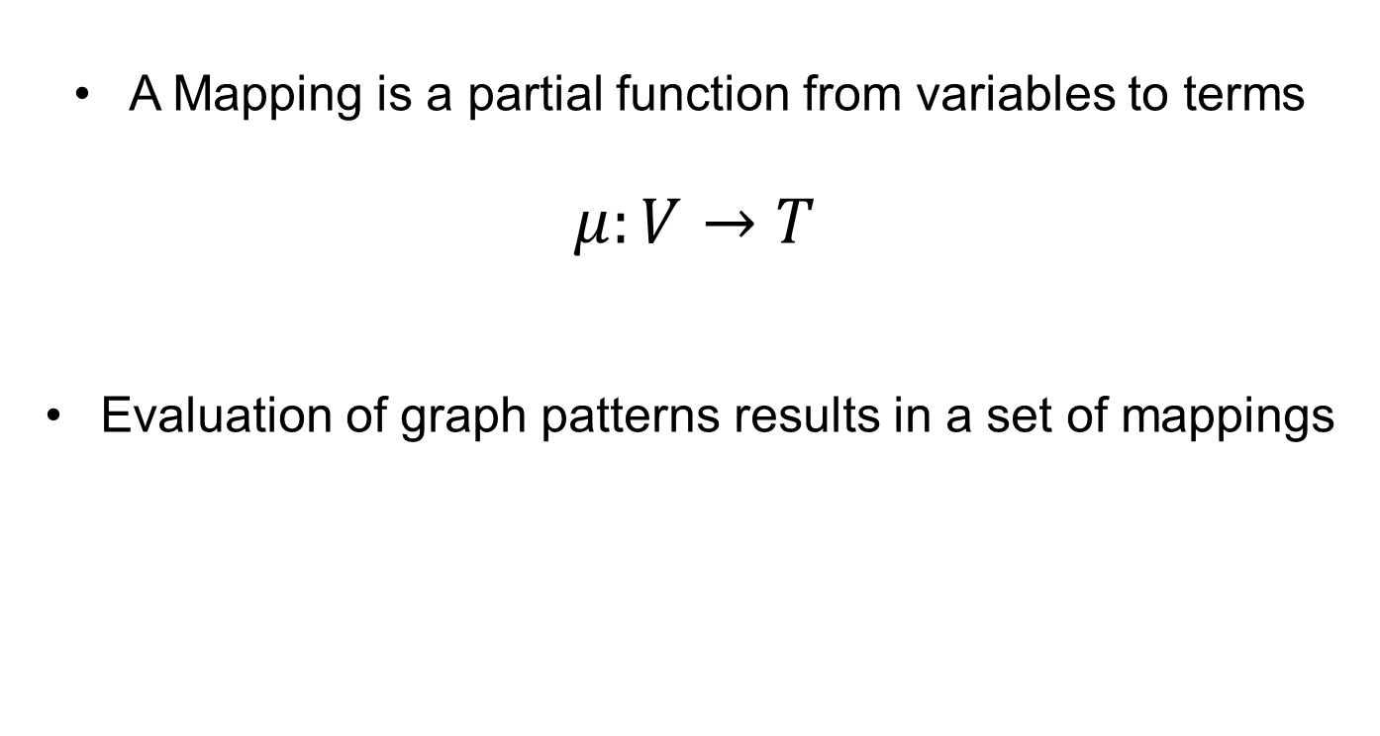
Mappings – building blocks for the semantics
A Mapping is a partial function from variables to terms
$μ:V→T$
Evaluation of graph patterns results in a set of mappings

Slide 94
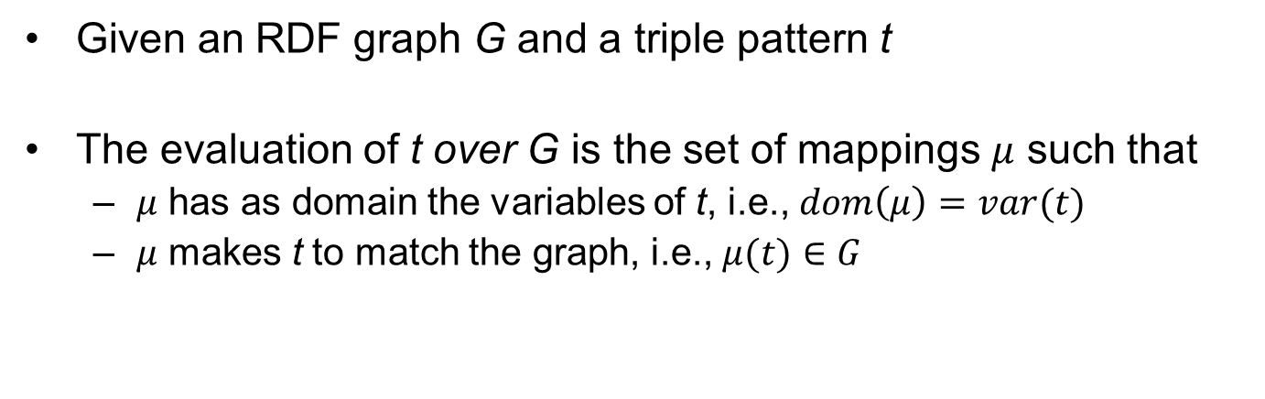
SPARQL – Semantics of Triple Patterns
Given an RDF graph G and a triple pattern t
The evaluation of t over G is the set of mappings $μ$ such that
  $μ$ has as domain the variables of t, i.e., $dom\left(μ\right)=var(t)$
  $μ$ makes t to match the graph, i.e., $μ(t)∈G$

Slide 95

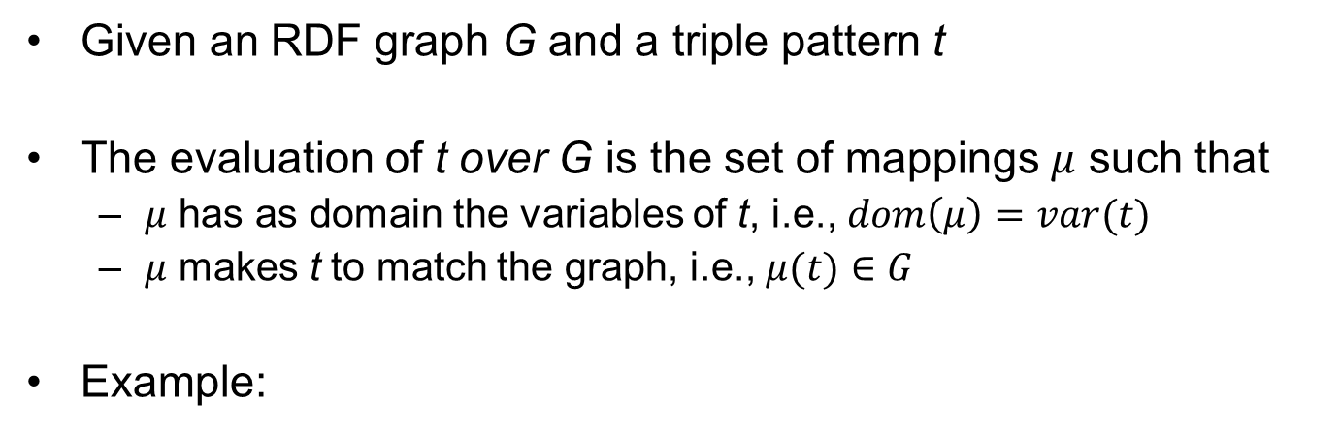

SPARQL – Semantics of Triple Patterns
Given an RDF graph G and a triple pattern t
The evaluation of t over G is the set of mappings $μ$ such that
  $μ$ has as domain the variables of t, i.e., $dom\left(μ\right)=var(t)$
  $μ$ makes t to match the graph, i.e., $μ(t)∈G$
Example:
graph
(S1, player, Rafa)
(S1, ranking, 1)
(S2, player, Roger)
triple pattern
(?X, player, ?Y)
evaluation
?X | ?Y
S1 | Rafa
S2 | Roger
$μ_{1}$:
$μ_{2}$:

Slide 96

SPARQL – Semantics of Triple Patterns
Given an RDF graph G and a triple pattern t
The evaluation of t over G is the set of mappings $μ$ such that
  $μ$ has as domain the variables of t, i.e., $dom\left(μ\right)=var(t)$
  $μ$ makes t to match the graph, i.e., $μ(t)∈G$
Example:
graph
(S1, player, Rafa)
(S1, ranking, 1)
(S2, player, Roger)
triple pattern
(?X, player, ?Y)
evaluation
?X | ?Y
S1 | Rafa
S2 | Roger
$μ_{1}$:
$μ_{2}$:

Slide 97

SPARQL – Semantics of Triple Patterns
Given an RDF graph G and a triple pattern t
The evaluation of t over G is the set of mappings $μ$ such that
  $μ$ has as domain the variables of t, i.e., $dom\left(μ\right)=var(t)$
  $μ$ makes t to match the graph, i.e., $μ(t)∈G$
Example:
graph
(S1, player, Rafa)
(S1, ranking, 1)
(S2, player, Roger)
triple pattern
(?X, player, ?Y)
evaluation
?X | ?Y
S1 | Rafa
S2 | Roger
$μ_{1}$:
$μ_{2}$:

Slide 98

SPARQL – Compatible Mappings
Mappings $μ_{1}$ and $μ_{2}$are compatible when they agree on their common variables:
if $?x∈dom(μ_{1})∩dom(μ_{2})$, then $μ_{1}\left(?x\right)=μ_{2}(?x)$

Slide 99




SPARQL – Compatible Mappings
Mappings $μ_{1}$ and $μ_{2}$are compatible when they agree on their common variables:
if $?x∈dom(μ_{1})∩dom(μ_{2})$, then $μ_{1}\left(?x\right)=μ_{2}(?x)$
Example:
?X | ?N | ?R | ?P
S1 | player
S1 |  | 1
 |  | 2 | 9000
$μ_{1}$:
$μ_{2}$:
$μ_{3}$:

Slide 100


SPARQL – Compatible Mappings
Mappings $μ_{1}$ and $μ_{2}$are compatible when they agree on their common variables:
if $?x∈dom(μ_{1})∩dom(μ_{2})$, then $μ_{1}\left(?x\right)=μ_{2}(?x)$
Example:
?X | ?N | ?R | ?P
S1 | player
S1 |  | 1
 |  | 2 | 9000
$μ_{1}$:
$μ_{2}$:
$μ_{3}$:

Slide 101

SPARQL – Compatible Mappings
Mappings $μ_{1}$ and $μ_{2}$are compatible when they agree on their common variables:
if $?x∈dom(μ_{1})∩dom(μ_{2})$, then $μ_{1}\left(?x\right)=μ_{2}(?x)$
Example:
?X | ?N | ?R | ?P
S1 | player
S1 |  | 1
 |  | 2 | 9000
S1 | player | 1
$μ_{1}$:
$μ_{2}$:
$μ_{3}$:
$μ_{1}∪$ $μ_{2}:$

Slide 102

SPARQL – Compatible Mappings
Mappings $μ_{1}$ and $μ_{2}$are compatible when they agree on their common variables:
if $?x∈dom(μ_{1})∩dom(μ_{2})$, then $μ_{1}\left(?x\right)=μ_{2}(?x)$
Example:
?X | ?N | ?R | ?P
S1 | player
S1 |  | 1
 |  | 2 | 9000
S1 | player | 1
$μ_{1}$:
$μ_{2}$:
$μ_{3}$:
$μ_{1}∪$ $μ_{2}:$

Slide 103


SPARQL – Compatible Mappings
Mappings $μ_{1}$ and $μ_{2}$are compatible when they agree on their common variables:
if $?x∈dom(μ_{1})∩dom(μ_{2})$, then $μ_{1}\left(?x\right)=μ_{2}(?x)$
Example:
?X | ?N | ?R | ?P
S1 | player
S1 |  | 1
 |  | 2 | 9000
S1 | player | 1
S1 | player | 2 | 9000
$μ_{1}$:
$μ_{2}$:
$μ_{3}$:
$μ_{1}∪$ $μ_{2}:$
$μ_{1}∪$ $μ_{3}:$

Slide 104

SPARQL – Compatible Mappings
Mappings $μ_{1}$ and $μ_{2}$are compatible when they agree on their common variables:
if $?x∈dom(μ_{1})∩dom(μ_{2})$, then $μ_{1}\left(?x\right)=μ_{2}(?x)$
Example:
$μ_{2}$ and $μ_{3}$ are not compatible
?X | ?N | ?R | ?P
S1 | player
S1 |  | 1
 |  | 2 | 9000
S1 | player | 1
S1 | player | 2 | 9000
$μ_{1}$:
$μ_{2}$:
$μ_{3}$:
$μ_{1}∪$ $μ_{2}:$
$μ_{1}∪$ $μ_{3}:$

Slide 105
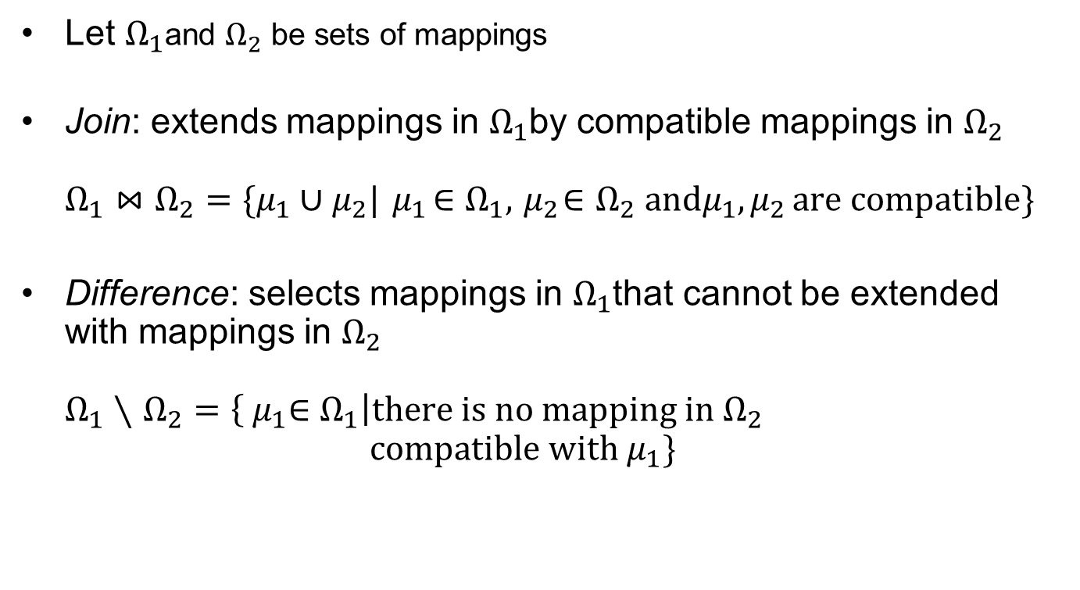
SPARQL – Sets of Mappings and Operators
Let $Ω_{1}$and $Ω_{2}$ be sets of mappings
Join: extends mappings in $Ω_{1}$by compatible mappings in $Ω_{2}$
$Ω_{1}⋈$ $Ω_{2}=\{μ_{1}∪μ_{2}|{ μ}_{1}∈Ω_{1},{ μ}_{2}∈Ω_{2} \text{and}μ_{1}{,μ}_{2}\text{are} \text{compatible}\}$
Difference: selects mappings in $Ω_{1}$that cannot be extended with mappings in $Ω_{2}$
$Ω_{1}∖$ $Ω_{2}=\left\{{ μ}_{1}∈Ω_{1}\right|\text{there} \text{is} \text{no} \text{mapping} \text{in} Ω_{2}$
$\text{compatible} \text{with}{ μ}_{1}\}$

Slide 106
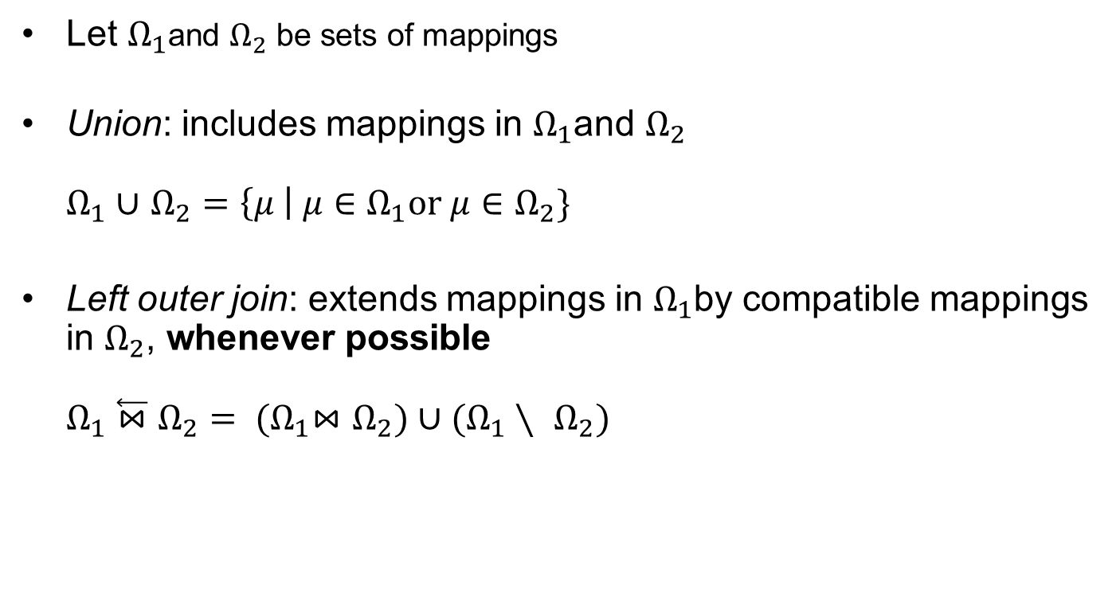
SPARQL – Sets of Mappings and Operators
Let $Ω_{1}$and $Ω_{2}$ be sets of mappings
Union: includes mappings in $Ω_{1}$and $Ω_{2}$
$Ω_{1}∪$ $Ω_{2}=\left\{μ \right| μ∈Ω_{1}\text{or} μ∈Ω_{2}\}$
Left outer join: extends mappings in $Ω_{1}$by compatible mappings in $Ω_{2}$, whenever possible
$Ω_{1}\overset{⃖}{⋈}$ $Ω_{2}= {(Ω}_{1}⋈$ $Ω_{2})∪(Ω_{1}∖ Ω_{2})$

Slide 107
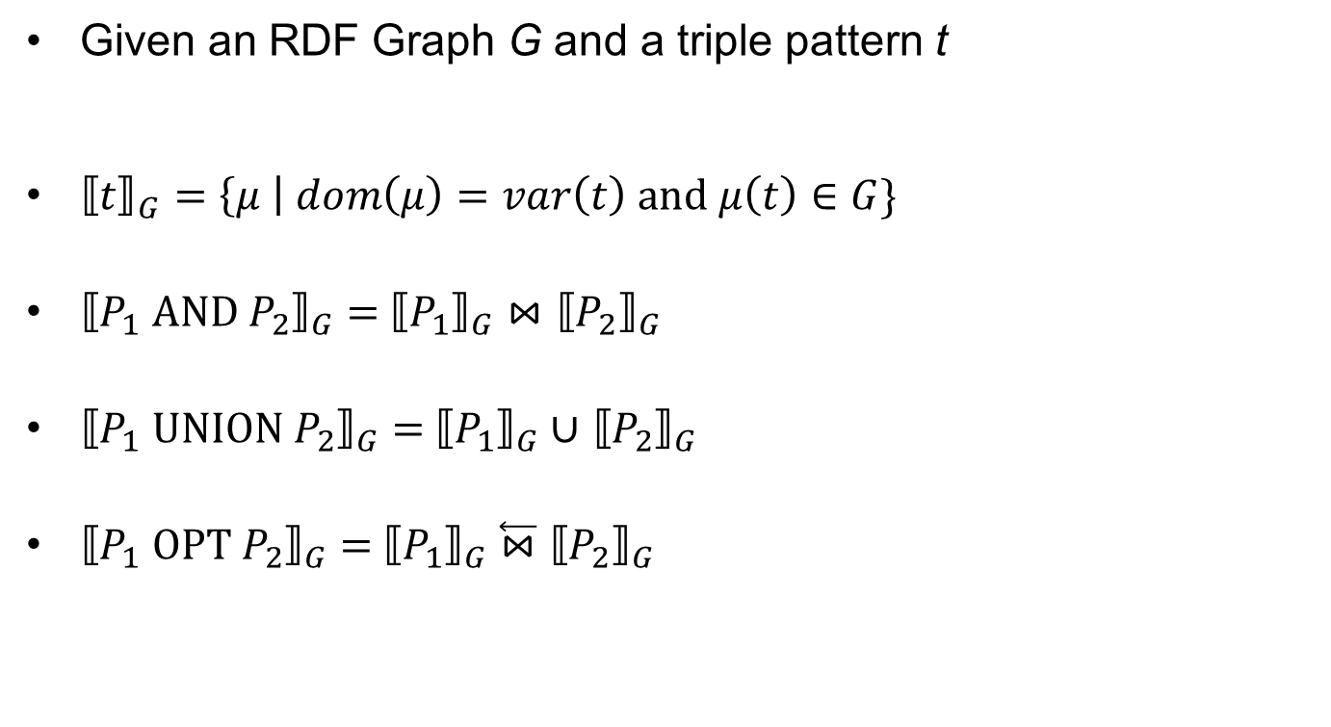
Semantics of SPARQL
Given an RDF Graph G and a triple pattern t
${⟦t⟧}_{G}=\left\{μ \right| dom\left(μ\right)=var\left(t\right) \text{and} μ\left(t\right)∈G\}$
${⟦P_{1} \text{AND} P_{2}⟧}_{G}=$ ${⟦P_{1}⟧}_{G}⋈$ ${⟦P_{2}⟧}_{G}$
${⟦P_{1} UNION P_{2}⟧}_{G}=$ ${⟦P_{1}⟧}_{G}∪$ ${⟦P_{2}⟧}_{G}$
${⟦P_{1} OPT P_{2}⟧}_{G}=$ ${⟦P_{1}⟧}_{G}$ $\overset{⃖}{⋈}$ ${⟦P_{2}⟧}_{G}$

Slide 108
Semantics of SPARQL: An example
(S1, player, Rafa)
(S1, ranking, “1”)
(S2, player, Roger)
((?X, player, ?Y) OPT (?X, ranking, ?R))

Slide 109
Semantics of SPARQL: An example
(S1, player, Rafa)
(S1, ranking, “1”)
(S2, player, Roger)
((?X, player, ?Y) OPT (?X, ranking, ?R))

Slide 110
Semantics of SPARQL: An example
(S1, player, Rafa)
(S1, ranking, “1”)
(S2, player, Roger)
((?X, player, ?Y) OPT (?X, ranking, ?R))
?X | ?Y
S1 | Rafa
S2 | Roger

Slide 111
Semantics of SPARQL: An example
(S1, player, Rafa)
(S1, ranking, “1”)
(S2, player, Roger)
((?X, player, ?Y) OPT (?X, ranking, ?R))
?X | ?Y
S1 | Rafa
S2 | Roger

Slide 112
Semantics of SPARQL: An example
(S1, player, Rafa)
(S1, ranking, “1”)
(S2, player, Roger)
((?X, player, ?Y) OPT (?X, ranking, ?R))
?X | ?Y
S1 | Rafa
S2 | Roger
?X | ?R
S1 | 1

Slide 113
Semantics of SPARQL: An example
(S1, player, Rafa)
(S1, ranking, “1”)
(S2, player, Roger)
((?X, player, ?Y) OPT (?X, ranking, ?R))
?X | ?Y
S1 | Rafa
S2 | Roger
?X | ?R
S1 | 1

Slide 114
Semantics of SPARQL: An example
(S1, player, Rafa)
(S1, ranking, “1”)
(S2, player, Roger)
((?X, player, ?Y) OPT (?X, ranking, ?R))
?X | ?Y
S1 | Rafa
S2 | Roger
?X | ?Y | ?R
S1 | Rafa | 1
S2 | Roger
?X | ?R
S1 | 1

Slide 115
Semantics of SPARQL: An example
(S1, player, Rafa)
(S1, ranking, “1”)
(S2, player, Roger)
((?X, player, ?Y) OPT (?X, ranking, ?R))
?X | ?Y
S1 | Rafa
S2 | Roger
?X | ?Y | ?R
S1 | Rafa | 1
S2 | Roger
?X | ?R
S1 | 1
From the JOIN

Slide 116
Semantics of SPARQL: An example
(S1, player, Rafa)
(S1, ranking, “1”)
(S2, player, Roger)
((?X, player, ?Y) OPT (?X, ranking, ?R))
?X | ?Y
S1 | Rafa
S2 | Roger
?X | ?Y | ?R
S1 | Rafa | 1
S2 | Roger
?X | ?R
S1 | 1
From the DIFFERENCE

Slide 117
Semantics of SPARQL: An example
(S1, player, Rafa)
(S1, ranking, “1”)
(S2, player, Roger)
((?X, player, ?Y) OPT (?X, ranking, ?R))
?X | ?Y
S1 | Rafa
S2 | Roger
?X | ?Y | ?R
S1 | Rafa | 1
S2 | Roger
?X | ?R
S1 | 1
From the UNION

Slide 118
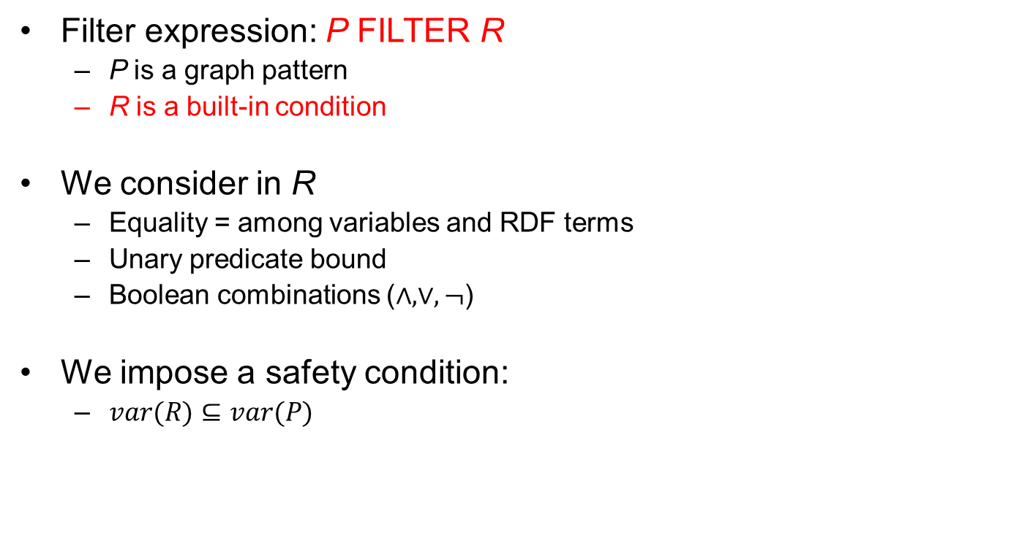
Filter expressions (value expressions)
Filter expression: P FILTER R
  P is a graph pattern
  R is a built-in condition
We consider in R
  Equality = among variables and RDF terms
  Unary predicate bound
  Boolean combinations ($∧,∨,¬$)
We impose a safety condition:
  $var(R)⊆var(P)$

Slide 119
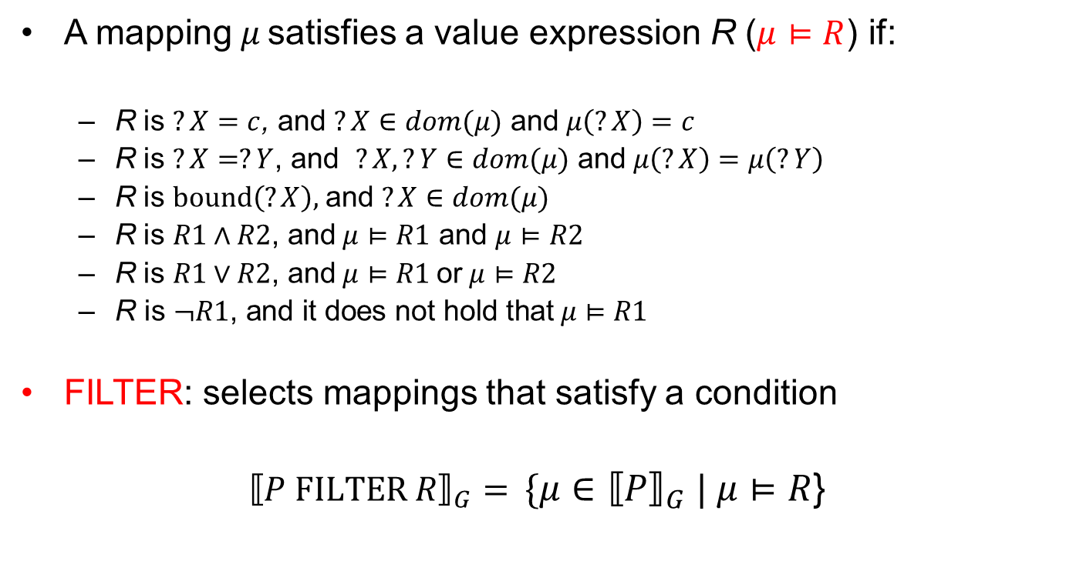
Satisfaction of value expressions
A mapping $μ$ satisfies a value expression R ($μ⊨R$) if:
  R is $?X=c$, and $?X∈dom(μ)$ and $μ\left(?X\right)=c$
  R is $?X=?Y$, and $?X,?Y∈dom(μ)$ and $μ\left(?X\right)=μ\left(?Y\right)$
  R is $bound\left(?X\right)\text{, }\text{and} ?X∈dom(μ)$
  R is $R1∧R2$, $\text{and} μ⊨R1$ $\text{and}$ $μ⊨R2$
  R is $R1∨R2$, $\text{and} μ⊨R1 \text{or} μ⊨R2$
  $\text{R} \text{is} ¬R1\text{, }\text{and} \text{it} \text{does} \text{not} \text{hold} \text{that} μ⊨R1$
FILTER: selects mappings that satisfy a condition
${⟦P FILTER R⟧}_{G}=$ ${\{μ∈⟦P⟧}_{G} | μ⊨R$}

Slide 120
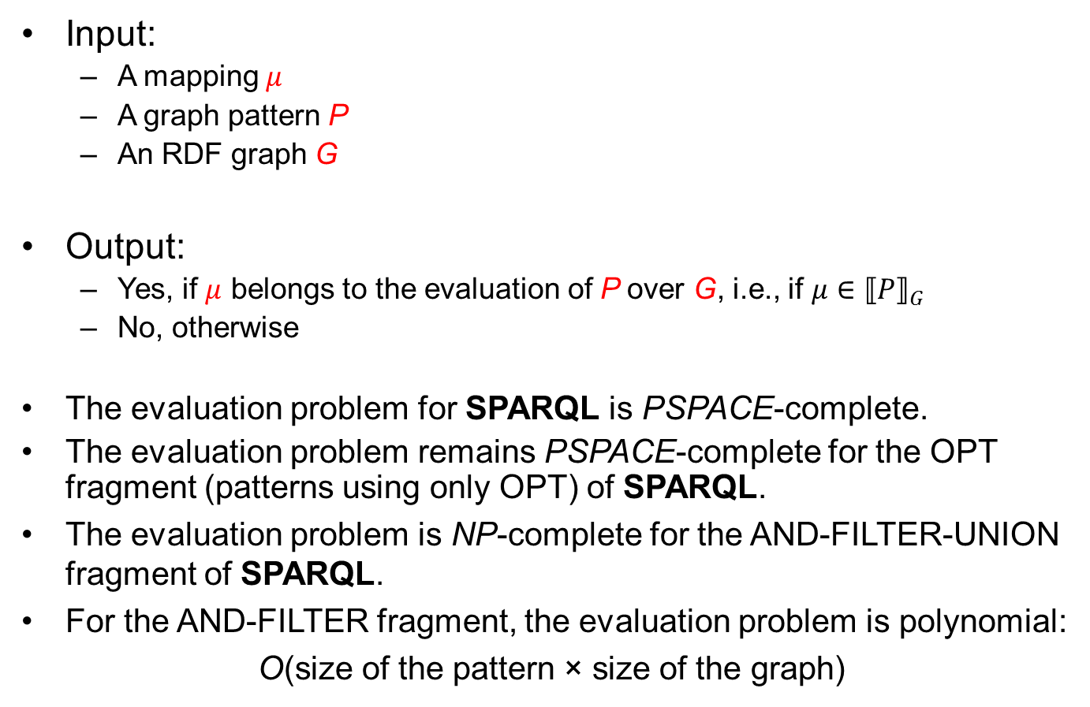
SPARQL Query Evaluation
Input:
  A mapping $μ$
  A graph pattern P
  An RDF graph G
Output:
  Yes, if $μ$ belongs to the evaluation of P over G, i.e., if ${μ∈⟦P⟧}_{G}$
  No, otherwise
The evaluation problem for SPARQL is PSPACE-complete.
The evaluation problem remains PSPACE-complete for the OPT fragment (patterns using only OPT) of SPARQL.
The evaluation problem is NP-complete for the AND-FILTER-UNION fragment of SPARQL.
For the AND-FILTER fragment, the evaluation problem is polynomial:
O(size of the pattern × size of the graph)

Slide 121
ILLUSTRATION
BY A LARGER EXAMPLE
An example of usage of SPARQL

Slide 122
A RDF Graph Modeling Movies
movie:Genre
movie:Movie
rdf:type
rdf:type
movie:Romance
rdf:type
movie:Comedy
movie:genre
movie:genre
movie1
movie:year
“1990”
movie:Role
movie:title
movie:hasPart
rdf:type
“Edward ScissorHands”
“Edward ScissorHands”
r1
movie:characterName
actor1
movie:playedBy
[http://www.openrdf.org/conferences/eswc2006/Sesame-tutorial-eswc2006.ppt]

Slide 123
Example Query 1
Select the movies that have a character called “Edward Scissorhands”
PREFIX movie: <http://example.org/movies/>
SELECT DISTINCT ?x ?t
WHERE {
?x movie:title ?t ;
movie:hasPart ?y .
?y movie:characterName ?z .
FILTER (?z = “Edward Scissorhands”@en)
}

Slide 124
Example Query 1
PREFIX movie: <http://example.org/movies/>
SELECT DISTINCT ?x ?t
WHERE {
?x movie:title ?t ;
movie:hasPart ?y .
?y movie:characterName ?z .
FILTER (?z = “Edward Scissorhands”@en)
}
Note the use of “;” This allows to create triples referring to the previous triple pattern (extended version would be ?x movie:hasPart ?y)
Note as well the use of the language speciation in the filter @en

Slide 125
Example Query 2
Create a graph of actors and relate them to the movies they play in (through a new ‘playsInMovie’ relation)
PREFIX movie: <http://example.org/movies/>
PREFIX foaf: <http://xmlns.com/foaf/0.1/>
CONSTRUCT {
?x foaf:firstName ?fname.
?x foaf:lastName ?lname.
?x movie:playInMovie ?m
}
WHERE {
?m movie:title ?t ;
movie:hasPart ?y .
?y movie:playedBy ?x .
?x foaf:firstName ?fname.
?x foaf:lastName ?lname.
}

Slide 126
Example Query 3
Find all movies which share at least one genre with “Gone with the Wind”
PREFIX movie: <http://example.org/movies/>
SELECT DISTINCT ?x2 ?t2
WHERE {
?x1 movie:title ?t1.
?x1 movie:genre ?g1.
?x2 movie:genre ?g2.
?x2 movie:title ?t2.
FILTER (?t1 = “Gone with the Wind”@en &&
?x1!=?x2 && ?g1=?g2)
}
Notes:
Note the use of the conjunction in the filter and the equality and inequality operators

Slide 127
EXTENSIONS

Slide 128
New requirements for semantic repositories
Application-specific requirements of end users and real usage
Web-scale and –style incomplete reasoning
Content-based retrieval modalities, like an RDF Search
Extensible architectures for efficient handling of specific, filter and lookup criteria, e.g.,
  Geo-spatial constraints
  Full-text search
  Social network analysis

Slide 129
Extending SPARQL
SPARQL is still under continuous development, possible extensions include:
  SPARQL only defined for simple RDF entailment, other entailment regimes missing:
    RDF(S), OWL
    OWL2
    RIF
  SPARQL update facility http://www.w3.org/TR/sparql11-update/
  Subqueries
  Property paths
  Aggregate functions
  Standards XPath functions
  Manipulation of Composite Datasets
  Access to RDF lists
SPARQL 1.1 overview http://www.w3.org/TR/sparql11-overview/

Slide 130
SUMMARY

Slide 131
Summary
RDF Repositories
  Optimized solutions for storing RDF
  Adopts different implementation techniques
  Choice has to be led by multiple factors
    In general there is no single solution better than every other
SPARQL
  Query language for RDF represented data
  More powerful than XPath based languages
  Supported by a communication protocol

Slide 132
References
Mandatory reading:
  Semantic Web Primer
    Chapter 3 (Sections 3.8)
  SPARQL Query Language for RDF
    http://www.w3.org/TR/rdf-sparql-query
    Chapters 1 to 11

Slide 133
References
Further reading:
  RDF SPARQL Protocol
    http://www.w3.org/TR/rdf-sparql-protocol/
  Sesame
    http://www.openrdf.org/
  OWLIM
    http://www.ontotext.com/owlim/

Slide 134
References
Wikipedia links:
  http://en.wikipedia.org/wiki/SPARQL
  http://en.wikipedia.org/wiki/Sesame_(framework)

Slide 135
Next Lecture
# | Title
1 | Introduction
2 | Semantic Web Architecture
3 | Resource Description Framework (RDF)
4 | Web of Data
5 | Generating Semantic Annotations
6 | Storage and Querying
7 | Web Ontology Language (OWL)
8 | Rule Interchange Format (RIF)

Slide 136

Questions?
136
Notes:
136

