Slide 1
COMPSCI732:
Semantic Web Technologies
Web of Data

Slide 2
Presentations
Monday. 21 May:
  12:05-12:20pm: asud012/xsun029 Social Semantic Web
  12:20-12:35pm: mlin117/iwan013 Ontologies and the Semantic Web
  12:35-12:50pm: sbae012/wcho072 Semantic Web Search Engines
Wednesday. 23 May:
  02:05-02:20pm: bmea011/rsim081 eScience
  02:20-02:35pm: jfin052/snot422 KM in Large Organizations
  02:35-02:50pm: yliu342/szhe024 eBusiness
Thursday. 24 May:
  12:05-12:20pm: lcui690/osag001 eGovernment
  12:20-12:35pm: sjoh140/asac008 Multimedia, Broadcasting, and eCulture
  12:35-12:50pm: rcab418/jdod012 Semantic Web Services
  01:00-01:15pm: sdso010/dlew026 Tools for the Semantic Web
  01:15-01:30pm: jlin213/ywan481 Social Semantic Web
  01:30-01:45pm: shoo893/phua014 eBusiness

Slide 3
Requirements/Suggestions
Time constraints:
  15 Minutes with room for questions and answers, e.g. 12+3
Submission of presentation:
  By Monday, 21 May, 10am via email to s.link@auckland.ac.nz
Guidelines:
  Motivation
  Set out context and scope of presentation
  State-of-the-art or Impact of Semantic Web on your topic area
  Issues/Future challenges
  Example(s)
  Presentation
Research report: due by Monday, 14 May at 5pm (Web drop-off)

Slide 4
Where are we?
# | Title
1 | Introduction
2 | Semantic Web Architecture
3 | Resource Description Framework (RDF)
4 | Web of Data
5 | Generating Semantic Annotations
6 | Storage and Querying
7 | Web Ontology Language (OWL)
8 | Rule Interchange Format (RIF)

Slide 5
Agenda
5
Motivation
“Building” the Web of Data by publishing structured data on the Web
  2.1 Embedding structured information in Web pages
    Technical solution
      Microformats
      RDFa
      GRDDL
    Example: Yahoo SearchMonkey
    Extensions and current developments: Microdata in HTML5
  2.2 Linked Data
    Technical solution
      Principles
      Publishing and consuming Linked Data
      Adding legacy data to the Web of Data
    Examples: Linked Data applications
    Extensions and current developments: Multimedia Interlinking
Summary
References

Slide 6
MOTIVATION

Slide 7
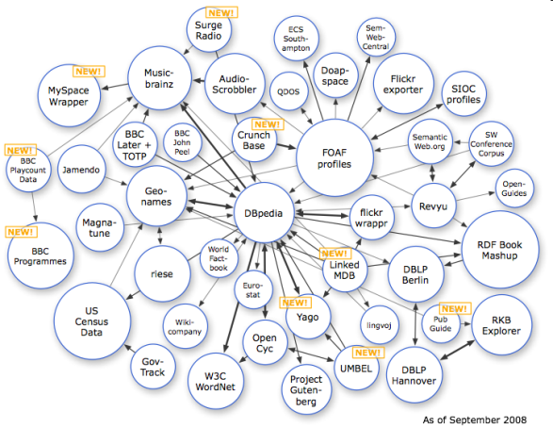

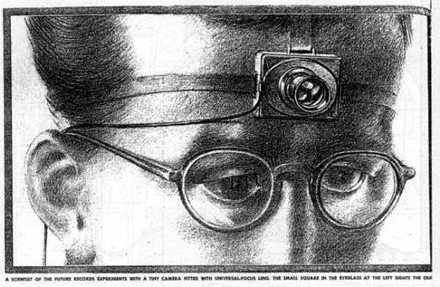
Evolution of the Web: The Origins
Web of Data
Semantic Web
Picture from [4]
?
Semantic
Annotations
Web
Hypermedia
Hypertext
“As We May Think”, 1945
Picture from [3]

Slide 8
Evolution of the Web: The Origins
As We May Think (1945):
Introduction of the Memex.
Memex was envisioned to provide access to huge collections of text in which people could follow trails of links and notes.
Memex is widely known as the pre-cursor of the Hypertext movement.
Web of Data
Semantic Web
Picture from [4]
?
Social Web
(Web 2.0)
Web
Semantic
Annotations
Hypermedia
Hypertext
“As We May Think”, 1945
Picture from [3]

Slide 9
Evolution of the Web
Hypertext:
Term coined 1965 by Ted Nelson
Definition: A hypertext is an organisation of objects in a highly connected fashion
Characteristic elements: Nodes (e.g., text parts) and hyperlinks (logical connections between nodes)
Further people: John Lickleder, Douglas Englbart
Web of Data
Semantic Web
Picture from [4]
?
Semantic
Annotations
Web
Hypermedia
Hypertext
“As We May Think”, 1945
Picture from [3]

Slide 10
Evolution of Hypertext: Hypermedia
Web of Data
Semantic Web
Picture from [4]
?
Semantic
Annotations
Web
Hypermedia
Hypertext
“As We May Think”, 1945
Picture from [3]

Slide 11
Evolution of the Web
Hypermedia:
Evolution of the hypertext idea
Novelty: Multimedia aspects; i.e., multimedia resources might be part of interlinked structure
Web of Data
Semantic Web
Picture from [4]
?
Semantic
Annotations
Web
Hypermedia
Hypertext
“As We May Think”, 1945
Picture from [3]

Slide 12
Evolution of Hypermedia: the Web
Web of Data
Semantic Web
Picture from [4]
?
Semantic
Annotations
Web
Hypermedia
Hypertext
“As We May Think”, 1945
Picture from [3]

Slide 13

Evolution of the Web
Web:
Exemplary hypermedia system
Proposed by Tim-Berners-Lee in 1990
Web of Data
Semantic Web
Picture from [4]
?
Semantic
Annotations
Web
Hypermedia
Hypertext
“As We May Think”, 1945
Picture from [3]

Slide 14
Evolution of the Web: The Semantic Web
Web of Data
Semantic Web
Picture from [4]
?
Semantic
Annotations
Web
Hypermedia
Hypertext
“As We May Think”, 1945
Picture from [3]

Slide 15
Evolution of the Web
Semantic Web:
Vision advocated by Tim Berners Lee.
Contents have well-defined meaning.
Backbone: formal ontologies allowing agents to draw automatic conclusions.
Web of Data
Semantic Web
Picture from [4]
?
Semantic
Annotations
Web
Hypermedia
Hypertext
“As We May Think”, 1945
Picture from [3]

Slide 16
Evolution of the Web: Web 2.0
Web of Data
Semantic Web
Picture from [4]
?
Semantic
Annotations
Web
Hypermedia
Hypertext
“As We May Think”, 1945
Picture from [3]

Slide 17
Evolution of the Web: Semantic Annotations
Web of Data
Semantic Annotations:
Annotations are generated for the existing Web
Generation automatic, semi-automatic, or manually based on human input
Semantic Web
Picture from [4]
?
Semantic
Annotations
Web
Hypermedia
Hypertext
“As We May Think”, 1945
Picture from [3]

Slide 18
Evolution of the Web: Web of Data
Web of Data
Semantic Web
Picture from [4]
?
Semantic
Annotations
Web
Hypermedia
Hypertext
“As We May Think”, 1945
Picture from [3]

Slide 19

Motivation:
From a Web of Documents to a Web of Data
Web of Documents
Fundamental elements:
  Names (URIs)
  Documents (Resources) described by HTML, XML, etc.
  Interactions via HTTP
  (Hyper)Links between documents or anchors in these documents
Shortcomings:
  Untyped links
  Web search engines fail on complex queries
Hyperlinks
“Documents”

Slide 20
Motivation:
From a Web of Documents to a Web of Data
Web of Documents
Web of Data
Typed Links
Hyperlinks
“Documents”
“Things”

Slide 21
Motivation:
From a Web of Documents to a Web of Data
Characteristics:
  Structure of data on Web pages is made explicit
  Things described on Web pages are named and get URIs
  Links between arbitrary things (e.g., persons, locations, events, buildings)
  Links between things are made explicit and are typed
Web of Data
Typed Links
“Things”

Slide 22
Vision of the Web of Data
The Web today
  Consists of data silos which can be accessed via specialized search engines in an isoltated fashion.
  One site (data silo) has movies, the other reviews, again another actors.
  Many common things are represented in multiple data sets
  Linking identifiers link these data sets
The Web of Data is envisioned as a global database
  consisting of objects and their descriptions
  with a high degree of object structure
  in which objects are linked with each other
  with explicit semantics for links and content
  which is designed for humans and machines
Content on this slide by Chris Bizer, Tom Heath and Tim Berners-Lee

Slide 23
BUILDING THE WEB OF DATA BY PUBLISHING STRUCTURED DATA ON THE WEB

Slide 24




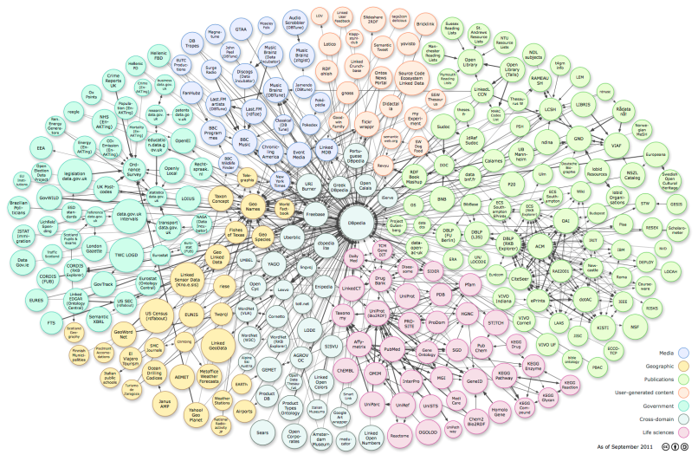
How to “Build” the Web of Data?
Publish structured data by
  using Web (2.0) APIs
  (The “Service Web”)
  embedding structured information (Microformats, RDFa, GRDDL)
  linking data
[5]
[2]
[6]
[7]
[4]

Slide 25
Web APIs
Provide access to underlying databases of major Web data sources
  Amazon, eBay, Flickr, Twitter
Enable ecosystems of participation based on usage of underlying data in range of applications and locations
Resulted in mash-ups, combining data from multiple different sources
Web APIs return documents in response to queries
  Have URIs and can be accessed via http
  Methods supported differ from API to API
  Entities referenced in documents may not have URI or are not globally identifiable
  Impossible to establish links between entities from different data sets
Creators of mash-ups must invest considerable efforts in application-level entity-consolidation
Mash-ups can, realistically speaking, not be implemented against all data available on the Web

Slide 26
2.1 EMBEDDING STRUCTURED INFORMATION IN WEB PAGES

Slide 27
Microformats
Recommended literature: [6], [8]
http://microformats.org/

Slide 28
What are Microformats?
An approach to add meaning to HTML elements and to make data structures in HTML pages explicit.
“Designed for humans first and machines second, microformats are a set of simple, open data formats built upon existing and widely adopted standards. Instead of throwing away what works today, microformats intend to solve simpler problems first by adapting to current behaviours and usage patterns (e.g. XHTML, blogging).” [6]

Slide 29
What are Microformats?
Are highly correlated with semantic (X)HTML / “Real world semantics” / “Lowercase Semantic Web” [9].
Real world semantics (or the Lowercase Semantic Web) is based on three notions:
  Adding of simple semantics with microformats (small pieces)
  Adding semantics to the today’s Web instead of creating a new one (evolutionary not revolutionary)
  Design for humans first and machines second (user centric design)
A way to combine human with machine-readable information.
Provide means to embed structured data in HTML pages.
Build upon existing standards.
Solve a single, specific problem (e.g. representation of geographical information, calendaring information, etc.).
Provide an “API” for your website.
Build on existing (X)HTML and reuse existing elements.
Work in current browsers.
Follow the DRY principle (“Don’t Repeat Yourself”).
Compatible with the idea of the Web as a single information space.

Slide 30
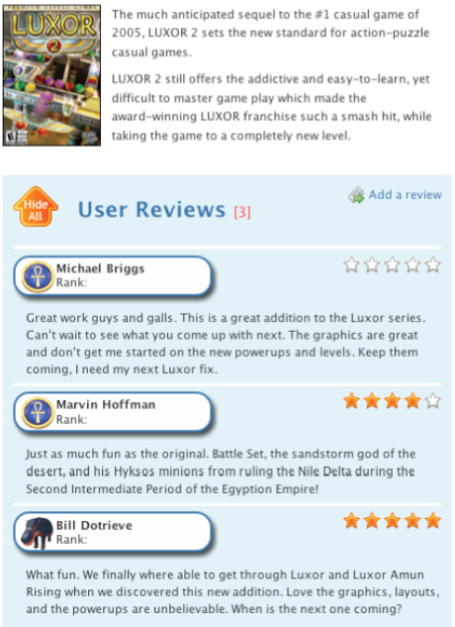
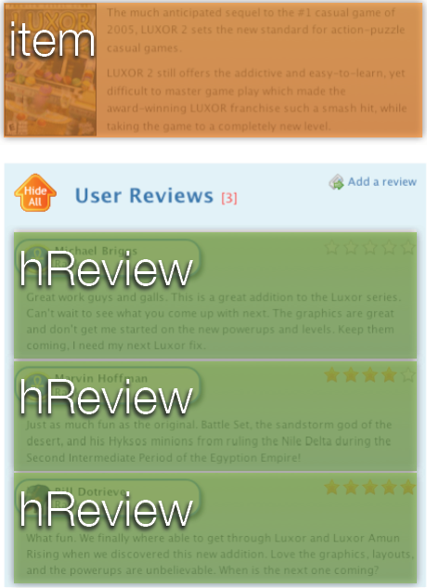
Microformats Illustrated
Structure understandable by humans
Structure understandable by machines
Example adapted from Chris Griego

Slide 31
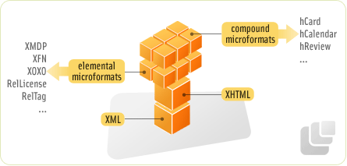
Design Patterns
Microformats are design patterns that make structure and semantics of data explicit.
Elemental microformats (consist of just one tag)
  Rel-home links to homepage <link href="http://technorati.com" rel="home" />
  Rel-License links to content license <a href="http://creativecommons.org/licenses/by/2.0/" rel="license">cc by2.0</a>
  Others: rel-tag, rel-encluse, xfn-tags
Compound microformats (more complex structures)
  Often based on existing standard
  E.g. hCard, hCalendar, hEvent, hReview
http://microformats.org/wiki/rel-license
http://microformats.org/wiki/hcard
http://gmpg.org/xmdp/
http://gmpg.org/xfn/
http://microformats.org/wiki/hcalendar
http://microformats.org/wiki/xoxo
Picture from [6]

Slide 32
Syntax
Microformats use existing HTML attributes to embed structured data types in an HTML document and to indicate the presence of metadata
Rel/rev-attribute is used for elemental microformts, e.g.,
<a href=“http://technorati.com/tag/semantics” rel=“tag”>semantics</a>
expresses that the current page is “tagged” with “semantics”
Class-attribute is used for compound microformats, e.g.
<span class=“geo”><span class=“latitude”>23.44</span><span class=“longitude”>44.33</span><span>
expresses that a given data block contains geo-coordinates (longitude/latitude)

Slide 33
Expressive Power
Microformats extend the expressive power of HTML.
Expressive power is limited as microformats are only designed to use pre-defined vocabularies to mark up content in Web pages using different HTML attributes.

Slide 34
Usage: Compound Microformat hCard
hCard is a simple format for representing people, companies, organizations, and places, using a 1:1 representation of the properties and values of the vCard standard (RFC2426).
BEGIN: VCARD
VERSION: 3
FN: Tim Berners-Lee
ORG: W3C
…
URL: http://www.w3.org/People/Berners-Lee/
TEL: +1 617 253 5702
END: VCARD
Example on this slide by Alexander Graf

Slide 35
Usage:
Compound Microformat hCard
hCard is a simple format for representing people, companies, organizations, and places, using a 1:1 representation of the properties and values of the vCard standard (RFC2426).
<div class="vcard">
<span class="fn">Tim Berners-Lee</span>
<a class="org url" href="http://www.w3.org/People/Berners-Lee/"> World Wide Web Consortium</a>
<a class="email" href="timbl@w3.org">mail me</a>
Phone: <div class="tel">+1 617 253 5702</div>
</div>
Example on this slide by Alexander Graf

Slide 36
Drawbacks of Microformats
Only a fixed set of microformats exist.
No way to connect data elements.
Fixed vocabulary, not extendable and customizable.
Separate parsing rules for each microformat needed.

Slide 37
Resource Description Framework in attributes (RDFa)
“RDFa is microformats done right” (Bob DuCharme)
Recommended literature: [2], [10]

Slide 38
RDFa
RDFa is a W3C recommendation.
RDFa is a serialization syntax for embedding an RDF graph into XHTML.
Goal:
Bringing the Web of Documents and the Web of Data closer together.
Overcomes some of the drawbacks of microformats.
Both for human and machine consumption.
Follows the DRY (“Don’t Repeat Yourself”) – principles.
RDFa is domain-independent. In contrast to the domain-dedicated microformats, RDFa can be used for custom data and multiple schemas.
Benefits inherited from RDF:
Independence, modularity, evolvability, and reusability.
Easy to transform RDFa into RDF data.
Tools for RDFa publishing and consumption exist [11].

Slide 39
Syntax: How to use RDFa in XHTML
Relevant XHTML attributes:
  @rel,
  @rev,
  @content,
  @href, and
  @src
  examples and explanations on the following slides
New RDFa-specific attributes:
  @about,
  @property,
  @resource,
  @datatype, and
  @typeof
  examples and explanations on the following slides
Listing from [10]

Slide 40
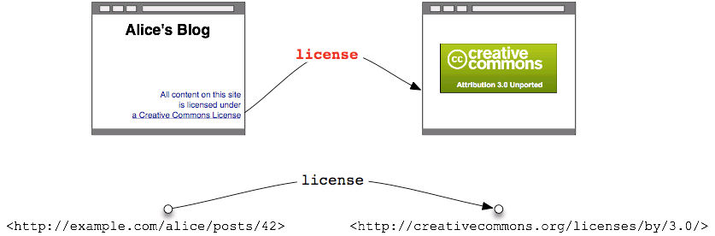
Syntax: How to use RDFa in XHTML
@rel: a whitespace separated list of CURIEs (Compact URIs), used for expressing relationships between two resources ('predicates’);
All content on this site is licensed under <a rel="license" href="http://creativecommons.org/licenses/by/3.0/"> a Creative Commons License </a>.
Samples from [2] , [10]

Slide 41
Syntax: How to use RDFa in XHTML
@rev: a whitespace separated list of CURIEs, used for expressing reverse relationships between two resources (also 'predicates');
All content on this site is licensed under <a rev=“islicenseOf" href="http://creativecommons.org/licenses/by/3.0/"> a Creative Commons License </a>.
Generated Triple:
<http://creativecommons.org/licenses/by/3.0/>
islicenseOf <http://example.com/alice/posts/42>
Samples from [2] , [10]

Slide 42
Syntax: How to use RDFa in XHTML
@content: a string, for supplying machine-readable content for a literal (a 'plain literal object‘)
<html xmlns="http://www.w3.org/1999/xhtml"> <meta name="author" content=“Alice" /> </html>
Generated Triple:
<http://example.com/alice/posts/42> author “Alice”
Samples from [2] , [10]

Slide 43
Syntax: How to use RDFa in XHTML
@href: a URI for expressing the partner resource of a relationship (a 'resource object‘);
<link rel=“xhv:next" href="http://example.org/page2.html" />
Generated Triple:
<> <http://www.w3.org/1999/xhtml/vocab#next>
<http://example.org/page2.html>
Samples from [2]

Slide 44
Syntax: How to use RDFa in XHTML
@src: a URI for expressing the partner resource of a relationship when the resource is embedded (also a 'resource object').
<div about="http://www.blogger.com/profile/1109404" rel="foaf:img"> <img src="photo1.jpg" rel="license" resource="http://creativecommons.org/licenses/by/2.0/" property="dc:creator" content="Mark Birbeck" /> </div>
Generated Triples:
  <http://www.blogger.com/profile/1109404> foaf:img <photo1.jpg> .
  <photo1.jpg> xhv:license <http://creativecommons.org/licenses/by/2.0/> .
  <photo1.jpg> dc:creator "Mark Birbeck" .
Sampes from [2]
Samples from [2] , [10]

Slide 45
Syntax: How to use RDFa in XHTML
@about: a URI or SafeCURIE, used for stating what the data is about (a 'subject’);
<div about="http://dbpedia.org/resource/Albert_Einstein"> <span property="foaf:name">Albert Einstein</span> <span property="dbp:dateOfBirth" datatype="xsd:date">1879-03-14</span> <div rel="dbp:birthPlace" resource="http://dbpedia.org/resource/Germany"> <span property="dbp:conventionalLongName">Federal Republic of Germany</span> <span rel="dbp:capital" resource="http://dbpedia.org/resource/Berlin" /> </div> </div>
Generated Triples:
  <http://dbpedia.org/resource/Albert_Einstein>
  foaf:name "Albert Einstein"
  <http://dbpedia.org/resource/Albert_Einstein>
  dbp:dateOfBirth "1879-03-14"^^xsd:date .
  <http://dbpedia.org/resource/Albert_Einstein>
  dbp:birthPlace <http://dbpedia.org/resource/Germany> .
  <http://dbpedia.org/resource/Germany>
  dbp:conventionalLongName "Federal Republic of Germany"
  <http://dbpedia.org/resource/Germany>
  dbp:capital <http://dbpedia.org/resource/Berlin>
Samples from [2] , [10]

Slide 46
Syntax: How to use RDFa in XHTML
@property: a whitespace separated list of CURIEs, used for expressing relationships between a subject and some literal text (also a 'predicate');
<div about="http://dbpedia.org/resource/Baruch_Spinoza" rel="dbp:influenced"> <div about="http://dbpedia.org/resource/Albert_Einstein"> <span property="foaf:name">Albert Einstein</span> <span property="dbp:dateOfBirth" datatype="xsd:date">1879-03-14</span> </div> </div>
Generated Triples:
  <http://dbpedia.org/resource/Baruch_Spinoza>
  dbp:influenced <http://dbpedia.org/resource/Albert_Einstein> .
  <http://dbpedia.org/resource/Albert_Einstein>
  foaf:name "Albert Einstein“ .
  <http://dbpedia.org/resource/Albert_Einstein>
  dbp:dateOfBirth "1879-03-14"^^xsd:date .
Samples from [2] , [10]

Slide 47
Syntax: How to use RDFa in XHTML
  @resource: a URI or SafeCURIE for expressing the partner resource of a relationship that is not intended to be 'clickable' (also an 'object');
<div about="http://www.blogger.com/profile/1109404" rel="foaf:img"> <img src="photo1.jpg" rel=“xhv:license" resource="http://creativecommons.org/licenses/by/2.0/" property="dc:creator" content="Mark Birbeck" /> </div>
Generated Triples:
  <http://www.blogger.com/profile/1109404> foaf:img <photo1.jpg> .
  <photo1.jpg> xhv:license <http://creativecommons.org/licenses/by/2.0/> .
  <photo1.jpg> dc:creator "Mark Birbeck" .
Samples from [2] , [10]

Slide 48
Syntax: How to use RDFa in XHTML
  @datatype:
  a CURIE representing a datatype, to express the datatype of a literal;
<div about="http://dbpedia.org/resource/Albert_Einstein"> <span property="foaf:name">Albert Einstein</span> <span property="dbp:dateOfBirth" datatype="xsd:date">1879-03-14</span> <div rel="dbp:birthPlace" resource="http://dbpedia.org/resource/Germany"> <span property="dbp:conventionalLongName">Federal Republic of Germany</span> <span rel="dbp:capital" resource="http://dbpedia.org/resource/Berlin" /> </div> </div>
Generated Triples:
  <http://dbpedia.org/resource/Albert_Einstein> foaf:name "Albert Einstein“ .
  <http://dbpedia.org/resource/Albert_Einstein>
  dbp:dateOfBirth "1879-03-14"^^xsd:date .
  <http://dbpedia.org/resource/Albert_Einstein> dbp:birthPlace <http://dbpedia.org/resource/Germany> .
Samples from [2] , [10]

Slide 49
Syntax: How to use RDFa in XHTML
  @typeof: a whitespace separated list of CURIEs that indicate the RDF type(s) to associate with a subject.
<p about="#bbq" typeof="cal:Vevent">
Generated Triple:
<#bbq> rdf:type cal:Vevent .
Samples from [2] , [10]

Slide 50
Expressive Power
The RDFa specification defines a syntax to embed RDF in any XML-based language.
Thus RDFa gets its expressive power from RDF.

Slide 51
RDFa – Usage Example
Example: Embedding FOAF into HTML using RDFa
<body xmlns:foaf ="http://xmlns.com/foaf/0.1/">
<span about ="#tim " typeof ="foaf:Person“
property ="foaf:name ">Tim Berners-Lee </ span >
<span about ="#tom" typeof ="foaf:Person“
property =" foaf:name">Tom Heath</span>
<span about ="#tom" rel ="foaf:knows“
resource ="#tim">Tom Heath knows Tim Berners-Lee.</span>
</body >
@prefix : <http://example.org/ns#>.
:tim a foaf:Person;
foaf:name “Tim Berners-Lee”.
:tom a foaf:Person;
foaf:name “Tom Heath”;
foaf:knows :tim.

Slide 52
GRDDL (“Gleaning Resource Descriptions from Dialects of Languages”)
Recommended literature: [12], [13], [14]

Slide 53
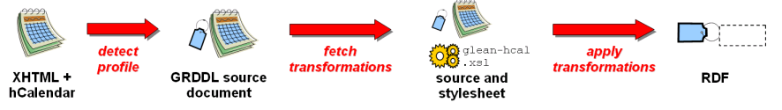
What is GRDDL?
The GRDDL specification introduces markup based on existing standards for declaring that an XML document includes data compatible with the Resource Description Framework (RDF) and for linking to algorithms (typically represented in XSLT), for extracting this data from the document.
Source: GRDDL Primer, see [12]

Slide 54
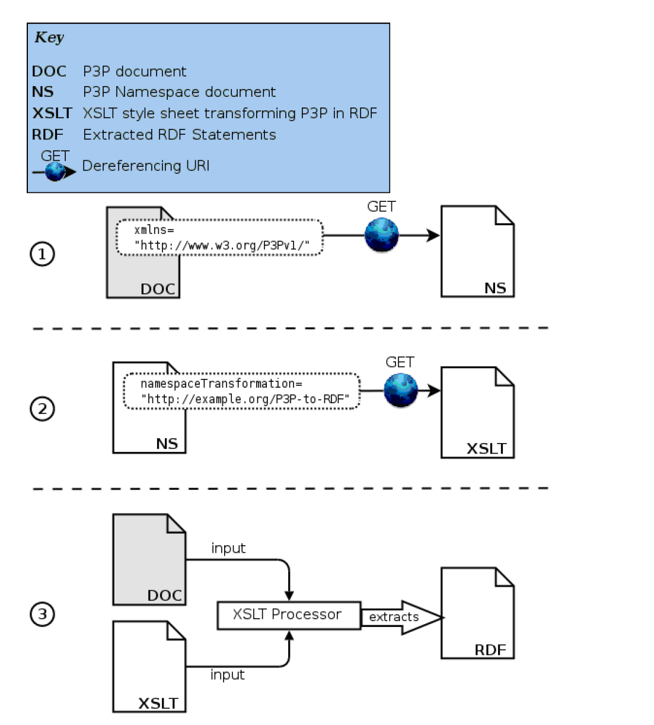
What is GRDDL?
GRDDL is a technique for obtaining RDF data from XML documents (a GRDDL transformation).
It is a means to associate transformations (preferably expressed in XSLT) with an individual document.
GRDDL applied in 3 steps:
(1) Declaration of a document as the source.
(2) Link to one or more extractors. (3) GRDDL agent extracts RDF from the document.
Figure from Daniel Hazael-Massieux.

Slide 55
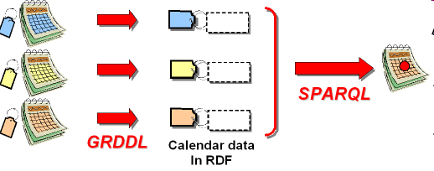
Use Case Scheduling:
Jane is Coordinating a Meeting
Aim: integration of information represented using different native formats, or coming from differently represented information “blocks” on Web sites.
Example:
  Robin publishes his schedule on his home page using the hCalendar microformat.
  David publishes his in Embedded RDF using some RDF calendar properties.
  Kate uses a blog engine that encodes her diary as RDFa.
  Jane uses an online calendaring service that publishes an RSS 1.0 feed of her schedule.
Example from [14]

Slide 56
ILLUSTRATION BY A LARGE EXAMPLE

Slide 57


SearchMonkey: Making use of RDFa and Microformats in Search
Recommended literature: [15], [16], [17]
Slides about SearchMonkey by E. Goar and P. Tarjan (Yahoo)

Slide 58




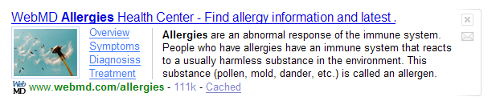


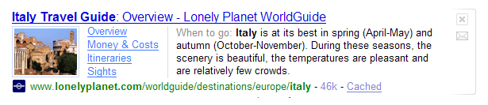
What is the SearchMonkey?
An open platform for using structured data to build more useful and relevant search results.
Excerpts of Yahoo! search engine results (left) enriched with structured data provided by owners of respective sites (right).
Before
After
powered by

Slide 59

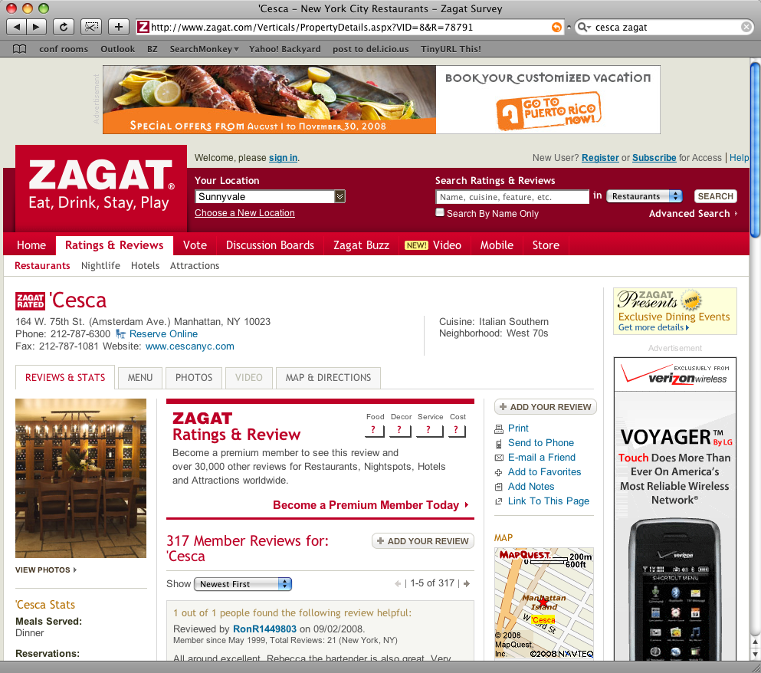
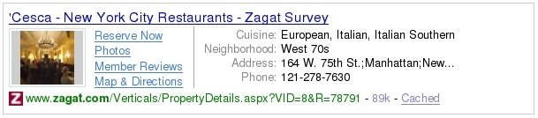
Enhanced Search Result
Image
(Deep) Links
Key/value Pairs
or abstract

Slide 60

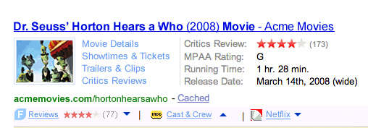
Feeding the Monkey: How does it Work?
1
site owners/publishers share structured data with Yahoo!
2
site owners & third-party developers build SearchMonkey apps
3
consumers customize their search experience with Enhanced Results or Infobars
Page Extraction
RDF/Microformat Markup
Acme.com’s Site
Index
DataRSS feed
Web Services
Acme.com’s DB

Slide 61
Feeding the Monkey: Data Sources
Name | Cached | Open | Mode | Notes
Yahoo! Index | yes | yes | Passive | Old-School Y! Index data
RDFa, eRDF | yes | yes | Passive | Vocab + markup decoupled
Microformats | yes | yes | Passive | Vocab + markup coupled
DataRSS feed | yes | no | Active | Atom + metadata
XSLT | no | no | Active | Good for prototyping
Web Service | no | no | Active | Brings in remote data
Remark: eRDF is one of the pre-cursors of RDFa (with similar expressivity)

Slide 62
EXTENSIONS

Slide 63
Current Developments: Microdata in HTML5
http://data-vocabulary.org
Recommended literature: [25]

Slide 64
Microdata in HTML5
Purpose: To provide means to annotate content with machine-readable labels [25]
New attributes in HTML5:
@itemscope, @itemprop, @subject, @itemtype, @itemid, @itemref
Define items:
<div itemscope> <p>My name is <span itemprop="name">Daniel</span>.</p> </div>
Items can be typed:
<section itemscope itemtype="http://example.org/animals#cat"> <h1 itemprop="name">Hedral</h1> <p itemprop="desc">Hedral is a male american domestic shorthair, with a fluffy black fur with white paws and belly.</p>
In this example the "http://example.org/animals#cat" item has two properties, a "name" ("Hedral") and a "desc" ("Hedral is...“).
Properties should be selected from external vocabularies:
<h1 itemprop="name http://example.com/fn">Hedral</h1>
Microformats can be easily expressed using Microdata syntax and RDF can be generated (see next slide)

Slide 65
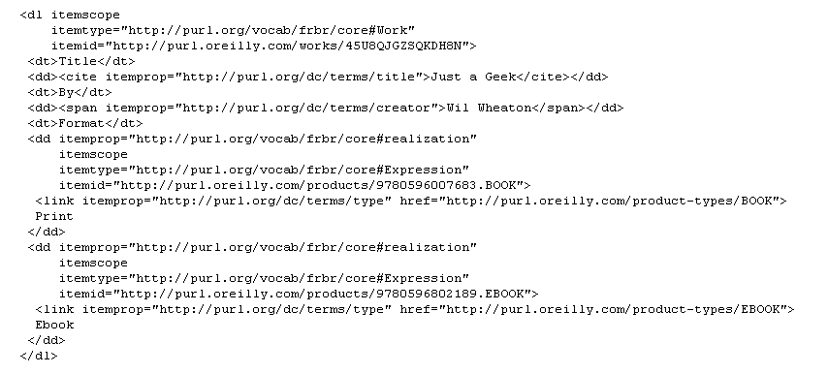
Using Microdata to Express RDF Statements

Slide 66
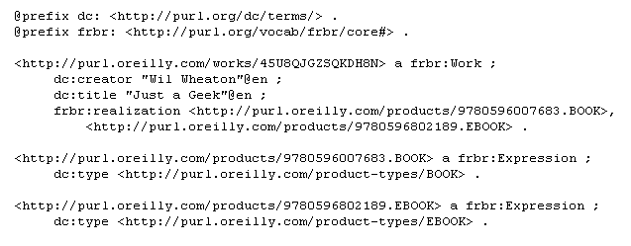
Using Microdata to Express RDF Statements (2)

Slide 67
2.2 LINKED DATA

Slide 68
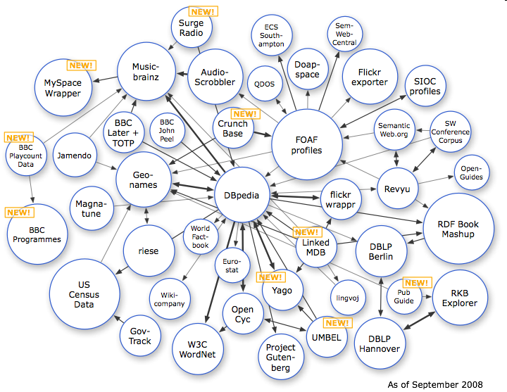
Linked Data
Recommended literature: [1], [4], [18-22]

Slide 69

Linked Data vs. Semantic Web
“In contrast to the full-fledged Semantic Web vision, linked data is mainly about publishing structured data in RDF using URIs rather than focusing on the ontological level or inference. This simplification - just as the Web simplified the established academic approaches of Hypertext systems - lowers the entry barrier for data providers, hence fosters a widespread adoption.” [20]
vs.

Slide 70
Linked Data: A Definition
“The Semantic Web isn't just about putting data on the web. It is about making links, so that a person or machine can explore the web of data. With linked data, when you have some of it, you can find other, related, data. “ (Tim Berners-Lee)
Linked Data is about the use of Semantic Web technologies to publish structured data on the Web and set links between data sources.
Figure from C. Bizer

Slide 71
Linked Data Principles
Use URIs as names for things.
Use HTTP URIs so that people can look up those names.
When someone looks up a URI, provide useful RDF information.
Include RDF statements that link to other URIs so that they can discover related things.

Slide 72

Linking Open Data Project
What? Community project with W3C
support
“The goal of the W3C SWEO Linking Open Data community project is to extend the Web with a data commons by publishing various open data sets as RDF on the Web and by setting RDF links between data items from different data sources. “ [24]
Aim:
Bootstrapping the Semantic Web through publishing datasets using RDF.
  Follows the Linked Data principles.
  Basic idea: take existing (open) data sets and make them available on the Web in RDF.
  Once published in RDF, interlink them with other data sets.
Example RDF link:
http://dbpedia.org/resource/Berlin [Identifier of Berlin in DBPedia] owl:sameAs http://sws.geonames.org/2950159 [Identifier of Berlin in Geonames].

Slide 73
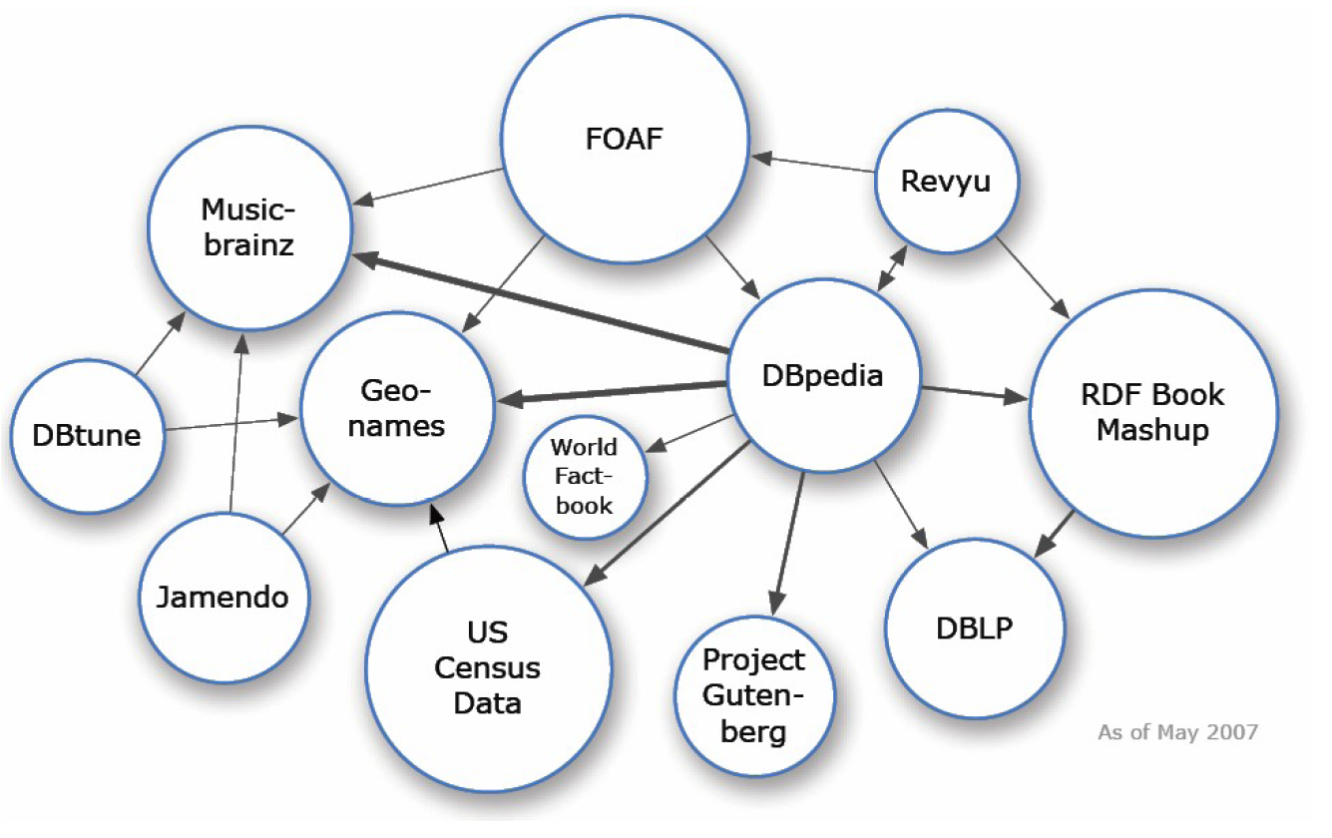
LOD Cloud May 2007
Figure from [4]

Slide 74
LOD Cloud May 2007
Basics:
The Linked Open Data cloud is an interconnected set of datasets all of which were published and interlinked following the Linked Data principles.
Facts:
Focal points:
  DBPedia: RDFized vesion of Wikipiedia; many ingoing and outgoing links
  Music-related datasets
Big datasets include FOAF, US Census data
Size approx. 1 billion triples, 250k links
12 data sets
Figure from [4]

Slide 75
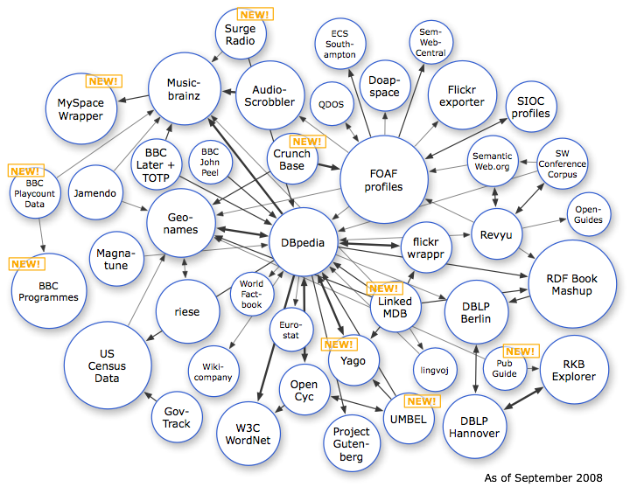
LOD Cloud September 2008
Figure from [4]

Slide 76
LOD Cloud September 2008
Facts:
More than 35 datasets interlinked
Commercial players joined the cloud, e.g., BBC
Companies began to publish and host dataset, e.g. OpenLink, Talis, or Garlik.
Size approx. 2 billion triples, 3 million links
45 data sets
Figure from [4]

Slide 77
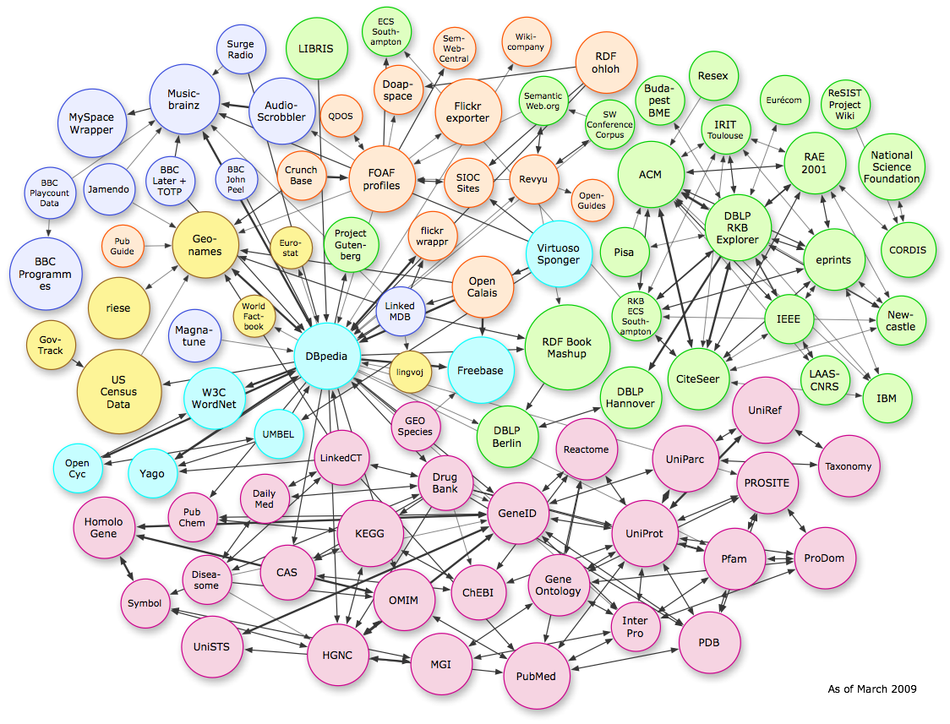
LOD Cloud March 2009
Figure from [4]

Slide 78
LOD Cloud March 2009
Facts:
Big part from Linking Open Drug cloud and the BIO2RDF project (bottom)
Notable new datasets:
Freebase, OpenCalais, ACM/IEEE
Size > 10 billion triples
93 data sets
Figure from [4]

Slide 79
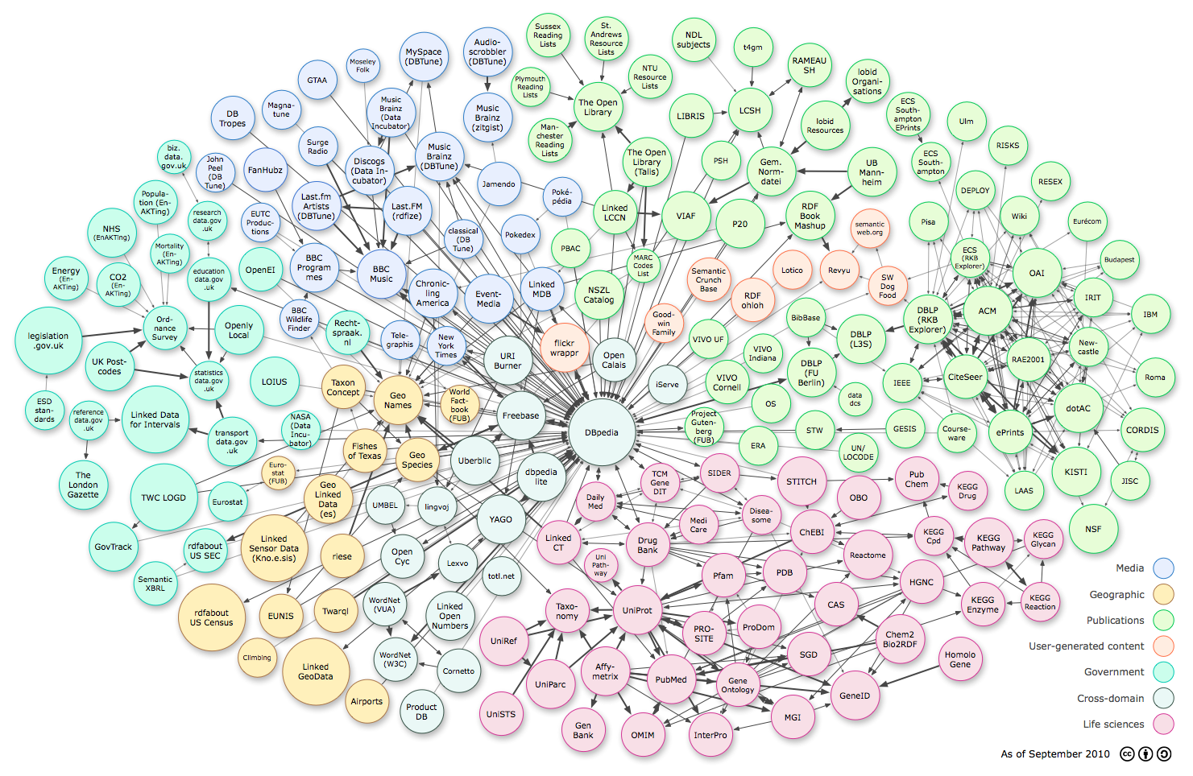
LOD Cloud September 2010
Figure from [4]

Slide 80
LOD Cloud September 2010
Facts:
More than 26 billion triples
More than 395 million links
203 data sets
Domain | Data Sets | Percent of triples | Percent of RDF links
Cross-domain | 20 | 7.42 | 7.36
Geographic | 16 | 21.93 | 4.19
Government | 25 | 43.12 | 4.46
Media | 26 | 9.11 | 12.74
Publications | 67 | 8.31 | 19.71
Life Sciences | 42 | 9.89 | 50.67
User Content | 7 | 0.21 | 0.86
Figure from [4]

Slide 81

LOD Cloud September 2011
Linked Data, http://linkeddata.org/

Slide 82
LOD Cloud September 2011
Facts:
More than 31 billion triples
More than 500 million links
295 data sets
Domain | Data Sets |  | Percent of triples |  | Percent of RDF links
 | 2010 | 2011 | 2010 | 2011 | 2010 | 2011
Cross-domain | 20 | 41 | 7.42 | 13.23 | 7.36 | 12.54
Geographic | 16 | 31 | 21.93 | 19.43 | 4.19 | 7.11
Government | 25 | 49 | 43.12 | 42.09 | 4.46 | 3.84
Media | 26 | 25 | 9.11 | 5.82 | 12.74 | 10.01
Publications | 67 | 87 | 8.31 | 9.33 | 19.71 | 27.76
Life Sciences | 42 | 41 | 9.89 | 9.6 | 50.67 | 38.06
User Content | 7 | 20 | 0.21 | 0.42 | 0.86 | 0.68
Linked Data, http://linkeddata.org/

Slide 83
Linked Data Publishing in 7 Steps
Select vocabularies
  Important: Reuse existing vocabularies to increase value of your dataset and align your own vocabularies to increase interoperability.
Partition the RDF graph into “data pages”
Assign a URI to each data page
Create HTML variants of each data page (to allow rendering of pages in browsers)
  Important: Set up content negotiation between RDF and HTML versions.
Assign a URI to each entity (cf. “Cool URIs for the Semantic Web”)
Add page metadata and link sugar
  Important: Make data pages understandable for consumers; i.e. add metadata such as publisher, license, topics, etc.
Add a Semantic Sitemap
  Important to allow crawlers to find the data set or SPARQL end points to access the data set.

Slide 84
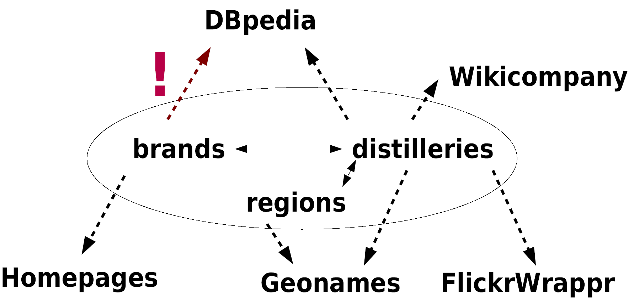
Linking
Popular predicates for linking: e.g., owl:sameAs, foaf:homepage, foaf:topic, foaf:based_near, foaf:maker/foaf:made, foaf:depiction, foaf:page, foaf:primaryTopic, rdfs:seeAlso
Example: Possible linking for Wiskii.com
Content on this slide by T. Heath, M. Hausenblas, C. Bizer, R. Cyganiak, O. Hartig

Slide 85

Describing Datasets
The problem:
  Only human comprehensible descriptions of datasets available
  Automation of tasks impossible such as
    Efficient & effective search
    Selection of datasets (for apps, interlinking targets)
    Generation of maps, etc.
Solution: voiD, the “Vocabulary of Interlinked Datasets”
  De-facto standard for describing linked datasets
Provides a formal description of
  What a dataset is about (topic, technical details).
  How and under which conditions to access it.
  How the dataset is interlinked with other datasets.
  Qualitative level: type of interlinking.
  Quantitative level: number of links, resources, etc.
  How to discover the metadata.
Content on this slide by K. Alexander, R. Cyganiak, M. Hausenblas and J. Zhao

Slide 86
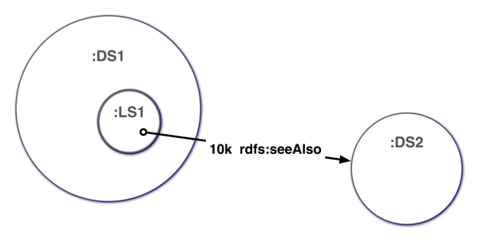
voiD – Core concepts
A dataset is a set of RDF triples that are published, maintained or aggregated by a single provider.
A dataset is authoritative with respect to a certain URI namespace if it contains information about resources named by URIs in this namespace, and is published by the URI owner
A linkset LS is a set of RDF triples where for all triples t_{i}=⟨s_{i},p_{i},o_{i}⟩ ∈ LS, the subject is in one dataset, i.e. all s_{i} are described in DS₁ , and the object is in another dataset, i.e. all o_{i} are described in DS₂ .
Content on this slide by K. Alexander, R. Cyganiak,
M. Hausenblas and J. Zhao

Slide 87
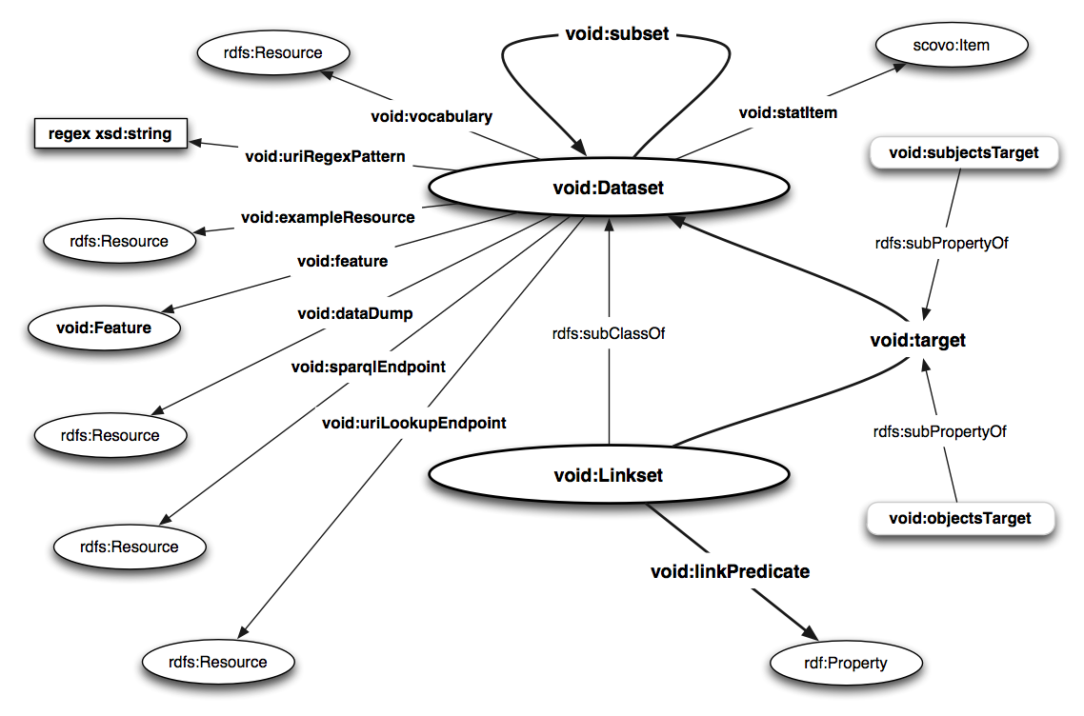
voiD Vocabulary
Content on this slide by K. Alexander, R. Cyganiak, M. Hausenblas and J. Zhao

Slide 88
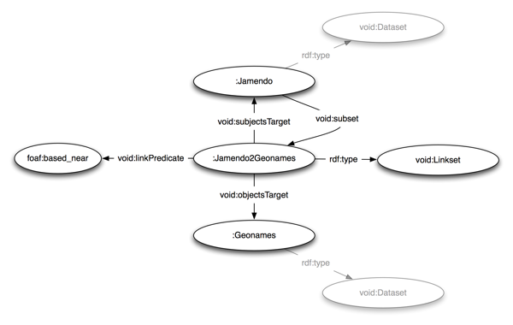
voiD – Usage Example
Content on this slide by K. Alexander, R. Cyganiak, M. Hausenblas and J. Zhao

Slide 89
Linked Data Tools and Applications
Tools to bring legacy data to the Web of Data
Tools to make use of Linked Data, i.e., to search, browse, and mashup Linked Data

Slide 90
Adding Legacy Data to the Web of Data
Approaches:
  Bring data hosted in relational databases to the Web of Data:
    Pubby (Server to provide access to triplestore on the Web)
    Triplify (Allows to specify SQL queries and to render them as RDF)
    D2RQ (Tool to map relational databases to RDF; provides a SPARQL endpoint to access the RDF data)
    Virtuoso RDF Views (offers declarative mapping language to map between SQL data and RDF)
  Extract data from the Web (e.g., DBPedia: data extraction from Wikipedia)
  Convert existing data and extract RDF from it using RDFizers: from JPEG, Email, BibTex, Java bytecode, Javadoc, weatherreport, Excel, ... to RDF

Slide 91
Consuming Linked Data
Linked Data browsers
  To explore things and datasets and to navigate between them.
  Tabulator Browser (MIT, USA), Marbles (FU Berlin, DE), OpenLink RDF Browser (OpenLink, UK), Zitgist RDF Browser (Zitgist, USA), Disco Hyperdata Browser (FU Berlin, DE), Fenfire (DERI, Ireland)
Linked Data mashups
  Sites that mash up (thus combine Linked data)
  Revyu.com (KMI, UK), DBtune Slashfacet (Queen Mary, UK), DBPedia Mobile (FU Berlin, DE), Semantic Web Pipes (DERI, Ireland)
Search engines
  To search for Linked Data.
  Falcons (IWS, China), Sindice (DERI, Ireland), MicroSearch (Yahoo, Spain), Watson (Open University, UK), SWSE (DERI, Ireland), Swoogle (UMBC, USA)
Listing on this slide by T. Heath, M. Hausenblas, C. Bizer, R. Cyganiak, O. Hartig

Slide 92
ILLUSTRATION BY EXAMPLES

Slide 93
Example Linked Data Browser: Marbles
Unique feature:
Indicates the origin of displayed data using colored dots.
Support for different views:
  Full view: all available data is displayed.
  Summary view: returns a short textual summary about a resource.
  Photo view: provides a photo for a given resource.
Retrieves data from multiple sources by (a) issuing parallel queries to multiple Linked Data search engines and (b) by following owl:sameAs and rdfs:seeAlso links.

Slide 94
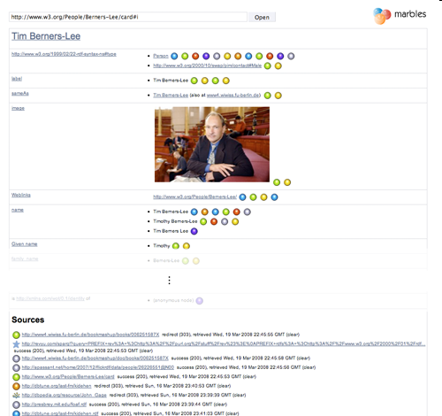
Example Linked Data Browser: Marbles (2)
(1) Entry of query URL
(2) Data display
Try yourself: http://marbles.sourceforge.net/
(3) Sources

Slide 95
Example Mashup: Revyu.com
Revyu.com is a website for rating everything.
Linked Data is used to augment ratings.
Ratings include links to the rated “thing” and seeAlso links to Wikipedia and other datasets.

Slide 96
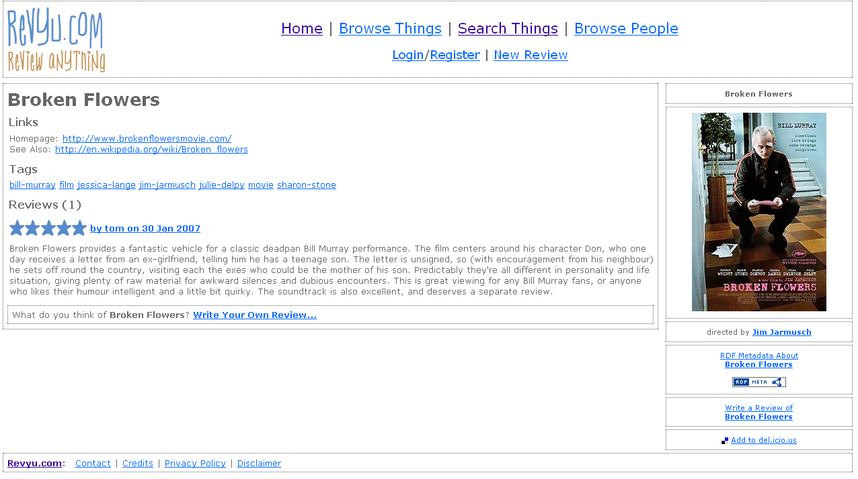
Example Mashup: Revyu.com (2)
Picture from revyu.com
Try yourself: http://revyu.com

Slide 97
Example Mashup: DBPedia Mobile
Geospatial entry point into the Web of Data.
It exploits information coming from DBpedia, Revyu and Flickr data.
It provides a way to explore maps of cities and gives pointers to more information which can be explored

Slide 98
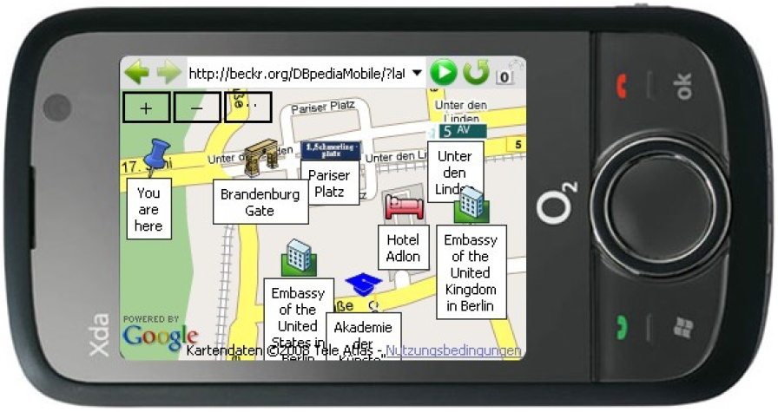
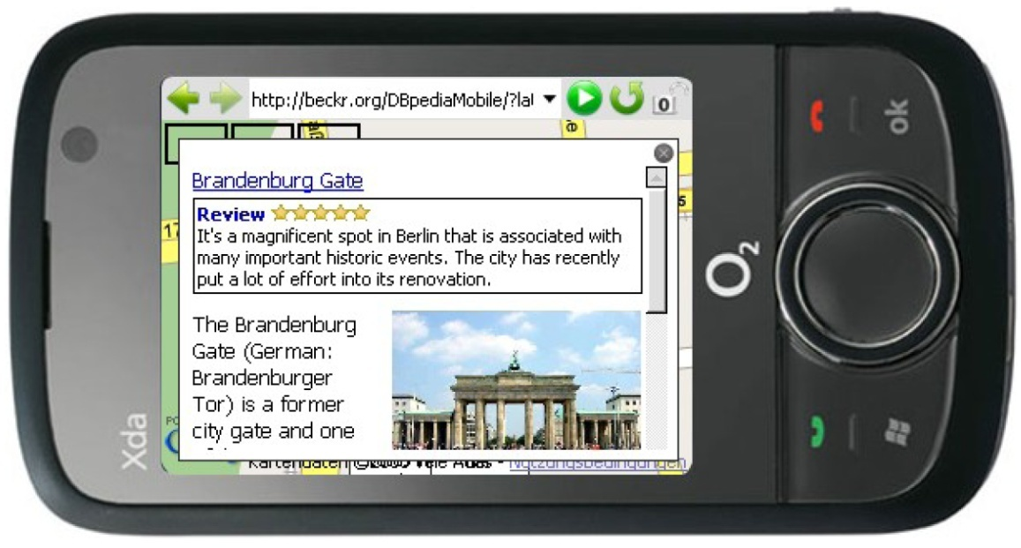
Example Mashup: DBPedia Mobile (2)
Pictures from DBPedia Mobile
Try yourself: http://wiki.dbpedia.org/DBpediaMobile

Slide 99
Example Search Engines: Falcons
Search engine for Linked Data.
Allows to search for Semantic Web content based on
  keywords.
  URIs (which identify objects, concepts, or documents.

Slide 100
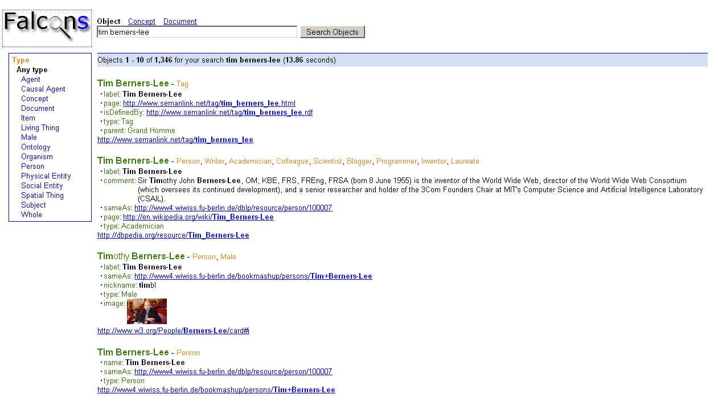
Example Search Engines: Falcons (2)
(1) Entry of keywords
(2) Results of objects
(3) Class hierarchy to refine search
Try yourself: http://iws.seu.edu.cn/services/falcons/

Slide 101
EXTENSIONS

Slide 102

Current Developments: Interlinking Multimedia
Recommended literature: [22], [24]

Slide 103
Interlinking Multimedia – The Vision
Show me photos of presidents of the European Commission visiting a country in Asia:
  DBpedia: list EC presidents -: [L-EP]
  Geonames: list Asian countries -: [L-AC]
  Google: list photos taken in a country of [L-AC] -: [L-ACP]
  Google: in [L-ACP] find regions that depict members of [L-EP] -: result
Give me a summary of all scenes from videos where EC presidents talk with an Asian monarch.
A solution?
MM Interlinking as a lightweight bottom up approach to interlink multimedia.

Slide 104
Interlinking Multimedia –
Principles and Requirements
To become part of the LOD cloud, the Linked Data principles should be followed.
Consider the characteristics of multimedia (e.g. highly subjective semantics) and thus consider provenance (who said what, when?).
Metadata descriptions have to be interoperable in order to reference and integrate parts of the described resources.
Localizing and identifying fragments is essential in order to link parts of resources with each other.
Interlinking methods need to be available, which are essential in order to manually or (semi-) automatically interlink multimedia resources (cf. [24]).

Slide 105
SUMMARY

Slide 106

Summary
Vision of the “Web of Data”
How-to build the “Web of Data”
  Embedding Structured Information via Microformats and
  RDFa
  Extracting and generating structured information via GRDDL
  Publishing Linked Data
Outlook:
  Microdata in HTML5
  Multimedia in the “Web of Data”

Slide 107
REFERENCES

Slide 108
References
Mandatory reading
  [1] C. Bizer, T. Heath, and T. Berners-lee “Linked Data – The Story So Far” International Journal on Semantic Web and Information Systems (IJSWIS) (2009)
  [2] RDFa Primer, http://www.w3.org/TR/xhtml-rdfa-primer/ (last accessed on 18.03.2009)

Slide 109
References
Further reading and references
  [3] V. Bush "As We May Think" The Atlantic Monthly, July, 1945. Re-print available online: http://www.theatlantic.com/doc/194507/bush (last accessed on 18.03.2009)
  [4] Linked Data, http://linkeddata.org/ (last accessed on 18.03.2009)
  [5] The Programmable Web – Web 2.0 APIs, http://www.programmableweb.com/ (last accessed on 18.03.2009)
  [6] Microformats, http://www.microformats.org (last accessed on 18.03.2009)
  [7] Gleaning Resource Descriptions from Dialects of Languages (GRDDL), W3C Recommendation, http://www.w3.org/TR/grddl/ (last accessed on 18.03.2009)
  [8] J. Allsop "Microformats: “Empowering Your Markup for Web 2.0", Friends of ed, 2007.
  [9] T. Celik and K. Marcs: “Real World Semantics” http://www.tantek.com/presentations/2004etech/realworldsemanticspres.html (last accessed on 18.03.2009)
  [10] RDFa in XHTML: Syntax and Processing, W3C Recommendation, http://www.w3.org/TR/rdfa-syntax/ (last accessed on 18.03.2009)

Slide 110
References
Further reading and references (2)
  [11] Tools. RDFa Wiki, http://rdfa.info/wiki/Tools (last accessed on 19.03.2009)
  [12] GRDDL Primer, http://www.w3.org/TR/grddl-primer/ (last accessed on 19.03.2009)
  [13] Gleaning Resource Descriptions from Dialects of Languages (GRDDL), W3C Recommendation 11 September 2007, http://www.w3.org/TR/grddl/ (last accessed on 19.03.2009)
  [14] GRDDL Use Cases, http://www.w3.org/TR/grddl-scenarios/ (last accessed on 19.03.2009)
  [15] Yahoo SearchMonkey, http://developer.yahoo.com/searchmonkey/
  [16] SearchMonkey Guide, http://developer.yahoo.com/searchmonkey/smguide/overview.html (last accessed on 19.03.2009)
  [17] P. Mika “The Anatomy of a SearchMonkey”, Nodalities Magazine Sep/Oct 2008. Available online: http://www.talis.com/nodalities/pdf/nodalities_issue4.pdf (last accessed on 19.03.2009)
  [18] T. Berners-Lee “Linked Data Principles”, http://www.w3.org/DesignIssues/LinkedData.html (last accessed on 19.03.2009)

Slide 111
References
Further reading and references (3)
  [19] C. Bizer, R. Cyganiak, and T. Heath “How to Publish Linked Data on the Web”, http://www4.wiwiss.fu-berlin.de/bizer/pub/LinkedDataTutorial/ (last accessed on 19.03.2009)
  [20] M. Hausenblas "Exploiting Linked Data For Building Web Applications" IEEE Internet Computing, 2009 (to appear)
  [21] Linking Open Data Community Project, http://esw.w3.org/topic/SweoIG/TaskForces/CommunityProjects/LinkingOpenData (last accessed on 19.03.2009)
  [22] M. Hausenblas, R. Troncy, T. Bürger, and Yves Raimond "Interlinking Multimedia: How to Apply Linked Data Principles to Multimedia Fragments." In: Proceedings of Linked Data on the Web 2009 (LDOW2009)
  [23] S. Auer, C. Bizer, G. Kobilarov, J. Lehmann, R. Cyganiak, and Z. Ives "DBpedia: A Nucleus for a Web of Open Data" In: Proc. of the 6th International Semantic Web Conference (ISCW) 2007.
  [24] T. Bürger and M. Hausenblas "Interlinking Multimedia - Principles and Requirements" In: Proceedings of the First International Workshop on Interacting with Multimedia Content on the Social Semantic Web, co-located with SAMT 2008, Dec, 3.-5., 2008
  [25] HTML5 draft standard, http://dev.w3.org/html5/spec/Overview.html#microdata

Slide 112
References
Wikipedia links
  [26]Hypertext, http://en.wikipedia.org/wiki/Hypertext
  [27] Linked Data, http://en.wikipedia.org/wiki/Linked_Data
  [28] Microformats, http://en.wikipedia.org/wiki/Microformats
  [29] RDFa, http://en.wikipedia.org/wiki/RDFa
  [30] HTML5, http://en.wikipedia.org/wiki/Html5

Slide 113
Next Lecture
# | Title
1 | Introduction
2 | Semantic Web Architecture
3 | Resource Description Framework (RDF)
4 | Web of Data
5 | Generating Semantic Annotations
6 | Storage and Querying
7 | Web Ontology Language (OWL)
8 | Rule Interchange Format (RIF)

Slide 114

Questions?
114
Notes:
114

