Slide 1
COMPSCI 732:
Semantic Web Technologies
Resource Description Framework (RDF)

Slide 2
Where are we?
# | Title
1 | Introduction
2 | Semantic Web Architecture
3 | Resource Description Framework (RDF)
4 | Web of Data
5 | Generating Semantic Annotations
6 | Storage and Querying
7 | Web Ontology Language (OWL)
8 | Rule Interchange Format (RIF)

Slide 3
Agenda
Introduction and Motivation
Technical Solution
  RDF
  RDF Schema
  Schema and Data Samples
  RDF(S) Semantics
  RDF(S) Serialization
  Tools
Illustration by a large example
Extensions
Summary
References
Notes:
First, why XML is not enough and we need other representation formalism?
This formalism are RDF and RDF Schema, first one for data second one for data schemas.
Maybe the part on semantics can be left out. It‘s quite long and tedious. I already comment out some slides. Up to you.

Slide 4
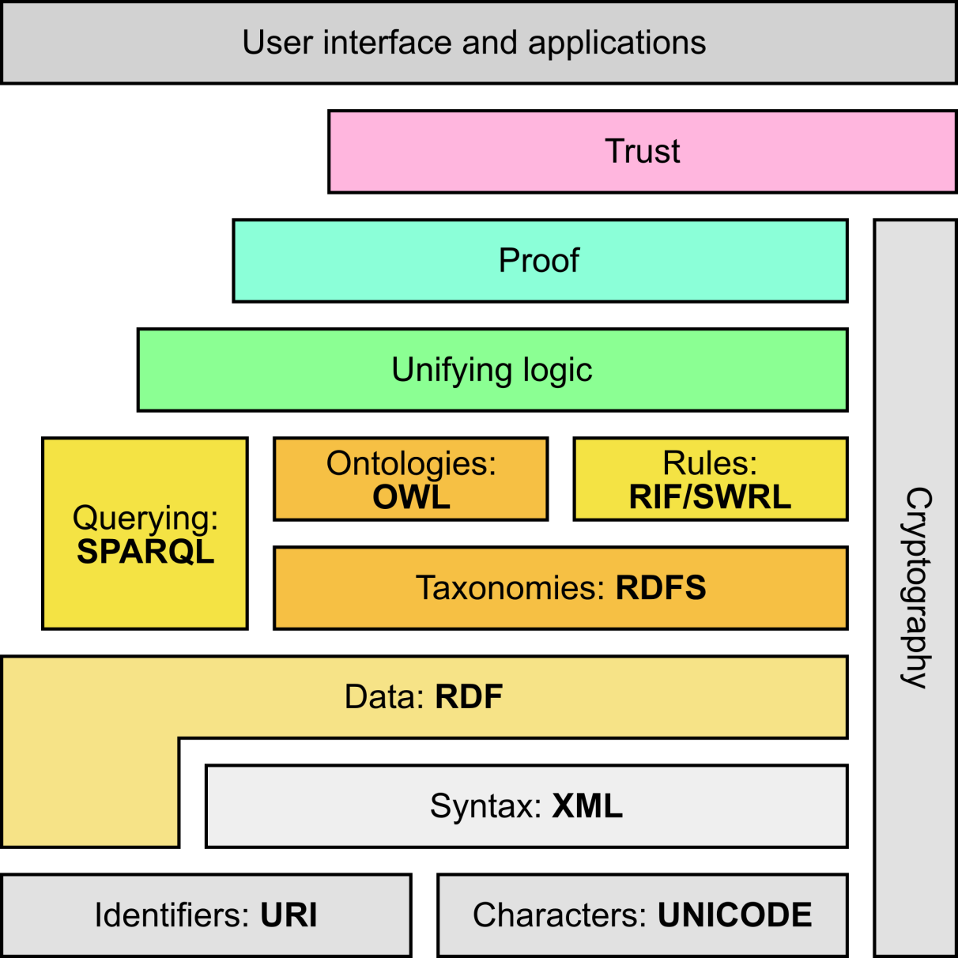
Semantic Web Stack
Adapted from http://en.wikipedia.org/wiki/Semantic_Web_Stack
Notes:
This

Slide 5
INTRODUCTION AND MOTIVATION

Slide 6
Motivating Example 1
Rafael Nadal plays the game of tennis.
Examples adapted from
Grigoris Antoniou and Frank van Harmelen: A Semantic Web Primer, MIT Press 2004

Slide 7
Motivating Example 1
Rafael Nadal plays the game of tennis.
  <game name=“Tennis">
  <player>Rafael Nadal</player>
  </game>
  What’s the problem you can spot in this representation?
Examples adapted from
Grigoris Antoniou and Frank van Harmelen: A Semantic Web Primer, MIT Press 2004

Slide 8
Motivating Example 1
Rafael Nadal plays the game of tennis.
  <game name=“Tennis">
  <player>Rafael Nadal</player>
  </game>
  <player name=“Rafael Nadal">
  <game>Tennis</game>
  </player>
The first two formalizations include essentially an opposite nesting although they represent the same information.
There is no standard way of assigning meaning to tag nesting.
Examples adapted from
Grigoris Antoniou and Frank van Harmelen: A Semantic Web Primer, MIT Press 2004

Slide 9
Motivating Example 1
Rafael Nadal plays the game of tennis.
  <game name=“Tennis">
  <player>Rafael Nadal</player>
  </game>
  <player name=“Rafael Nadal">
  <game>Tennis</game>
  </player>
  <plays>
  <player>Rafael Nadal</player>
  <game>Tennis</game>
  </plays>
Examples adapted from
Grigoris Antoniou and Frank van Harmelen: A Semantic Web Primer, MIT Press 2004
Notes:
And there’s even a third way… a fourth and so on…..
They all carry the same information, but in a different way.

Slide 10
Motivating Example 2
A player is a subclass of an athlete.
This sentence means that every player is also an athlete. It is important to understand that there is an intended meaning associated with “is a subclass of”. It is not up to the application to interpret this term; its intended meaning must be respected by all RDF processing software.
Examples adapted from
Grigoris Antoniou and Frank van Harmelen: A Semantic Web Primer, MIT Press 2004

Slide 11
Motivating Example 2
A player is a subclass of an athlete.
  <athlete>Rafael Nadal</athlete>
  <player>Rafael Nadal</player>
  <game name=“Tennis">
  <isPlayedBy>Roger Federer</isPlayedBy>
  </game>
Examples adapted from
Grigoris Antoniou and Frank van Harmelen: A Semantic Web Primer, MIT Press 2004
Notes:
An example Xpath query to achieve the second bullet task over presented XML is:
//academicStaffMember
The result is only Dieter Fensel.
Correct from the XML viewpoint, But semantically unsatisfactory.
Human readers would have also included Me
This kind of information makes use of the semantic model of the particular domain and cannot be represented in XML or in RDF but is typical of knowledge
written in RDF Schema.
RDFS makes semantic information machine accessible

Slide 12
Motivating Example 2
Retrieve all the athletes.
An example Xpath query to achieve the second bullet task over presented XML is: //athlete
Examples adapted from
Grigoris Antoniou and Frank van Harmelen: A Semantic Web Primer, MIT Press 2004
Notes:
An example Xpath query to achieve the second bullet task over presented XML is:
//academicStaffMember
The result is only Dieter Fensel.
Correct from the XML viewpoint, But semantically unsatisfactory.
Human readers would have also included Me
This kind of information makes use of the semantic model of the particular domain and cannot be represented in XML or in RDF but is typical of knowledge
written in RDF Schema.
RDFS makes semantic information machine accessible

Slide 13
Motivating Example 2
The result is only Rafael Nadal.
Correct from the XML viewpoint, but semantically unsatisfactory. Human readers would have also included Roger Federer.
This kind of information makes use of the semantic model of the particular domain and cannot be represented in XML or in RDF but is typical of knowledge written in RDF Schema.
RDFS makes semantic information machine accessible
Examples adapted from
Grigoris Antoniou and Frank van Harmelen: A Semantic Web Primer, MIT Press 2004
Notes:
An example Xpath query to achieve the second bullet task over presented XML is:
//academicStaffMember
The result is only Dieter Fensel.
Correct from the XML viewpoint, But semantically unsatisfactory.
Human readers would have also included Me
This kind of information makes use of the semantic model of the particular domain and cannot be represented in XML or in RDF but is typical of knowledge
written in RDF Schema.
RDFS makes semantic information machine accessible

Slide 14
What Are RDF and RDF Schema?
RDF (Resource Description Framework)
  RDF is a universal language that lets users describe resources in their own vocabularies
  Data model
    Syntax (XML)
  Domain independent
    RDF does not assume, nor does it define semantics of any particular application domain
    Vocabulary is defined by RDF Schema
RDF Schema (RDF Vocabulary Description Language)
  The user can define the semantics of an application domain in RDFS (semantic model of a domain), using
    Classes and Properties
    Class Hierarchies and Inheritance
    Property Hierarchies
Notes:
RDF basic building block is an object-attribute-value triple, called a statement
no assumptions about a particular domain of use are made
concrete syntax of RDF is in XML
It is up to users to define their own terminology in a schema language called RDF Schema (RDFS)
RDF Schema has a different relation to RDF than XML Schema has to XML.
XML Schema constrains the structure of XML documents
RDF Schema defines the vocabulary used in RDF data models

Slide 15
TECHNICAL SOLUTION
RDF and RDF Schema

Slide 16
THE RESOURCE DESCRIPTION FRAMEWORK
The power of triple representation joint with XML serialization
Most of the examples in the upcoming slides are taken from: http://www.w3.org/TR/rdf-primer/

Slide 17
RDF Basics
RDF is a language for making statements on resources
  John is father of Bill
Statement (or triple) as a logical formula P(x,y), where
the binary predicate P relates the object x to the object y
  E.g., father-of(john,bill)
Triple data model:
  <subject, predicate, object>
  Subject: Resource or blank node
  Predicate: Resource denoting some property
  Object: Resource, blank node or literal
Example: <ex:john, ex:father-of, ex:bill>
RDF offers only binary predicates (properties)
  E.g, father-of is a binary predicate

Slide 18
Resources
A resource may be:
  A Web page (e.g. http://www.w3.org)
  A person (e.g. http://www.vamosbrigade.com/)
  A book (e.g. urn:isbn:0-345-33971-1)
  Anything denoted with a URI!
A URI is an identifier and not a location on the Web
RDF allows making statements about resources:
  http://www.w3.org has the format text/html
  http://www.vamosbrigade.com/ has first name Rafael
  urn:isbn:0-345-33971-1 has author Tolkien

Slide 19
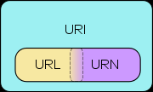
URI, URN, URL
A Uniform Resource Identifier (URI) is a string of characters used to identify a name or a resource on the Internet
A URI can be a URL or a URN
A Uniform Resource Name (URN) defines an item's identity
  the URN urn:isbn:0-395-36341-1 is a URI that specifies the identifier system, i.e. International Standard Book Number (ISBN), as well as the unique reference within that system and allows one to talk about a book, but doesn't suggest where and how to obtain an actual copy of it
A Uniform Resource Locator (URL) provides a method for finding it
  the URL http://www.auckland.ac.nz/ identifies a resource (UoA’s home page) and implies that a representation of that resource (such as the home page's current HTML code, as encoded characters) is obtainable via HTTP from a network host named www.auckland.ac.nz

Slide 20
Literals
Plain literals
  E.g. ”any text”
  Optional language tag, e.g. ”Hello, how are you?”@en-GB
Typed literals
  E.g. "hello"^^xsd:string, "1"^^xsd:integer
  Recommended datatypes:
    XML Schema datatypes
Only as object of a triple, e.g.:
⟨<http://example.org/#john>,
<http://example.org/#hasName>,
”John Smith”ˆˆxsd:string⟩

Slide 21
Datatypes
One pre-defined datatype: rdf:XMLLiteral
  Used for embedding XML in RDF
Recommended datatypes are XML Schema datatypes, e.g.:
  xsd:string
  xsd:integer
  xsd:float
  xsd:anyURI
  xsd:boolean

Slide 22
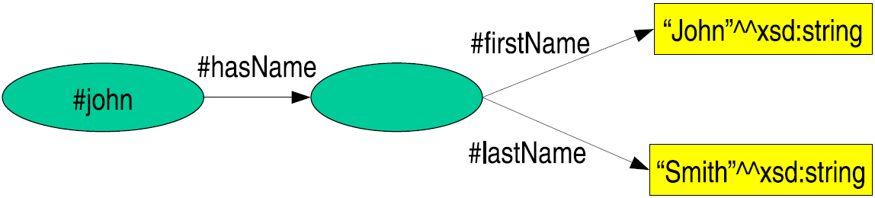
Blank Nodes I
Blank nodes are nodes without a URI
  Underscore _ in prefix indicates unknown namespace
  No global identification possible, no reference from outside of RDF graph
  Unnamed resources or more complex constructs
Representation of blank nodes is syntax-dependent
  Blank node identifier
For example:
  ⟨<#john>, <#hasName>, _:johnsname⟩
  ⟨_:johnsname, <#firstName>, ”John”ˆˆxsd:string⟩
  ⟨_:johnsname, <#lastName>, ”Smith”ˆˆxsd:string⟩

Slide 23
Blank Nodes II
Representation of complex data
A blank node can be used to indirectly attach to a resource a consistent set of properties which together represent complex data.
Anonymous classes in OWL
The ontology language OWL uses blank nodes to represent anonymous classes such as unions or intersections of classes, or classes called restrictions, defined by a constraint on a property.

Slide 24
RDF Containers
Grouping property values:
“The lecture is attended by John, Mary and Chris” | Bag
“[RDF-Concepts] is edited by Graham and Jeremy (in that order)” | Seq
“The source code for the application may be found at ftp1.example.org, ftp2.example.org, ftp3.example.org.” | Alt

Slide 25
RDF Containers 2
Three types of open containers:
  rdf:Bag – unordered container, where each element is resource or literal
  rdf:Seq – sequence, where each element is resource or literal
  rdf:Alt – set of alternatives, each element is resource of literal (just one selected)
Every container has a triple declaring the rdf:type
Items in the container are denoted with
  rdf:_1, rdf:_2, . . . ,rdf:_n
Limitations:
  Semantics of the container is up to the application
  What about closed sets?
    How do we know whether Graham and Jeremy are the only editors of [RDF-Concepts]?

Slide 26
RDF Containers 2
Three types of open containers:
  rdf:Bag – unordered container, where each element is resource or literal
  rdf:Seq – sequence, where each element is resource or literal
  rdf:Alt – set of alternatives, each element is resource of literal (just one selected)
Every container has a triple declaring the rdf:type
Items in the container are denoted with
  rdf:_1, rdf:_2, . . . ,rdf:_n
Limitations:
  Semantics of the container is up to the application
  What about closed collections?
    How do we know whether Graham and Jeremy are the only editors of [RDF-Concepts]?
Notes:
This is because, while one graph may describe some of the members, there is no way to exclude the
possibility that there is another graph somewhere that describes additional members.

Slide 27
RDF Triple Graph Representation
The triple data model can be represented
as a graph
Such graph is called in the Artificial
Intelligence community a semantic net
Labeled, directed graphs
  Nodes: resources, literals
  Labels: properties
  Edges: statements
Notes:
Statement (or triple) as a logical formula P(x, y), where the binary predicate P relates the object x to the object y.
RDF offers only binary predicates (properties)
The graph is called in the Artificial Intelligence community as a semantic net.

Slide 28
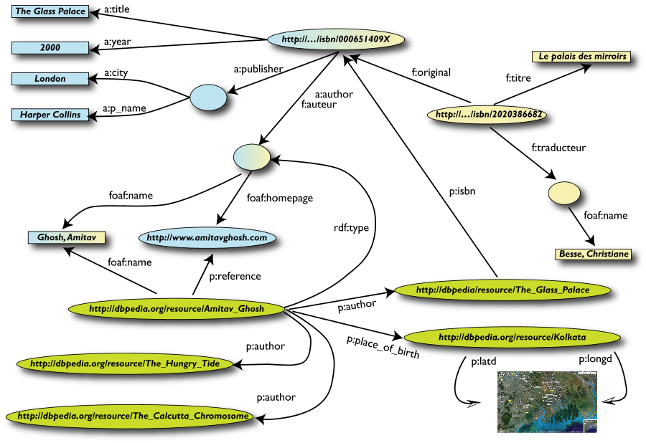
RDF: A Direct Connected Graph based Model
Different interconnected triples lead to a more complex graphic model
Basically an RDF document is a directed, connected graph
  http://en.wikipedia.org/wiki/Connectivity_%28graph_theory%29

Slide 29
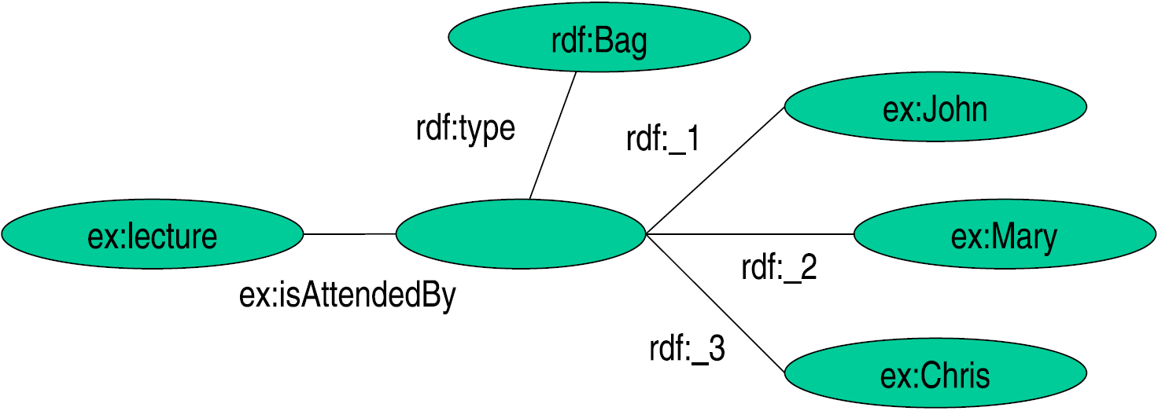
RDF Containers Graph Representation: Bag
“The lecture is attended by John, Mary and Chris”

Slide 30
RDF Containers Graph Representation: Seq
“[RDF-Concepts] is edited by Graham and Jeremy
(in that order)”

Slide 31
RDF Containers Graph Representation: Alt
“The source code for the application may be found at
ftp1.example.org, ftp2.example.org, ftp3.example.org”

Slide 32
RDF Collections
“[RDF-Concepts] is edited by Graham and Jeremy
(in that order) and nobody else”
RDF provides support for describing groups containing only the specified members, in the form of RDF collections.

Slide 33
Reification I
Reification: statements about statements
Lars Graf referees a game of tennis between Roger Federer and Rafael Nadal.
  ⟨<#theGame>, rdf:type, rdf:Statement⟩
  ⟨<#theGame>, rdf:subject, “RogerFederer”⟩
  ⟨<#theGame>, rdf:predicate, <#plays>⟩
  ⟨<#theGame>, rdf:object, “Rafael Nadal”⟩
This kind of statement can be used to describe belief or trust in other statements, which is important in some kinds of applications
Necessary because there are only triples in RDF: we cannot add an identifier directly to a triple (then it would be a quadruple)

Slide 34
Reification II
Reification: statements about statements
Lars Graf referees a game of tennis between Roger Federer and Rafael Nadal.
  ⟨<#theGame>, rdf:type, rdf:Statement⟩
  ⟨<#theGame>, rdf:subject, “RogerFederer”⟩
  ⟨<#theGame>, rdf:predicate, <#plays>⟩
  ⟨<#theGame>, rdf:object, “Rafael Nadal”⟩
  
  ⟨“Lars Graf”, <#referees>, <#theGame>⟩
  In such a way we attached a label to the statement.
Notes:
In such a way we attached a label to the statement.

Slide 35
Reification III
Reification: statements about statements
Lars Graf referees a game of tennis between Roger Federer and Rafael Nadal.
  ⟨<#theGame>, rdf:type, rdf:Statement⟩
  ⟨<#theGame>, rdf:subject, “RogerFederer”⟩
  ⟨<#theGame>, rdf:predicate, <#plays>⟩
  ⟨<#theGame>, rdf:object, “Rafael Nadal”⟩
  ⟨“Lars Graf”, <#referees>, <#theGame>⟩
RDF uses only binary properties. This restriction seems quite serious because often we use predicates with more than two arguments. Such predicates can be simulated by a number of binary predicates.

Slide 36
RDF Vocabulary
RDF defines a number of resources and properties
We have already seen: rdf:XMLLiteral, rdf:type, . . .
RDF vocabulary is defined in the namespace: http://www.w3.org/1999/02/22-rdf-syntax-ns#
Classes:
  rdf:Property, rdf:Statement, rdf:XMLLiteral
  rdf:Seq, rdf:Bag, rdf:Alt, rdf:List
Properties:
  rdf:type, rdf:subject, rdf:predicate, rdf:object,
  rdf:first, rdf:rest, rdf:_n
  rdf:value
Resources:
  rdf:nil

Slide 37
RDF Vocabulary
Typing using rdf:type:
  <A, rdf:type, B>
  “A belongs to class B”
All properties belong to class rdf:Property:
  <P, rdf:type, rdf:Property>
  “P is a property”
  <rdf:type, rdf:type, rdf:Property>
  “rdf:type is a property”

Slide 38
The RDF Schema (RDFS)
How to represent the semantics of data models

Slide 39
RDF Vocabulary Description Language 1
Types in RDF:
    <#john, rdf:type, #Student>
What is a “#Student”?
RDF is not defining a vocabulary about the statements, but only to express statements
We know that “#Student” identifies a category (a concept or a class), but this is only implicitly defined in RDF

Slide 40
RDF Vocabulary Description Language 2
We need a language for defining RDF types:
  Define classes:
    “#Student is a class”
  Relationships between classes:
    “#Student is a sub-class of #Person”
  Properties of classes:
    “#Person has a property hasName”
RDF Schema is such a language

Slide 41
RDF Vocabulary Description Language 3
Classes:
  <#Student, rdf:type, #rdfs:Class>
Class hierarchies:
  <#Student, rdfs:subClassOf, #Person>
Properties:
  <#hasName, rdf:type, rdf:Property>
Property hierarchies:
  <#hasMother, rdfs:subPropertyOf, #hasParent>
Associating properties with classes (a):
  “The property #hasName only applies to #Person”
  <#hasName, rdfs:domain, #Person>
Associating properties with classes (b):
  “The type of the property #hasName is xsd:string”
  <#hasName, rdfs:range, xsd:string>

Slide 42
RDFS Vocabulary
RDFS extends the RDF Vocabulary
RDFS vocabulary is defined in the namespace:
  http://www.w3.org/2000/01/rdf-schema#
RDFS Classes rdfs:Resource rdfs:Class rdfs:Literal rdfs:Datatype rdfs:Container rdfs:ContainerMembershipProperty | RDFS Properties rdfs:domain rdfs:range rdfs:subPropertyOf rdfs:subClassOf rdfs:member rdfs:seeAlso rdfs:isDefinedBy rdfs:comment rdfs:label

Slide 43
RDFS Principles
Resource
  All resources are implicitly instances of rdfs:Resource
Class
  Describe sets of resources
  Classes are resources themselves (Webpages, people, document types)
    Class hierarchy can be defined through rdfs:subClassOf
    Every class is a member of rdfs:Class
Property
  Subset of RDFS resources
    Domain: class associated with property rdfs:domain
    Range: type of the property values rdfs:range
    Property hierarchy defined through rdfs:subPropertyOf

Slide 44
RDFS Example
ex:Faculty-
Staff

Slide 45
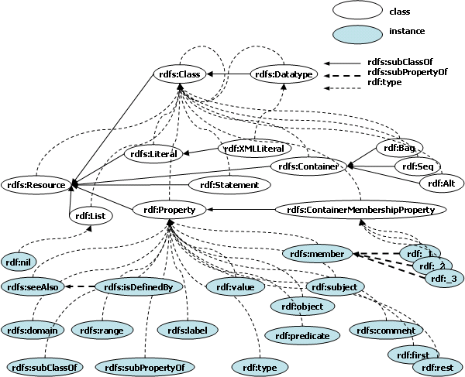
RDFS Hierarchy Graph

Slide 46
RDFS Metadata Properties
Metadata is “data about data”
Any meta-data can be attached to a resource, using:
  rdfs:comment
    Human-readable description of the resource, e.g.
      ⟨<ex:Person>, rdfs:comment, ”A person is any human being”⟩
  rdfs:label
    Human-readable version of the resource name, e.g.
      ⟨<ex:Person>, rdfs:label, ”Human being”⟩
  rdfs:seeAlso
    Indicate additional information about the resource, e.g.
      ⟨<ex:Person>, rdfs:seeAlso, <http://xmlns.com/wordnet/1.6/Human>⟩
  rdfs:isDefinedBy
    A special kind of rdfs:seeAlso, e.g.
      ⟨<ex:Person>,rdfs:isDefinedBy,<http://xmlns.com/wordnet/1.6/Human>⟩

Slide 47
SCHEMA AND DATA SAMPLES

Slide 48
Dublin Core Vocabulary – Schema Sample
Annotation of title, author, creation date, or subject among many other properties, e.g., to make digital library content usable to applications on the Web
Schema Examples:
  http://purl.org/dc/terms/Agent is a Class: a resource that acts or has that power
  http://purl.org/dc/terms/contributor is a Property: an entity responsible for making contributions to the resource with range http://purl.org/dc/terms/Agent
  http://purl.org/dc/terms/creator is a Property: an entity primarily responsible for making the resource that is SubPropertyOf: http://purl.org/dc/terms/contributor and that has as range: http://purl.org/dc/terms/Agent
  http://purl.org/dc/terms/created is a Property: Date of creation of the resource that is SubPropertyOf: http://purl.org/dc/terms/date with range: http://www.w3.org/2000/01/rdf-schema#Literal
  http://purl.org/dc/terms/isReplacedBy is a Property: A related resource that displaces, or supersedes the described resources that is SubPropertyOf: http://purl.org/dc/terms/relation

Slide 49
Dublin Core Vocabulary – Data Sample
There is a document Document1 with three contributors, whereof one is the main creator. The document is a DCMI Metadata example and was created on June 15, 2009; subsequently, it was replaced by a new documents referred to as Document2.
@prefix dc: <http://purl.org/dc/terms/>.
@prefix ex: <http://www.example.org>.
ex:Document 1 dc:contributor ex:Contributor2, ex:Contributor3;
dc:creator ex:Contributor1;
dc:created “2009-06-15”;
dc:description “This is a DCMI Metadata example”;
dc:isReplacedBy ex:Document2.

Slide 50
Creative Commons – Schema Sample
License and conditions for the reuse of digital works to filter search results to those that can actually be used for one’s task
Schema Examples:
  http://creativecommons.org/ns#Work is a Class: a potentially copyrightable work
  http://creativecommons.org/ns#License is a Class: A set of request/permissions to users of some piece of work
  http://creativecommons.org/ns#license is a Property: A work has a license and SubPropertyOf: http://purl.org/dc/terms/license with domain http://creativecommons.org/ns#Work and range http://creativecommons.org/ns#License
  http://creativecommons.org/ns#legalcode is a Property: The URL of the legal text of a license with domain: http://creativecommons.org/ns#License

Slide 51
Creative Commons – Data Sample
There is a piece of work with an Attribution-ShareAlike 3.0 license from creative commons that allows distribution of the work under the conditions that the owner is attributed. The human-readable legal text of the license is published at http://creativecommons.org/licenses/by-sa/3.0/legalcode.
@prefix cc: <http://creativecommons.org/ns#>.
@prefix ex: <http://www.example.org>.
Ex:myWork cc:license <http://creativecommons.org/licenses/by-sa/3.0/>.
<http://creativecommons.org/licenses/by-sa/3.0/>
cc:permits <http://web.resource.org/cc/Distribution>;
cc:requires <http://web.resource.org/cc/Attribution>;
cc:legalcode <http://creativecommons.org/licenses/by-sa/3.0/legalcode>.

Slide 52
GeoNames – Schema Sample
Geographical locations, coordinates, countries to combine geo data with mapping views or use location and places as filtering criterion in Web searches
Schema Examples:
  http://www.geonames.org/ontology#Feature is a Class: a geographical object uniquely identified by its geonames id
  http://www.geonames.org/ontology#name is a Property: The preferred name of the feature with domain: http://www.geonames.org/ontology#Feature
  http://www.geonames.org/ontology#countryCode is a Property: a two letters country code in the ISO 3166 list with domain: http://www.geonames.org/ontology#Feature
  http://www.w3.org/2003/01/geo/wgs84_pos#SpatialThing is a Class: anything with spatial extent
  http://www.w3.org/2003/01/geo/wgs84_pos#lat is a Property: The WGS84 latitude of a SpatialThing with domain: http://www.w3.org/2003/01/geo/wgs84_pos#SpatialThing
  http://www.w3.org/2003/01/geo/wgs84_pos#llong is a Property: The WGS84 longitude of a SpatialThing with domain: http://www.w3.org/2003/01/geo/wgs84_pos#SpatialThing

Slide 53

GeoNames – Data Sample
The resource with geonames ID 6695380 represents Itsukushima in Japan, given by the ISO country code JP. The geographic location is given by the WSG84 latitude/longitude coordinates 40.53851/141.55761.
@prefix geo: <http://www.geonames.org/ontology#>.
@prefix wsg: <http://www.w3.org/2003/01/geo/wgs84_pos#>.
<http://sws.geonames.org/6695380> geo:name “Itsukushima”;
geo:countryCode “JP”;
wsg:lat “40.53851”;
wsg:long “141.55761”.

Slide 54
SKOS – Schema Sample
Semantic descriptions of thesauri, classification schemes, subject heading lists, and taxonomies.
Schema example:
  http://www.w3.org/2004/02/skos/core#Concept is a class: a concept in a knowledge organization system
  http://www.w3.org/2004/02/skos/core#OrderedCollection is a class: an ordered collection of concepts
  http://www.w3.org/2004/02/skos/core#prefLabel is a property: the preferred lexical label for a resource, in a given language and SubPropertyOf: http://www.w3.org/2000/01/rdf-schema#label
  http://www.w3.org/2004/02/skos/core#narrower is a property: relates a concept to a concept that is more specific in the meaning
  http://www.w3.org/2004/02/skos/core#broader is a property: relates a concept to a concept that is more general in the meaning
  http://www.w3.org/2004/02/skos/core#related is a property: relates concepts for which there is an associative semantic relationships
  http://ns.inria.fr/nicetag/2010/07/21/voc#AnnotatedResource is a class: a dereferencable resource on the Web that is taggable
  http://ns.inria.fr/nicetag/2010/07/21/voc#isRelevantToSt is a property: links a resource to anything that it may be relevant to

Slide 55
SKOS – Data Sample
The topic annotation is related to the concepts metadata and footnote, where footnote is a narrower term than annotation. The annotation concept is moreover described as being relevant to the book chapter on RDF/S.
@prefix skos: <http://www.w3.org/2004/02/skos/core#>.
@prefix voc: <http://ns.inria.fr/nicetag/2010/07/21/voc#>.
<http://example.org/topics/annotation> a skos:Concept;
skos:definition “Any descriptive notation applied to data”;
skos:prefLabel “Annotation”;
skos:narrower <http://example.org/topics/footnote>;
skos:related <http://example.org/topic/metadata>;
a voc:AnnotatedResource;
voc:isRelevantToSt <http://example.org/bookchapter/RDFS>.

Slide 56
Genetics and Life Science – Schema Sample
Molecular functions, biological processes, cellular components, and vocabularies to describe the human anatomy and genes, biochemistry, genetic disorders or phenotypes.
Schema example:
  http://www.geneontology.org/dtd/go.dtd#term is a class: any term in the gene ontology is of type term
  http://www.geneontology.org/dtd/go.dtd#is_a is a property: if A is_a B, then A is a subtype of B with domain and term http://www.geneontology.org/dtd/go.dtd#term
  http://www.geneontology.org/dtd/go.dtd#part_of is a property: representation of part-whole relationships
  http://www.geneontology.org/dtd/go.dtd#negatively_regulates is a property: one process directly affects the manifestation of another process or quality

Slide 57
Genetics and Life Science – Data Sample
The term GO:0000001 represents the concept of mitochondrion inheritance which is a subtype of the concept GO:0048308 (organelle inheritance), a part of the concept GO:0009530 (primary cell wall), and negatively regulates GO:0006312 (mitotic recombination).
@prefix godtd: <http://www.geneontology.org/dtd/go.dtd#>.
@prefix go: <http://www.geneontology.org/go#>.
go:GO:0000001 a go:term;
godtd:accession “GO:0000001”;
godtd:name “mitochondrion inheritance”;
godtd:synonym “mitochondrial inheritance”;
godtd:definition “The distribution of mitochondria, including the mitochondrial genome, into daughter cells after mitosis or meiosis, mediated by interactions between mitochondria and the cytoskeleton.”
godtd:is_a go:GO:0048308;
godtd:part_of go:GO:0009530;
godtd:negatively_regulates go:GO:0006312.

Slide 58
RDF(S) SEMANTICS

Slide 59
Semantics
RDF(S) vocabulary has built-in “meaning”
RDF(S) Semantics
  Makes meaning explicit
  Defines what follows from an RDF graph
Semantic notions
  Subgraph
  Instance
  Entailment

Slide 60
Subgraph
E is a subgraph of S if and only if E predicates are a subset of S predicates
  ⟨<#john>, <#hasName>, _:johnsname⟩
  ⟨_:johnsname, <#firstName>, ”John”ˆˆxsd:string⟩
  ⟨_:johnsname, <#lastName>, ”Smith”ˆˆxsd:string⟩
Some subgraphs:
  ⟨<#john>,<#hasName>, _:johnsname⟩
  ⟨_:johnsname, <#firstName>, ”John”ˆˆxsd:string⟩
  ⟨_:johnsname, <#firstName>, ”John”ˆˆxsd:string⟩
  ⟨_:johnsname, <#lastName>, ”Smith”ˆˆxsd:string⟩
  ⟨<#john>, <#hasName>, _:johnsname⟩

Slide 61
Instance
S’ is an instance of S if and only if some blank nodes in S are replaced with blank nodes, literals or URIs
  ⟨<#john>, <#hasName>, _:johnsname⟩
  ⟨_:johnsname, <#firstName>, ”John”ˆˆxsd:string⟩
  ⟨_:johnsname, <#lastName>, ”Smith”ˆˆxsd:string⟩
Instances:
  ⟨<#john>, <#hasName>, <#abc>⟩
  ⟨<#abc>, <#firstName>, ”John”ˆˆxsd:string⟩
  ⟨<#abc>, <#lastName>, ”Smith”ˆˆxsd:string⟩
  ⟨<#john>, <#hasName>, _:X⟩
  ⟨_:X, <#firstName>, ”John”ˆˆxsd:string⟩
  ⟨_:X, <#lastName>, ”Smith”ˆˆxsd:string⟩
  ⟨<#john>, <#hasName>, _:johnsname⟩
  ⟨_:johnsname, <#firstName>, ”John”ˆˆxsd:string⟩
  ⟨_:johnsname, <#lastName>, ”Smith”ˆˆxsd:string⟩
Every graph is an instance of itself!

Slide 62
Entailment
Entailment or logical implication is a relation between sentences of a formal language
S entails E if E logically follows from S
  Written: S |= E
A graph entails all it subgraphs
  If S’ is a subgraph of S: S |= S’
All instances of a graph S entail S
  If S’’ is an instance of S: S”|= S
Notes:
Or logical implication.
Entailment is a relation between sentences of a formal language, such that if S is a set of predicates and E is a predicate then S entails E just in case E is true in every interpretation in which all members of S are true

Slide 63
RDFS Entailment

Slide 64
RDFS Entailment

Slide 65
RDFS Entailment

Slide 66
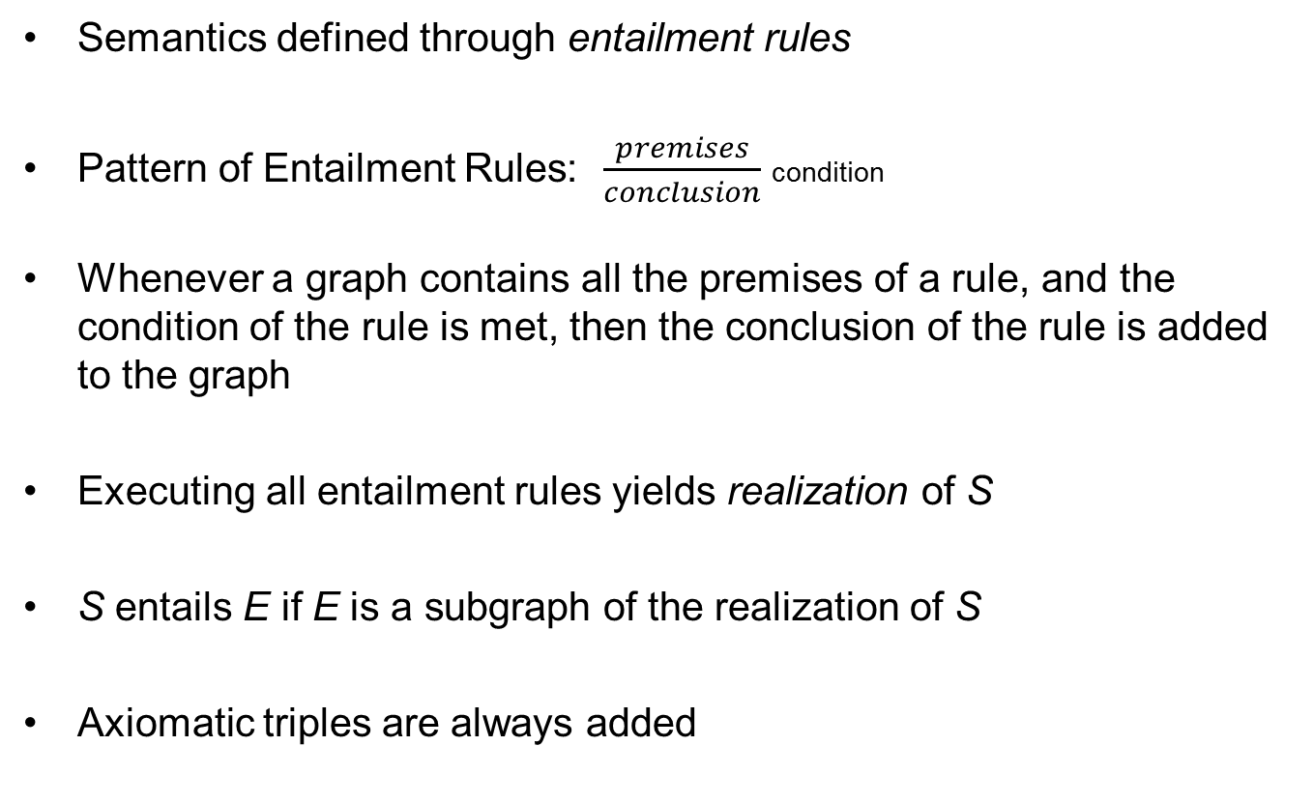
Entailment Rules

Slide 67
Axiomatic RDF Triples
The following triples are always RDF-entailed:
  rdf:type rdf:type rdf:Property.
  rdf:subject rdf:type rdf:Property.
  rdf:predicate rdf:type rdf:Property.
  rdf:object rdf:type rdf:Property.
  rdf:first rdf:type rdf:Property.
  rdf:rest rdf:type rdf:Property.
  rdf:value rdf:type rdf:Property.
  rdf:_1 rdf:type rdf:Property.
  rdf:_2 rdf:type rdf:Property.
  …
  rdf:nil rdf:type rdf:Property.

Slide 68
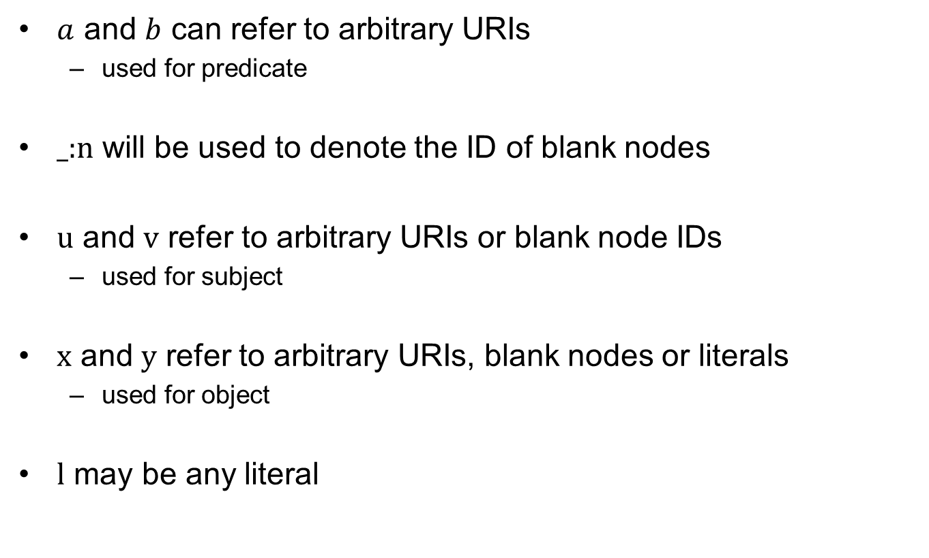
Some notation

Slide 69
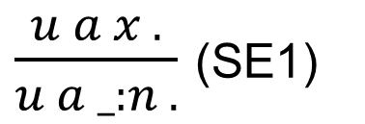
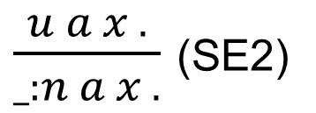
Simple RDF Entailment
When applying (SE1) and (SE2) attention must be paid that _:n has not been assigned to a different URI, blank node or literal in previous applications of these rules
An RDF Graph G₂ is simply-entailed by an RDF Graph G₁, if there is a realization G’₁ of G₁ by applications of the rules (SE1) and (SE2) such that G₂ is a subgraph of G’₁.

Slide 70
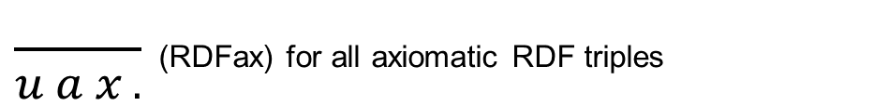
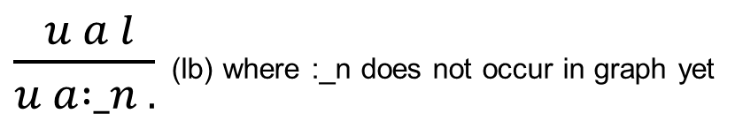
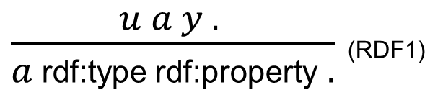
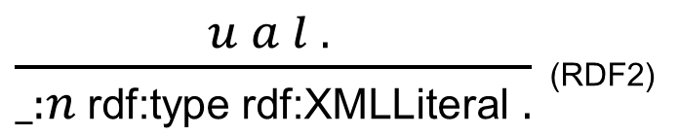
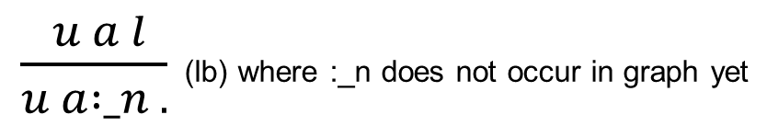
RDF Entailment
Where l is XMLLiteral and _:n
the blank node id assigned to
l by (lb) rule
An RDF Graph G₂ is RDF-entailed by an RDF Graph G₁, if there is a realization G’₁ of G₁ by applications of the rules (RDFAx), (lb), (RDF1) and (RDF2) such that G₂ is simply-entailed by G’₁.

Slide 71
Axiomatic RDFS Triples (1/3)
The following triples are always RDFS-entailed:
  rdf:type rdfs:domain rdfs:Resource.
  rdfs:domain rdfs:domain rdf:Property.
  rdfs:range rdfs:domain rdf:Property.
  rdfs:subPropertyOf rdfs:domain rdf:Property.
  rdfs:subClassOf rdfs:domain rdf:Class.
  rdf:subject rdfs:domain rdf:Statement.
  rdf:predicate rdfs:domain rdf:Statement.
  rdf:object rdfs:domain rdf:Statement.
  rdfs:member rdfs:domain rdfs:Resource.
  rdf:first rdfs:domain rdf:List.
  rdf:rest rdfs:domain rdf:List.
  rdfs:seeAlso rdfs:domain rdfs:Resource .
  rdfs:isDefinedBy rdfs:domain rdfs:Resource.
  rdfs:comment rdfs:domain rdfs:Resource.
  rdfs:label rdfs:domain rdfs:Resource.
  rdf:value rdfs:domain rdfs:Resource.

Slide 72
Axiomatic RDFS Triples (2/3)
The following triples are always RDFS-entailed:
  rdf:type rdfs:range rdfs:Class.
  rdfs:domain rdfs:range rdfs:Class.
  rdfs:range rdfs:range rdfs:Class.
  rdfs:subPropertyOf rdfs:range rdf:Property.
  rdfs:subClassOf rdfs:range rdfs:Class.
  rdf:subject rdfs:range rdfs:Resource.
  rdf:predicate rdfs:range rdfs:Resource.
  rdf:object rdfs:range rdfs:Resrouce.
  rdfs:member rdfs:range rdfs:Resource.
  rdf:first rdfs:range rdfs:Resource.
  rdf:rest rdfs:range rdf:List.
  rdfs:seeAlso rdfs:range rdfs:Resource .
  rdfs:isDefinedBy rdfs:range rdfs:Resource.
  rdfs:comment rdfs:range rdfs:Literal.
  rdfs:label rdfs:range rdfs:Literal.
  rdf:value rdfs:range rdfs:Resource.

Slide 73
Axiomatic RDFS Triples (3/3)
The following triples are always RDFS-entailed:
  rdfs:ContainerMembershipProperty
  rdfs:subClassOf rdf:Property.
  rdf:Alt rdfs:subClassOf rdfs:Container.
  rdf:Bag rdfs:subClassOf rdfs:Container.
  rdf:Seq rdfs:subClassOf rdfs:Container.
  Rdfs:isDefinedBy rdfs:subPropertyOf rdfs:seeAlso.
  rdf:XMLLiteral rdf:type rdfs:Datatype.
  rdf:XMLLiteral rdfs:subClassOf rdfs:Literal.
  rdfs:Datatype rdfs:subClassOf rdfs:Class.
  rdf:_1 rdfs:subClassOf rdfs:ContainerMembershipProperty.
  rdf:_1 rdfs:domain rdfs:Resource.
  rdf:_1 rdfs:range rdfs:Resource.
  rdf:_2 rdfs:subClassOf rdfs:ContainerMembershipProperty.
  rdf:_2 rdfs:domain rdfs:Resource.
  rdf:_2 rdfs:range rdfs:Resource.
  …

Slide 74
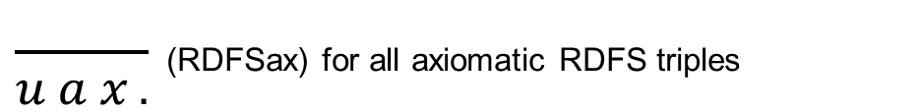
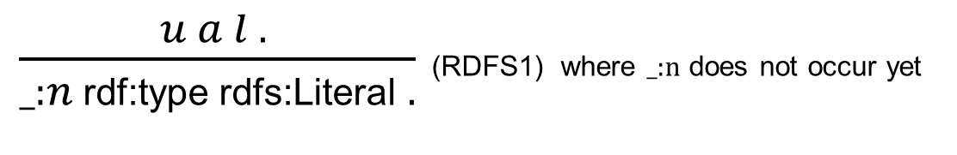
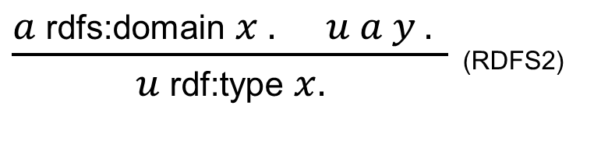
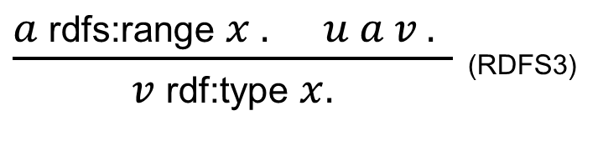
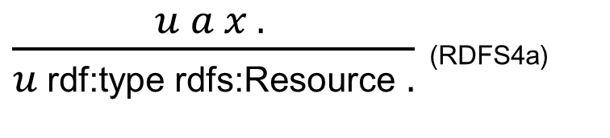
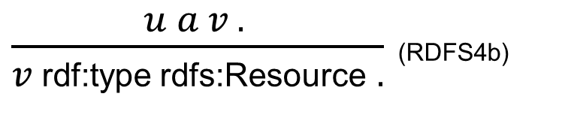
RDFS Entailment (1/3)
where _:n is the blank node id
assigned to l by (lb) rule

Slide 75
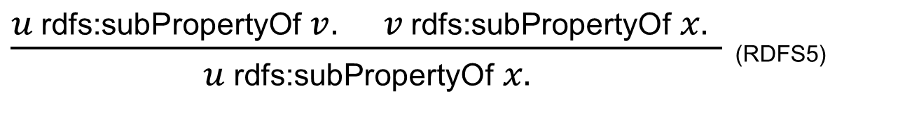
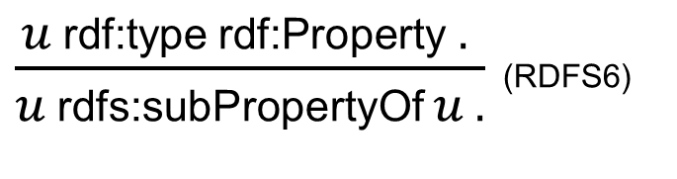
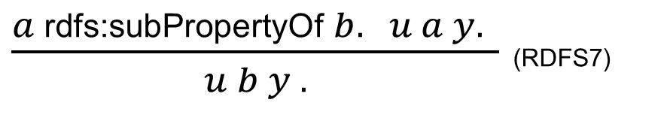
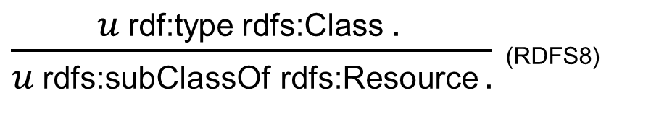
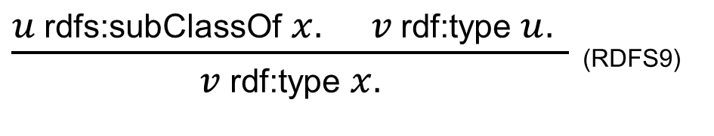
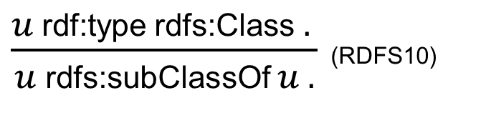
RDFS Entailment (2/3)

Slide 76
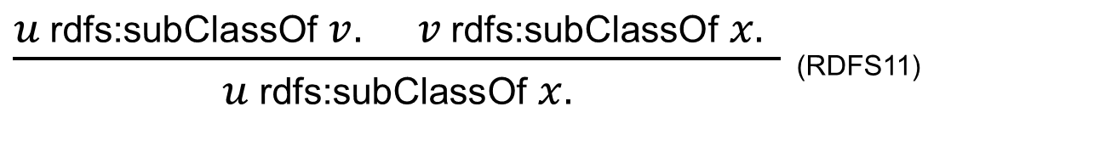
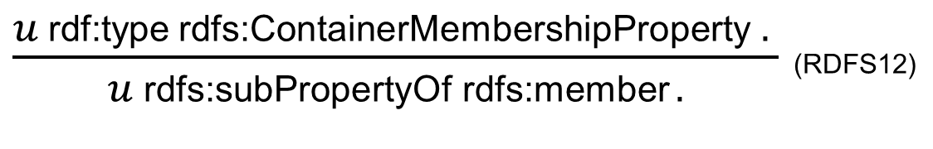
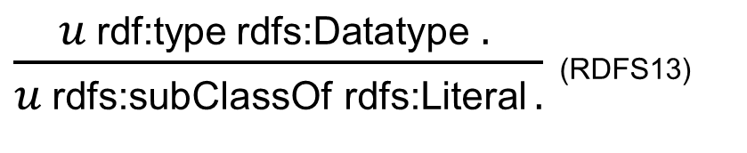
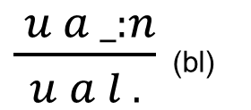
RDFS Entailment (3/3)
where _:n identifies
blank node introduced
by earlier weakening
of literal l via rule (lb)
If there is a realization G’₁ of the RDF graph G₁ by applications of the rules (RDFAx), (RDFSAx), (lb), (bl), (RDF1), (RDF2), (RDFS1)-(RDFS13) such that the RDF graph G₂ is simply-entailed by G’_{1 ,} , thenG₂ is RDFS-entailed by G₁.

Slide 77
RDF(S) SERIALIZATION

Slide 78
RDF Serialization Formats
There are several machine-readable serialization formats for RDF
RDF/XML
Turtle
N3

Slide 79
RDF/XML 1
Serializing RDF for the Web
  XML as standardized interchange format:
    Namespaces (e.g. rdf:type, xsd:integer, ex:john)
    Encoding (e.g. UTF8, iso-8859-1)
    XML Schema (e.g. datatypes)
Reuse of existing XML tools:
  Syntax checking (i.e. schema validation)
  Transformation (via XSLT)
    Different RDF representation
    Layout (XHTML)
    Different XML-based formats
Parsing and in-memory representation/manipulation (DOM/SAX)
. . .

Slide 80
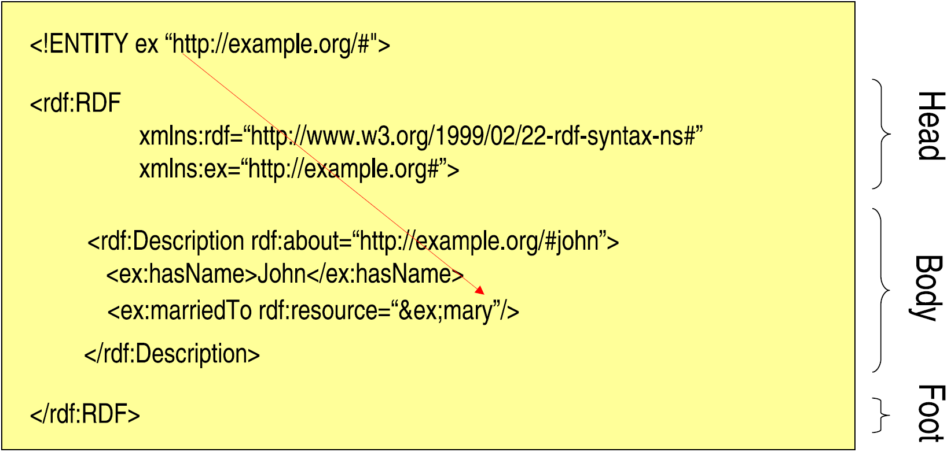
RDF/XML 2
<#john, #hasName, “John”>
<#john, #marriedTo, #mary>

Slide 81
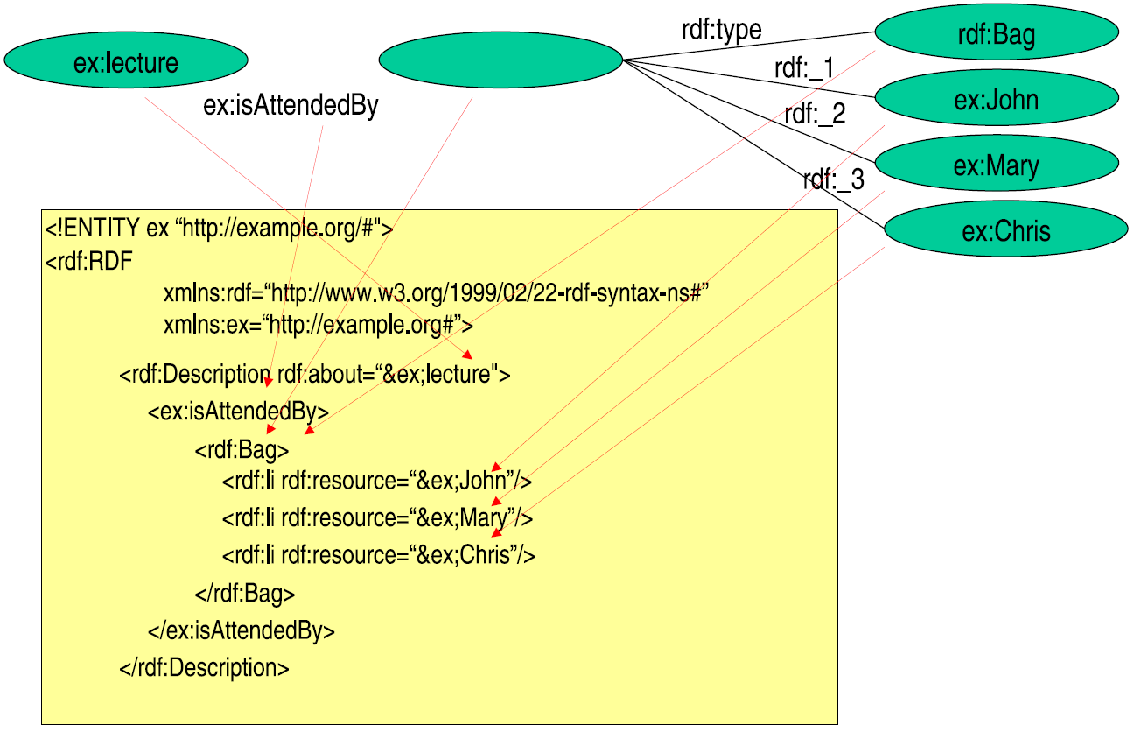
RDF/XML 3

Slide 82
Turtle
Turtle stands for Terse RDF Triple Language
An RDF serialization
Triple representation of <Subject, Predicate, Object>
Example:
  @prefix person: <http://example/person/> .
  @prefix foaf: <http://xmlns.com/foaf/0.1/> .
  person: A foaf:name “Jek" .
  person: A foaf:mbox <mailto:jek@example.net> .
  person: B foaf:name “Yuan" .
  _:b foaf:name “Jeff" .
  _:b foaf:mbox <mailto:jeff@example.org> .

Slide 83
RDF N3 syntax
Notation3, or N3
A shorthand non-XML serialization of RDF models
Designed for human-readability
  much more compact and readable than XML RDF notation
Example
  {:John :Loves :Mary} :accordingTo :Bill

Slide 84
TOOLS

Slide 85
Tool Support for RDF/RDFS
Ontology editors
  Protégé (http://protege.stanford.edu/)
Browser
  /facet (http://slashfacet.semanticweb.org/)
RDF repositories
  Sesame (http://www.openrdf.org/)
APIs
  RDF2Go – Java (http://semanticweb.org/wiki/RDF2Go)
  Jena – Java (http://jena.sourceforge.net/)
Validator
  W3C Validator (http://www.w3.org/RDF/Validator/)

Slide 86

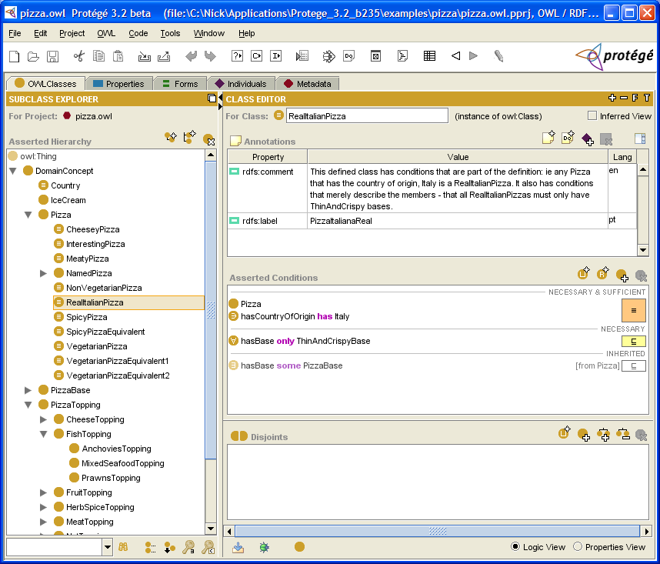
Free, open-source Java ontology editor and knowledge-base framework
  Developed by Stanford Medical Informatics
  Extensible plug-and-play environment
Has a large user community (approx 30k)
Support
  Graph view, consistency check, web, merging
No support
  Addition of new basic types
  Limited multi-user support

Slide 87
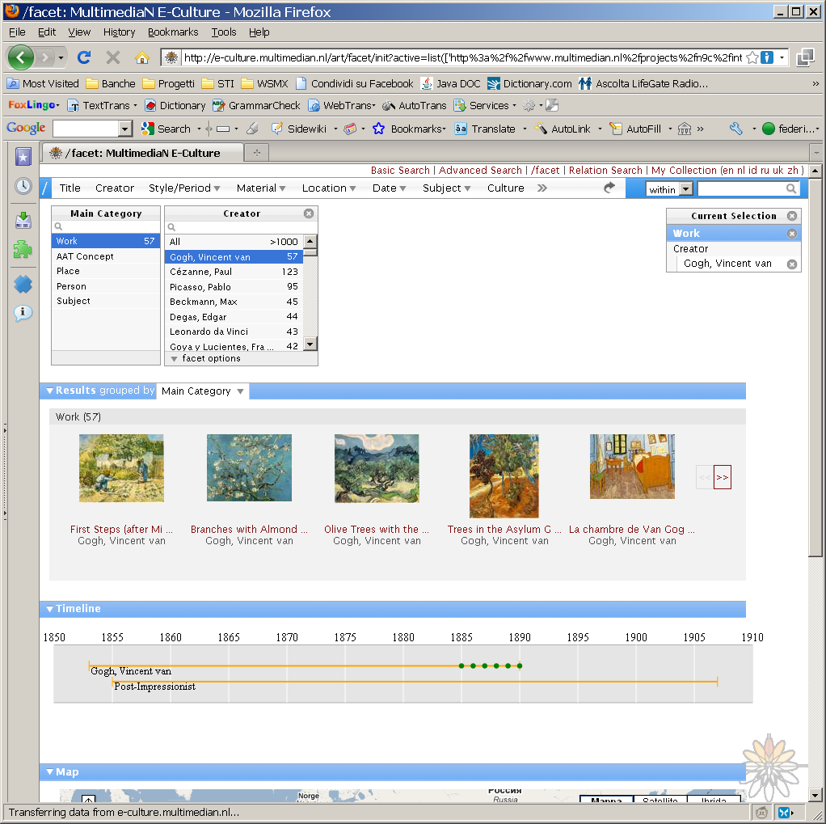
/facet
/facet is a generic browser for heterogeneous Semantic Web repositories
Works on any RDFS dataset without any additional configuration
Select and navigate facets of resources of any type
Make selections based on properties of other, semantically related, types
Allows the inclusion of facet-specific display options

Slide 88
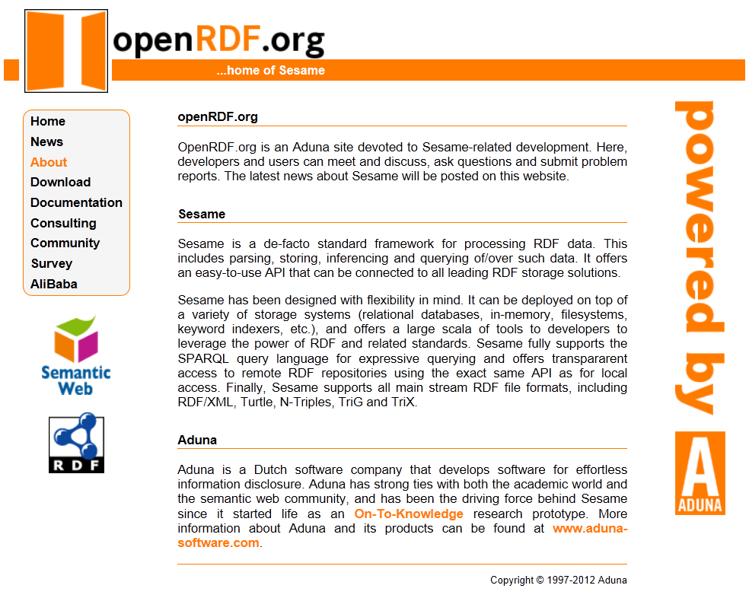
Sesame
An open-source framework for storage, querying and inferencing of RDF and RDF Schema
A Java Library for handling RDF
A Database Server for (remote)
access to repositories of RDF data
Features:
  Light-weight yet powerful Java API
  SeRQL, SPARQL
  High scalability (O(10⁷) triples on
  desktop hardware)
  Various backends (Native Store,
  RDBMS, main memory)
  Reasoning support
  Transactional support
  Context support
  RDF/XML, Turtle, N3, N-Triples

Slide 89

RDF2Go
RDF2Go is an abstraction over triple (and quad) stores. It allows developers to program against rdf2go interfaces and choose or change the implementation later easily
It can be extended: you can create an adapter from any RDF Object Model to RDF2Go object model
Directly supported implementations:
  Jena
  Sesame
  OWLIM (family of RDF database management systems)

Slide 90
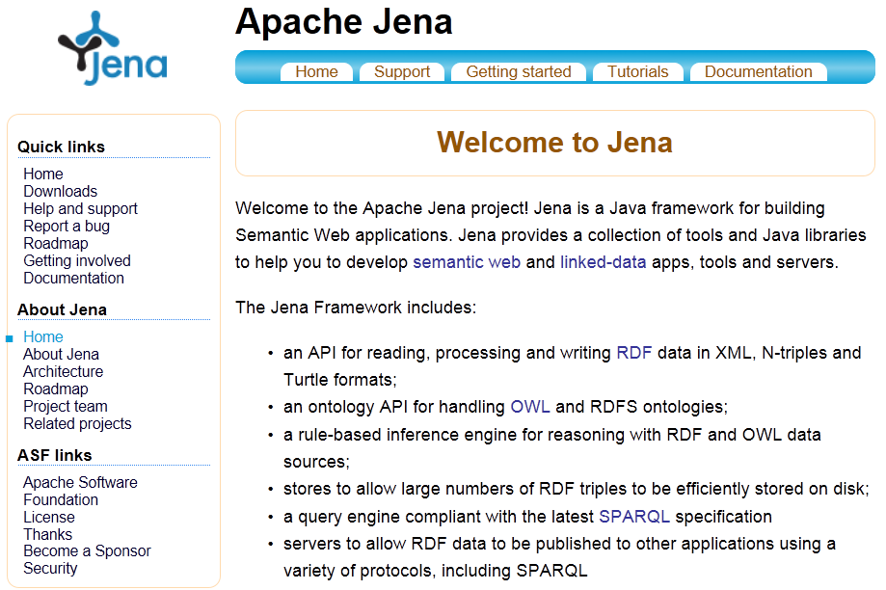
Jena
A Java framework for building Semantic Web applications
Initiated by Hewlett Packard (HP) Labs Semantic Web Programme.
Includes:
  An RDF API
  Reading and writing RDF in
  RDF/XML, N3 and N-Triples
  An OWL API
  In-memory and persistent
  storage
  SPARQL query engine

Slide 91
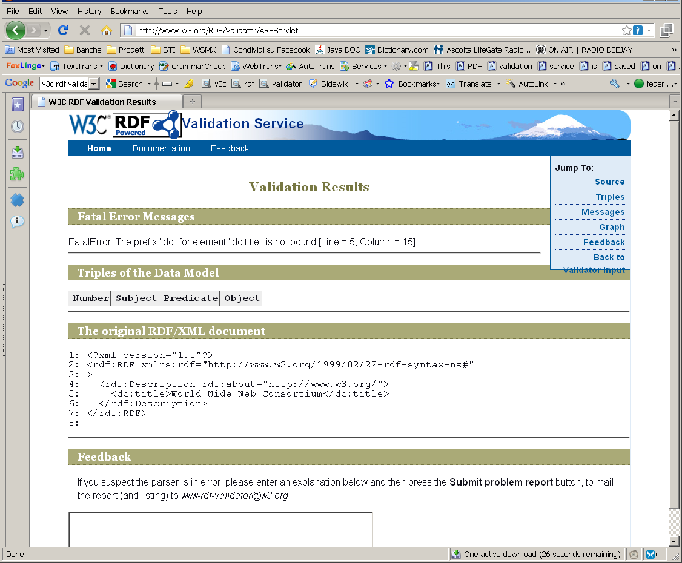
W3C Validator
RDF Validator
Parses RDF documents and detects errors w.r.t. the current RDF specification
Available online service
Downloadable code
Based on ARP parser (the one also adopted in Jena)

Slide 92
ILLUSTRATION BY A LARGER EXAMPLE
An example of usage of RDF and RDF(S)

Slide 93
Friend of a Friend (FOAF)
Friend of a Friend is a project that aims at providing simple ways to describe people and relations among them
FOAF adopts RDF and RDFS
Full specification available on: http://xmlns.com/foaf/spec/
Tools based on FOAF:
  FOAF search (http://foaf.qdos.com/)
  FOAF builder (http://foafbuilder.qdos.com/)
  FOAF-a-matic (http://www.ldodds.com/foaf/foaf-a-matic)
  FOAF.vix (http://foaf-visualizer.org/)
Notes:
FOAF is an application of the Resource Description Framework (RDF) because the subject area we're describing -- people -- has so many competing requirements that a standalone format could not do them all justice. By using RDF, FOAF gains a powerful extensibility mechanism, allowing FOAF-based descriptions can be mixed with claims made in any other RDF vocabulary

Slide 94
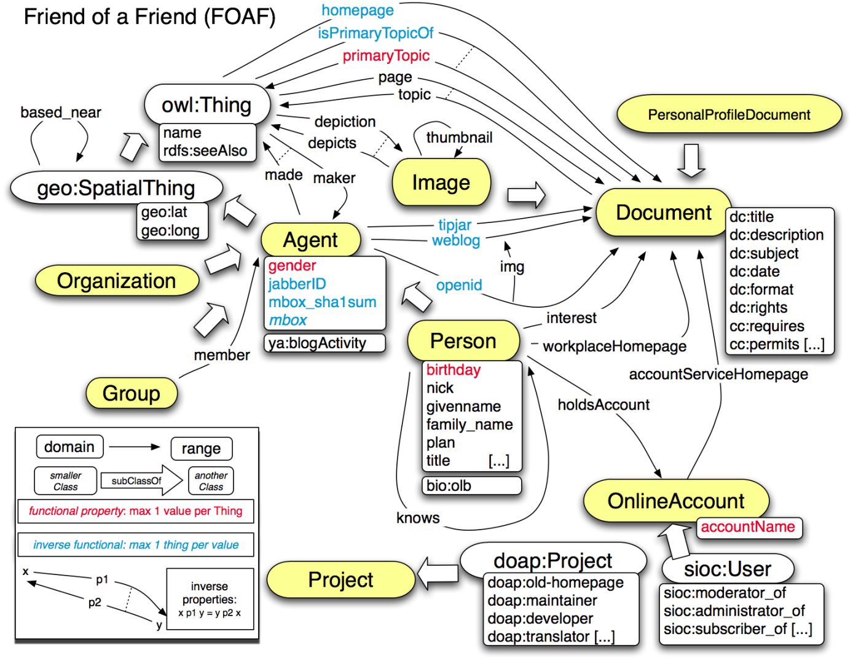
FOAF Schema
http://sioc-project.org/
http://semanticweb.org/wiki/DOAP
[http://www.foaf-project.org/]

Slide 95
FOAF RDF Example
<rdf:RDF
xmlns:rdf="http://www.w3.org/1999/02/22-rdf-syntax-ns#"
xmlns:rdfs="http://www.w3.org/2000/01/rdf-schema#"
xmlns:foaf="http://xmlns.com/foaf/0.1/"
xmlns:admin="http://webns.net/mvcb/">
<foaf:Person rdf:ID=“Sebastian Link">
<foaf:name>Sebastian Link</foaf:name>
<foaf:title>Associate Professor</foaf:title>
<foaf:givenname>Sebastian</foaf:givenname>
<foaf:family_name>Link</foaf:family_name>
<foaf:mbox_sha1sum>03bdb3d9a5dddb33489a4417849eb9e91a0cc23f</foaf:mbox_sha1sum>
<foaf:homepage rdf:resource="slink.foiks.org"/>
<foaf:depiction rdf:resource="http://slink.foiks.org/Images/SebastianLink.jpg"/>
<foaf:phone rdf:resource="tel:+64-9-373-7599-extn-88758"/>
<foaf:workplaceHomepage rdf:resource="http://www.cs.auckland.ac.nz/our_staff/profile.php?id=slin921"/>
<foaf:schoolHomepage rdf:resource="http://www.gymnasium-stadtfeld.de/"/></foaf:Person>
</rdf:RDF>

Slide 96
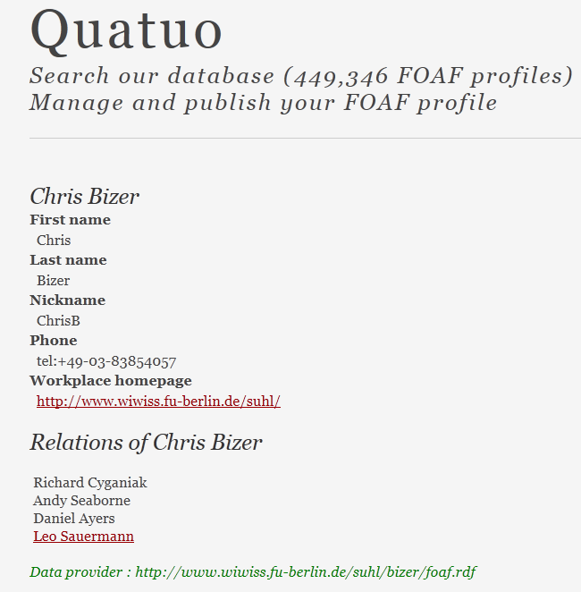
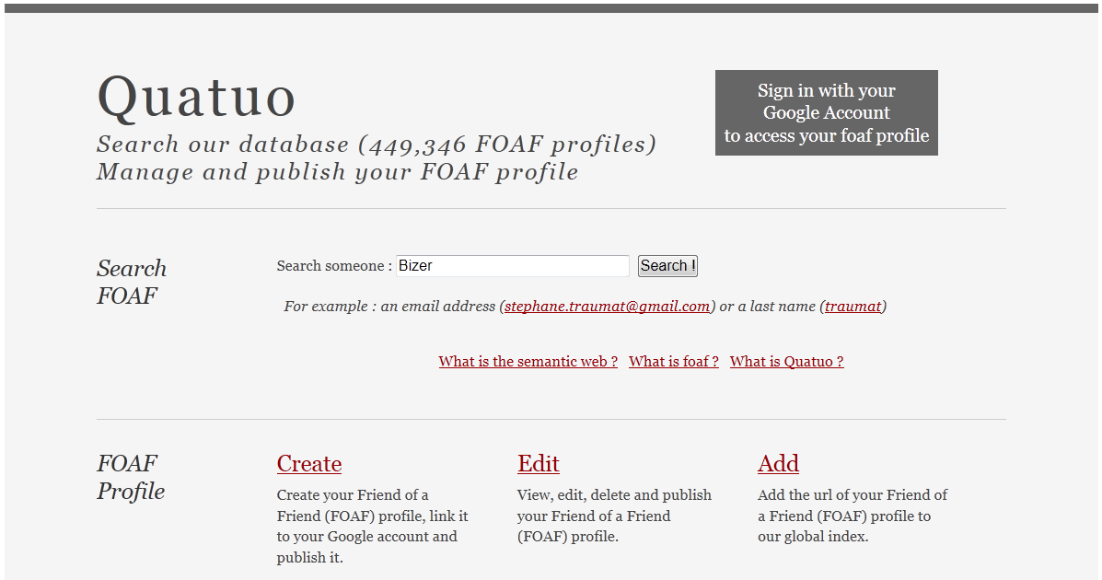
FOAF Search (http://www.quatuo.com/)

Slide 97
EXTENSIONS

Slide 98
Where can we go from here?
RDF(S) has some limitations in terms of representation and semantics, thus OWL was built on top of it to overcome some of them
We have seen how to represent statements in RDF, how to query them? SPARQL is currently the standard language to query RDF data
RDF(S) by itself is not providing any instrument to define personalized entailment rules
  The entailment process is driven by RDF(S) Semantics
  This is not enough in many practical contexts
RDF can be extend to add rule support
  RULE-ML based extensions
  Horn Logic based extensions
  OWL Horst (include a fragment of DL as well)
  OWLIM (include a fragment of DL as well)
Notes:
Hermant ter Horst defines RDFS extensions aiming at more general rule support and a fragment of OWL, which is more expressive than DLP and fully compatible with RDFS. First, he defines R-entailment, which extends the RDFS-entailment in the following ways:
* it can operate on the basis of any set of rules R (i.e. allows for extension or replacement of the standard set, defining the semantics of RDFS);
* it operates over the so-called generalized RDF graphs, where blank nodes can appear as predicates (a possibility disallowed in RDF);
* rules without premises are used to declare axiomatic statements;
* rules without consequences imply inconsistency.

Slide 99
SUMMARY

Slide 100
Summary
RDF
  Advantages:
    Reuse existing standards/tools
    Provides some structure for free (e.g. for containers)
    Standard format
  Disadvantages:
    Verbose
    Reconstructing RDF graph non-trivial

Slide 101
Summary
RDF Schema
  Advantages
    A primitive ontology language
    Offers certain modeling primitives with fixed meaning
    Key concepts of RDF Schema
      subclass relations, property, subproperty relations, domain and range restrictions
    There exist query languages for RDF and RDFS
    Allows metamodeling
  Disadvantages
    Quite primitive as a modeling language for the Web
    Many desirable modeling primitives are missing
      An ontology layer on top of RDF/RDFS is needed

Slide 102
References
Mandatory reading
  Semantic Web Primer
    Chapter 3 (only Sections 3.1 to 3.6)
Further reading
  RDF Primer
    http://www.w3.org/TR/REC-rdf-syntax/
  RDF Vocabulary Description Language 1.0: RDF Schema
    http://www.w3.org/TR/rdf-schema/

Slide 103
References
Wikipedia
  http://en.wikipedia.org/wiki/Resource_Description_Framework
  http://en.wikipedia.org/wiki/RDF_schema
  http://en.wikipedia.org/wiki/Turtle_(syntax)
  http://en.wikipedia.org/wiki/Notation_3
  http://en.wikipedia.org/wiki/N-Triples

Slide 104
Next Lecture
# | Title
1 | Introduction
2 | Semantic Web Architecture
3 | Resource Description Framework (RDF)
4 | Web of Data
5 | Generating Semantic Annotations
6 | Storage and Querying
7 | Web Ontology Language (OWL)
8 | Rule Interchange Format (RIF)

Slide 105

Questions?
105
Notes:
105

