Slide 1
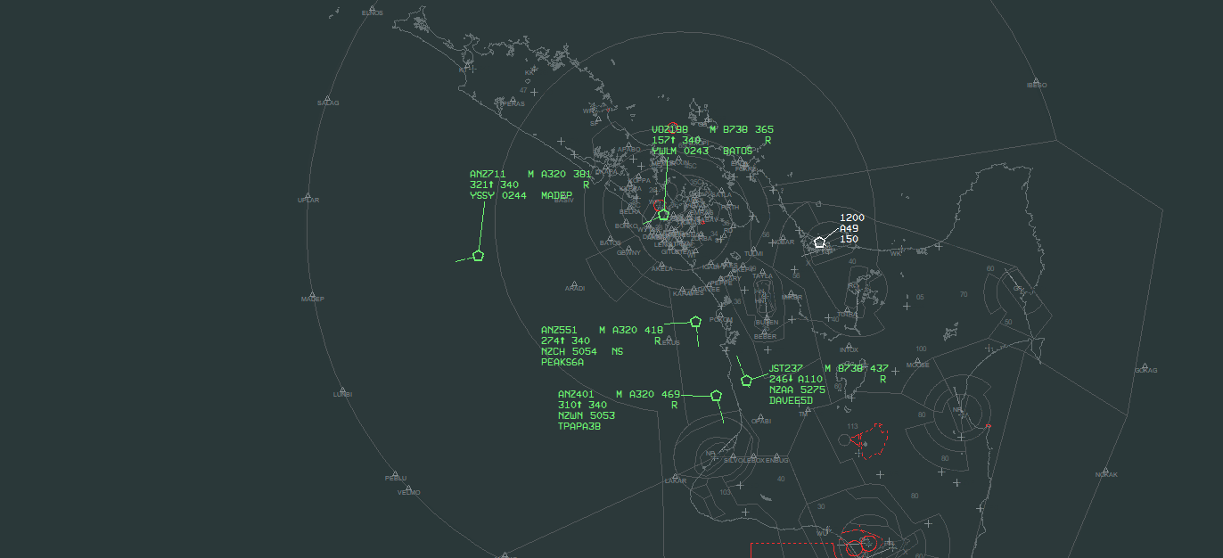
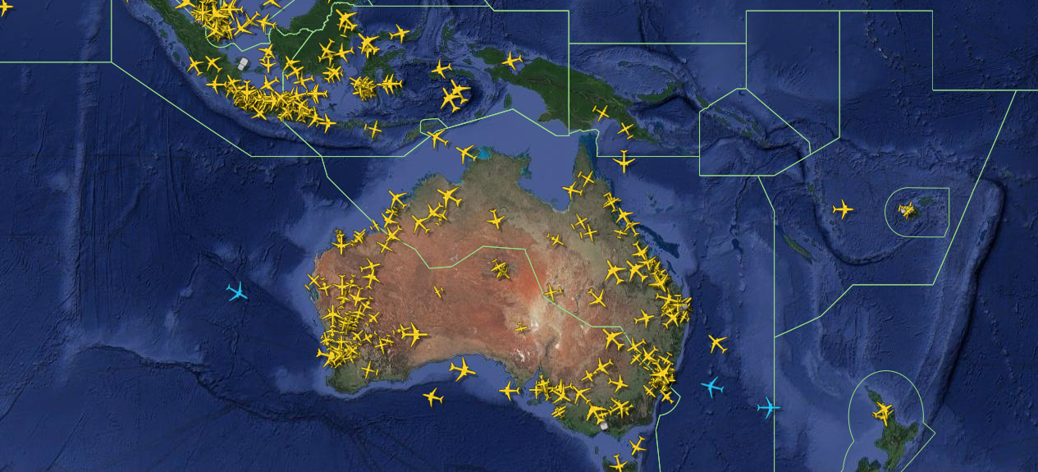
Detecting wireless attacks on ADS-B based Air Traffic Surveillance
Zain Khan

Slide 2
What is ADS-B?
ADS-B (Automatic Dependent Surveillance – Broadcast) is an automated aircraft tracking system involving broadcasts of precise position and velocity data – like radar
Used in many flight tracking applications (Flightradar24, FlightAware, etc.)
Used in air traffic control (ATC) services providing airspace surveillance
Mandated in several countries worldwide (including Australia, US and soon New Zealand from late 2022)

Slide 3
ADS-B at work
Source: Airways New Zealand – New Southern Sky project

Slide 4
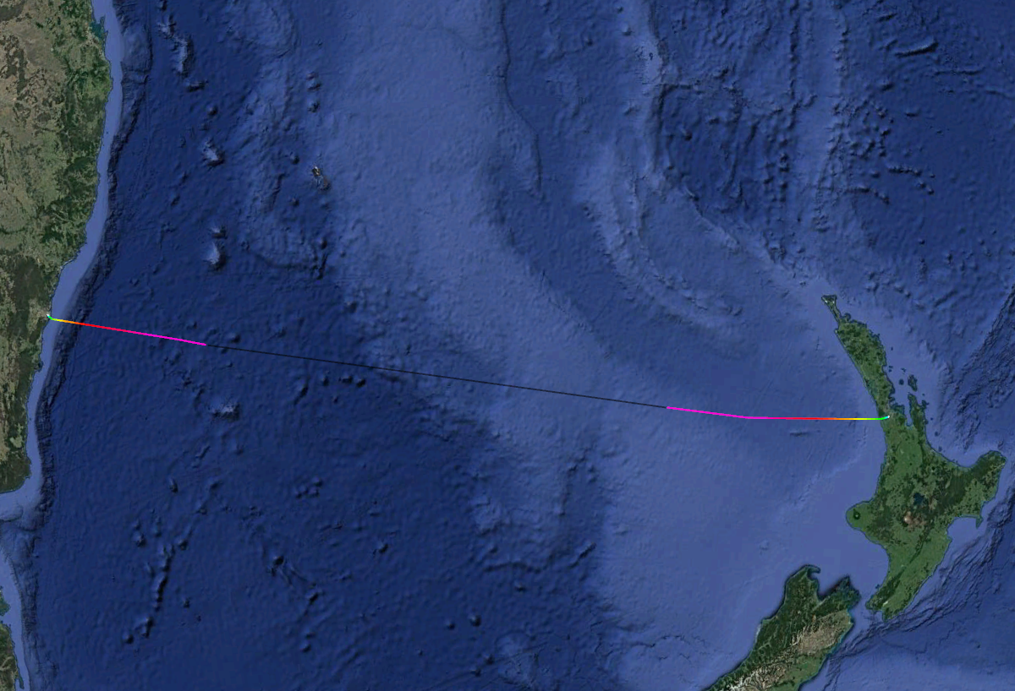
ADS-B tracking data exemplar
Source: Flightradar24

Slide 5
Security inconsistencies of ADS-B – The Problem
The ADS-B protocol does not currently support encryption or authentication of data
Openness of the ADS-B protocol increases risk of attacks – receivers are cheap to get and data can be easily obtained from the internet and manipulated
Updates to aviation technologies only occur every 10-20 years on average, and over time lags behind in security updates

Slide 6
ADS-B attack vectors – The Problem
ADS-B is prone to the following kinds of attacks:
Spoofing attacks on GPS and ADS-B data – faking of GPS and ADS-B data reports which look like actual reports – targeting aircraft and receivers
Sensor control attacks – adversaries intercept ADS-B signals through one or more sensors and inject arbitrary data into ADS-B reports
Sybil attacks – overruling network protection systems and deployment of sensors at different locations

Slide 7
Suggested solution
Jansen et. al have come up with a ADS-B trust system that verifies the authenticity of ADS-B data packets
Survey of verification undertaken on ADS-B data from aircraft in European airspace
A series of checks before making a consensus as to authenticity.
Confidentiality and integrity not guaranteed

Slide 8
The model of ADS-B authenticity

Slide 9
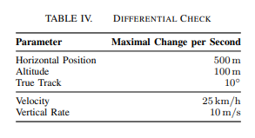
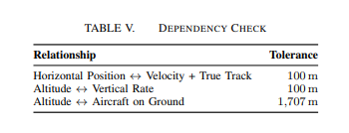
The checks of ADS-B authenticity – broken down
And then a final cross check of the receiving sensor to see if its in order with expected coverage (if all other checks pass)

Slide 10
Attack sensitivity

Slide 11
Attack detection performance results
Dependency check classification scores decreased when GPS spoofing attacks were detected. (up to 99.5% detection with increase in deviation)
Cross checking classification scores decreased significantly (60-95%) when at least one sensor is affected by an ADS-B spoofing attack
Cross checking for sensor control and sybil attacks yielded similar results to ADS-B spoofing attacks – can be traced!
A combination of GPS and ADS-B spoofing decreases scores even further

Slide 12
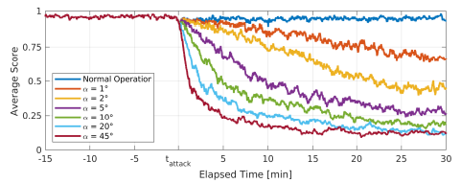
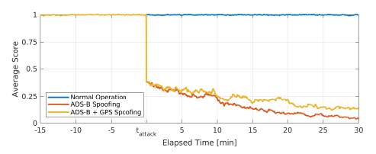
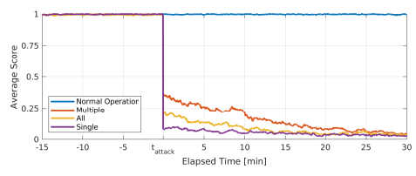
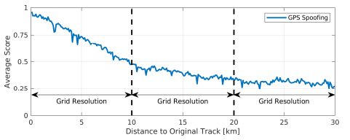
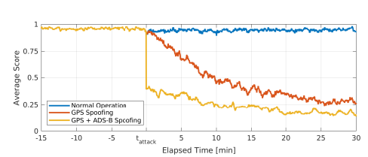
Score analysis
GPS spoofing (Dependency check)
ADS-B spoofing (Cross check)
ADS-B spoofing + GPS spoofing

Slide 13
Criticism
Study undertaken in Europe – does not consider different regions of the world
Other attack vectors?
Does not discuss implications on ATC services and flight tracking apps
Not enough data security

Slide 14
Overcoming limitations
Consider attacks on databases hosting ADS-B data and attacks designed to downgrade or shut off ADS-B tracking
Expand studies to countries outside of the EU and countries with challenging airspace – compare and contrast
Investigate TLS style security – maybe Checksums on ADS-B messages or encryption
Consult with ATC service providers (such as Airways NZ) and flight tracking websites (such as Flightradar24)

Slide 15
Further readings on ADS-B and security
Jansen et. al’s literature - https://www.ndss-symposium.org/wp-content/uploads/ndss2021_1A-5_24552_paper.pdf
ADS-B security concerns on US military aircraft - https://www.aviationtoday.com/2018/04/06/latest-us-military-aircraft-ads-b-security-concerns/
Broadcast (ADS-B): A survey - https://ieeexplore.ieee.org/stamp/stamp.jsp?arnumber=9133434
Cyber Security threat to Air Navigation Service Provider - https://www.icao.int/Meetings/MIDCyberSec/PublishingImages/Pages/Presentations/2_Cyber%20Security.pdf (slides 11-16)

Slide 16
Thanks for listening

