Slide 1
COMPSCI 705 / SOFTENG 702 Exam Review Lecture
Jim Warren Professor of Health Informatics
Course coordinator CS705/SE702

Slide 2
Overview
Exam format
Review of key points from lectures
Identification of the examinable literature review topics

Slide 3
Exam format
One question each (3) from material of the course lectures
Jim (and/or possibly Andrew)
Beryl (and/or Rachel)
Robert
One question based on your individual project experience
I.e. answers will vary from group to group
One question from the literature reviews
Multiple options
You choose one other than what you reviewed

Slide 4
Literature review topics
Smart watches
Video games to promote health behaviour
Brain computer interface (BCI)
Freehand gesture-based interaction (‘natural’ user interface)

Slide 5
Opening lecture: the expanding interaction space
Jim
Growth in power of computing devices
Changes in who is using computers and how
From experts to everyone
Working, learning and communicating differently
Yet in some ways the field in very stable – common interaction options for decades:
Text, Voice, Direct manipulation
2D and 3D metaphors, Web/Hypertext
Diverse research paradigms
Engineering, Experimental, Action Research

Slide 6
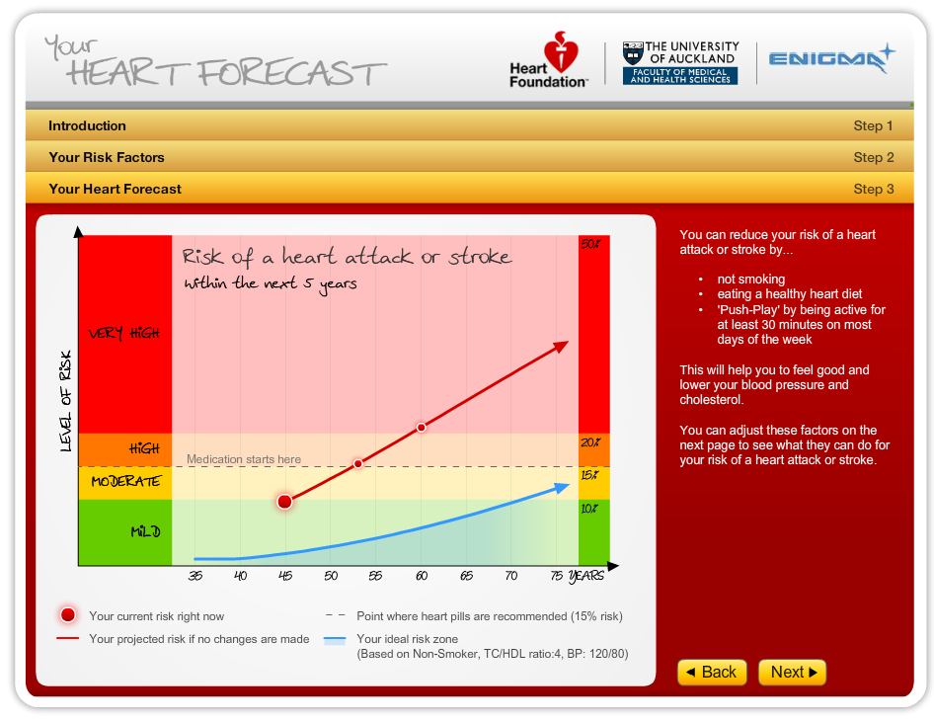
Visualisation: Data and Associations
Jim
‘Big data’; Bayes’ Theorem, probability and associations
e.g. Netica
Looking at temporal data
e.g. GapMinder, animation, interaction

Slide 7
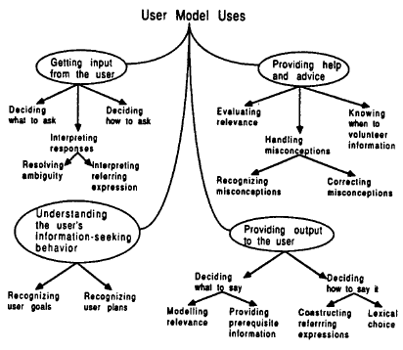
Agents and Interaction
Jim
Interacting as an ‘agent’, user modelling and changing user behaviour (e.g. stages of change and STOMP)
Robots
Information retrieval as an interaction paradigm
The Social Network (e.g. patientslikeme)
Andrew’s lecture…
Gamification, peer questions

Slide 8
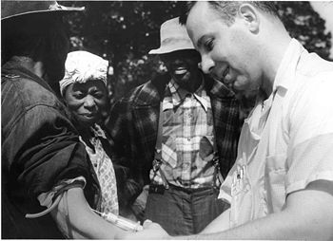
Evaluation
Jim
Usability factors and goals
Heuristic evaluation
Analytic performance measurement
e.g. Fitts’ Law
Usability studies
Test planning and task selection
Questionnaires
Piloting and iteration
Foundations of human research ethics
e.g. informed consent
Tuskegee syphilis experiment

Slide 9
Beryl
Pens and other Tangibles
Hardware
Sensing
Recognition
Interaction
Applications
Evaluations
Accuracy
Environment
Feature, algorithms and data
Accuracy rates
1 pen or a few tangibles to replace lots and lots of keys and mouse
Diagrams and sketching
Geometry
Usable?
Compared to paper, CAD tools
Screen types
Fabrication tangibles
Annotation
Visually Impaired multimodal

Slide 10
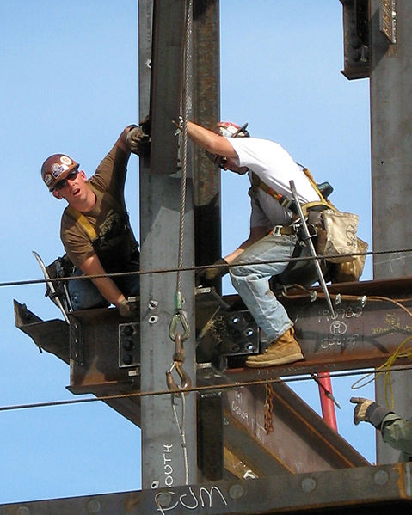
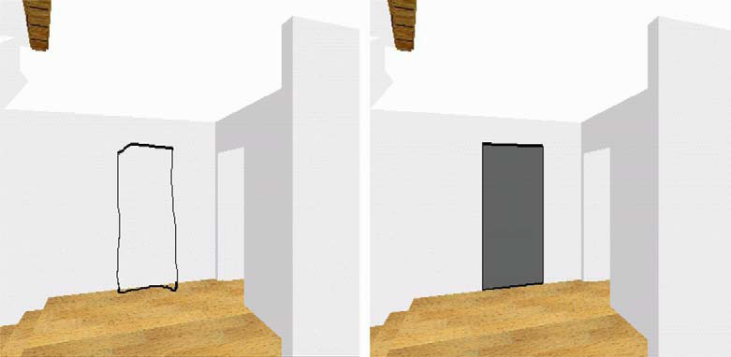
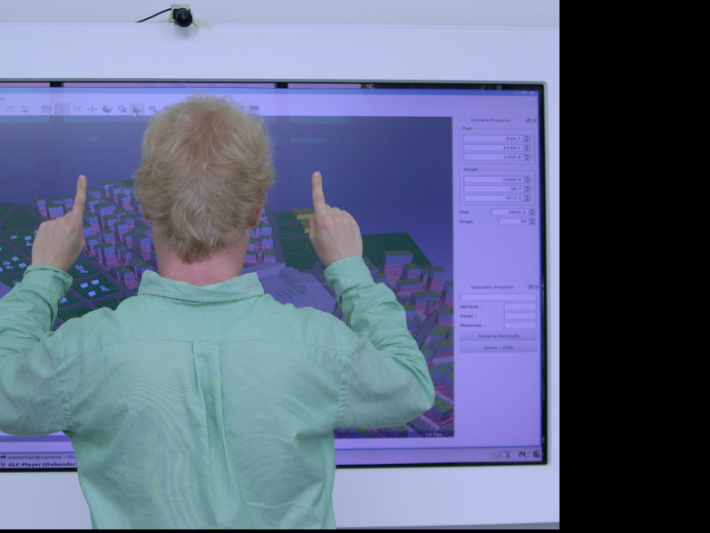
Domain Specific HCI
Robert
Understanding characteristics and peculiarities of the domain
Collaboration approaches
Appropriate types of interaction
Multi-criteria decision making
Domain specific devices

Slide 11
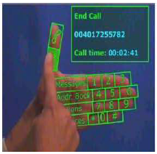
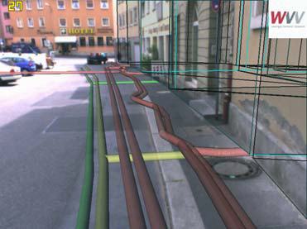
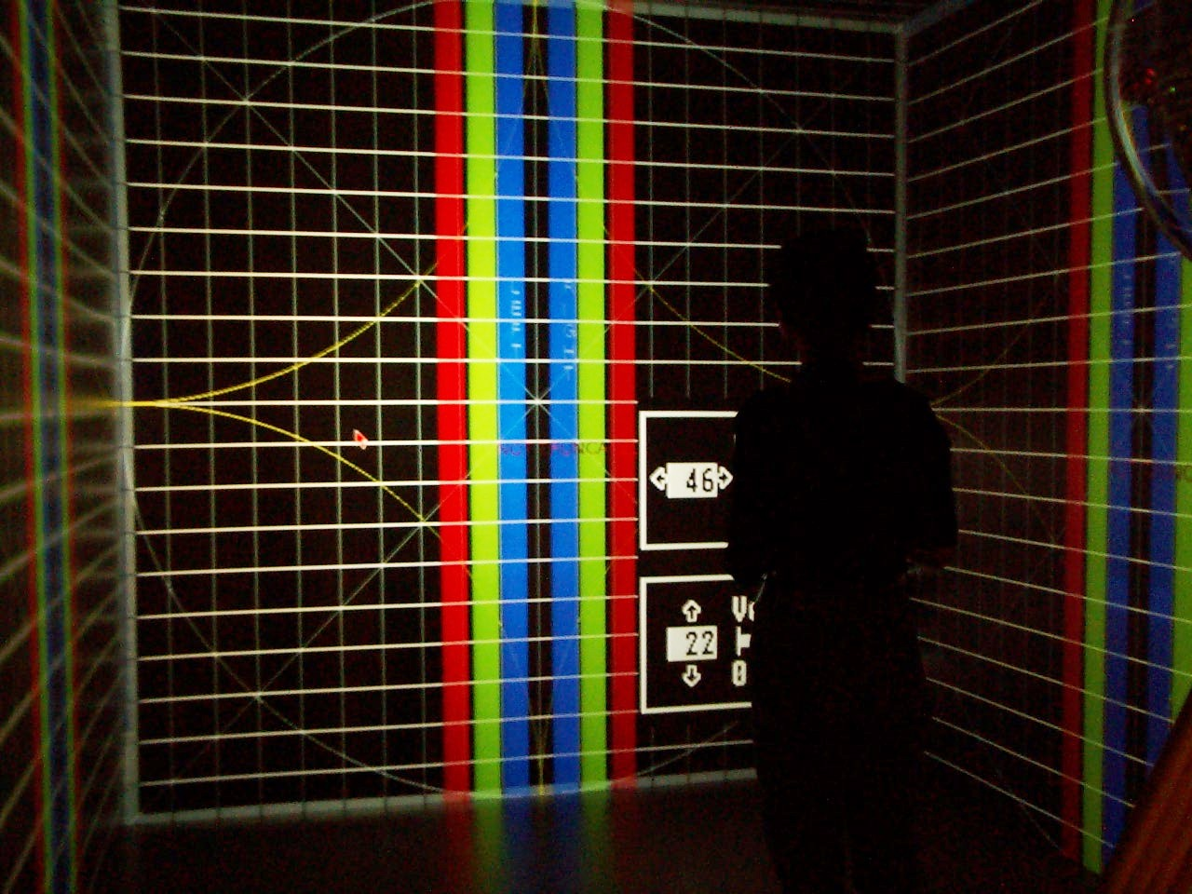
VR/MR/AR
Robert
Abilities of technologies across the virtuality continuum
For AR and VR considered
Enabling technologies
Applications
Limitations

Slide 12
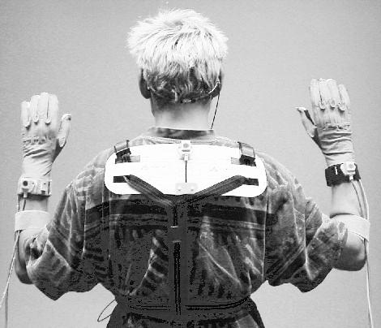
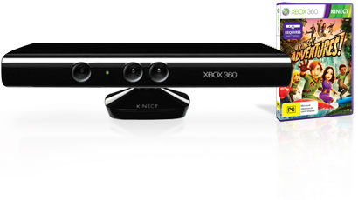
Gesture-based UI
Robert
Technologies to recognise gestures
Costs vs benefits

Slide 13
Questions?
And we hoped you learned something and had some fun, too!
Jim (jim@cs.auckland.ac.nz)
Beryl (beryl@cs.auckland.ac.nz)
Robert (trebor@cs.auckland.ac.nz)

