Slide 1
CompSci 230 Software Construction
Lecture Slides #2: Hello World! S1 2015

Slide 2
Agenda
Topics:
“Hello world!” in Java and Python
Backward and forward compatibility
Syntax and semantics

Slide 3
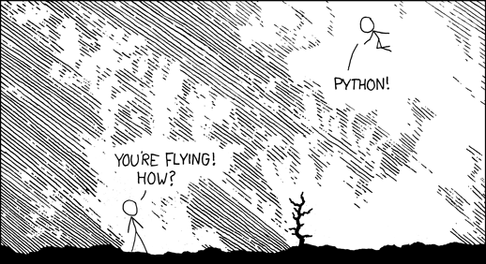
xkcd 353: Python
This work is licensed under a Creative Commons Attribution-NonCommercial 2.5 License.

Slide 4
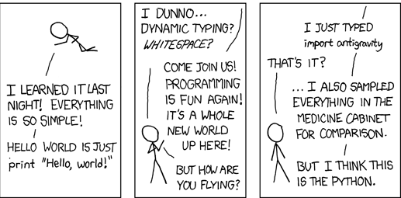
xkcd 353: Python (2 of 2)
This work is licensed under a Creative Commons Attribution-NonCommercial 2.5 License.

Slide 5
Hello World!
Hello.py (Python source code):
print "Hello World!"
Python has a shell -- a command-line interface which will execute a single line of code immediately after you type it. Very convenient!!
Sigh. We’re running Python 3.4.3, but the code was written for Python 2.
Python 3.4.3 (v3.4.3:9b73f1c3e601, Feb 24 2015, 22:43:06) [MSC v.1600 32 bit (Intel)] on win32
Type "help", "copyright", "credits" or "license" for more information.
>>>
File "<stdin>", line 1
print "Hello World!"
^
SyntaxError: Missing parentheses in call to 'print'
>>>
print "Hello World!"
import antigravity

Slide 6
“Hello World!” in Python 3
Hello.py (Python 3 source code):
print("Hello World!")
Python 3 isn’t backward compatible.
It won’t run “old code” correctly.
Python 2.5 (2006) wasn’t forward compatible.
In Python 2.6 (2008) and 2.7 (2010), it is possible to write code which can be translated (using 2to3) into code that will run correctly on Python 3 (2008-).
A slow transition:
Some commonly-used libraries in Python 2 still haven't been ported to Python 3.
Python 3.4.3 (v3.4.3:9b73f1c3e601, Feb 24 2015, 22:43:06) [MSC v.1600 32 bit (Intel)] on win32
Type "help", "copyright", "credits" or "license" for more information.
>>>
Hello World!
>>>
print("Hello World!")

Slide 7
“Hello World!” in Java
Hello.java (Java source code):
public class Hello {
public static void main(String[] args) {
System.out.println("Hello World!");
}
}
Python programs have much less gobbledygook than Java programs.
“language that is … made unintelligible by excessive use of technical terms” (OED online).
Syntax is a set of rules defining what a compiler or interpreter “should accept” as a program.
You saw a syntax error message on slide #5.
Syntax is the “form” of a program.
Semantics is the “meaning” of a program.
The semantics of a programming language define what a computer “should do” when it executes a program in that language.

Slide 8
More on Backward Compatibility
Until 2011, Java had excellent backward compatibility.
Java programs that were compiled into bytecode in 2002 (J2SE 1.4) would still run in 2008, if you maintained a Java 1.4 runtime system on your platform.
Note: after 2008, Java 1.4 was no longer supported – no more security patches.
Java programs that were compiled into bytecode in 2006 (Java SE 6) would still run in 2012, if you maintained a Java 1.6 runtime system.
Backward-compatibility of compiled code is
very desirable in software applications, because you can upgrade a system without affecting the software.
very undesirable for malware, because it is still dangerous on the upgraded system!
In 2011, Oracle advised that
“keeping old and unsupported versions of Java on your system presents a serious security risk.”
The authors of Java are very careful to preserve backward-compatibility at the source-code level.
With few exceptions, old source code is syntactically correct on the current edition of Java.
Semantics are carefully controlled; but there are some changes across versions, so recompiled code should be tested to assure correct behaviour.
The main problem: you must rewrite any source code that imports an obsolete library.
The authors of Python are now very aware of the importance of backward compatibility.
In April 2014, the end-of-life for Python 2 (2000-) was extended from 2014 to 2020, so that users who hadn’t yet completed the port to Python 3 (2008-) would have enough time to do so.

Slide 9
Syntax and semantics of Java
Java’s syntax is similar to C/C++.
There’s a lot of detail to learn, but it does make some sense (eventually ;-).
Once you have learned Java’s syntax, you’ll have a good head-start on C!
I won’t attempt to teach Java syntax in my lectures.
Learning Java syntax is like learning how to spell words correctly in English: there’s an awful lot to memorise, and only a few concepts.
The only way to learn Java syntax is by writing, and reading, a lot of Java programs!
The Java compiler will issue an error message when you “get it wrong”.
Practice… and learn from your mistakes!
Don’t aim for perfection.
You’ll have Eclipse in the lab.
On a test or exam, yr mrkr cn prbbly ndrstnd wht y wrt vn f y mk fw rrrs.
Python’s semantics is similar to Java.
If you have a good working understanding of “what a Python program is supposed to do”, you have a good head-start on Java semantics.
However, Python is weakly-typed, and Java is strongly-typed.
Learning Java’s type system is a significant achievement for any programmer.
I’ll devote quite a bit of lecture time to this concept, and the assignments should help.
You won’t understand Java’s type system in an hour, or in a day… but once you “get it”, you’ll be a competent Java programmer. Give it a go! We’ll start on the next slide…

Slide 10
Dissection of a Java Class
public class Hello {
public static void main(String[] args) {
System.out.println("Hello World!");
}
}
This simple example illustrates a few very important rules:
Every Java program must define a class, all code is inside a class.
Everything in Java must have a type.
Every Java program must have a function called public static void main(String[] args).
[Section 2.4 of java4Python]

Slide 11
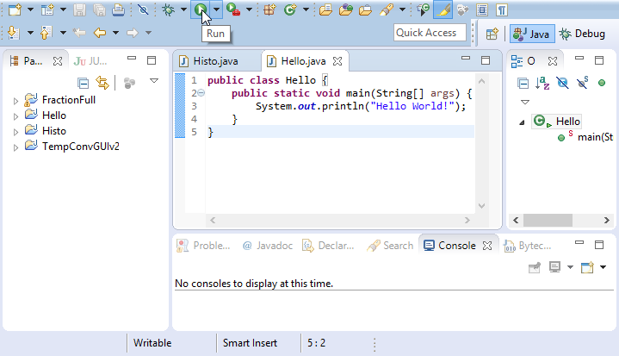
Try it in Eclipse!

Slide 12
Review
“Hello world!” in Java and Python
Python 2 and Python 3 are different languages, with different syntax
Any version of Python has simpler syntax than any version of Java
Python and Java have similar semantics
Syntax and semantics: roughly, “form and meaning”
Backward compatibility = designing new systems so they’ll run old programs. Not always desirable:
Is a program malicious, or is it a “good” application?
Most Pythonistas agree that Python 3 is a big advance on Python 2, despite its lack of backward-compatibility.
Forward compatibility = writing programs so that they’ll run on future systems. Desirable but difficult!
(Predicting the future is outside the scope of this paper ;-)

