Slide 1
THE SEMANTIC WEB’S IMPACT UPON E-BUSINESS
Stephen Hood
Po-cheng Huang

Slide 2
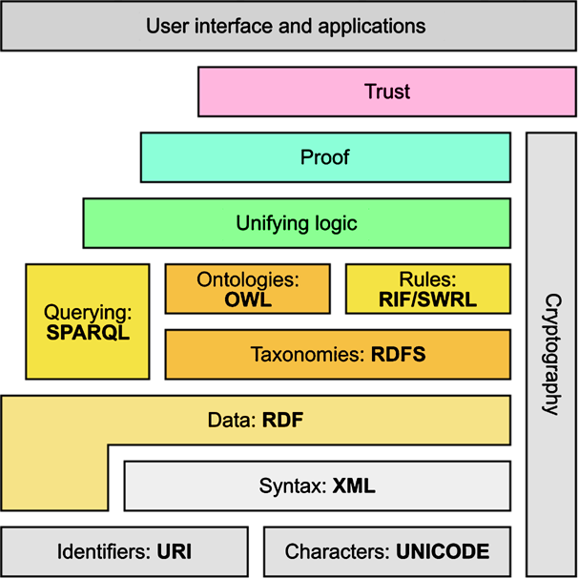
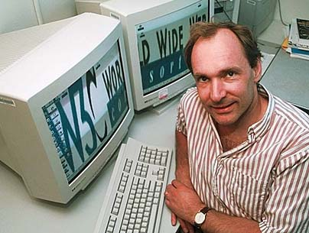
The Semantic Web
The original World Wide Web
The Semantic Web
RDF/S
SPARQL
SKOS
OWL
RIF…
Web of Data
Web of Documents
Sir Tim Berners-Lee

Slide 3
E-Business
Definition: All use of Electronic Information and Communication Technology to support Business Activity
Structure:
Business Intelligence
Internal Business Systems
Enterprise Communi-cation and Collaboration
Electronic Commerce (E-Commerce)

Slide 4
E-Business continued...
Business Intelligence
Int. Business Systems
Customer Relationship Management
Enterprise Resource Planning
Human Resources Management
Document Management Systems
Decision Support Systems
Enterprise
Comm. & Collab.
E-Commerce
E-Mail
Voice Mail
Web Conferencing
Internet Telephony
Content Management Systems
Business Process Management
Supply Chain Management
Online Shopping
Internet Marketing

Slide 5
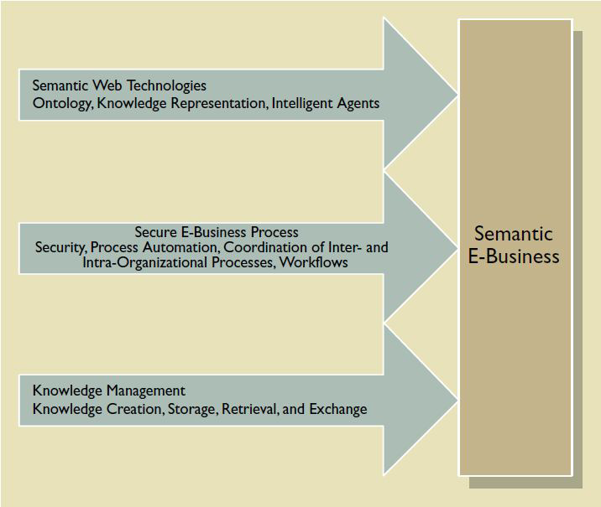
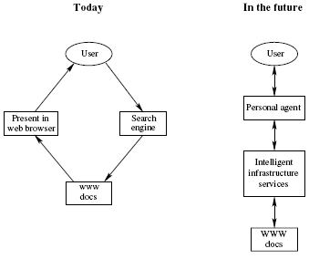
The Impact Upon E-Business
The Semantic Web: Can increase Efficiency, Productivity and Profitability in all areas of E- Business, either directly or indirectly.
How?
The ability to automatically retrieve, exchange and process information without compatibility issues.

Slide 6
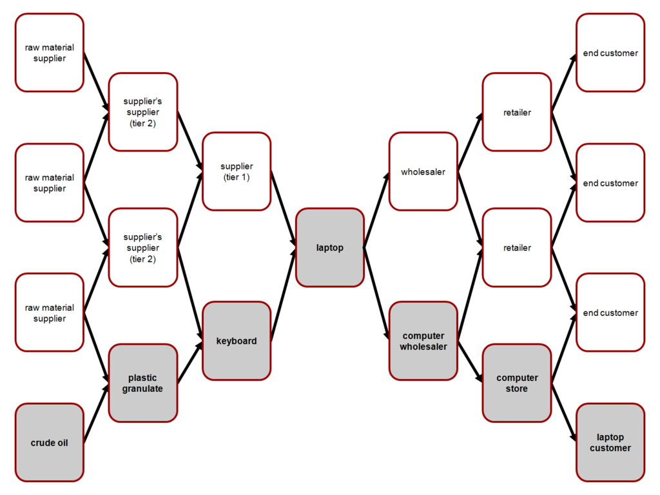
Application to Supply-Chain Management
DEFINITION: Management of
a network of interconnected businesses involved in the eventual provision of products & services to the end consumer.
PROBLEM: A huge number of different systems need to be able to communicate with each other.
SOLUTION: The automated compatibility provided
by Semantic Web Services.
RESULT: Quicker, cheaper, easier, wider-ranging and less error-prone business-to-business (B2B) and business-to-consumer (B2C) communication – and the opportunity for internet-based Supply-Chain Management Systems to flourish.

Slide 7
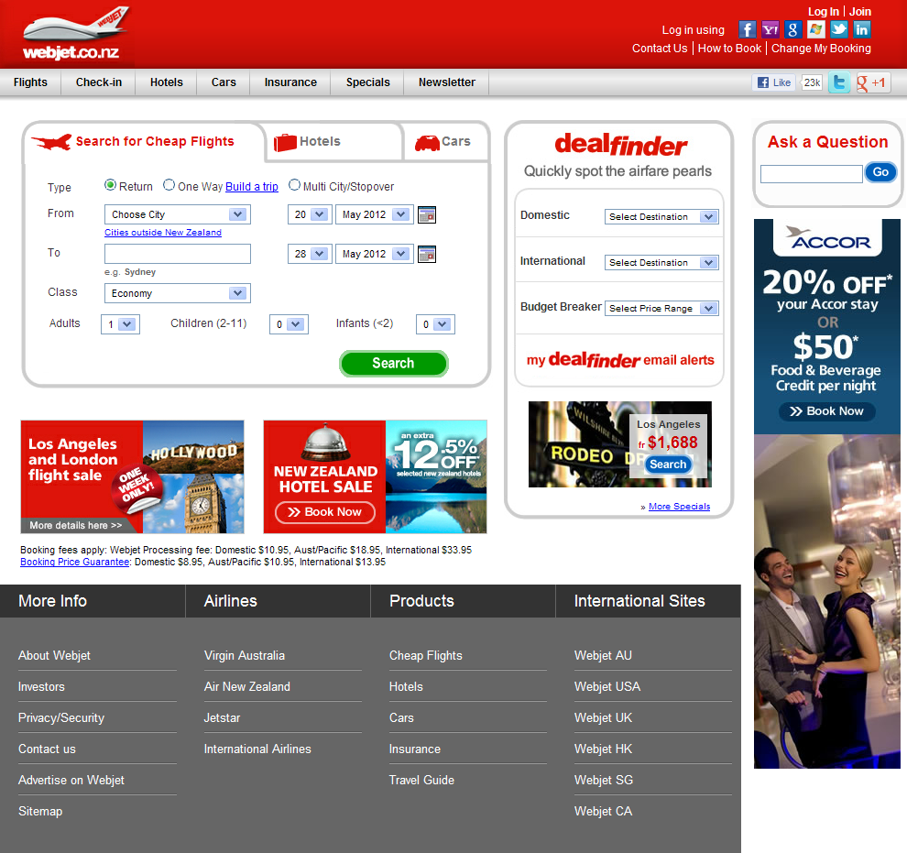
Application to Online Shopping
PROBLEM: Finding the best price – or deal – online can be a time-consuming, complicated, and arduous task for consumers on the original WWW.
SOLUTION:
What if much of their work could be done automatically… say, via the Semantic Web?
RESULT:
More satisfied consumers, resulting in more B2C trade being conducted via Web-based E-Commerce.
To be made obsolete by the Semantic Web?

Slide 8
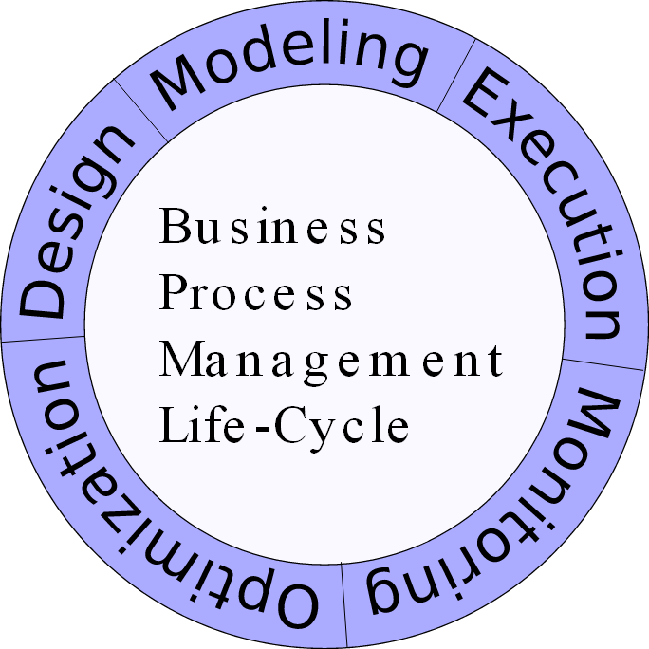
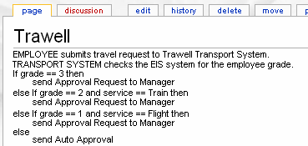
Application to Business Process Management
PROBLEM: How to automate the Execution step of the BPM Life-Cycle.
SOLUTION: The inter-operability of Semantic Web technologies can be utilised.
RESULT: The automated transformation of a design document into executable code.
A Semantic Wiki on which Business Process Design is performed – the design document can then be automatically converted into executable code, aided by Semantic Web technologies.

Slide 9
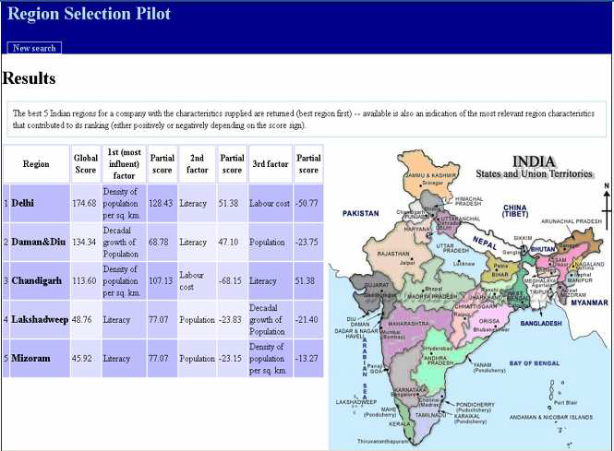
Application to Business Intelligence
PROBLEM: In order to provide useful intelligence to business, Decision Support Systems need to process huge amounts of data derived from widely varying sources.
SOLUTION: Utilise the automated compatibility and interpretation provided by Semantic Web technologies.
RESULT: Better decision-making, due to faster provision of more informed business intelligence.
An example Decision Support System providing business intelligence about regions in India

Slide 10
Future Issues
Risk Minimisation: Very important in
Business Planning
TRUST –
A brave new world of information on the Semantic Web: But how do you determine which information can be relied on?
Currently a risky proposition…
Needed: A W3C Recommendation for determining Trustworthiness on the Semantic Web – currently in development
?
?
?

Slide 11
Summary
The Semantic Web
E-Business
IMPACT
Lower Operating Costs
Faster Performance
Wider Sphere of Operations
Less Error & Better Decisions
= Greater Profit
!
!
!
Future Issues: Trust System for the Semantic Web

Slide 12
References
R. Singh, L. S. Iyer, and A. F. Salam, “The semantic e-business vision,” Communications of the ACM, vol. 48, no. 12, pp. 38–41, December 2005; http://dx.doi.org/10.1145/1101779.1101806.
H. Saggion, A. Funk, D. Maynard, and K Bontcheva, “Ontology-based information extraction for business intelligence,” Lecture Notes in Computer Science, vol. 4825, pp. 843–856, 2007; http://dx.doi.org/10.1007/978-3-540-76298-0_61.
D. Trastour, C. Bartolini, and C. Preist, “Semantic web support for the business-to-business e-commerce pre-contractual lifecycle,” Computer Networks, vol. 42, no. 5, pp. 661–673, 5 August 2003; http://dx.doi.org/10.1016/S1389-1286(03)00229-9.
H. Jagdev, L. Vasiliu, J. Browne and M. Zaremba, “A semantic web service environment for B2B and B2C auction applications within extended and virtual enterprises,” Computers in Industry, vol. 59, no. 8, pp. 786–797, October 2008; http://dx.doi.org/10.1016/j.compind.2008.04.001.
E. Cimpian, M. Moran, E. Oren, T. Vitvar, and M. Zaremba, “Overview and Scope of WSMX,” WSMX Deliverable D13.0, WSMX Final Draft v0.2, E. Cimpian, T. Vitvar, and M. Zaremba, Eds., 23 February 2005; http://www.wsmo.org/TR/d13/d13.0/v0.2.
T. Hussain, R. Balakrishnan, and A. Viswanathan, “Semantic wiki aided business process specification,” Proc. 18th International Conference on World Wide Web (WWW '09), pp. 1135–1136, ACM Press, 2009; http://dx.doi.org/10.1145/1526709.1526894.
S. Galizia, A. Gugliotta, C. Pedrinaci, “A formal model for classifying trusted semantic web services,” Lecture Notes in Computer Science, vol. 5367, pp. 540–554, 2008; http://dx.doi.org/10.1007/978-3-540-89704-0_37.
Berners-Lee, T., J. Hendler, and O. Lassila, The Semantic Web - A new form of Web content that is meaningful to computers will unleash a revolution of new possibilities. Scientific American, 2001. 284(5): p. 34-+.
Fensel, D., et al., Semantic Web, in Semantic Web Services. 2011, Springer Berlin Heidelberg. p. 87-104.

Slide 13
References continued...
Shadbolt, N., W. Hall, and T. Berners-Lee, The Semantic Web revisited. Ieee Intelligent Systems, 2006. 21(3): p. 96-101.
W3C. SEMANTIC WEB. Available from: http://www.w3.org/standards/semanticweb/
Gerstner, L.V., Who says elephants can't dance? : inside IBM's historic turnaround. 2002, New York, NY: HarperBusiness. xi, 372 p.
Amor, D., The e-business (r)evolution : living and working in an interconnected world. 2000, Upper Saddle River, NJ: Prentice Hall PTR. xxxii, 636 p.
Heidari, K., The Impact of Semantic Web on ECommerce. World Academy of Science, Engineering and Technology, 2009. 51: p. 303-306.
Beynon-Davies, P., E-Business. 2004, London/Basingstoke: Palgrave Macmillan. 480 s.
W3C. W3C SEMANTIC WEB ACTIVITY. 2001; Available from: http://www.w3.org/2001/sw/
Katia, M., Toward a Semantic Web e-commerce.
Davies, J., Applications of semantic technology. Ieee Intelligent Systems, 2008. 23(1): p. 77-80.
Ding, Y., et al., The semantic web: yet another hip? Data & Knowledge Engineering, 2002. 41(2-3): p. 205-227.
Tolksdorf, R., et al., Business to consumer markets on the Semantic web. On the Move to Meaningful Internet Systems 2003: Otm 2003 Workshops, 2003. 2889: p. 816-828.
Frank Manola and E. Miller. RDF Primer. 2004; Available from: http://www.w3.org/TR/rdfprimer/#typedliterals
Deborah L. McGuinness and F.v. Harmelen. OWL Web Ontology Language. 2004; Available from: http://www.w3.org/TR/2004/REC-owl-features-20040210/
Thuraisingham, B., Directions for security and privacy for semantic e-business applications. Commun. ACM, 2005. 48(12): p. 71-73.

Slide 14
Any Questions?
?

