Slide 1
Seminar
What Apps Did You Use?": Understanding the Long-term Evolution of Mobile App Usage
Li, Tong, Mingyang Zhang, Hancheng Cao, Yong Li, Sasu Tarkoma, and Pan Hui
David Wang
2021.05.12

Slide 2
01
INTRODUCTION
02
MACRO-LEVEL
03
CONTENT
MICRO-LEVEL
04
CONCLUSION

Slide 3
Part
INTRODUCTION
1
App economy growth reaches 6.3 trillion
Number of apps reached 2.7 million
Notes:
As todays topic is understanding the long term evolution of mobile app, we need to know that todays app economy growth reached 6.3 trillion ….

Slide 4
INTRODUCTION
Carat – An app to collect long-term user data
Difficult to collect long-term user data
Understand long-term evolution of App Usage
Most collections on data are based on short-term
Notes:
Difficult to collect initial data from users.
Privacy
Volunteers
Carat is a partly open-source data collection platform, that asks user to agree with their terms and conditions before installing the app, where platform promise not to collect personal data and user can check the source code for collection part as it is open source.
Battery diagnosis app, keep user using the app by monitoring battery and provide suggestions. Collected data from 30,000 users from over 100 countries.

Slide 5
INTRODUCTION
Grasp Market Opportunities
Improve User Experience
Why?
Forecasting Trend
Monitoring
Track User Preference
Increase App Competitivity
Understand Maturity of 66
Different Category
Motivation
Vast Market
Understand Market

Slide 6
Part
MACRO-LEVEL
2
Focus on App-Category
From 2012 - 2017

Slide 7
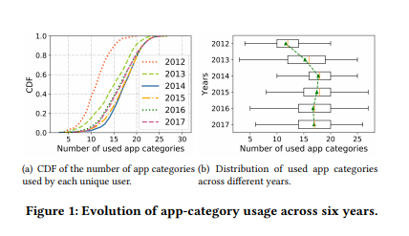
MACRO-LEVEL
Stage One (2012 - 2014)
Used App Categories Increases
Stage Two (2014- 2017)
Remained Stable Over Time
Notes:
Evolution of app-category usage:
Stage one (2012 - 2014). In this stage, the number of app categories used by each user increased significantly. Average number of used app category from 12 in 2012 to 17 in 2014
One possible reason is because of the new rising technique, deploying fourth generation of mobile networks(4G).
Stage two (2014 - 2017). During this stage, the number of used app categories remained stable over time. As you can see the curve are very close together.

Slide 8
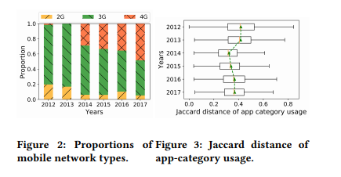
MACRO-LEVEL
New Technology
Fourth Generation of Mobile Network (4G)
Jaccard Distance
Notes:
Jaccard distance is used to compare the similarity of two different sets. In our case, app-cate used by user A and app-cate used by user B.
The more similar, the closer to 0. Vice versa. When 4G released, online gaming experience become better, user all tends to play games online and only download game category app.

Slide 9
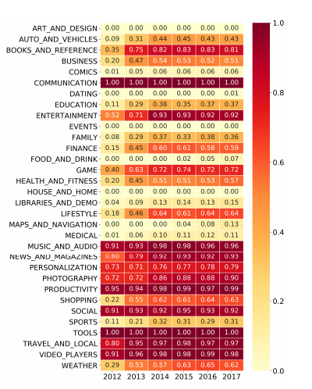
MACRO-LEVEL
Prior Prevalent App Category
Communication
Music and Audio
Productivity
Social
Tools
Posterior Prevalent App Category
Entertainment
News and Magazines
Photography
Notes:
• Prior prevalent app category. This type refers to the category whose popularity has exceeded 0.9 since 2012. Communication’, ‘Music and audio’, ‘Productivity’, ‘Social’, ‘Tools’, and ‘Video players’, which suggests smartphones have already acted as communication devices and multimedia players since 2012.
• Posterior prevalent app category. This type refers to the category whose popularity reached 0.9 after 2012, ‘Entertainment’, ‘News and magazines’, ‘Photography’, and ‘Travel and local’. Relevant to life services, due to improve on technology, better screen size, better reading experience.

Slide 10
MACRO-LEVEL
Growth Rate
Notes:
Showing the growth rate of popularity of category. Medical in the first stage, implies that mobile has changed into life assistance. Maps& navigation in the second stage also implies that highest growth rate are concentrated in life services.

Slide 11
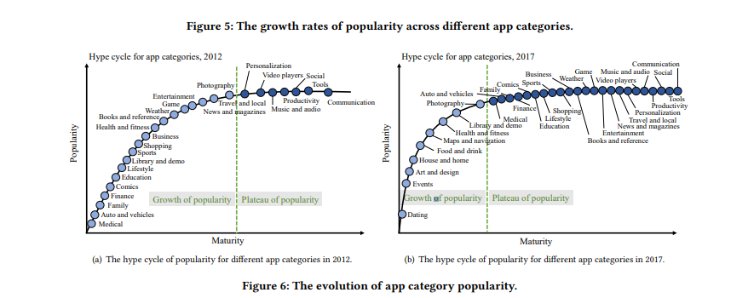
MACRO-LEVEL
App is more mature the popularity is more stable
Notes:
Generally, as the app is more mature the popularity is more stable.
Two stages, Growth of popularity -> newly introduced. New technology will trigger increase in popularity.
Plateau of popularity -> mature
But the stable popularity of different categories is different, for example communication, designed for all users, stable at popularity of 1. Education around 0.37.

Slide 12
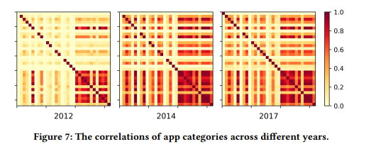
MACRO-LEVEL
No decline stage during the popularity evolution of app categories
Irreplaceable
Notes:
There is no decline stage during the popularity evolution of app categories.
App is irreplaceable. Sports app can not replace food ordering app.
Second, user form community, your friend use whatsapp, its hard for you to communicate with SMS messages or phone call.
Third, apps are connected, login using google services or payment using finance apps in shopping apps. Share music through social media apps.

Slide 13
Part
MICRO-LEVEL
3
Focus on App Usage
From 2012 - 2017

Slide 14
MICRO-LEVEL
The proportion of users used up to 150 apps has increase then dropped
Unlike Macro-level analysis
Notes:
The proportion of users used up to 150 apps has increased and then dropped unlike macro level. People tends to use less apps after peaking in 2014. Also, Pareto effect.
The stage of elimination caused the drop.

Slide 15
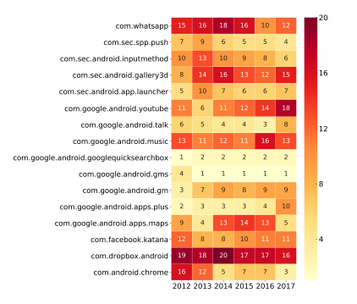
MICRO-LEVEL
Dominant Apps in the market
Pareto Effect
Notes:
There are few dominant apps in the market. It’s a sign of pareto effect, where small portion of app have 80% of users in the market.

Slide 16
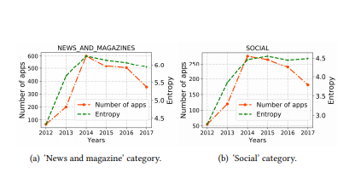
MICRO-LEVEL
Entropy is used to map centralization of App usage
The higher the entropy the lower the centralization of App usage.
Comparing trends for two apps
Correspond to the trend for all apps
Notes:
Both ‘News and magazine’ and ‘Social’ categories, the number of apps peaked in 2014 and then decreased. Their trends correspond to the trend for all apps. However, the increase in app number has disperse users concentration. The reason why the entropy curve of two apps are different, ones steady and the other one is decreasing after 2014 is because. Social app is prior prevalent category app whereas it has prior dominant apps, it competes with new apps, eliminating bad apps, new apps merging together. User are dominated by previous and new dominant app. That’s why the decrease is not dramatic.

Slide 17
Part
Conclusion
4

Slide 18
Conclusion
User’s app usage indeed changes over time.
The apps with high correlations have a greater chance of gaining popularity in the future.
Growth stage is caused by the release of new technologies.
The evolution processes in app category usage and individual app usage are different in terms of popularity distribution, usage diversity, and correlations.
Discarding low-quality apps by users caused the elimination stage.

Slide 19
Thank You
Any Questions?
2021.05.12

